Slide 1
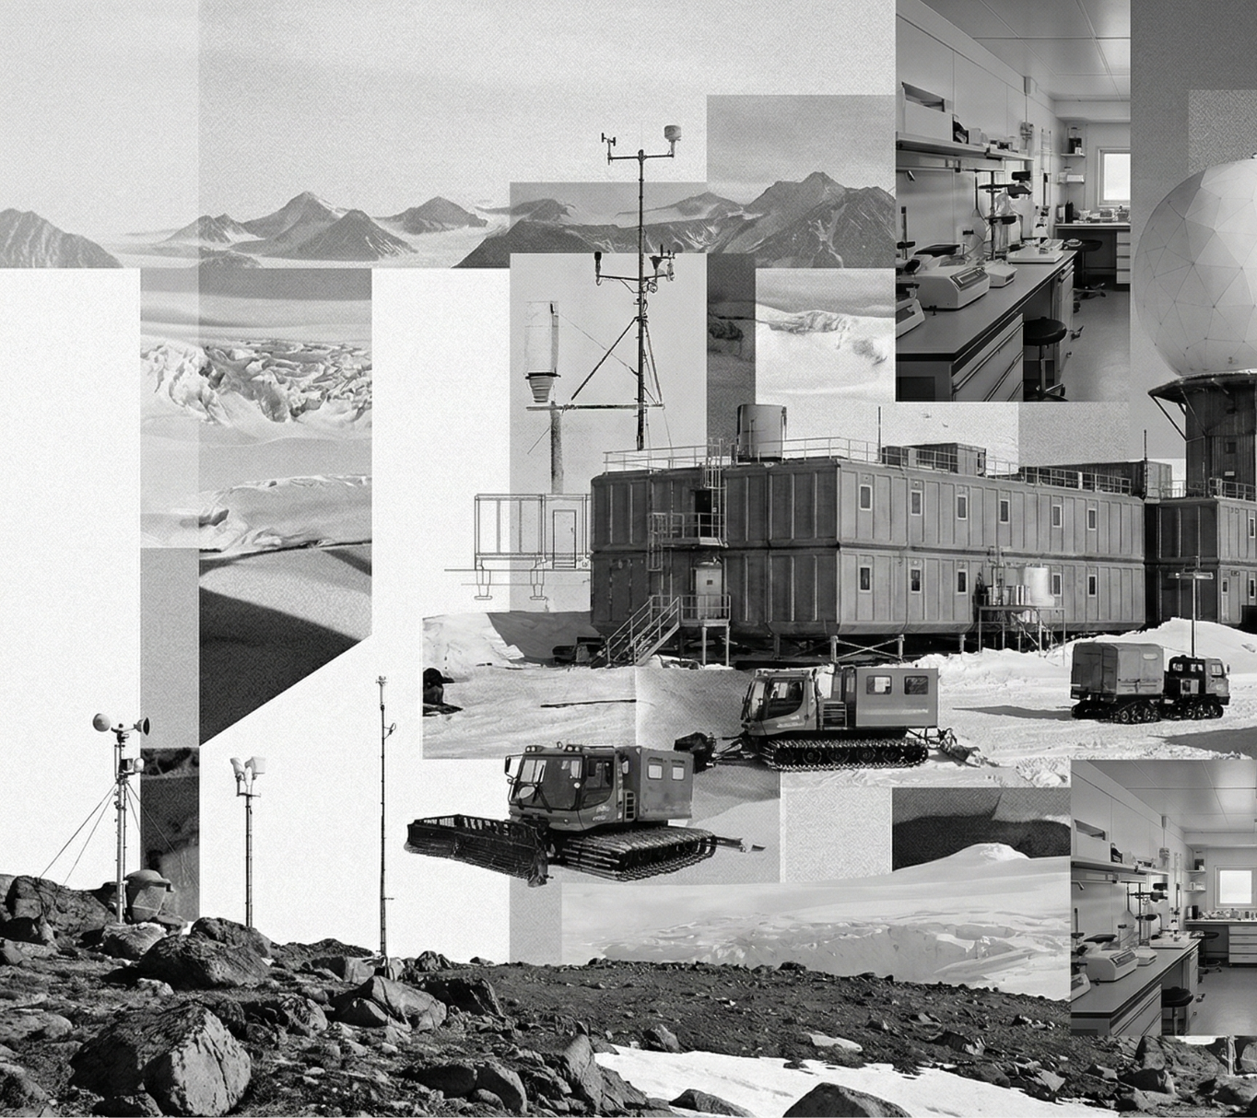
Mission-drivenhabitability
Designing habitats to support mission-driven confinement,​
TROLL Station Containers
Week 3.5_Midterm
Group 2_ Brendan Exterkate, Gabriel Marks, Giorgia Vercelloni,
Maciej Sachse, Ruxandra Florut, Zuzanna Schleifer, Long Ki​

Slide 2
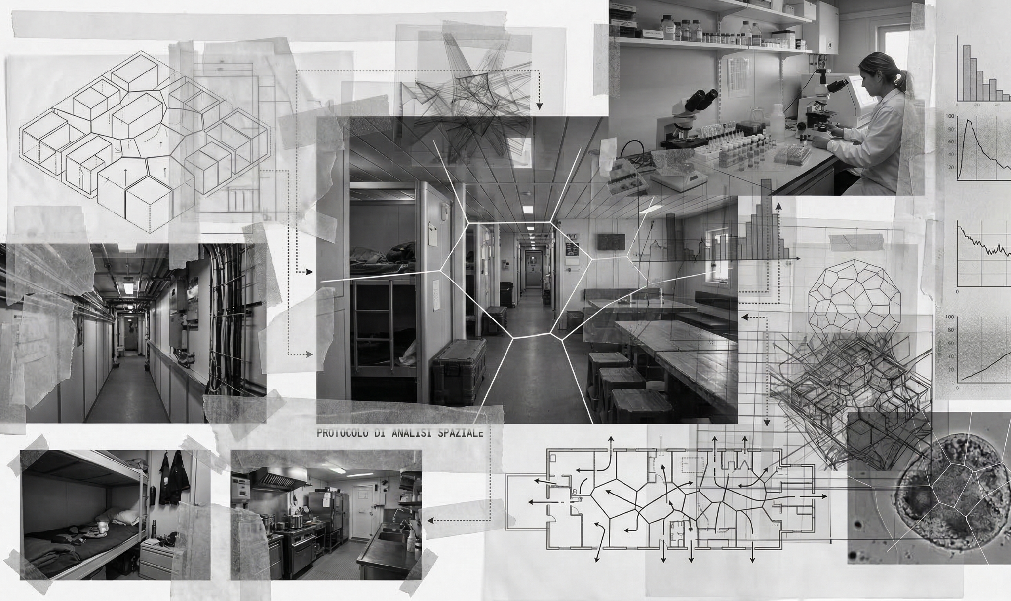
Index
_Why?
_Cohabiting when schedules collide
_Different case scenarios
_Adaptive lighting system
_Dynamic design
_Lighting integration
_Voronoi pattern, zoom in
_Implementing Artificial Intelligence
_Materials

Slide 3
Why?
Designing habitats to support mission-driven confinement
Mission-driven confinement is a condition of necessity; our task is to transform it into a space that can still feel human, familiar, and supportive of everyday life.

Slide 4
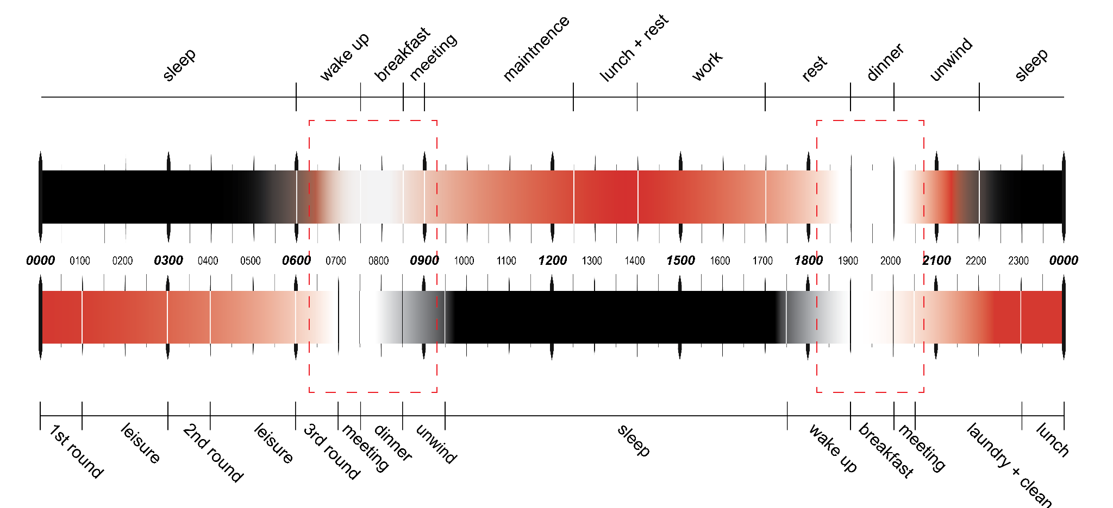
Cohabiting when schedules collide
01_ Two scientists schedules
Person 1:
Day Shift
Person 2:
Night Shift

Slide 5
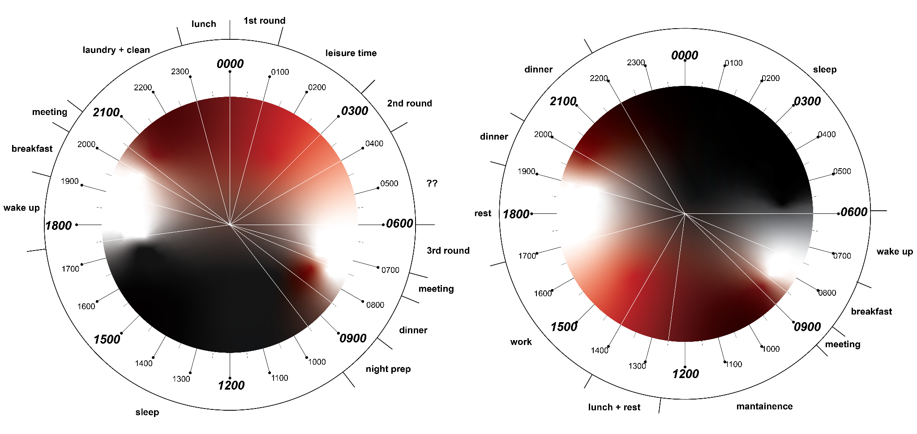
Cohabiting when schedules collide
01_ Two scientists schedules
Person 1:
Day Shift
Person 2:
Night Shift

Slide 6
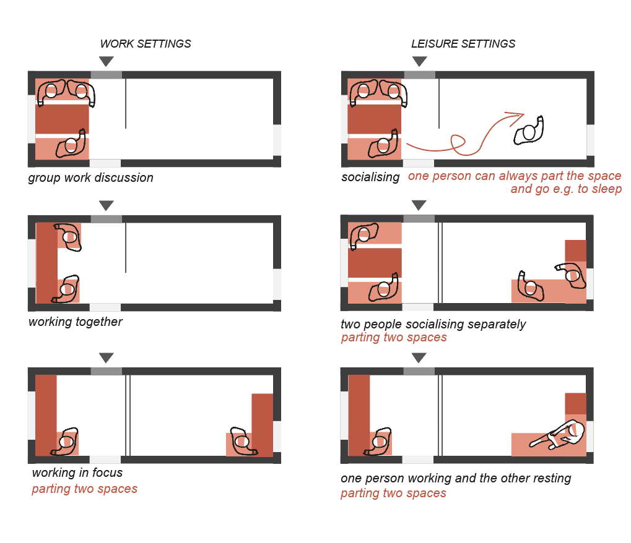
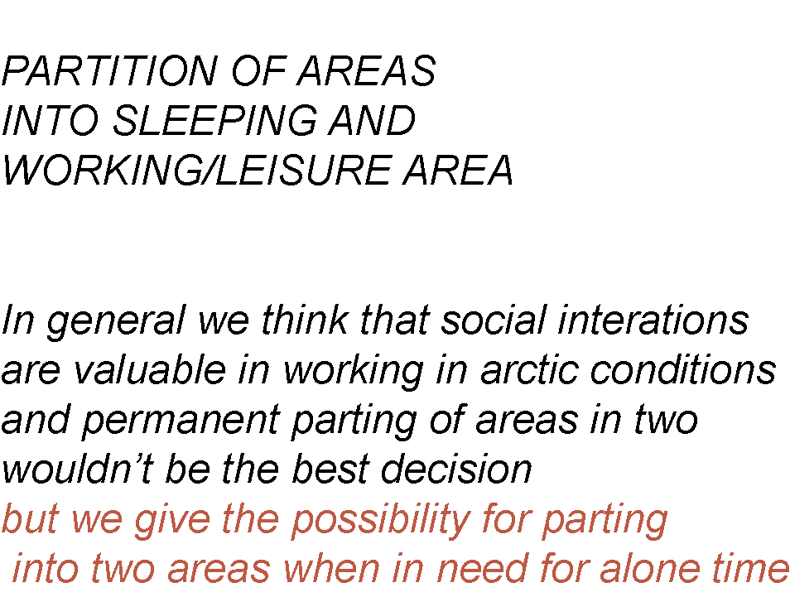
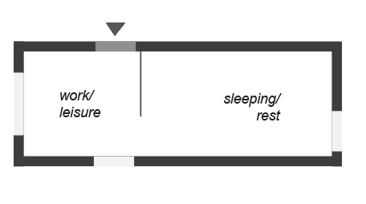
Different case scenarios
What is reconfigurable?
01_furniture
02_spaces
03_windows
04_lights
24H ACTIVITIES MAPPING & schedules collisions

Slide 7
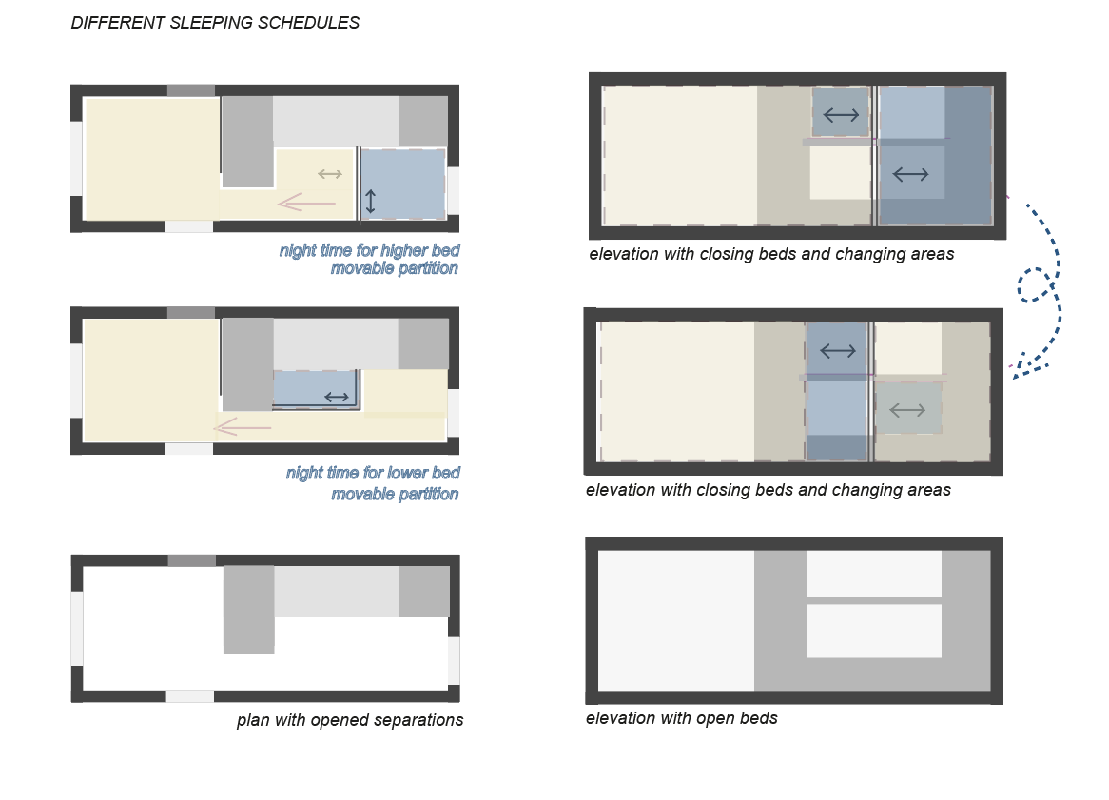
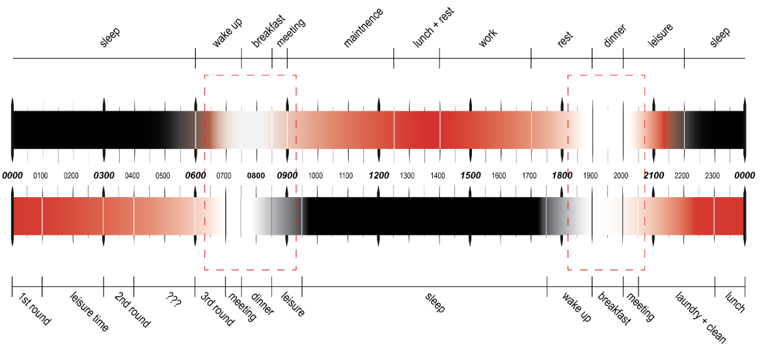
Different case scenarios
What is reconfigurable?
01_furniture
02_spaces
03_windows
04_lights
24H ACTIVITIES MAPPING & schedules collisions

Slide 8
Adaptive lighting system
01_ Personalised circadian cycle
For rebalancing the sleep cycle with: light, light tone and timing
INPUT:
_personalised schedule
_time of day
_CCT
_illuminance
_HAR (movement)
_ heartbeat
_Morning_sunrise light
Exposure to cool light tones
(high temperatures > 5000K, 10000lux)
with increasing intensity after awakening
_Evening_sunset light
1.5 hour (at least one hour) before sleep
Transition to warmer tones (<2700K)
With decreasing intensity
Eliminating blue frequencies > for rising melatonin levels

Slide 9
Adaptive lighting system
02_Personalised functional lighting
For helping with stress focus and recovery
INPUT (biodata feedback) :
_heart rate
_movement (HAR)
__blink rate
_respiratory rate
_facial emotions :)
_Stress management
Biodata feedback (e.g. smart watch)
Input: _heart rate_respiratory rate
_Focus mode
Personalised schedule and needs
Input: blink rate_heart rate_respiratory rate
_Recovery
Personalised schedule and needs
Input: blink rate_heart rate_respiratory rate_Human Action Recognition
Red light 630-850K
_Mood boost
Personalised needs
Input: respiratory rate_facial expression

Slide 10
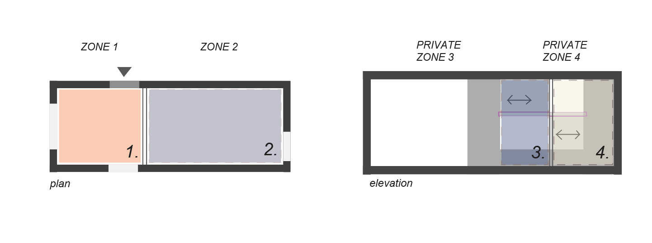
24h activities mapping
WITH LIGHTING CONSIDERATION
_LIGHT ZONES
With possibility of personalised lighting according to personal preferences
_01 MAIN ZONES
_02 PERSONAL SPACES

Slide 11
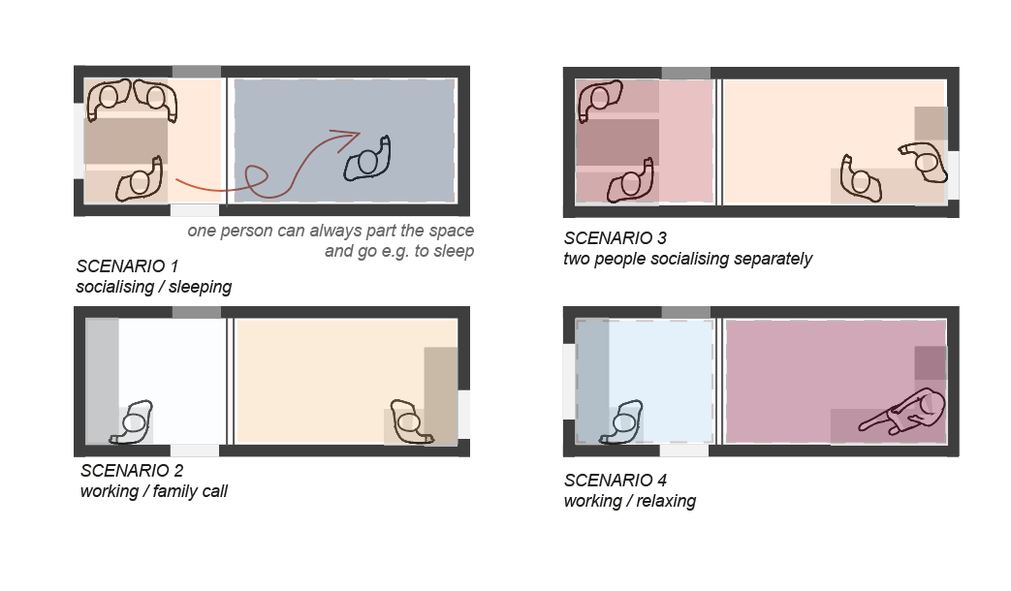
24h activities mapping
What is reconfigurable?
01_furniture
02_spaces
03_windows
04_lights
WITH LIGHTING CONSIDERATION

Slide 12
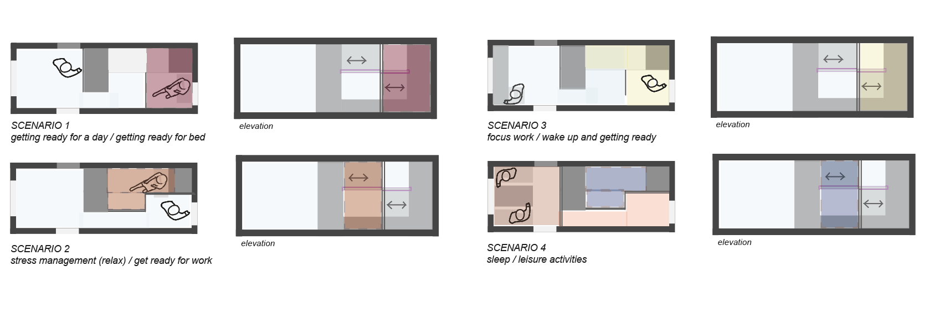
24h activities mapping
What is reconfigurable?
01_furniture
02_spaces
03_windows
04_lights
WITH SCHEDULE COMPARISON AND LIGHTING CONSIDERATION

Slide 13
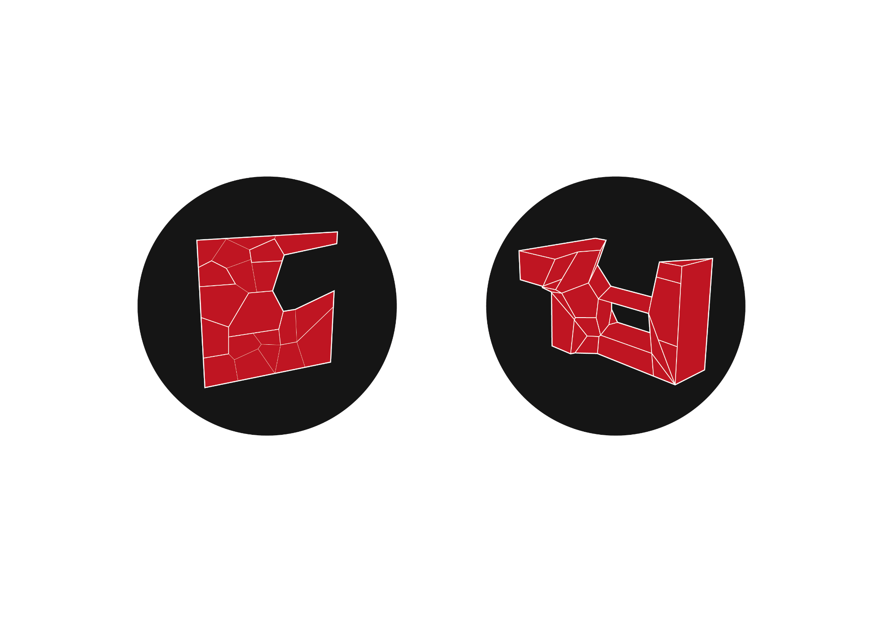
Dynamic design, 2D and 3D approach to Voronoi
“Functionalized wall”
Approaching voronoi geometries in two dimensions
“Main habitat element”
Approaching voronoi geometries in three dimensions

Slide 14
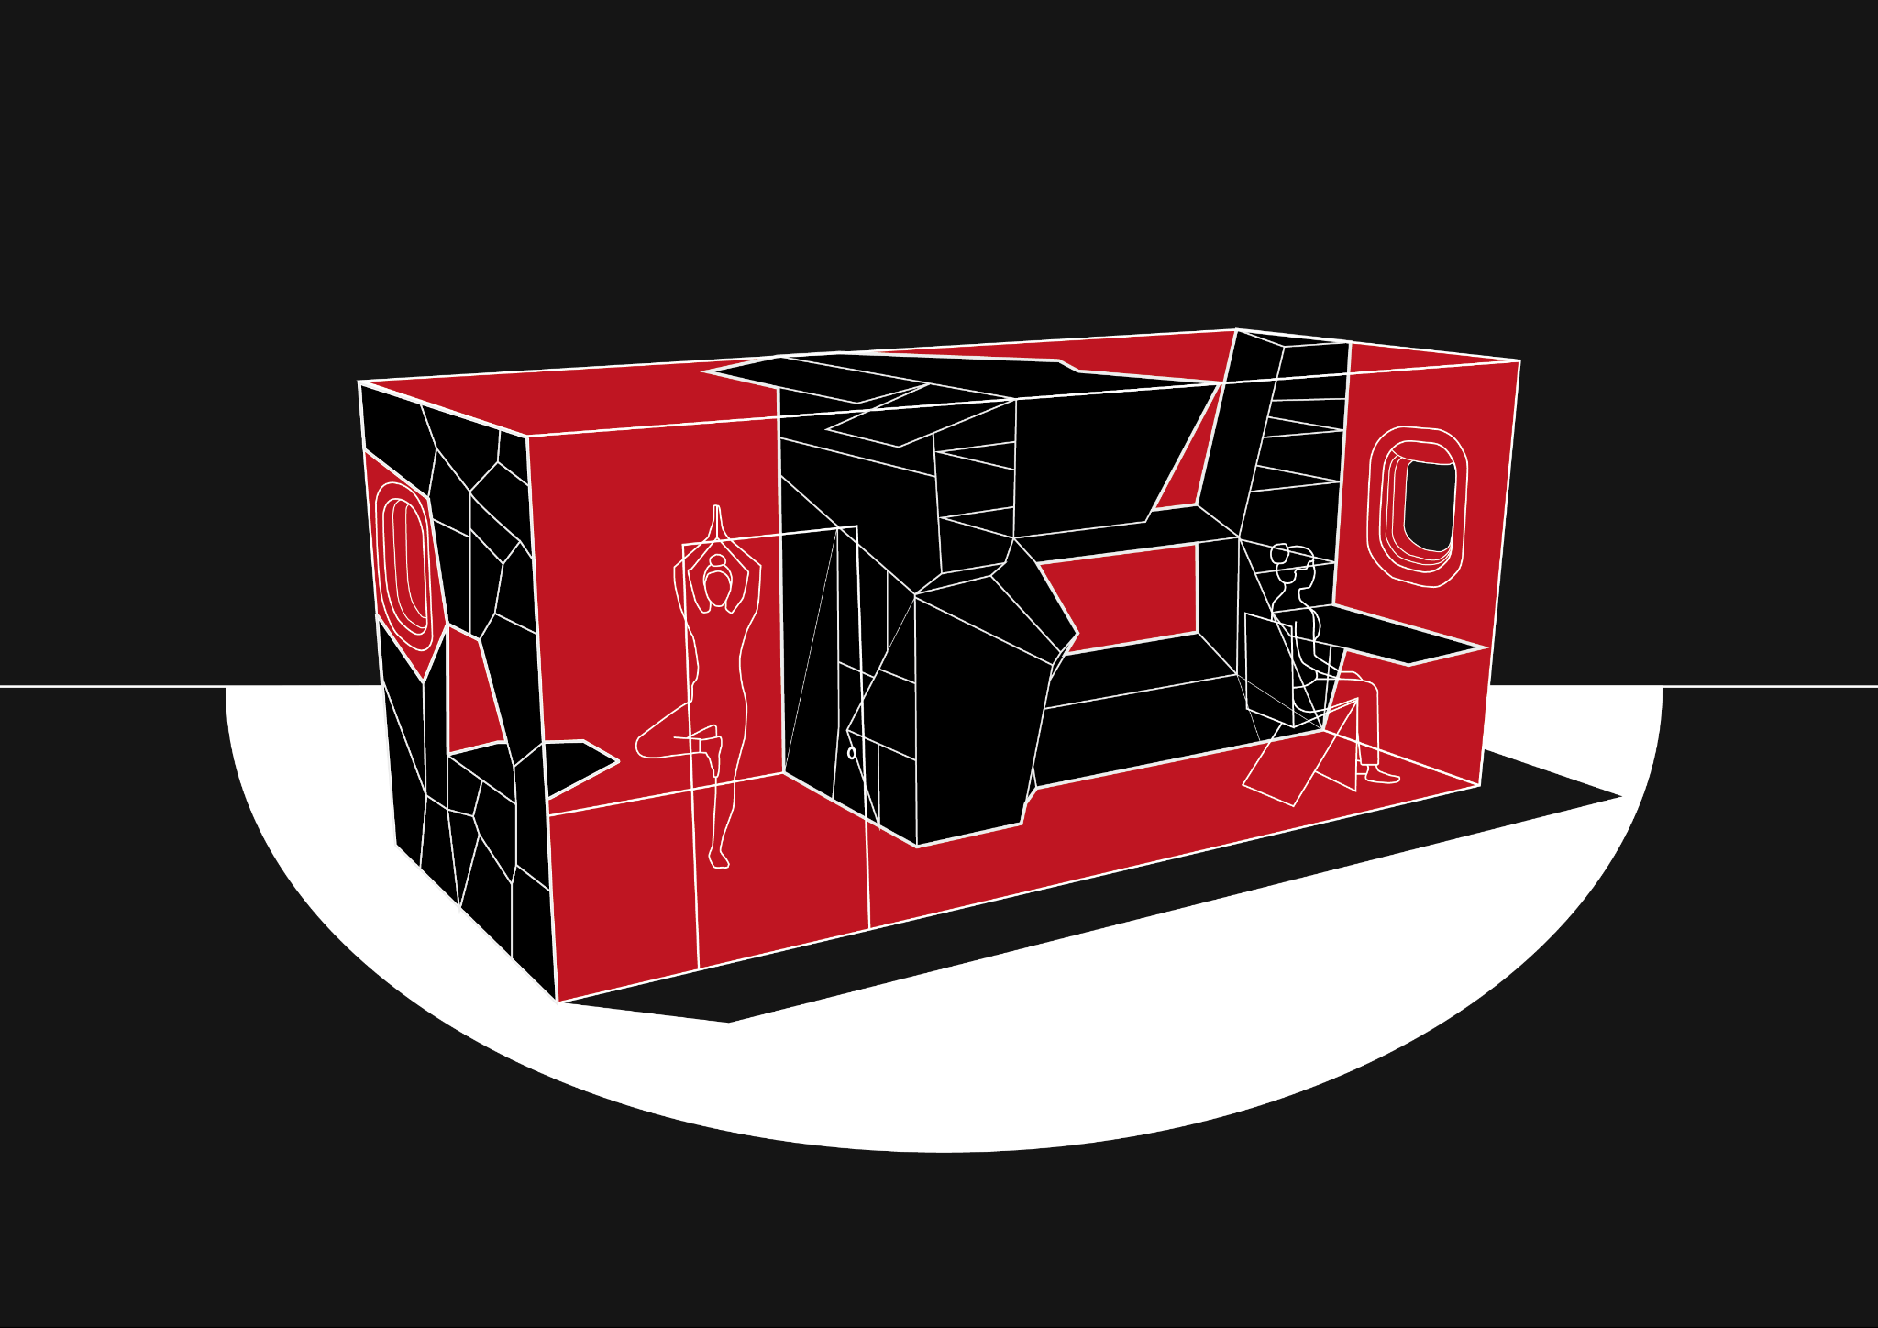
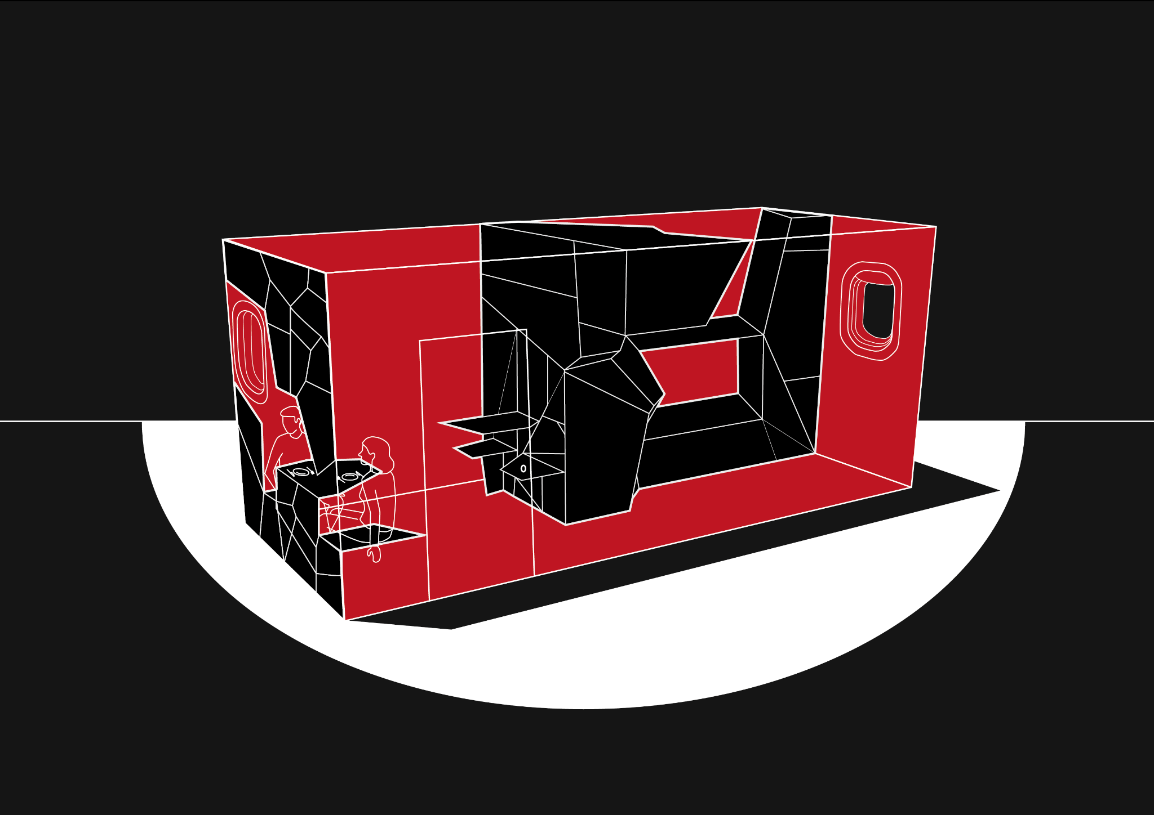
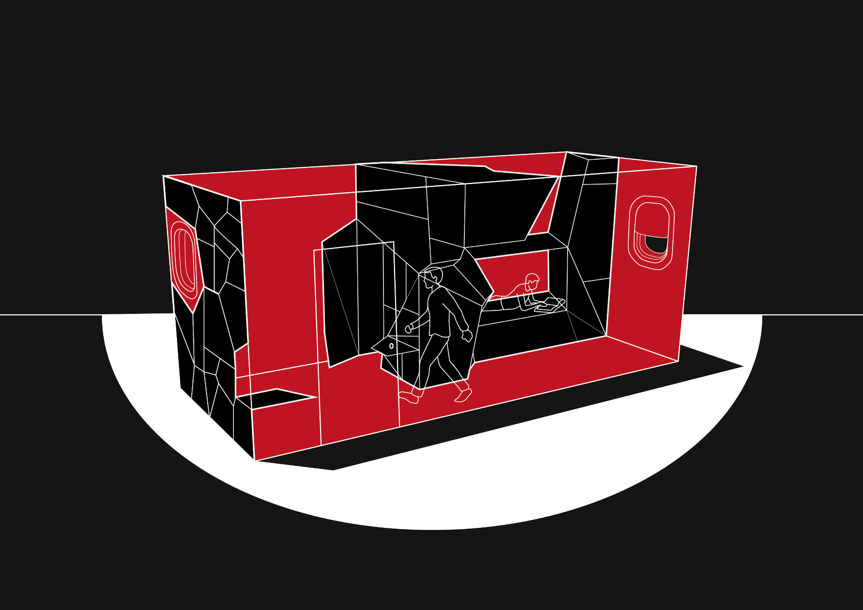
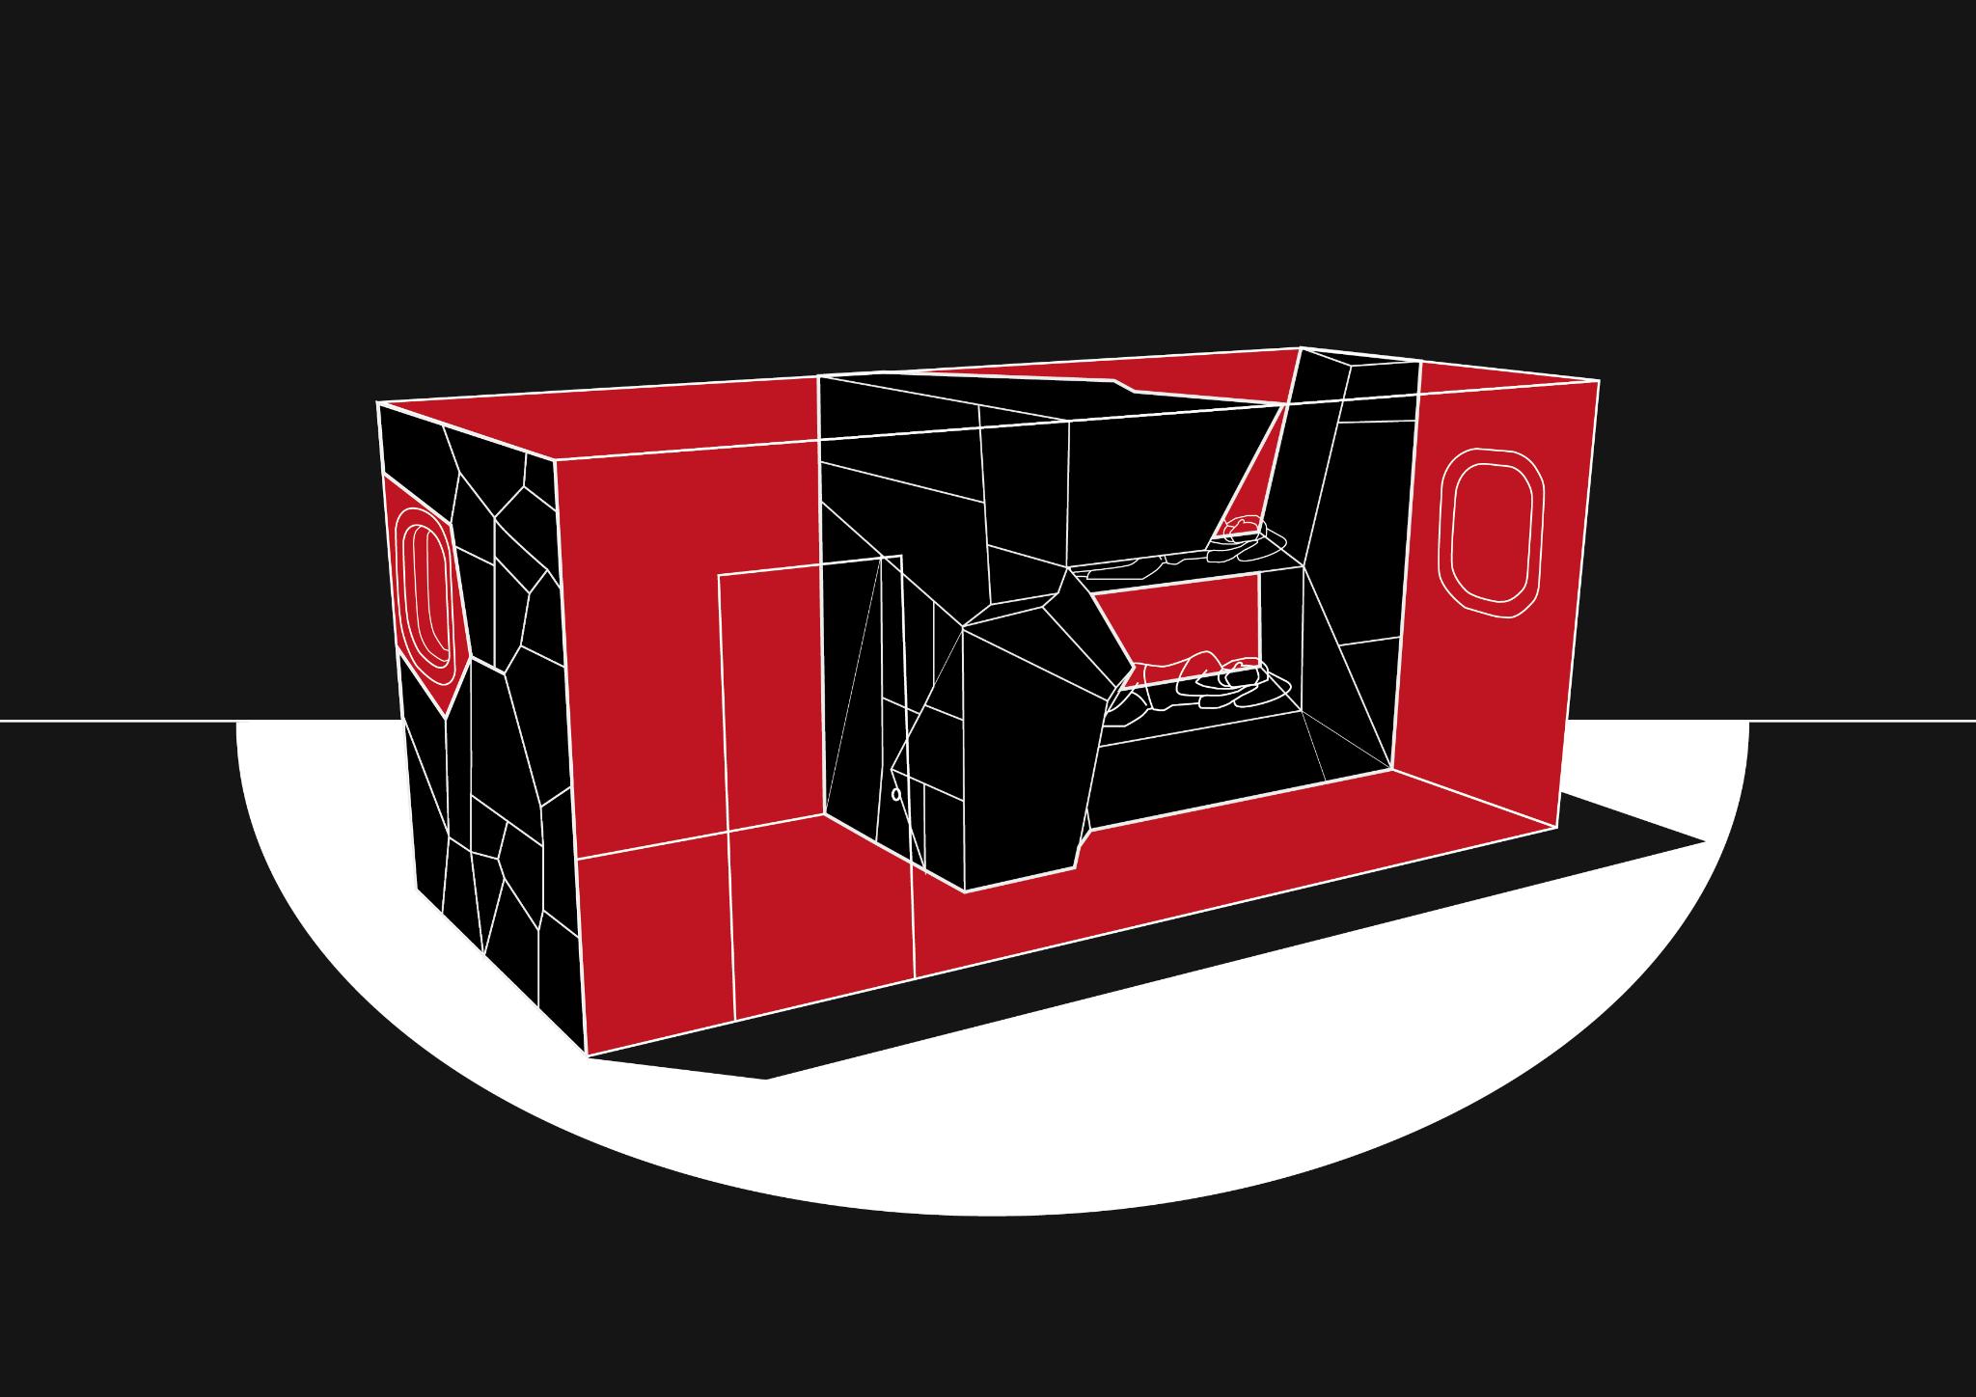
Dynamic design
01_ Work + Leisure
02_ Eating together
03_ Rest + Getting ready
04_ Sleeping
01
02
03
04

Slide 15
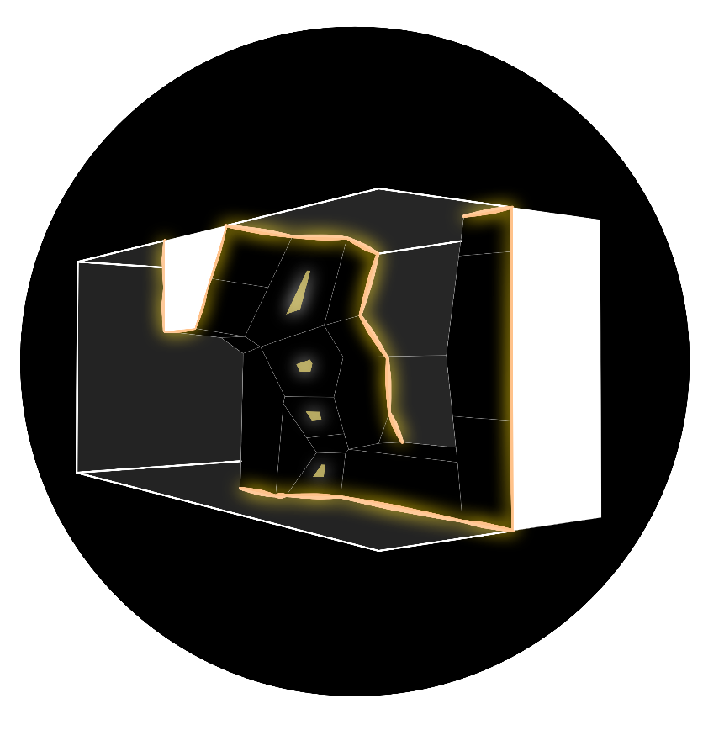

Lighting integration
Boarders
Boxes
Easy integration with panel system
Act as elegant material transition solution
Even lighting across surfaces
Task lighting
Responds to specific user activity

Slide 16
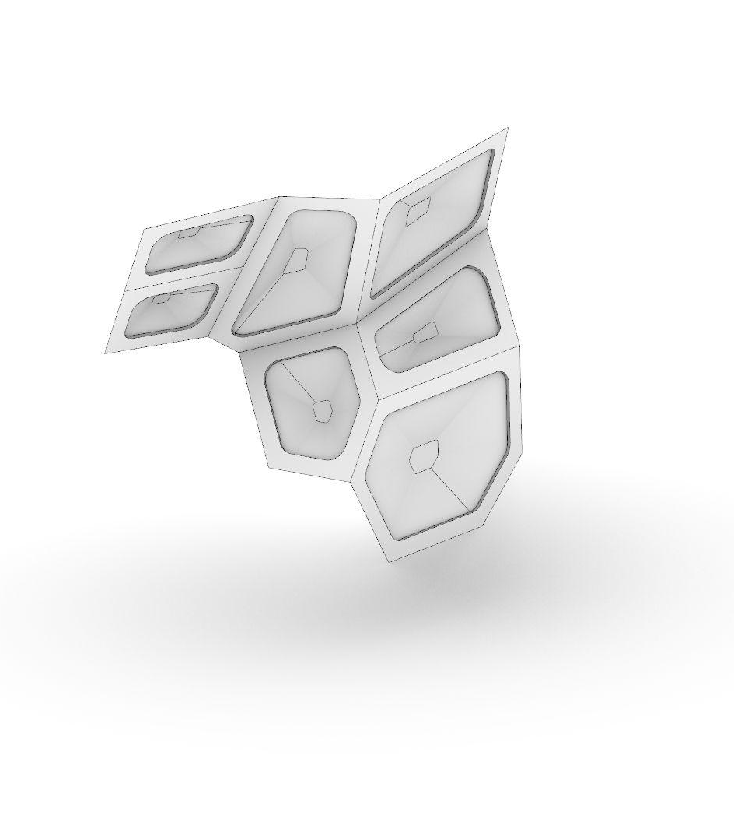
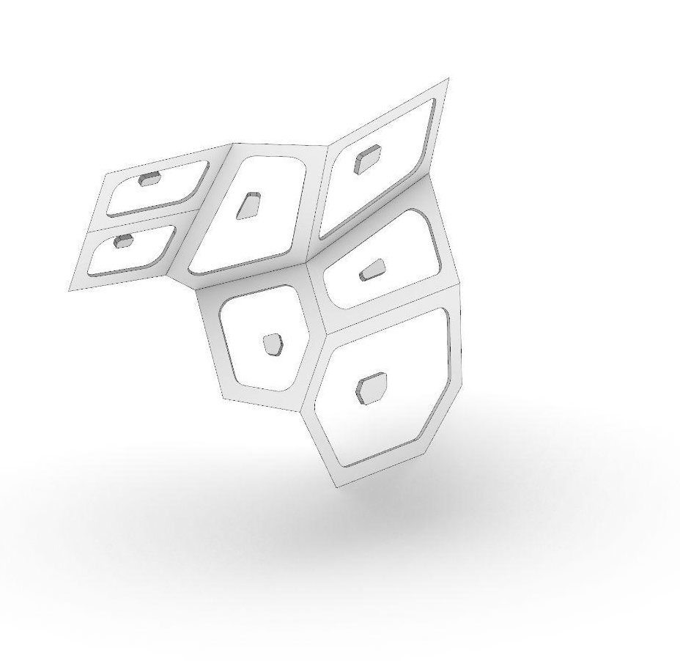
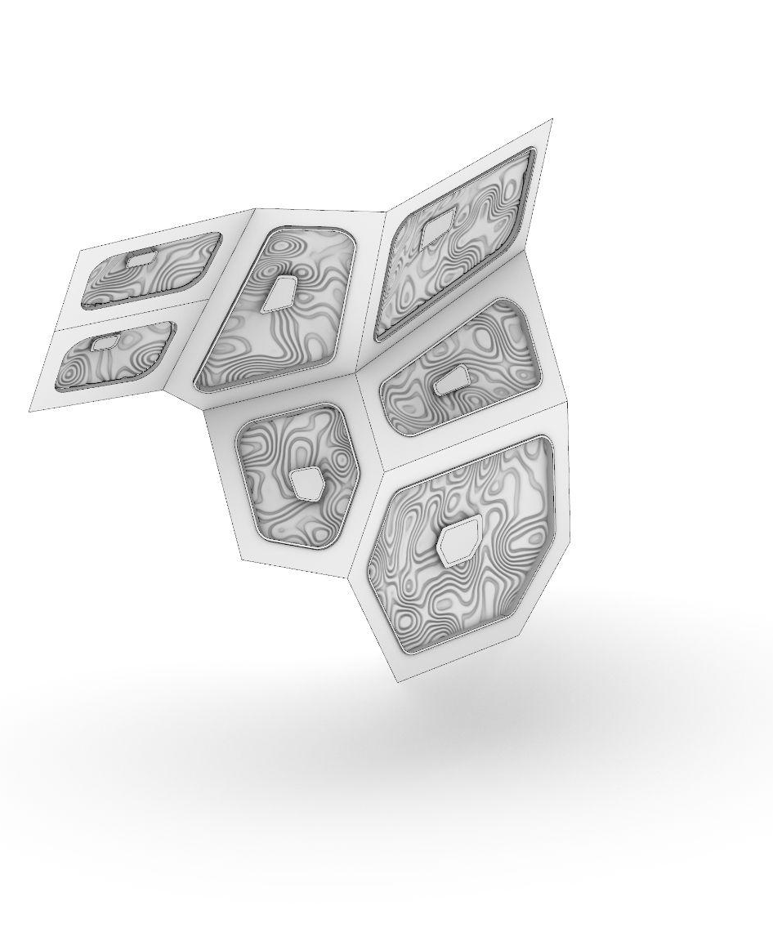
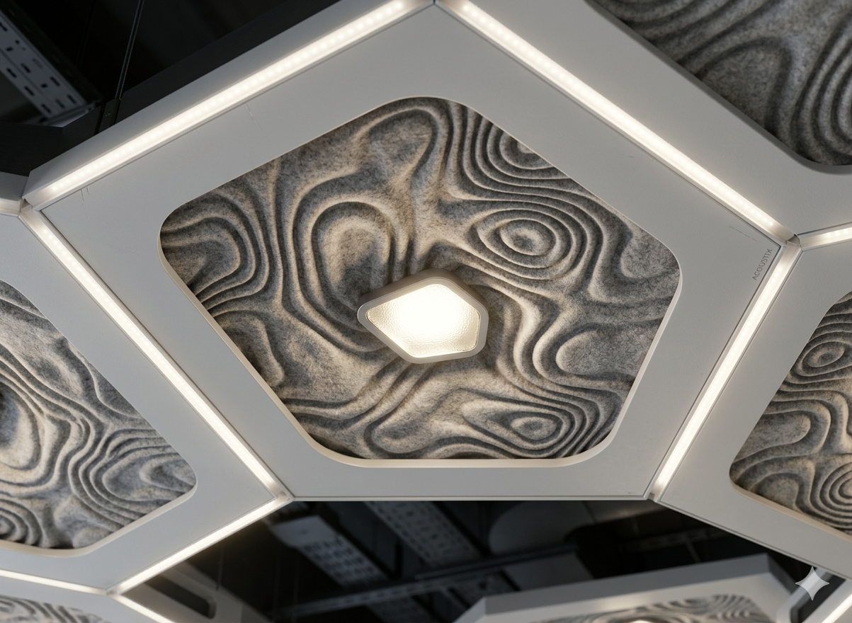
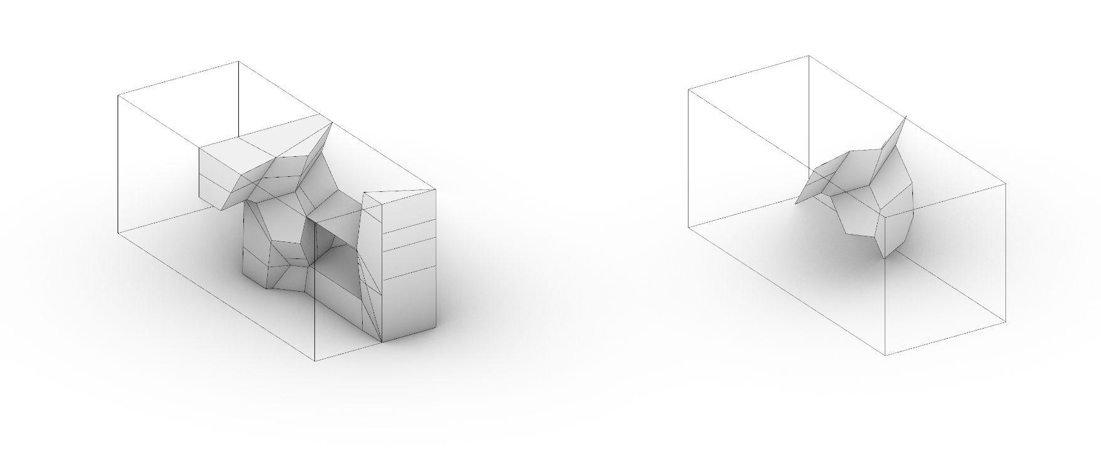
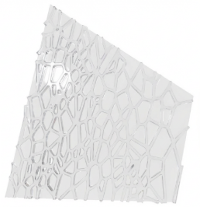
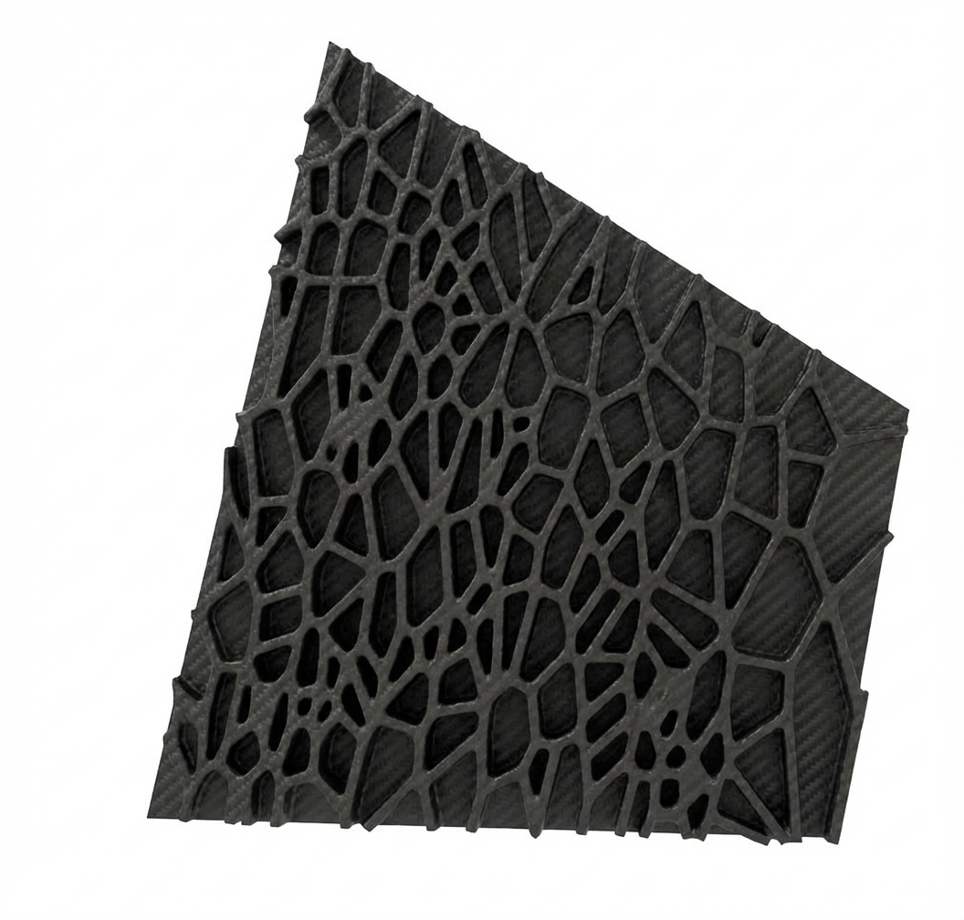
Voronoi pattern, zoom in
General Geometry
Structure + Light Points
Version 3.0
Starting surfaces are divided into 2 elements. Light surface and structural surface.
Based on the Arwins tutorial the structural optimisation is run on the edges of the panels that are shown above.
A seamless fusion of light and texture: these waved panels double as acoustic cushions, providing both visual depth and enhanced auditory comfort.
Visualisation of the panel inside the container
Structural optimisation of the panel
To minimze the use of the material and also the weight of the panels structural optimisation have been used only on the edges of the panels.
Starting geometry​
Habitat for two
Extracted surfaces
Habitat for two

Slide 17
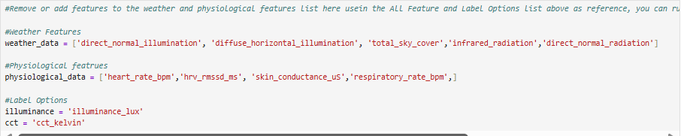
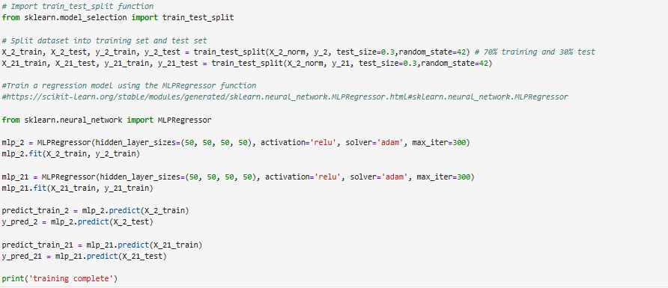
Implementing Artificial Intelligence
Filtering inputs to better fit our vision of the project
Splitting the data into training and testing data for both CCT and Illuminance
Training models

Slide 18
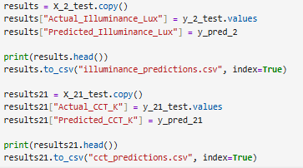
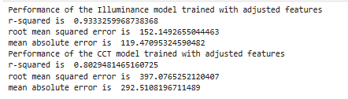
Implementing Artificial Intelligence
Compare the training data and result to check accuracy and extract data into CSV file
Check performance

Slide 19
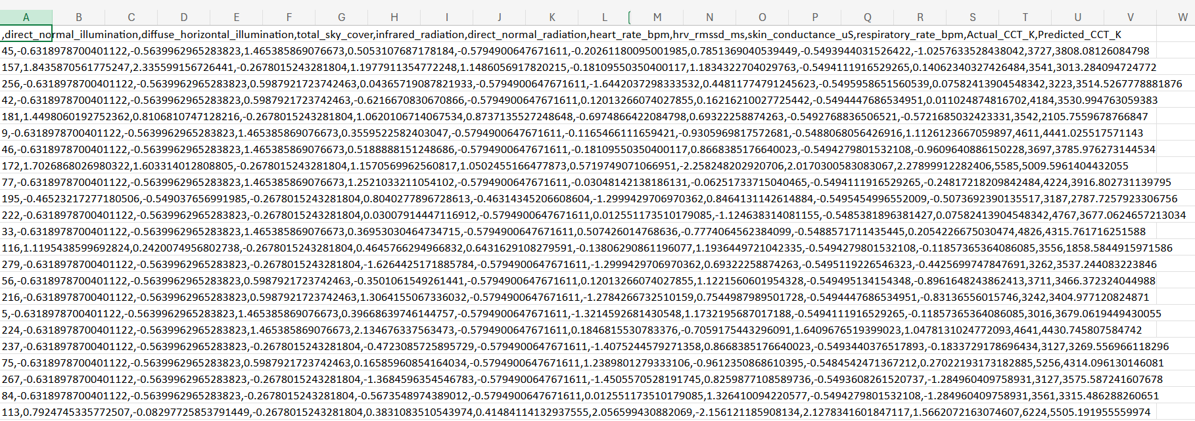
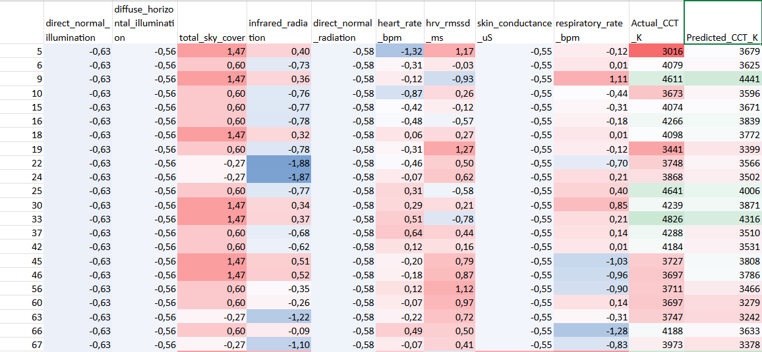
Implementing Artificial Intelligence
Data cleaning and extraction of relevant data in separate CSV

Slide 20
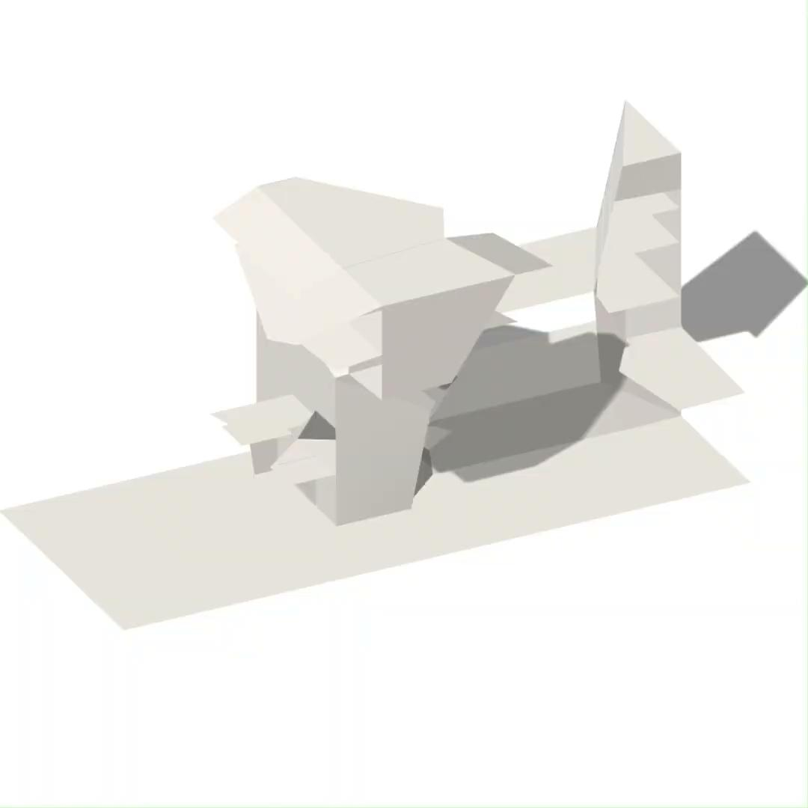
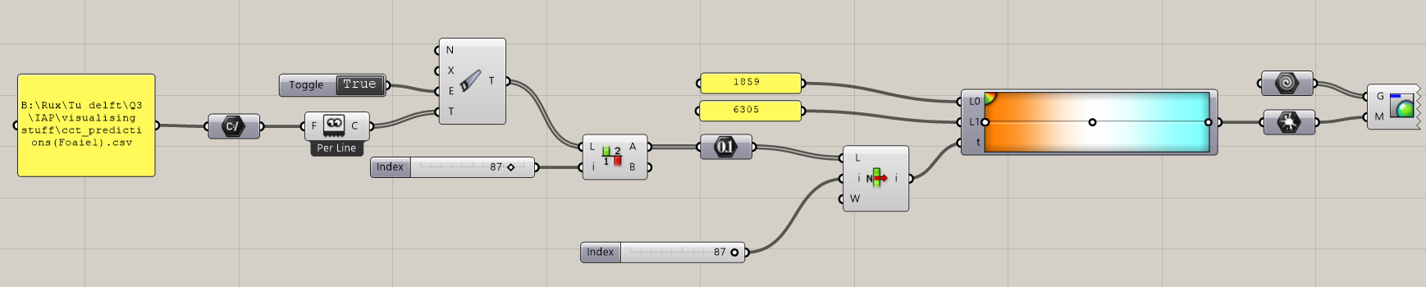
Changing CCT based on AI Data

Slide 21
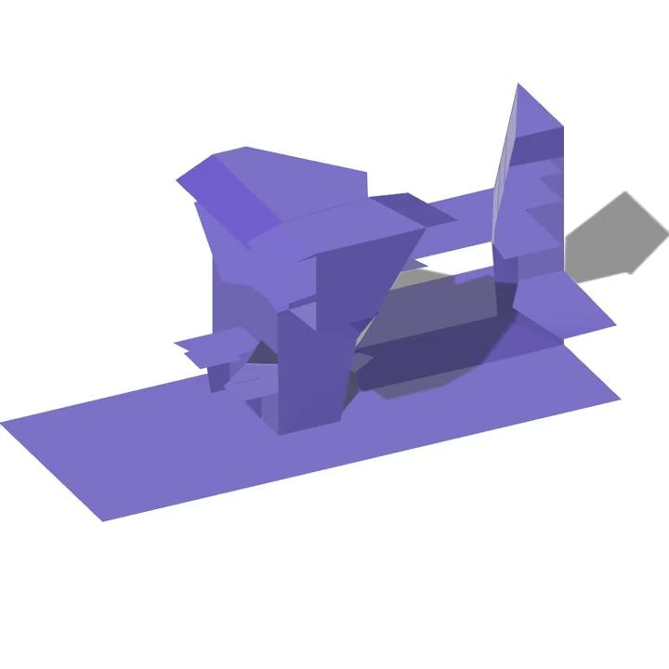
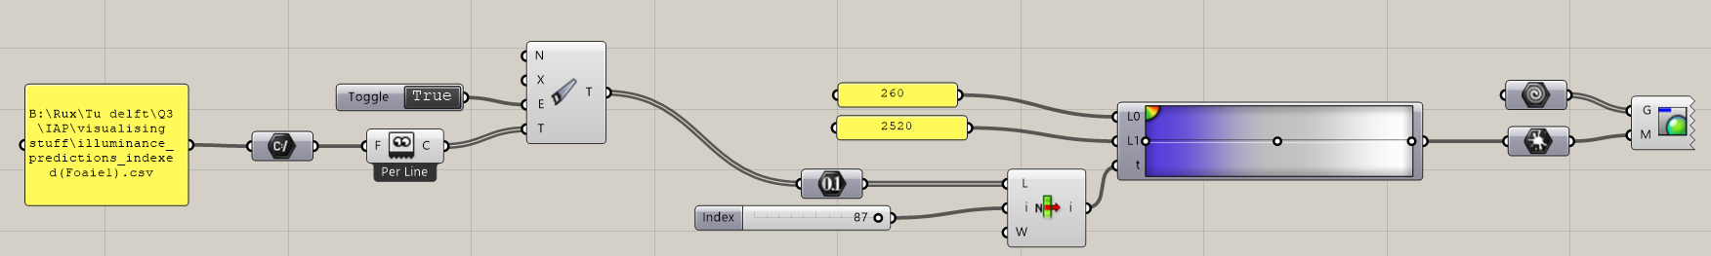
Changing Illuminance based on AI Data

Slide 22
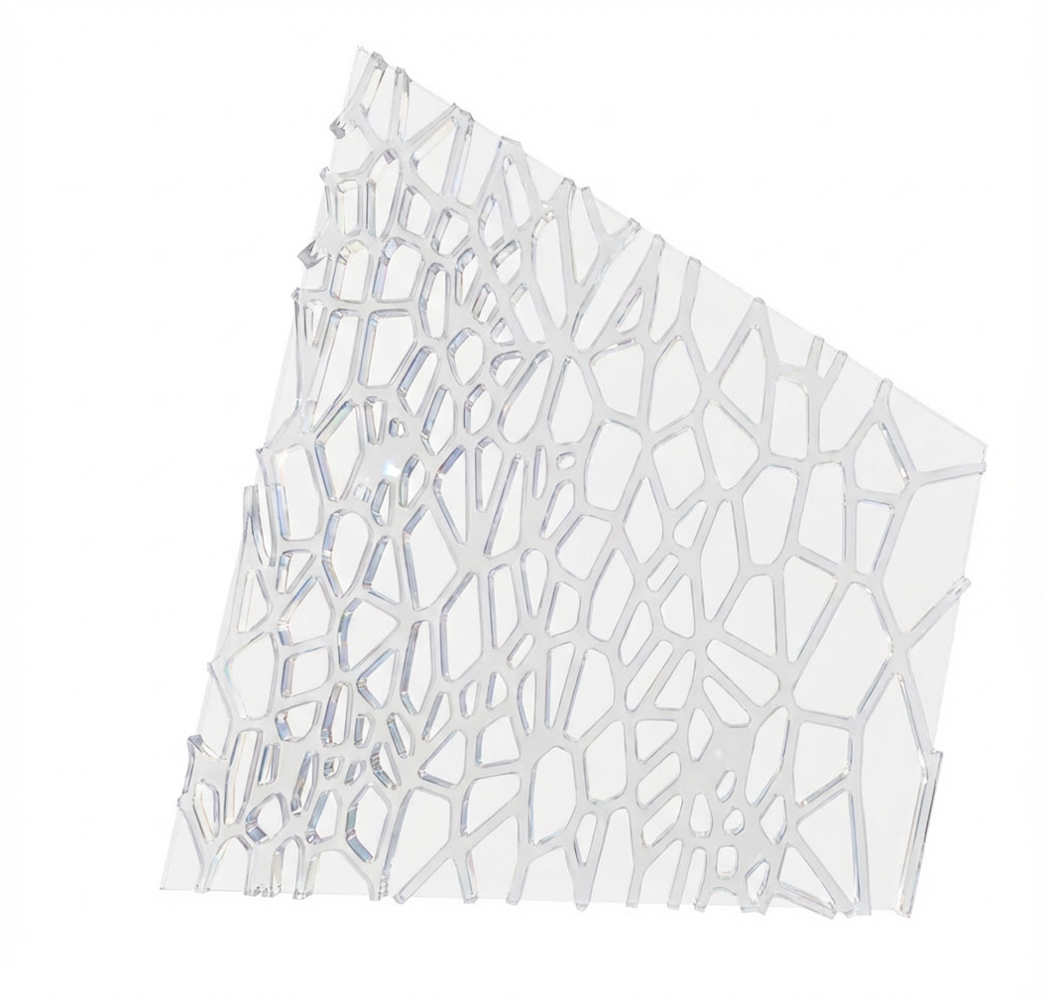
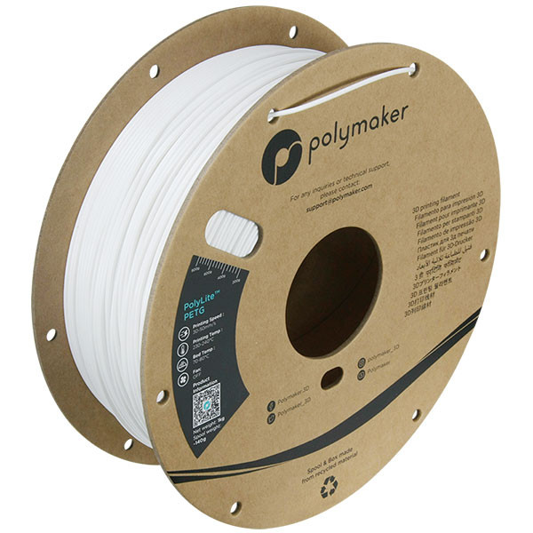
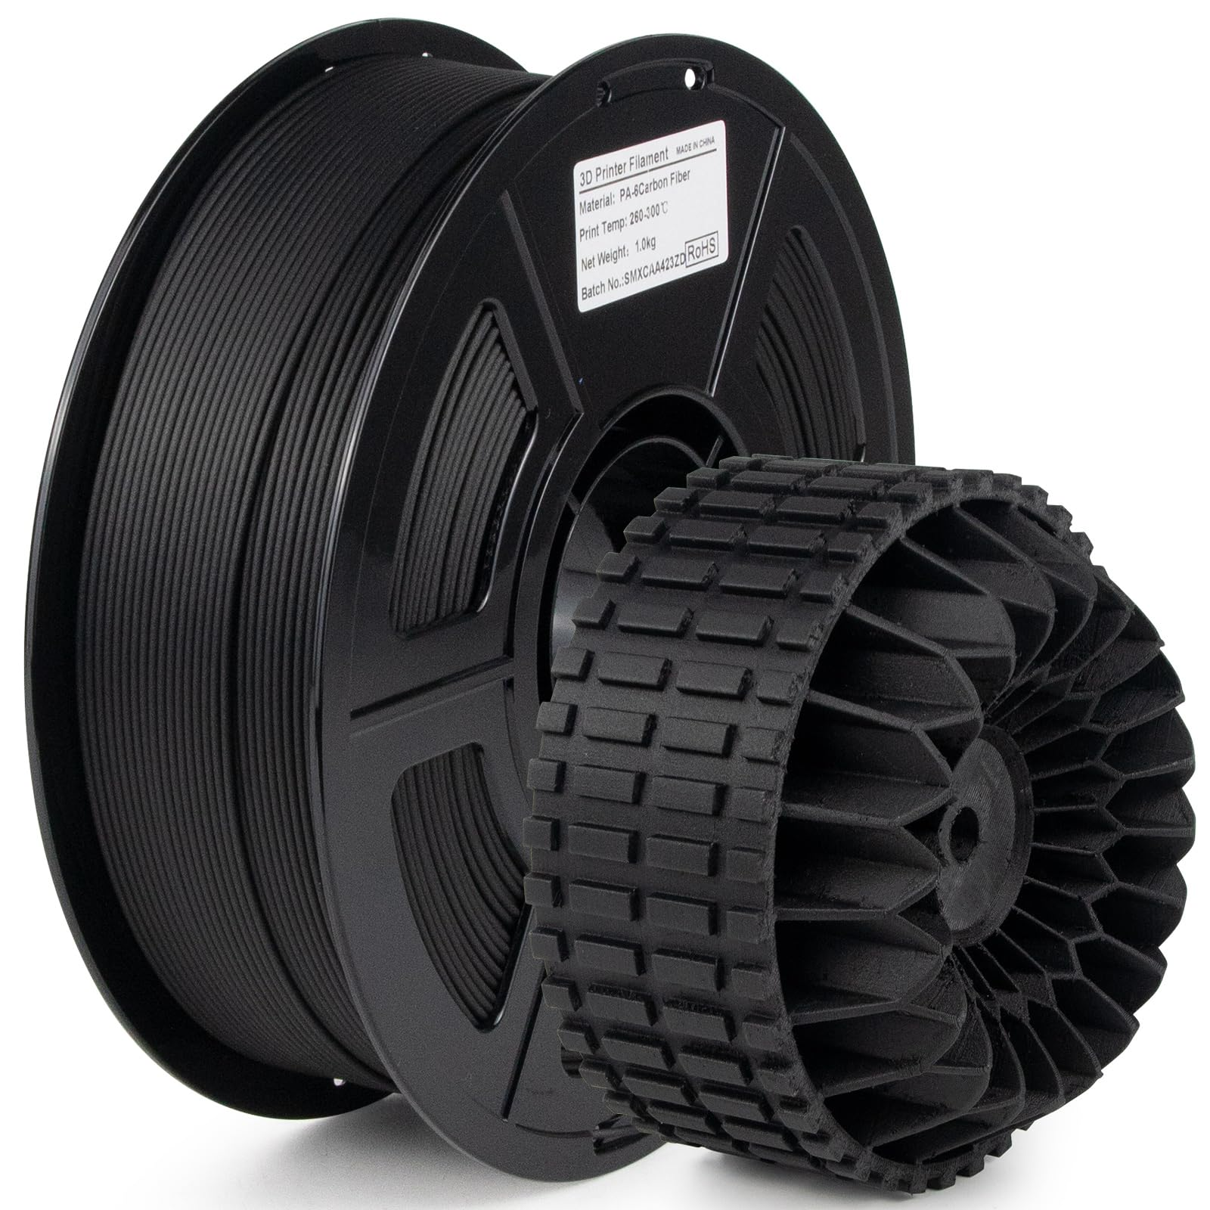
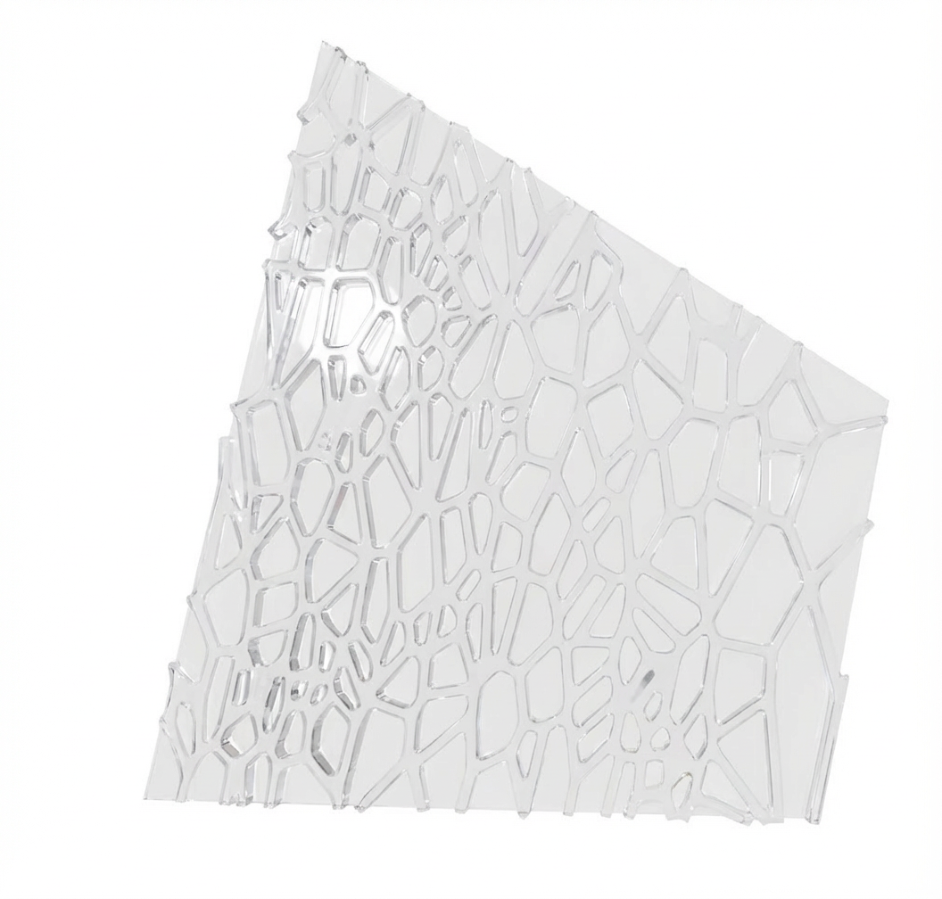
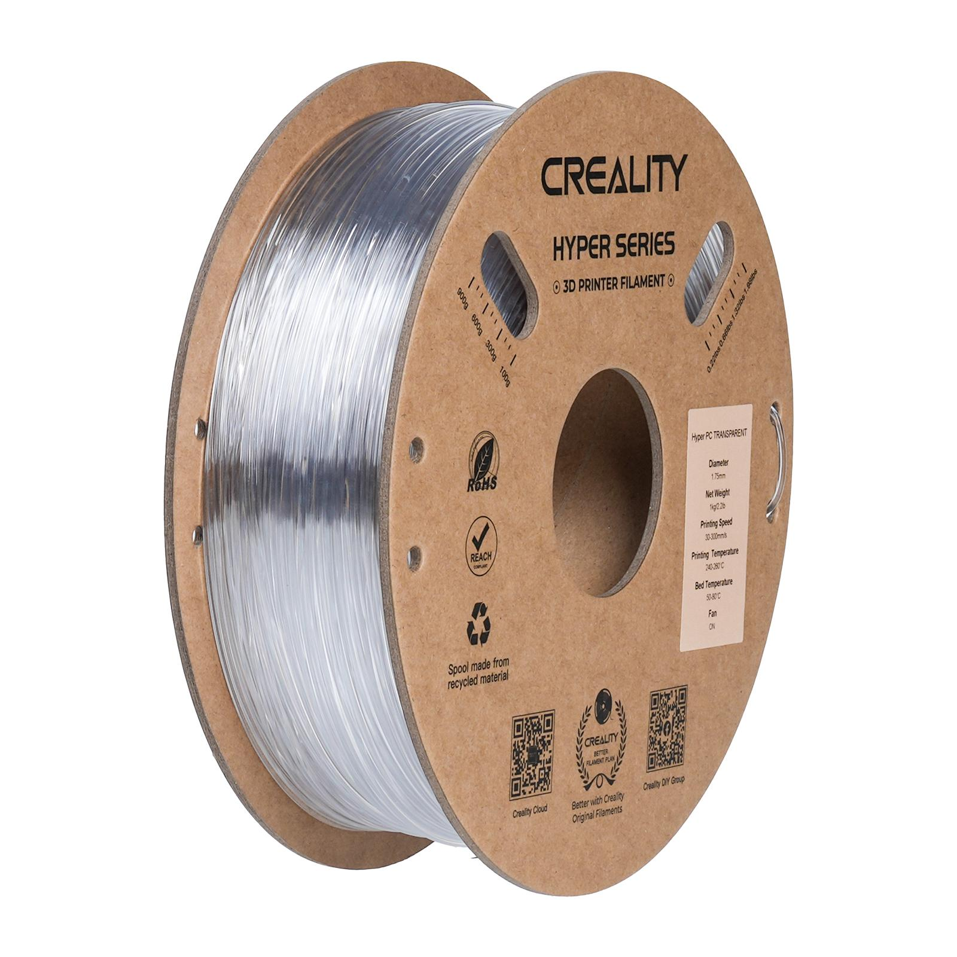
Material performance
Requirement:
Temperature range: -30°C to +25°C (Jutulsessen indoor)
Static load: 150kg (safety factor 1.5×)
Dynamic load: 200kg (impact from sitting down)
PETG - (60MPa tensile strength)
Carbon-fiber reinforced Nylon (PA) - 70–110 MPa tensile strength
Weight: 1.2–1.4 g/cm³
End up in landfill (hard to recylce)
Polycarbonate (PC)
Specifications:
Tensile strength: 60-70 MPa
Flexural modulus: 2,300 MPa
Impact resistance: -30°C
Recycle: Mechanical Recycling
Recycling process 1. COLLECTION
2. SORTING & IDENTIFICATION
3. CLEANING / WASHING
4. SIZE REDUCTION (Shredding into flakes)
5. SEPARATION OF CONTAMINANTS
6. DRYING
7. MELT EXTRUSION / REPROCESSING
8. PELLETIZING (Cutting into pellets)
9. REMANUFACTURING
(Injection molding, extrusion, thermoforming)
END: NEW PC PRODUCTS
(Electronic components, sheets, automotive parts)

Slide 23
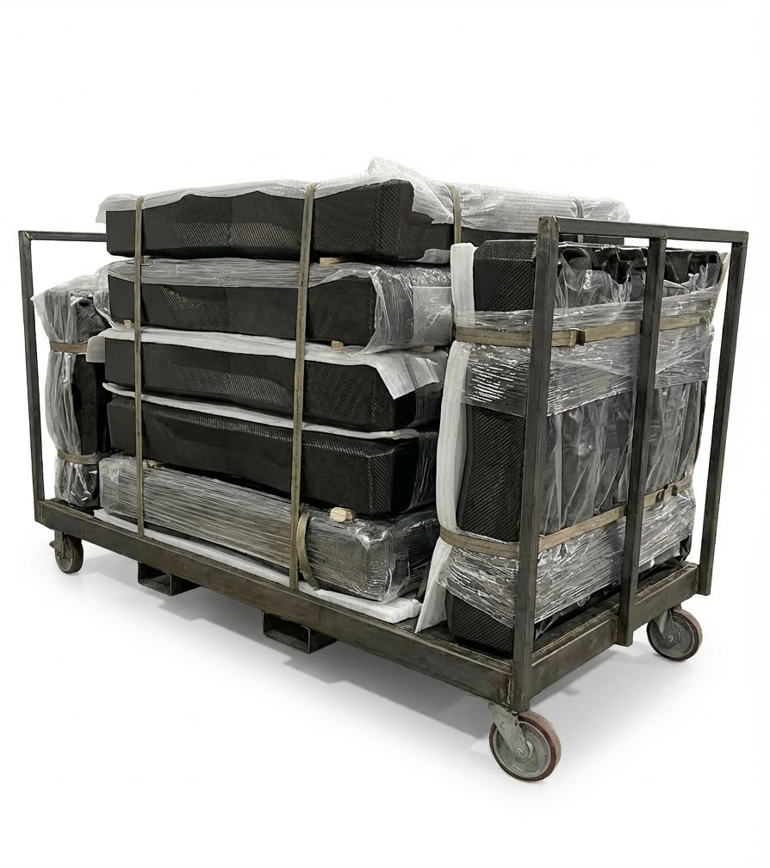
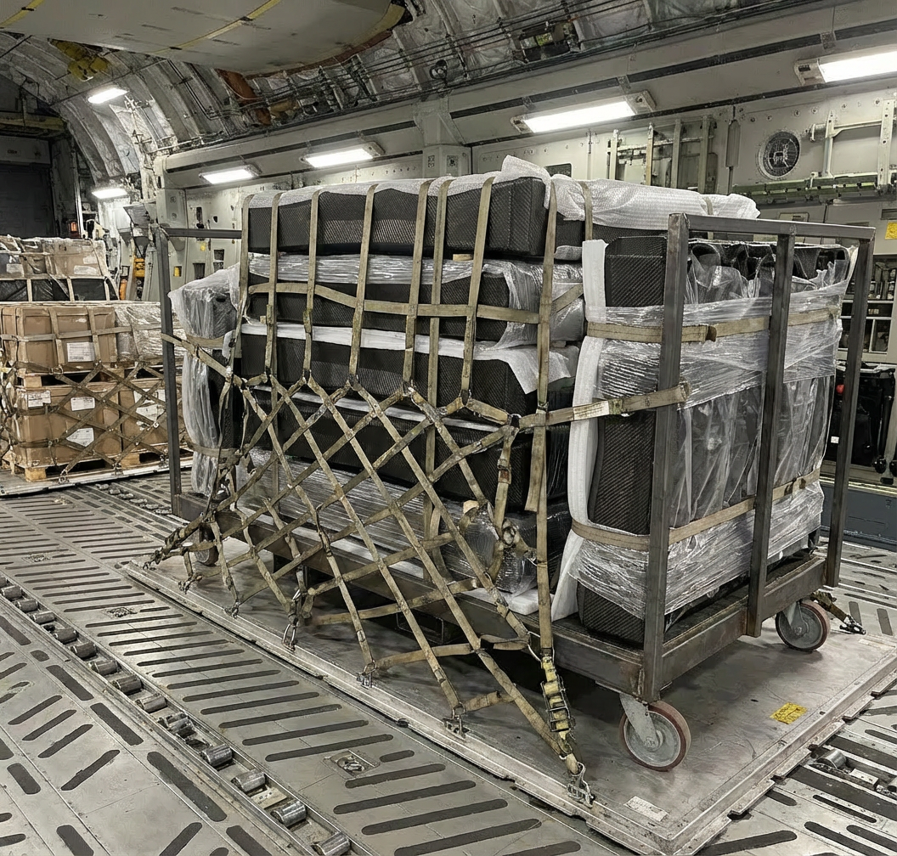
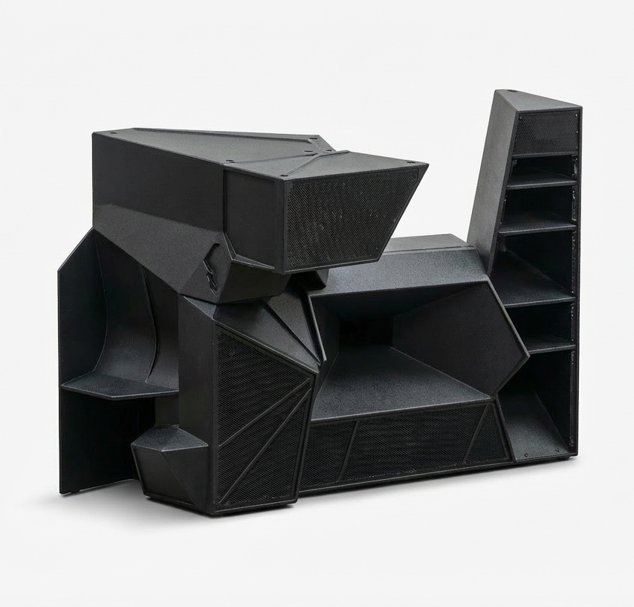
Material transportation
3D print
Packed the piece in vacuum bags
Transfer by plane
Combine together on site

Slide 24
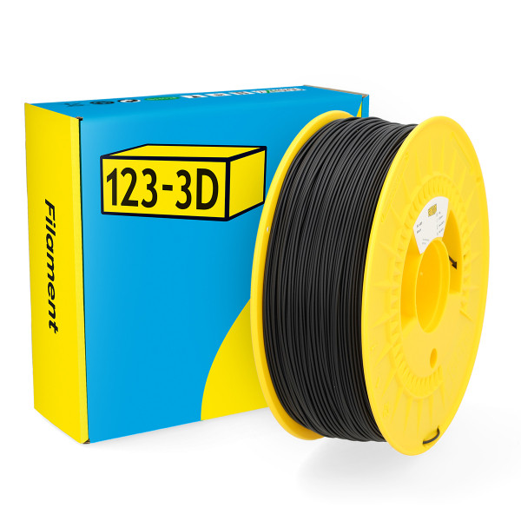
Material Prototype
Prototyping material: PLA
easy to print
low cost
suitable for geometry and concept testing
Final manufacturing material: Polycarbonate PC
stronger and tougher than PLA
better heat resistance
more suitable for functional parts
For the robotic arm prototype case study, we use PLA because it is simple and cost-effective for testing geometry. For future manufacturing, polycarbonate could be a better option due to its higher mechanical strength and heat resistance.

