Slide 1
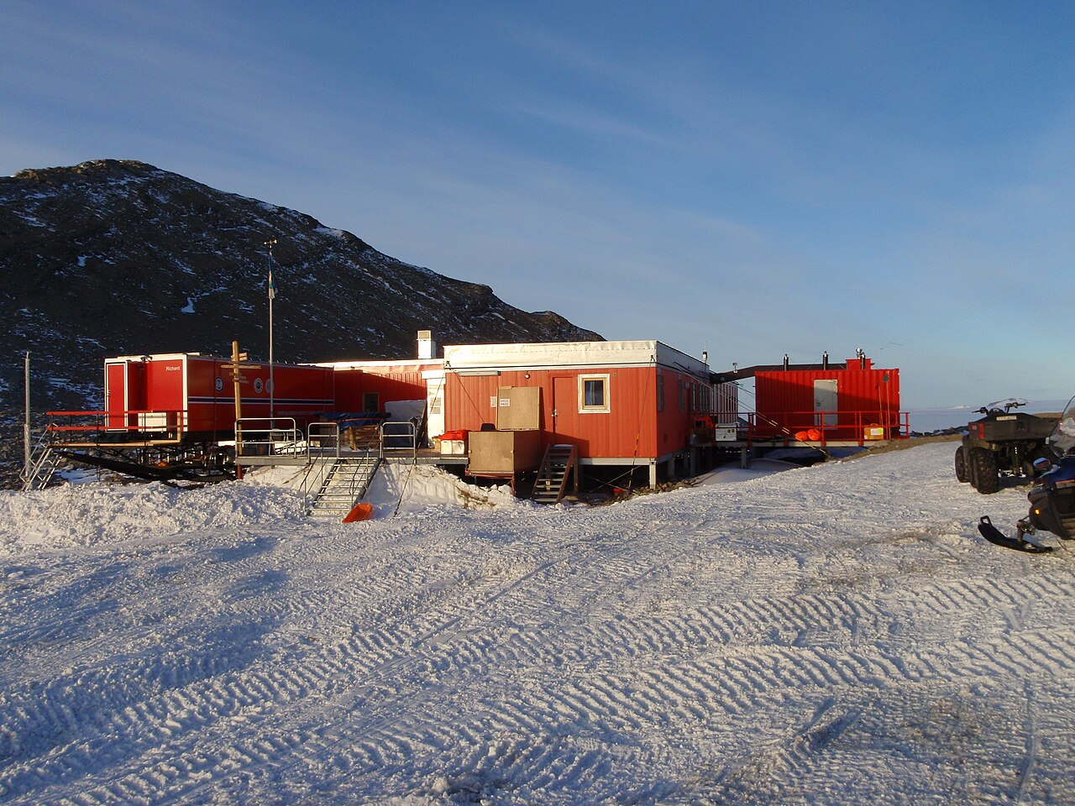
TROLL RESEARCH STATION
Project presentation_week 2
Students: Iris Claus, Catriona Darcy, Daphne Kamsteeg, Ludovica Perone Pacifico, Chloé Phan, Marieke van Wijk
IAP Workshop
Spring semester 2026
Prof. Henriette Bier, Arwin Hidding, Lisa-Marie Mueller, Vera Laszlo

Slide 2
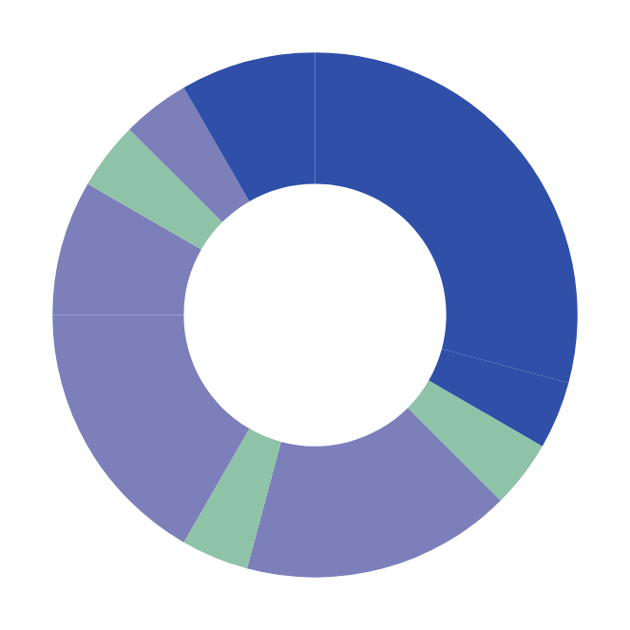
01
24/7 ACTIVITY MAPPING - TIME
ORDINARY USE
EMERGENCY USE
Relaxing
21.00 - 22.00
Relaxing
21.00 - 22.00
Dining
20.00 - 21.00
Sleeping
22.00 - 7.00
1 h
Dining
20.00 - 21.00
1 h
Sleeping
22.00 - 7.00
1 h
00.00
9 h
1 h
00.00
9 h
Relaxing
/ exercising
18.00 - 20.00
Relaxing
/ exercising
18.00 - 20.00
2 h
2 h
18.00
06.00
18.00
06.00
1 h
Hygiene
7.00 - 8.00
1 h
Hygiene
7.00 - 8.00
4 h
12.00
1 h
4 h
12.00
1 h
Working
14.00 - 18.00
Working
14.00 - 18.00
1 h
Dining
8.00 - 9.00
1 h
Dining
8.00 - 9.00
4 h
4 h
Individual
Dining
13.00 - 14.00
Specialised working
9.00 - 13.00
Dining
13.00 - 14.00
Working
9.00 - 13.00
Collective
Both
+ Storage: personal items, clothing, first aid kit, emergency food reserve
Conclusions: Sleeping and working: primary time-occupancy functions. Dining: highest frequency, hence must be more easiliy accessible. Working, relaxing, exercising: must allow both collective and private fruition, hence at least two configurations each.

Slide 3
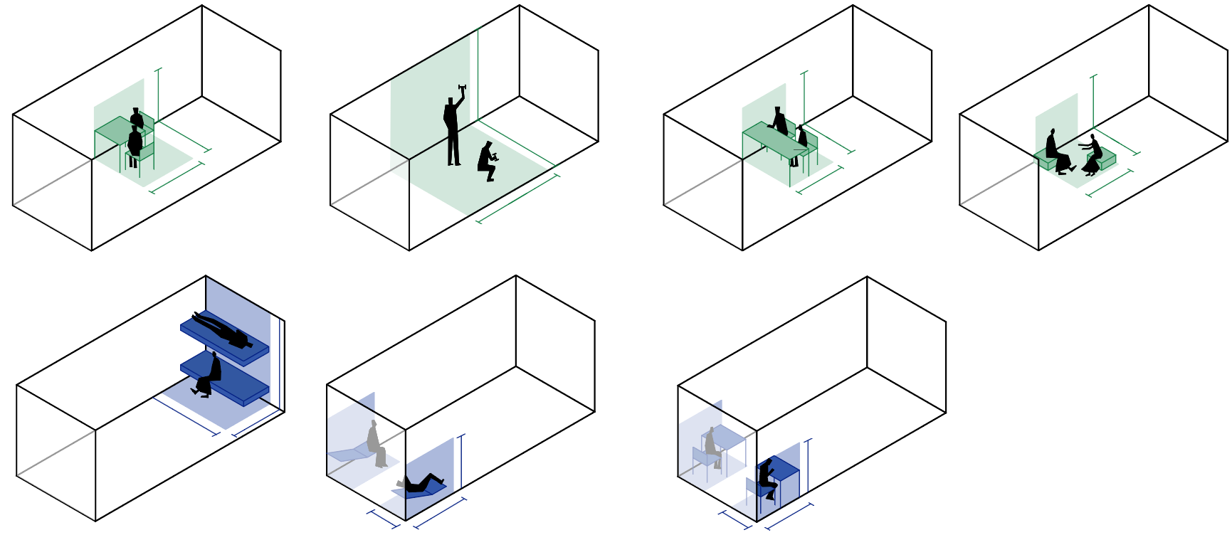
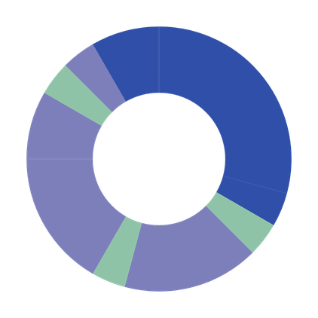
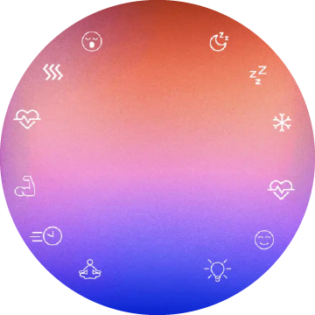
01
24/7 ACTIVITY MAPPING
Relaxing
21.00 - 22.00
2.5 m
Dining
20.00 - 21.00
2 m
1.5 m
1.5 m
1 h
Sleeping
22.00 - 7.00
1 h
9 h
1.5 m
00.00
0.8 m
Relaxing /
exercising
18.00 - 20.00
2 h
2.5 m
18.00
06.00
2.5 m
1.4 m
4 h
1 h
Hygiene
7.00 - 8.00
1.6 m
Working
14.00 - 18.00
12.00
1 h
2.5 m
1.6 m
1 h
Dining
8.00 - 9.00
4 h
Dining
13.00 - 14.00
+ Storage:
personal items, clothing, first aid kit, emergency food reserve
Working
9.00 - 13.00
1.5 m
Individual
Collective
Both
0.8 m
1.5 m
Conclusions: Sleeping: primary time-occupancy function. Dining: highest frequency, hence must be more easiliy accessible. Working, relaxing, exercising: must allow both collective and private fruition, hence at least two configurations each.

Slide 4
02
24/7 ACTIVITY MAPPING - SPACE
INDIVIDUAL ACTIVITIES
During individual use, occupants tend to appropriate peripheral zones.
2.5 m
2 m
1.5 m
1.5 m
1.5 m
0.8 m
1.5 m
0.8 m
1.5 m
Sleeping
Bunk beds for maximum privacy.
At one extremity of the container to minimise daytime circulation interference, creating an “alcove” enhancing privacy, while allowing visual control over the room (Prospect-refuge theory).
Working
Opposite side of sleeping area to ensure physical and psychological separation.
Visual control over the room.
Relaxing
As an alternative function, place in same space of the working area, supporting spatial efficiency.

Slide 5
02
24/7 ACTIVITY MAPPING - SPACE
COLLECTIVE ACTIVITIES
During social activities, occupants gravitate toward the centre, naturally acting as buffer between sleeping and working areas.
1.4 m
2.5 m
1.4 m
3.7 m
1.6 m
2.5 m
1.6 m
Working
1.6 m
2.5 m
1.4 m
1.6 m
Dining
Centrally positioned for accessibility and equal reach from all zones, since activity with highest frequency.
Excercising
Demands maximum clearance of floor area.
1.6 m
Relaxing

Slide 6
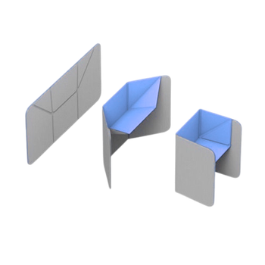
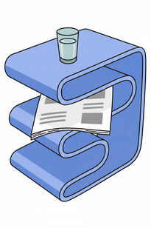
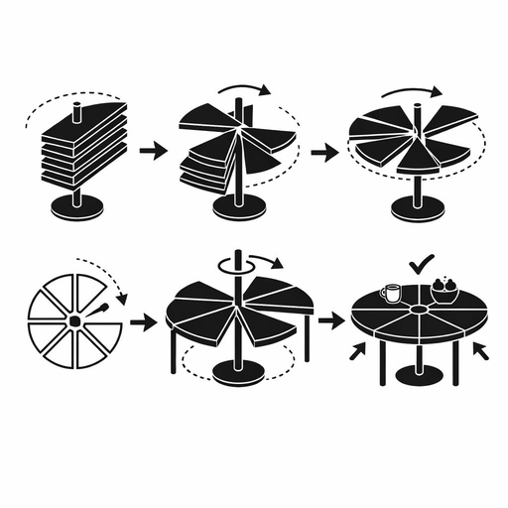
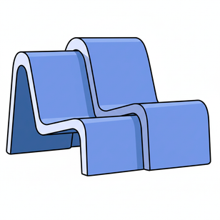
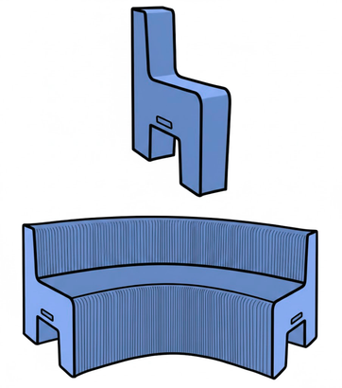

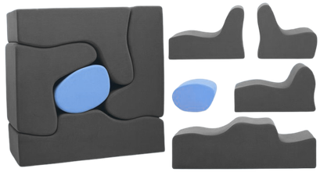
03
ADAPTIVE TRANSFORMATION PRINCIPLES
!! ADD REFERENCES (at different scales)
Active change
Passive change
Changing the shape
with a mechanism or manually
Changing the function
Folding - creating a bigger/smaller volume by using a/several hinge point(s)
Hybridisation- a multipurpose object, low-tech and for easy use (also Active)
Rotating- creating a different shape by rotating.
Zoning- changing the lighting or color, material or height differentses (layering).
Extruding- creating a bigger/smaller volume by extruding or sliding parts together
Nesting- taking an object out of another to create several objects/ putting an object inside another to safe space
Modular Clustering- creating a bigger/smaller volume by building something with modules

Slide 7
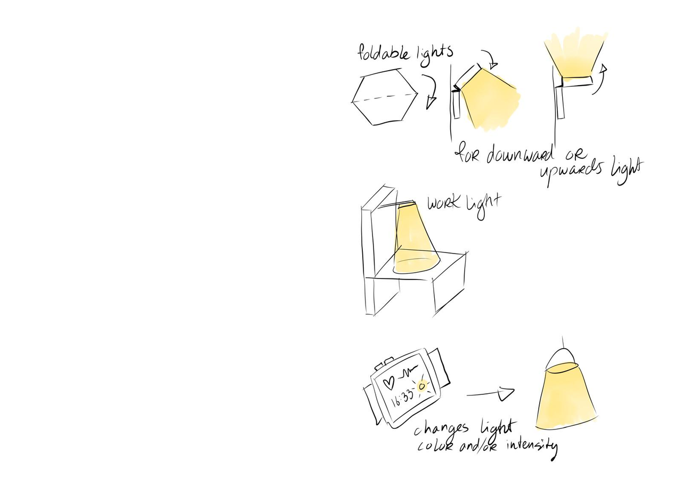
04
LIGHTING PRINCIPLES
Responding to light cycles - overhead lighting to mimic solar movement
To prevent the extreme Antarctic light cycles from disrupting circadian health
Mimics the light color and intensity for that time of day/ activity
Examples
colours
Relaxing
21.00 - 22.00
Dining
20.00 - 21.00
1 h
Sleeping
22.00 - 7.00
1 h
00.00
9 h
Relaxing
/ exercising
18.00 - 20.00
2 h
Responding to activities - localized lighting to create activity zones and boost productivity, mood and comfort
Soft, warm light near the beds, brighter focused light at the desk, etc.
sensors to track movement for example during the night
ability to localize lighting
18.00
06.00
4 h
1 h
Hygiene
7.00 - 8.00
12.00
1 h
Working
14.00 - 18.00
Dining
8.00 - 9.00
1 h
4 h
Dining
13.00 - 14.00
Working
9.00 - 13.00
Responding to health - To enhance emotional well-being, measure stress levels, alertness and mood, changing the lighting accordingly.
Elevated stress -> warmer light and reduced intensity
Alertness during work -> cooler and brighter light
Before sleep -> amber and gradual dimming
source: SAGA, Circadian lights for ISS

Slide 8
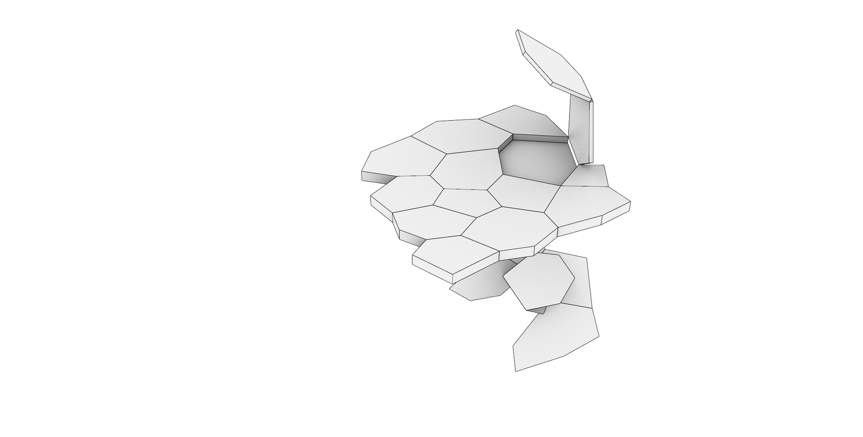
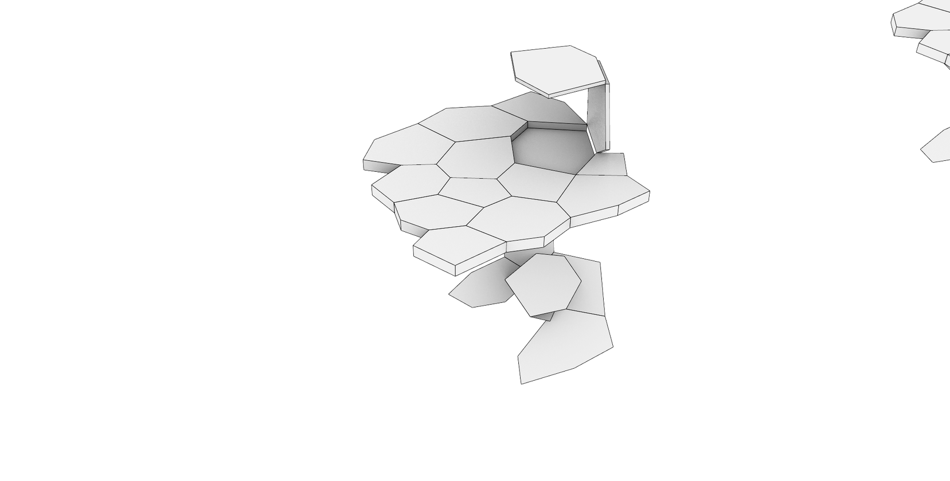
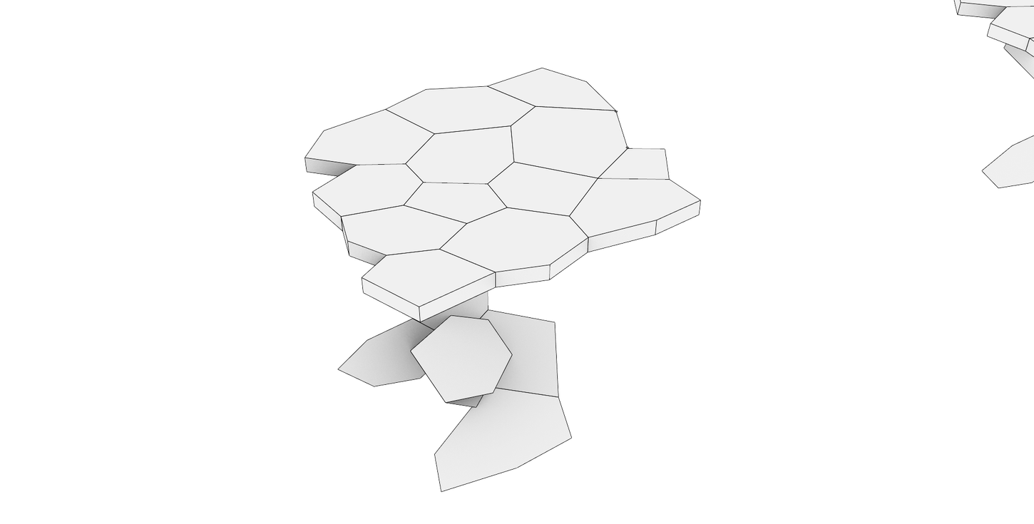
05
FURNITURE IDEAS
Folded table Initial state
Voronoi tabletop
Openable foldable cell panel
Emits lights underneath the top panel
Adjustable inclination of the light
Pivot allows better light control

Slide 9
Thank you for your attention !

