Slide 1
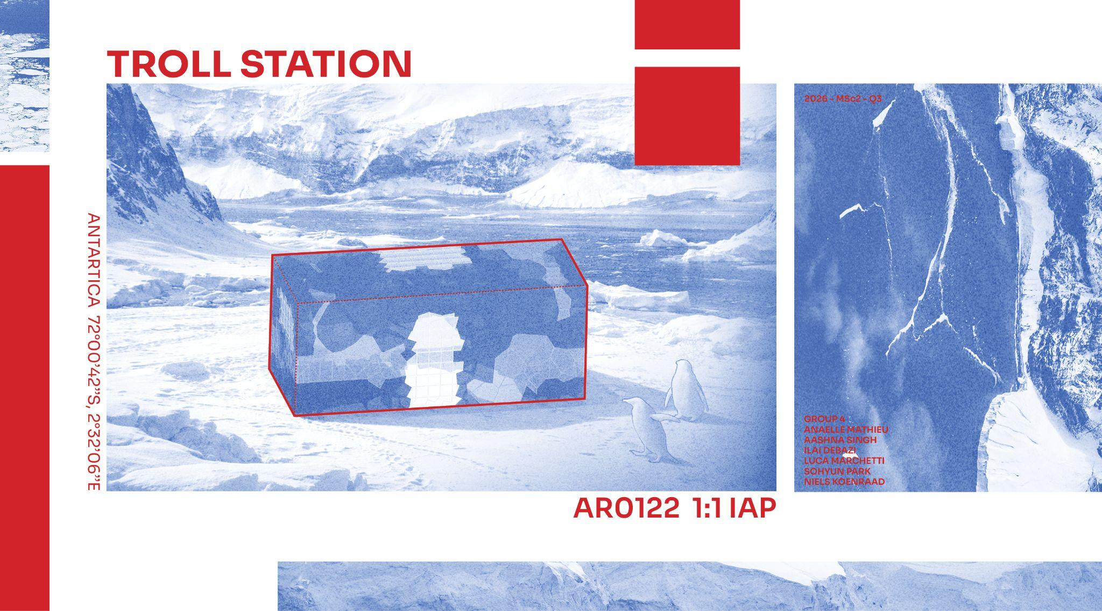

Slide 2
FONT Sora SemiBold FONT Sora Medium
FONT Sora Light

Slide 3
Intro
context
temporalities & logistics
24/7 mapping

Slide 4
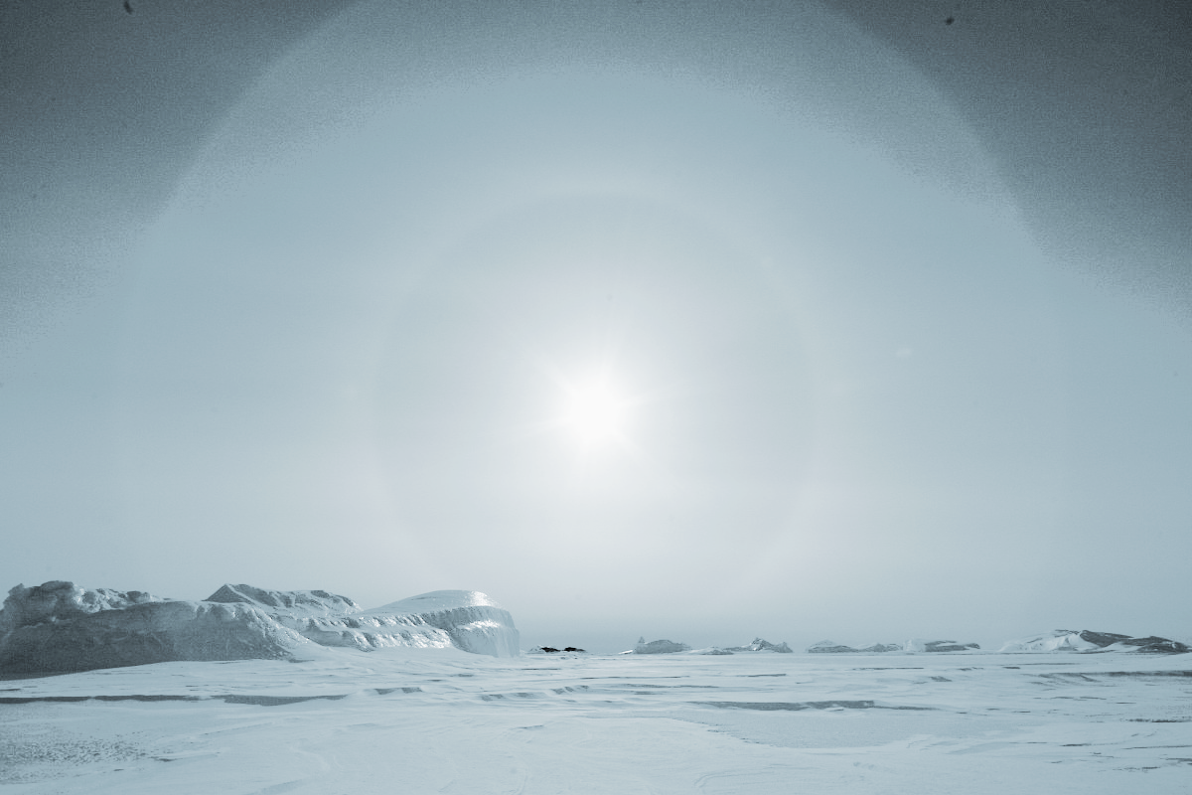
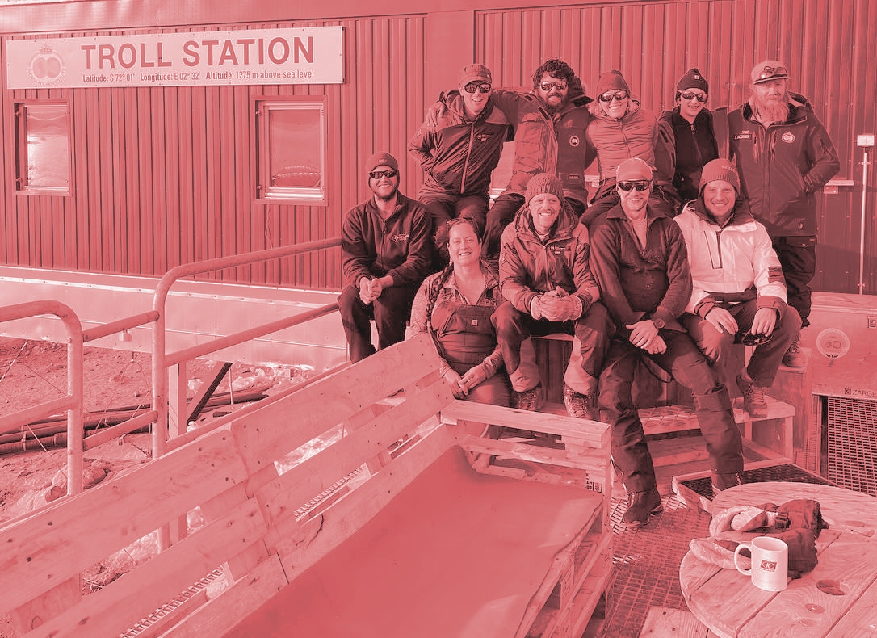
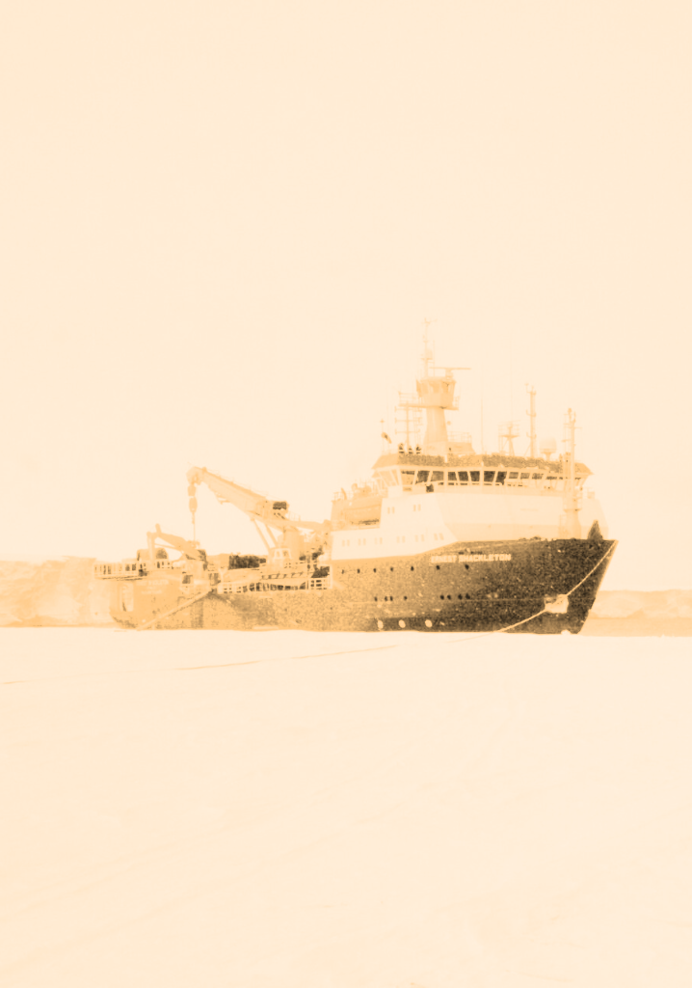

Context
Environment
Crew
Logistics

Slide 5
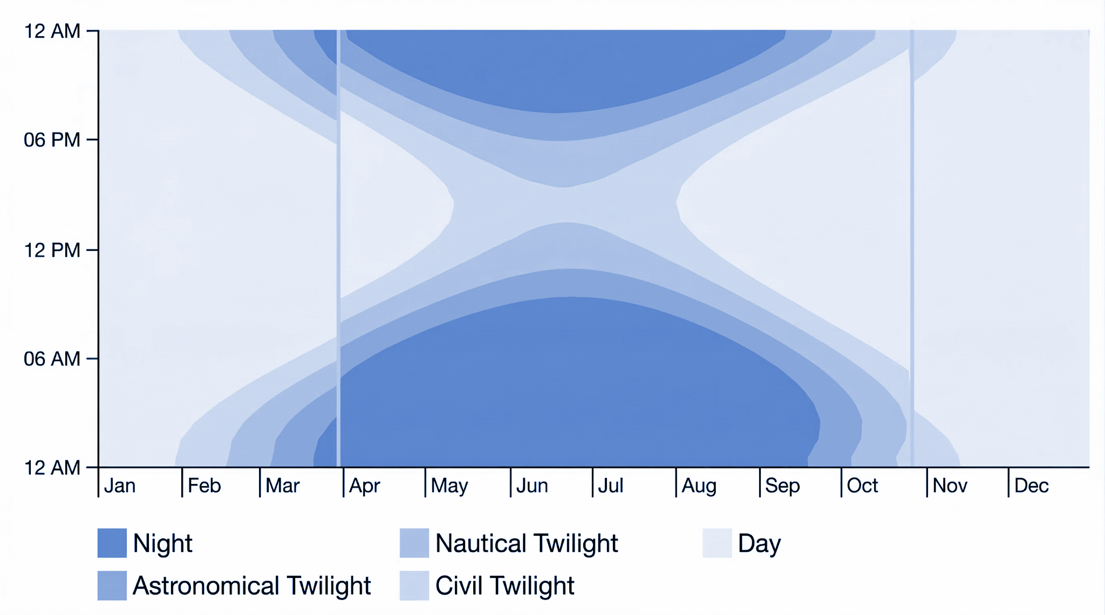
Temporalities
| Jan | Feb | Mar | Apr | May | Jun | Jul | Aug | Sep | Oct | Nov | Dec |
Re-supply ship
via Aircraft
Summer (40-70)
Overwintering (6)
Seasonal Cycle
Daylight Cycle
Logistics
Crew
Environment
Notes:
ILAI:

Slide 6
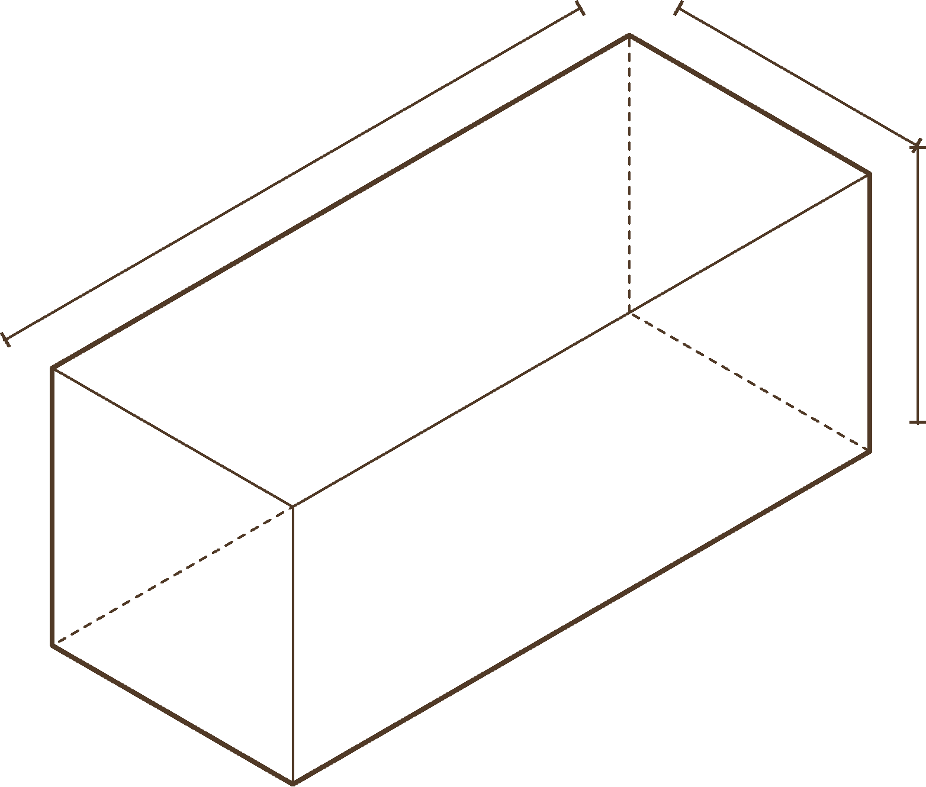

Design parameters
2.5m
6m
2.5m
Container Dimensions: 6,000 x 2,500 x 2,500 mm
Number of Occupants: 2

Slide 7
Overwintering crew
01
Station Leader
02
Mechanical Engineer/Technician
03
Electrical Engineer/Systems Technician
04
Atmospheric Scientist/
Meteorologist
05
Cook/Logistics Coordinator
06
Communications + Medical officer
Niels
Sohyun
Luca
Aashna
Ilai
Anaelle
Station Coordination
Safety Oversight
Norway & Mission Control Communication
Operational Planning
Emergency Decision-Making
Infrastructure Inspections
monitoring electrical systems
maintaining sensors and scientific instruments
troubleshooting electronic equipment
supporting station technical infrastructure
maintenance of generators
heating and fuel systems
repair of vehicles and mechanical equipment
inspection of infrastructure
workshop maintenance and spare part preparation
weather observations
atmospheric measurements
operation of monitoring instruments
climate data analysis and reporting to international network
meal preparation for crew
management of food storage and inventory
kitchen hygiene
monitoring long-term food supplies
operation of communication systems
management of satellite links and IT infrastructure
coordination of external communication
medical monitoring and emergency response

Slide 8
Crew members and functions
01
Station Leader
02
Mechanical Engineer/Technician
03
Electrical Engineer/Systems Technician
04
Atmospheric Scientist/
Meteorologist
05
Cook/Logistics Coordinator
06
Communications + Medical officer
Niels
Sohyun
Luca
Aashna
Ilai
Anaelle
Station Coordination
Safety Oversight
Norway & Mission Control Communication
Operational Planning
Emergency Decision-Making
Infrastructure Inspections
monitoring electrical systems
maintaining sensors and scientific instruments
troubleshooting electronic equipment
supporting station technical infrastructure
maintenance of generators
heating and fuel systems
repair of vehicles and mechanical equipment
inspection of infrastructure
workshop maintenance and spare part preparation
weather observations
atmospheric measurements
operation of monitoring instruments
climate data analysis and reporting to international network
meal preparation for crew
management of food storage and inventory
kitchen hygiene
monitoring long-term food supplies
operation of communication systems
management of satellite links and IT infrastructure
coordination of external communication
medical monitoring and emergency response
Daily Rhythm
Spatial Needs
Lighting Preferences
Acoustic Sensitivity
Environmental Comfort
Storage demand and ownership
Conflict management
Individual Needs / Rituals:
Private Time Demand
Sleep Window

Slide 9
Occupancy of Container
01
Station Leader
02
Mechanical Engineer/Technician
03
Electrical Engineer/Systems Technician
04
Atmospheric Scientist/
Meteorologist
05
Cook/Logistics Coordinator
06
Communications + Medical officer
1 | 2 | 3 | 4 | 5 | 6 | 7 | 8 | 9 | 10 | 11 | 12 | 13 | 14 | 15 | 16 | 17 | 18 | 19 | 20 | 21 | 22 | 23 | 24
CM 01
CM 02
CM 03
CM 04
CM 05
CM 06

Slide 10
24/7 mapping
Sleeping
Resting
Personal Storage
Individual Tasks
Microsozializing
01
Station Leader
02
Mechanical Engineer/Technician
03
Electrical Engineer/Systems Technician
04
Atmospheric Scientist/
Meteorologist
05
Cook/Logistics Coordinator
06
Communications + Medical officer
1 | 2 | 3 | 4 | 5 | 6 | 7 | 8 | 9 | 10 | 11 | 12 | 13 | 14 | 15 | 16 | 17 | 18 | 19 | 20 | 21 | 22 | 23 | 24
CM 01
CM 02
CM 03
CM 04
CM 05
CM 06
Sleeping Resting Micro-socializing Individual Task Personal storage

Slide 11
Challenges
(I) Temporal (II) Spatial (III) Material
VORONOI BASED D2RP
(*Design-to-Robotic-Production)
(II) Spatial
(III) Material
AI BASED D2RO
(*Design-to-Robotic-Operation)
(II) Temporal

Slide 12
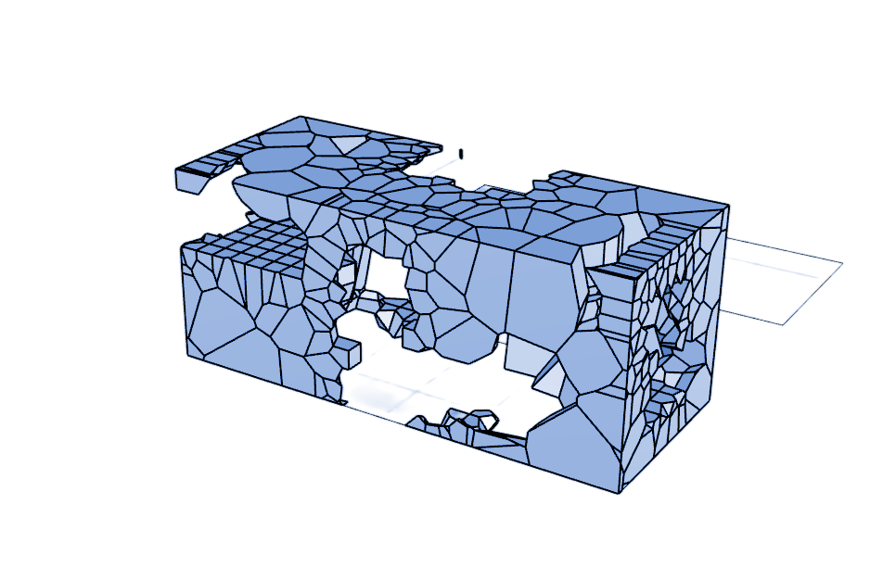
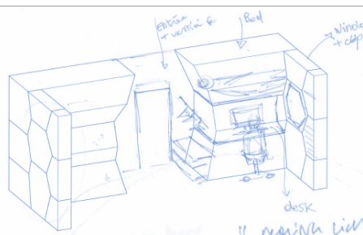
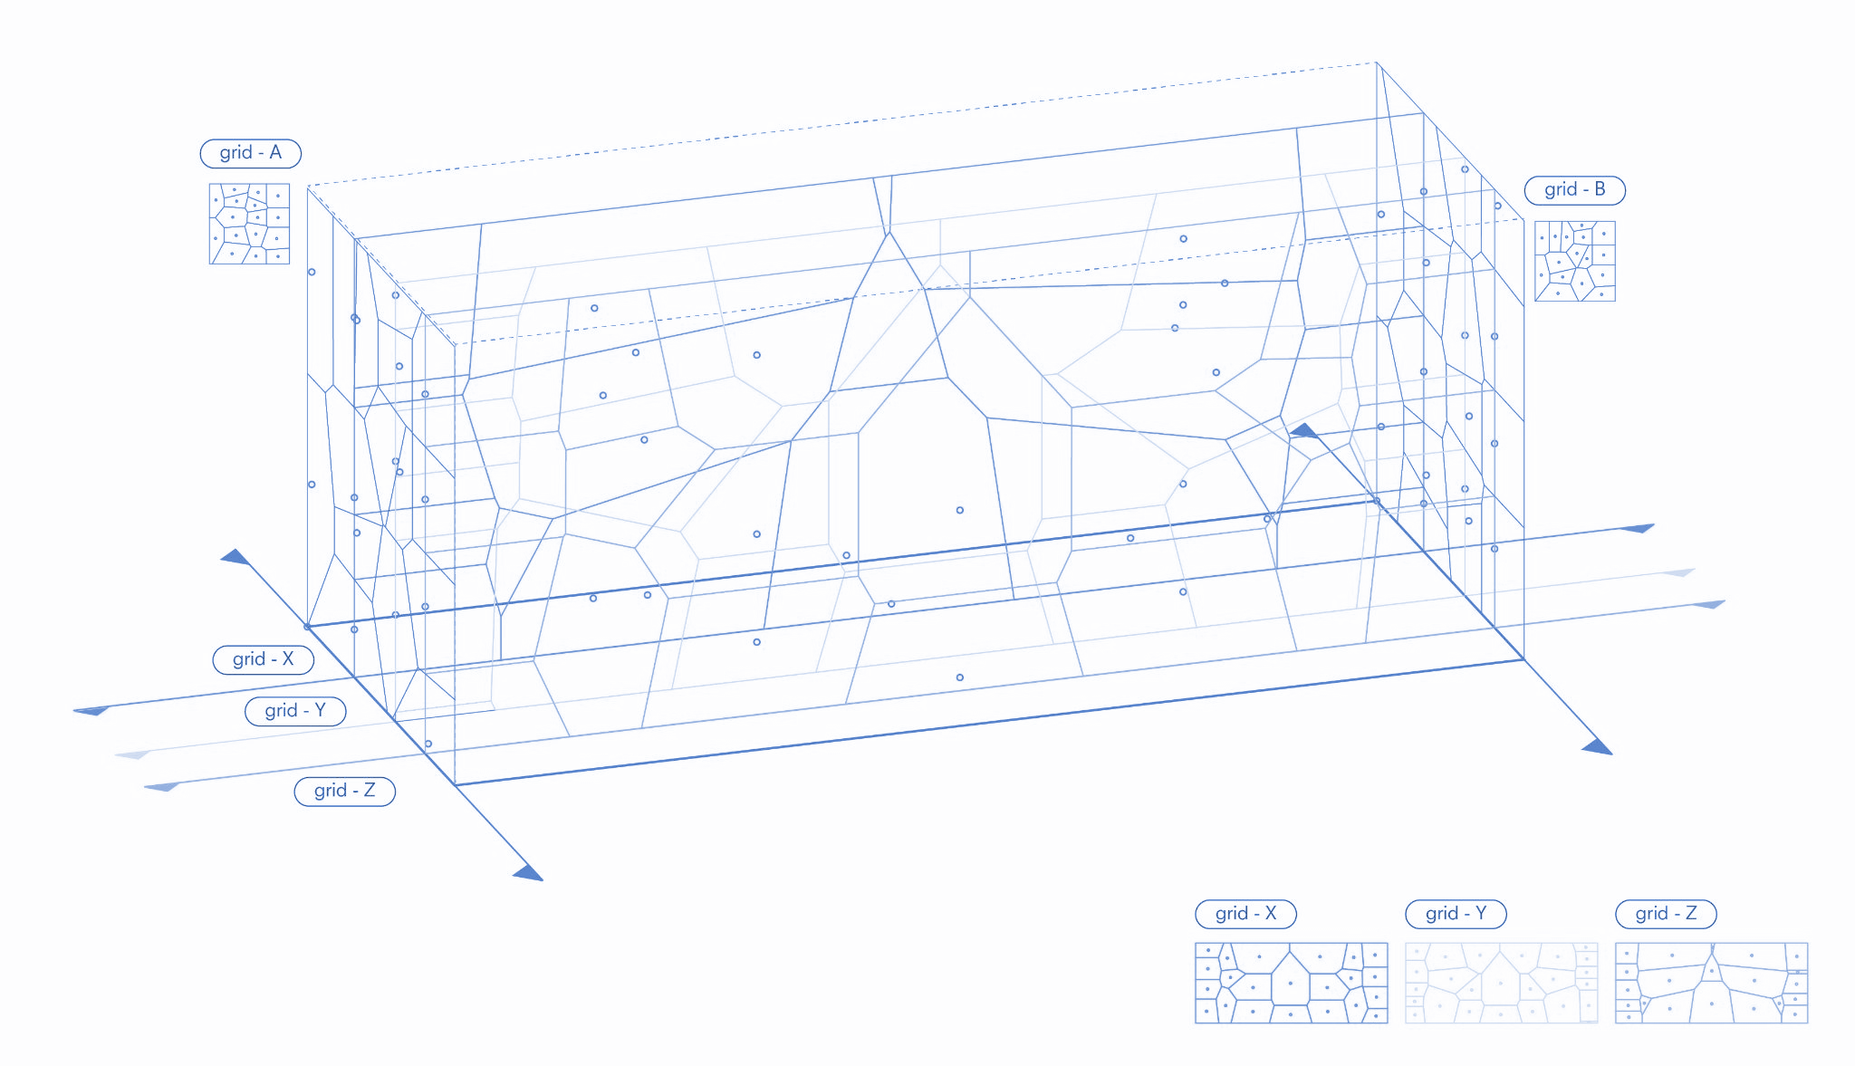

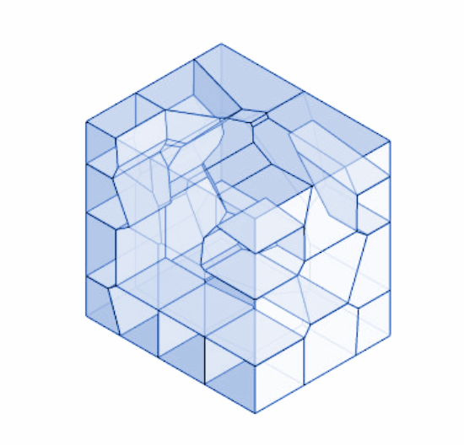
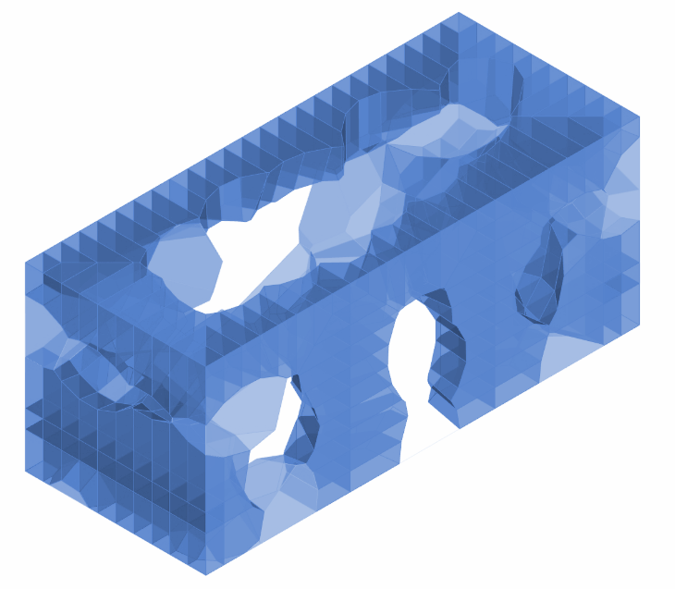
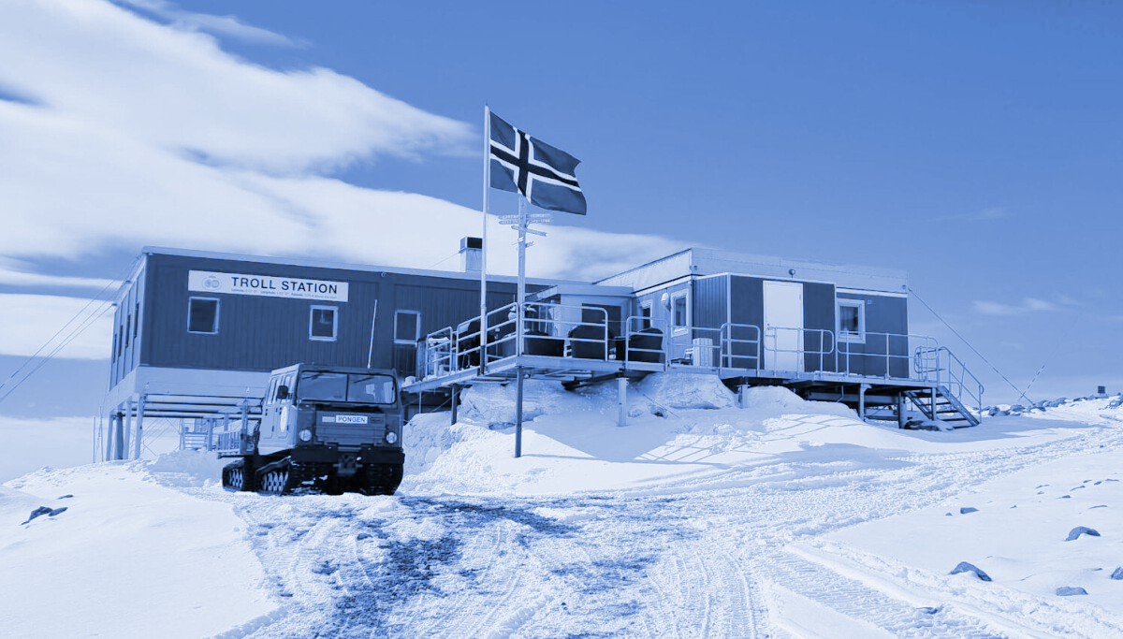
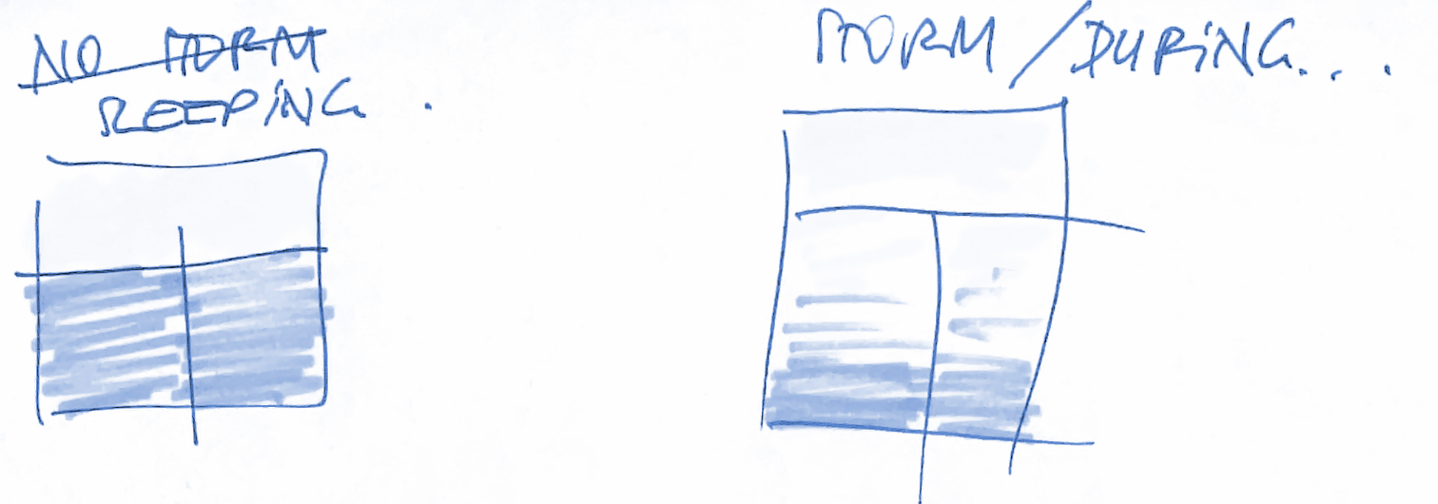
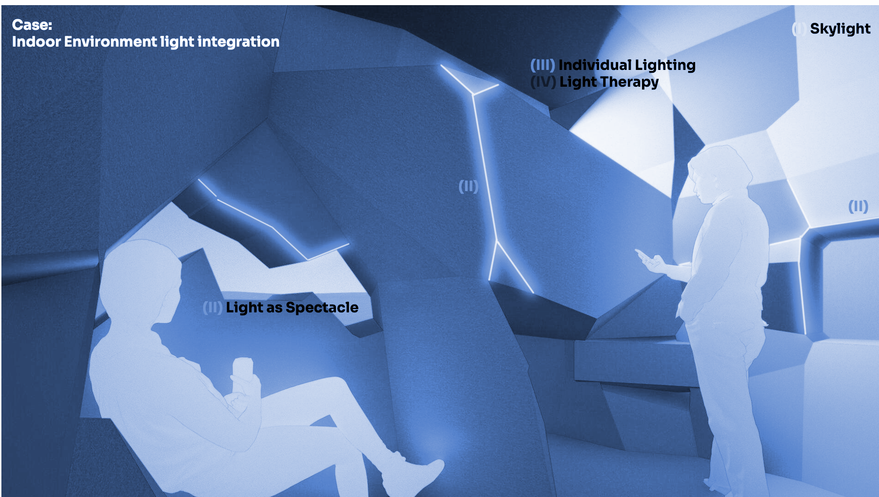
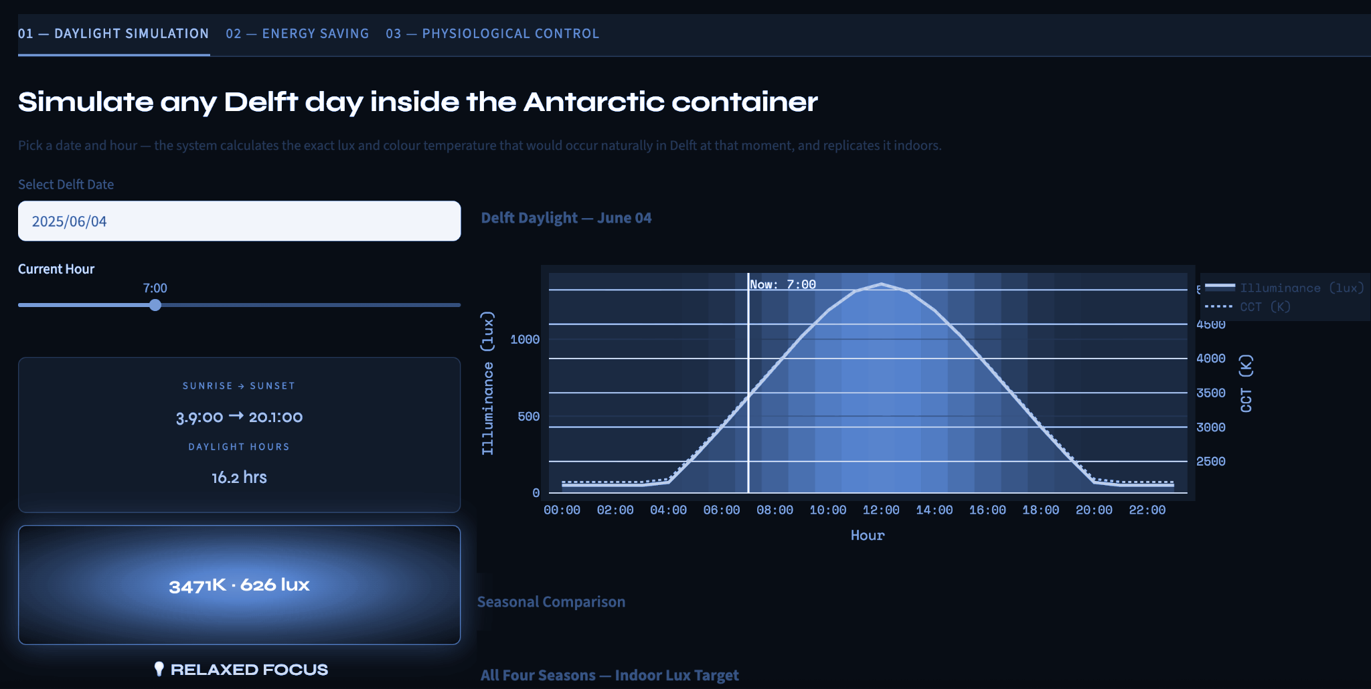
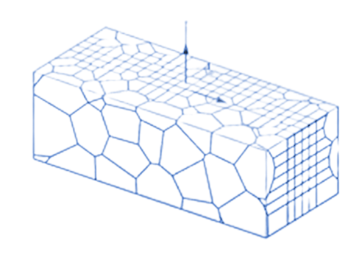
Developing a Data-driven System
Troll overview
Spatial arrangement, 24/7 mapping
Lighting (I) Skylight
(II) Light as Spectacle
(III) Individual light
(IV) Therapy light
Integration of lighting / Physiological Implications
AI Controlled lighting with the Trained Model
Vornoi and orthogonal integration
Controlling the Voronoi vs orthogonal system through lines :
-Voronoi
- In between
- Orthogonal
Input
Personalisation and possible reconfiguration of the system through boxes, integration of AI lightning in the script and window study
Thought experiment
“Form studies”
3D Voronoi V1.3
2D Longitudinal Section
v.1.1
2D Crosssection
v1.2
3D Voronoi V1.1
3D Voronoi V1.2
…
System
0
Vornoi Script
Output
Notes:
Ilai 1-13

Slide 13
Voronoi based D2RP
System development
Formstudies
Voronoi & Orthogonality

Slide 14
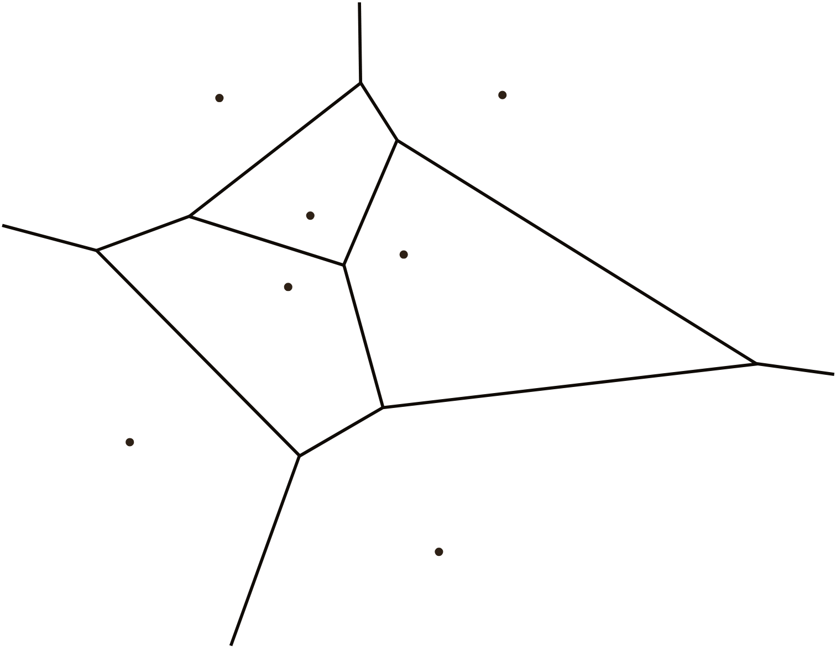
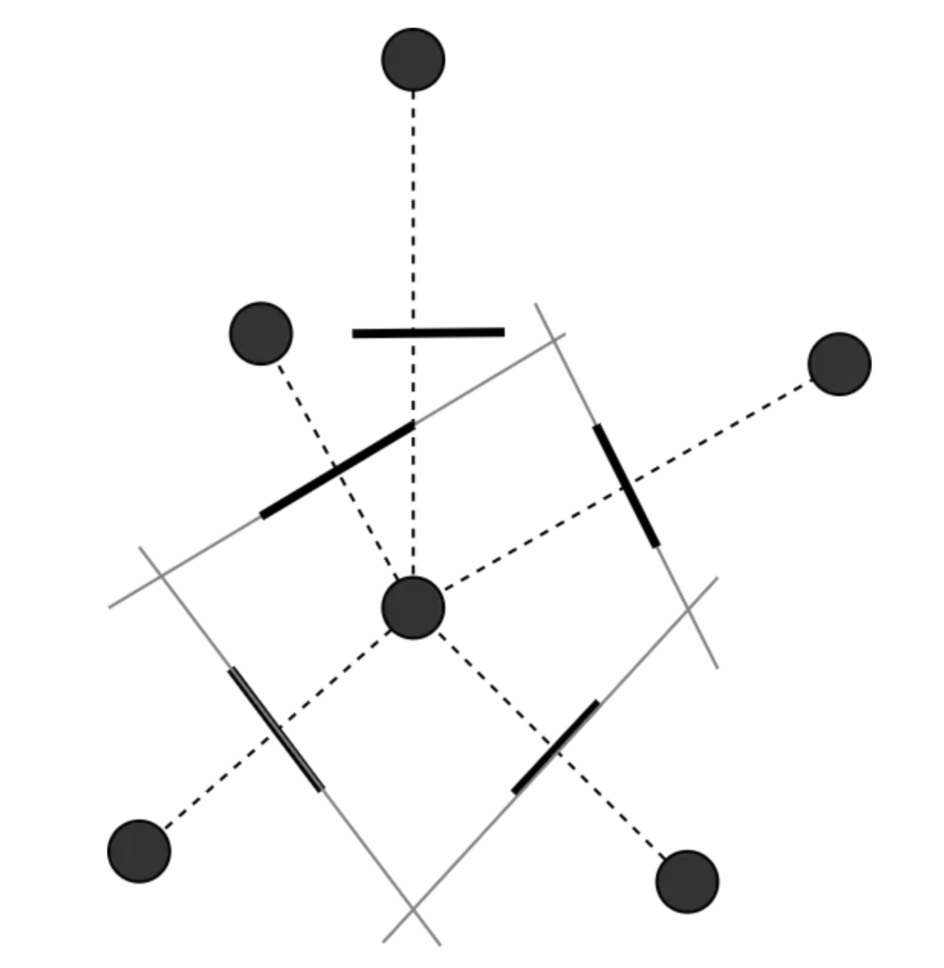
VORONOI BASED D2RP
Introduction into voronoi
Why voronoi for us - Ilai
Scalable strcuture, materially efficient, integrates system, so you dont have them separate, build with material that you can
Notes:
A Voronoi diagram is a spatial partitioning method that divides space into regions based on proximity to a set of points, where each region contains all locations closest to one point.
Voronoi matters for D2RP because it enables a component-based system where geometry, structure, and variation are integrated into a single, efficiently producible pattern.
That makes it scalable, materially efficient and allows you to integrate different systems with it

Slide 15
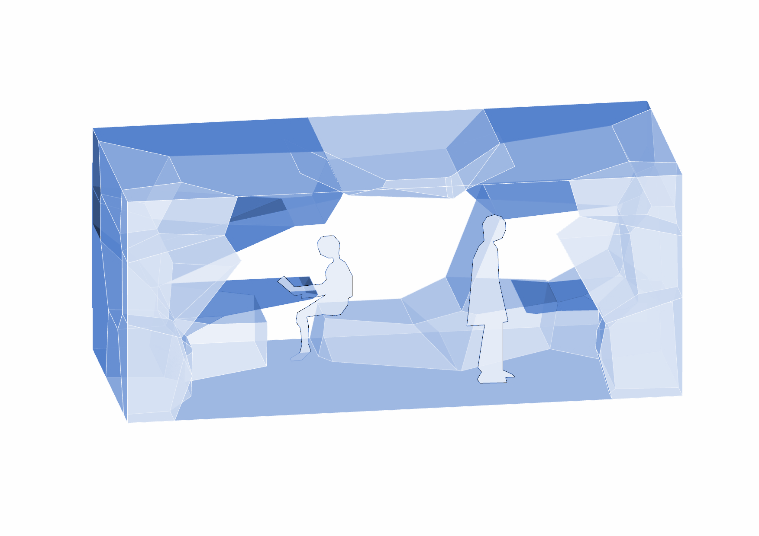
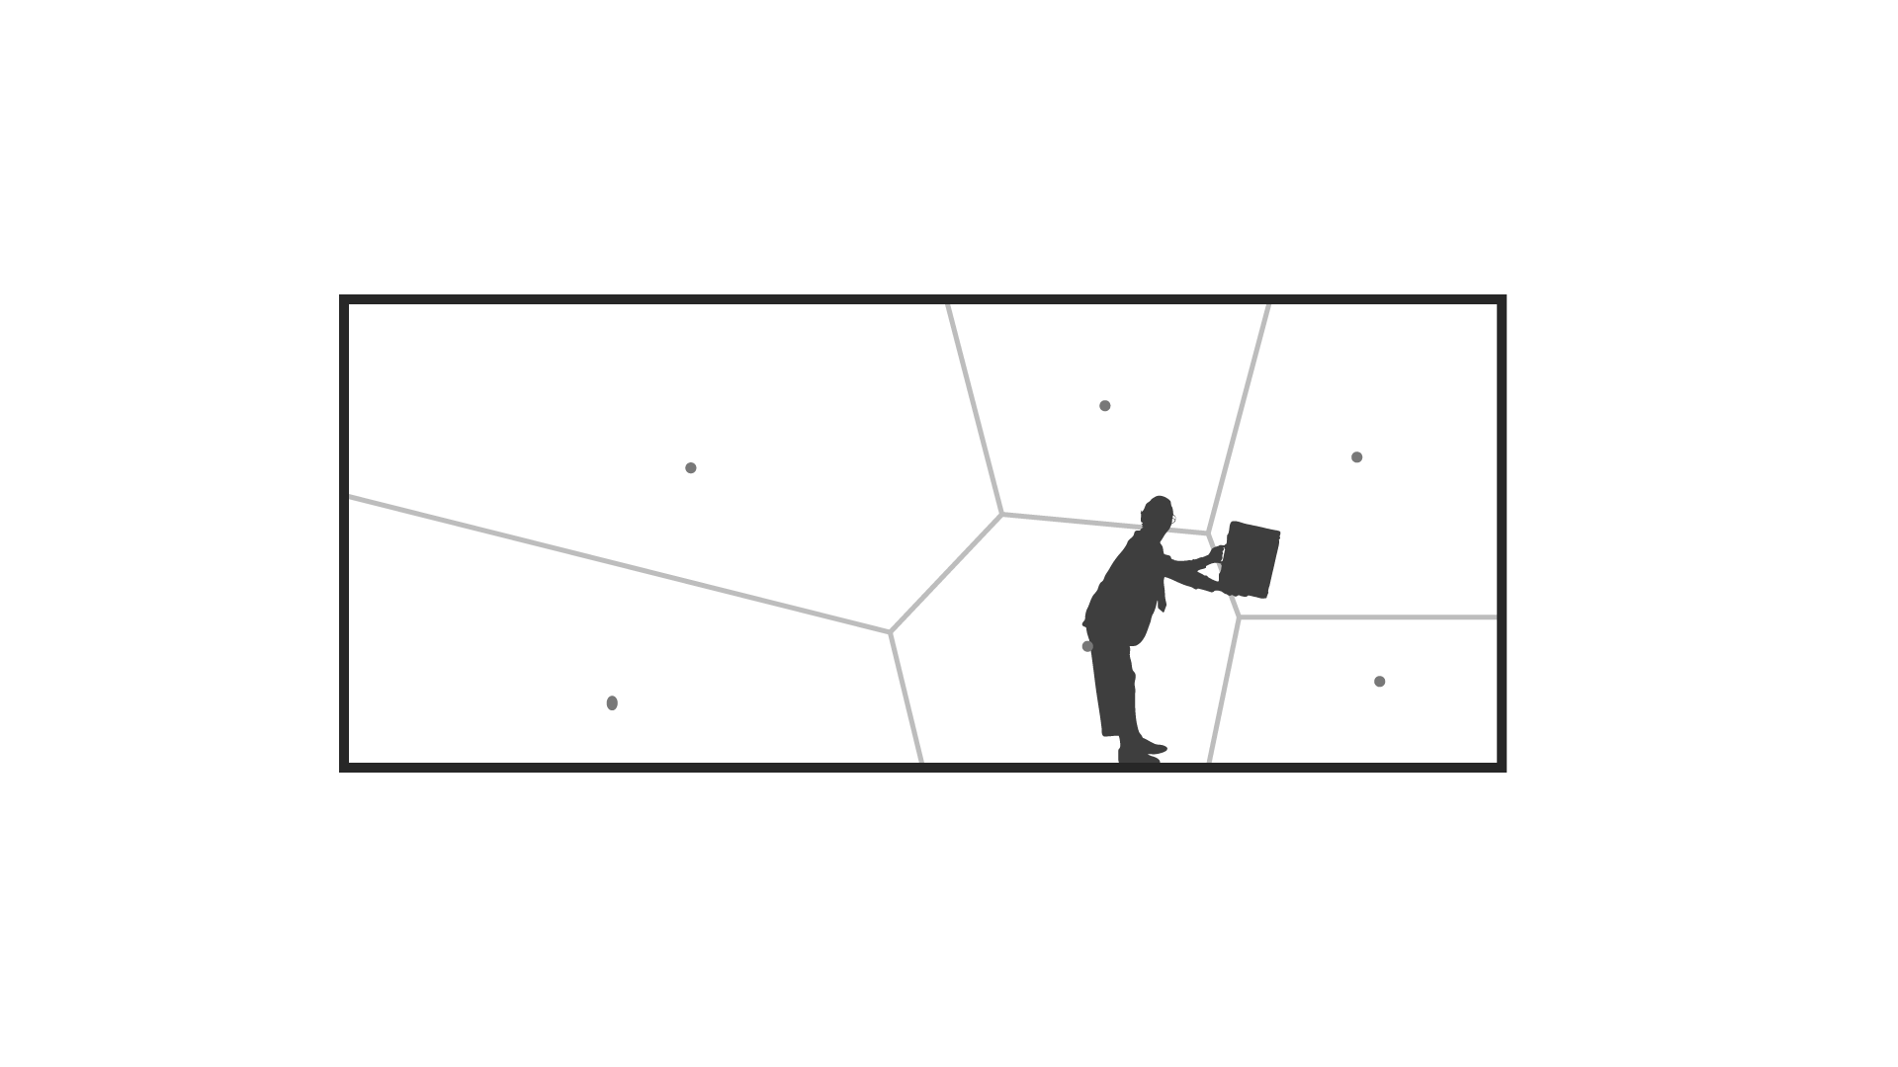
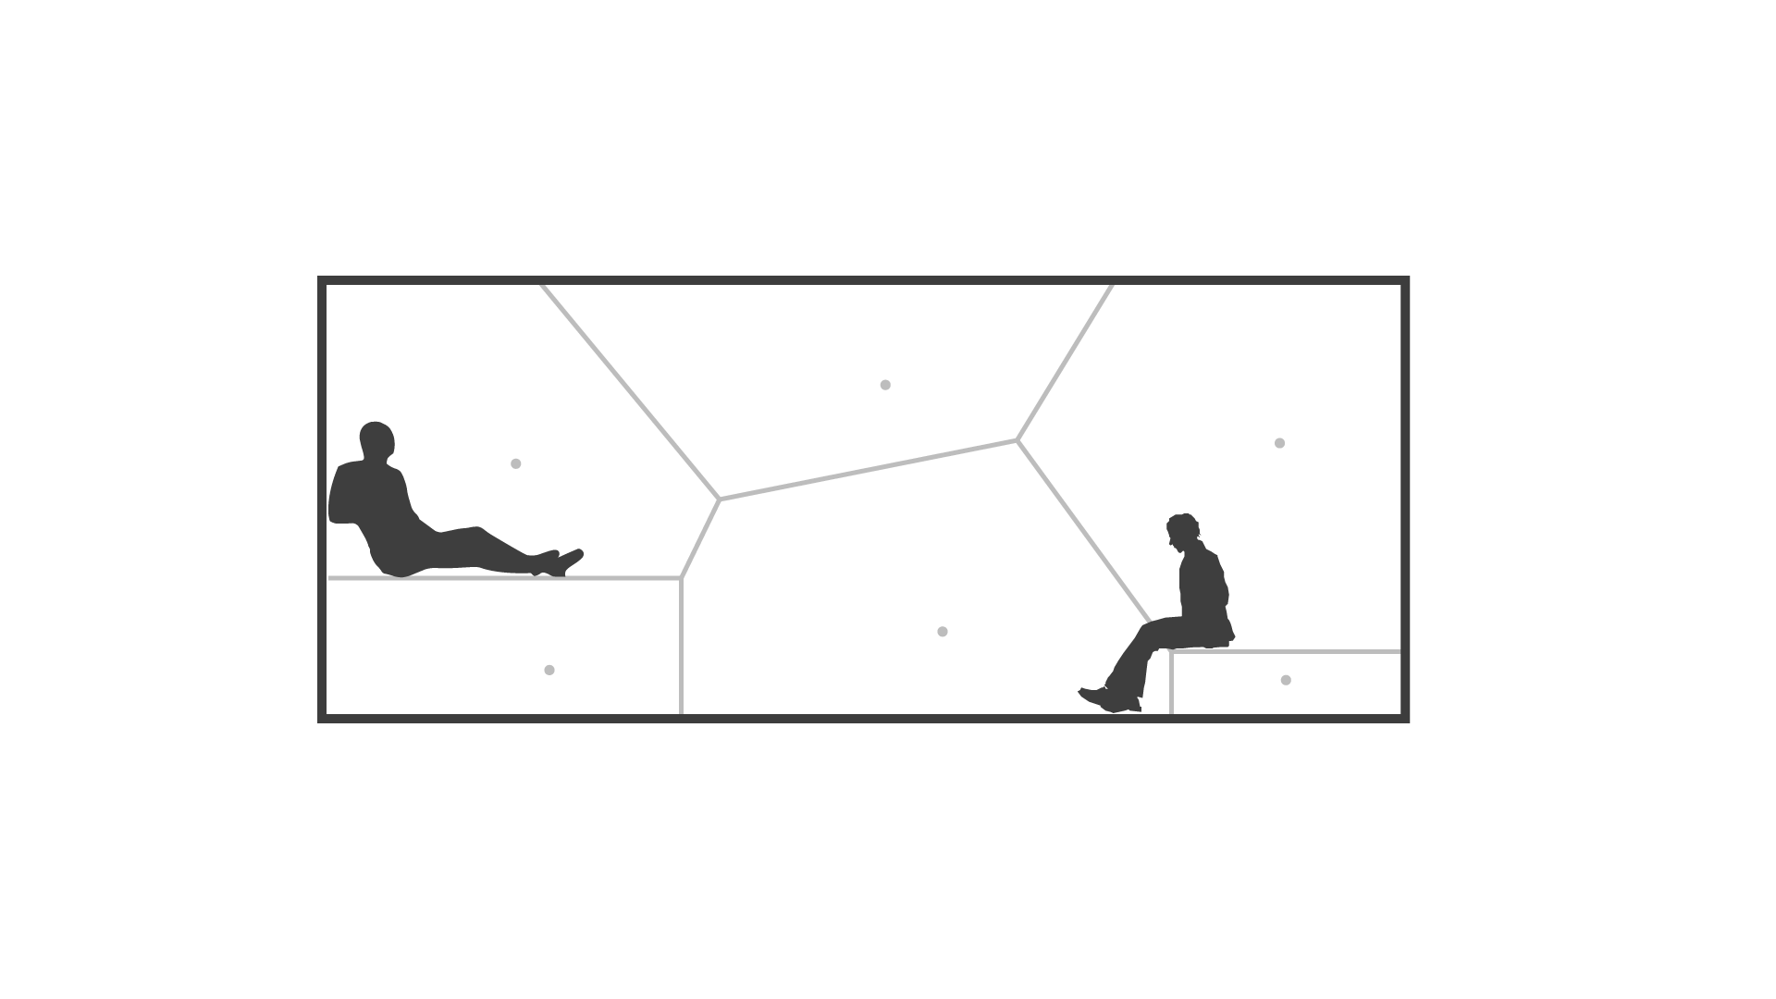
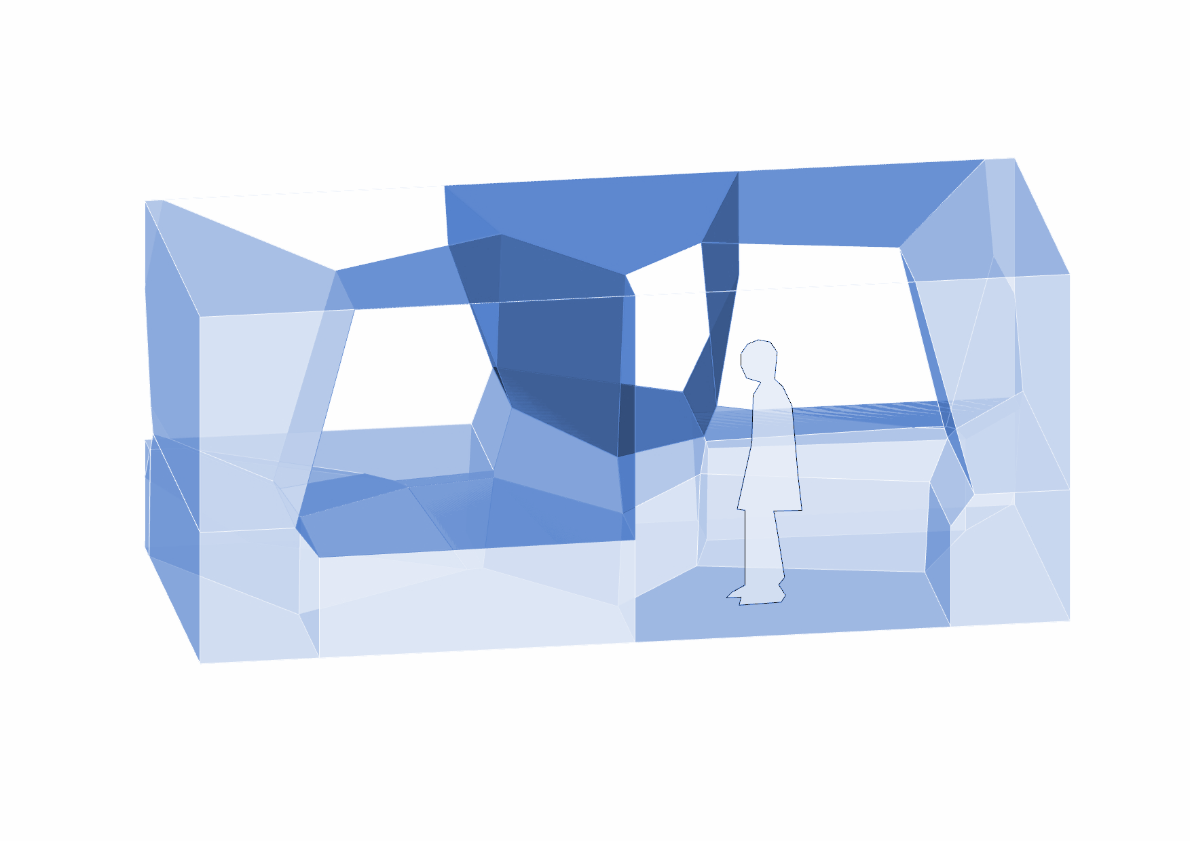
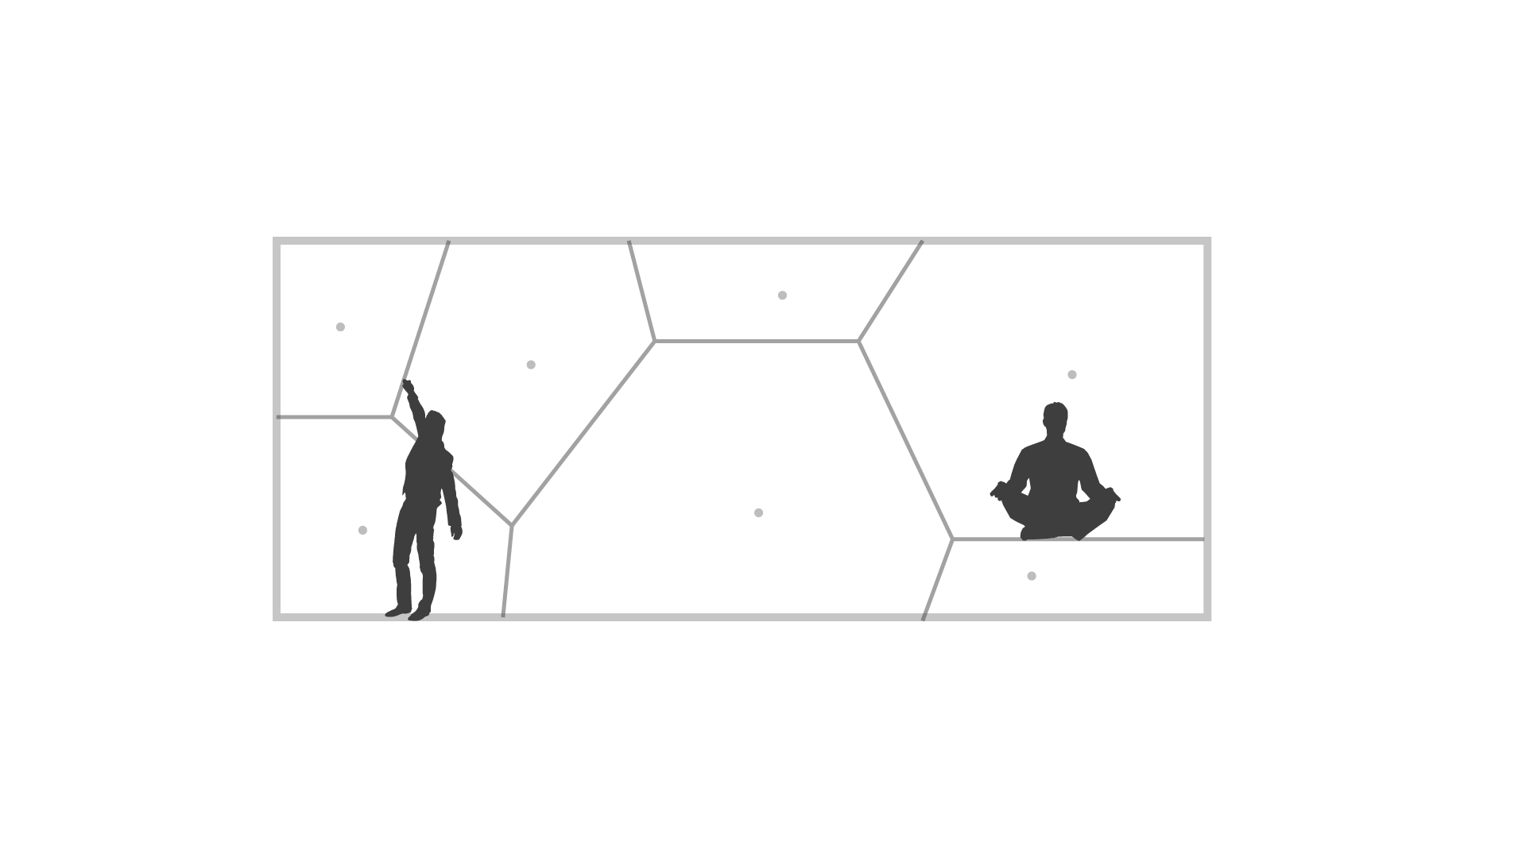

Integration of Program
Input
Script
Output
What do we miss?
Conclusions / Thoughts / input for what comes next
24/7 mapping
⬇︎
Shared space
Sleeping
Lounging
Individual Work
Storage
Notes:
Accommodating the program from the 24/7 mapping

Slide 16
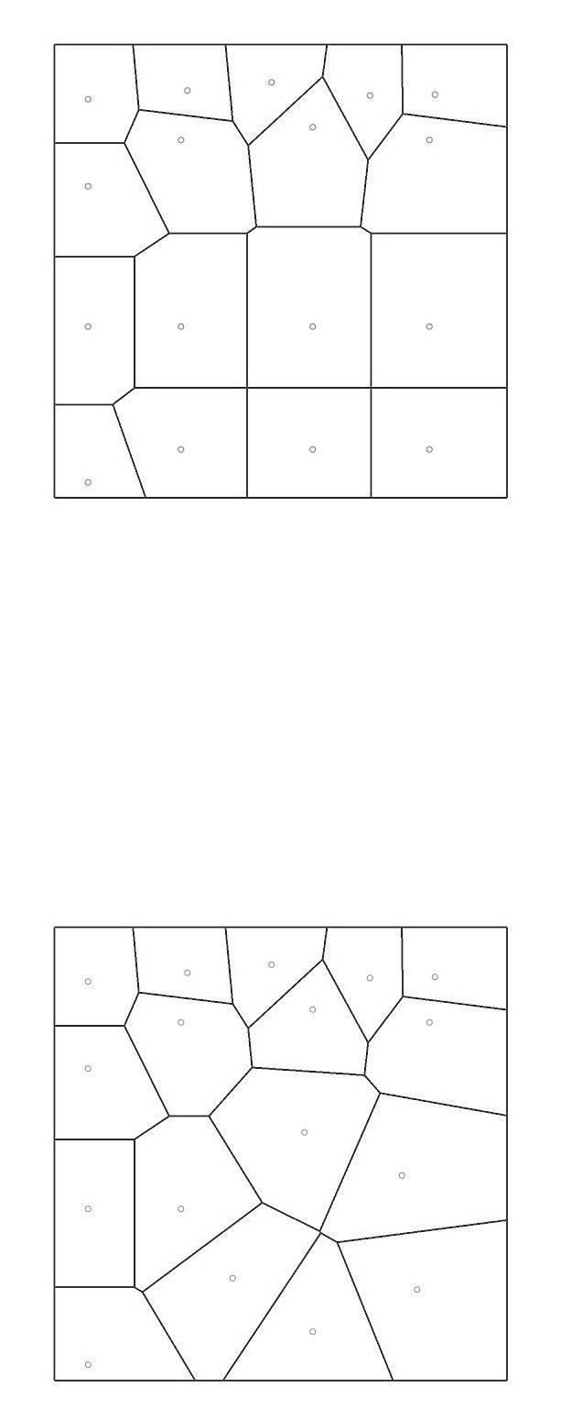
Flat Surfaces and Voronoi
Notes:
Intorudcing Orthogonality

Slide 17
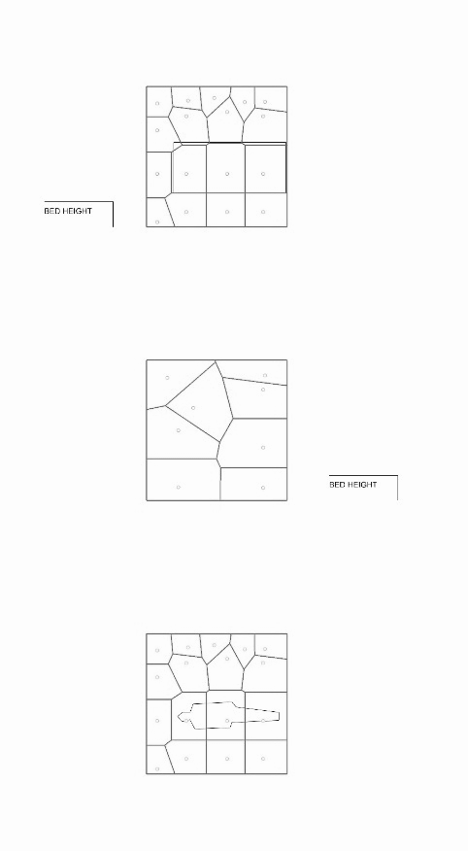
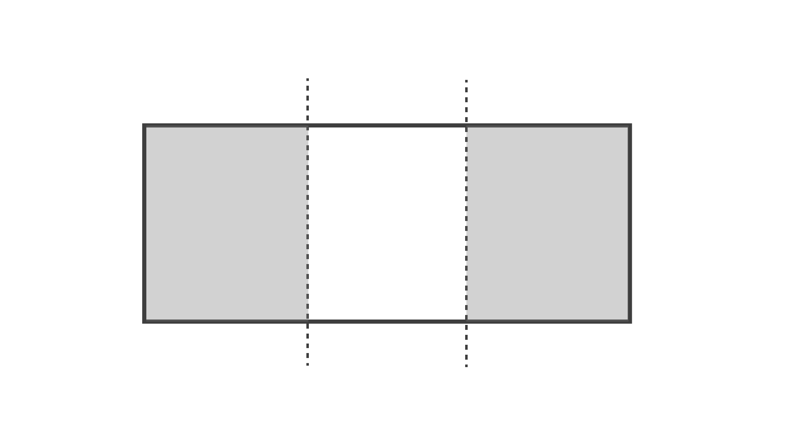

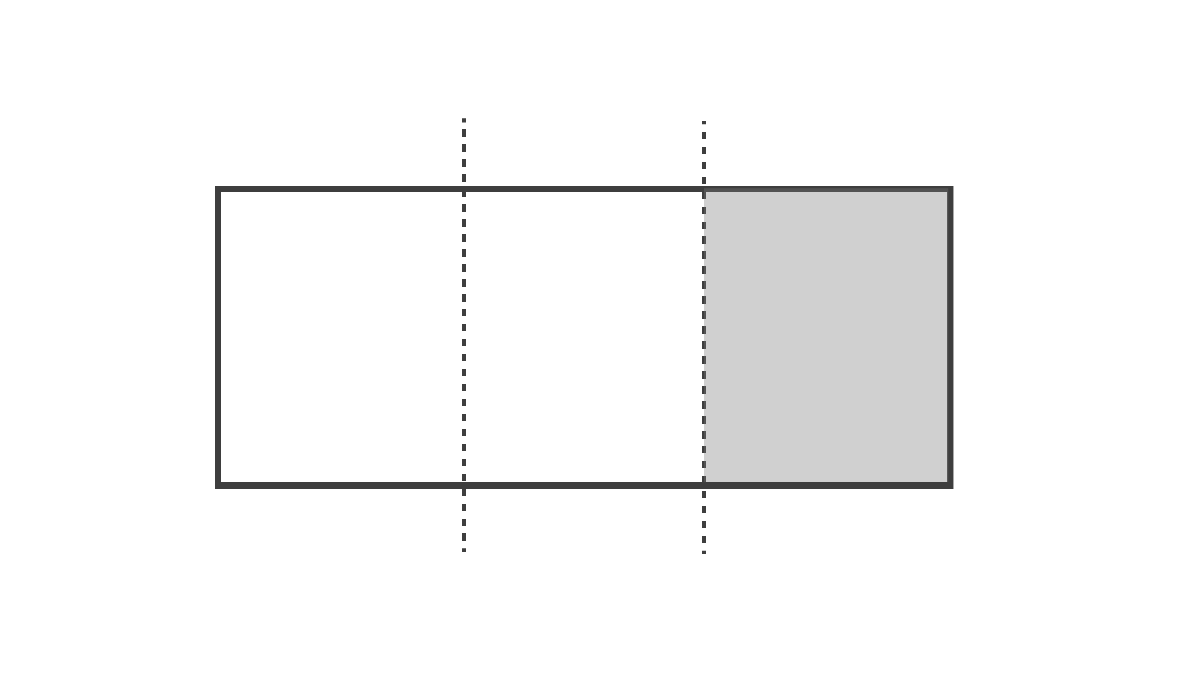
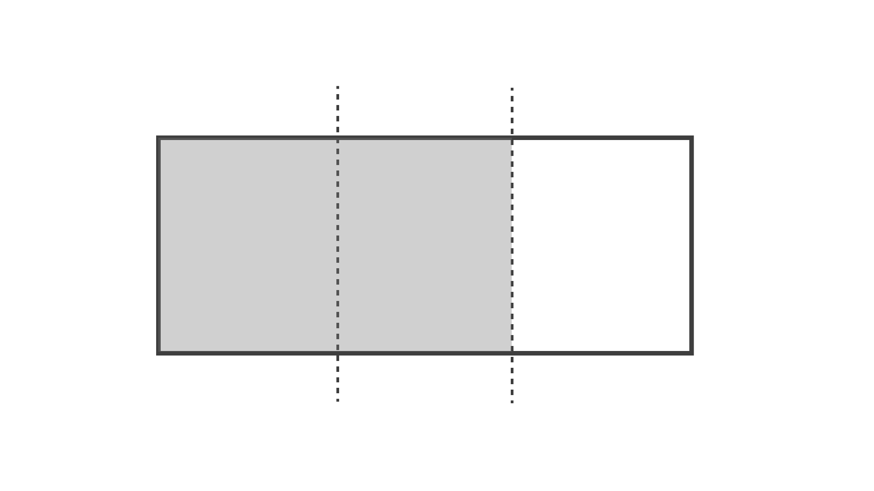
Reconfigurability through Compartmentalising
Input
Script
Output
What do we miss?
Conclusions / Thoughts / input for what comes next
Notes:
from Longitudinal sections to cross sectionsfor reconfiguable wall - Introduce another problem (privacy),
—> reconfiguability in a space

Slide 18
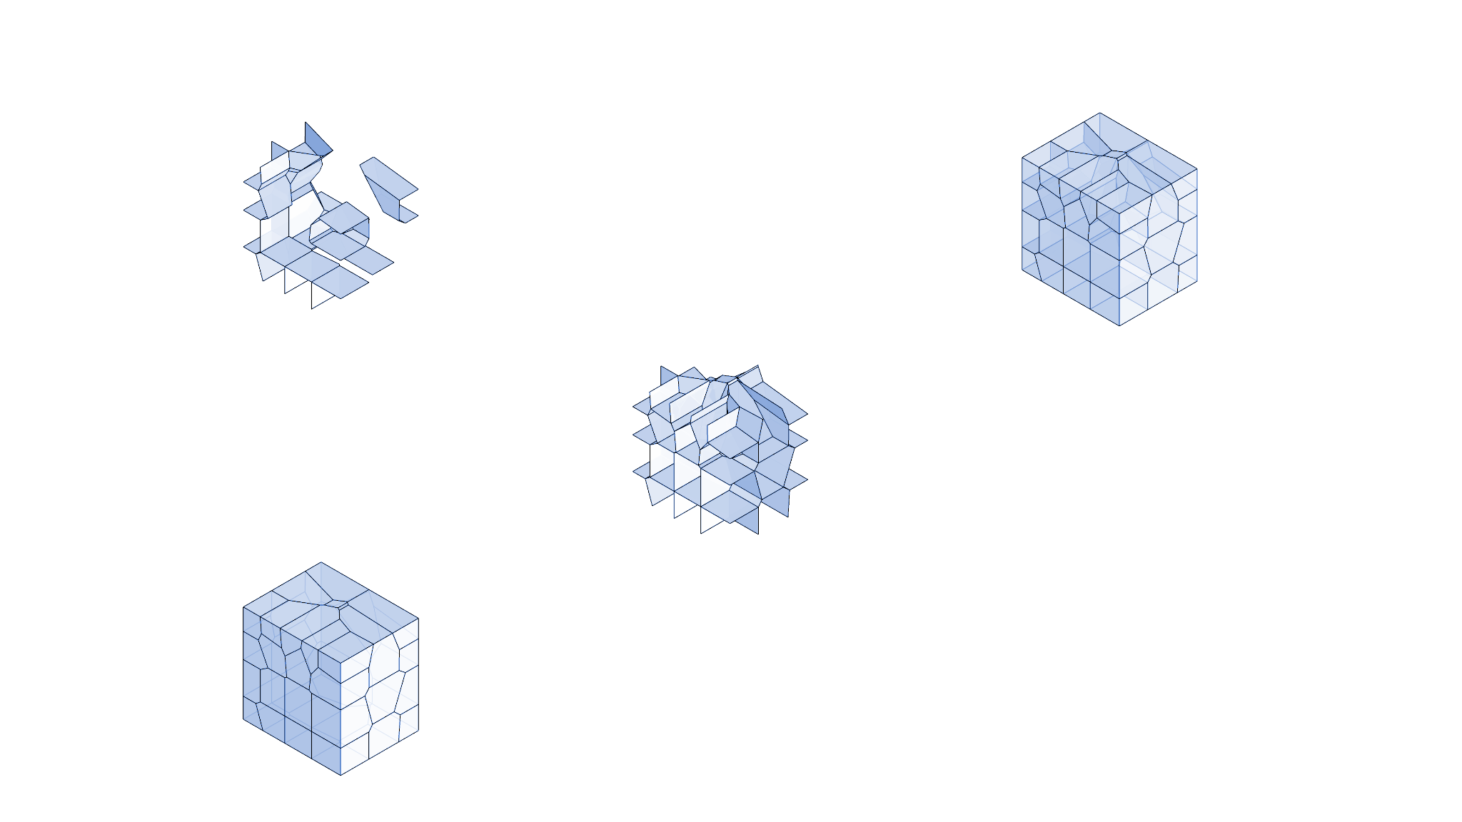
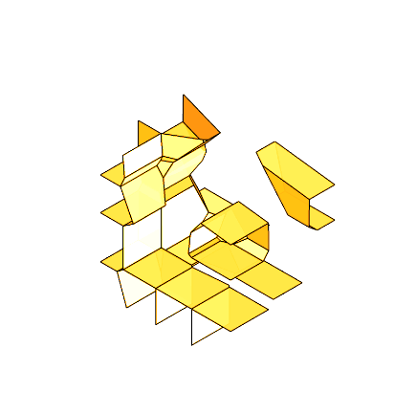
Reconfigurability through folding
Input
Script
Output
Notes:
Instead of design a whole container we focus on a part of it → from reconfigurable furniture to reconfigurable container

Slide 19
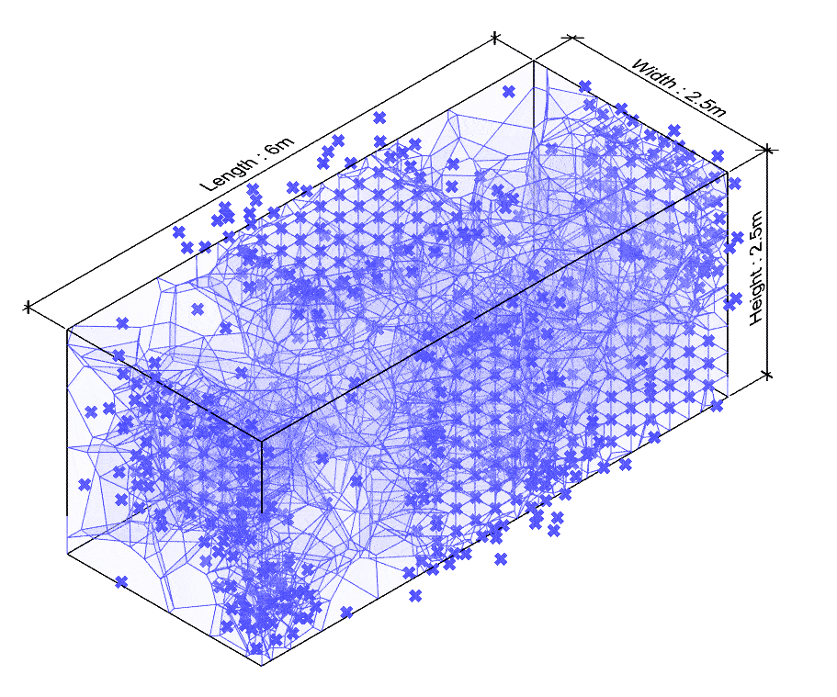
Re-thinking Reconfigurability through Voronoi
Input
Script
Output
Shared space
Sleeping
Lounging
Individual Work
Storage

Slide 20
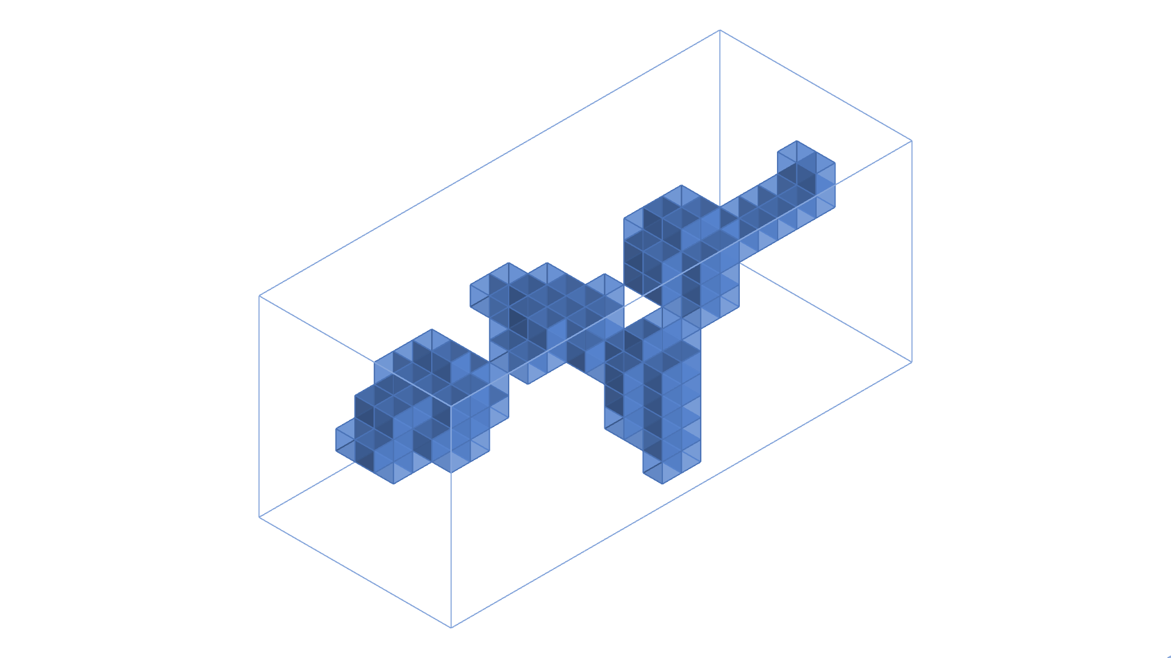
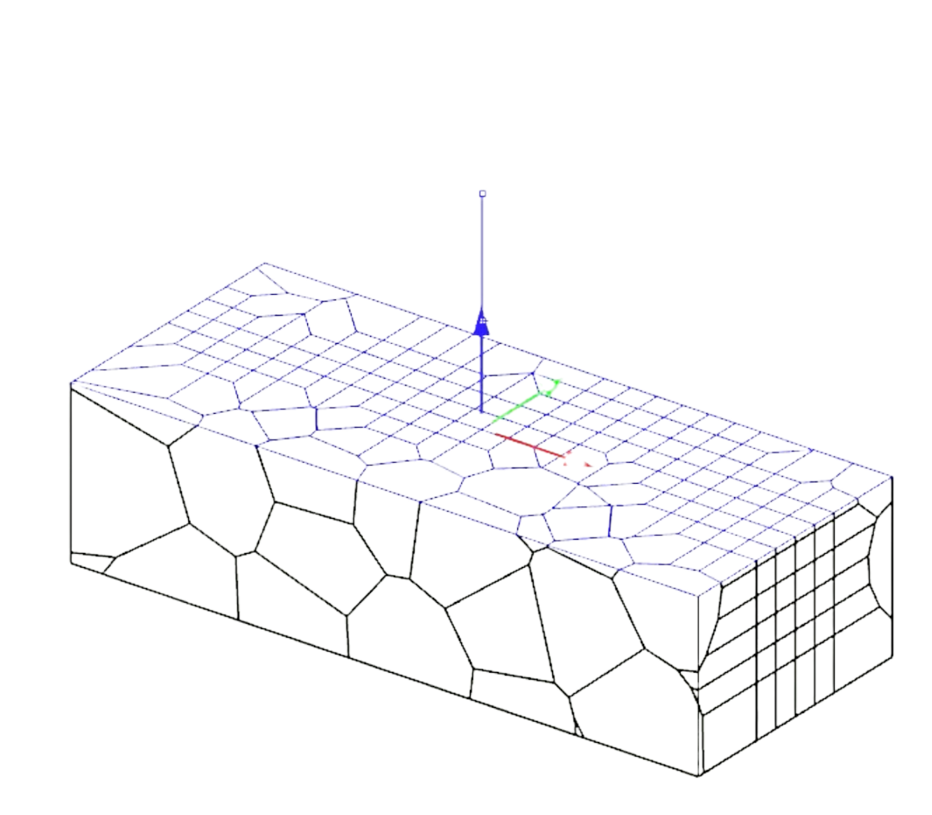


Voronoi & Orthogonality
Input
Script
Output
What do we miss?
Conclusions / Thoughts / input for what comes next
Re-thinking Reconfigurability

Slide 21
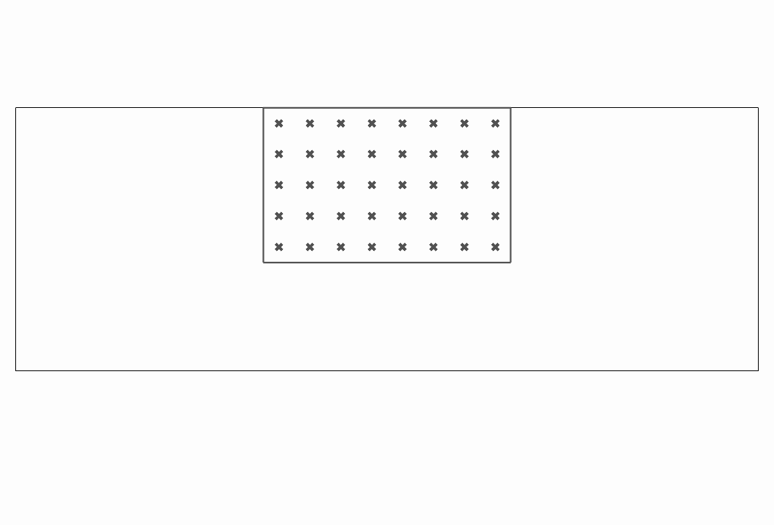
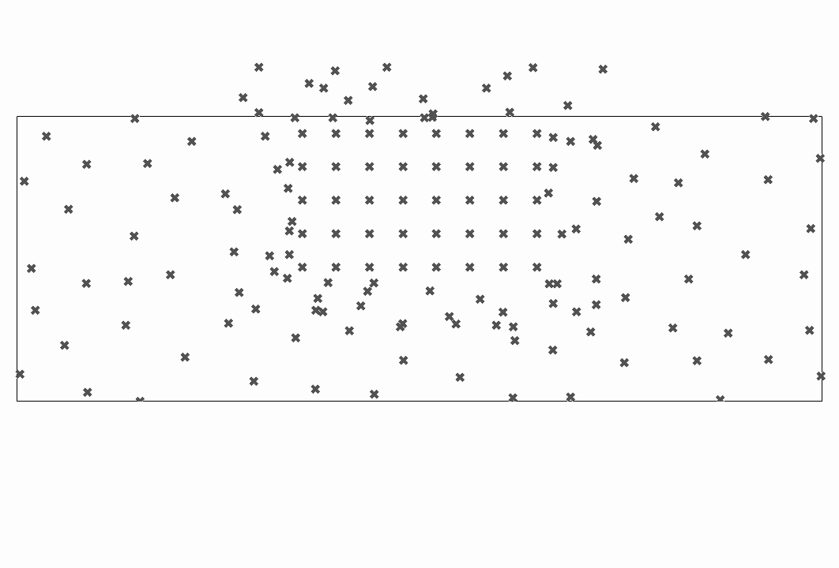
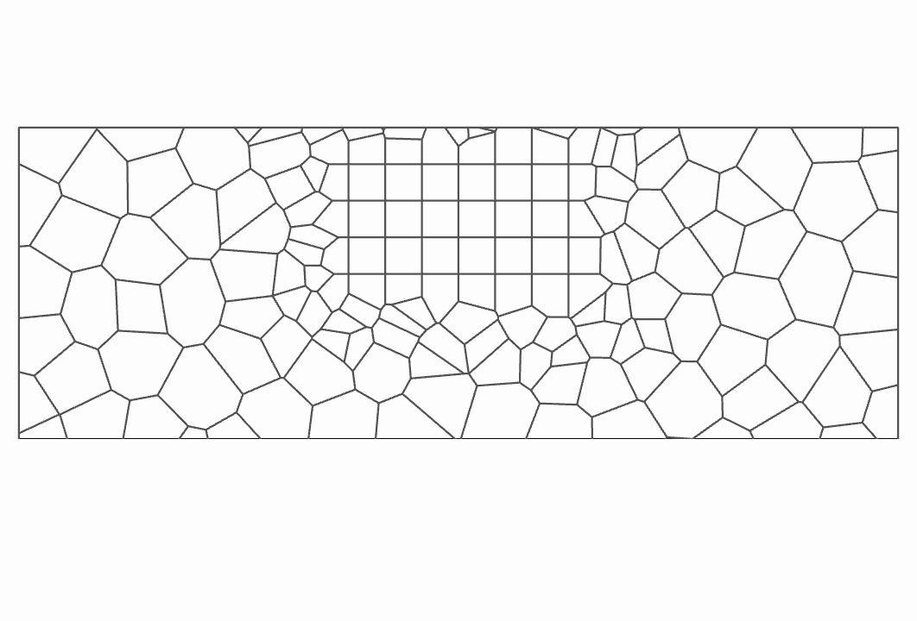
Voronoi & Orthogonality
Integration of orthogonal and voronoi (windows, furniture, doors, …)
Orthogonal
→
Merging with voronoi

Slide 22
System development
System Input
System Output

Slide 23
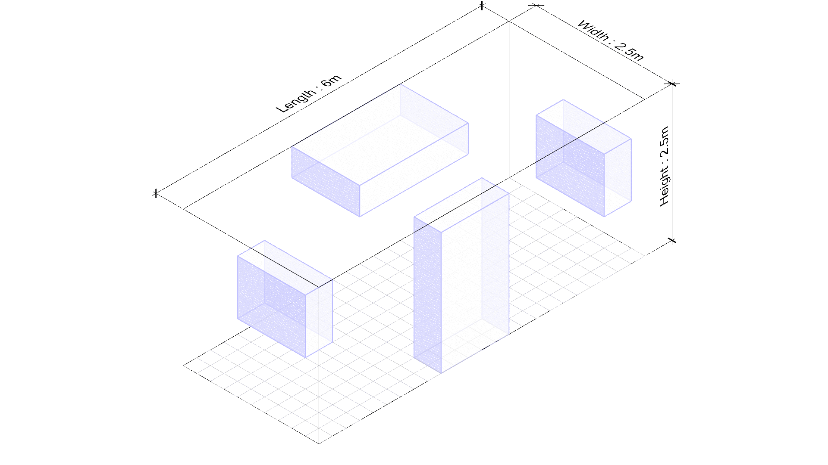
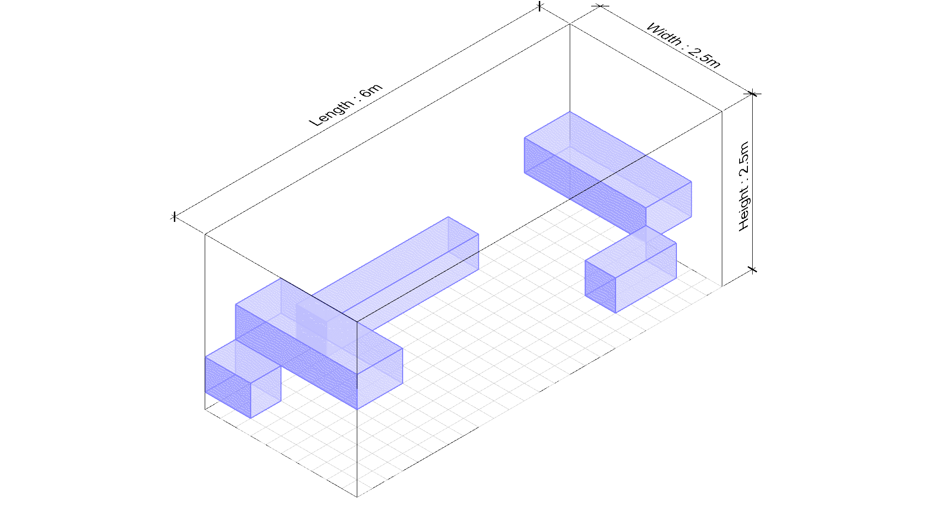
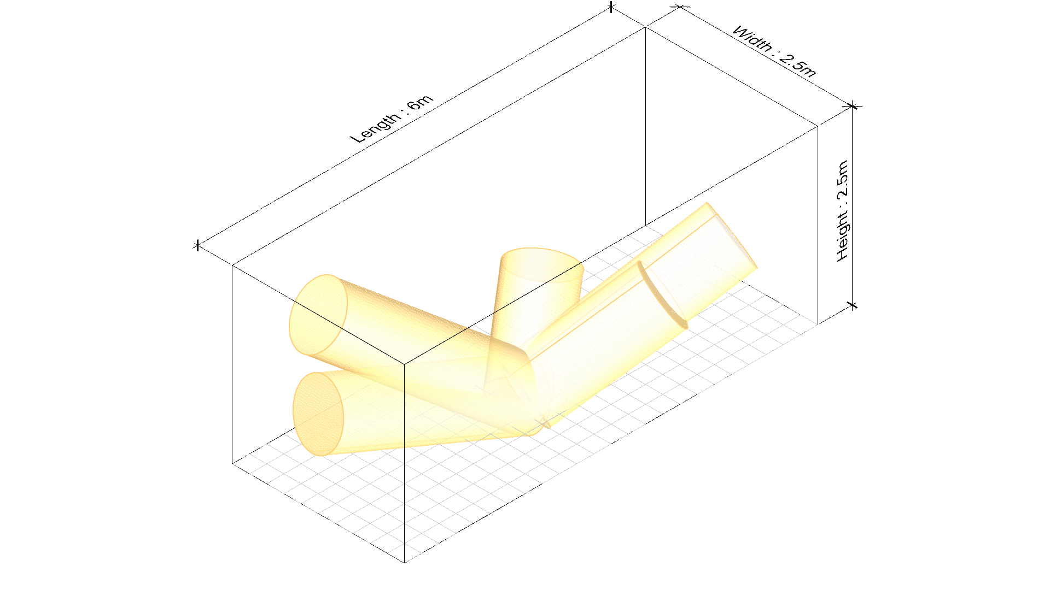
Input
(I) Objects (II) Openings (III) Movement

Slide 24
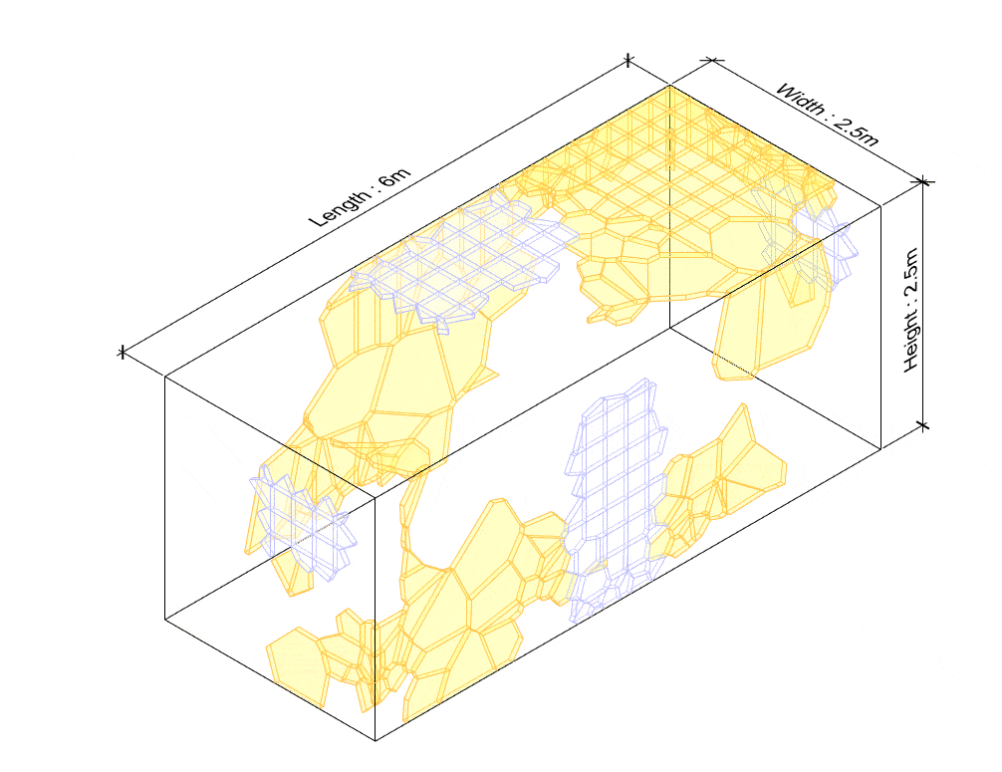
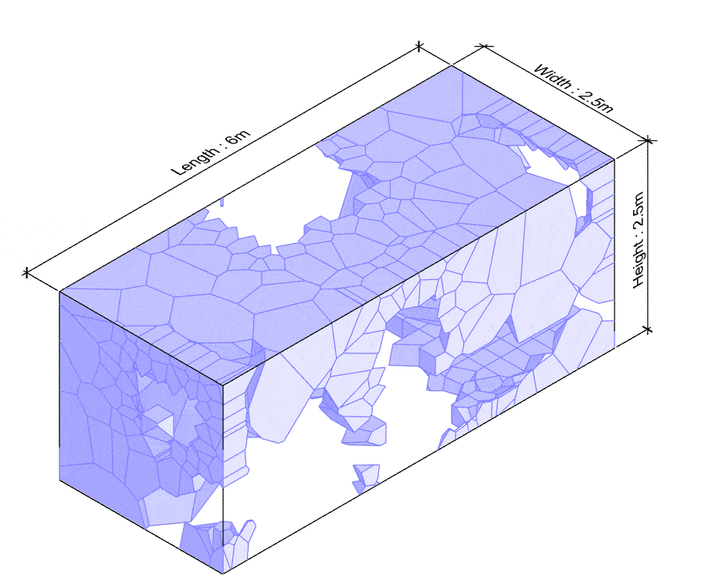
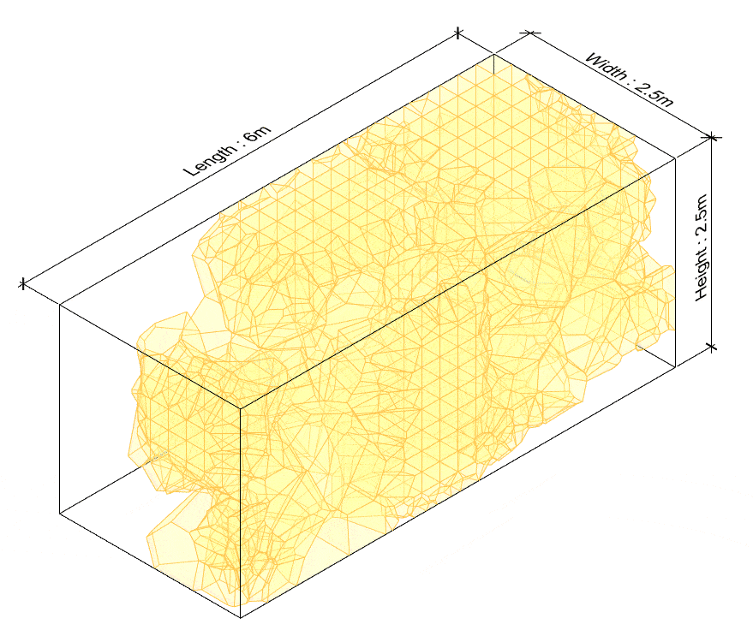
Output
(I) Volume (II) Panels (III) Void

Slide 25
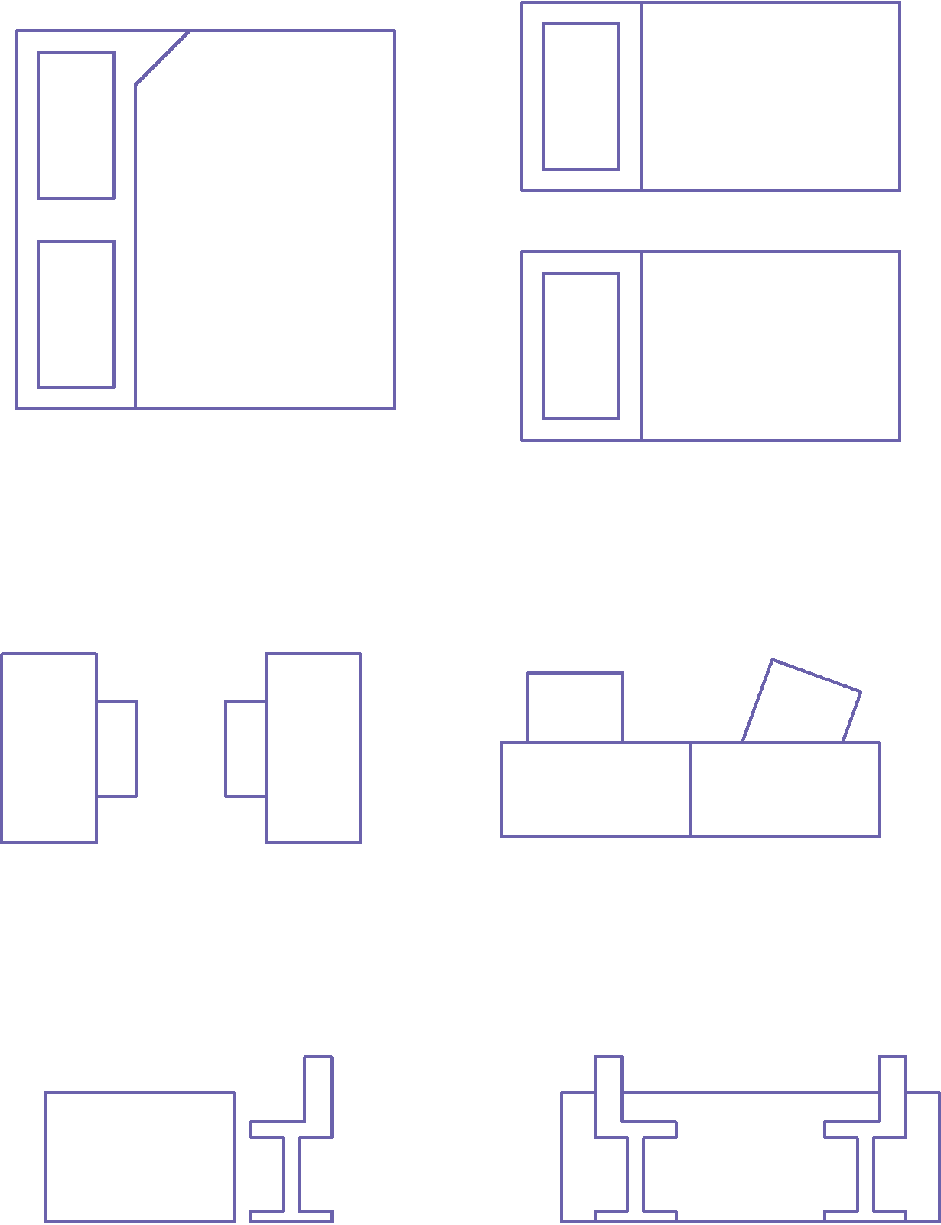
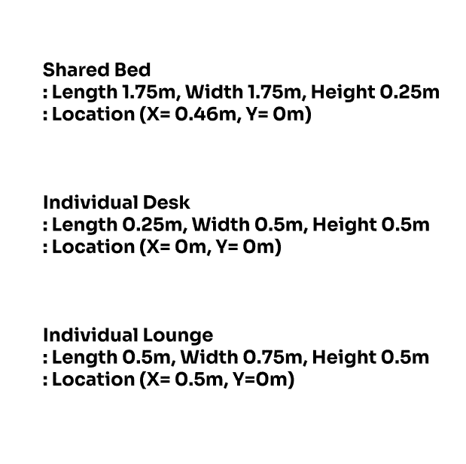
Design process | Furniture placement
Input
Script
Output

Slide 26
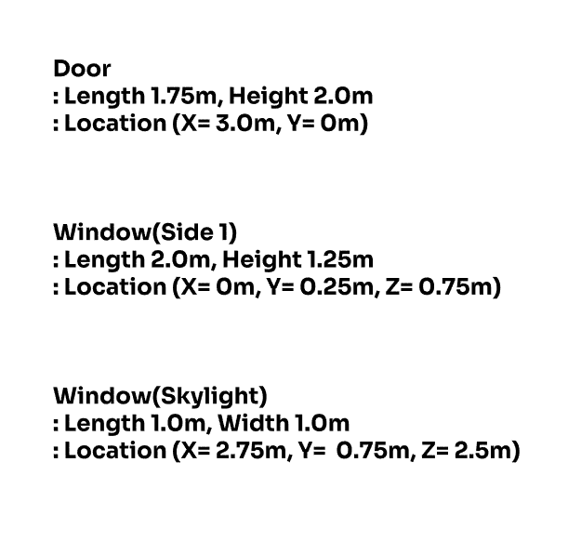
Design process | Opening
Input
Script
Output

Slide 27
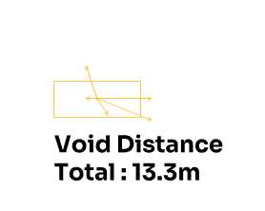
Design process | Movement
Input
Script
Output

Slide 28
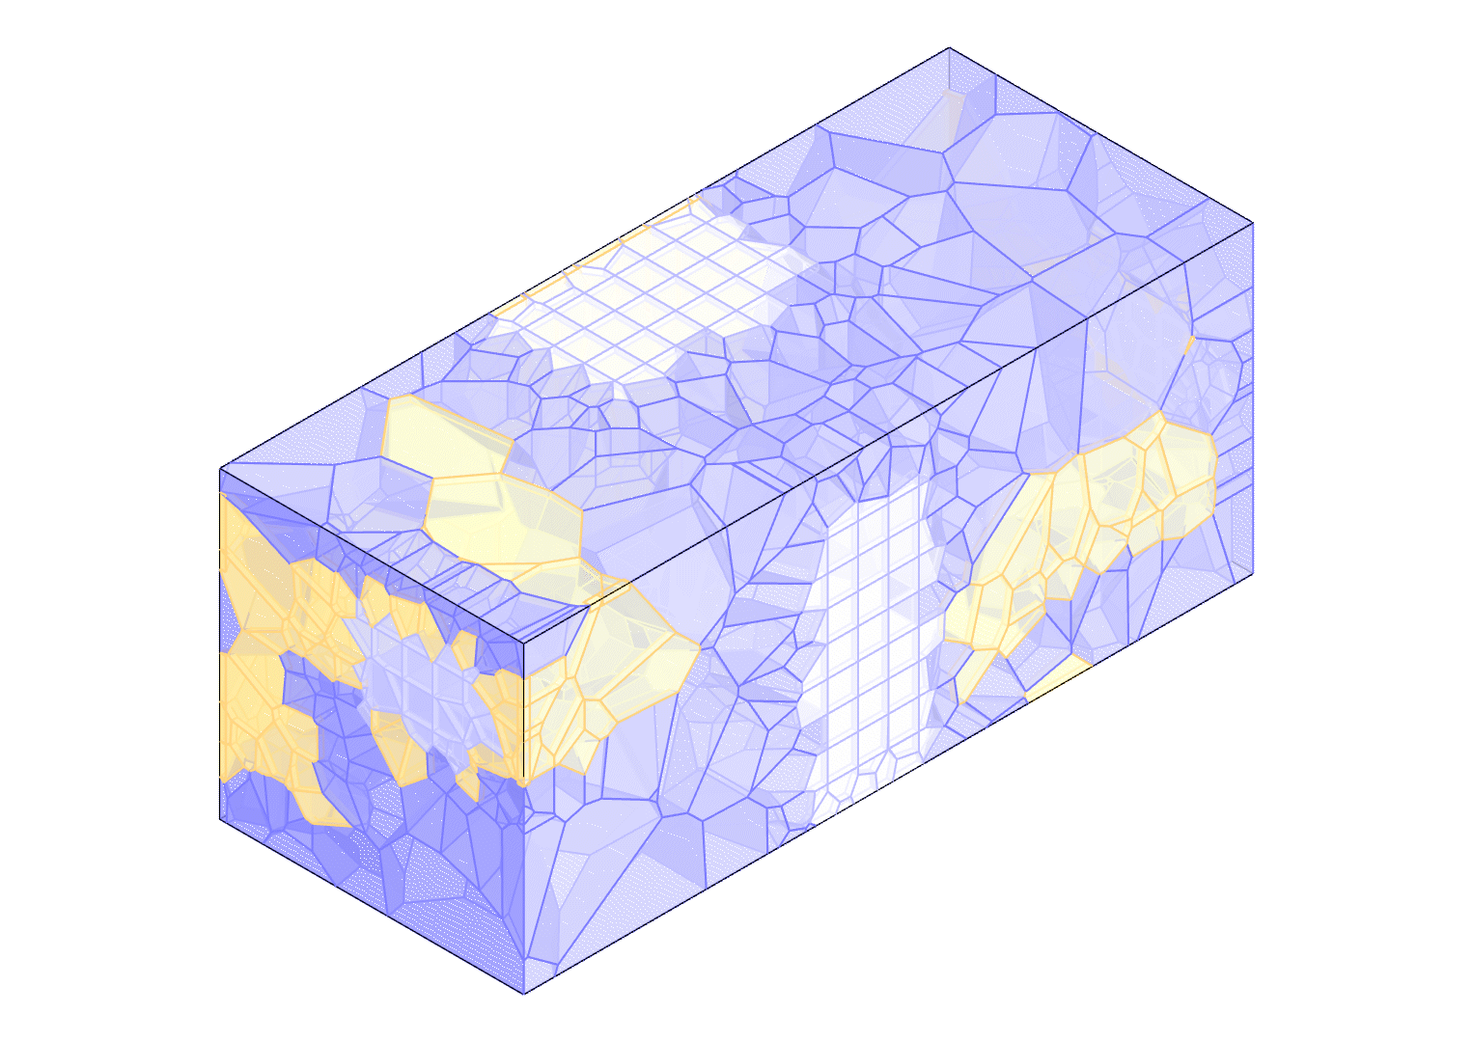
Output possibilities
Legend
Volume
Void
Opening

Slide 29

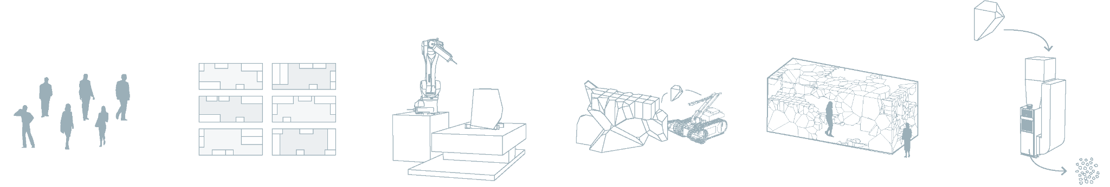
Customizable
Rather then
Re-configurable
System overview
Crew for Antarctic stay
Customized layout
On-site fabrication
On-site assembly
Crew arrival and habitation
Melting and re-use
Notes:
Customizing

Slide 30
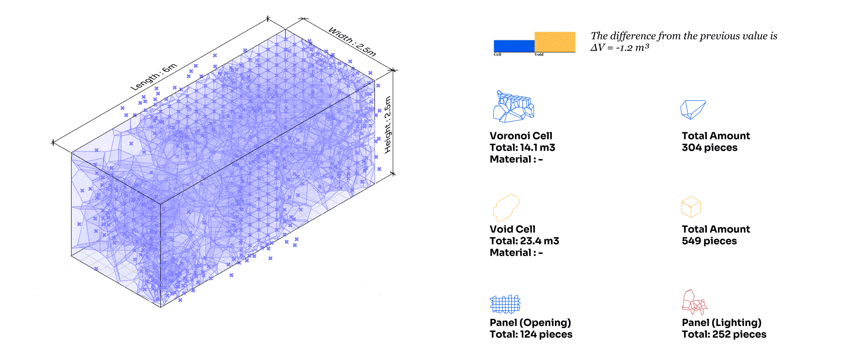
Material

Slide 31
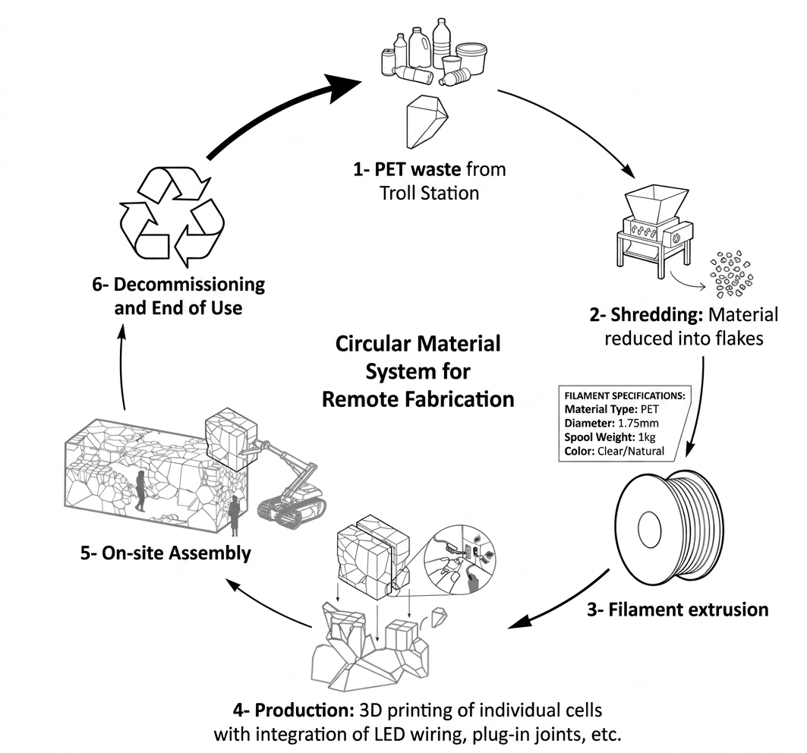






Material Process
From waste to filament
The starting material is plastic waste accumulated at Troll Station: PET bottles, packaging, and everyday polymer-based materials.
The design objective is to transform this waste stream into the raw material for the Voronoi structure, closing the material loop within the station itself.
To convert waste into printable filament, three machines are required in sequence:
Shredder: reduces collected plastic into flakes or coarse pellets
Extruder: melts the material and transforms it into filament with a controlled diameter (typically 1.75 mm or 2.85 mm)
Robotic deposition printer: uses the filament to directly produce the Voronoi cells
Robotic positioning machine: places and aligns the printed cells inside the container structure
1- PET Waste from Troll Station
2-Shredding process into PET Pellet
Production & assembly
The Voronoi structure is composed of cells, each individually printed and then assembled on site.
This hybrid approach (prefabrication of cells + in situ assembly) responds to the logistical constraints of Antarctica:
Cells are dimensionally compact and optimized for container transport.
LEDs and wiring are integrated during the printing process, not added afterward
Connections between cells are made through plug-in joints, without glue or specialized fasteners
If local plastic is insufficient, missing cells are prefabricated in a controlled environment and shipped ready to install
The main limitation remains the amount of waste available at the station: the goal is to maximize local production, but the system is designed to function even with a partial supply of external material.
3D Printing + Wiring / Lighting integration
3-Filament Extrusion
Notes:
This slide explains the material process, from waste to built architecture.
We start from plastic waste collected at the Troll Station, mainly PET bottles, packaging, and everyday materials. Instead of treating this as waste, we consider it as a resource already available on site.
The first step is shredding. The plastic is reduced into small flakes or pellets, making it easier to process and standardize for the next phase.
Then we move to filament extrusion. Here, the shredded plastic is melted and transformed into a continuous filament, with a controlled diameter, suitable for 3D printing.
This filament is then used in the 3D printing phase, where each Voronoi cell is individually produced. During this step, we also integrate wiring and lighting systems directly into the structure, so they are not added later but become part of the material itself.
Once the cells are printed, they are transported and assembled on site, using plug-in joints and mechanical connections that allow precision and flexibility.
Finally, the system is designed as a circular process. At the end of its life, the structure can be disassembled, shredded again, and reintroduced into the cycle — minimizing waste and closing the material loop.

Slide 32








05 Material From waste to use
LUCA WILL FIX
Reference: KLM - From recycled plastic bottles to 3D printed aircraft tools for maintenance
https://www.voxelmatters.com/klm-3d-printing-tools-plastic-bottles/
Collect leftover PET bottles
Plastic Pellet
PLA Filament
1:1 Interactive Architecture Prototype - Troll Station

Slide 33
Material | process
Production & assembly
The Voronoi structure is composed of cells, each individually printed and then assembled on site.
This hybrid approach (prefabrication of cells + in situ assembly) responds to the logistical constraints of Antarctica:
Cells are dimensionally compact and optimized for container transport.
LEDs and wiring are integrated during the printing process, not added afterward
Connections between cells are made through plug-in joints, without glue or specialized fasteners
If local plastic is insufficient, missing cells are prefabricated in a controlled environment and shipped ready to install
The main limitation remains the amount of waste available at the station: the goal is to maximize local production, but the system is designed to function even with a partial supply of external material.

Slide 34
AI Based lighting D2RO
Goal of integration
Workflow to train AI model
User Interface (UI)

Slide 35

Goals of AI integration
01: Circadian Rhythm Preservation
Simulates a full Delft daylight cycle inside the container
02: Environmental Energy Optimisation
Outdoor conditions drive indoor light levels automatically to optimize energy
03: Personalised Physiological Response
Neural network predicts ideal light from body signals and biometric data

Slide 36



How are we utilising AI?
Input
Model
Output
Data Input
Training + Evaluation
Lighting parameters
Choose features from data set
Color temperature (Kelvin)
Weather data
(De Bilt, Netherlands 2024-2025 weather data)
R-squared: Accuracy of model in %
Root mean squared error
Mean absolute error
Illuminance
(Lux)
+
Use Python to train model
Physiological data
(Synthetic dataset)

Slide 37


Data input
Weather data
(De Bilt, Netherlands 2024-2025 weather data)
Physiological data
(Synthetic dataset)
Outdoor temp,direct normal radiation, rel humidity, diffuse, normal radiation, global horizontal radiation,infrared radiation, direct normal Illumination diffuse_horizontal illumination, global horizontal illumination, total sky cover
Hrv rmssd ms, heart rate bpm, pupil mm, blink rate per min, skin conductance uS, Respiratory rate bpm

Slide 38
Train Model | Data Selection through grouping
DATA
A
B
WEATHER
PHYSIOLOGICAL
Outdoor temp,direct normal radiation, rel humidity, diffuse, normal radiation, global horizontal radiation,infrared radiation, direct normal Illumination diffuse_horizontal illumination, global horizontal illumination, total sky cover
Hrv rmssd ms, heart rate bpm, pupil mm, blink rate per min, skin conductance uS, Respiratory rate bpm
GROUP 1: SOLAR RADIATION FEATURES:
GROUP 2: VISIBLE LIGHT FEATURES
GROUP 3: ATMOSPHERIC CONDITIONS
GROUP 4: PHYSIOLOGICAL STRESS INDICATORS
GROUP 5:
EYE RESPONSE METRICS
Direct normal radiation, diffuse normal radiation, global horizontal radiation
(Measures total solar energy form different angles)
Direct normal illumination, diffuse horizontal illumination, global horizontal illumination
(Visible portion of light to human eye)
Outdoor temp, relative humidity, infrared radiation, total sky cover
(overall atmosphere and weather)
HRV rmssd ms, heart rate, skin conductance, respiratory rate
(reflect stress and nervous system)
Pupil diameter, blink rate
(visual strain and fatigue measurements)
1:1 Interactive Architecture Prototype - Troll Station

Slide 39

Train Model | Data Selection through scatter maps
Between Illuminance and features (inputs(weather data+physiological data))
GROUP 1: SOLAR RADIATION FEATURES:
GROUP 4: PHYSIOLOGICAL STRESS INDICATORS
GROUP 2: VISIBLE LIGHT FEATURES
GROUP 3: ATMOSPHERIC CONDITIONS
GROUP 5: EYE RESPONSE METRICS

Slide 40

Train Model | Data Selection through scatter maps

Slide 41
Train Model | Data Selection and model training
FINAL FEATURE SELECTION
TRAINING AI THROUGH SUPERVISED LEARNING FLOW
Weather data
Direct Normal Radiation
Direct Normal Illumination
Outdoor Temp
Total Sky Cover
Physiological data
HRV RMSSD MS
Heart Rate BPM
Skin Conductance
Pupil size

Slide 42
Evaluate Model
HOW WELL IS THE MODEL TRAINED?
Evaluation tools:
R-squared: Accuracy of model in %
Root mean squared error: Average size of prediction errors in %
Mean absolute error: typical prediction error in units
Illuminance:
r-squared is 0.963
root mean squared error is 112.473
mean absolute error is 86.35
96% accurate: Strong predictive performance
CCT:
r-squared is 0.859
root mean squared error is 335.232
mean absolute error is 242.0791
85% accurate: Good predictive performance

Slide 43

Lighting output | 01 Circadian rhythm preservation

Slide 44

Lighting output | 02 Environmental energy optimisation

Slide 45

Lighting output | 03 Personalised Physiological response

Slide 46
Integration of Voronoi & AI
Design Process
Demo

Slide 47


Design process | Integration of lighting
Integration of AI lighting within RHINO
Weather data
controlled by faces
Physiological data
controlled by pipes

Slide 48

Demo
DEMO

Slide 49
Control of lighting through Bluetooth in REAL TIME!
AR0122 1:1 Interactive Architecture Prototyping Workshop
Group 4
Anaelle Mathieu, Niels Koenraad, Luca Marchetti, Aashna Singh, Sohyun Park, Ilai Debazi

