Slide 1

Troll Research Station Midterm Presentation
AR0122 1:1 Interactive Architecture Prototyping Workshop
13/03/2026
* 72°00′42″S, 2°32′06″E
Group 4
Anaelle Mathieu, Niels Koenraad, Luca Marchetti, Aashna Singh, Sohyun Park, Ilai Debazi

Slide 2

01
Research station users
Do we need 2 “cover” slides for each chapter?

Slide 3
01
Context
A Temporalities
B Crew
C 24/7 mapping

Slide 4
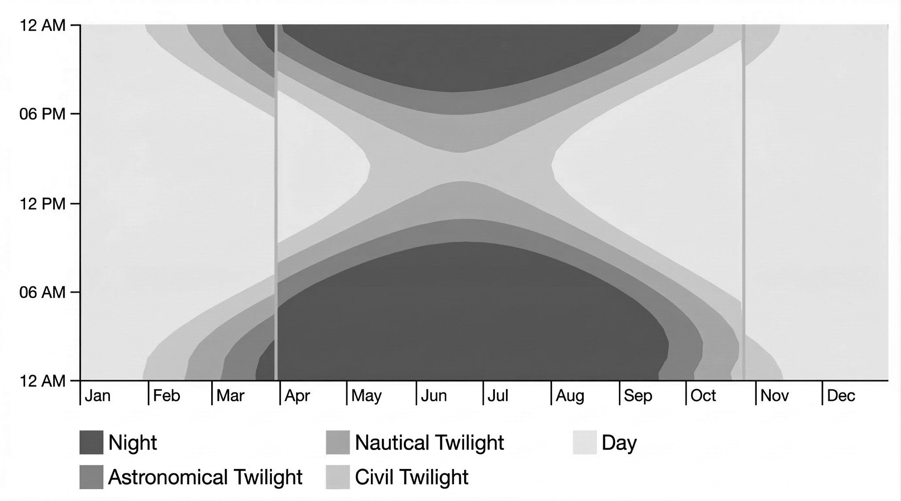
01 Context Temporalities
◼︎ Yearly re-supply ship
◼︎ Reachable via aircraft
◼︎ Summer-crew (40-70 people)
◻︎ Overwintering-crew (6 people)
◼︎ Antarctic Summer (4 months)
◼︎ Antarctic Winter (4 months)
◼︎ Transition (Spring+Autumn, 4 months)
Antarctic Seasons

Slide 5
01 Context Temporalities
◼︎ Yearly re-supply ship
◼︎ Reachable via aircraft
◼︎ Summer-crew (40-70 people)
◻︎ Overwintering-crew (6 people)
◼︎ Antarctic Summer (4 months)
◼︎ Antarctic Winter (4 months)
◼︎ Transition (Spring+Autumn, 4 months)
Operation
Antarctic Seasons

Slide 6
01 Context Temporalities
◼︎ Yearly re-supply ship
◼︎ Reachable via aircraft
◼︎ Summer-crew (40-70 people)
◻︎ Overwintering-crew (6 people)
◼︎ Antarctic Summer (4 months)
◼︎ Antarctic Winter (4 months)
◼︎ Transition (Spring+Autumn, 4 months)
Logistics
Operation
Antarctic Seasons

Slide 7
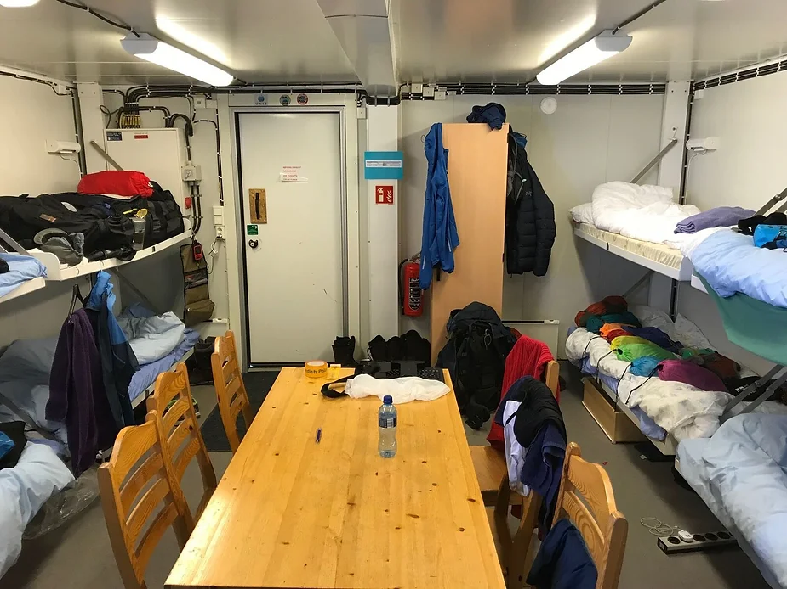
01 Context Status quo

Slide 8
01 Context Overwintering crew
01
Station Leader
02
Mechanical Engineer/Technician
03
Electrical Engineer/Systems Technician
04
Atmospheric Scientist/
Meteorologist
05
Cook/Logistics Coordinator
06
Communications + Medical officer
Station Coordination
Safety Oversight
Norway & Mission Control Communication
Operational Planning
Emergency Decision-Making
Infrastructure Inspections
monitoring electrical systems
maintaining sensors and scientific instruments
troubleshooting electronic equipment
supporting station technical infrastructure
maintenance of generators
heating and fuel systems
repair of vehicles and mechanical equipment
inspection of infrastructure
workshop maintenance and spare part preparation
weather observations
atmospheric measurements
operation of monitoring instruments
climate data analysis and reporting to international network
meal preparation for crew
management of food storage and inventory
kitchen hygiene
monitoring long-term food supplies
operation of communication systems
management of satellite links and IT infrastructure
coordination of external communication
medical monitoring and emergency response

Slide 9
01 Context Overwintering crew
01
Station Leader
02
Mechanical Engineer/Technician
03
Electrical Engineer/Systems Technician
04
Atmospheric Scientist/
Meteorologist
05
Cook/Logistics Coordinator
06
Communications + Medical officer
Niels
Sohyun
Luca
Aashna
Ilai
Anaelle
Station Coordination
Safety Oversight
Norway & Mission Control Communication
Operational Planning
Emergency Decision-Making
Infrastructure Inspections
monitoring electrical systems
maintaining sensors and scientific instruments
troubleshooting electronic equipment
supporting station technical infrastructure
maintenance of generators
heating and fuel systems
repair of vehicles and mechanical equipment
inspection of infrastructure
workshop maintenance and spare part preparation
weather observations
atmospheric measurements
operation of monitoring instruments
climate data analysis and reporting to international network
meal preparation for crew
management of food storage and inventory
kitchen hygiene
monitoring long-term food supplies
operation of communication systems
management of satellite links and IT infrastructure
coordination of external communication
medical monitoring and emergency response
Daily Rhythm
Spatial Needs
Lighting Preferences
Acoustic Sensitivity
Environmental Comfort
Storage demand and ownership
Conflict management
Individual Needs / Rituals:
Private Time Demand
Sleep Window

Slide 10
01 Context Occupancy of container
01
Station Leader
02
Mechanical Engineer/Technician
03
Electrical Engineer/Systems Technician
04
Atmospheric Scientist/
Meteorologist
05
Cook/Logistics Coordinator
06
Communications + Medical officer
1 | 2 | 3 | 4 | 5 | 6 | 7 | 8 | 9 | 10 | 11 | 12 | 13 | 14 | 15 | 16 | 17 | 18 | 19 | 20 | 21 | 22 | 23 | 24
CM 01
CM 02
CM 03
CM 04
CM 05
CM 06

Slide 11
01 Context Occupancy of container
01
Station Leader
02
Mechanical Engineer/Technician
03
Electrical Engineer/Systems Technician
04
Atmospheric Scientist/
Meteorologist
05
Cook/Logistics Coordinator
06
Communications + Medical officer
1 | 2 | 3 | 4 | 5 | 6 | 7 | 8 | 9 | 10 | 11 | 12 | 13 | 14 | 15 | 16 | 17 | 18 | 19 | 20 | 21 | 22 | 23 | 24
CM 01
CM 02
CM 03
CM 04
CM 05
CM 06

Slide 12
01 Context Occupancy of container
01
Station Leader
02
Mechanical Engineer/Technician
03
Electrical Engineer/Systems Technician
04
Atmospheric Scientist/
Meteorologist
05
Cook/Logistics Coordinator
06
Communications + Medical officer
1 | 2 | 3 | 4 | 5 | 6 | 7 | 8 | 9 | 10 | 11 | 12 | 13 | 14 | 15 | 16 | 17 | 18 | 19 | 20 | 21 | 22 | 23 | 24
CM 01
CM 02
CM 03
CM 04
CM 05
CM 06
Micro-socializing Sleeping Resting Individual Task Personal storage

Slide 13
01 Context Occupancy of container
01
Station Leader
02
Mechanical Engineer/Technician
03
Electrical Engineer/Systems Technician
04
Atmospheric Scientist/
Meteorologist
05
Cook/Logistics Coordinator
06
Communications + Medical officer
1 | 2 | 3 | 4 | 5 | 6 | 7 | 8 | 9 | 10 | 11 | 12 | 13 | 14 | 15 | 16 | 17 | 18 | 19 | 20 | 21 | 22 | 23 | 24
CM 01
CM 02
CM 03
CM 04
CM 05
CM 06
Micro-socializing Sleeping Resting Individual Task Personal storage

Slide 14
01 Context Conceptual idea
Not your workstation
Not your gym
Not your sauna
Not your dinner table
…
It's a place for micro-socialising and retreating,
It boosts you physiological and psychological well-being
In favour of you, your team and the mission.

Slide 15
02
Spatial layout exploration

Slide 16
02
Spatial layout exploration
A Program mapping
B Design tool
C Iterations

Slide 17
02 Spatial layout exploration Activities in the container
Shared space
Sleeping
Lounging
Individual Work
Storage

Slide 18
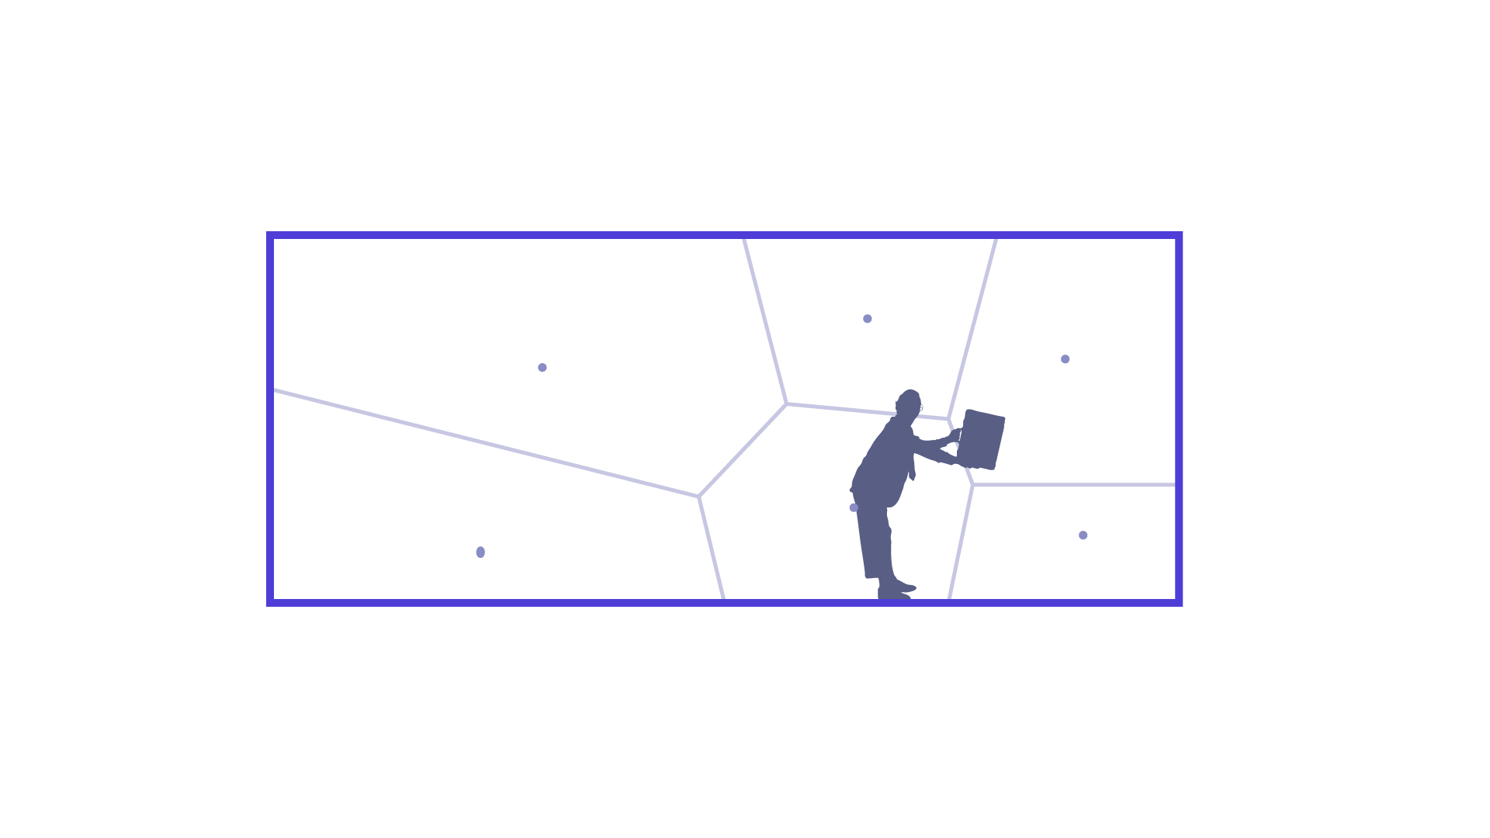
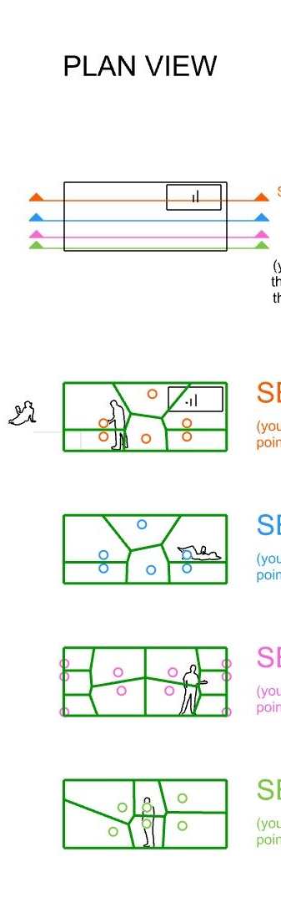
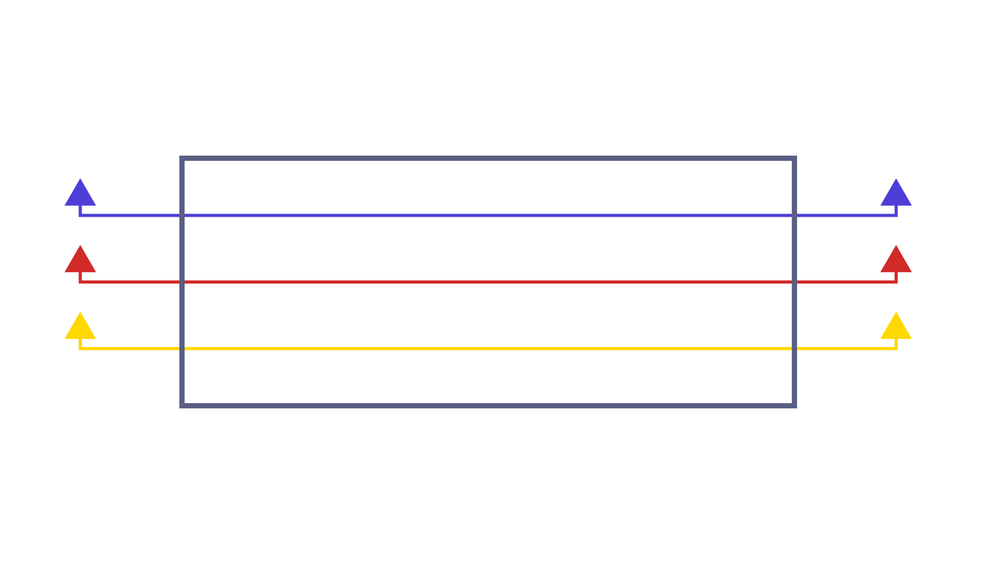
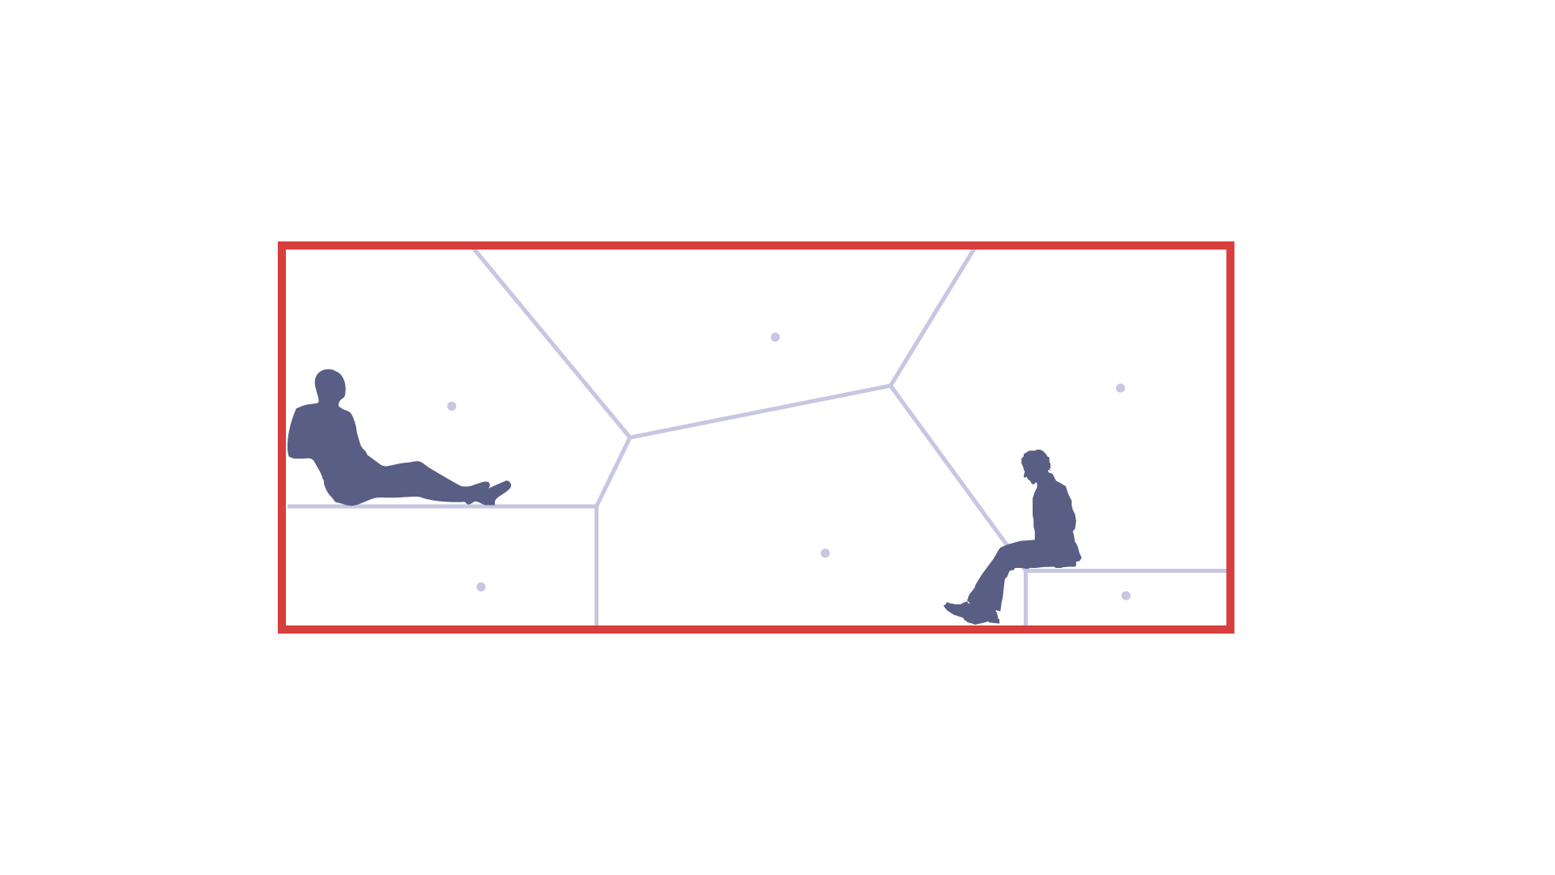
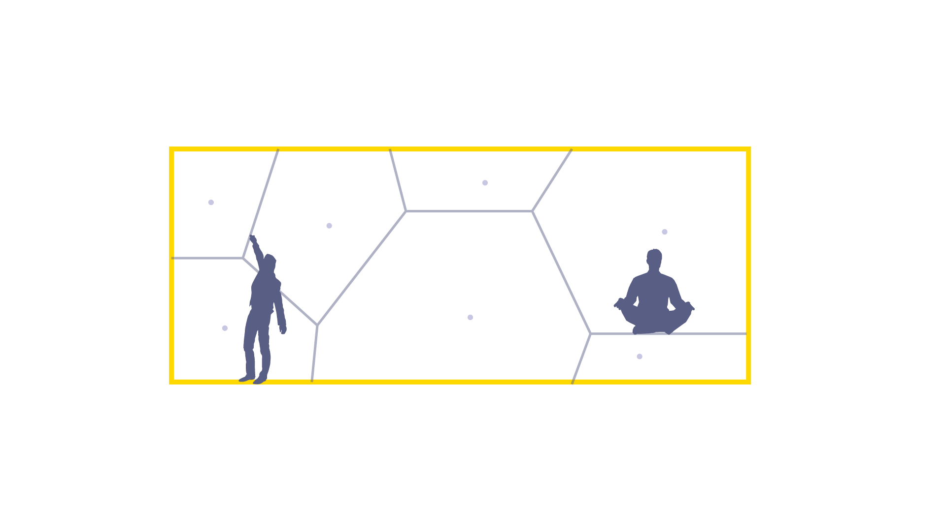
02 Spatial layout exploration Design tool
Section 01
Section 02
01
02
03
Plan
The plan is divided into a couple of sections through which the 3D voronoi can be manipulated
Section 03

Slide 19
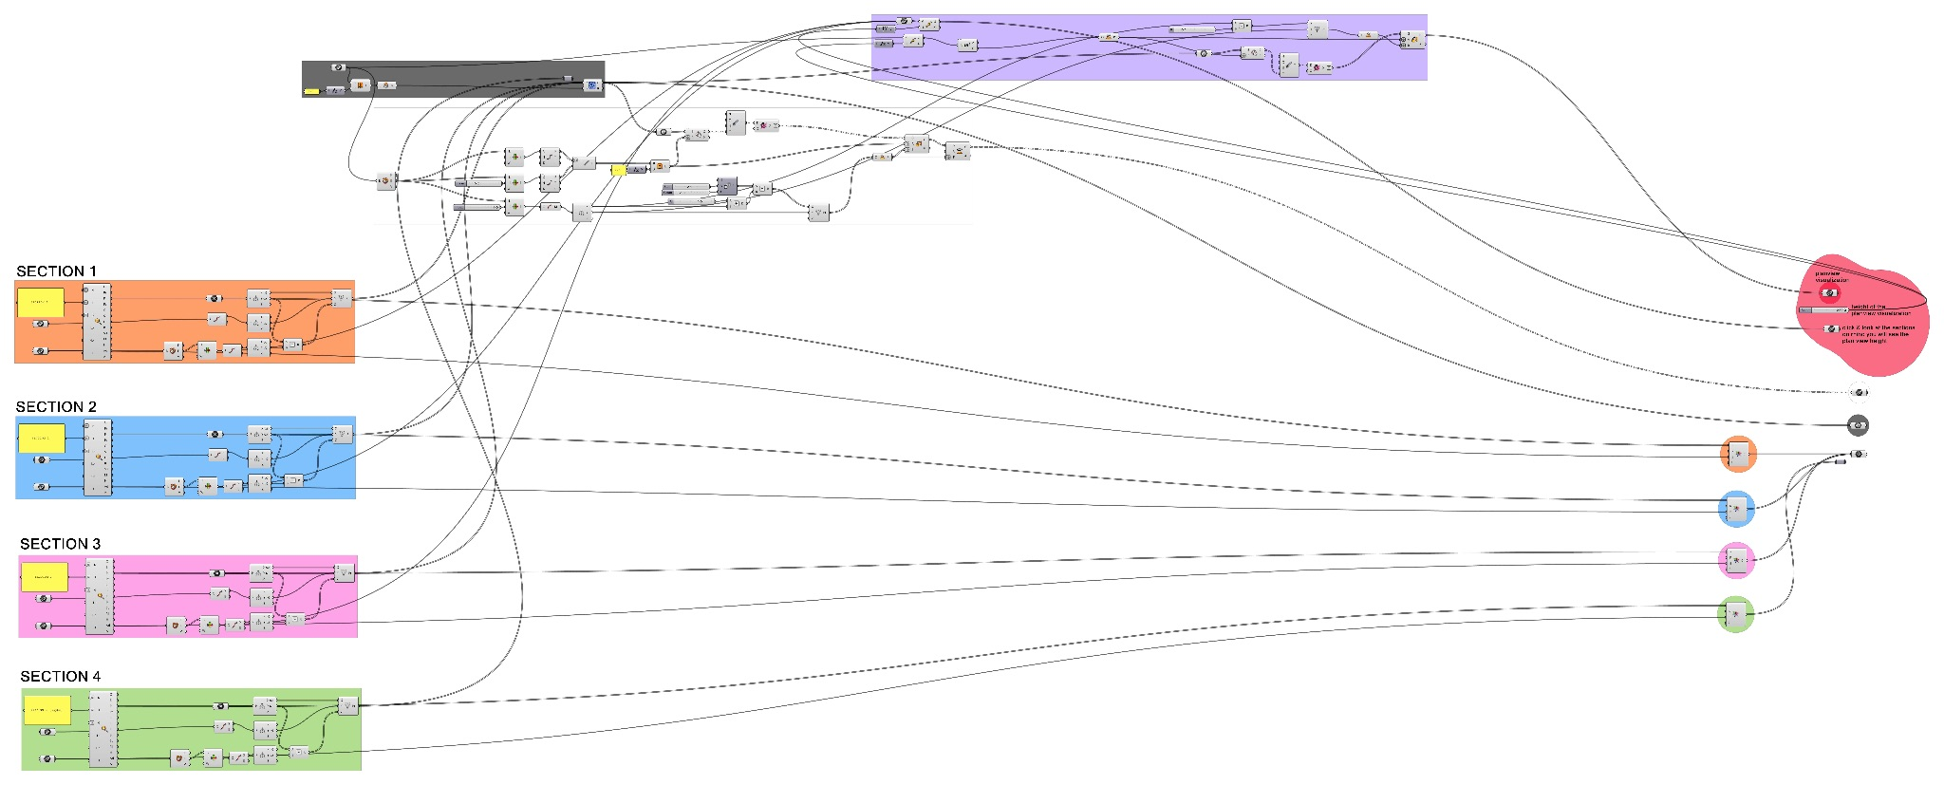
02 Spatial layout exploration Design tool

Slide 20
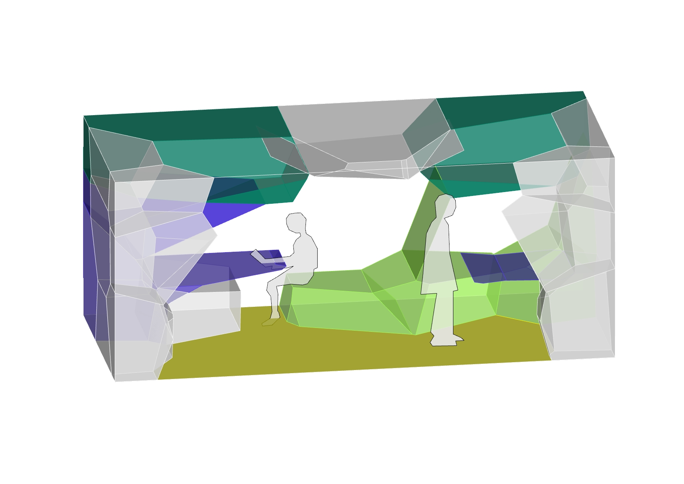
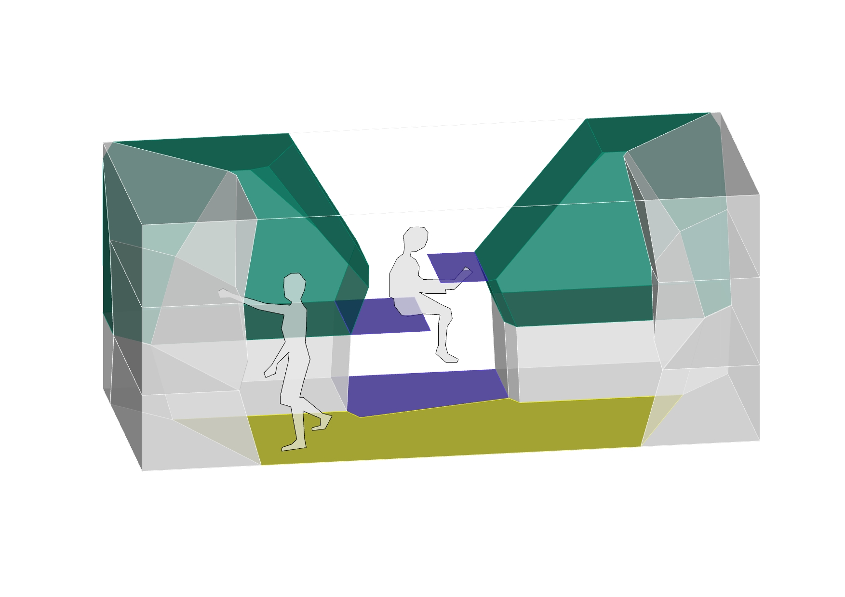
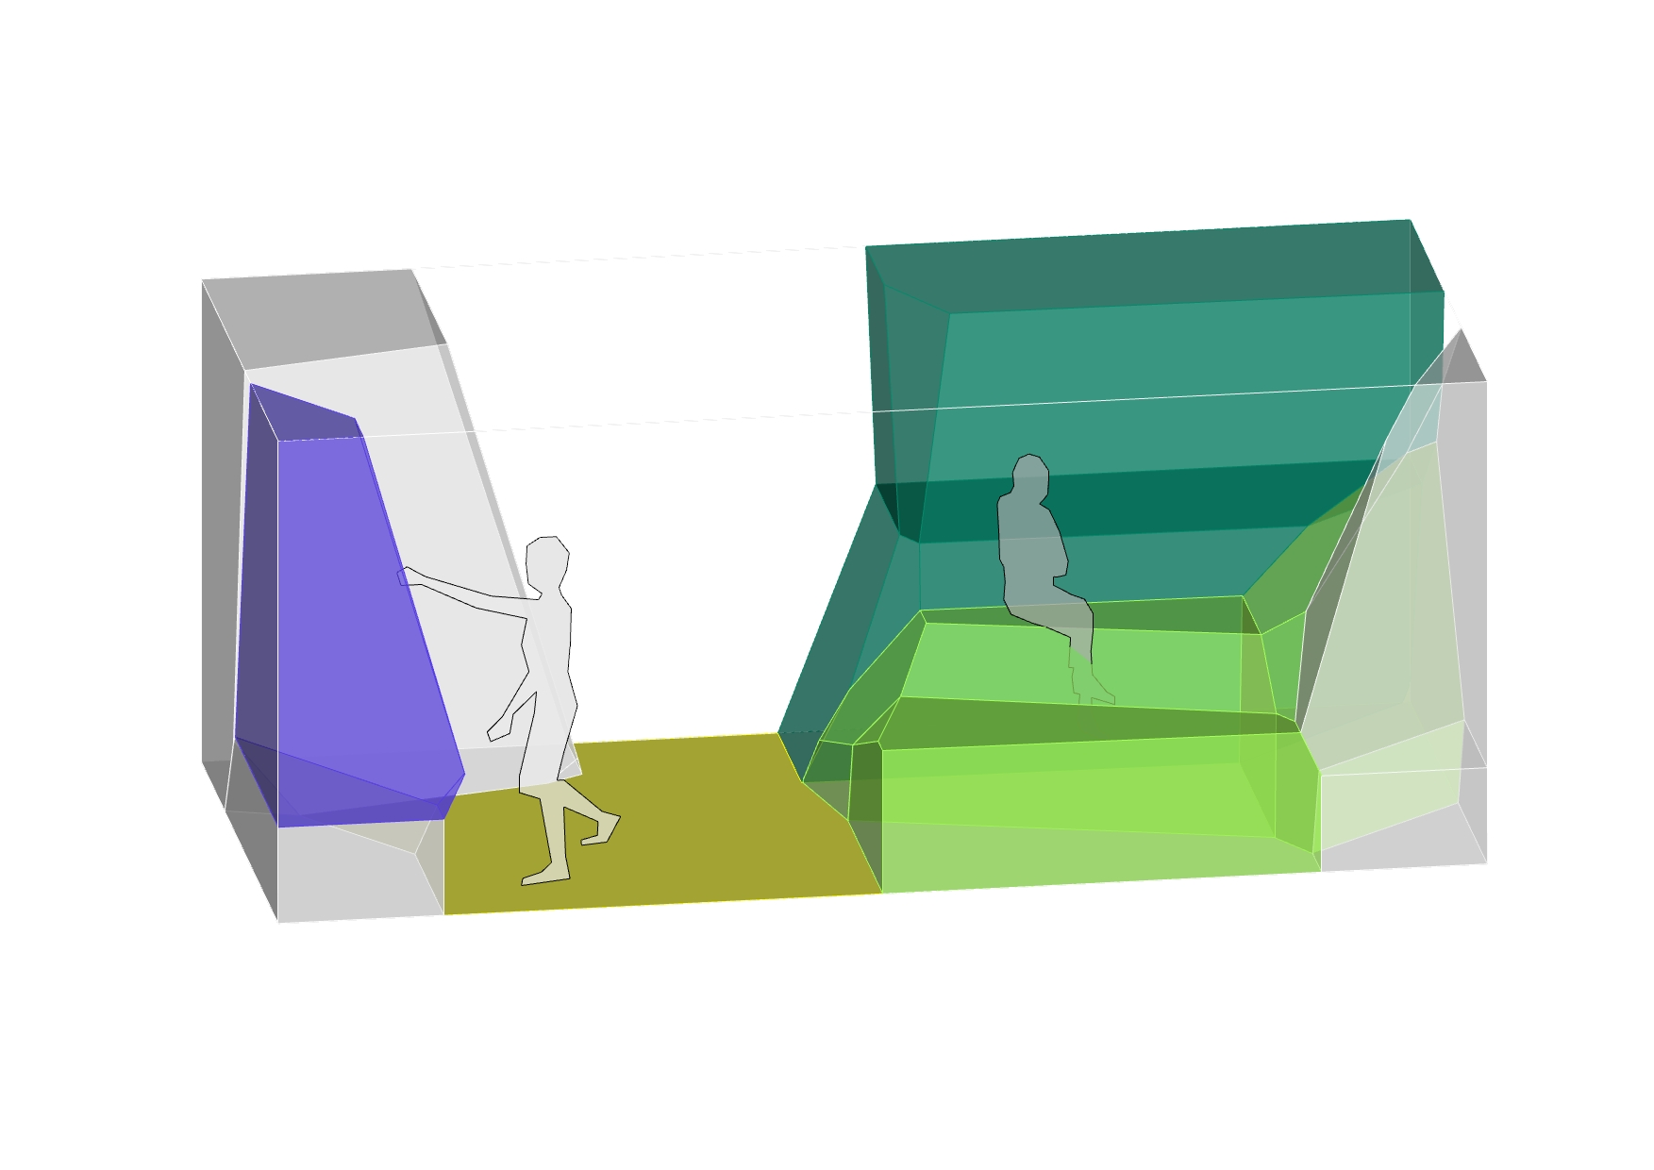
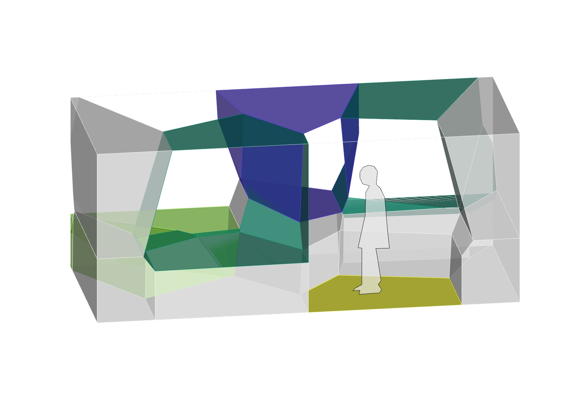
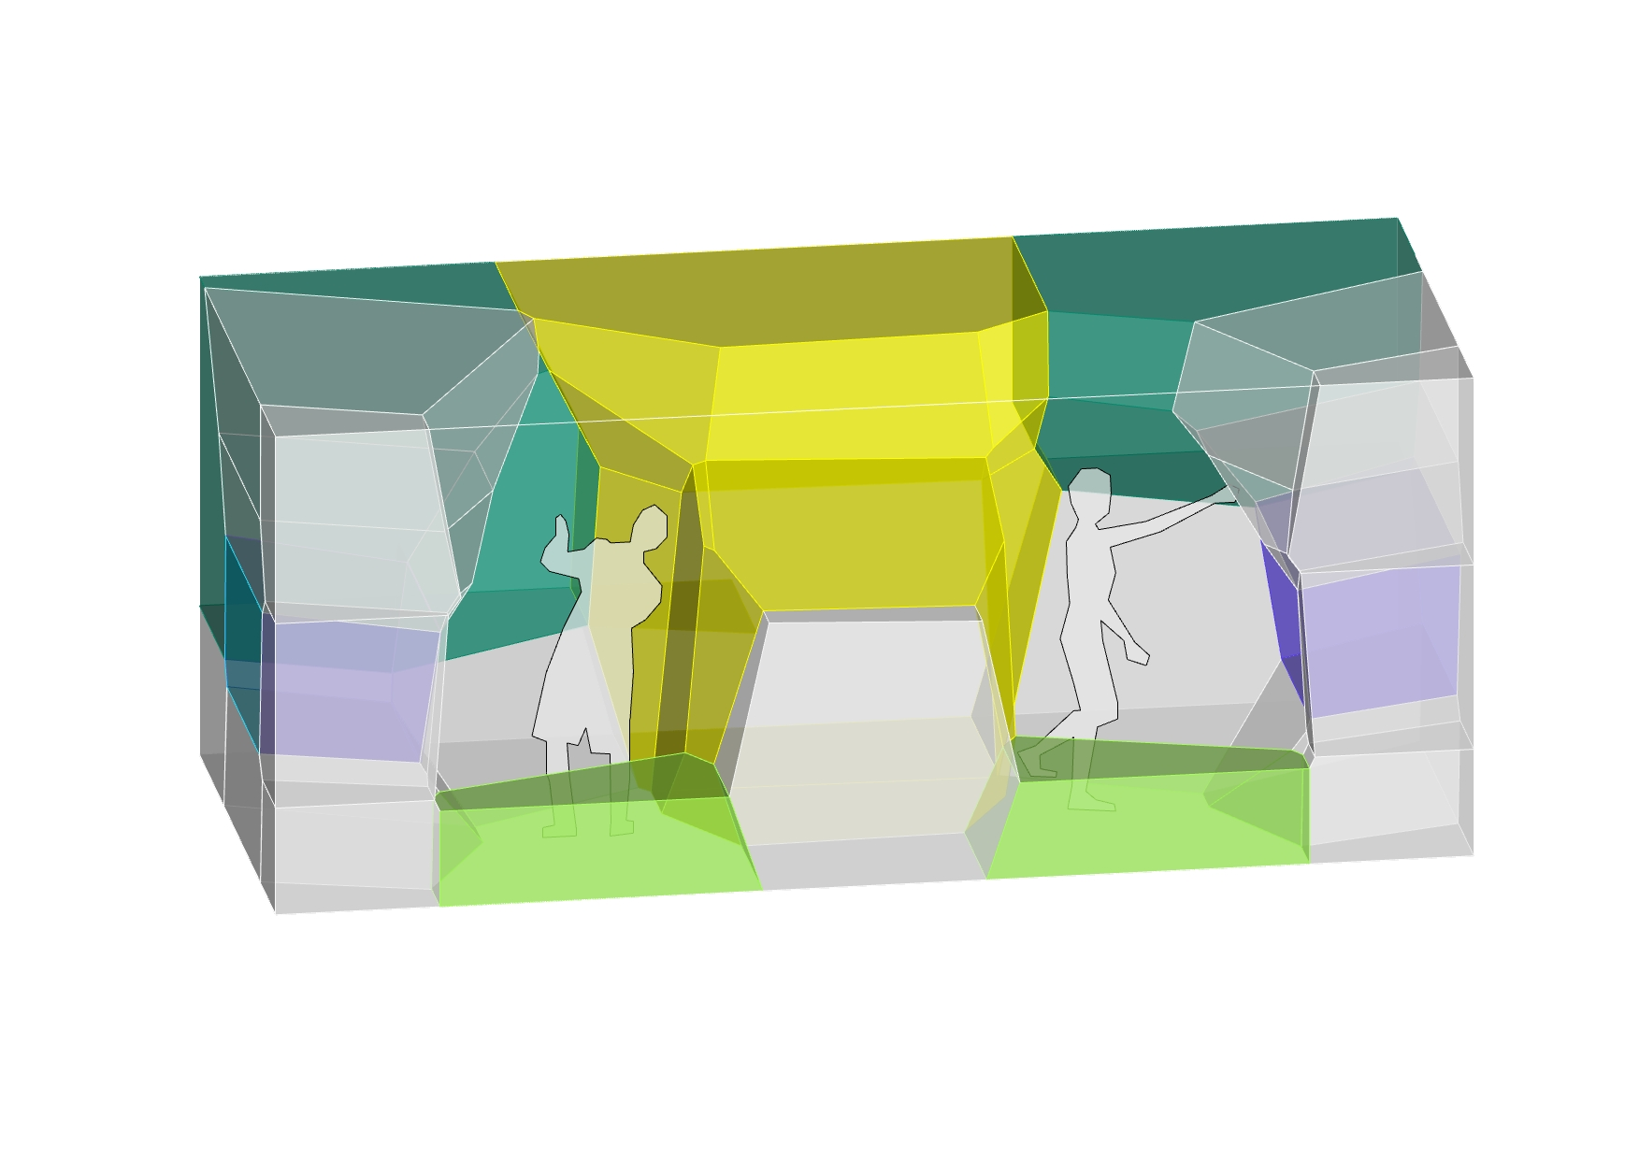
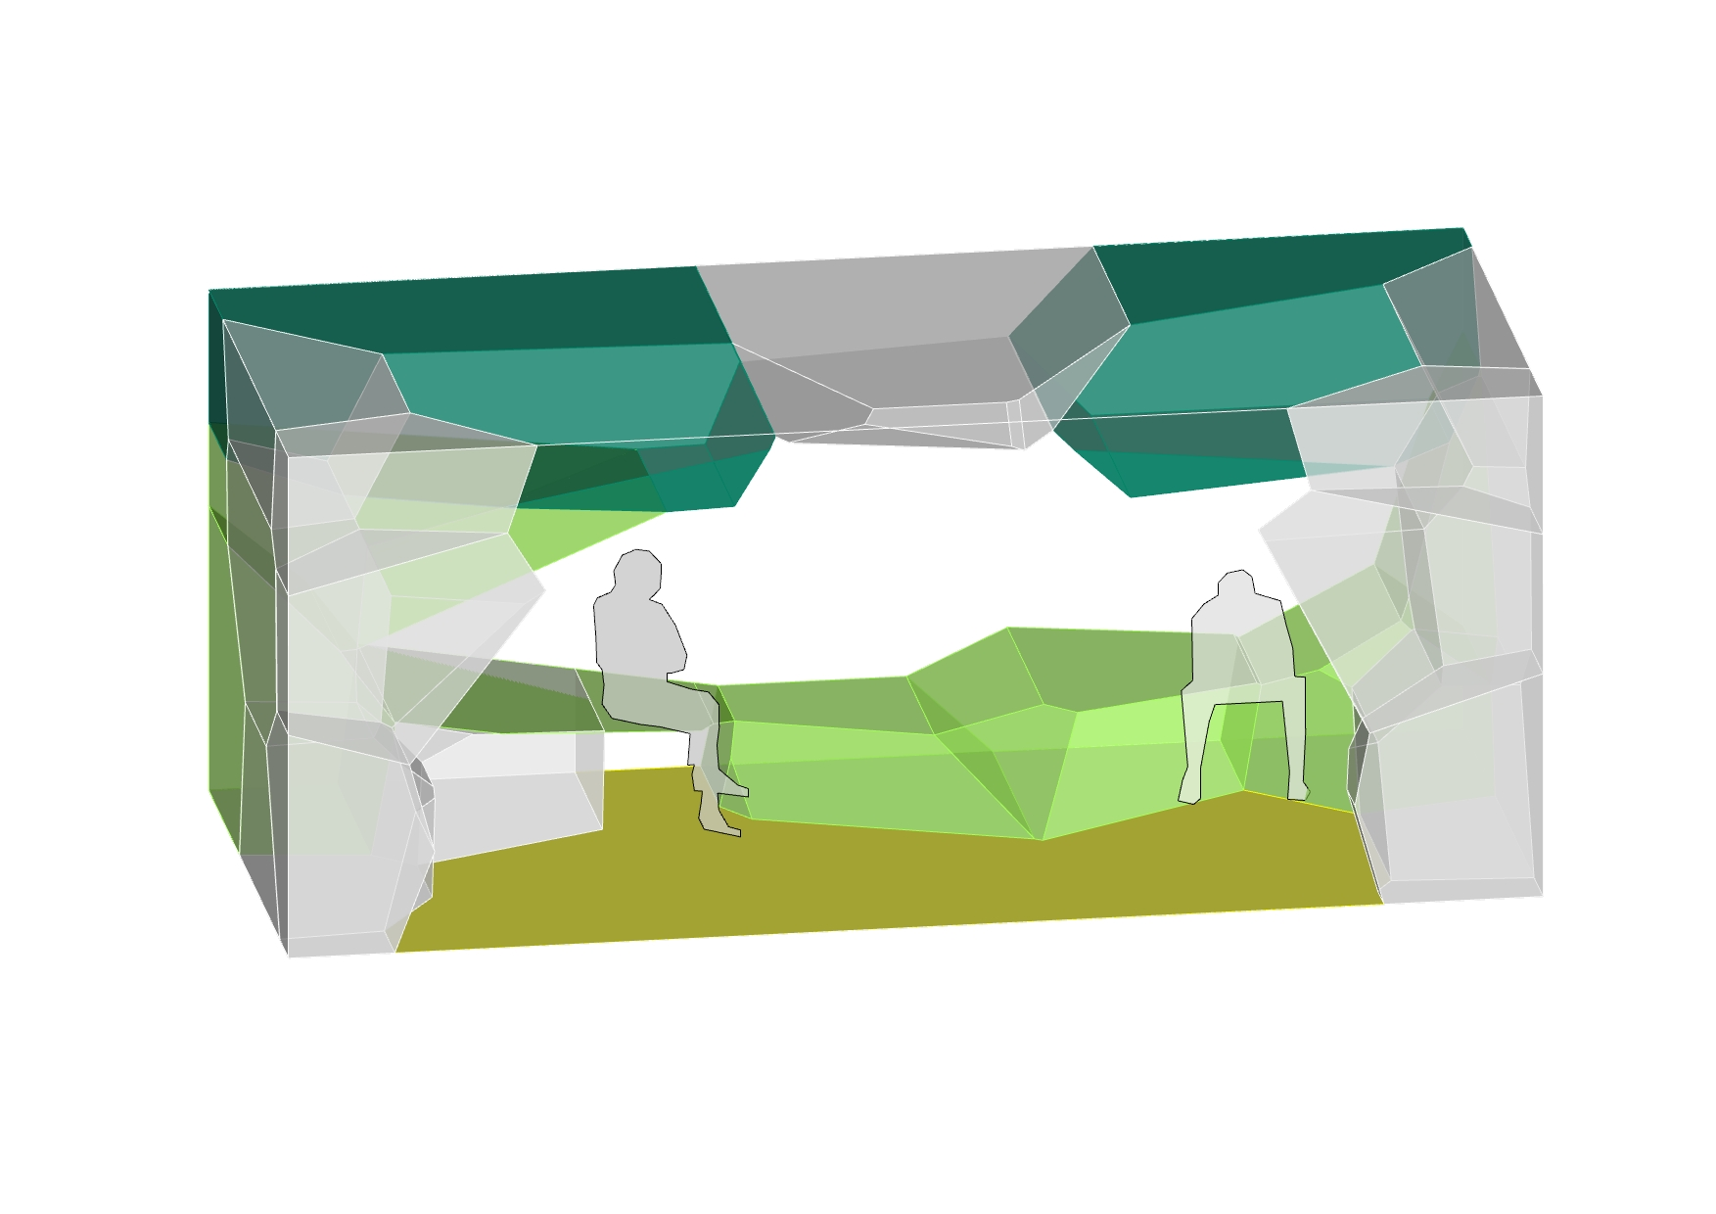
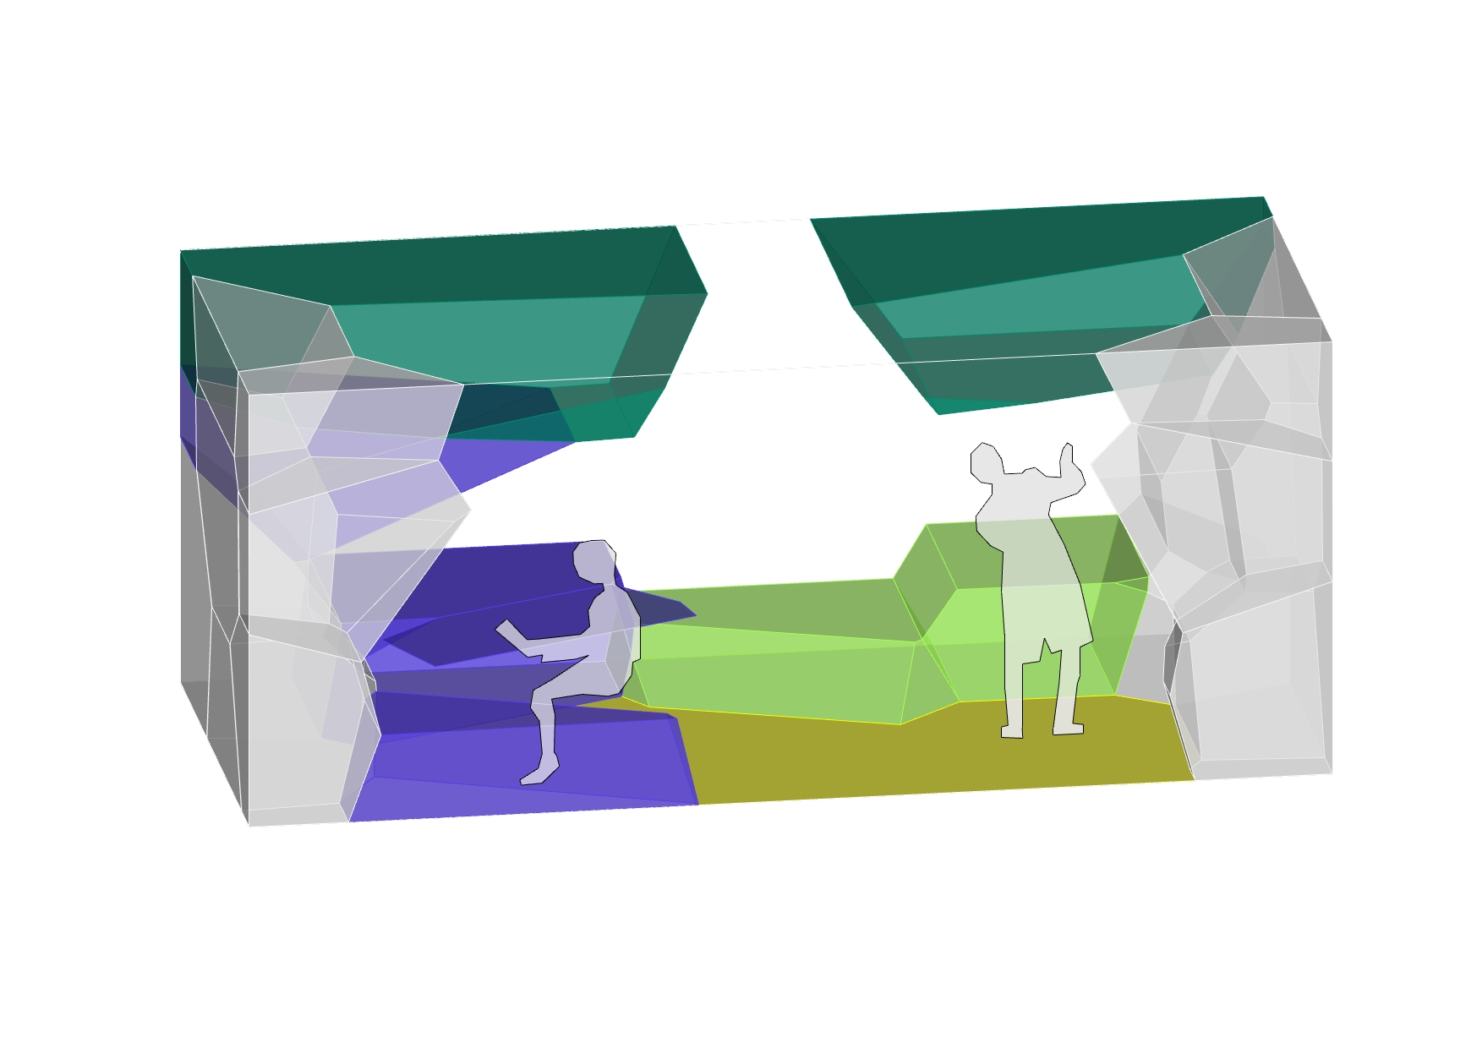
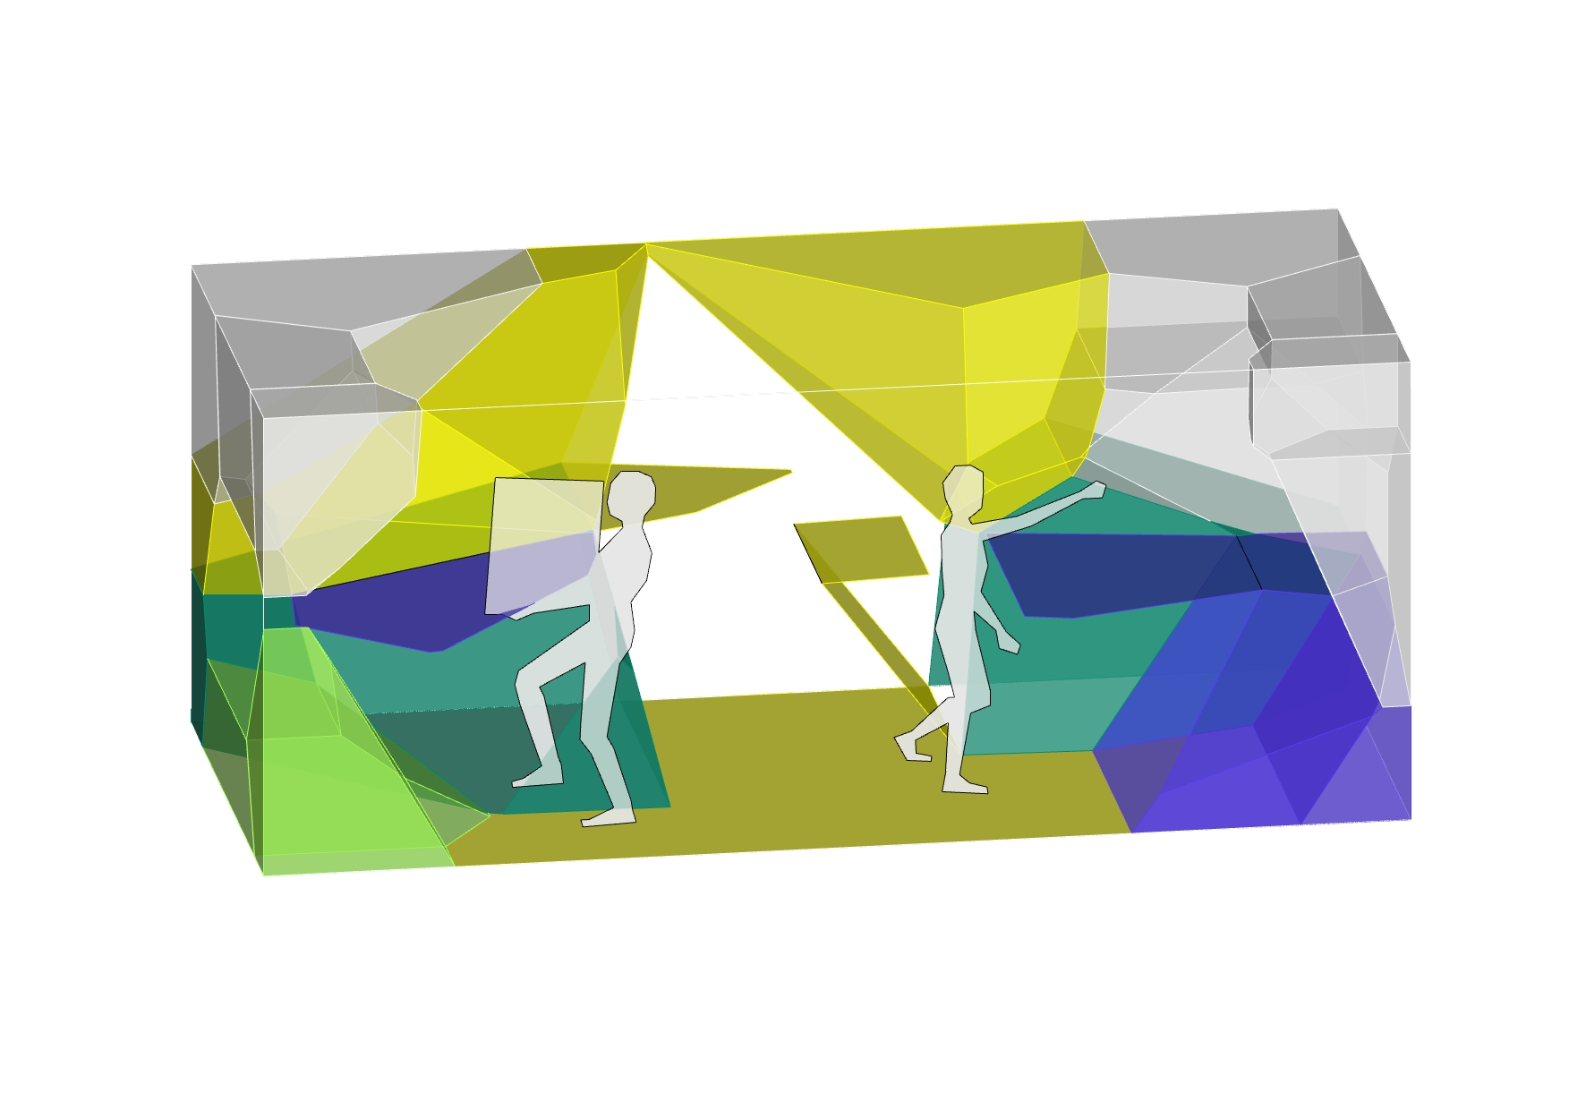
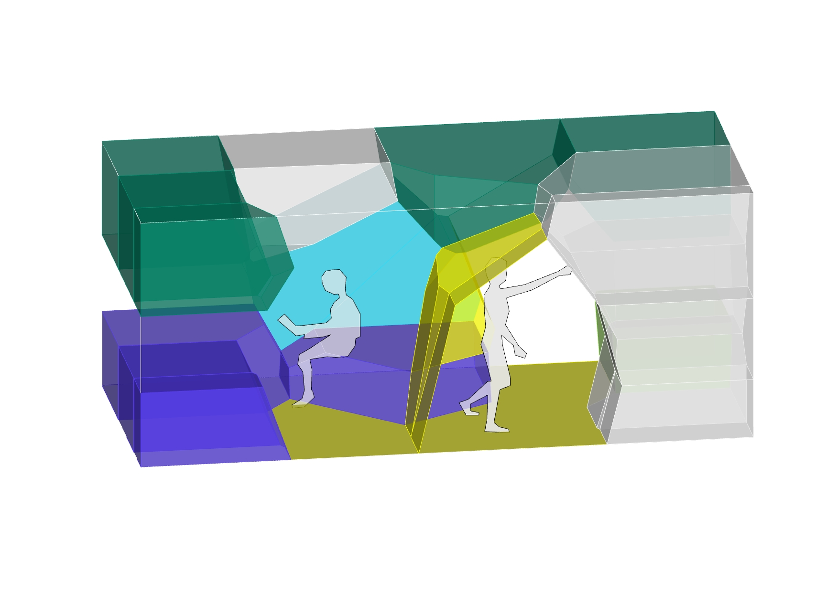
02 Design Process Iterations
01
02
03
04
05
06
◼︎ Shared space
◼︎ Sleeping
◼︎ Lounging
◼︎ Individual work
◼︎ Storage
07
08
09
1:1 Interactive Architecture Prototype - Troll Station

Slide 21




02 Design Process Iterations
Adaptability > personalized “Pods”
◼︎ Shared space
◼︎ Sleeping
◼︎ Lounging
◼︎ Individual work
◼︎ Storage

Slide 22
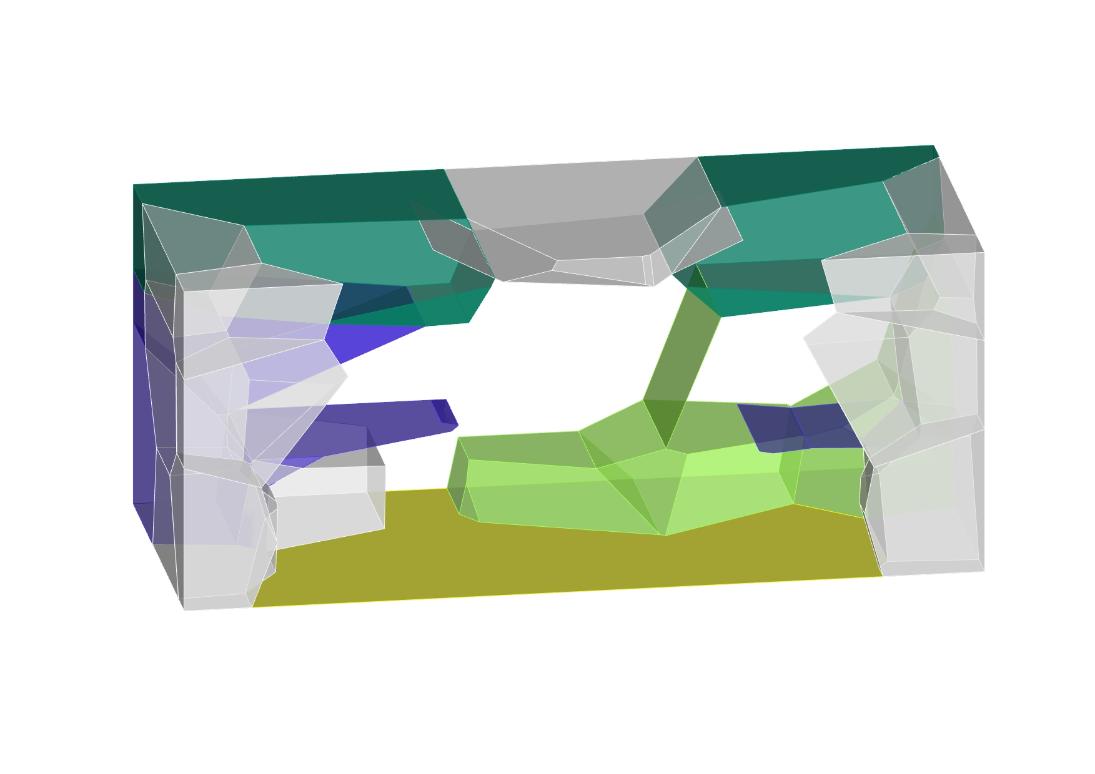



02 Design Process Iterations
◼︎ Shared space
◼︎ Sleeping
◼︎ Lounging
◼︎ Individual work
◼︎ Storage

Slide 23
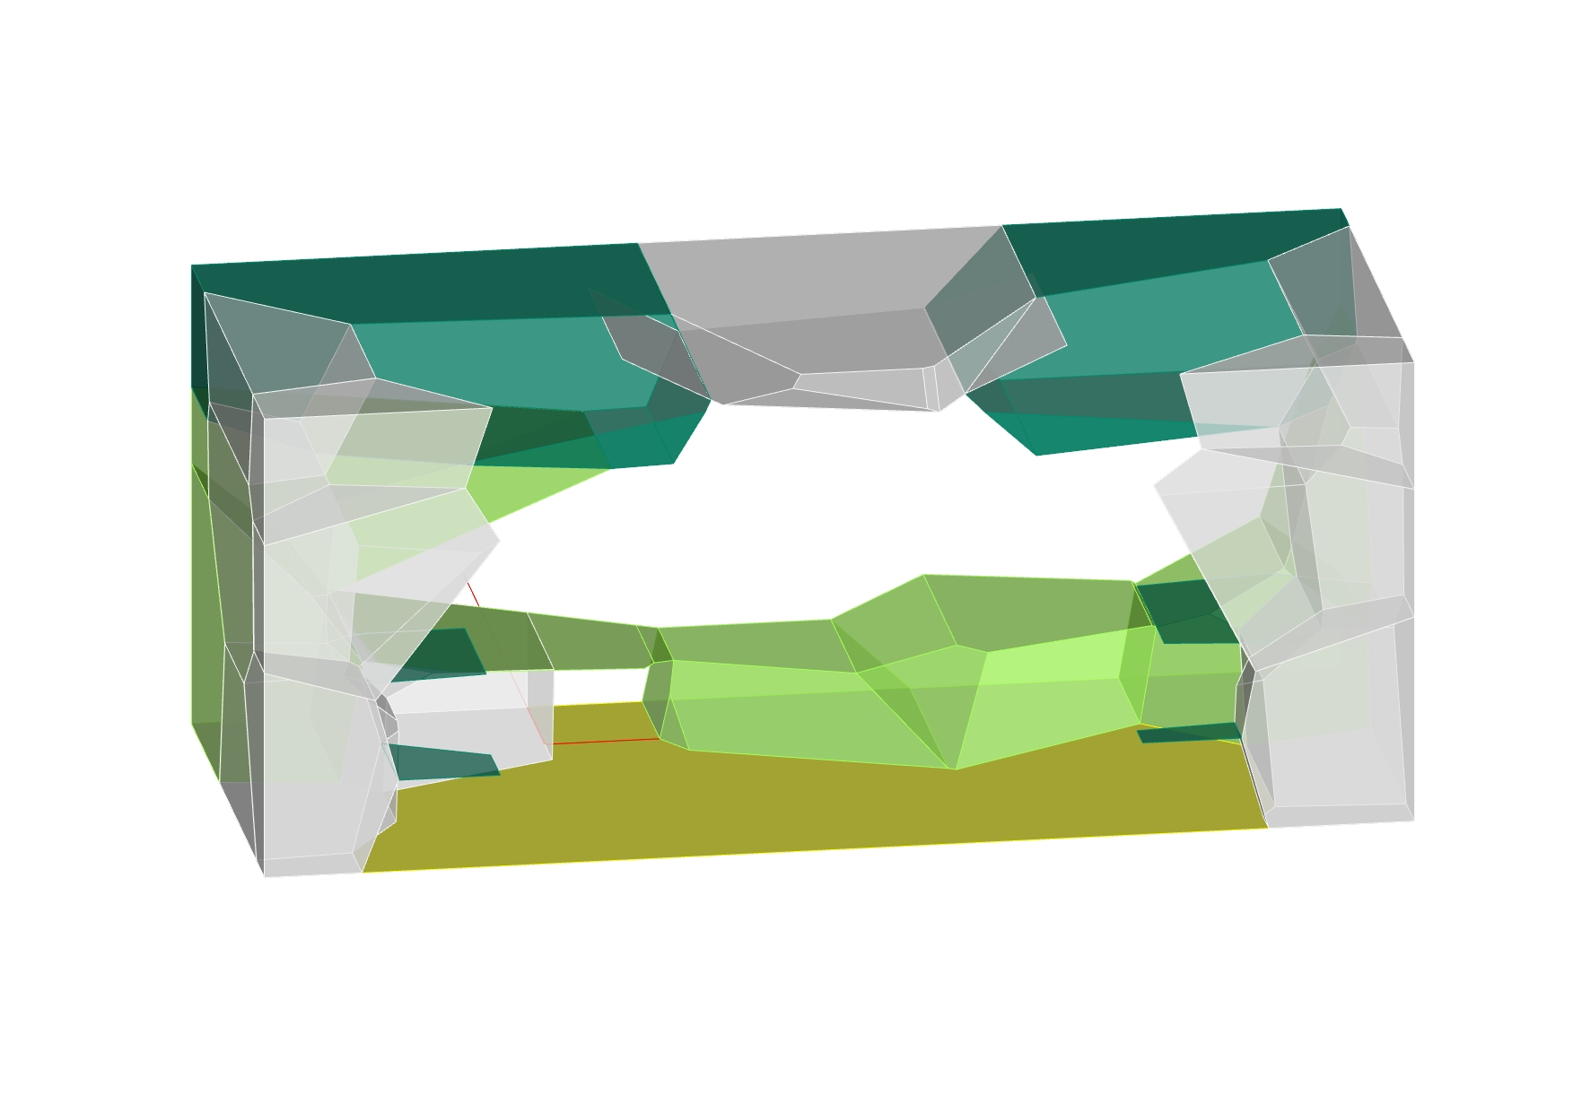
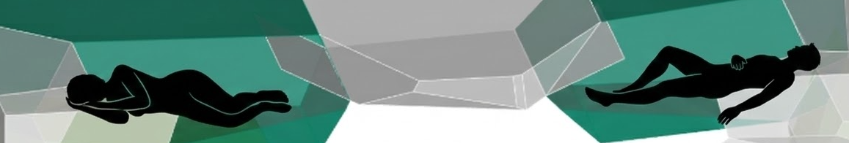

02 Design Process Iterations
◼︎ Shared space
◼︎ Sleeping
◼︎ Lounging
◼︎ Individual work
◼︎ Storage

Slide 24
03
Design

Slide 25
03
Design
A Spatial modulation & reconfigurability
B 3D Voronoi
C Individual reconfiguration

Slide 26
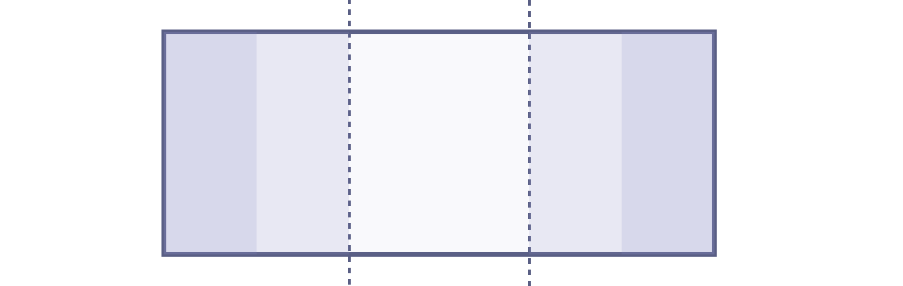
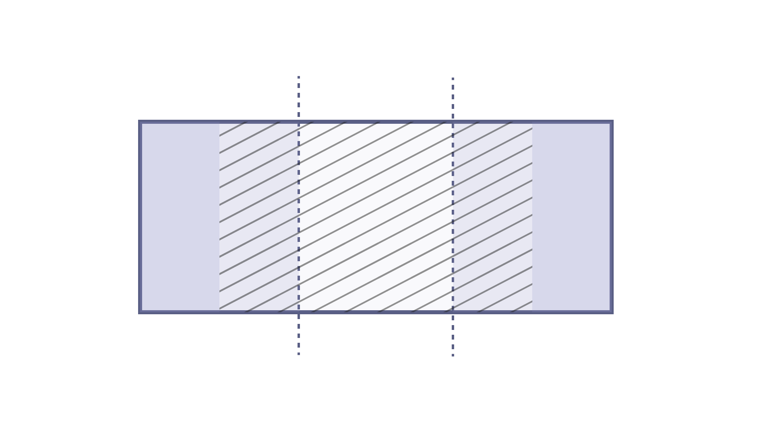
03 Spatial layout exploration Activities Gradient
Gradient
What happens where?
→ How Furniture is gonna adapt
niels
Private
Interaction
Private
1 2 3 4

Slide 27
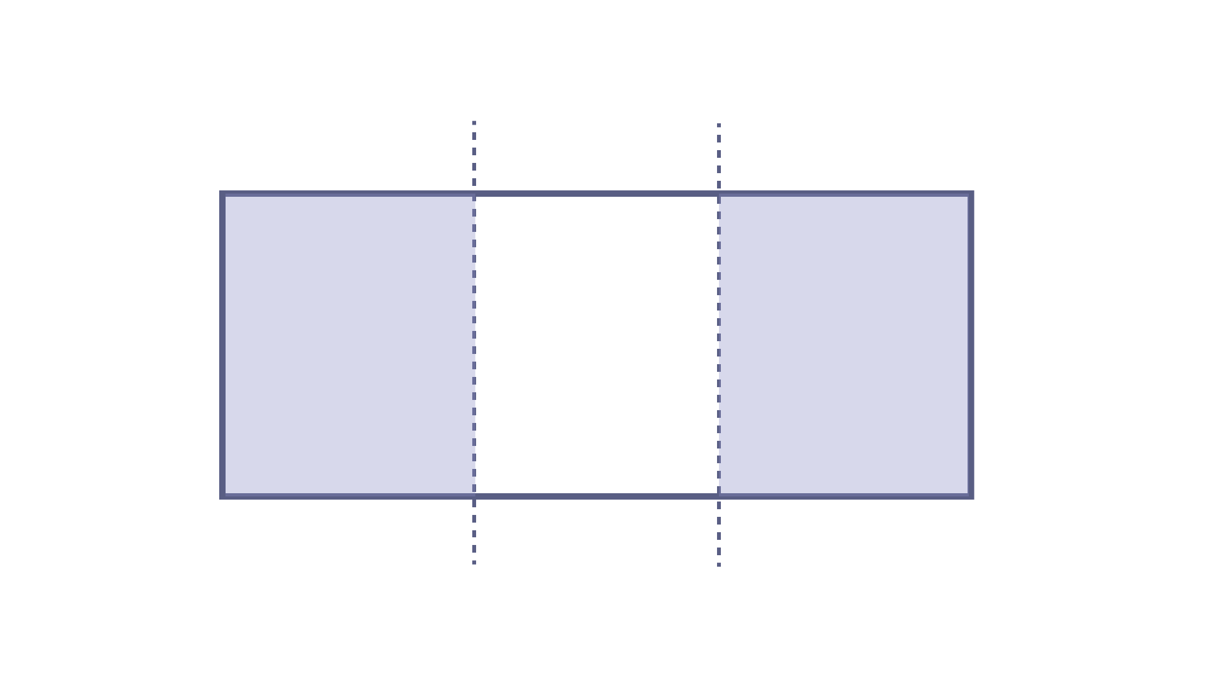
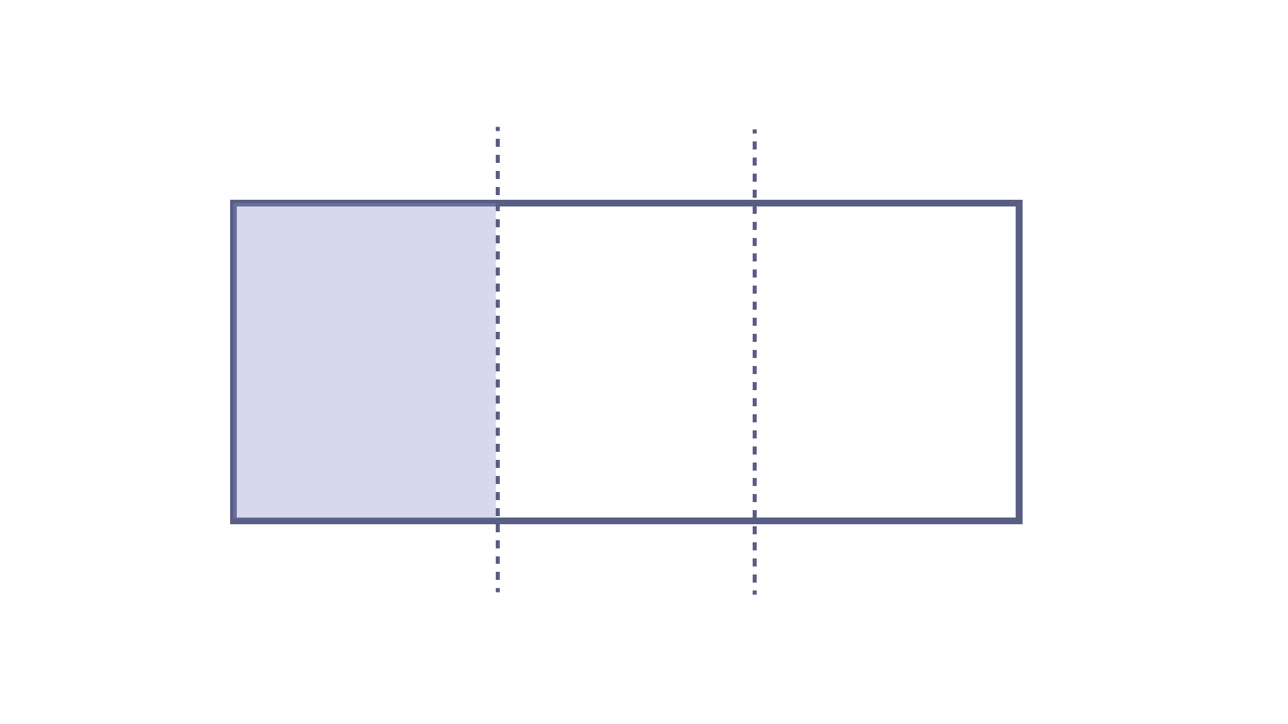
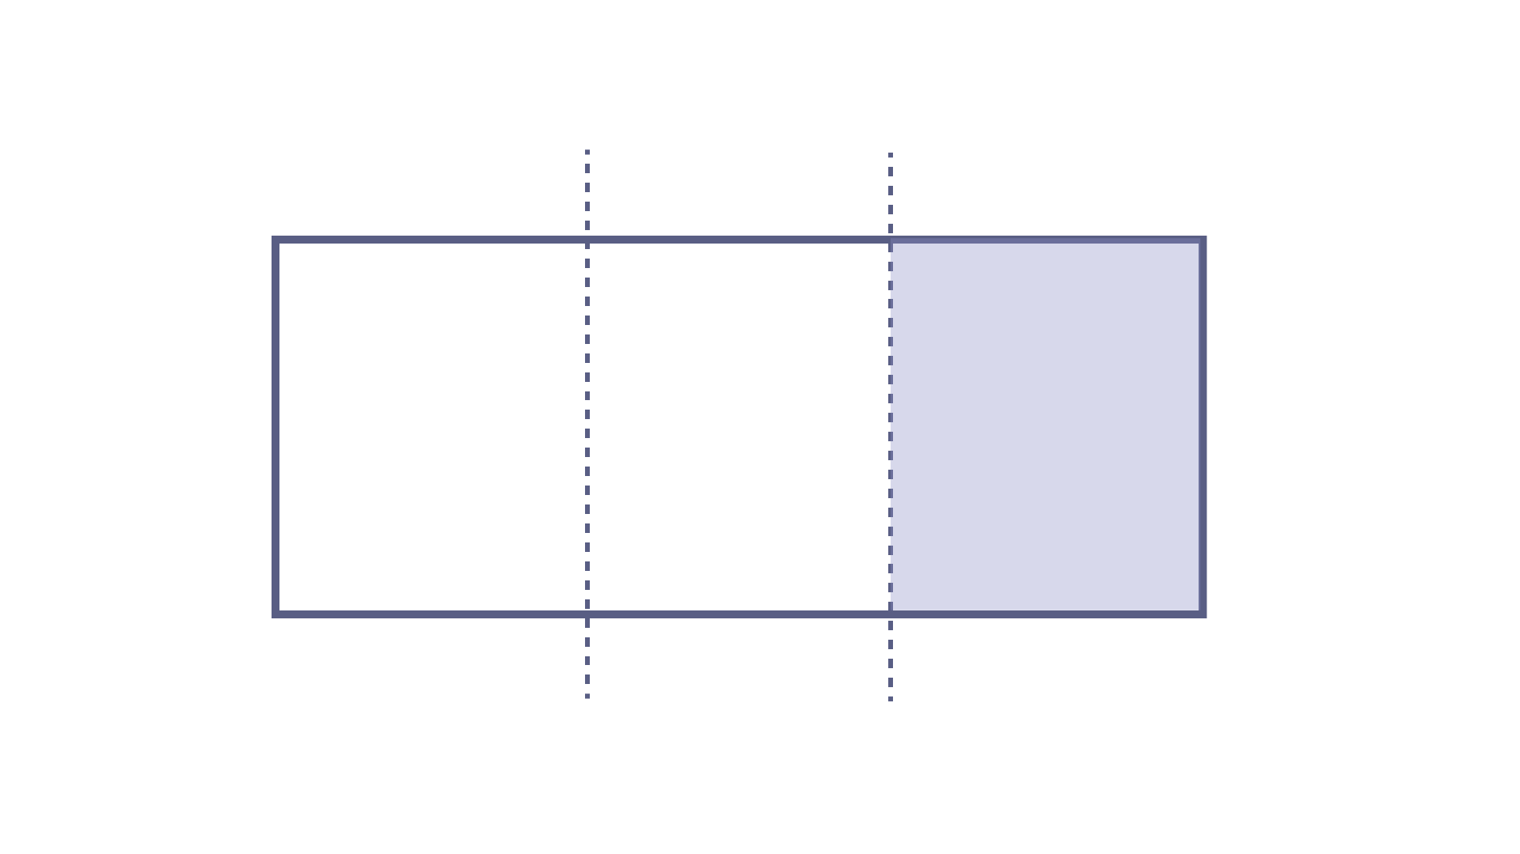
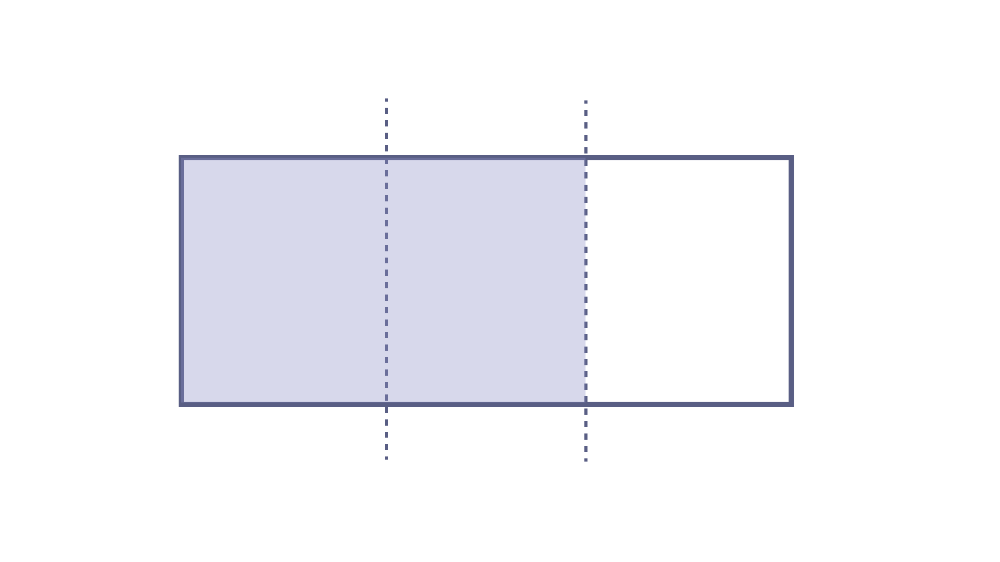
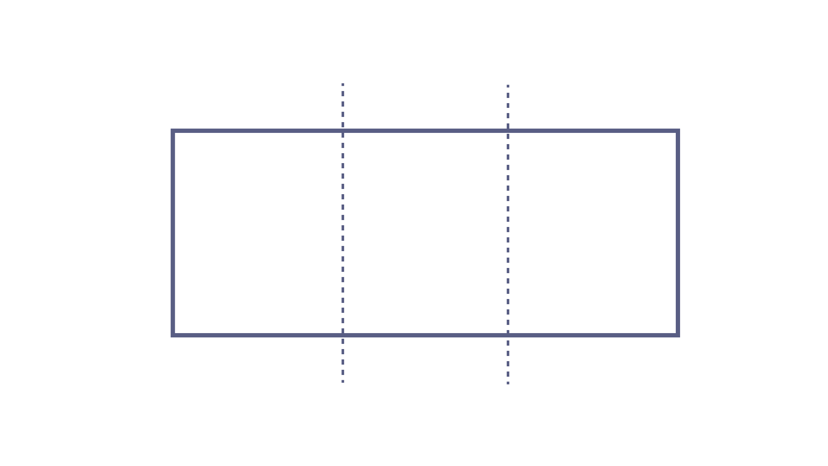
03 Design Scale 01 - Spatial modulation
Scenario 01
6:00 AM
Bob just woke up and is changing, Sigrid is still asleep
Scenario 02
8:00 AM
Sigrid is doing some work in her room and doesn’t want to be disturbed
Scenario 03
10:00 AM
Bob has a visitor and is hanging out in the lounge space.
…
◻︎ Interaction
◼︎ Private

Slide 28
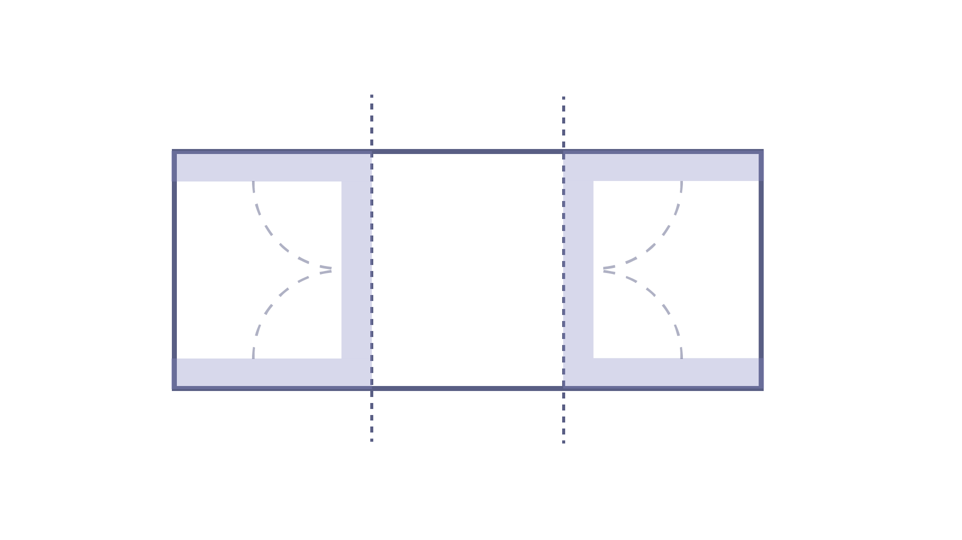
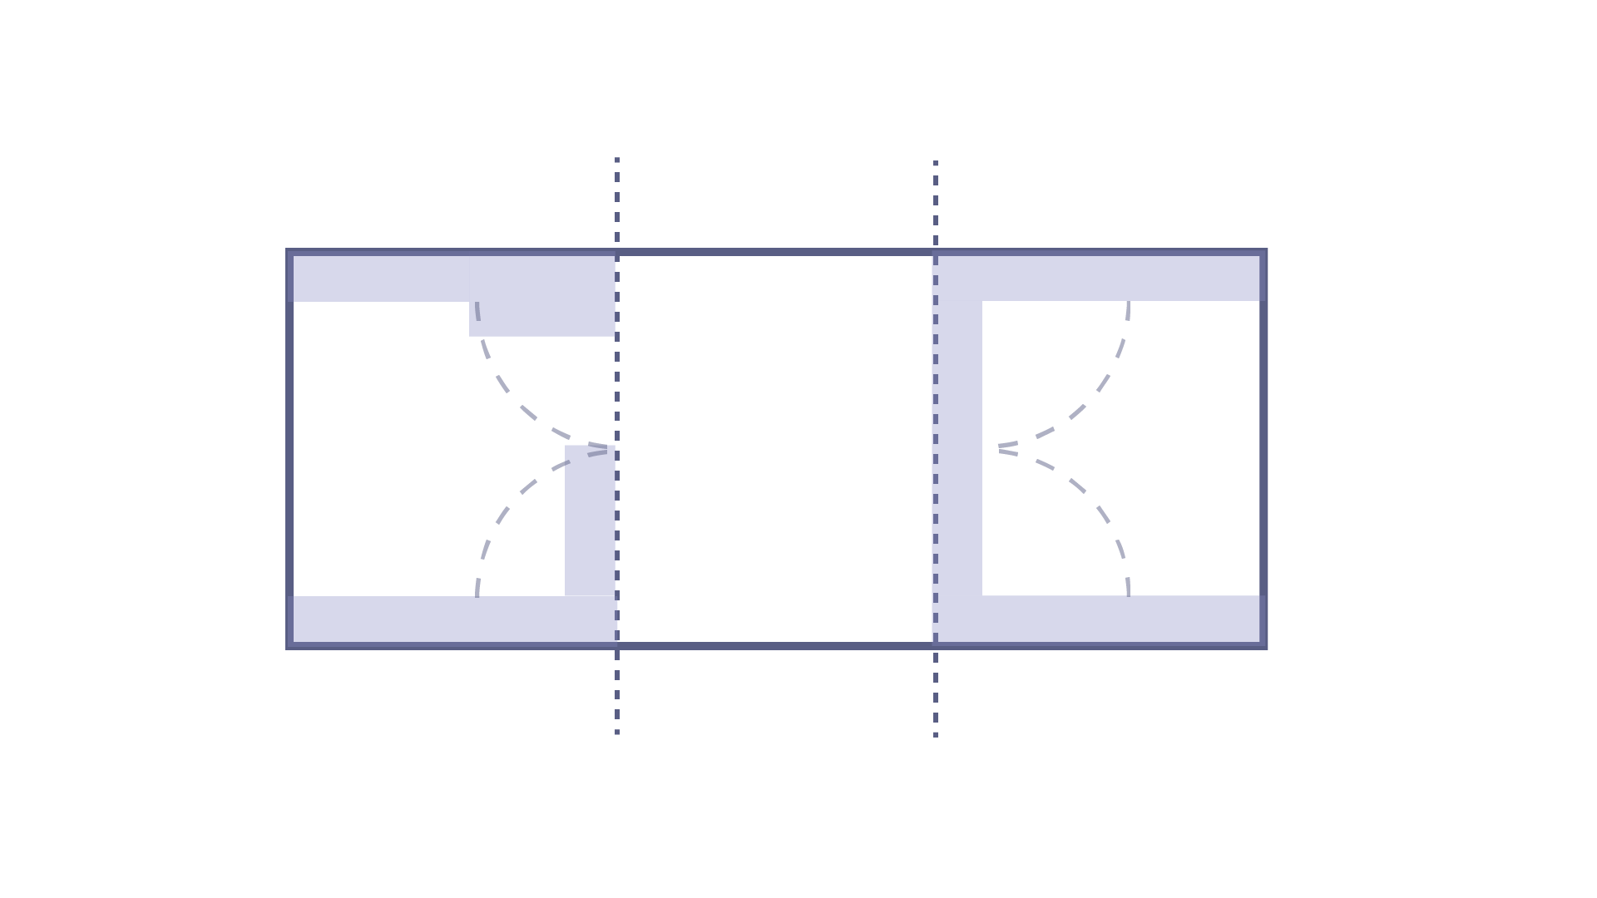
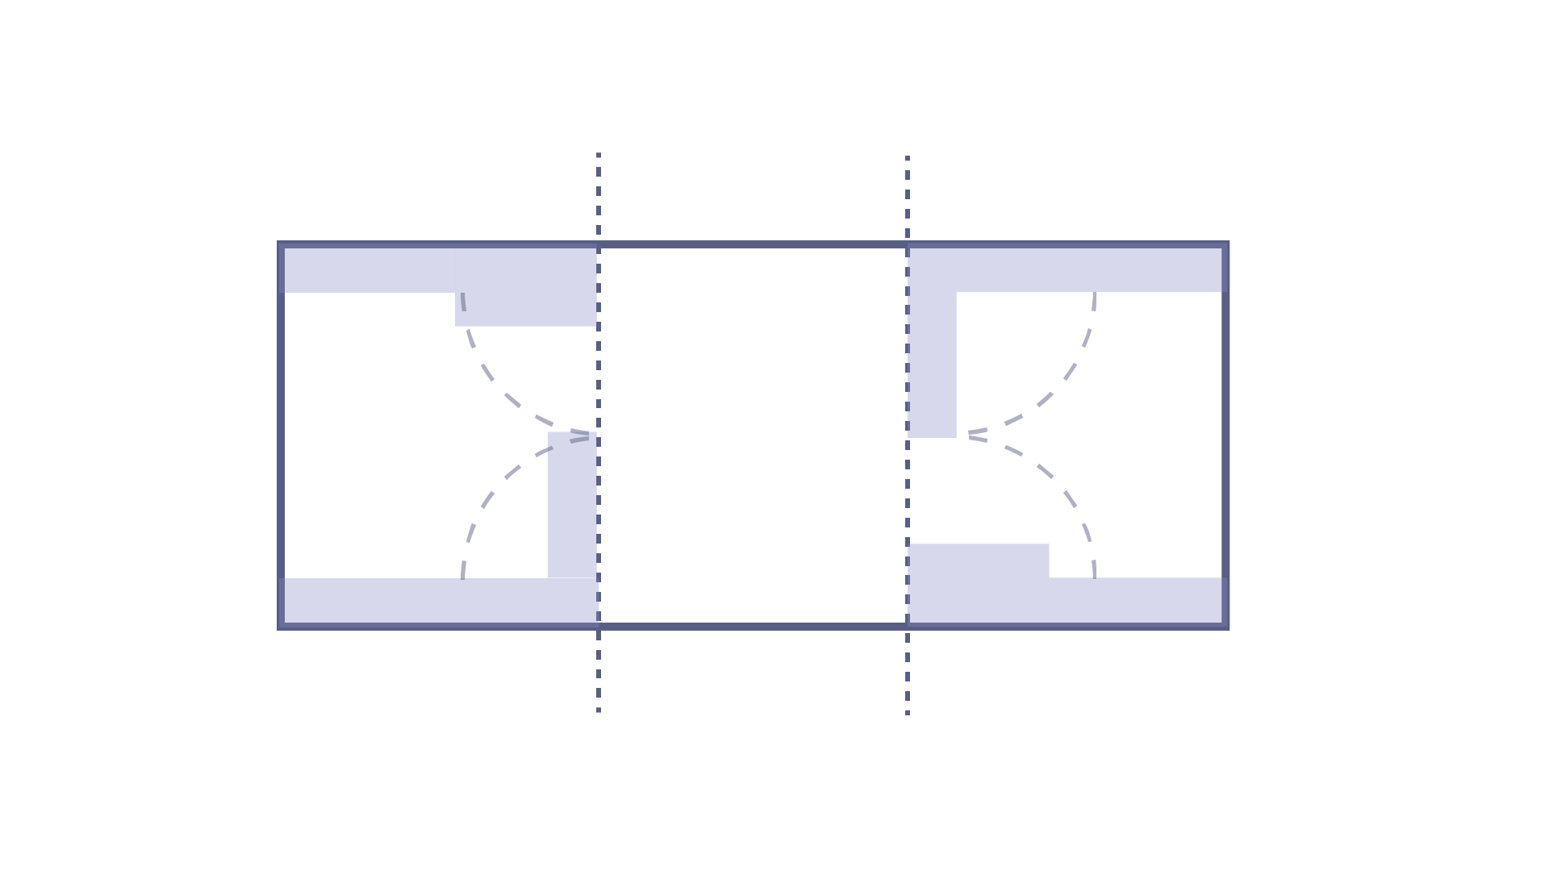
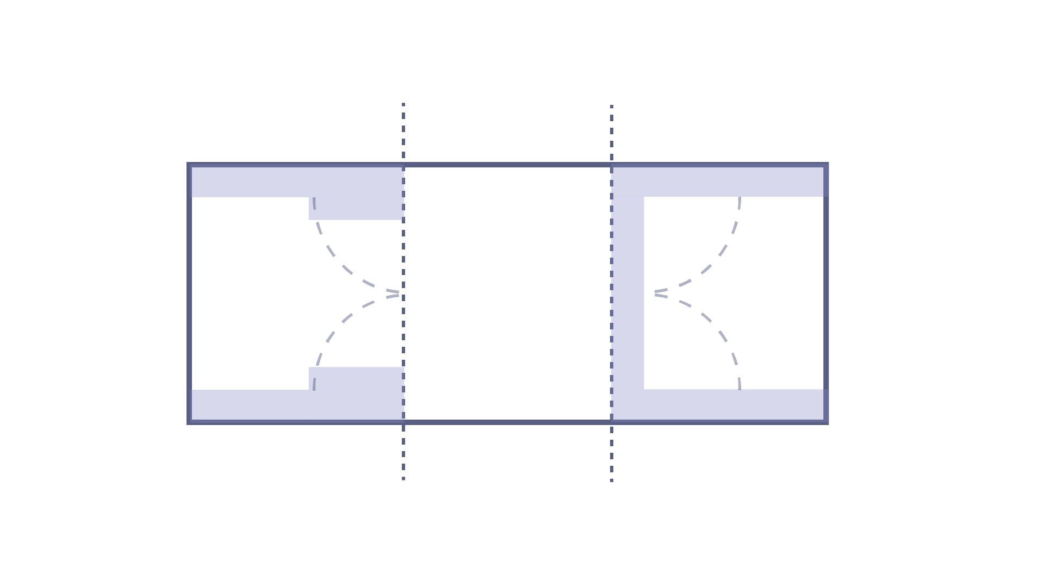
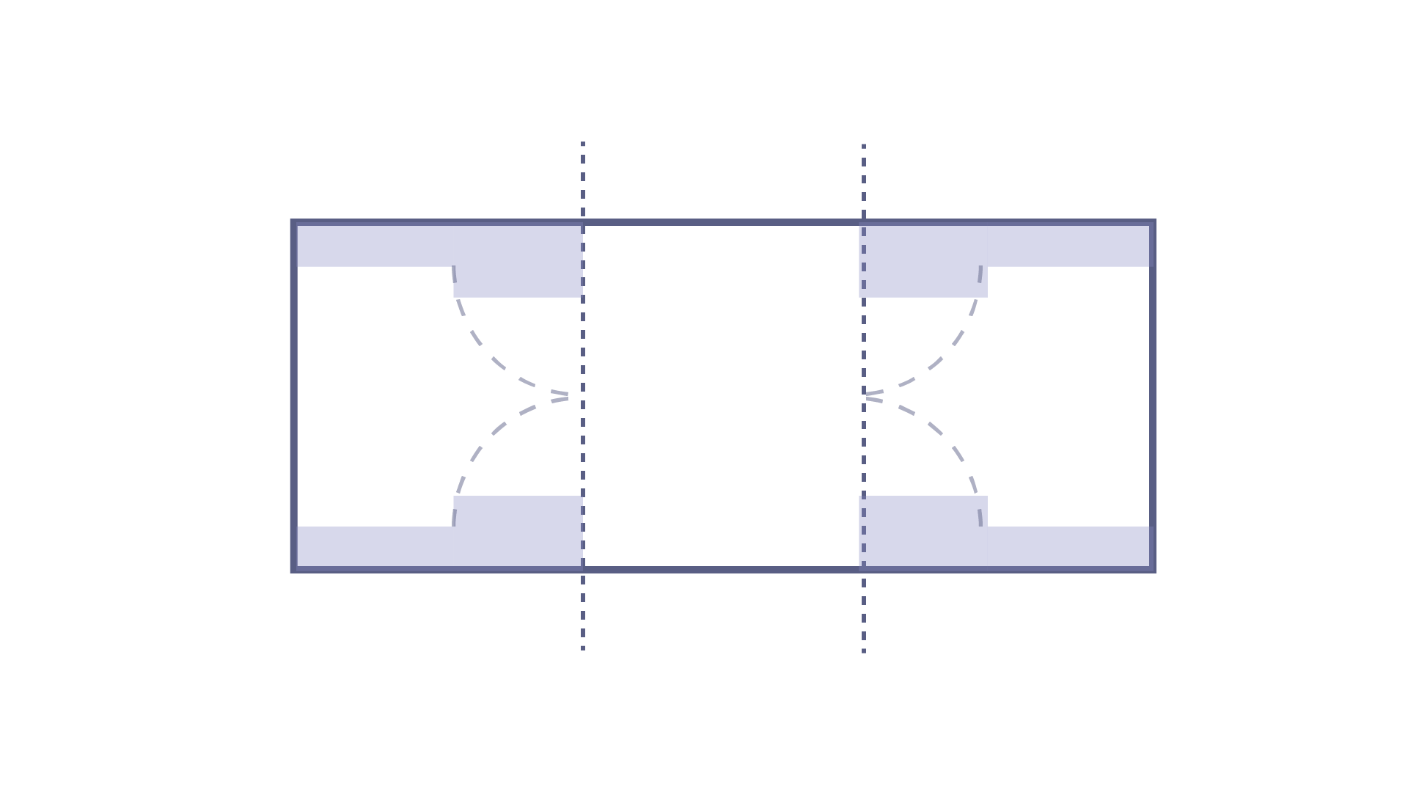
03 Design Scale 02 - Reconfigurability
Scenario 01
Bob wants to use the lounge space. Sigrid wants to be alone in her room to read a book
Scenario 04
Bob is working in his room but doesn’t mind to be disturbed. Sigrid want to be alone in her room.
Scenario 02
Bob and Sigrid are lounging together.
Scenario 05
Both Bob and Sigrid are working, sometimes they need one another for help.
Scenario 03
Bob and Sigrid are both sleeping.
Scenario 06
Sigrid needs some extra space because she has a visitor over. Bob is having a nap in his room

Slide 29
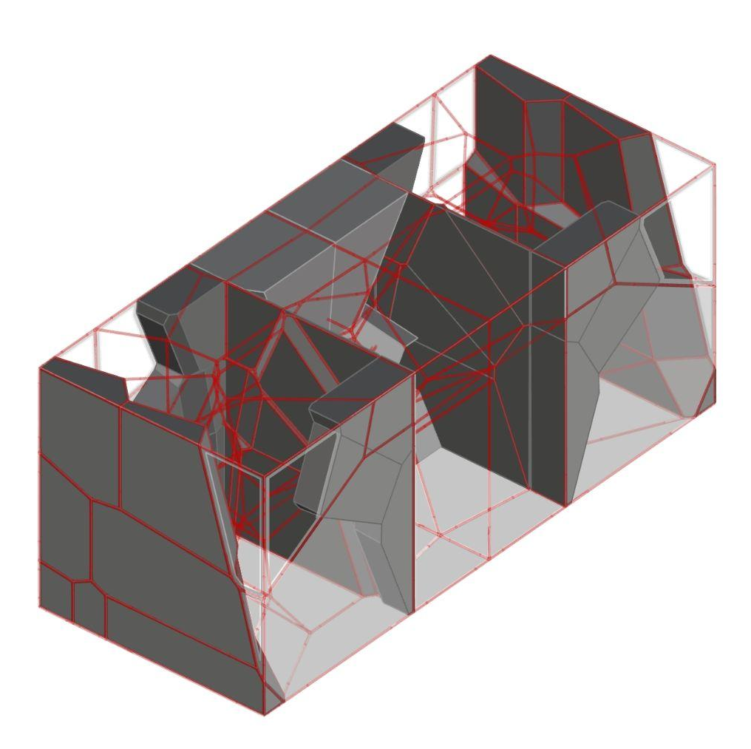
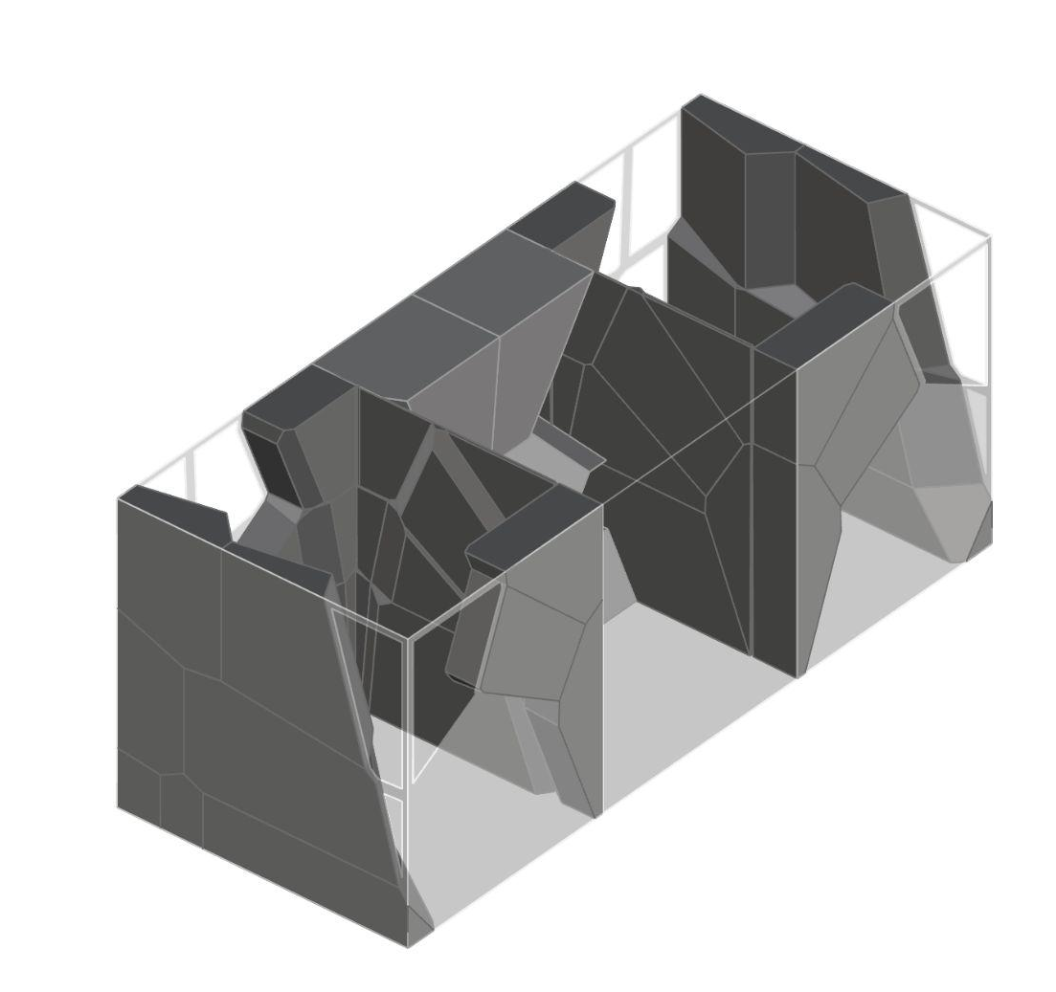
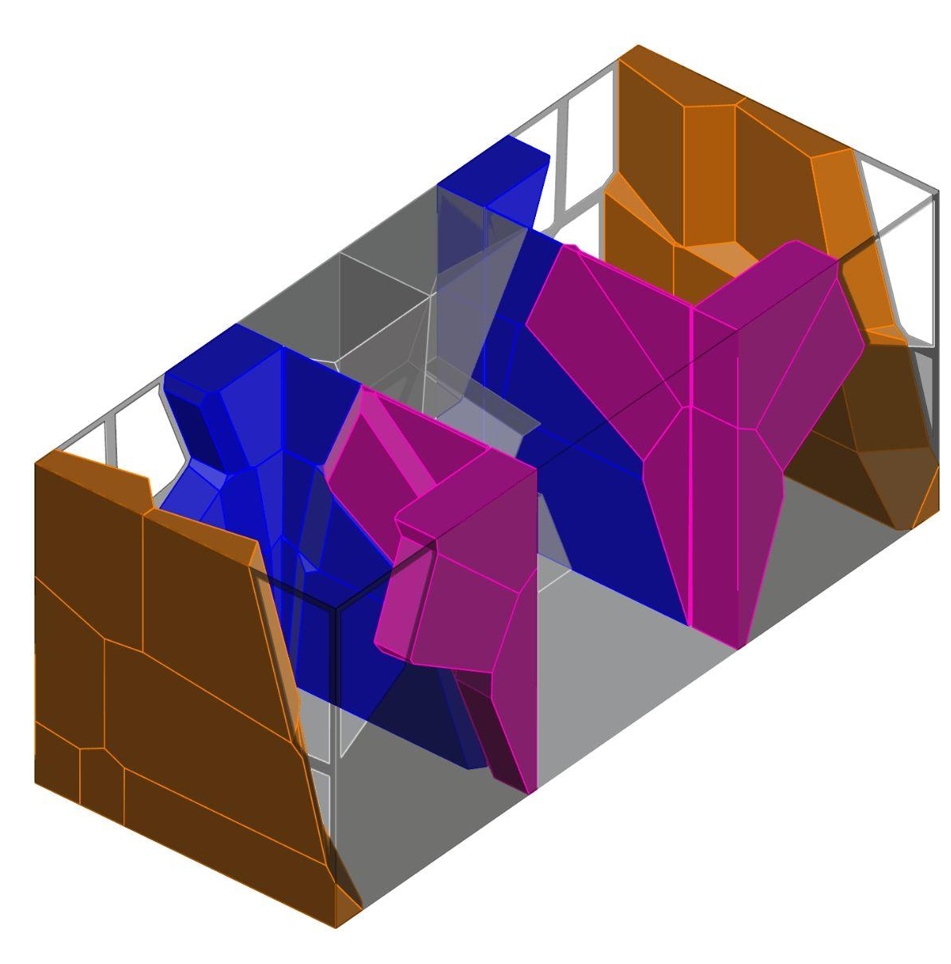
03 Design Scale 02 - from voronoi to container
Private
Interaction
Private
Private
Interaction
Private
Private
Interaction
Private

Slide 30
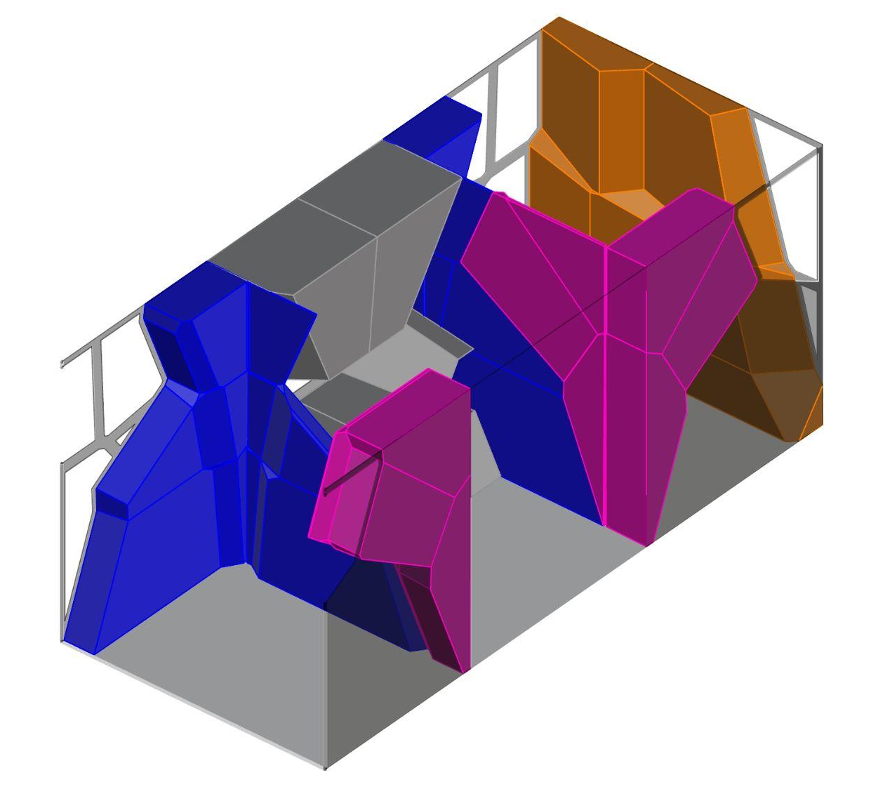
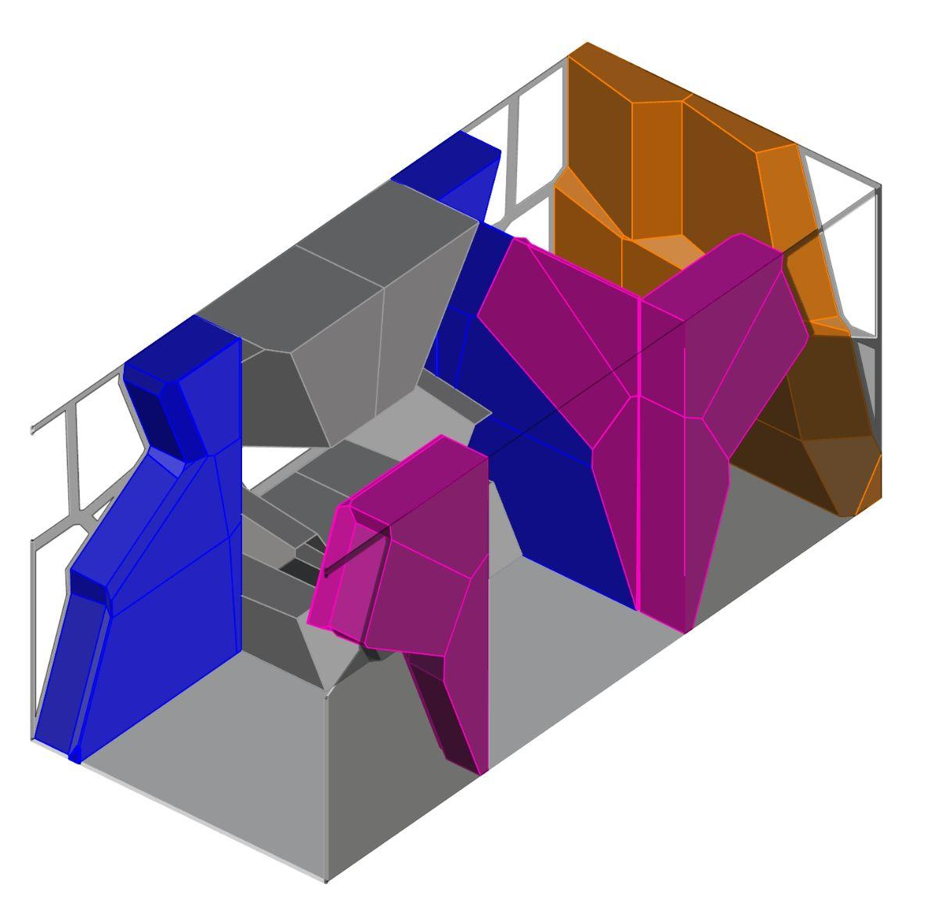
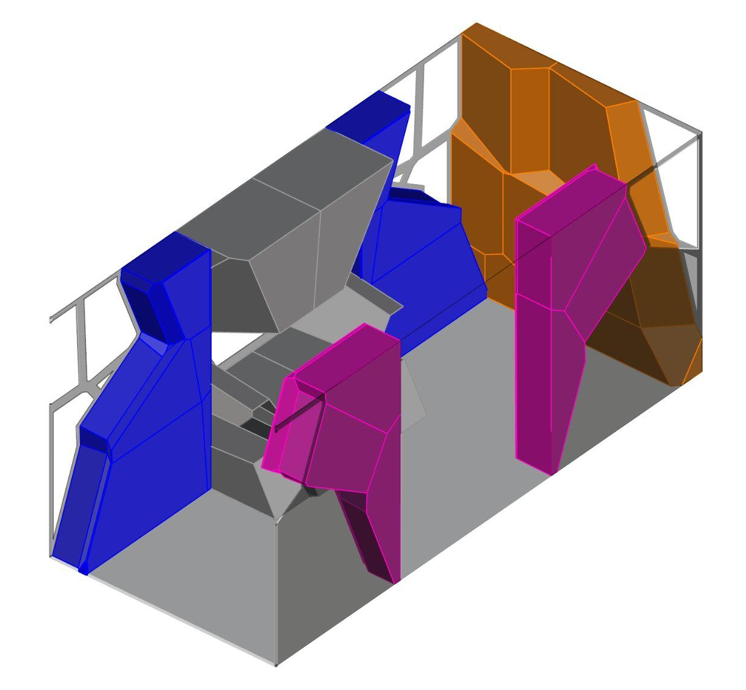
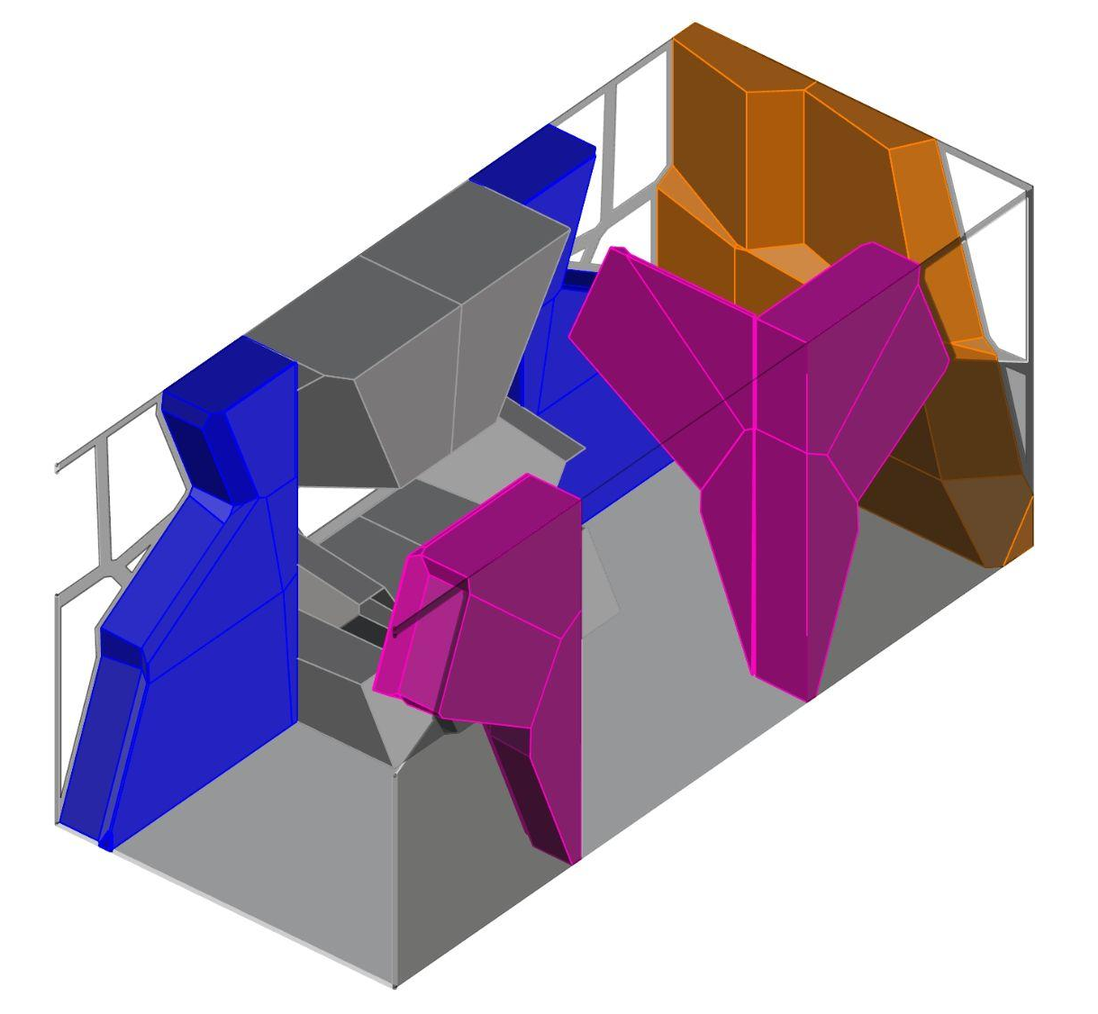
03 Design Scale 02 - Reconfigurability
Close: little interaction
Open: interaction

Slide 31
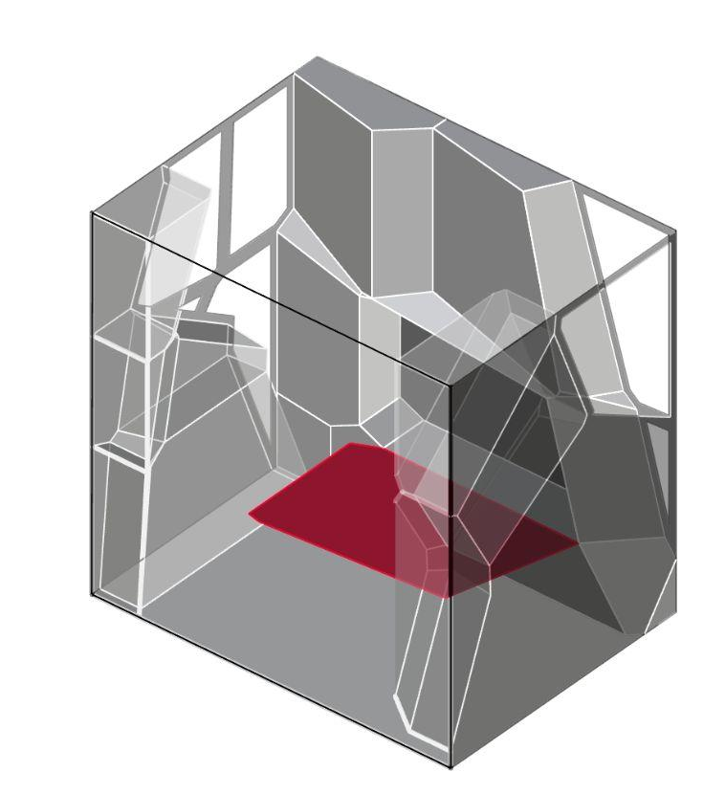
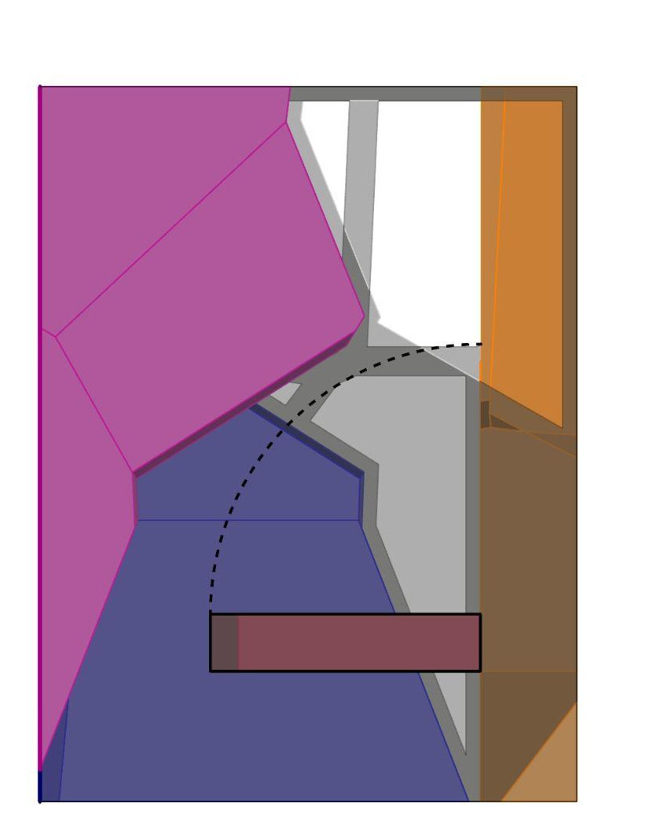
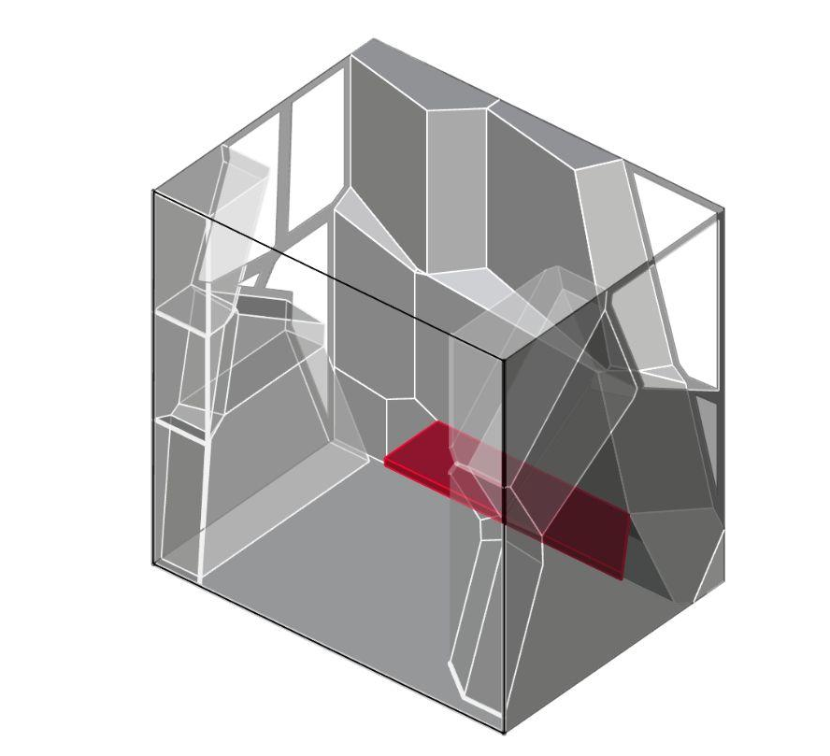
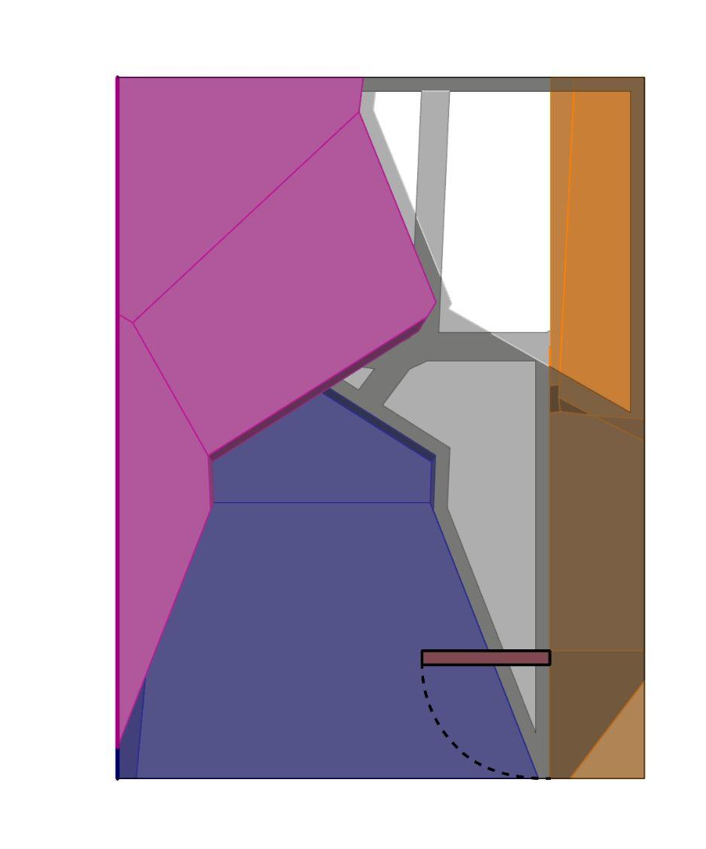
03 Design Scale 02 - Reconfigurability
Reconfigurable bed
Reconfigurable lounge

Slide 32
03 Design Scale 02 - Individual reconfiguration
▼
▼
Scenario 01
7:00 AM
Bob and Sigrid just woke up and are getting out of bed without disturbing each other
Scenario 02
12:00 PM
Bob is taking a nap
▼
▼
Scenario 03
12:30 PM
Bob just woke up, Sigrid and Bob have a briefing together in the common space.
Scenario 04
21:30 PM
Bob is calling his partner. Sigrid is having a friend over

Slide 33
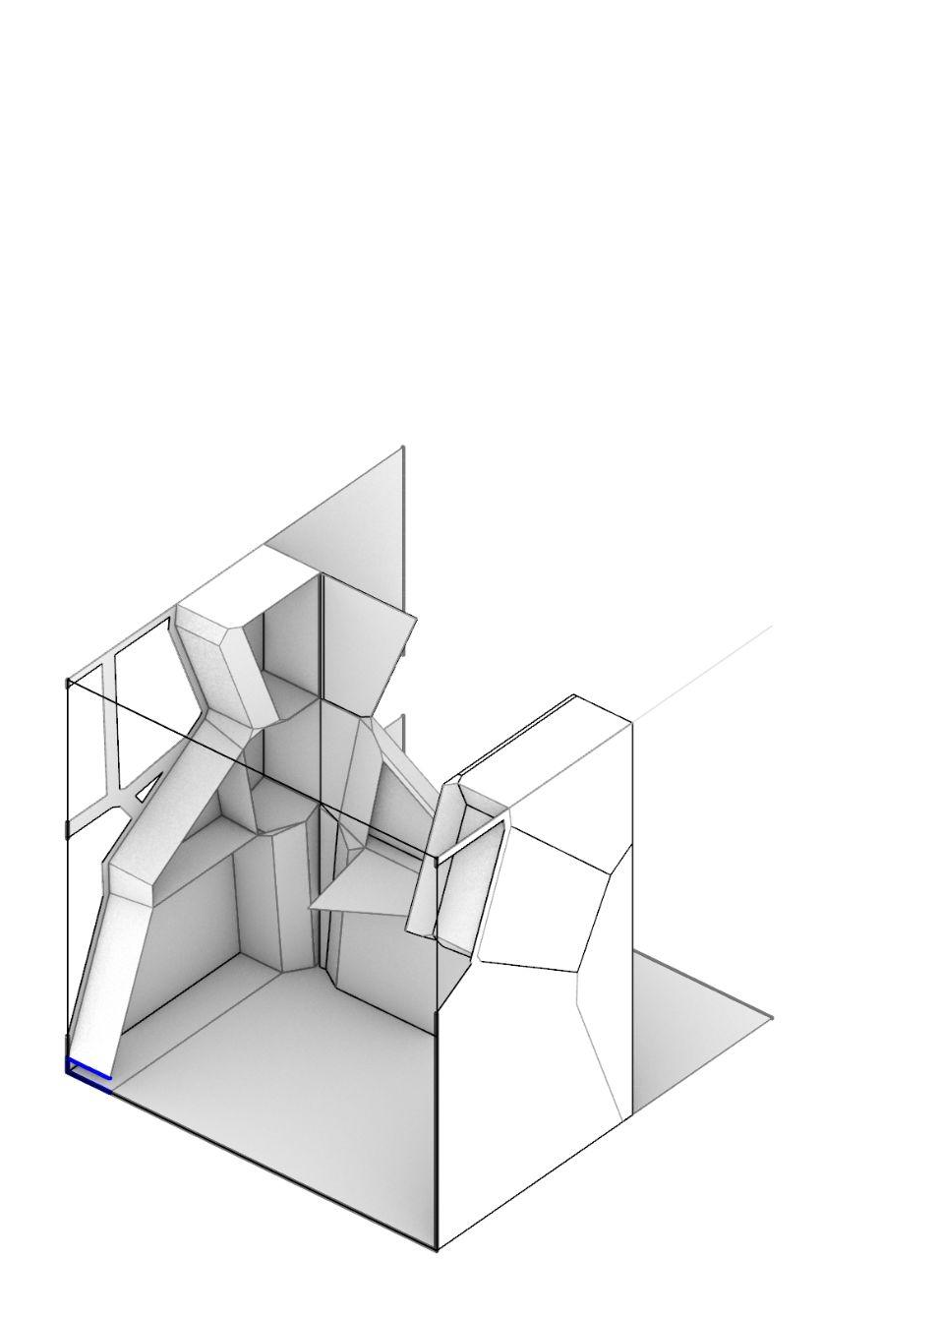
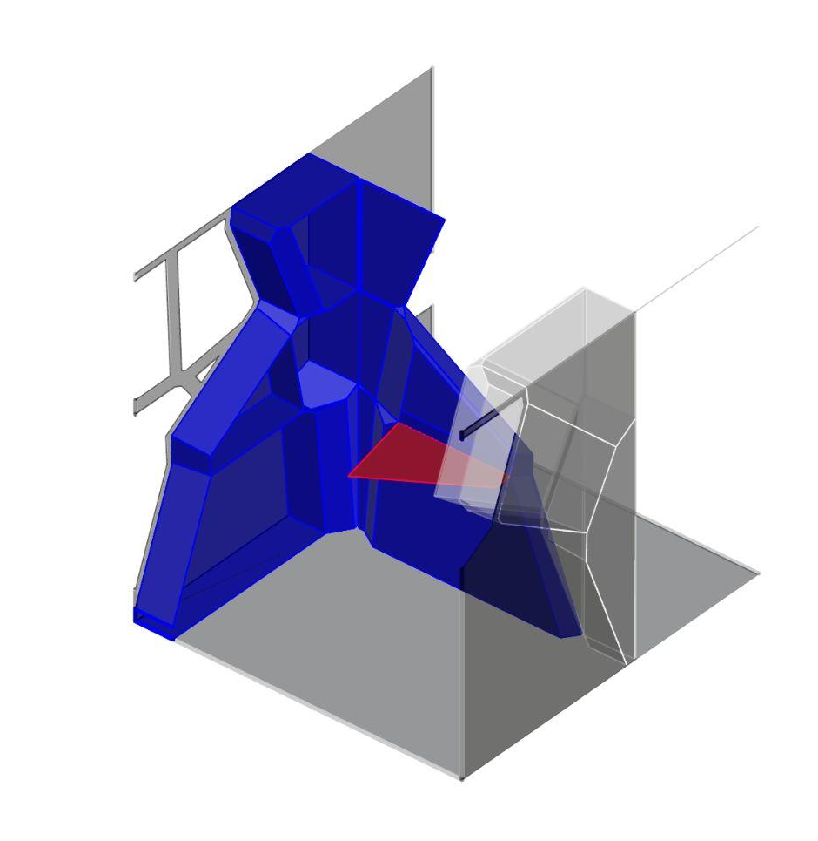
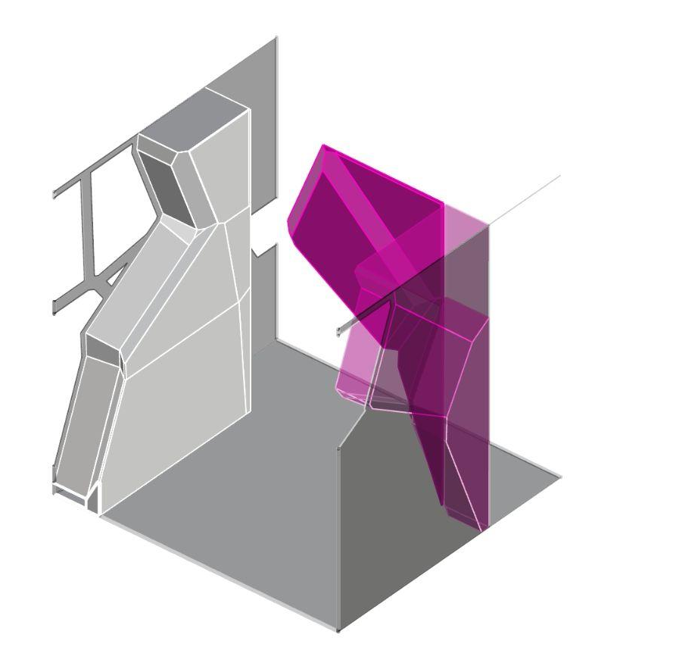
03 Design Scale 02 - Reconfigurability - wall
Reconfigurable wall 1: workstation
Desk
Desk storage
Reconfigurable wall 2: wardrobe & privacy screen

Slide 34
03 Design Scale 03 - Reconfigurable Element
(3) Scale
Zoom in on 1 Elemtent (partitioning wall= most important spatial element) Folding table,
Wardrobe
Bed
Workstation
Anaelle

Slide 35
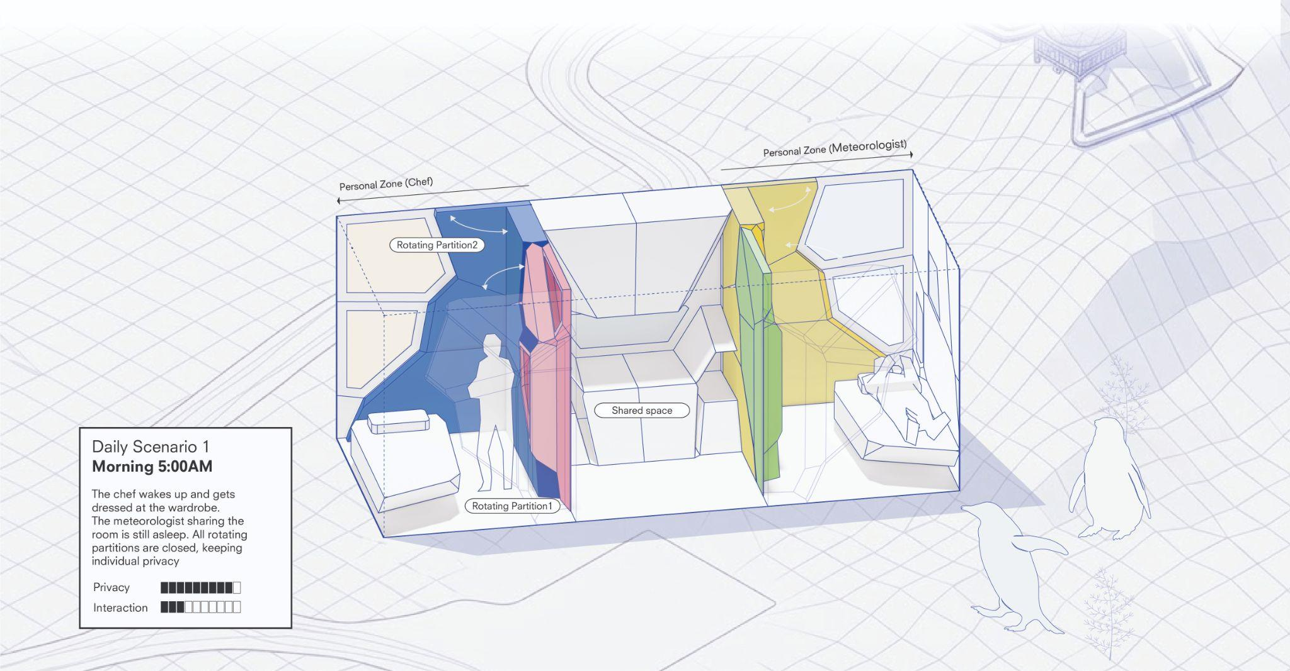

Slide 36
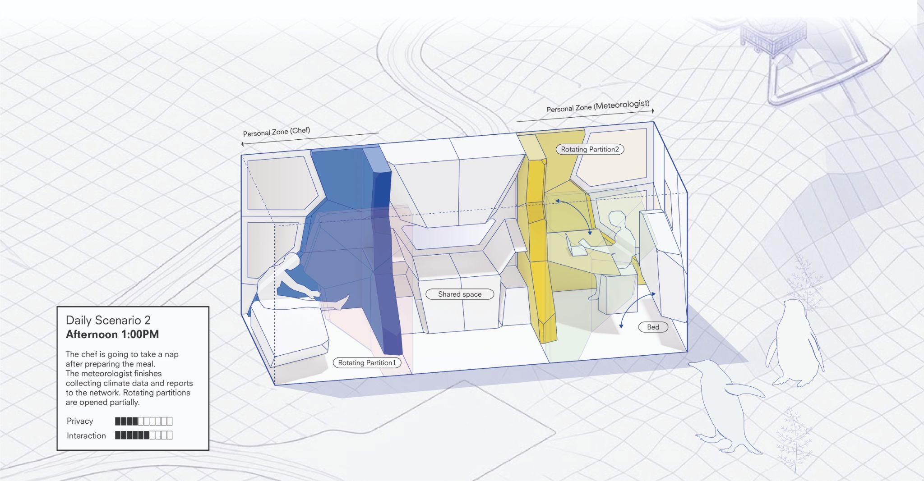

Slide 37
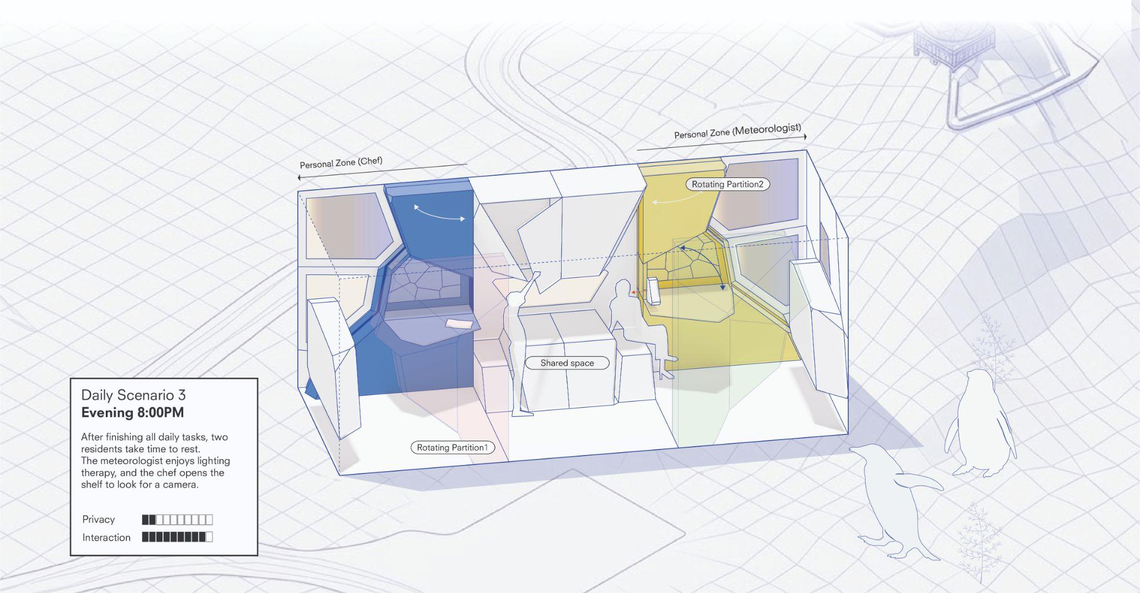

Slide 38
04
Lighting and AI integration

Slide 39
04
Lighting and AI integration
A Integration of Light in Design
Skylight (ceiling)
Light as a Spectacle (windows and walls)
Individual Light
Light Therapy
B Goals
C Training the model
Scatter plots
Model training
Evaluation of model
Visualisation of model

Slide 40
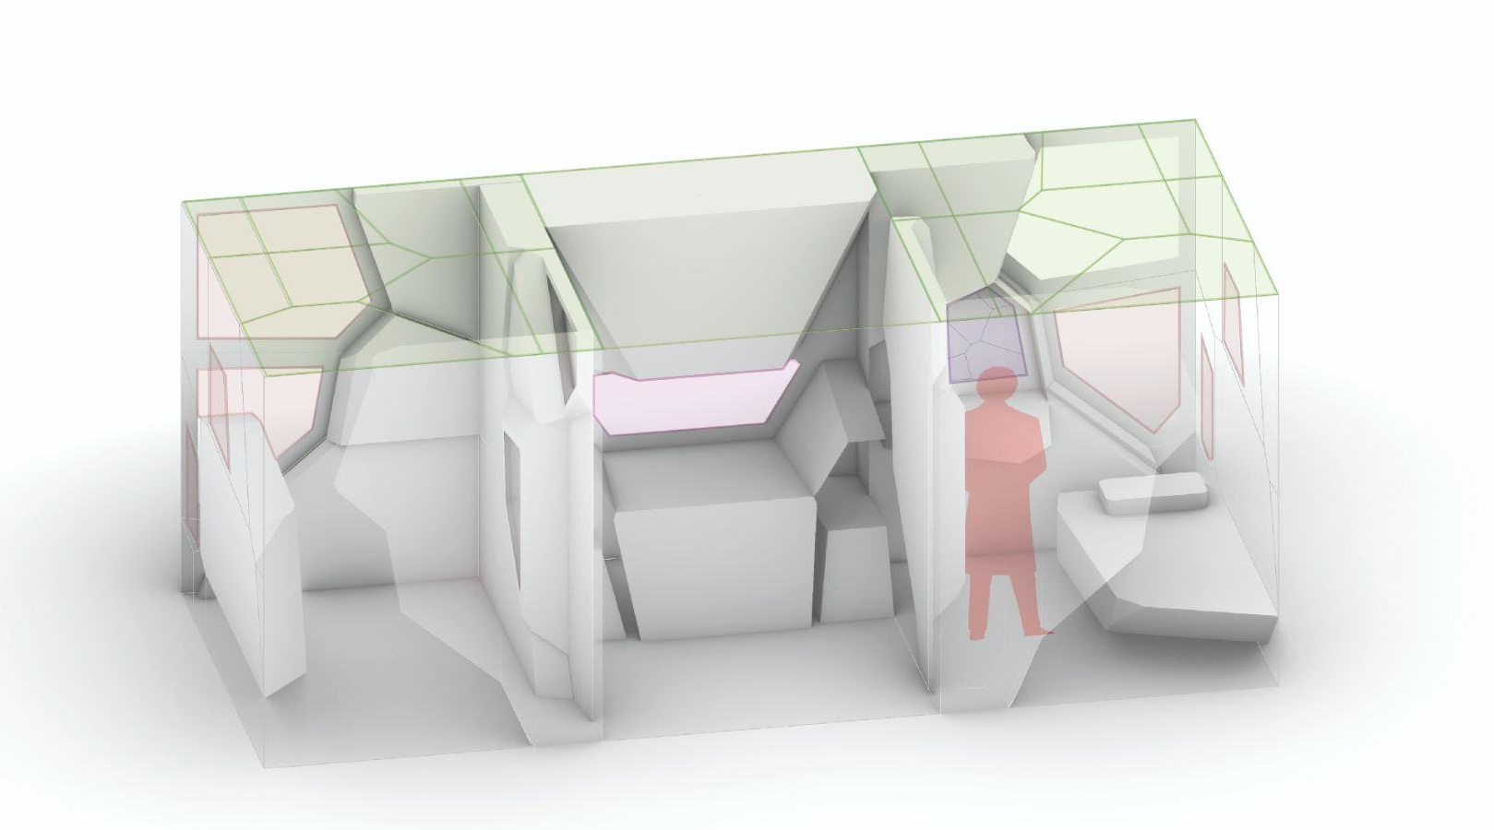
04 Lighting and AI Integration Lighting types
(I) Skylight
(II) Light as Spectacle
(III) Individual Lighting
(IV) Light Therapy
1:1 Interactive Architecture Prototype - Troll Station

Slide 41




04 Lighting and AI Integration Lighting types
(I) Skylight
(II) Light as Spectacle
(III) Individual Lighting
(IV) Light Therapy

Slide 42




04 Lighting and AI Integration Lighting types
(I) Skylight
(II) Light as Spectacle
(III) Individual Lighting
(IV) Light Therapy
Human Activity Recognition (HAR)
Reacting to a daylight cycle
Performative Uses (i.e. Wind blowing through leaves
Computer Vision (CV) translates outdoor environment into spectacle
Performative
Cognitive Stimulation and Psychological orientation
Shows live from outside
Autoregressive (AR)
Personalized circadian cycle
Personalized atmospheric lighting
Reaction to physiological factors eg. heart rate
Red-light (630–850nm) for recovery + mood
10,000 lux daylight therapy for winter activation

Slide 43


04 Lighting and AI Integration Summary of tutorial
Supervised learning:
Input variables / features (weather data and physiological data)
Output values / labels (lighting condition generation)
Data Visualization:
Visualizing data sets using scatter plots (show correlations in the data)
Understanding the data before training the model for more accuracy
Training the model:
Supervised learning regression: learning to predict from data
Poor or limited datasets can cause the model to learn incorrect patterns and produce unreliable results
Evaluation of model performance:
R square score (MSE, MAE)
Evaluation of how well the model is trained to reflect the data accurately
1:1 Interactive Architecture Prototype - Troll Station

Slide 44

04 Lighting and AI Integration Goals for AI integration
01: Circadian Rhythm Preservation
Simulates a full Delft daylight cycle inside the container
Any date selectable — captures seasonal variation across the year
Maintains sleep, melatonin and mood cycles during polar night
(I) Skylight
(II) Light as Spectacle
02: Environmental Energy Optimisation
Outdoor conditions drive indoor light levels automatically
Bright sun outside —-> dims indoor lights
Heavy cloud / polar darkness —-> boosts indoor light
Minimises energy use
(I) Skylight
03: Personalised Physiological Response
Neural network predicts ideal light from body signals
High stress detected —-> warm dim light to lower heart rate
Balanced state —-> model prediction applied directly
Lighting actively responds to each researcher's biological state
(III) Individual Lighting
(IV) Light Therapy
04: Ability to choose own lighting
Overrides system lighting for user needs (Have 4 simulation modes for users to choose from - or full RGB range)
(I) Skylight
(III) Individual Lighting
1:1 Interactive Architecture Prototype - Troll Station

Slide 45
04 Lighting and AI Integration Step 1: Data groupings and scatter maps
DATA
A
B
WEATHER
PHYSIOLOGICAL
Outdoor temp,direct normal radiation, rel humidity, diffuse, normal radiation, global horizontal radiation,infrared radiation, direct normal Illumination diffuse_horizontal illumination, global horizontal illumination, total sky cover
Hrv rmssd ms, heart rate bpm, pupil mm, blink rate per min, skin conductance uS, Respiratory rate bpm
GROUP 1: SOLAR RADIATION FEATURES:
GROUP 2: VISIBLE LIGHT FEATURES
GROUP 3: ATMOSPHERIC CONDITIONS
GROUP 4: PHYSIOLOGICAL STRESS INDICATORS
GROUP 5:
EYE RESPONSE METRICS
Direct normal radiation, diffuse normal radiation, global horizontal radiation
(Measures total solar energy form different angles)
Direct normal illumination, diffuse horizontal illumination, global horizontal illumination
(Visible portion of light to human eye)
Outdoor temp, relative humidity, infrared radiation, total sky cover
(overall atmosphere and weather)
HRV rmssd ms, heart rate, skin conductance, respiratory rate
(reflect stress and nervous system)
Pupil diameter, blink rate
(visual strain and fatigue measurements)
1:1 Interactive Architecture Prototype - Troll Station

Slide 46

04 Lighting and AI Integration Training the model
Step 1: Data groupings and scatter maps
Between CCT (kelvins) and features (inputs(weather data+physiological data))

Slide 47

04 Lighting and AI Integration Training the model
Step 1: Data groupings and scatter maps
Between Illuminance and features (inputs(weather data+physiological data))

Slide 48


04 Lighting and AI Integration Training the model
Step 1: Data groupings and scatter maps
Between Illuminance and features (inputs(weather data+physiological data))

Slide 49
04 Lighting and AI Integration Training the model
Step 1: Data groupings and scatter maps
Summary of findings
Final features model was trained on:
Direct Normal Radiation
Direct Normal Illumination
Outdoor Temp
Total Sky Cover
HRV RMSSD MS
Heart Rate BPM
Skin Conductance
Pupil size
Group 01: Solar Radiation features
All features show similar trends
Keep Direct normal radiation (Most direct measurement of incoming solar energy)
Group 02: Visible light features
All features show similar trends
Keep Direct normal illumination (Visible spectrum)
Group 03: Atmospheric conditions
Weak to moderate correlations
Keep Outdoor temp and Total sky cover (Most important for energy savings mode)
Group 04: Physiological stress indicators
Weak to moderate correlations - keep more features
Keep hrv rmssd ms, heart rate bpm, skin conductance (most relevant features and capture opposite ends of spectrum)
Group 05:
Similar trends
Keep pupil size (most able to reflect lighting)

Slide 50


04 Lighting and AI Integration Training the model
Step 2: Training the model

Slide 51
04 Lighting and AI Integration Training the model
Step 3: Evaluation of model
Evaluation tools:
R-squared: Accuracy of model in %
Root mean squared error: Average size of prediction errors in %
Mean absolute error: typical prediction error in units
Illuminance:
r-squared is 0.9635652190910206
root mean squared error is 112.47336167325606
mean absolute error is 86.35875507688202
96% accurate: Strong predictive performance
CCT:
r-squared is 0.8595488325766288
root mean squared error is 335.2328948281677
mean absolute error is 242.07912366948045
85% accurate: Good predictive performance

Slide 52

04 Lighting and AI Integration Training the model
Step 4: Adding complexity to model
Daylight Simulation model
Training model on Netherlands Bilt Data (For seasonal variation)
The model predicts both illuminance and colour temperature, replicating how light changes across seasons and times of day. Can modify hour/month

Slide 53

04 Lighting and AI Integration Training the model
Step 5: Visualization of model
01 Daylight simulation

Slide 54

04 Lighting and AI Integration Training the model
Step 5: Visualization of model
02 Energy Saving

Slide 55

04 Lighting and AI Integration Training the model
Step 5: Visualization of model

Slide 56

04 Lighting and AI Integration Training the model
Step 5: Visualization of model

Slide 57

Thursday (12/03)
ilai
1:1 Interactive Architecture Prototype - Troll Station

Slide 58

Thursday (12/03)
ilai
1:1 Interactive Architecture Prototype - Troll Station

Slide 59

Thursday (12/03)
ilai
1:1 Interactive Architecture Prototype - Troll Station

Slide 60
Thank you
: >]

Slide 61
EXTRA SLIDES/OLD SLIDES

Slide 62

04 Design Process Iterations
Iterations of zoning possibilities (translated in 3D and 2D Diagrams)
- Shared space
- Sleeping
- Lounging
- Individual Work
- Storage
1:1 Interactive Architecture Prototype - Troll Station

Slide 63

04 Design Process: from concept diagram to concept voronoi
concept diagram
concept voronoi
concept voronoi
Notes:
Before implementing it as a 3D Voronoi cell, we first considered the programmatic functions on the plan and translated them into a 2D Voronoi pattern.

Slide 64

03 Design 2D → 3D
2D → 3D
And update drawing
Notes:
Before implementing it as a 3D Voronoi cell, we first considered the programmatic functions on the plan and translated them into a 2D Voronoi pattern.

Slide 65

03 Design 2D → 3D
3D Result
Whats void? Panels?
Notes:
Through this process, we finally defined one Voronoi cell shape designed for two researchers.

Slide 66

03 Design 2D → 3D
Bob
Sigrid
Scenario (1)
Morning
Geting out of bed without disturbin other person
Notes:
The first scenario is a container for two residents who prioritize communication. In this case, the central space works as a shared zone, including shelves and a reconfigurable table. The sleeping pods are located on the upper level, while individual shelves are placed along the edges.

Slide 67

Bob
Sigrid
Scenario (2)
Noon
Bob takes a Nap

Slide 68
Bob
Sigrid
Scenario (3)
Noon
Bob takes a Nap, Sigrid comes back from checking the instruments: they briefly sit together

Slide 69
Bob
Sigrid
Scenario (4)
Evening
Bob Facetimes his GF
Sigrid has a friend from the station over

Slide 70


04 Design Process(skylight)
How can polar daylight
be integrated into living spaces?
Crown Shyness

Slide 71

04 Design Process

Slide 72
03 Physiological Implication: Concept Diagram
1. - Deep Sleep
- Wake-up - Light Shower
- Music
- Reading
- Relax
2. - Deep Focus Work
- General Work
- Reading
3. - Personal Storage
4. - Reading
- Music
- Relax (Lounge)
- Socializing
5. - Breakfast
- Lunch
- Dinner
- Debrief
- Socializing
6. - Kitchen
7. - Hygiene
- Shower
- Toilet
1.
4.
3.
2.
3.
I
5.
7.
6.
II
III
1:1 Interactive Architecture Prototype - Troll Station

