Slide 1
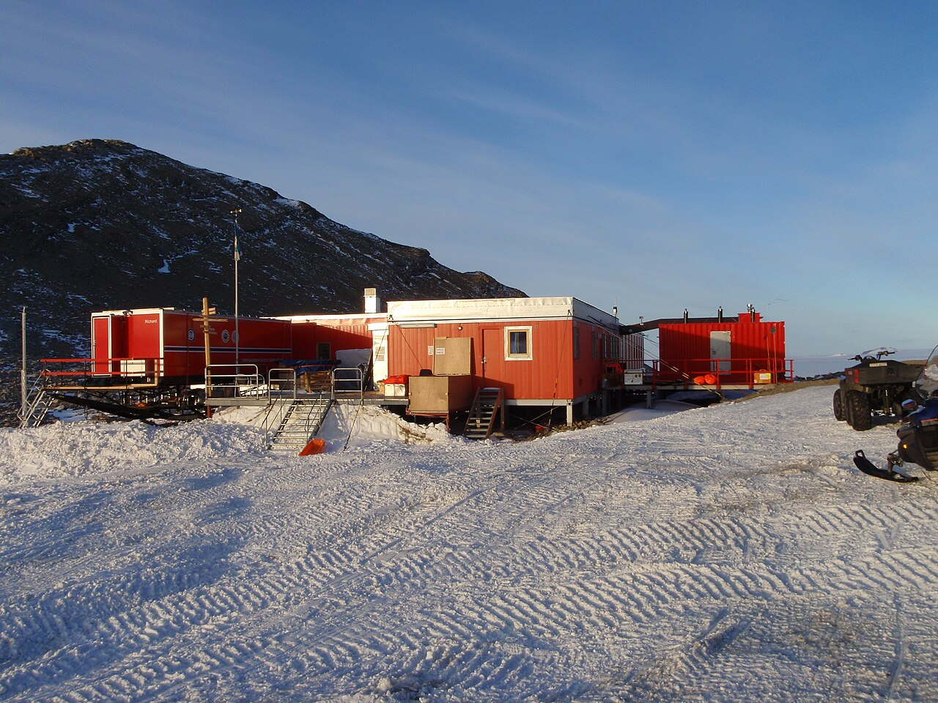
TROLL RESEARCH STATION
TROLL RESEARCH STATION
Updated Project Proposals week 3
Midterm presentation 13/3
Group 1: Iris Claus, Daphne Kamsteeg, Ludovica Perone Pacifico, Chloé Phan, Marieke van Wijk
Group 1: Iris Claus, Daphne Kamsteeg, Ludovica Perone Pacifico, Chloé Phan, Marieke van Wijk
IAP Workshop
Q3 2026
Prof. Henriette Bier, Arwin Hidding, Lisa-Marie Mueller, Vera Laszlo
IAP Workshop
Q3 2026
Prof. Henriette Bier, Arwin Hidding, Lisa-Marie Mueller, Vera Laszlo

Slide 2
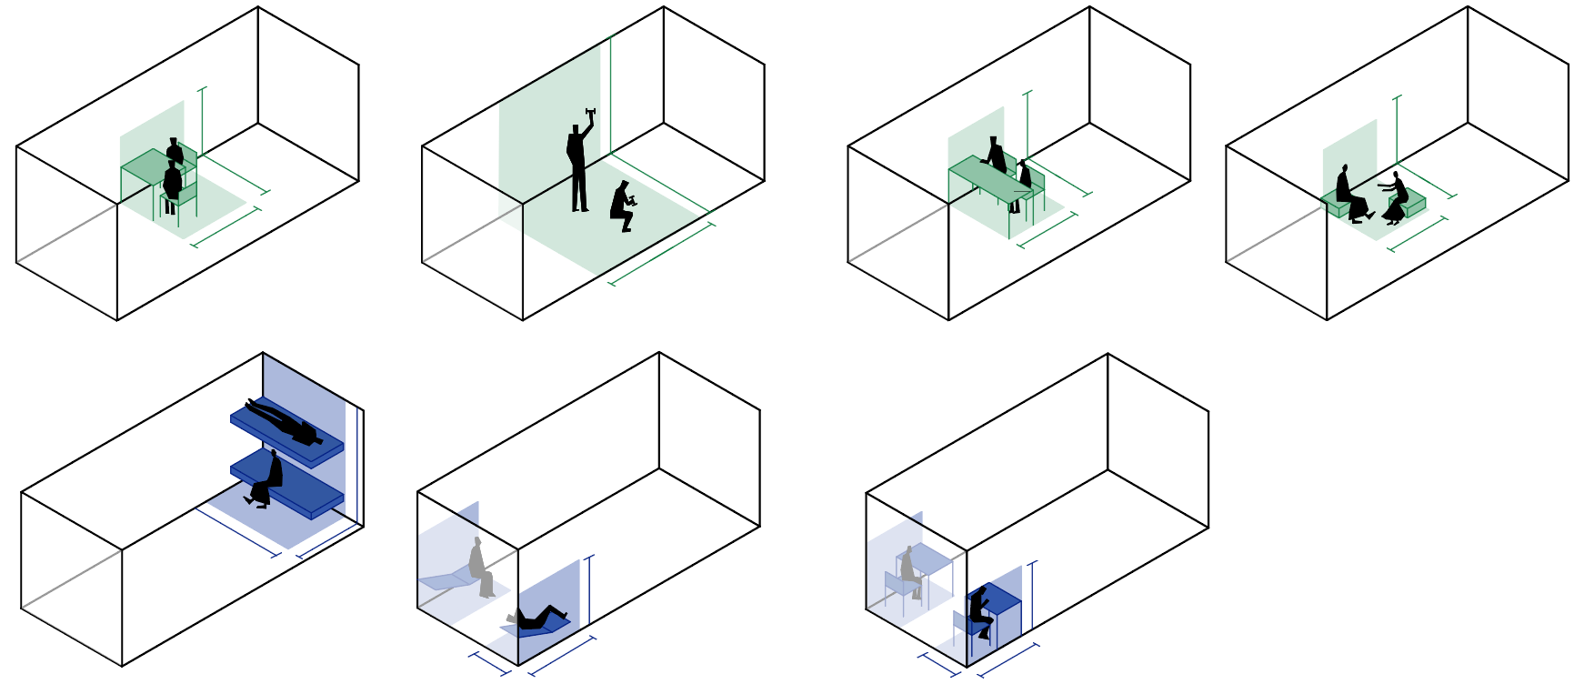
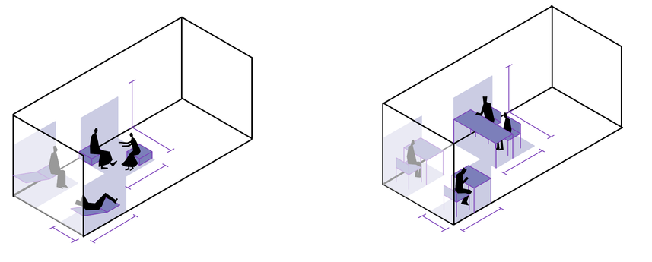
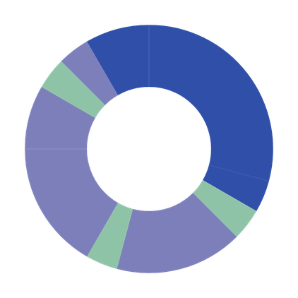
01
RESEARCH | ACTIVITY MAPPING
Relaxing
21.00 - 22.00
2.5 m
2 m
1.5 m
1.4 m
1.6 m
1.6 m
Sleeping
22.00 - 7.00
1.5 m
Dining
20.00 - 21.00
1 h
0.8 m
1 h
9 h
Highest duration. Lowest frequency, hence must be folded away or reconfigured. At extremities to minimise daytime circulation interference.
00.00
Relaxing / exercising
18.00 - 20.00
2 h
18.00
06.00
2.5 m
1 h
Hygiene
7.00 - 8.00
1.4 m
2.5 m
Working
14.00 - 18.00
4 h
12.00
1 h
1.6 m
2.5 m
1 h
1.6 m
4 h
Dining
8.00 - 9.00
Demands maximum clearance of floor area.
Dining
13.00 - 14.00
Highest frequency, hence must be easily accessible.
+ Storage space
of personal items, clothing, working equipment.
Fixed. Compact, to maximise space clearance
at least two modules
1.4 m
Legend
3.7 m
Individual
peripheral zones
1.5 m
Collective
central zones
Working
9.00 - 13.00
1.5 m
Both
demand two configurations, one for collective and one for private fruition
1.5 m
0.8 m
1.5 m
0.8 m
Notes:
Activity mapping in container + minimum dimensions for each activity.
lighting requirements for each activity? (is it a repetition with lighting needs?)

Slide 3
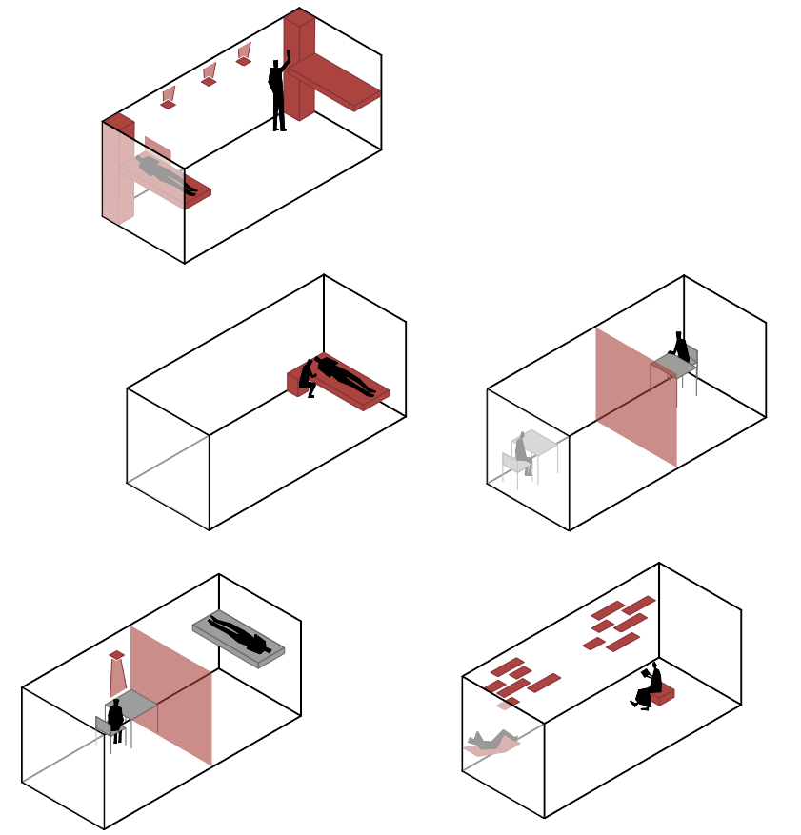

02
ACTIVITY MAPPING | SCENARIO ANALYSIS
1 - Standard ops day
4 - Asynchronous shifts
3 - Emergency mode
Separate beds with integrated personal storage and privacy separator. For optimized circulation with no functional overlap and light and acoustic shielding in sleeping zone.
Foldable partition to subdivide container into two private rooms.. Indepentent light control between the two zones. For increase acoustic and light insulation.
2 - Active recovery day
5 - Patient care
Foldable partition to subdivide container into two private rooms. For increased privacy and psychological benefits during prolonged isolation
Adjustable modules for user-driven spatial reconfiguration to enable environmental personalization and reduce visual monotony.
Bed at ergonomic standing height and integrated bedside surface to enable assisted care.
Notes:
update based on evolutio of design

Slide 4
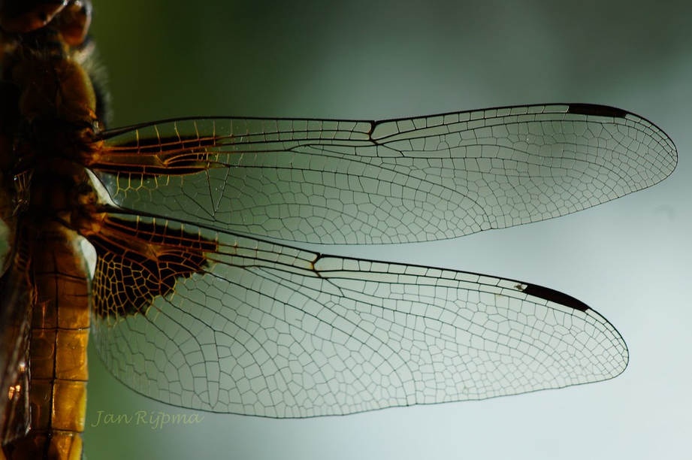
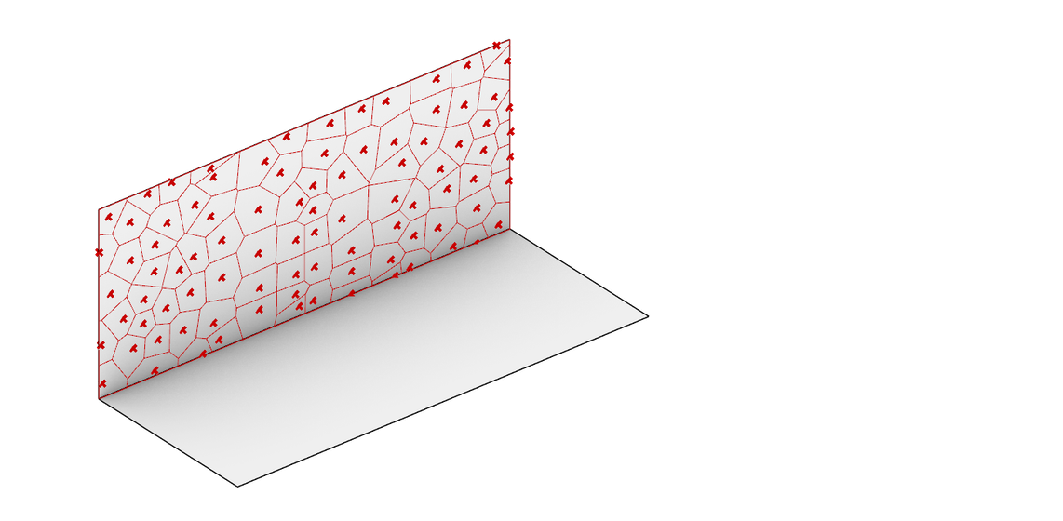
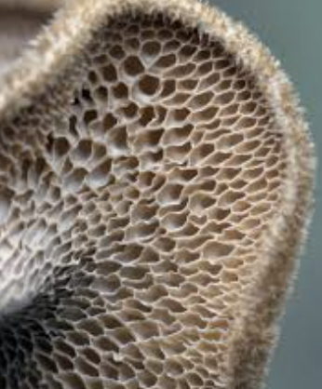
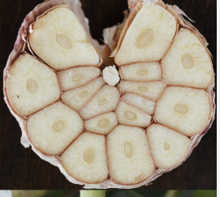
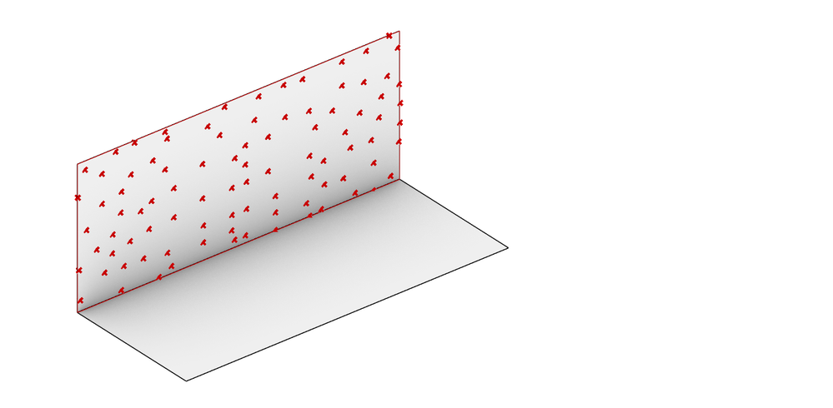
03
LECTURE SUMMARY | VORONOI
What is Voronoi?
Mathematical Partitioning: Dividing space into cells based on proximity to "seed points."
Nature’s Blueprint
Organic Efficiency: eliminating "dead corners"
Application & Objective
Optimal Spatial Efficiency
Transforming "stiff" furniture into foldable furniture
Breaking the Box: eliminates "tunnel vision"

Slide 5
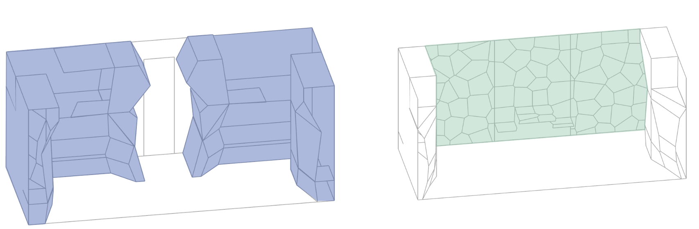
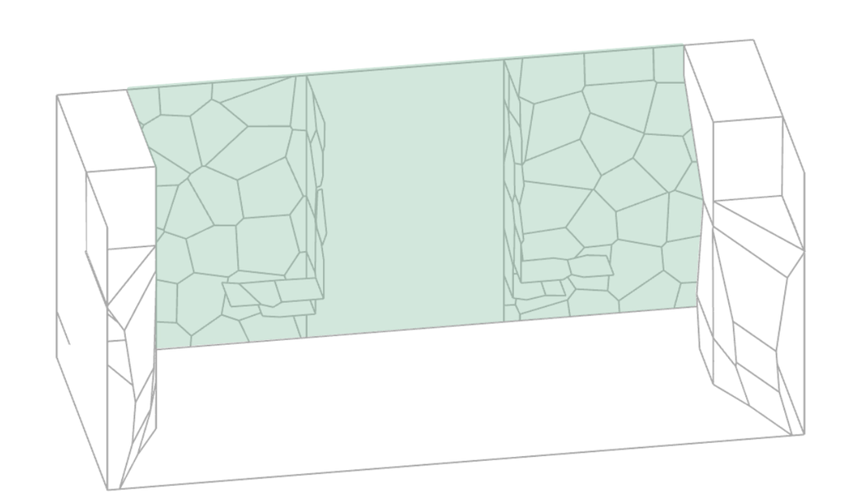
04
ADAPTIVE FURNISHING | OVERVIEW
Distribution principles
1
1
2
1
4
4
1
2
3
6
3
6
5
5
Legend
Static core
Kinetic skin
More space-consuming and/or fixed furnitures are placed adjacent to the walls. For individual fruition
Storage 2. Bed 3. Workstation
Furniture in the center of the container is easily reconfigurable and can be folded to a surface, for maximum clearance of the space. For both collective or individual fruition
4. Multipurpose room divider 5. Chair/Lounge chair 6. Table

Slide 6


05
KINETIC SKIN | GENERATION PROCESS
Base Voronoi pattern
Re-arranged pattern
Voronoi points population on the wall plane
Manually re-arranging the Voronoi points to have horizontal demarcations for folds
Checking how the generated cells look like
Organization of the newly generated cells

Slide 7
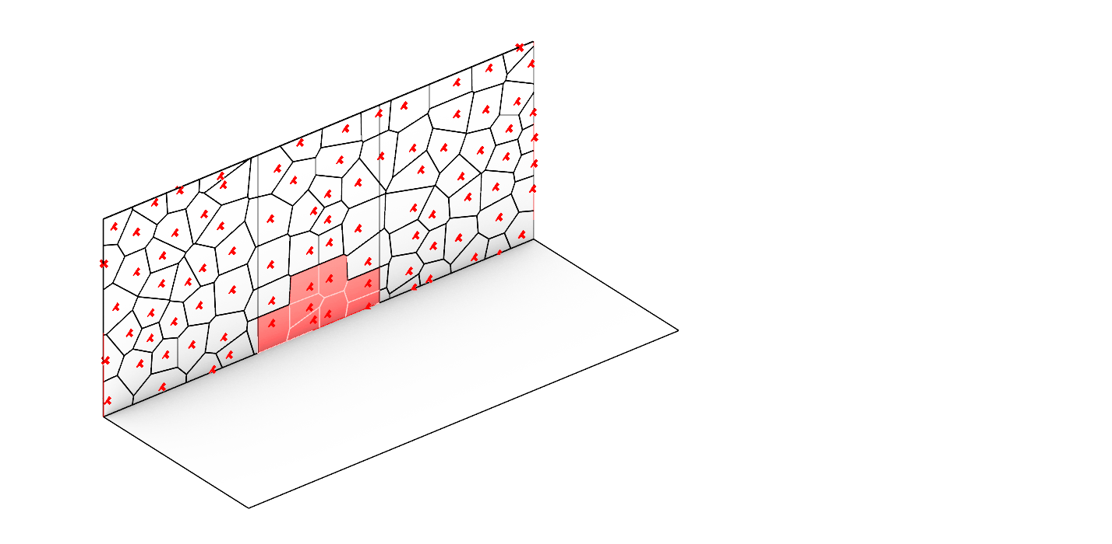
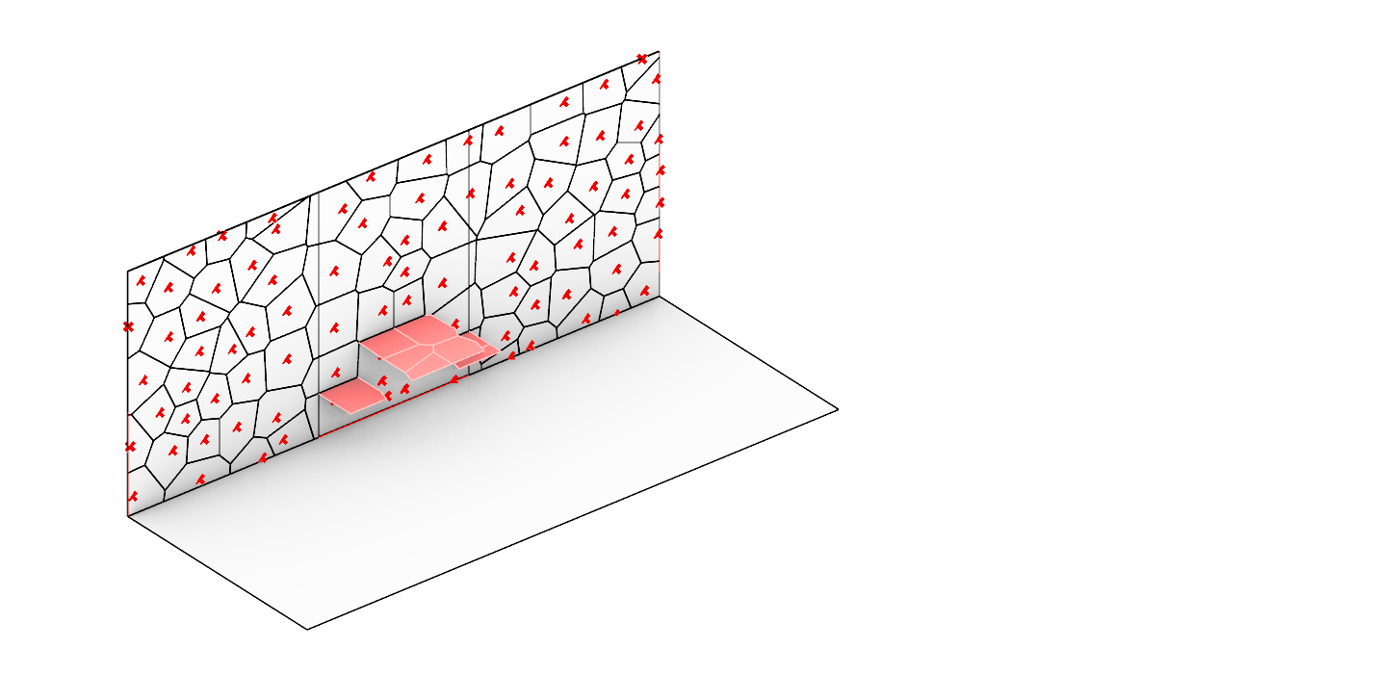
05
KINETIC SKIN | GENERATION PROCESS
Selecting the cells for the seating and table
Unfolded seating and table

Slide 8
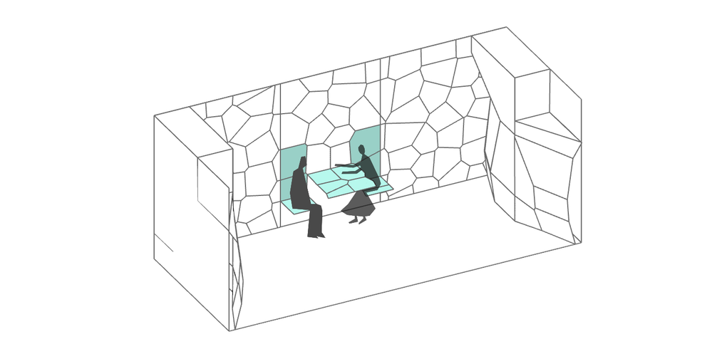
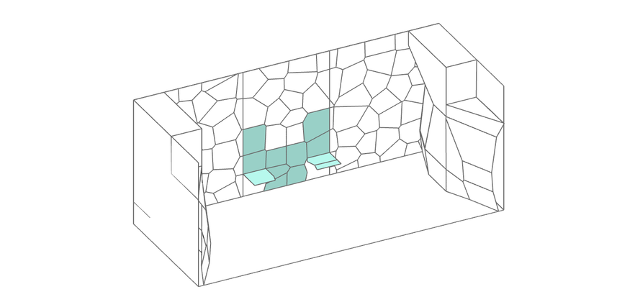


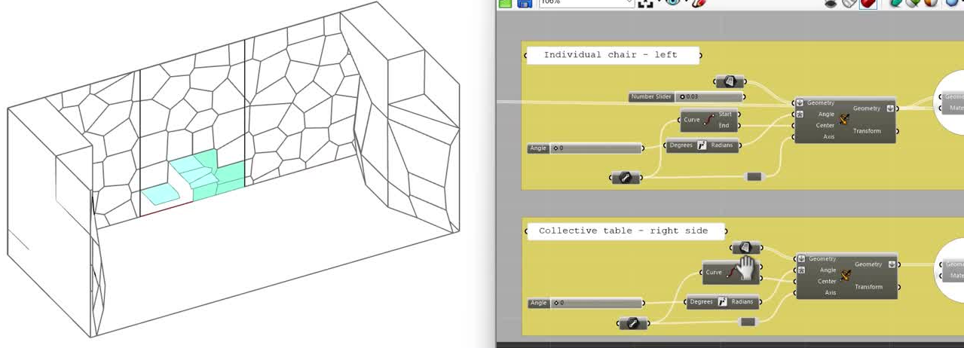
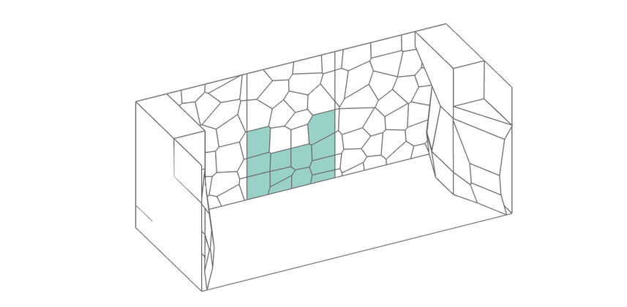
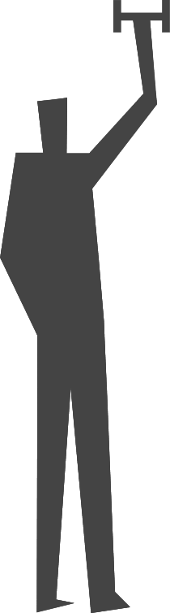

06
KINETIC SKIN | CONFIGURATIONS
Collective
Dining table and chairs open (for dining)
Just chairs open (for socialising)
8.00h-9.00h, 13.00h-14.00h, 20.00h-21.00h
8.00h-9.00h, 13.00h-14.00h, 14.00-18.00 20.00h-21.00h
Everything closed (for collective excercising)
18.00h-20.00h

Slide 9
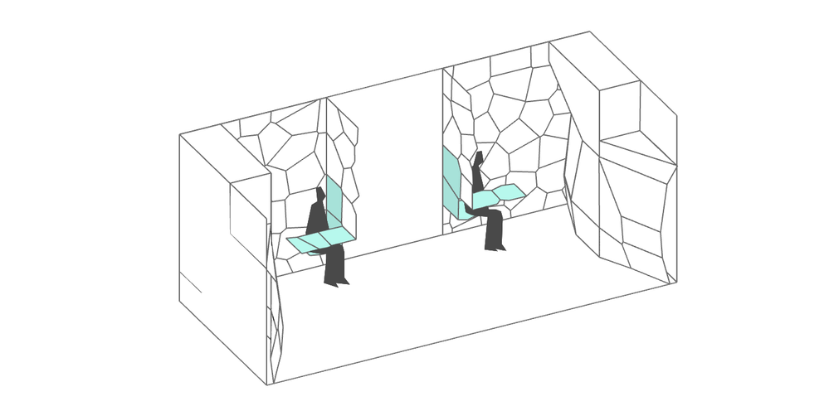
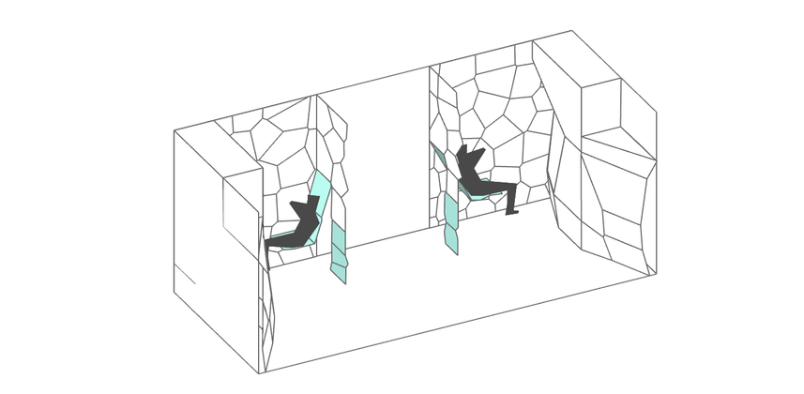
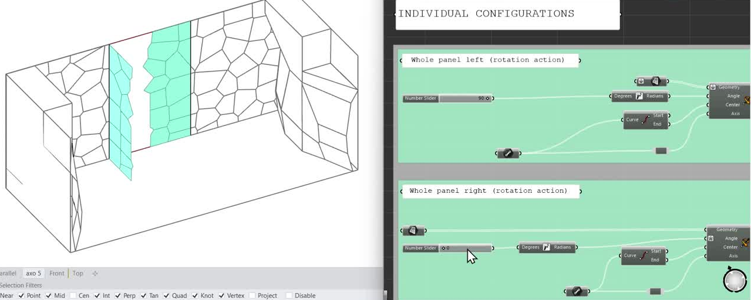


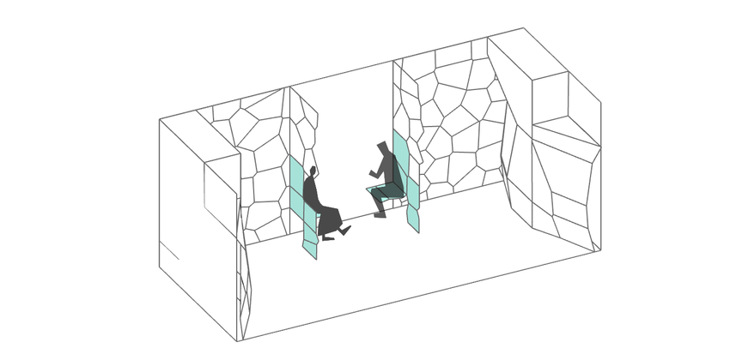
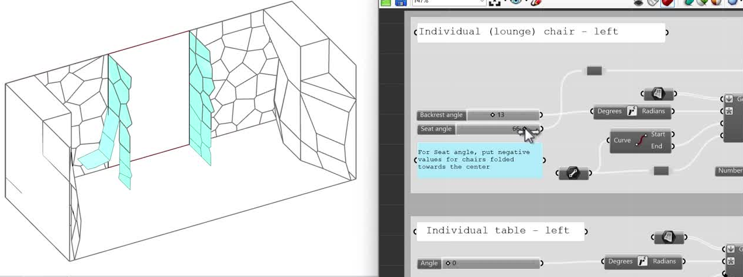
06
KINETIC SKIN | CONFIGURATIONS
Individual
Individual table + chair open (for individual dining)
Lounge chairs open (for resting)
8.00h-9.00h, 13.00h-14.00h, 20.00h-21.00h
18.00h-20.00h, 21.00-22.00
Lounge chair + individual table open (for resting with side table next to it)
Chairs folded towards the center (for socialising while maintaining privacy inside the room)
18.00h-20.00h, 21.00h-22.00h
9.00h-13.00h

Slide 10
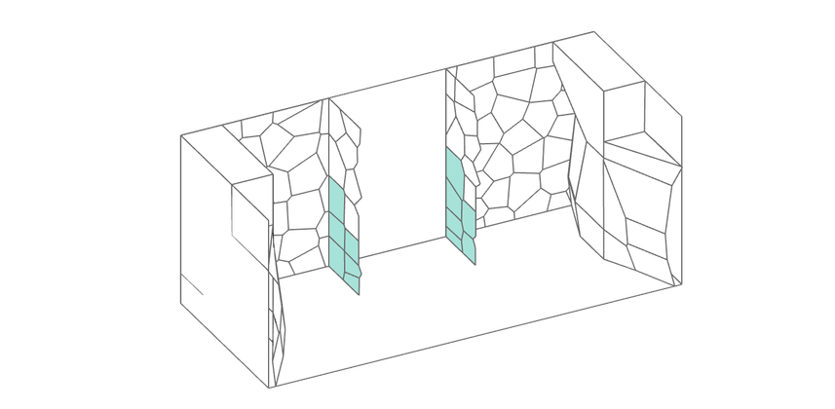
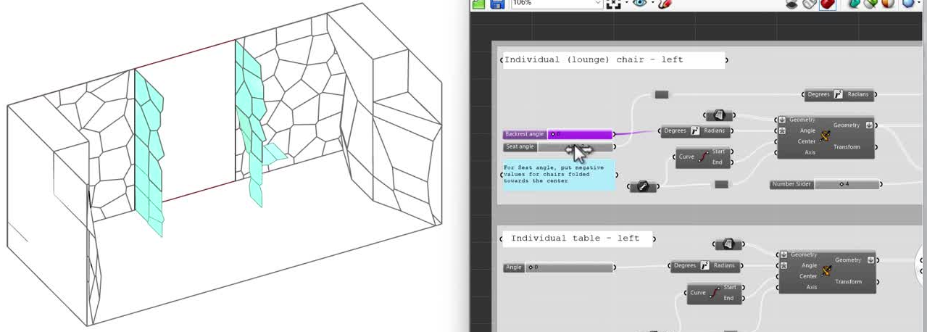
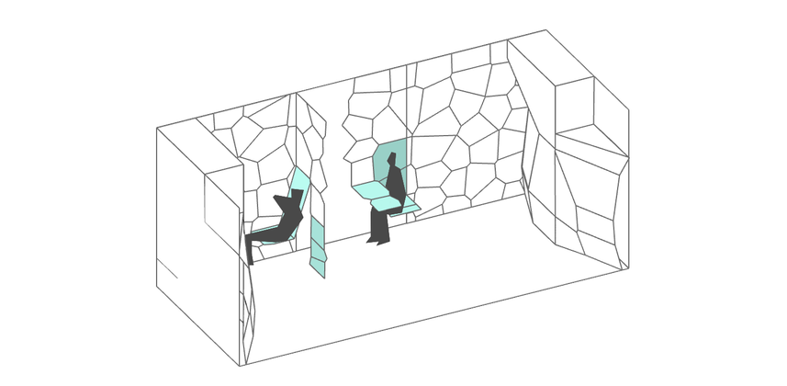
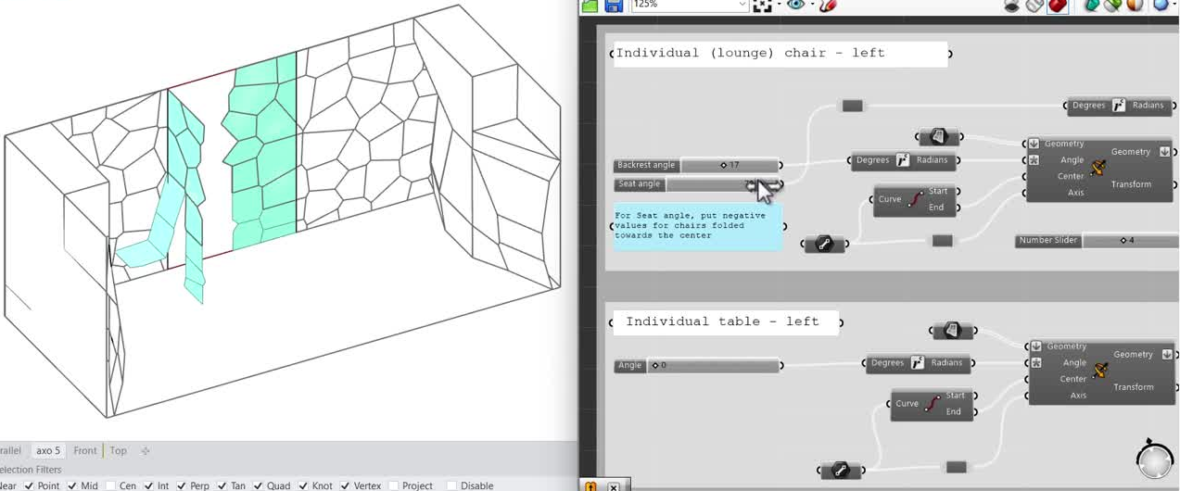
06
KINETIC SKIN | CONFIGURATIONS
Individual
Just wall (for individual excercising)
18.00h-20.00h
Hybrid
Lounge chair in individual configuration, dining in collective one
18.00h-20.00h

Slide 11
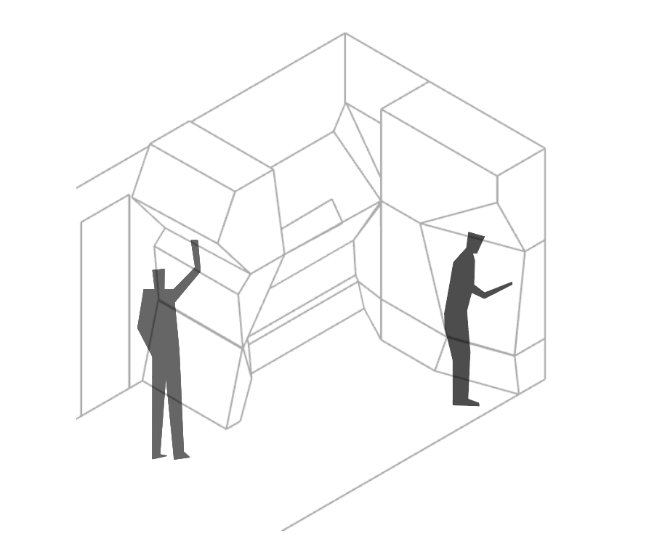
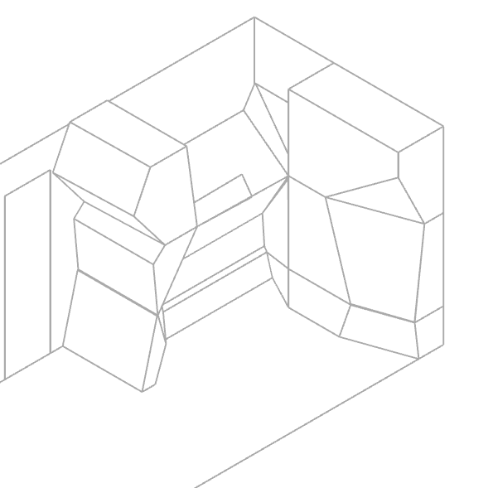
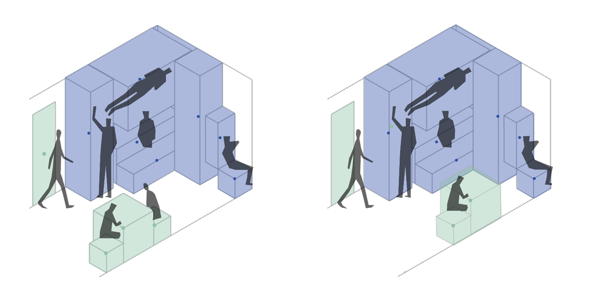
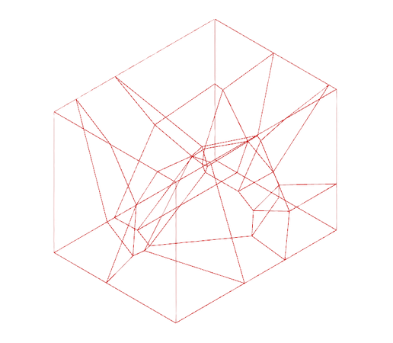
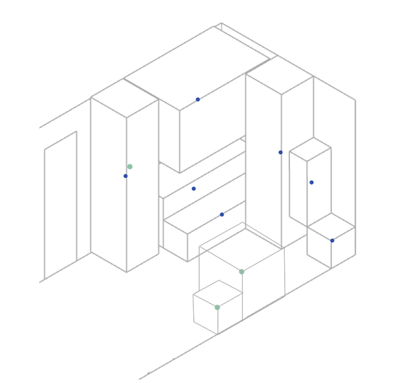
07
STATIC CORE | GENERATION PROCESS
Bedside table
Bed
Bed safety barrier
Clothing storage
Dining storage
Work station
Work equipment storage
Process
Optimisation of activities distribution in space
minimal dimensions obtained from activity mapping
Centroids as seeds points
minimal dimensions obtained from activity mapping
Optimised ergonomic design

Slide 12
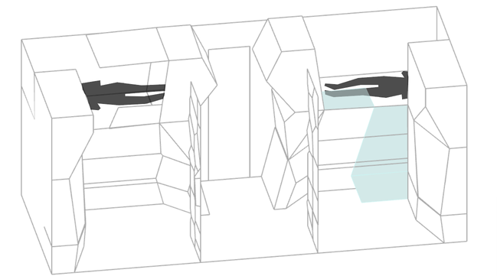
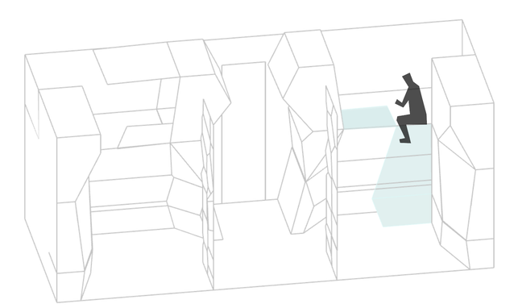
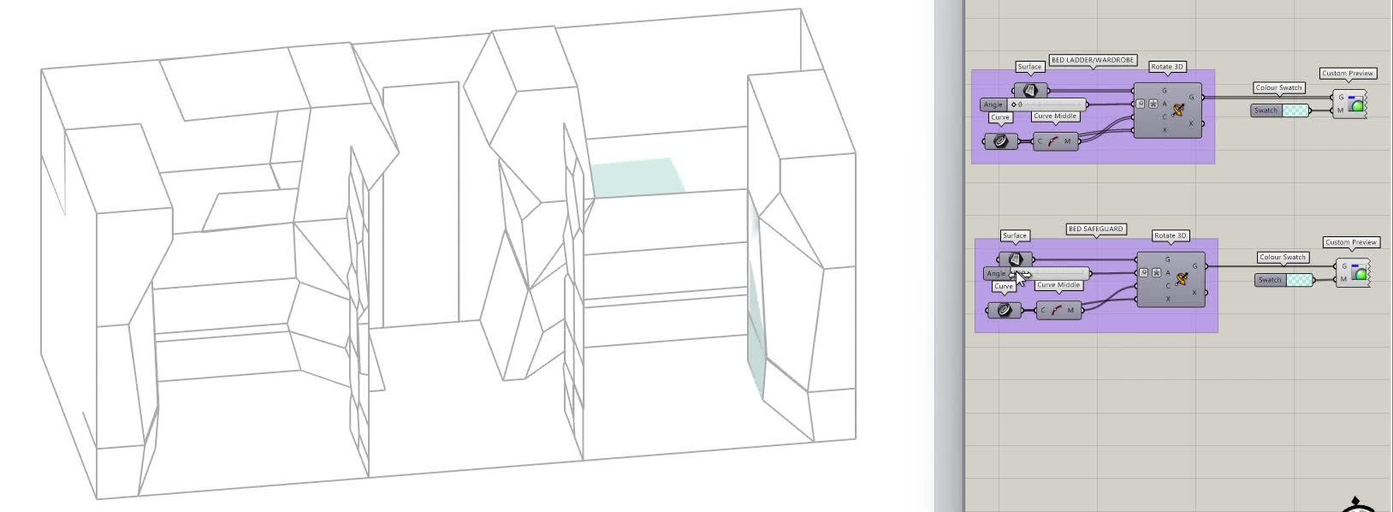
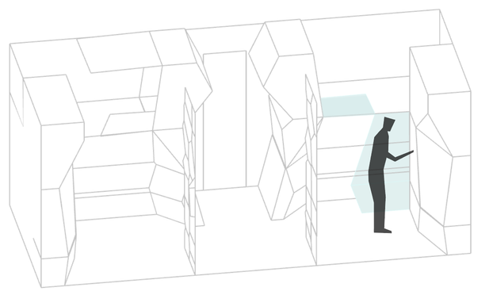
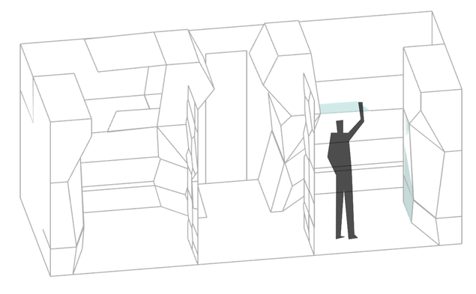
08
ADAPTIVE FURNISHING | 24H MAPPING
6.00-7.00: Waking up & Hygine - User 1
Waking up
Getting off the bed
Bed ladder integrated in clothing storage surface
Getting clothes from wardrobe
Closing wardrobe and bed safety barrier

Slide 13
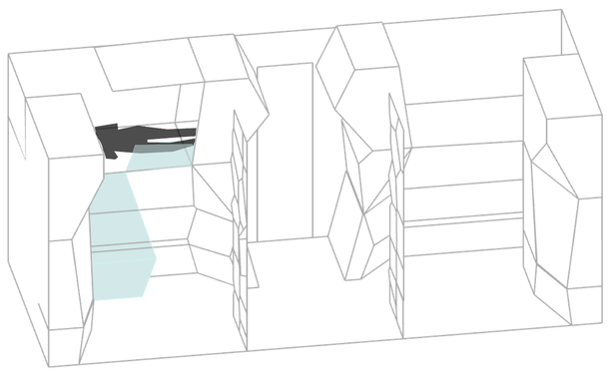
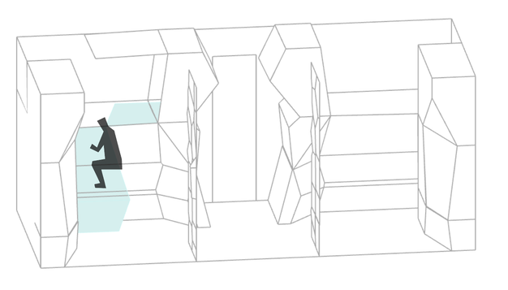
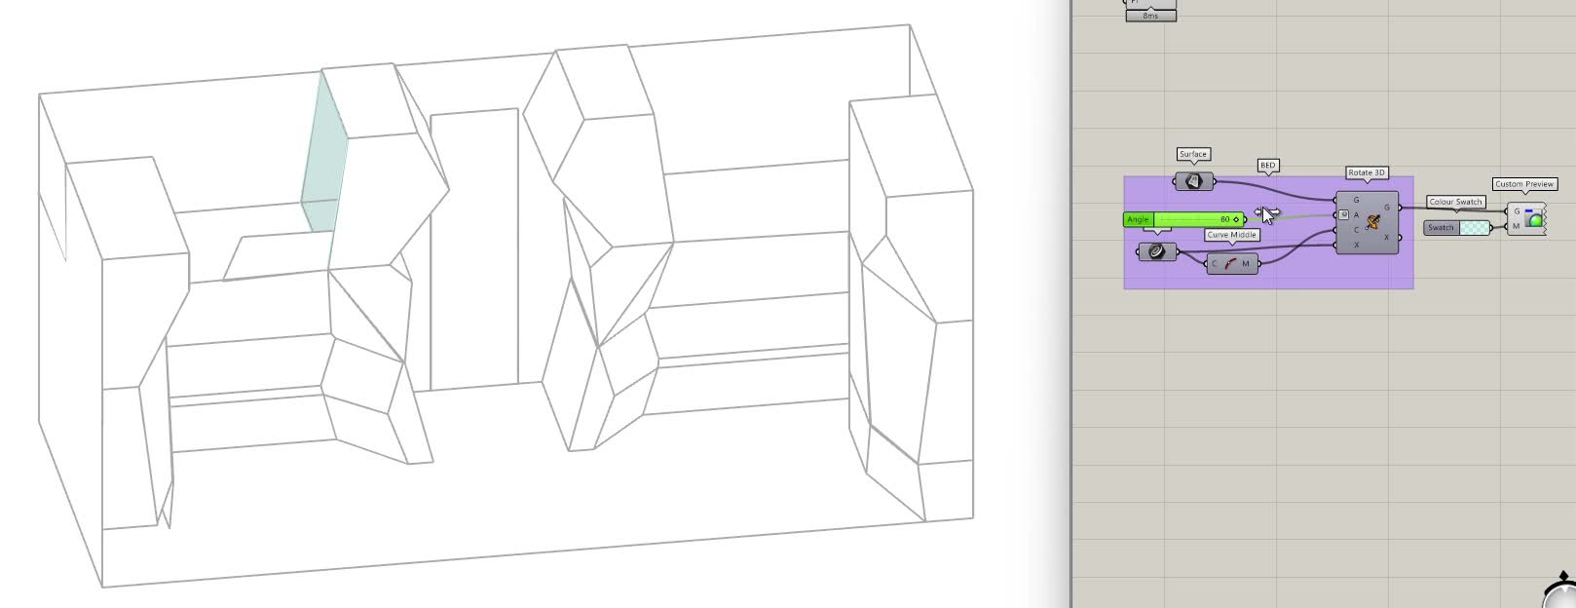
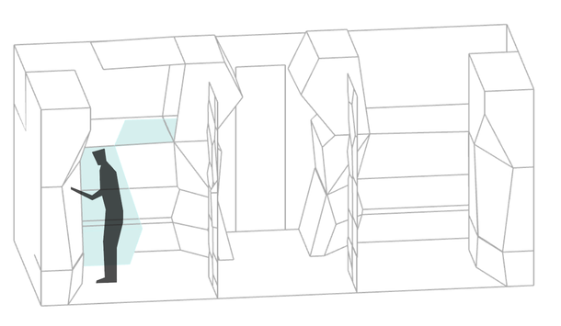
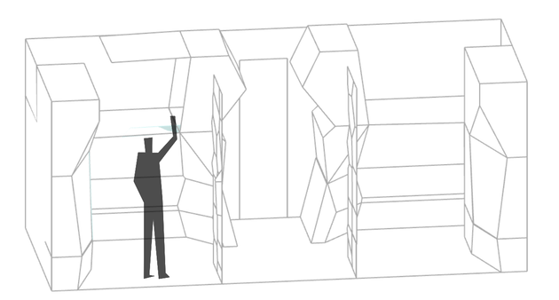
08
ADAPTIVE FURNISHING | 24H MAPPING
7.00-8.00: Waking up & Hygine - User 2
Waking up
Getting off the bed
Extended bed
(alternatively serving as additional storage)
Getting clothes from wardrobe
Closing wardrobe and bed safety barrier

Slide 14
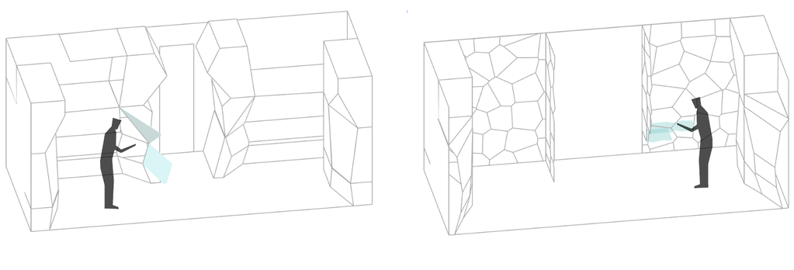
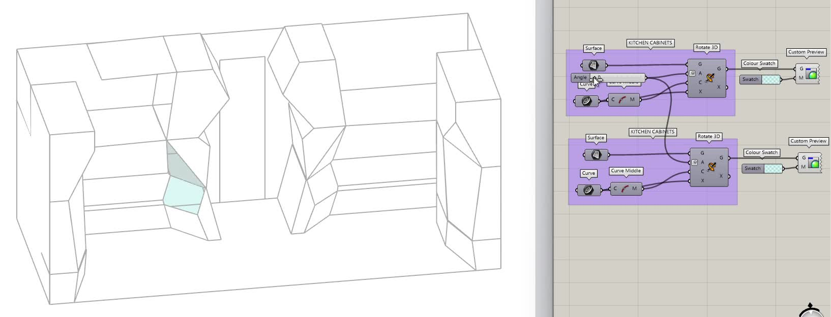
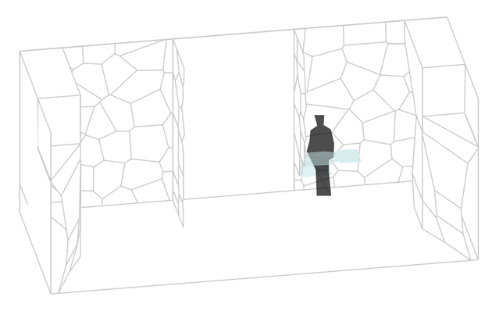
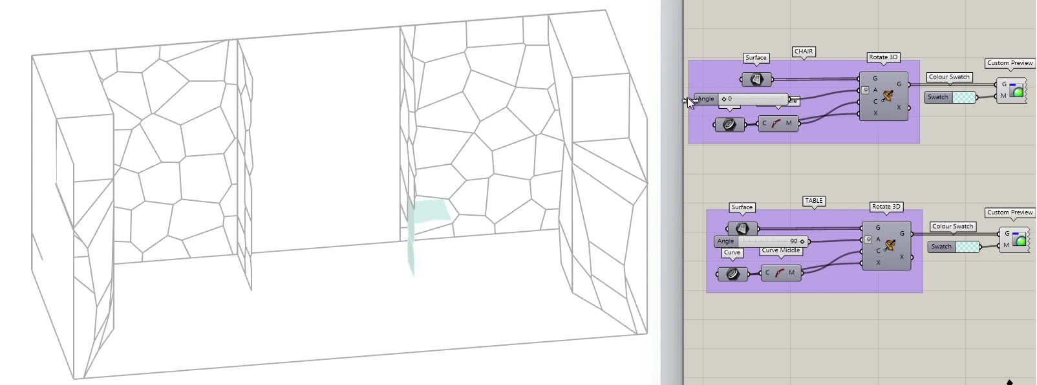
08
ADAPTIVE FURNISHING | 24H MAPPING
8.00-9.00: Individual Dining - User 2
Getting food/dishes from kitchen storage
Folding out dining chair and table
Having breakfast

Slide 15
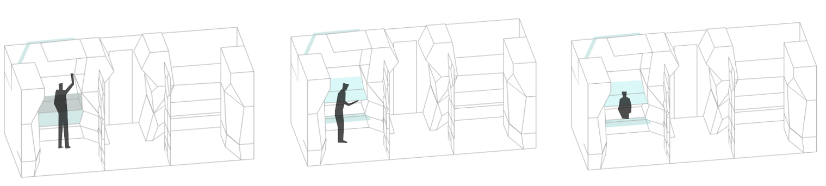
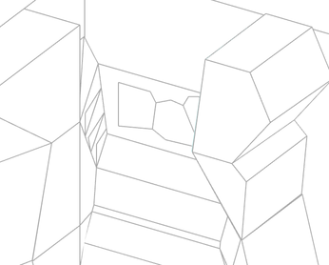
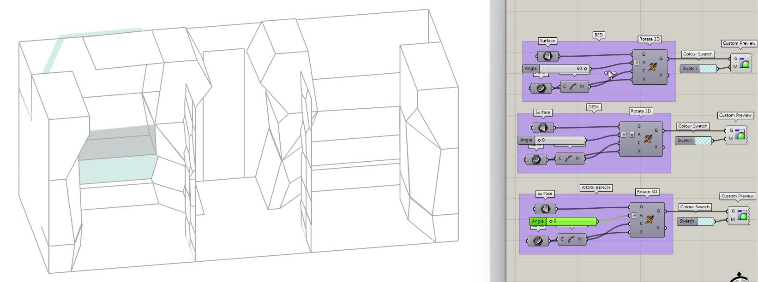

08
ADAPTIVE FURNISHING | 24H MAPPING
9.00-13.00: Individual Working - User 2
allows fruition of window and storage
Folding away bed
Working
Folding out desk and work bench
Allows fruition of larger space in heigth, natural light and view of the sky from skylight above bed
Working
Folding in desk and work bench

Slide 16
08
ADAPTIVE FURNISHING | 24H MAPPING
13.00-14.00: Individual Dining - User 2
Having lunch
Putting food/dishes back in kitchen storage

Slide 17


08
ADAPTIVE FURNISHING | 24H MAPPING
14.00-18.00: Collective Working
Reconfiguring walls
Folding out table and chair
Working

Slide 18


08
ADAPTIVE FURNISHING | 24H MAPPING
18.00-20.00: Relaxing/Exercising
Reconfiguring walls
Folding out lounge chair
Relaxing/exercising
Notes:
Hi I did that part (slides 27 to 29)
(do you want me to delete these or keep) ?
I also thought of doing the screen recordings for the table and chair part next to the diagrams on slides 27-29 to see the cells better, can I do it ?

Slide 19
08
ADAPTIVE FURNISHING | 24H MAPPING
20.00-21.00: Collective dining
Folding away lounge chair
Reconfiguring walls
Folding out table and chairs
Dining
Notes:
Hi I did that part (slides 27 to 29)
(do you want me to delete these or keep) ?
I also thought of doing the screen recordings for the table and chair part next to the diagrams on slides 27-29 to see the cells better, can I do it ?

Slide 20


08
ADAPTIVE FURNISHING | 24H MAPPING
21.00-22.00: Relaxing
Folding in chair and table
Reconfiguring wall
Relaxing
Notes:
Hi I did that part (slides 27 to 29)
(do you want me to delete these or keep) ?
I also thought of doing the screen recordings for the table and chair part next to the diagrams on slides 27-29 to see the cells better, can I do it ?

Slide 21

08
ADAPTIVE FURNISHING | 24H MAPPING
21.00-22.00: Relaxing & Sleeping - User 1
Folding out ladder and bed safety barrier
Climbing up the bed
In bed activities
Sleeping
Notes:
Hi I did that part (slides 27 to 29)
(do you want me to delete these or keep) ?
I also thought of doing the screen recordings for the table and chair part next to the diagrams on slides 27-29 to see the cells better, can I do it ?

Slide 22
08
ADAPTIVE FURNISHING | 24H MAPPING
22.00-23.00: Sleeping - User 2
Foldinf out ladder and bed safety barrier
Climbing up the bed
Sleeping

Slide 23


09
LIGHTING | NEEDS
Task lighting
Ambient lighting
Natural light
Base lighting
Secondary
Secondary
Secondary
Navigating lighting
Primary
Tertiary
Notes:
With our activity mapping, we established our lighting needs, Which we divided Into primary secondary and tertiary.
The primary lighting need is the circadian light, which will be the base lighting.
Layered on top will be the Secondary lighting like, task-, ambient- and natural light. (Additional)
And last, Tertiary lighting, our navigation lighting. (Incidental)

Slide 24



10
LIGHTING | ARCTIC AND CIRCADIAN
Arctic winter: the sun never rises above the horizon-> no direct sunlight, dim light 1-50lux and very cool blue twilight
Arctic summer: the sun never sets, moves circular in the sky --> low angle warm light, 5-20,000 and 20.000-100.000 lux
Circadian cycle: Bright daytime light, dark nights and regular 24h cycles
Problem:
Arctic conditions provide either
Too much light ⟶ Summer
Too little light ⟶ Winter
Solution:
Permanent Circadian sleep/wake light cyle
artificially managed
Is there any way to use the Arctic light?
Notes:
So when looking at the arctic daylights and circadian rythm, we see a lot of diffeerences.
the problem: the natural arctic light cycle is either excessively bright or almost absent (winter).
Sollution
but iss there any way to use arctic liggt

Slide 25




10
LIGHTING | ARCTIC AND CIRCADIAN
Windows are not a reliable primary light source in the Arctic environment
But provide essential phycophysiological benefits
Window eye level
Skylight window
For orientation:
seeing the outside ⟶
improves wellbeing through visual connection
make the space ‘feel’ wider & less isolated
helps to stay connected to outside world
For light:
gives a stronger ‘feeling’ of daylight
help space feel less enclosed
works well together with artificial circadian lighting
Arctic summer
Arctic winter
Notes:
For oreintation:
helps people to see the horizon ⟶
improves wellbeing through visual connection
helps to stay connected to outside world
For light:
help space feel less enclosed
works well together with artificial circadian lighting

Slide 26
10
LIGHTING | ARCTIC AND CIRCADIAN
Windows can support the circadian light cycle inside the container
but must be controlled to support the system
Arctic summer
Arctic winter
There is too much light from the window
Solar-control glass, filters brightness
Diffusion, softens glare
Shading, blocks excess light (lux-sensors)
Artificial night, shading blocks all natural light
Artificial lighting dims to maintain circadian schedule inside with AI (lux- & CCT-sensors)
There is too little light from the window
Circadian daylight cycle as primary light provider
is about perception an information not light
Artificial lighting adjusts color to maintain circadian schedule inside with AI ( CCT-sensors)
The AI system dynamically adjusts intensity and CCT in relation to outside to maintain the “controlled artificial day” despite changing external lighting conditions.
Notes:
as mentioned before..

Slide 27


11
LIGHTING OVERVIEW
3
3
1
4
1
1
1
1
1
2
2
4
Notes:
overview of what activity has what location etc, linking activities to lighting to ai

Slide 28



11
LIGHTING OVERVIEW
9
7
5
8
9
8
9
8
6
Notes:
overview of what activity has what location etc, linking activities to lighting to ai

Slide 29




12
LIGHTING | OPTIMAL LUX AND CCT
Primary
Secondary
Notes:
Based on the activity mapping, we identified the optimal ranges for illuminance and colour per activity and time of the day

Slide 30







13
LIGHTING AND AI |CONTROL SYSTEMS
COMPUTER VISION
Strategy
Minimising n. of different control systems, detection errors and maintenance requirements
3 systems
Computer Vision (CV) → Acts as the 'eyes'.
Smartwatch → Provides the 'biological data'.
Manual Overrides → Users can always take control via manual sliders
Hierarchy
1. individual preferences and adaptation
2. environmental context
Health Safeguards
Red Warning: Shown when manual settings are outside healthy ranges.
Corrective Fade: A gradual 30-minute transition back to healthy light levels.
Dual Control Logic
We distinguish between Trigger Control (turning lights on/off) and Atmospheric Control (adjusting CCT and Lux).
CCT/LUX
ON/OFF
AI SYSTEM
LIGHTS
SMARTWATCH
MANUAL OVERRIDERS
Brightness
Light colour
–
W
–
–
–
–
–
–
–
–
C
–
Sliders for manual control
Brightness
Light colour
–
W
–
–
–
–
–
–
–
–
C
–
Sliders for manual control for values outside of safeguard limits

Slide 31

15
LIGHTING AND AI |CONTROL SYSTEMS
Layer 1: Identity
Key: smartwatch (who is in the room?)
Personal preferences: CCT & Lux
Circadian: sunrise simulation (30 min)
Layer 2: Activity
Eyes: computer vision
Intent: Detects when the desk is unfold to activate a 'Work' scene
Stress-relief lighting (heart rate)
Layer 3: Context
Exterior sync: actic weather data
Polar night: increases the light quality to mimic sunlight (High CRI)
Midnight sun: digital darkness (melatonin support)
Unfolded → light goes on
Folded → Light goes off

Slide 32
16
LIGHTING AND AI | AMBIENT LIGTHTING
Collective mode
Two Modes: Vision-Driven Logic
Computer Vision recognizes the furniture configuration to trigger the correct mode automatically.
Collective Mode (Table Centered):
Trigger: Table in the center (detected by CV).
Collective Balancing. The AI calculates an average between both users.
All lighting zones are synced to for example a warm 3000K setting for shared activities.
Private Mode (Table Rotated or Split):
Trigger: Table split or rotated.
The AI divides the container into two personalized "light bubbles."
These bubbles follow the residents through the space using UWB (Apple Watch) tracking.
Private mode
transition zone

Slide 33

17
MACHINE LEARNING | INTRODUCTION
TUTORIAL 27/02/26 OF JUPITER NOTEBOOK
The values the Jupiter Notebook model produces is the prediction of what the lux should be according to the model. This model uses the technique of neural networks.
Machine learning, unlike AI, infers patterns from data while AI needs the patterns as an input.
To implement the control systems we used machine learning to control
and predict the lighting systems, this was done by a Jupyter Notebook code with neural networks.

Slide 34

18
MACHINE LEARNING | PRE-TRAINING
SUPERVISED LEARNING
FEATURES ARE THE INPUT VARIABLES, POSSIBLE FEATURES;
Weather features; outdoor_temp, direct_normal_radiation, rel_humidity, diffuse_normal_radiation, global_horizontal_radiation, infrared_radiation, direct_normal_illumination, diffuse_horizontal_illumination, global_horizontal_illumination, total_sky_cover.
Physological features; hrv_rmssd_ms, heart_rate_bpm, pupil_mm, blink_rate_per_min, skin_conductance_uS, respiratory_rate_bpm.
LABELS ARE THE OUTPUT VALUES, IN THIS CASE THE PREDICTED ILLUMINANCE_LUX AND CCT_kelvin
SELECTING THE FEATURES AND LABELS: BALANCING ACCURACY OF MODEL WITH RISK OF OVERFITTING
Choosing and grouping features.
Features with high correlation >0.8 with each other may be redundant, so they can be grouped or dropped.
Features with high correlation with labels are likely strong predictors.
With cross-validation we are testing the overfitting, if results are similar to the test score, that means low overfitting.
Feature correlation heatmap

Slide 35

19
MACHINE LEARNING | TRAINING
feature grouping
For the weather features e.g. I found strong correlations, which can be grouped together to reduce redundancy: Direct radiation and direct illumination (0.94) and diffuse horizontal and global horizontal illumination (0.88)
For the physiological features e.g. I found inversely correlated features, one of these can be used as a representative feature. HRV and heart rate (0.85).
EVALUATING MODEL PERFORMANCE
R-square is used to evaluate how well the model represents the data (the variance of the mean). For example, if R-square is 80%, then the model can express 80% of the variability.
Error functions such as RMSE and MAE provide information about how far off the estimation is from the actual value. RMSE penalizes large errors and MAE takes the average. Both of the scores are relative to the scale of the dataset.
Performance of the first model vs second model trained with adjusted features;
R-square = 0.13752631245104485 → 0.6972536094819399,
RMSE = 547.2232257652937 → 401.7306132398937,
MAE = 463.33269614523095 → 322.292021438062
Conclusion; clear improvement of the model performance.

Slide 36

20
MACHINE LEARNING | TRAINING - FEATURE GROUPS

Slide 37






21
MACHINE LEARNING | TRAINING - EXAMPLE
Stressed
Calm/relaxed
>90 bpm
60 - 90 bpm
< 20 ms
20 - 70 ms
200-350
lux
500-700
lux
2700-3500 K
4000-5000 K

Slide 38

23
CHOOSEN FRAGMENT
A piece of the kinetic wall:
Lounge chair/DIning chair

Slide 39
Thank you for your attention !

