Slide 1
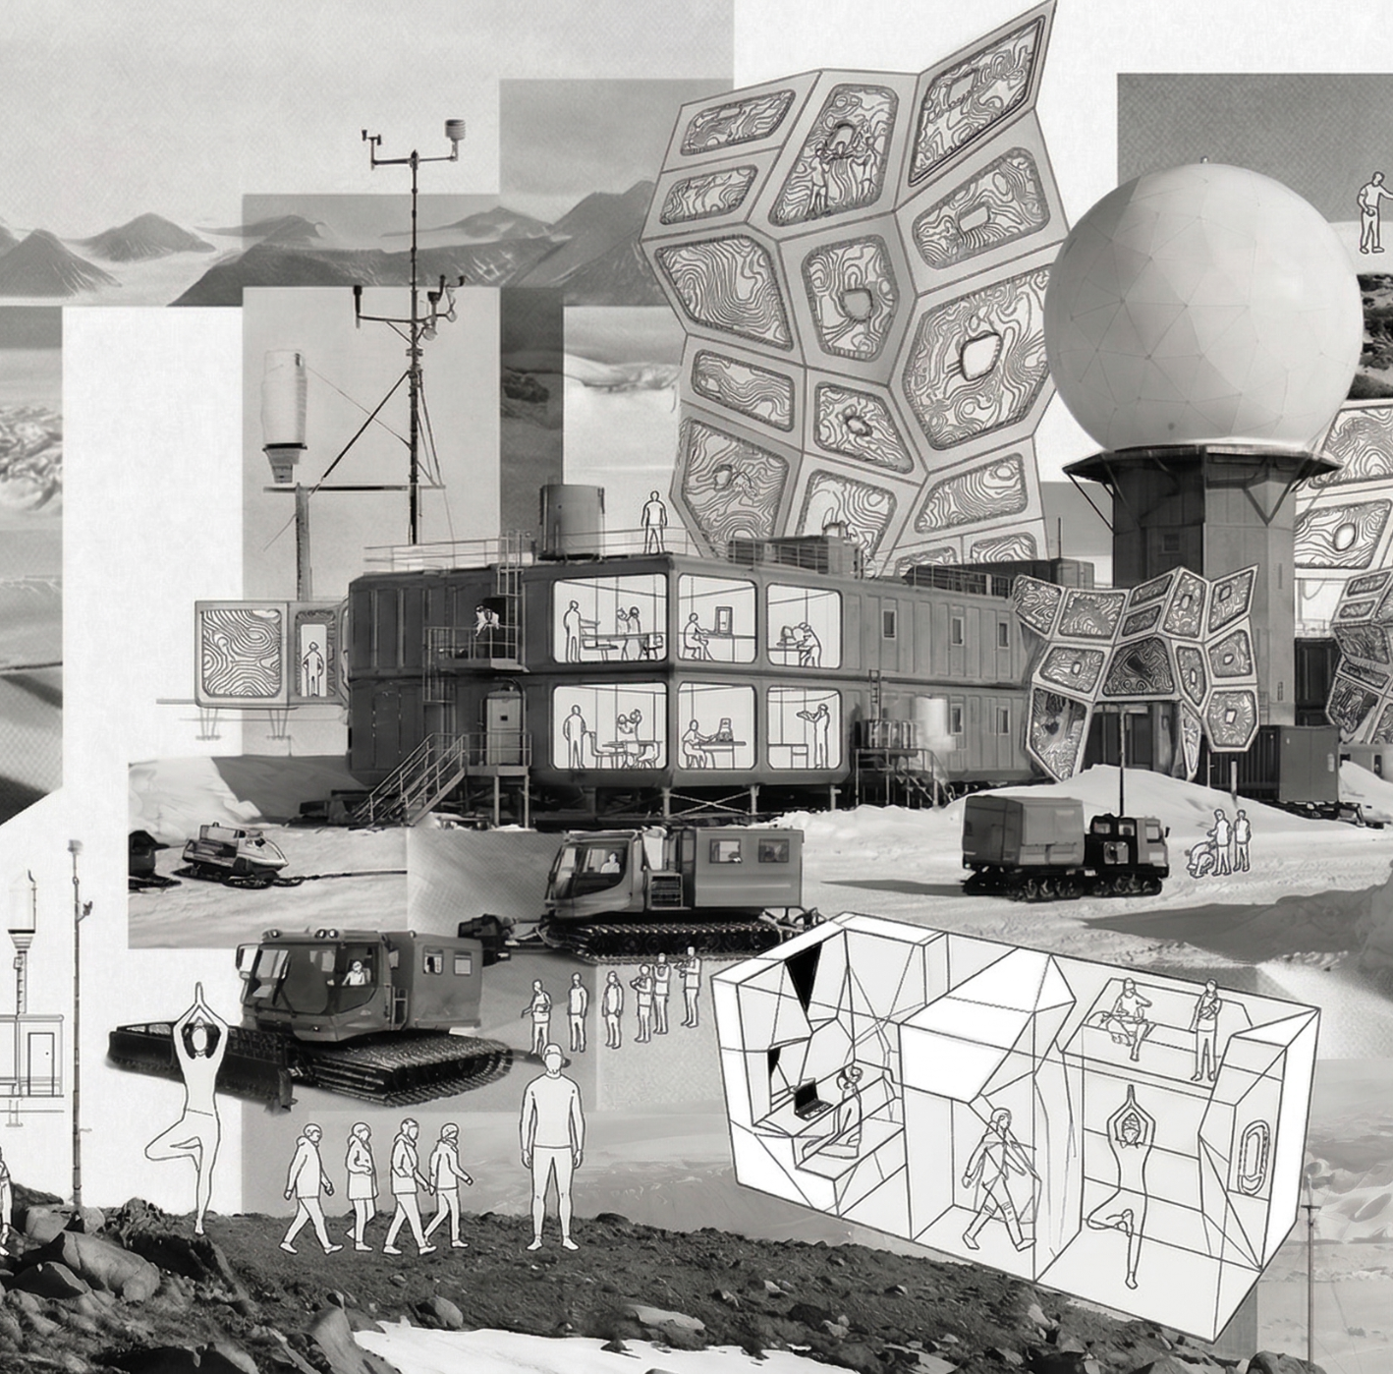
Mission-drivenhabitability
Designing habitats to support mission-driven confinement,​
TROLL Station Containers
Week 3.7
Group 2_ Brendan Exterkate, Gabriel Marks, Giorgia Vercelloni,
Maciej Sachse, Ruxandra Florut, Zuzanna Schleifer, Long Ki​

Slide 2
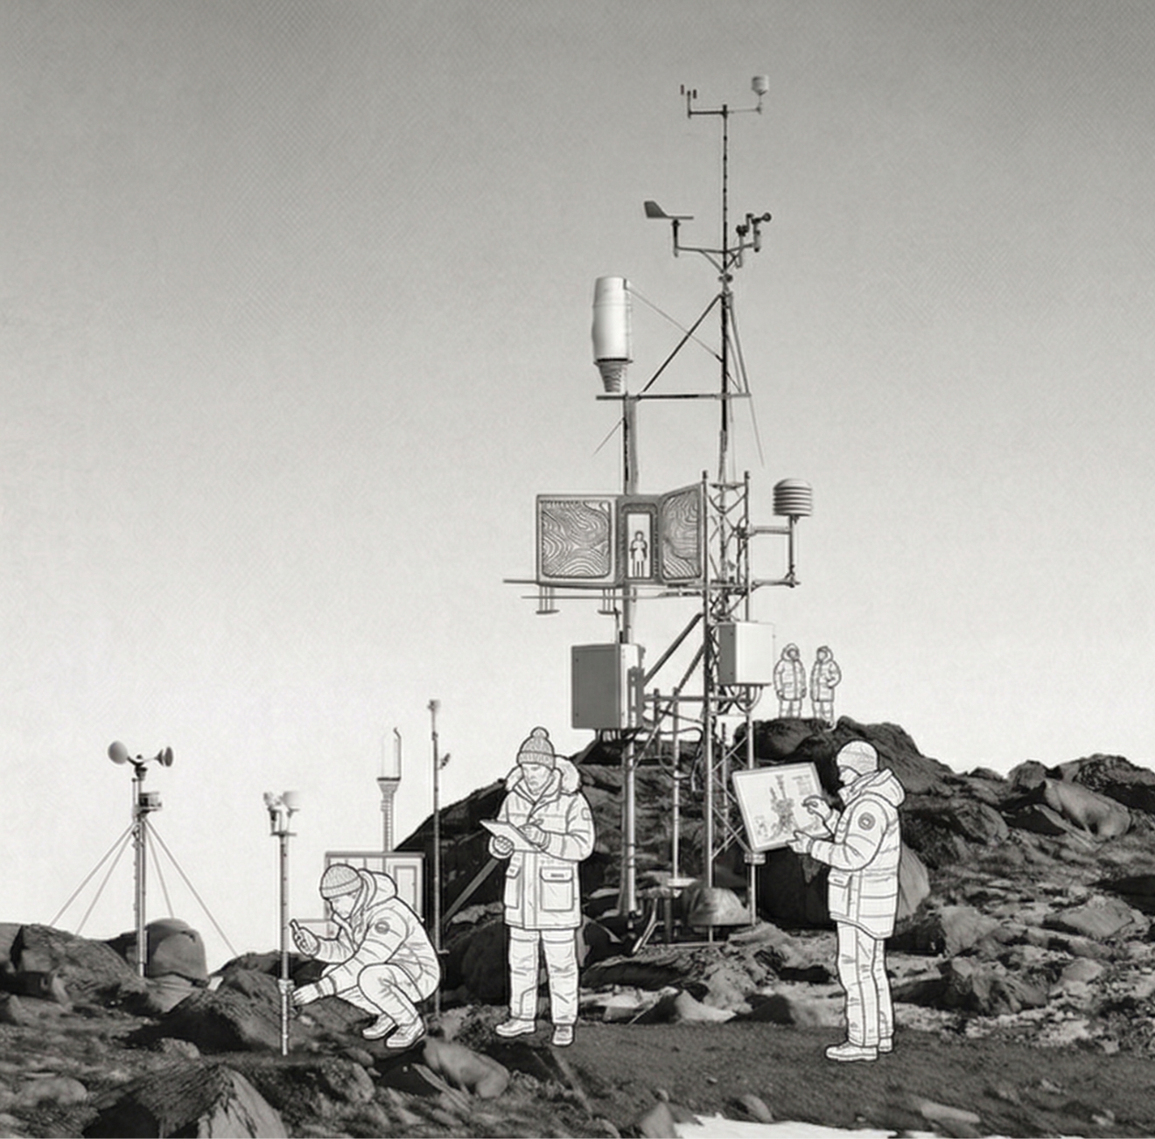
Index
_Environmental introduction
_On the project
_Two lives in a volume
_Adaptive space
_24h of lighting needs
_The focus: geometry and light
_Prefabrication process
_Further AI implementation
_Light implementation
_Hardware list
_What next?
_Material considerations

Slide 3
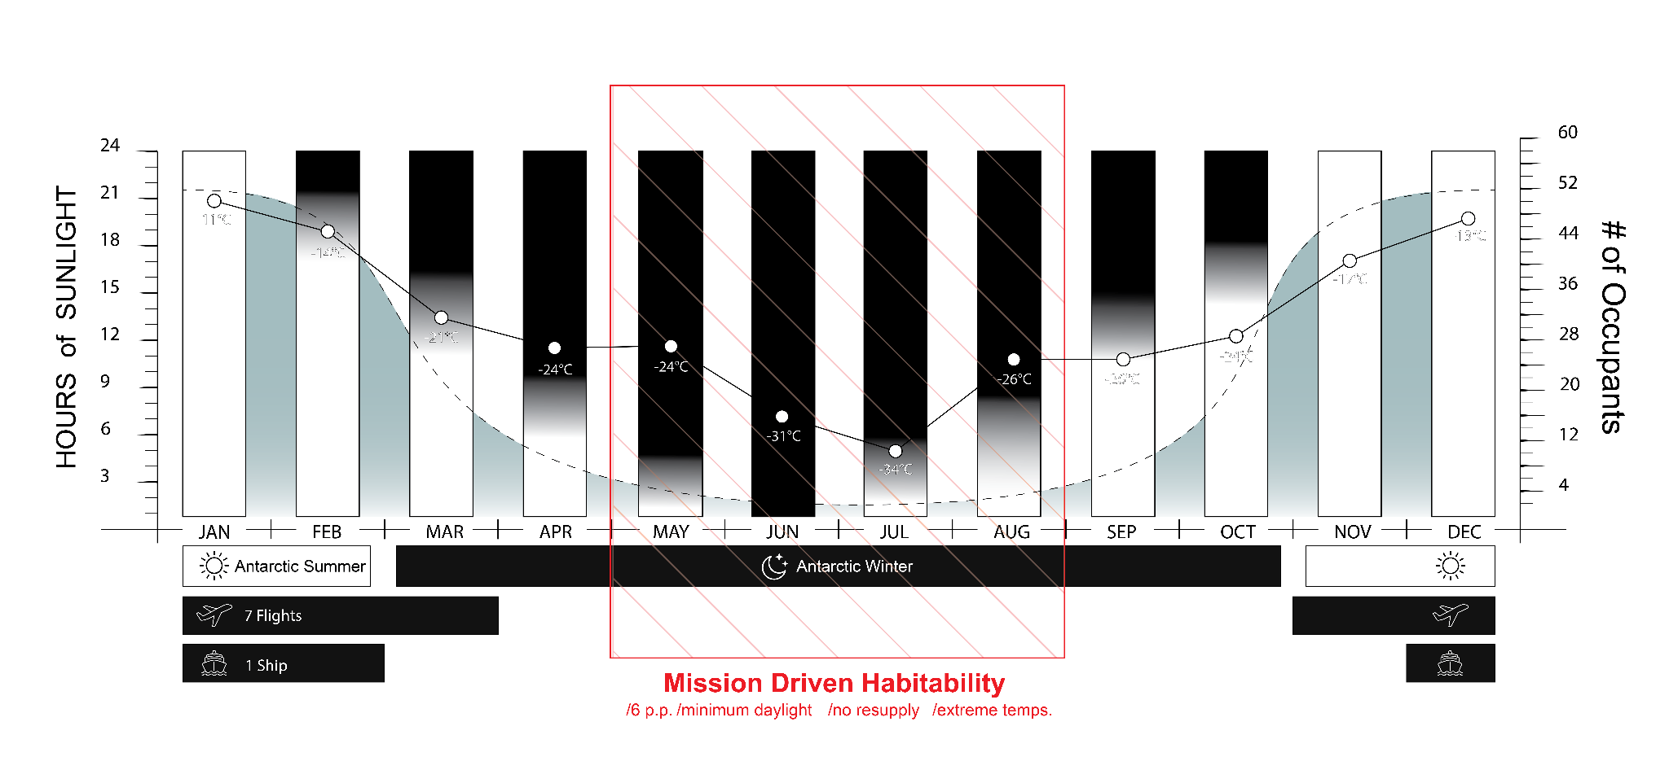
Environmental introduction
Notes:
doesn’t change that much
enhances our specific area of interest (extreme condition)
mission driven habitability in every slide

Slide 4
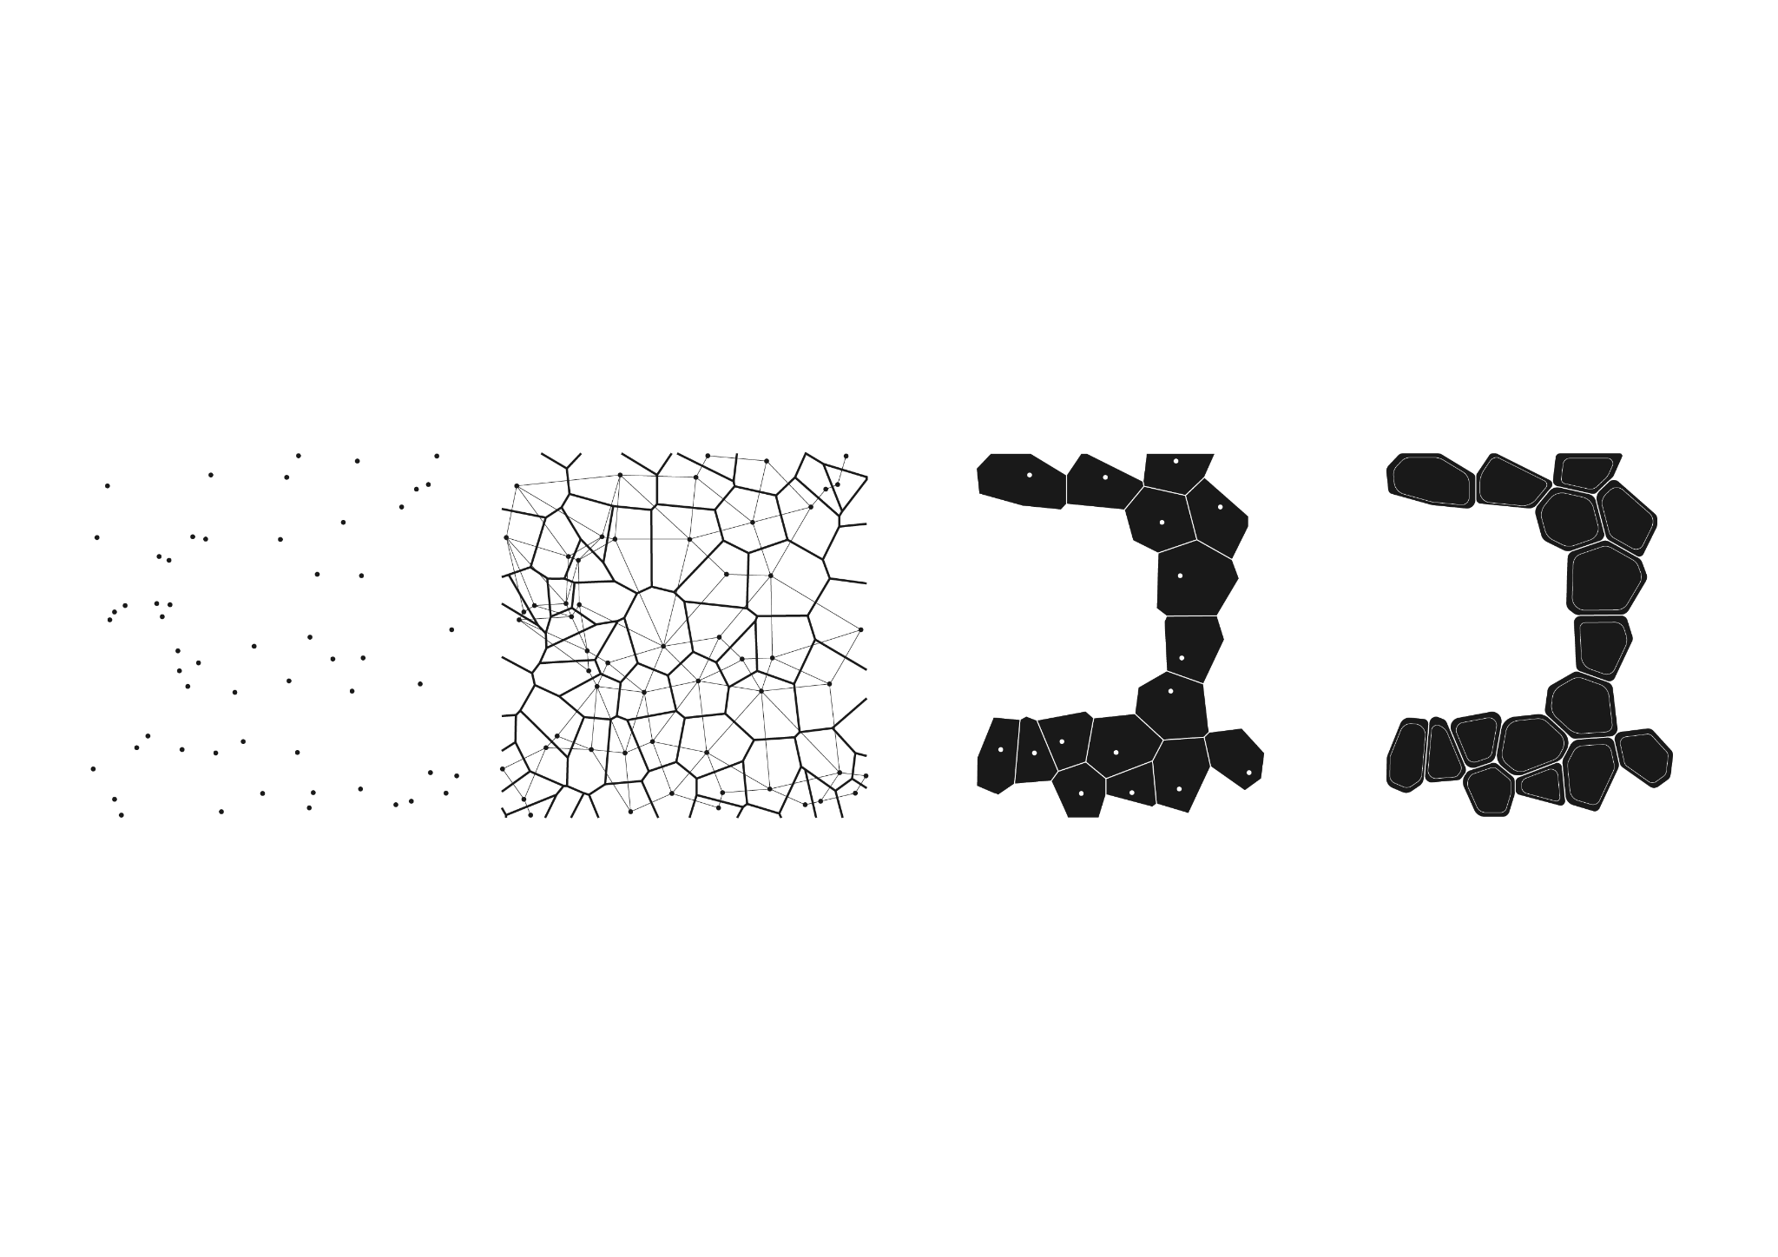
On the project: Voronoi
points
Voronoi 2D space
chosen surfaces
organic cells​

Slide 5
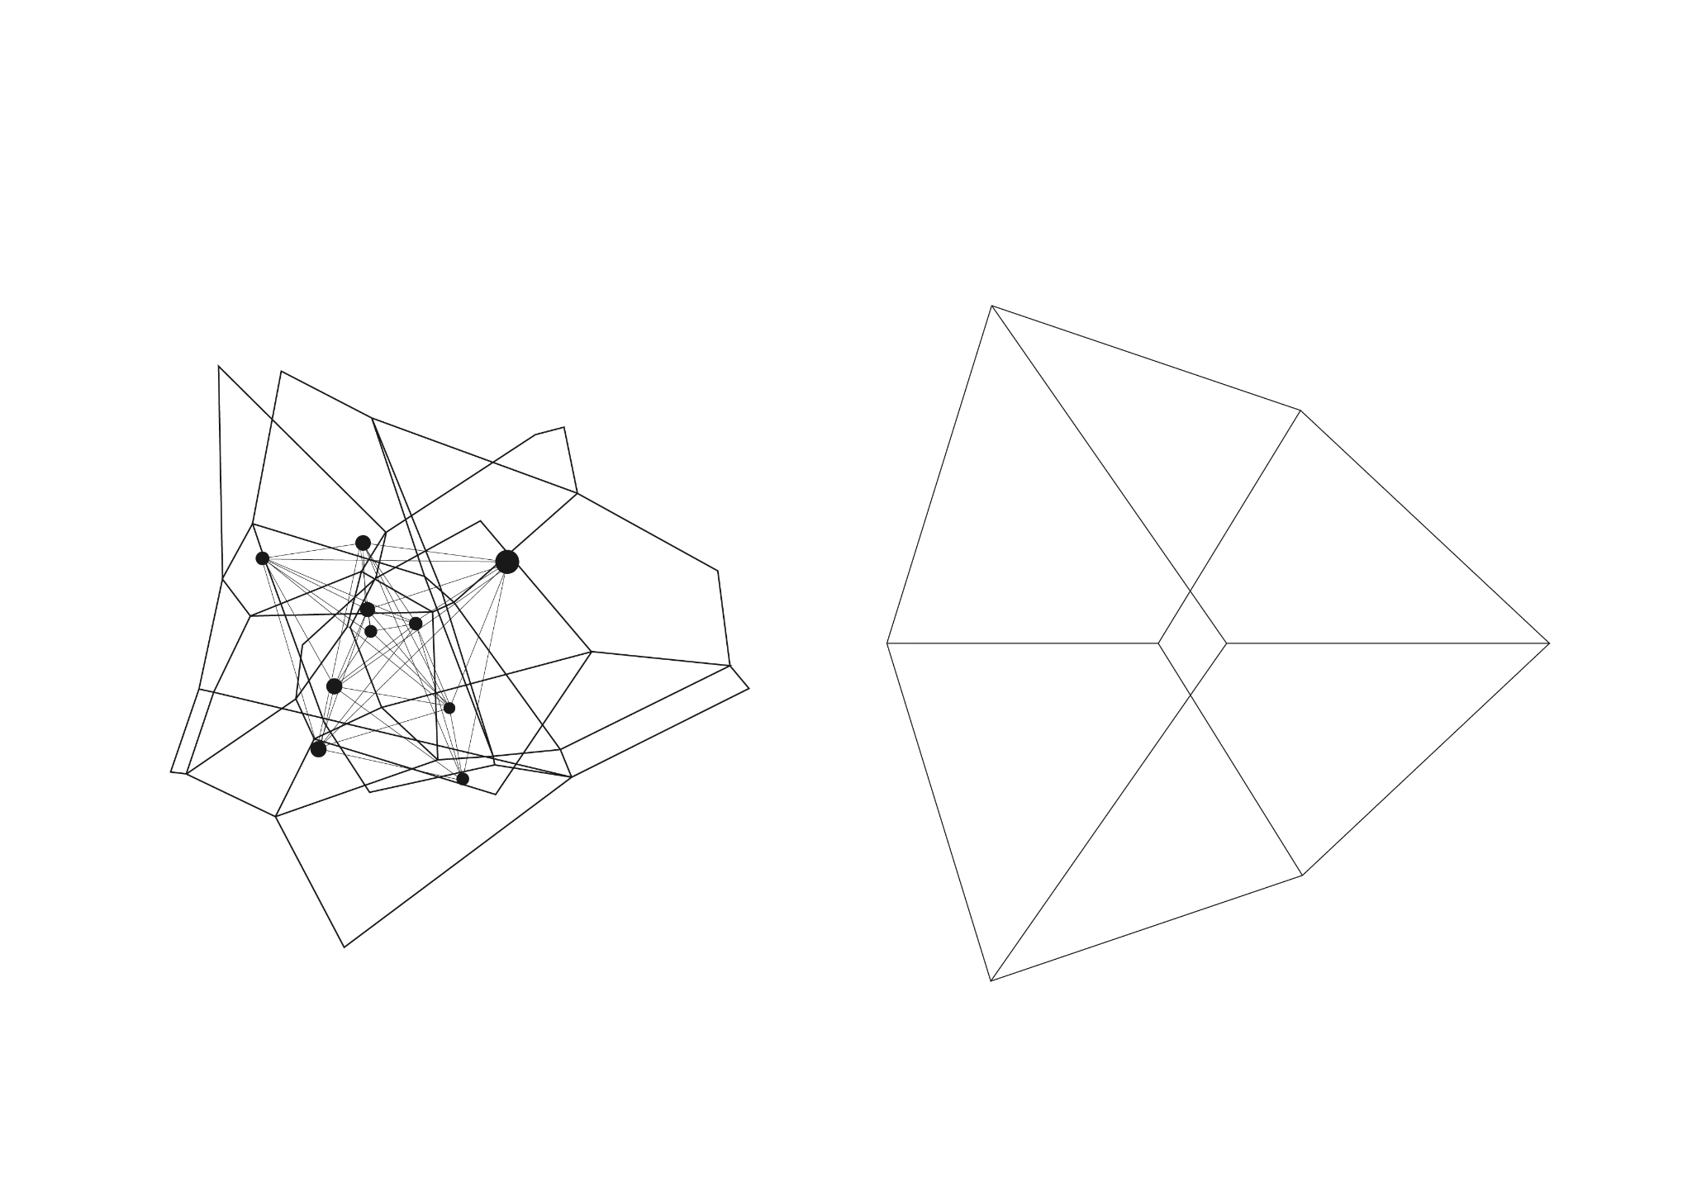
On the project: the two systems
voronoi system
orthogonal system

Slide 6
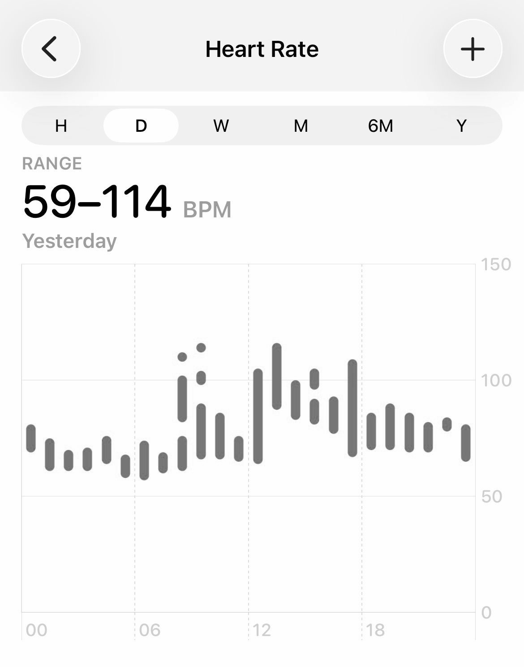
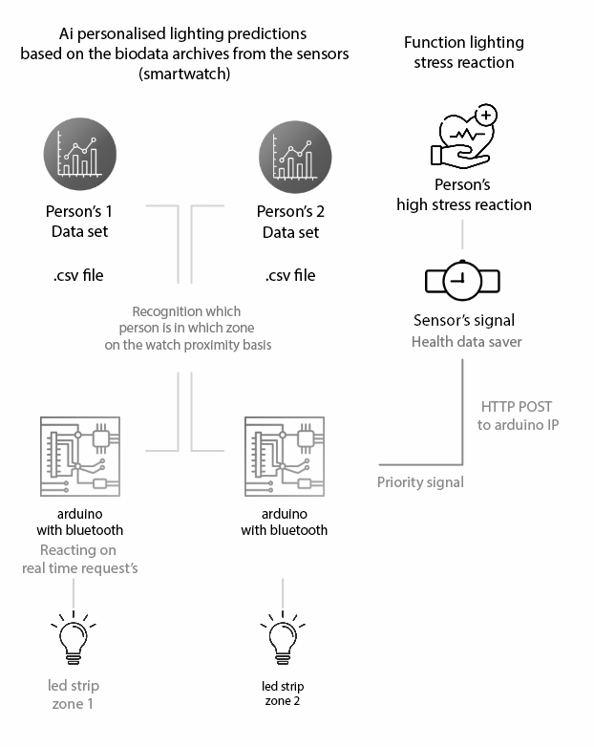
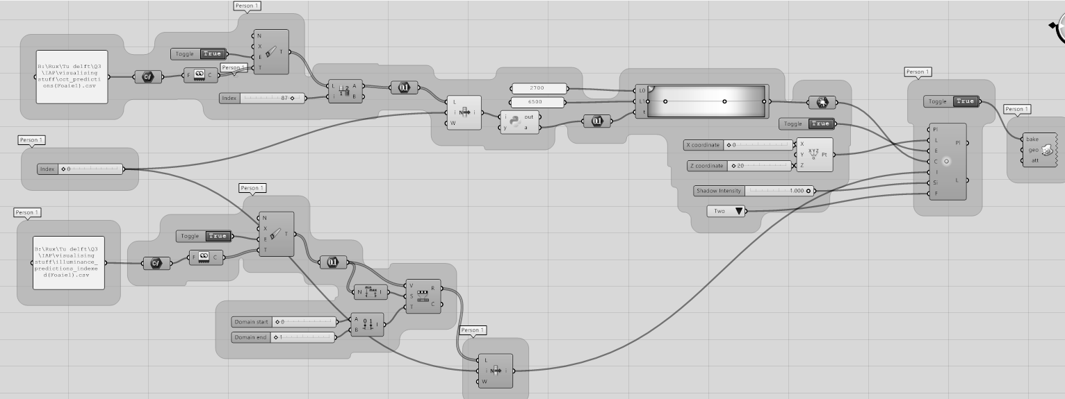
On the project: overview of steps
Sensor Input (Heart Rate, etc.)
AI Model
Adaptive Lighting Output

Slide 7
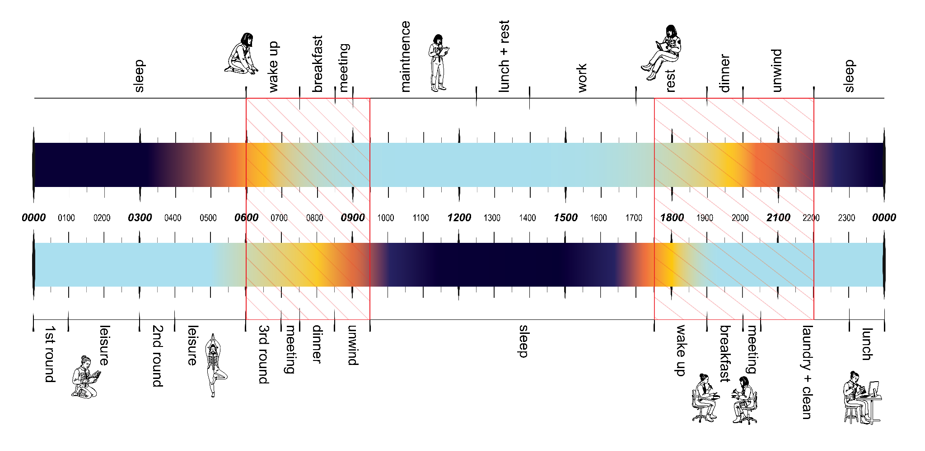
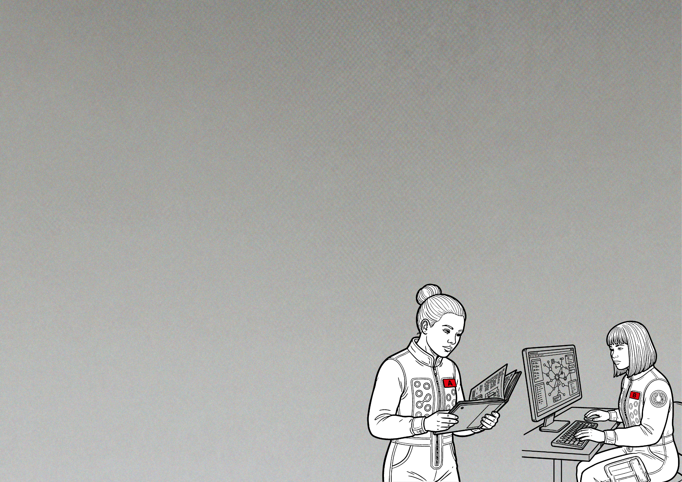
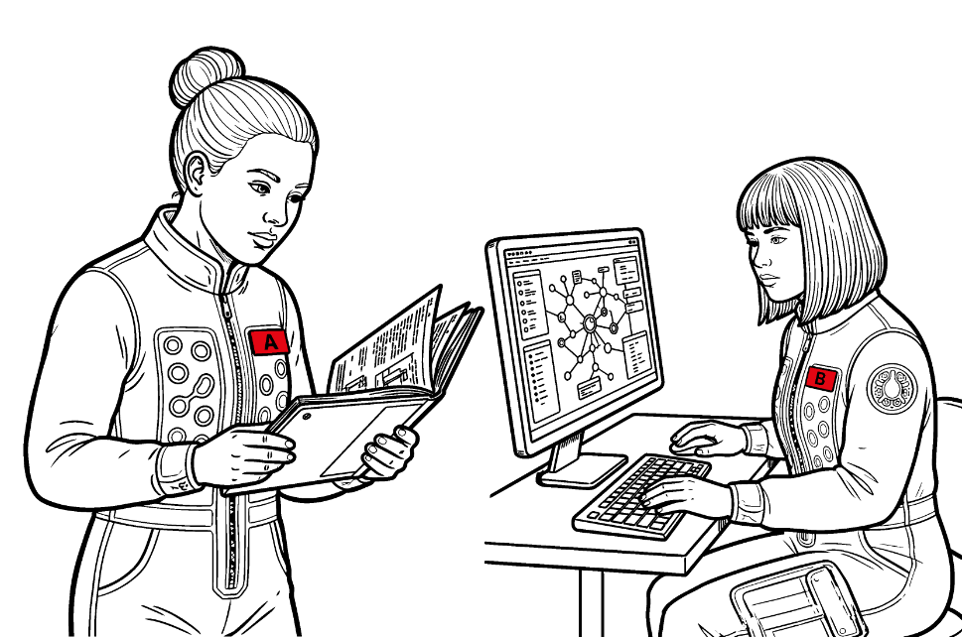
Two lives in a volume
Day Shift - Brenda
-Meteorologist
-Atmospheric sampling
-Ice measurements
-Data gathering
Night Shift - Angela
-Researcher
-Runs Simulations
-Maintains equipment
-Data Analysis
Angela
Brenda

Slide 8
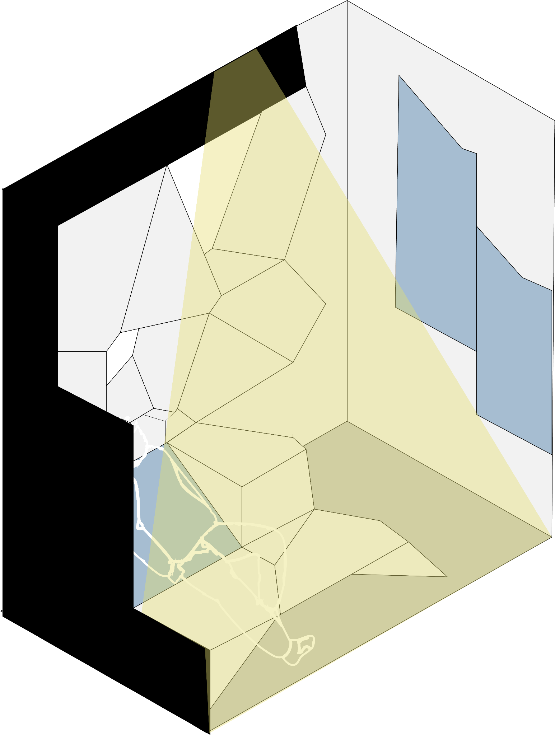
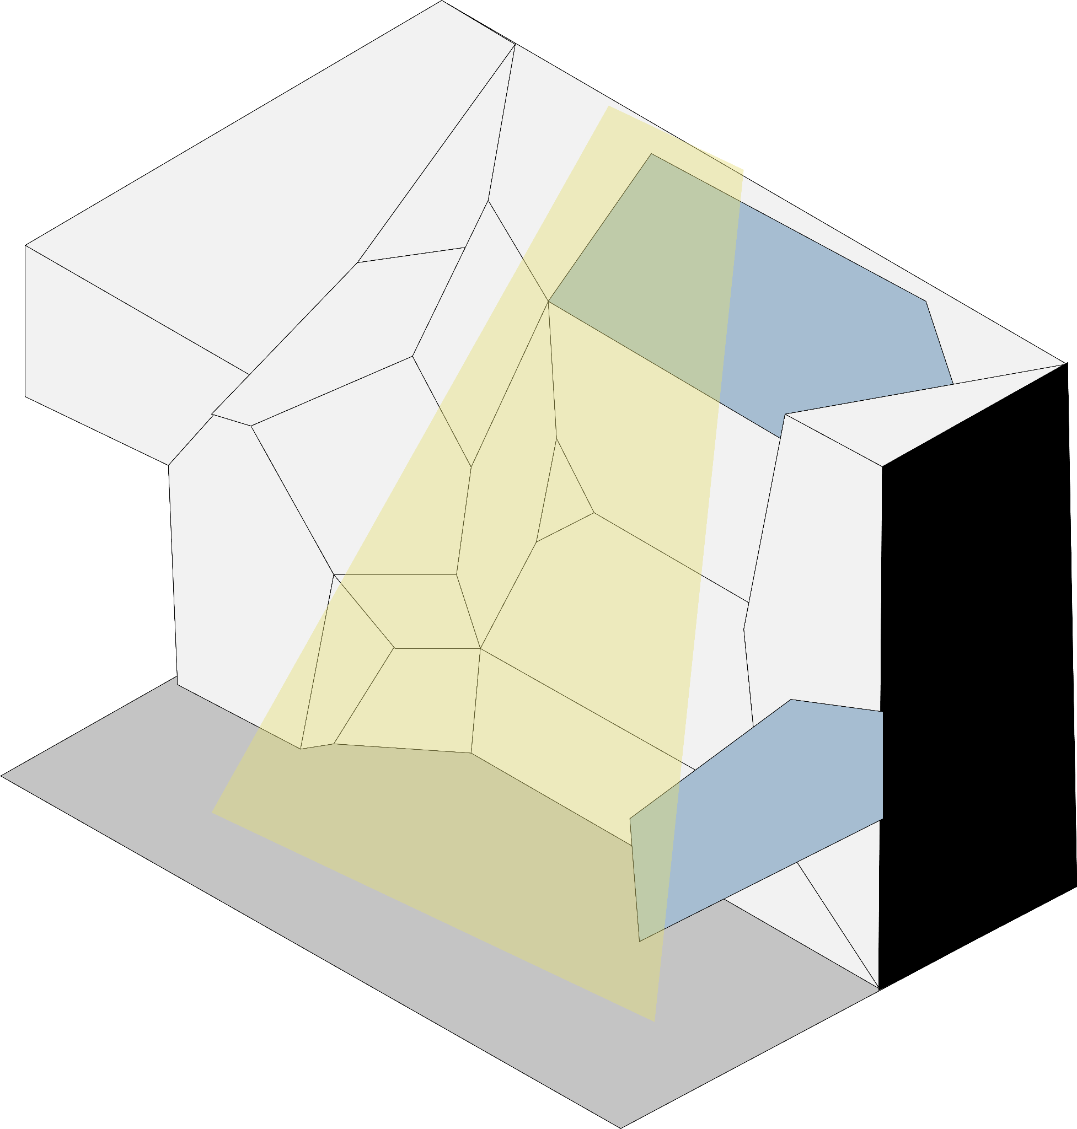
On the project: lighting
two zones with merging schedules
light inside furniture
we make two zones with merging schedules
schedules
Zone2
Zone1

Slide 9
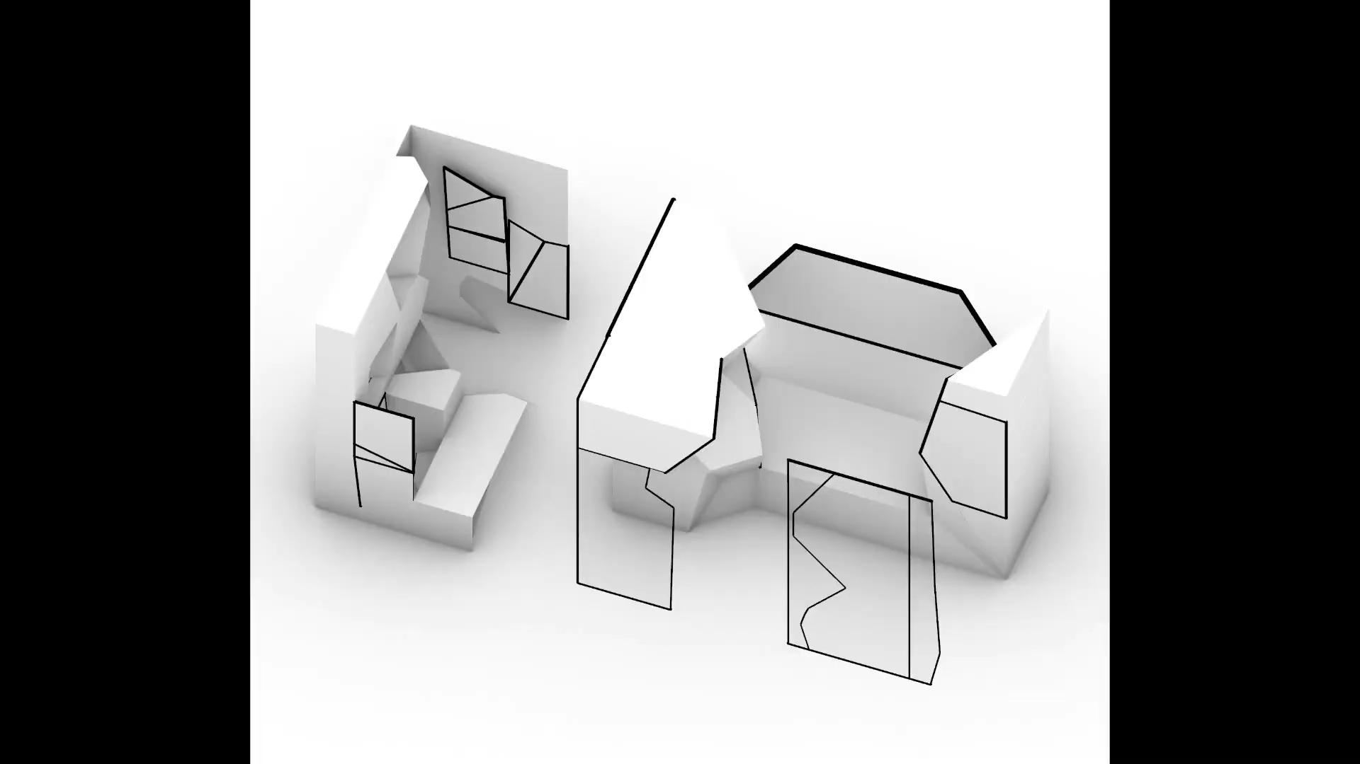
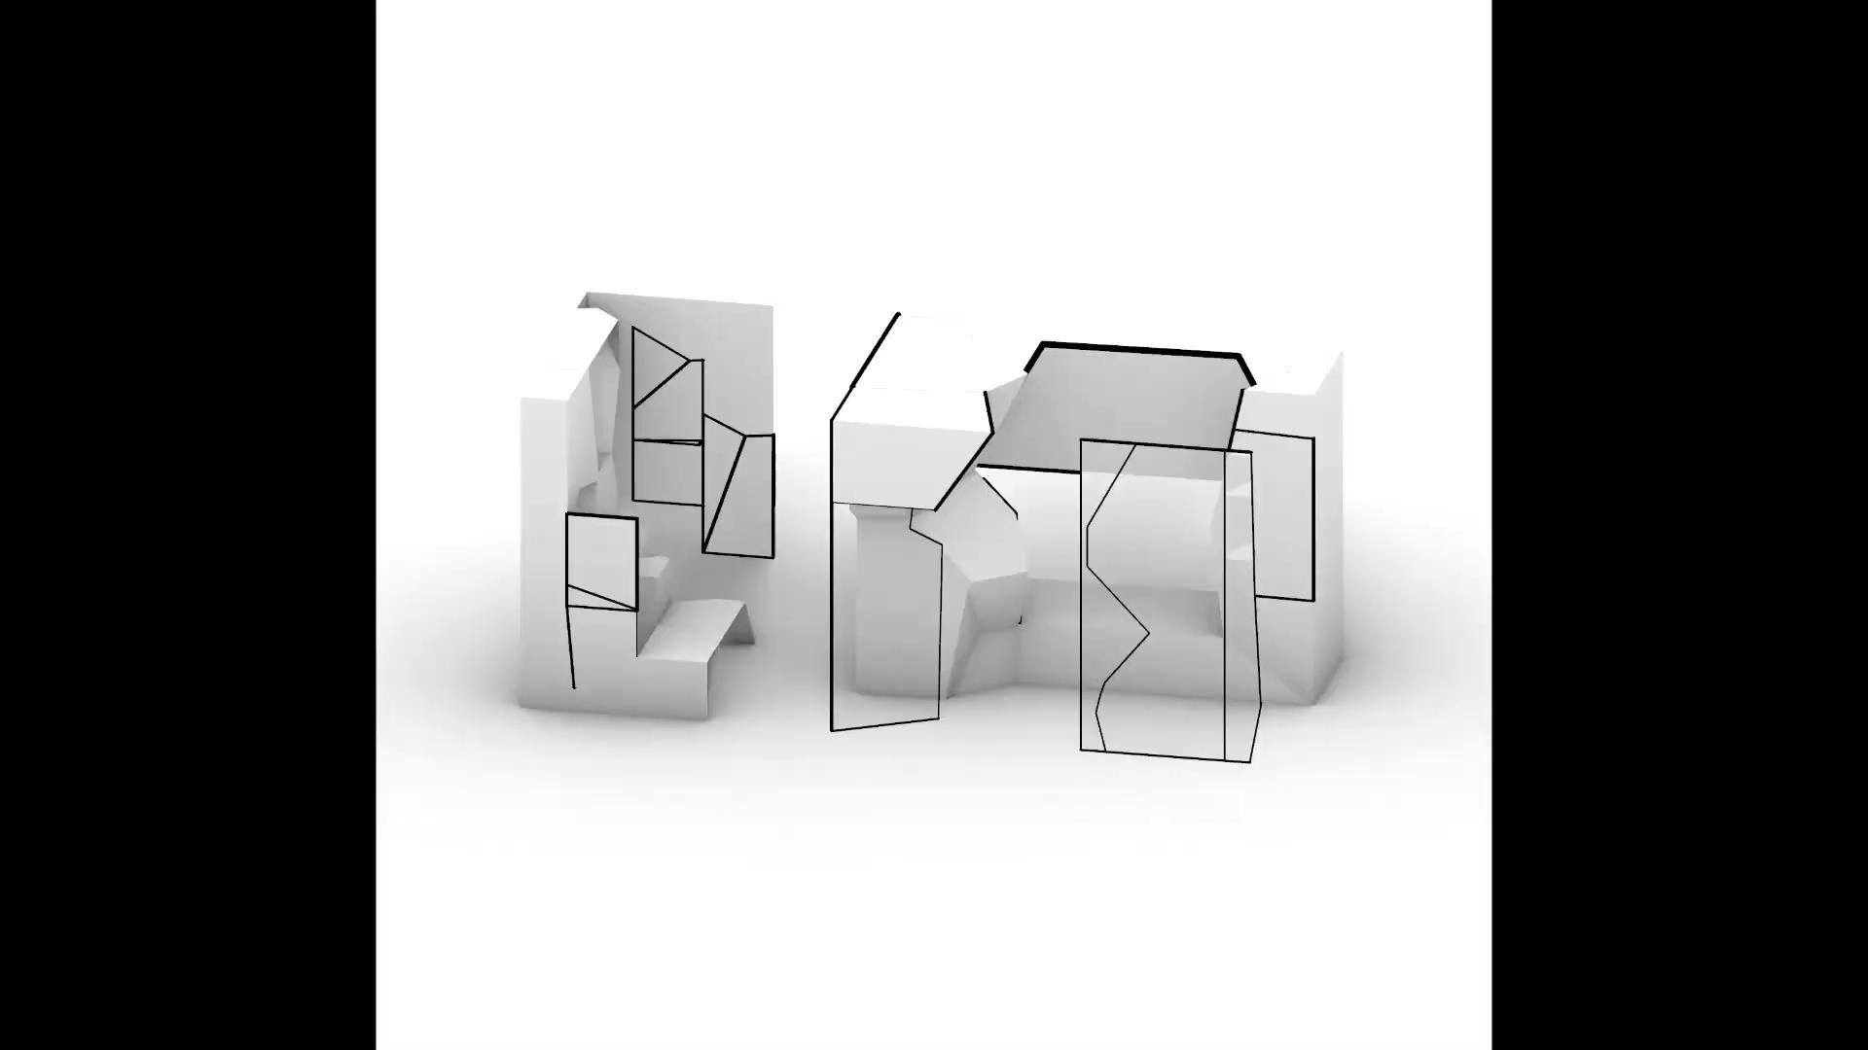
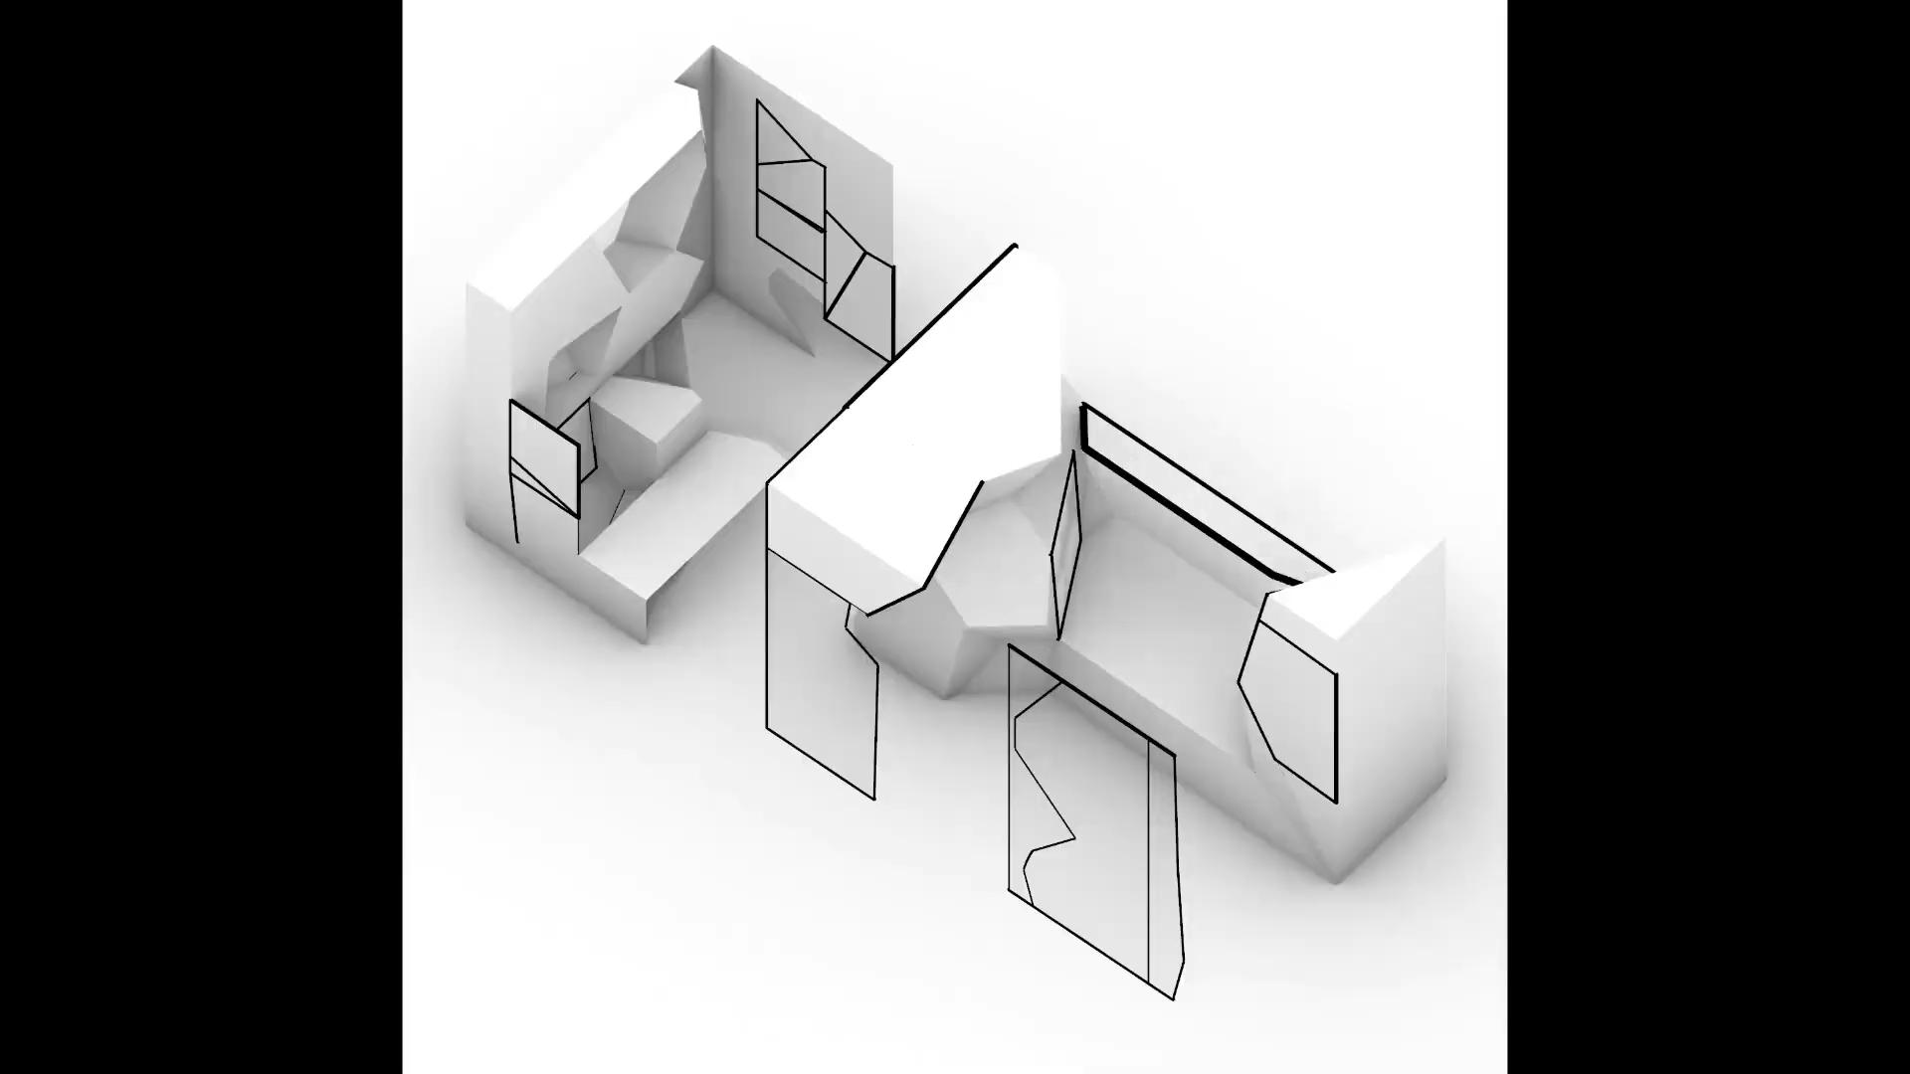
Adaptive design : 3 elements on psychological well being
agency
(2) privacy
(3) sleep

Slide 10
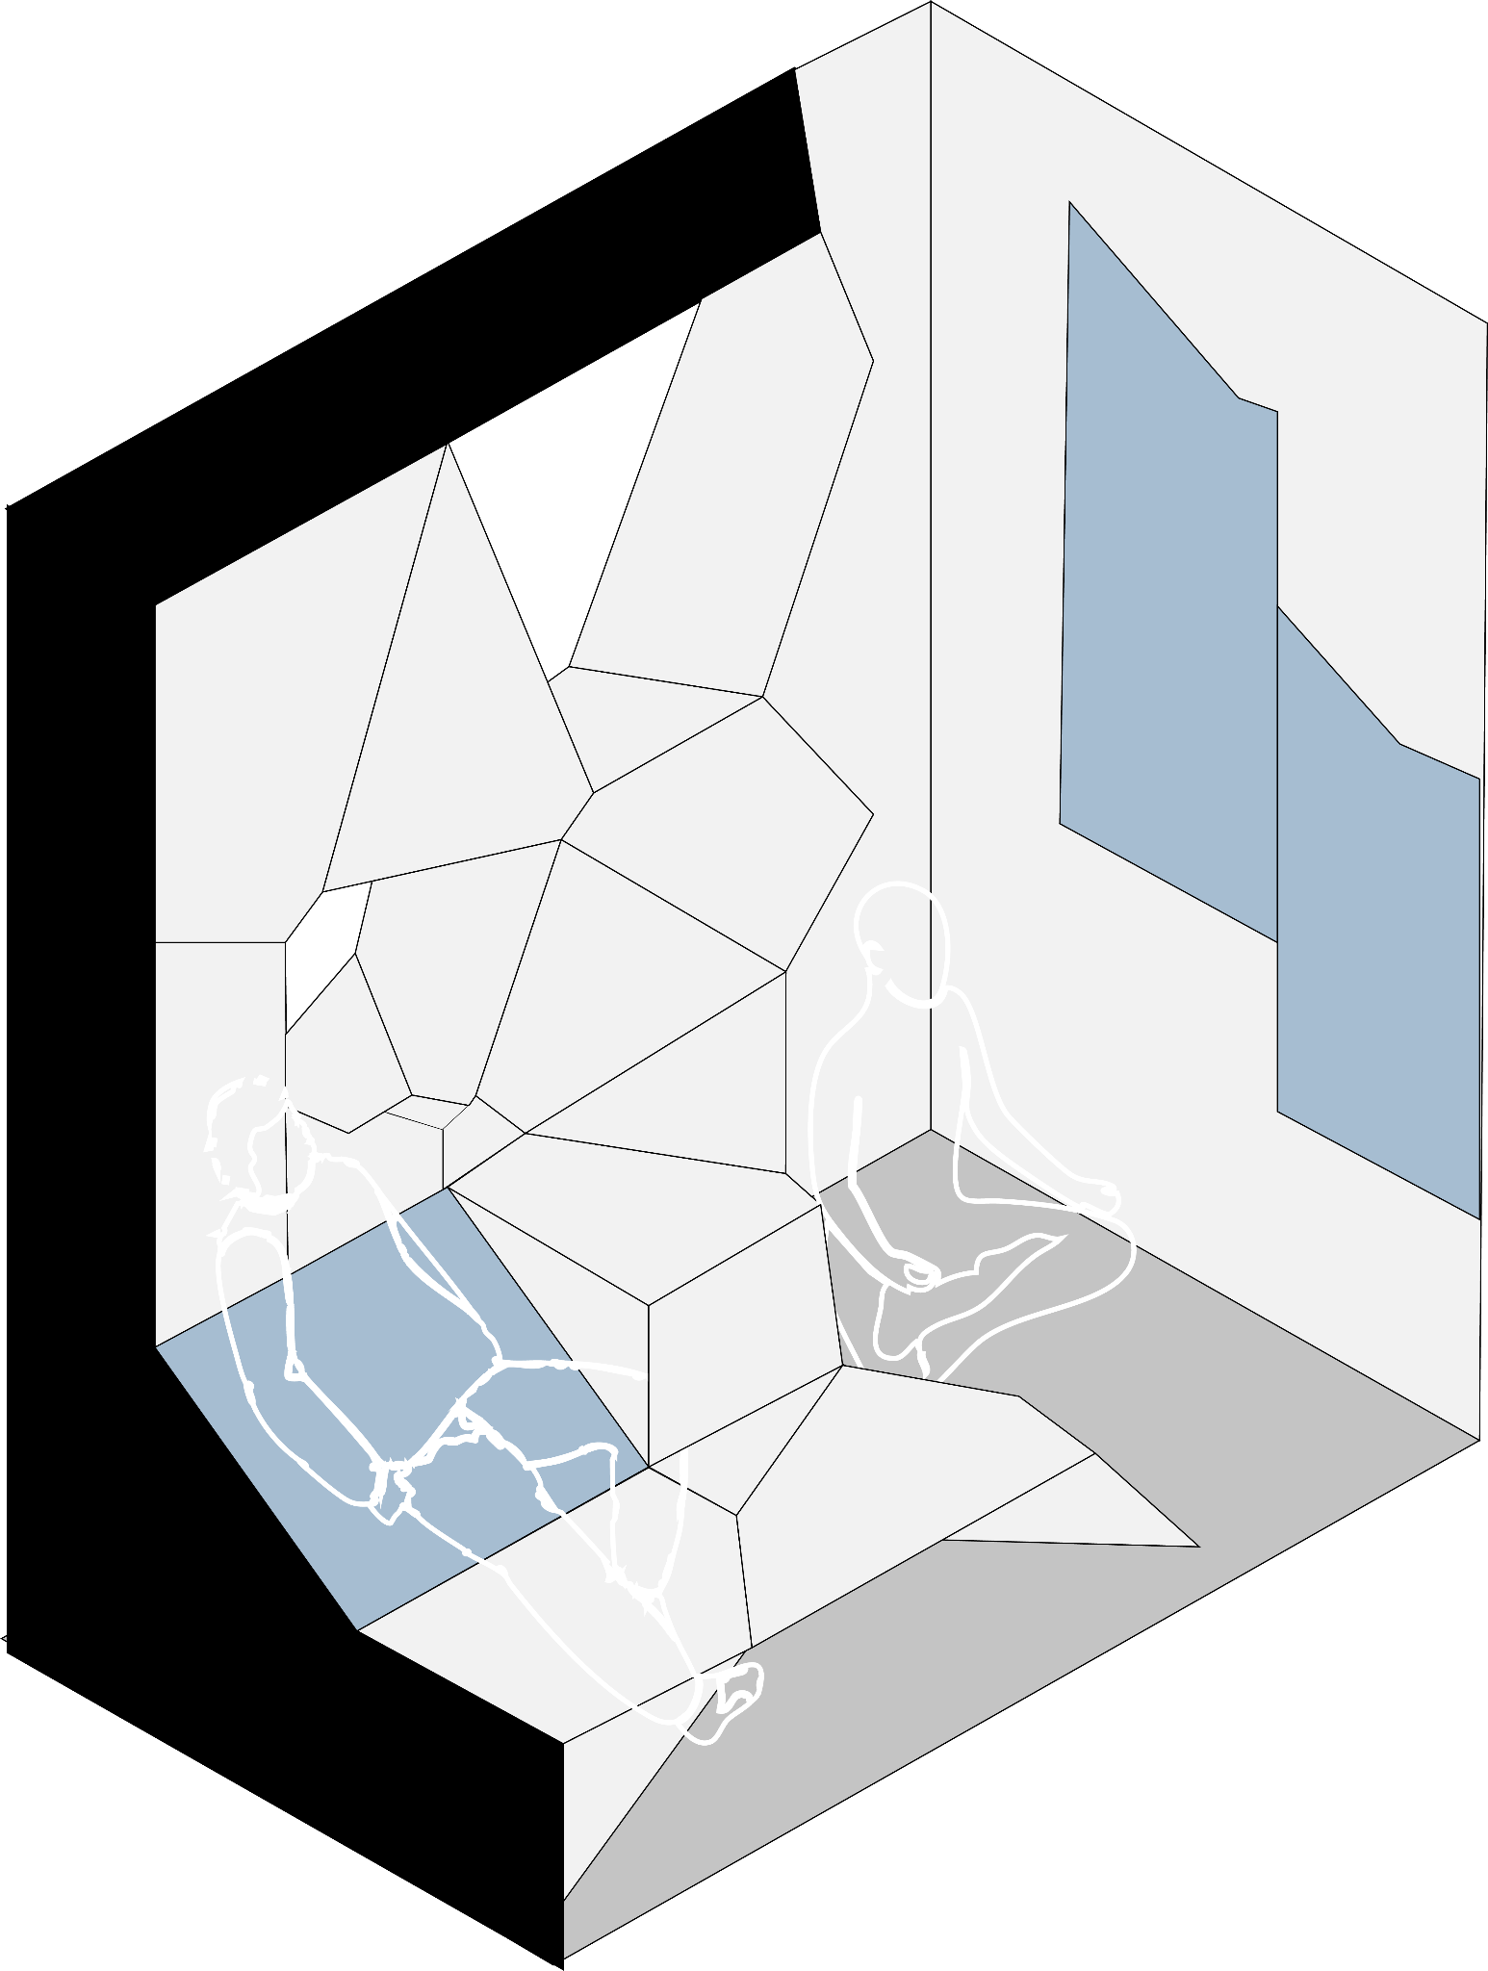
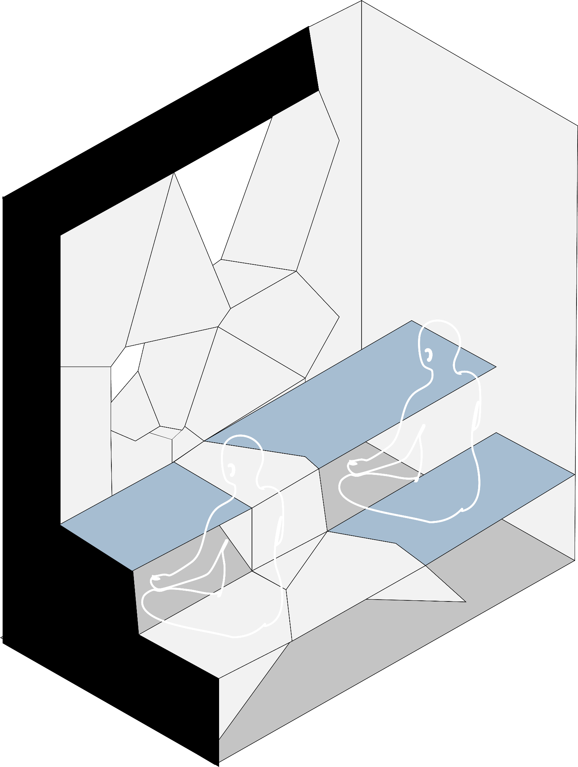
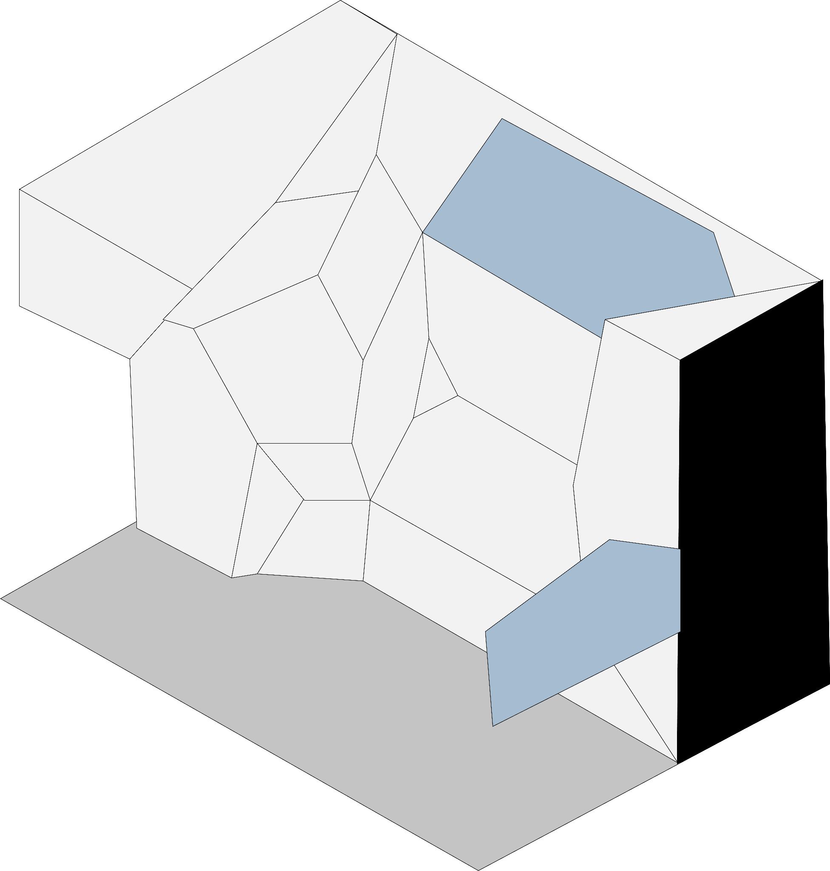
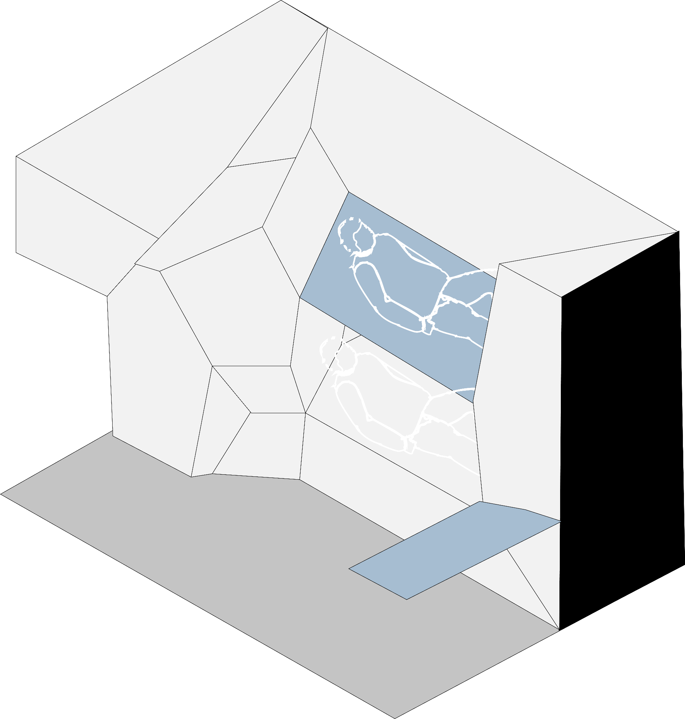
Adaptive space : variations
Meditation
Sleep
Sofa
Co-working

Slide 11
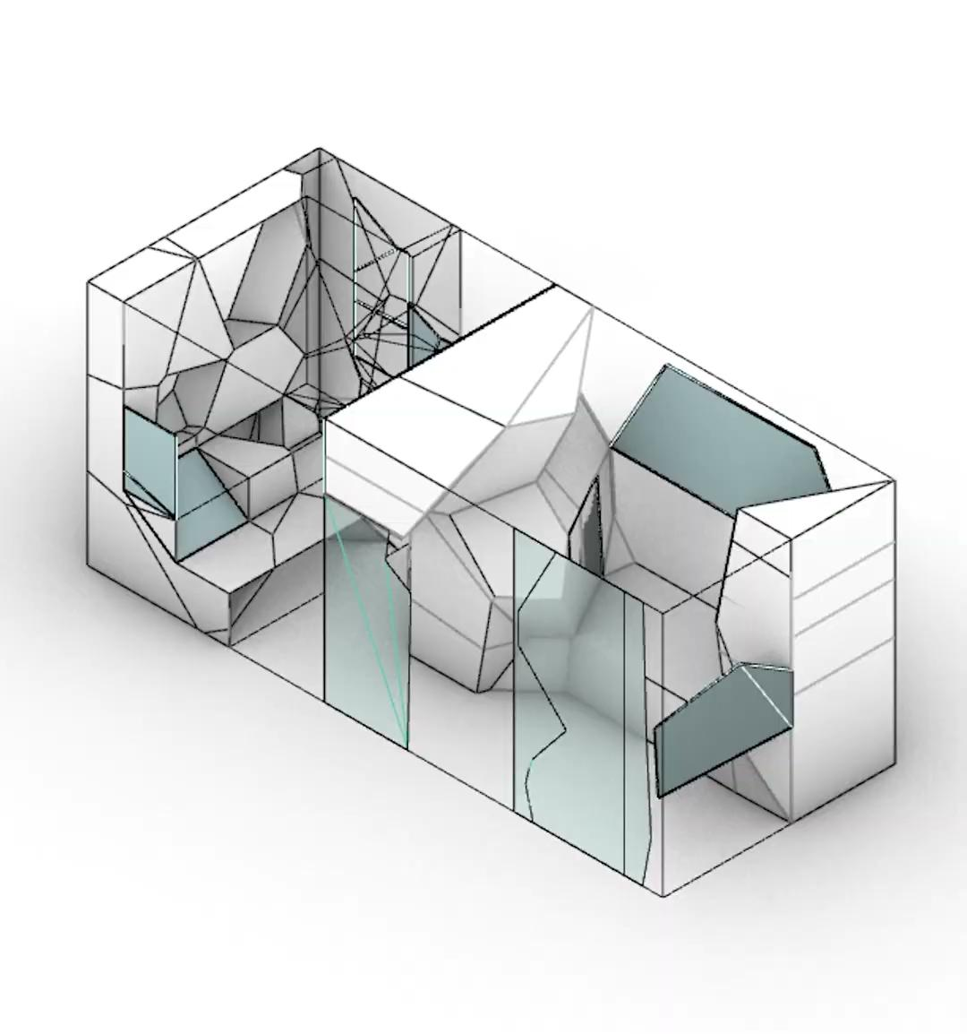
Adaptive space : reconfigurable furniture variations

Slide 12
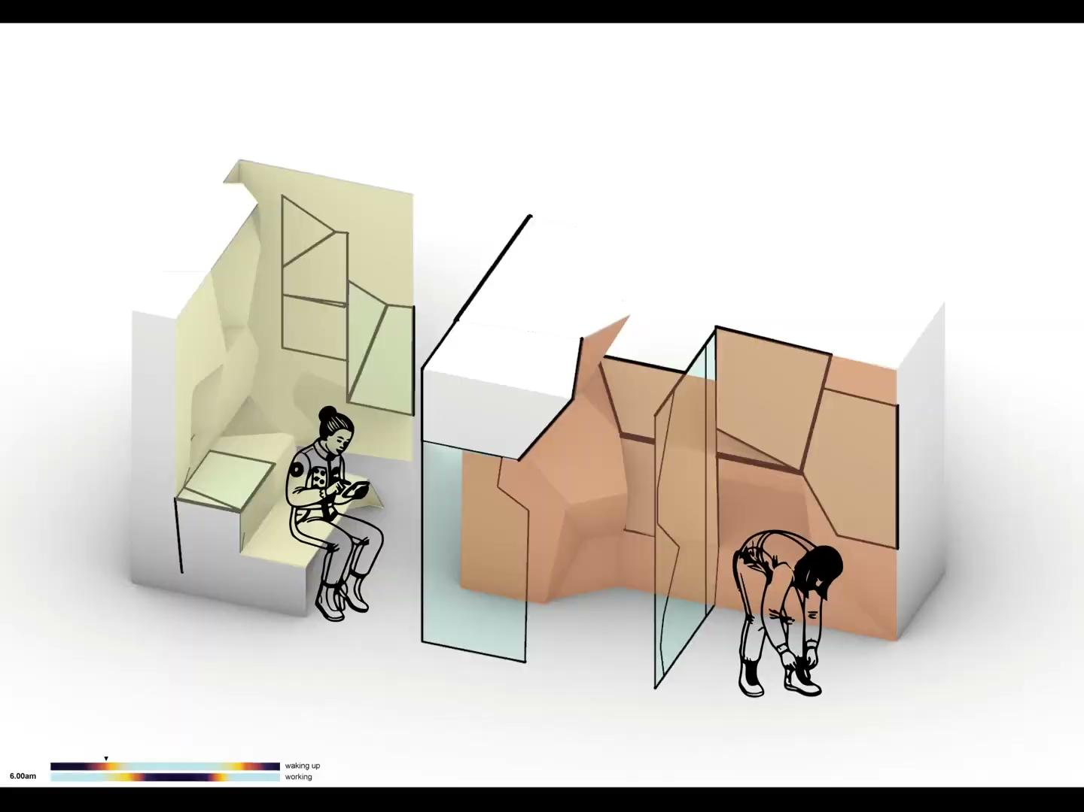
24h of lighting needs
hp. extreme environmental conditions [antarctic winter storm], imposed confinement 24/7.

Slide 13
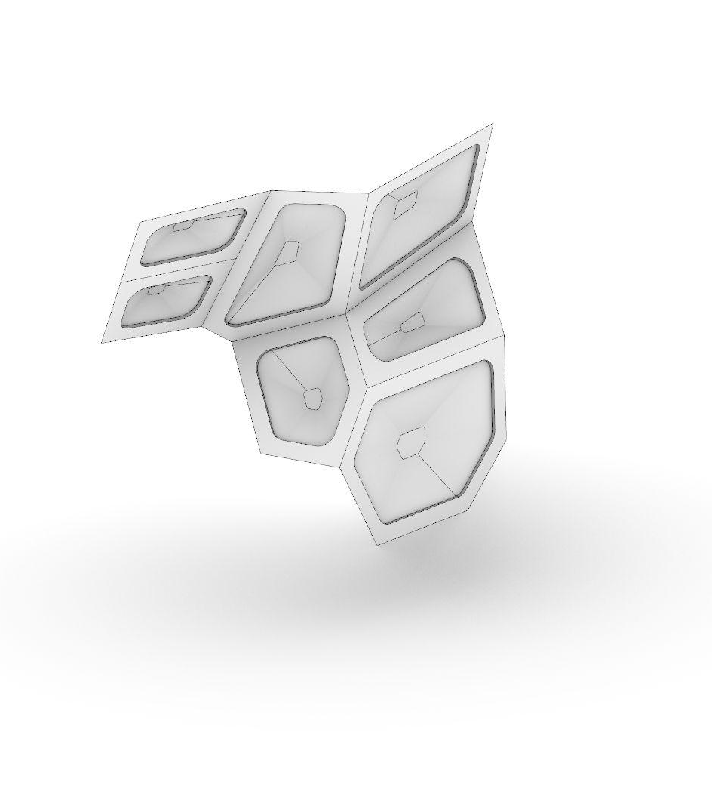
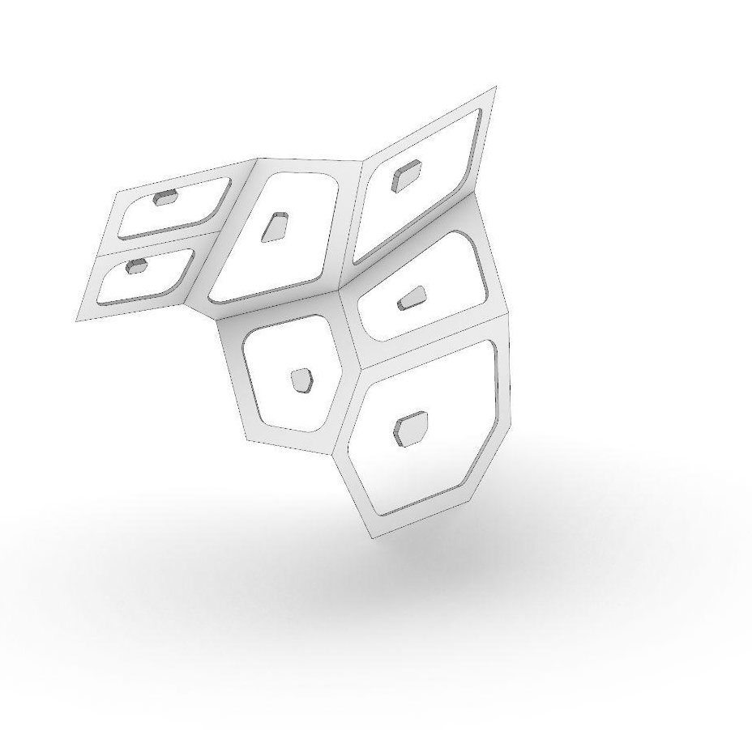
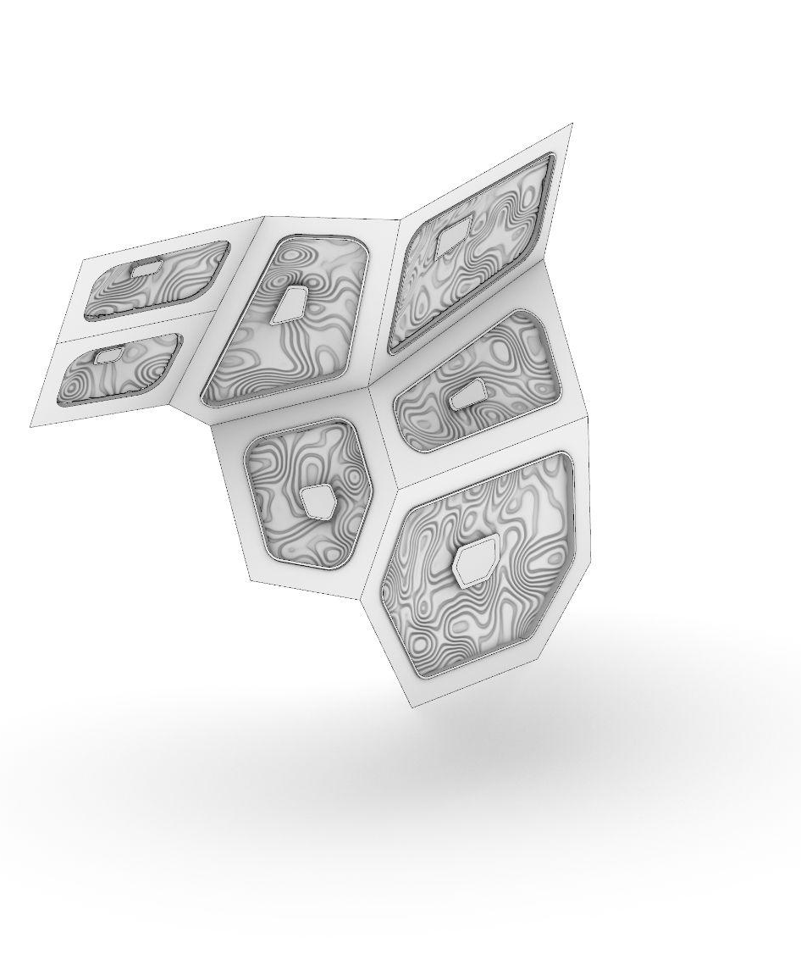
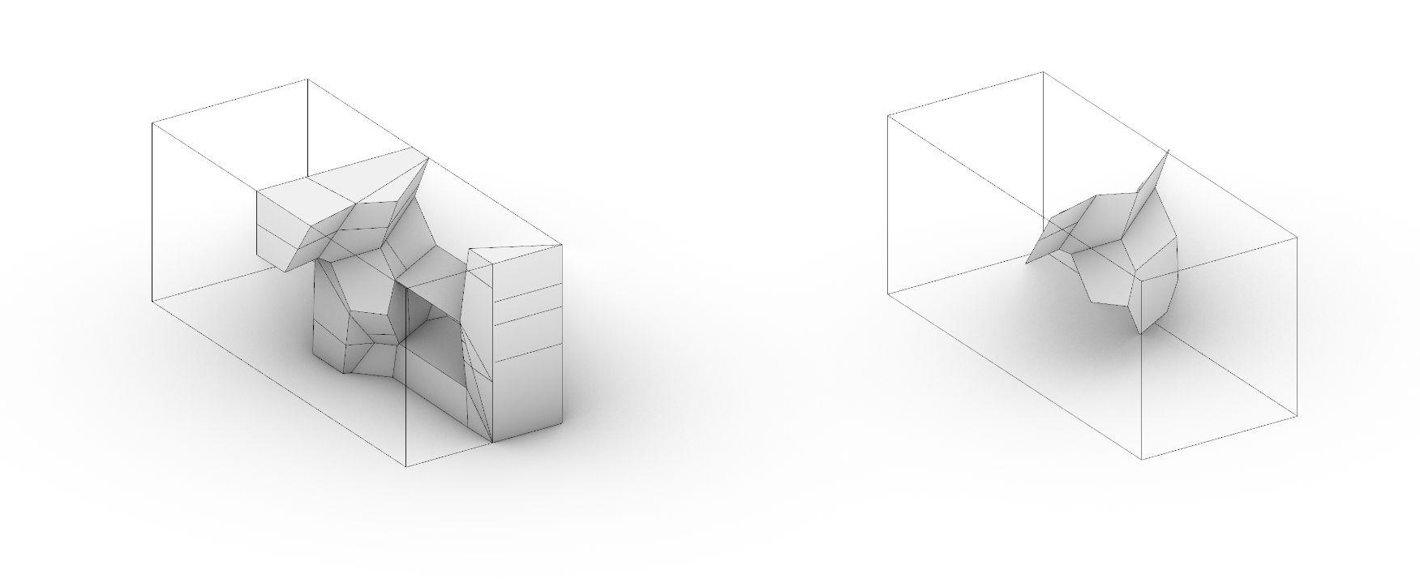
Geometry
Starting geometry​
Habitat for two
Extracted surfaces
Habitat for two
General Geometry
Structure + Light Points
Version 3.0
Starting surfaces are divided into 2 elements. Light surface and structural surface.
Based on the Arwins tutorial the structural optimisation is run on the edges of the panels that are shown above.
A seamless fusion of light and texture: these waved panels double as acoustic cushions, providing both visual depth and enhanced auditory comfort.

Slide 14
Geometry
/// On the container scale

Slide 15
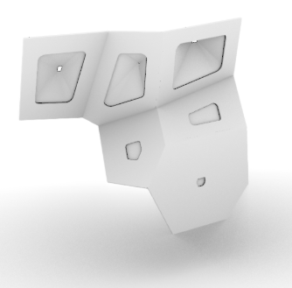
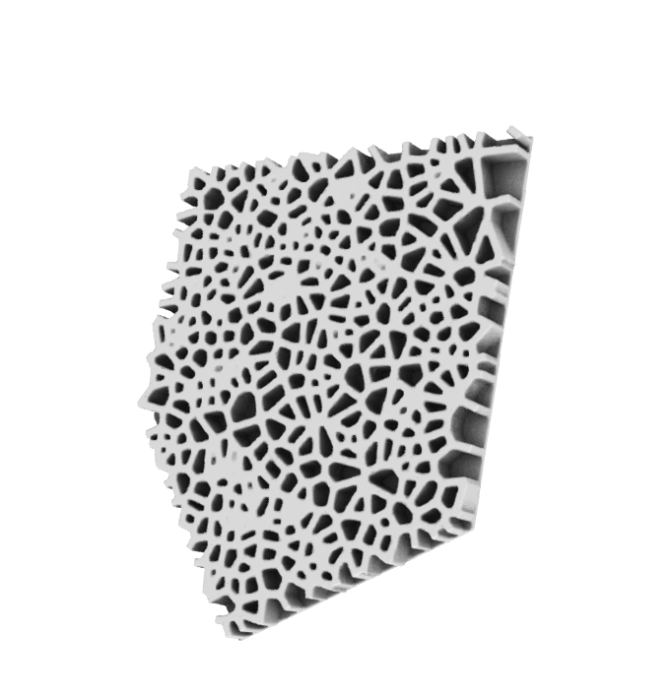
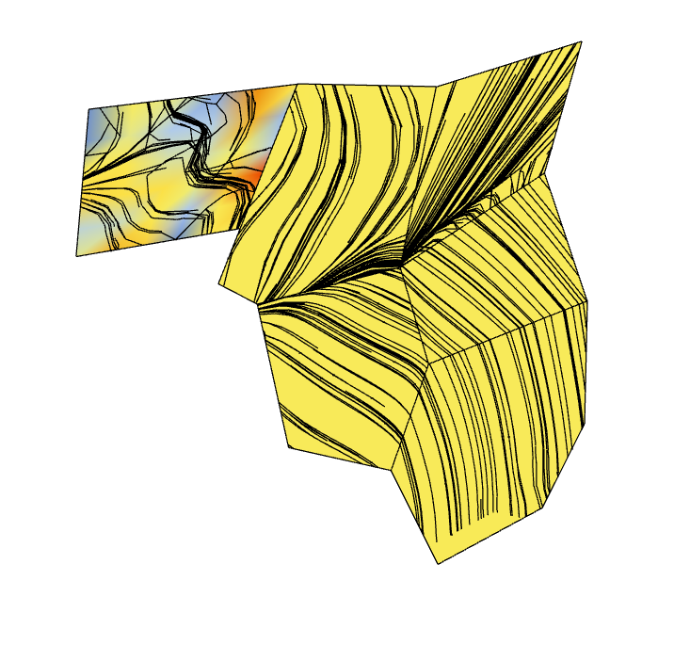
Voronoi-based structural reinforcement [WIP]
Light to panel ratio
To mimic a natural light distribution, the density of light panels is greatest on the ceiling and gradually decreases as they reach the lower levels.
Correlation Between Panel Aspect Ratio and Structural Efficiency
Structural optimisation of the panel
To minimze the use of the material and also the weight of the panels structural optimisation have been used only on the edges of the panels.
As a panel’s height-to-width ratio increases, its geometric efficiency improves. This allows the structure to become lighter while maintaining high stability

Slide 16
Ai light implementation
Explain how we use the ai model in our lighting scheme
show what happens inside and how the outcomes works with the correlation to the biodata

Slide 17
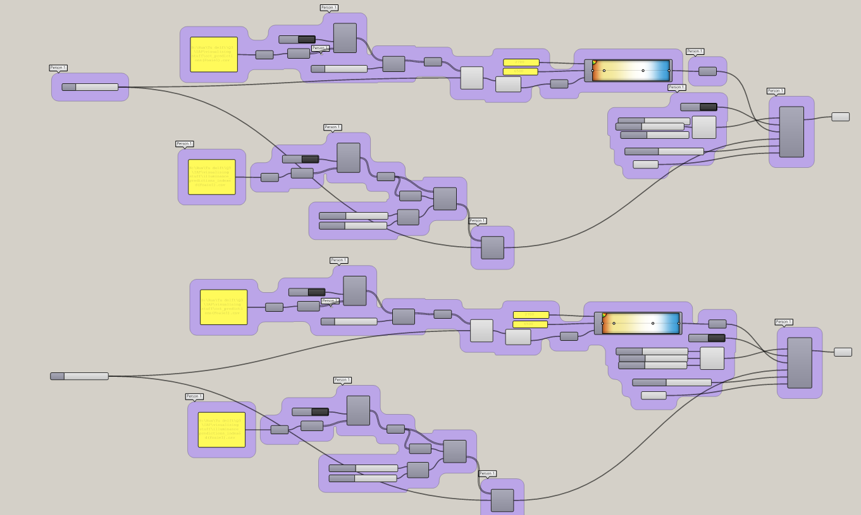
Two schedules - Grasshopper

Slide 18
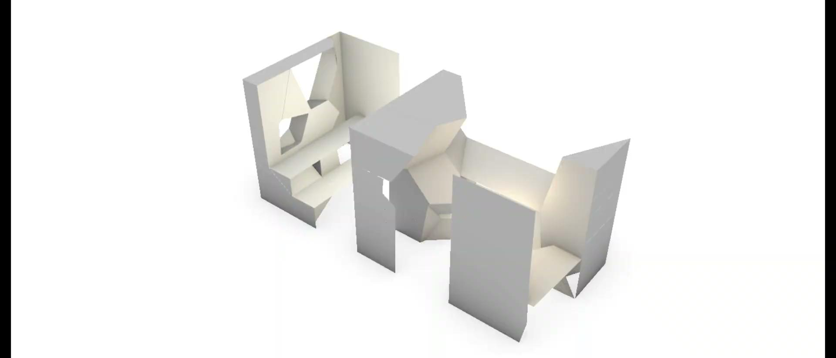
Two schedules

Slide 19
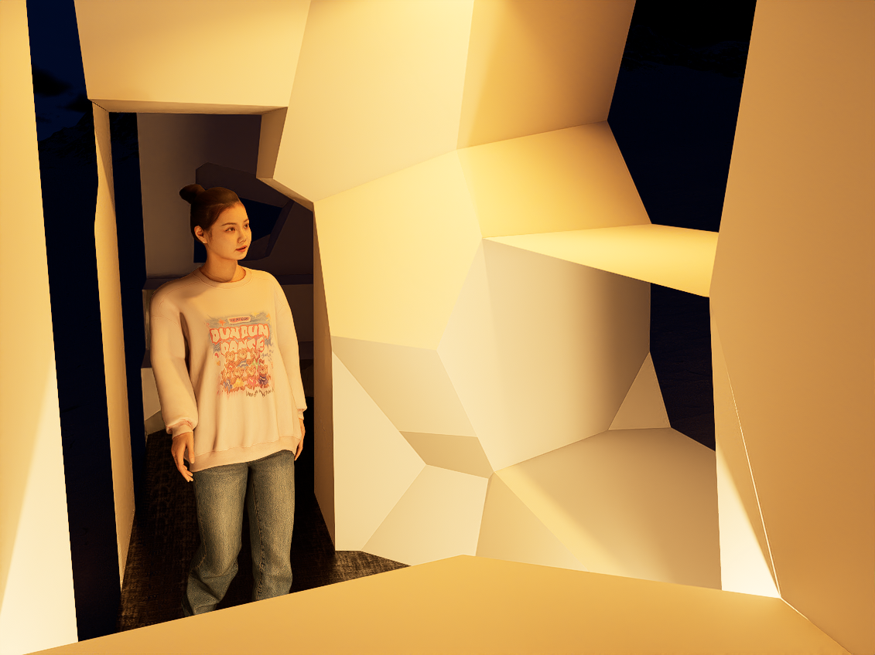
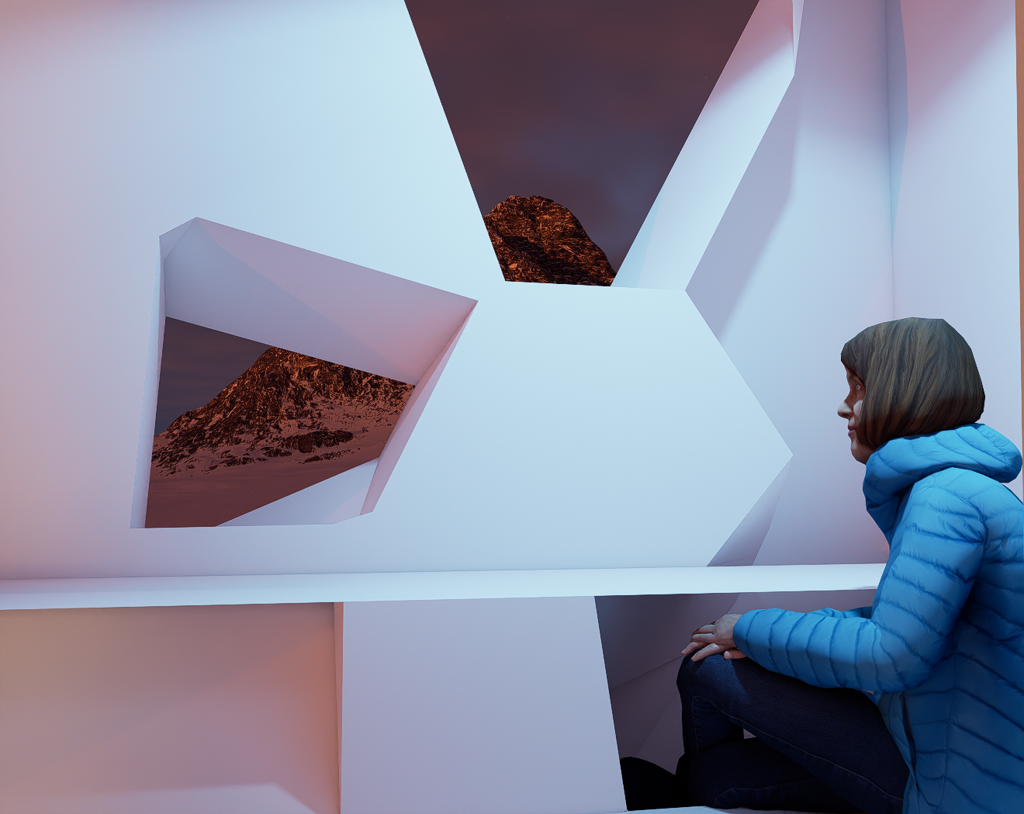
Atmosphere
Angela
Brenda

Slide 20
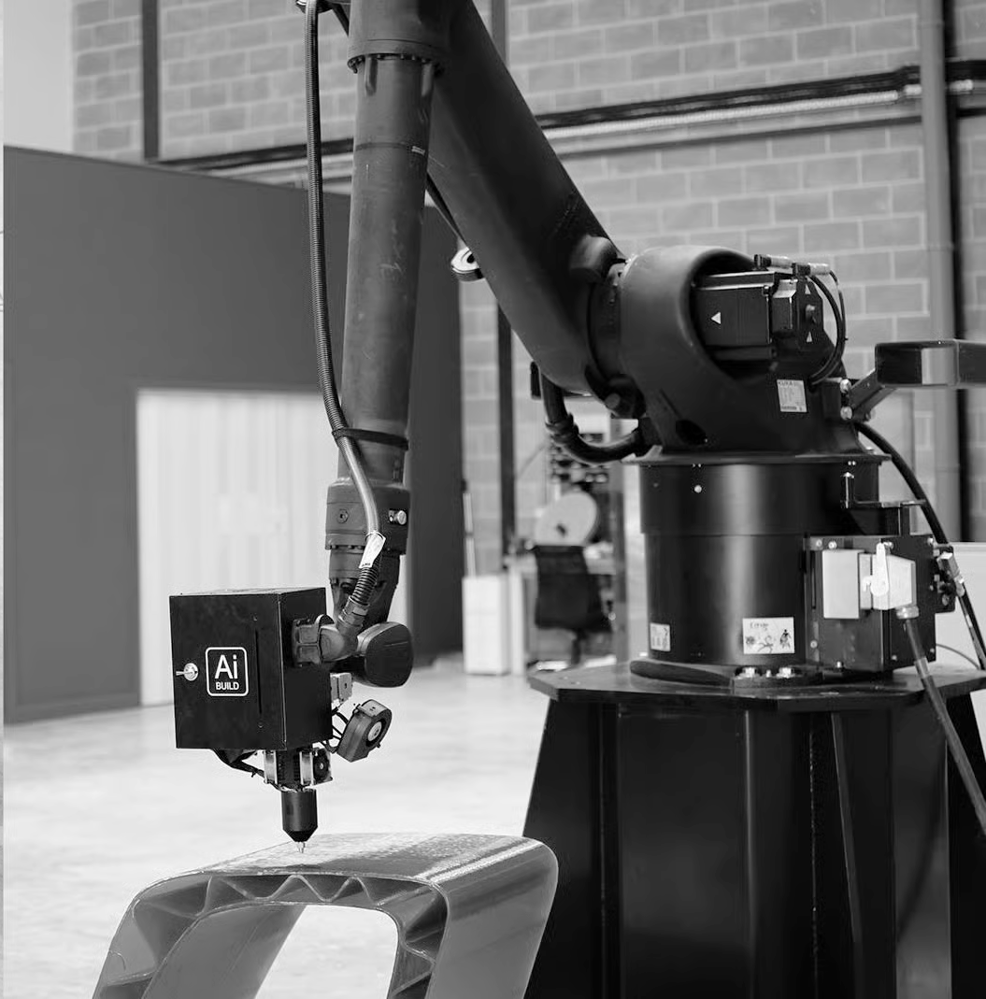
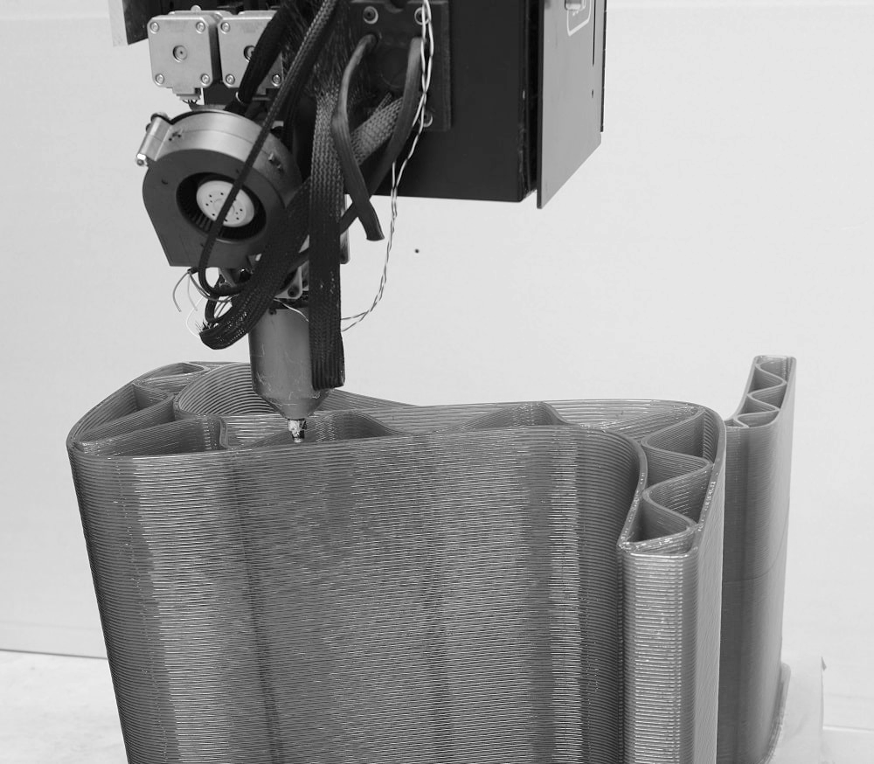
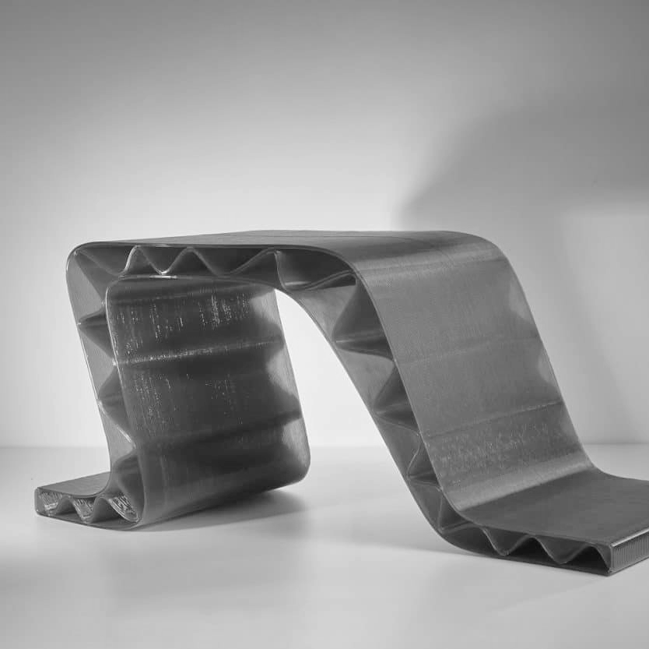
On site manufacturing
KUKA robotic arm
ReFlow filament from recycled plastic bottles
furniture made by recycled plastic
credits: Kuka, ArchiExpo e-Magazine

Slide 21
Geometry
geometry + steps + explanation

Slide 22
Prototype geometry
geometry + steps + explanation

Slide 23
Prototype geometry
connections
WITH FURTHER CONSIDERATIONS

Slide 24
Prototype geometry
SHOW THE FURTHER CONSIDERATIONS ON DESIGN PATTERNS POSSIBLE

Slide 25
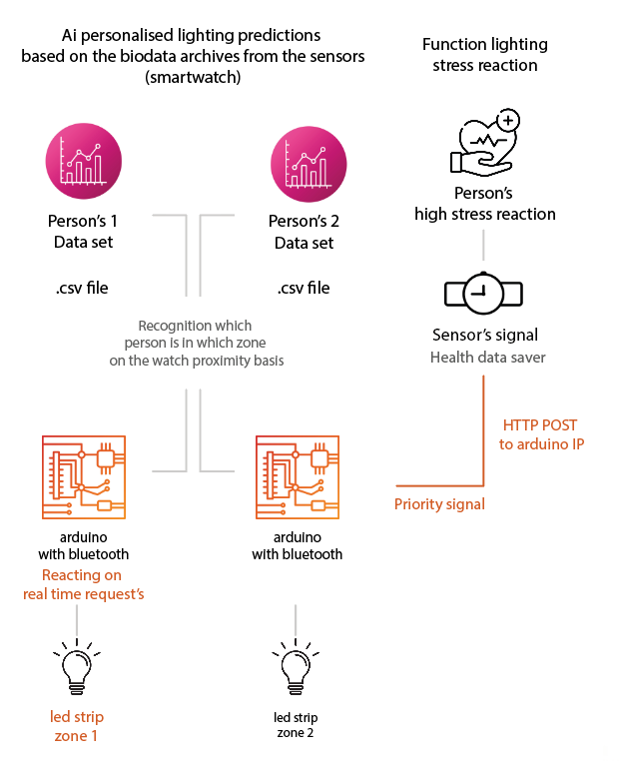
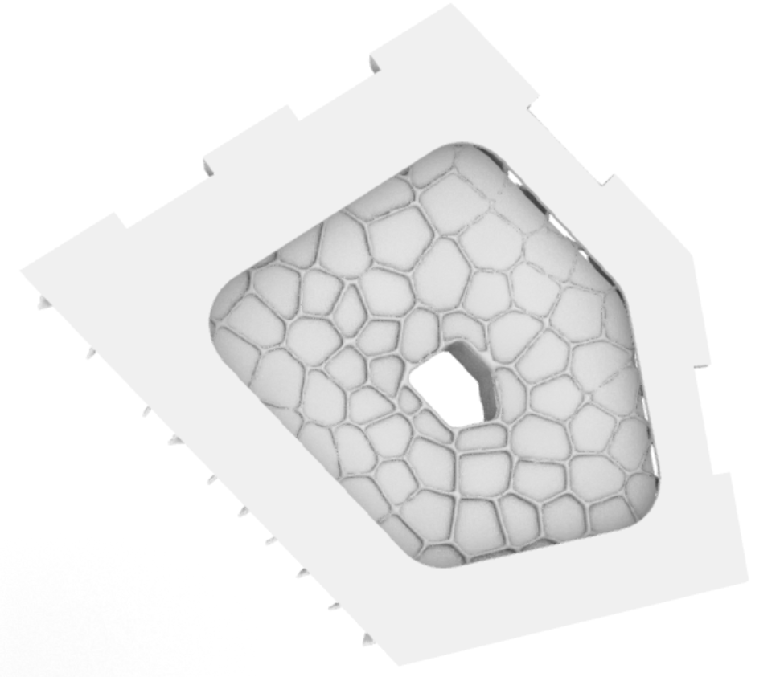
Light implementation
Two LED strips represent the two zones
Lighting changes are based on CSV schedule data
Lighting overrides occur in response to real-time stress input

Slide 26
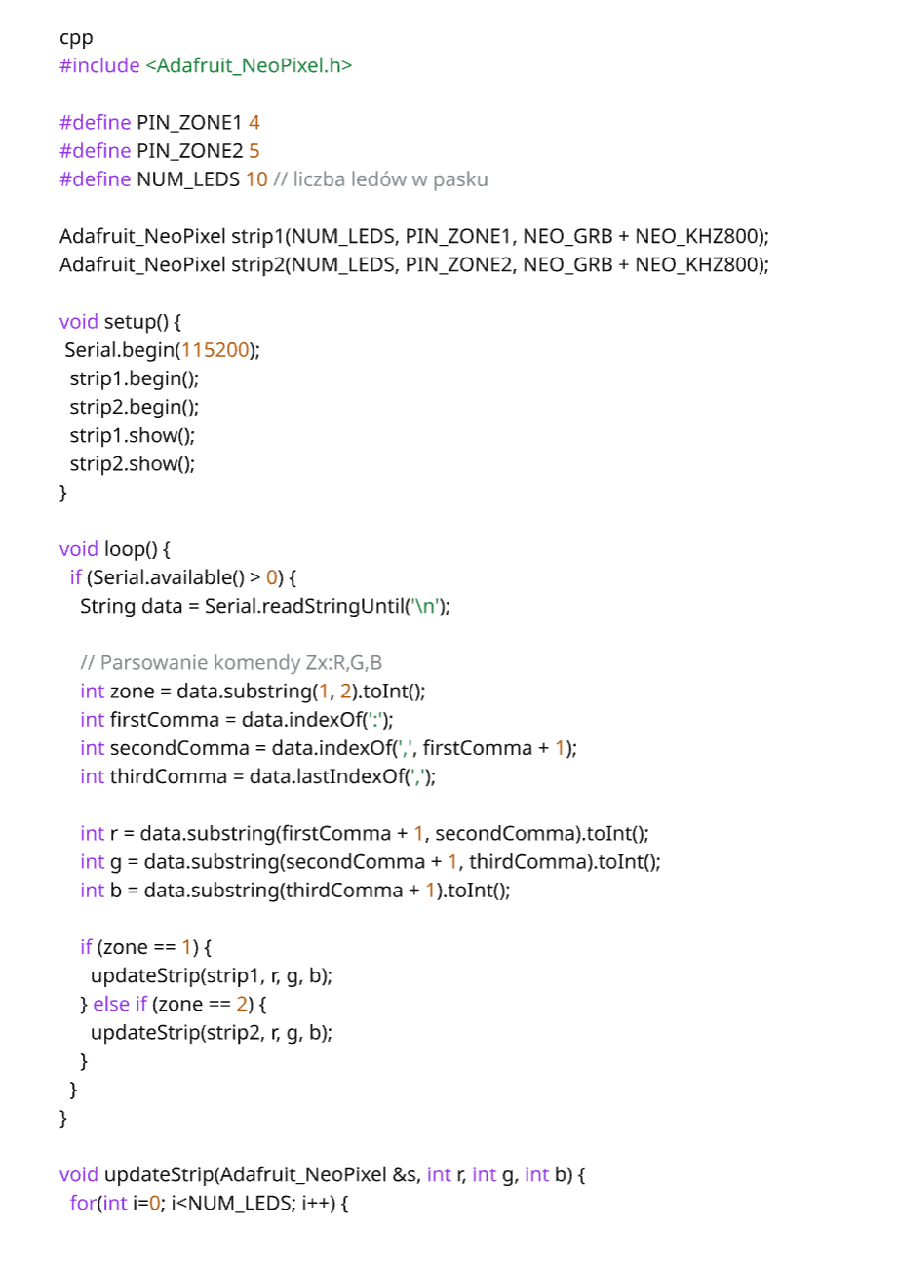
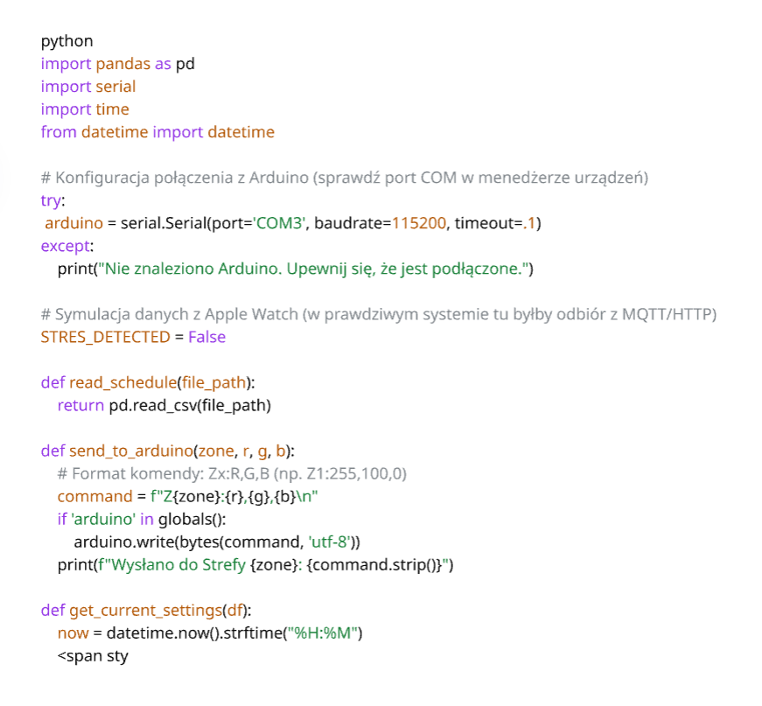
Light implementation
Python script
Arduino (Arduino IDE)
(brain)
as executive

Slide 27
Hardware list
Microcontroller:
1× ESP32 (e.g., NodeMCU or DevKit V1) with built in Bluetooth and wiffi
Lighting (Zones)
2× Addressable LED strip WS2812B (NeoPixel):
Short segments are sufficient (e.g., 10–30 LEDs per zone). These allow you to control each LED individually using only a single data wire.
Alternative:
2× RGB LED modules (if you only need point-based lighting instead of full strips).
Power Supply
5V Power supply (minimum 2A–3A):
LED strips draw a significant amount of current. Do not power longer strips directly from a computer USB port or Arduino, as this may damage the device.
USB-C or Micro-USB cable:
For programming the ESP32 and communication with Python.
Others
Breadboard:
For connecting components without soldering.
Jumper wires (male-to-male and male-to-female):
Around 20 pieces.
1000µF 6.3V capacitor (optional):
Protects LED strips from voltage spikes.
330Ω resistors (2 pieces):
Placed between the microcontroller pin and the LED strip data input (to protect the pin).

Slide 28
Prototype
show the video or sth:

