Slide 1

Mission-drivenhabitability
Designing habitats to support mission-driven confinement,​
TROLL Station Containers
Week 3.6
Group 2_ Brendan Exterkate, Gabriel Marks, Giorgia Vercelloni,
Maciej Sachse, Ruxandra Florut, Zuzanna Schleifer, Long Ki​

Slide 2
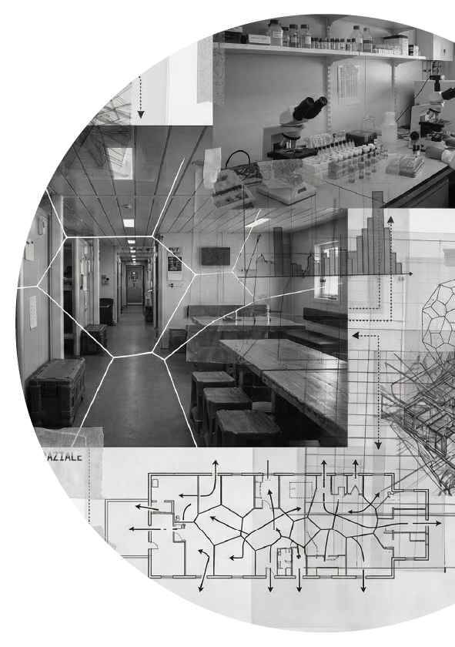
Index
_Environmental introduction
_On the project
_Two lives in a volume
_Adaptive space
_24h of lighting needs
_The focus: geometry and light
_Prefabrication process
_Further AI implementation
_Light implementation
_Hardware list
_What next?
_Material considerations

Slide 3
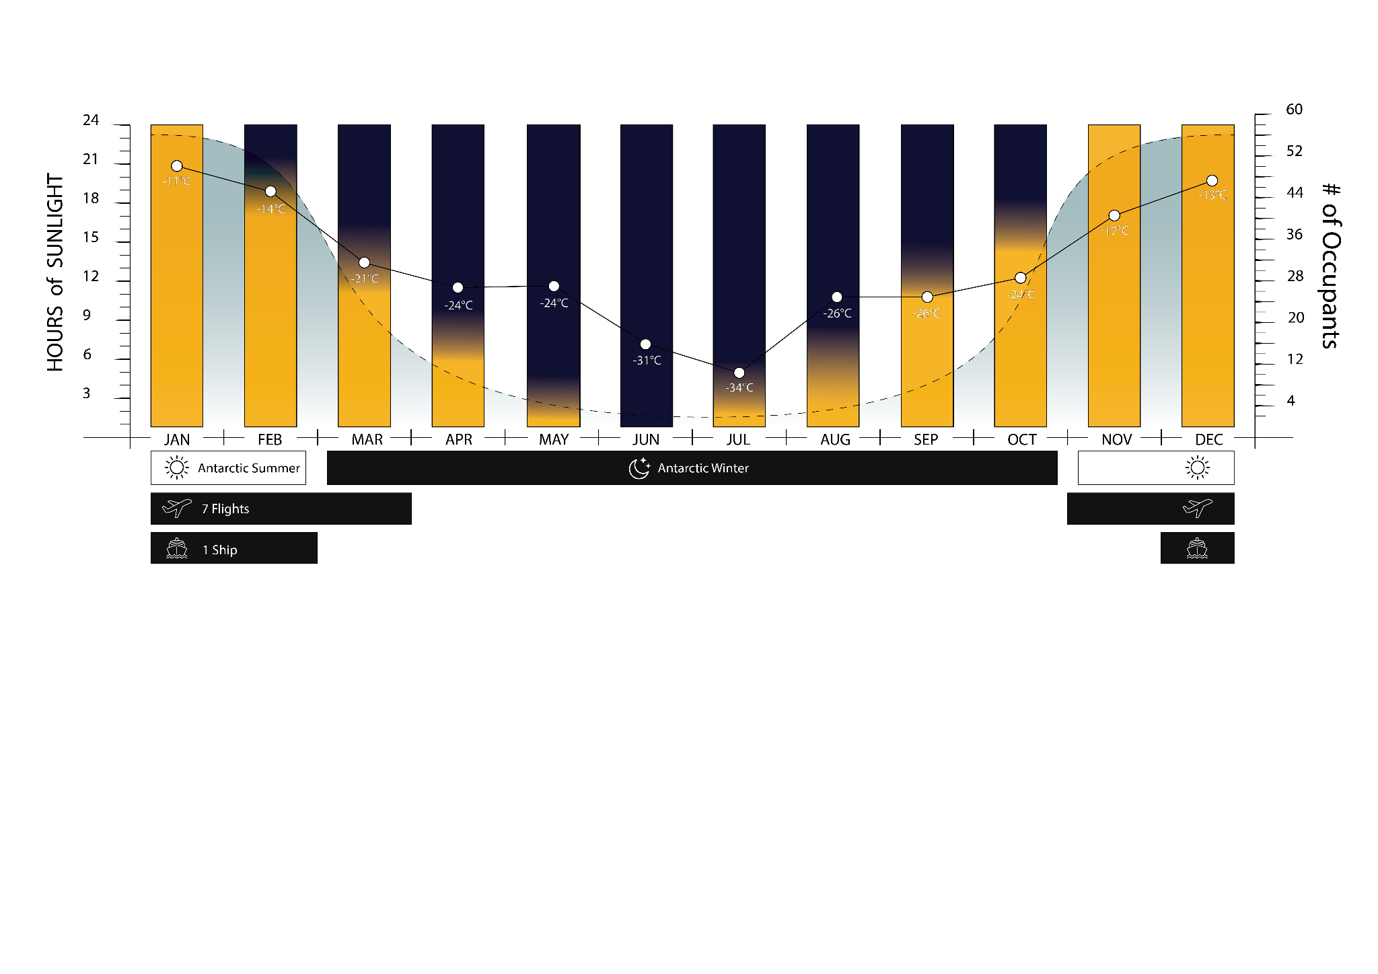
Environmental introduction

Slide 4
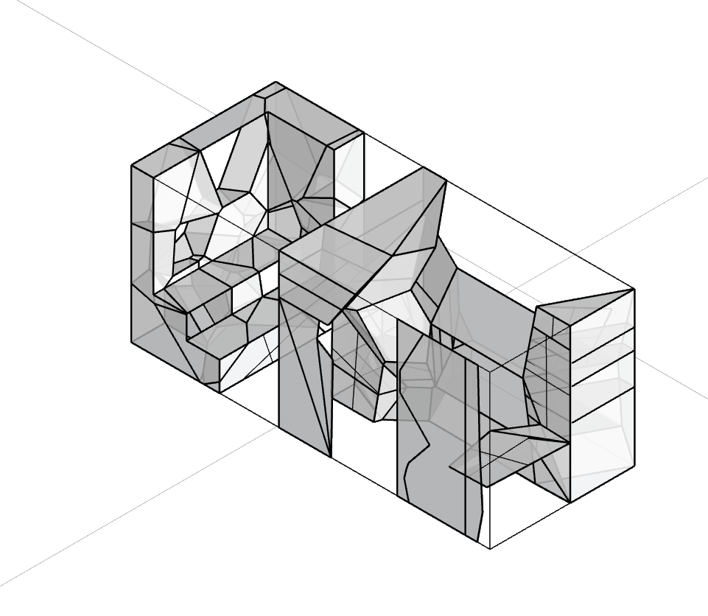


On the project
Voronoi
AI
Lighting

Slide 5
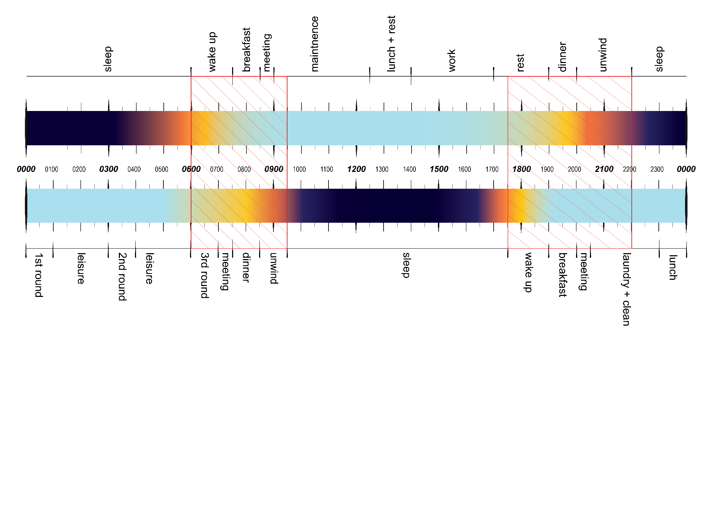
Two lives in a volume

Slide 6

Adaptive space

Slide 7
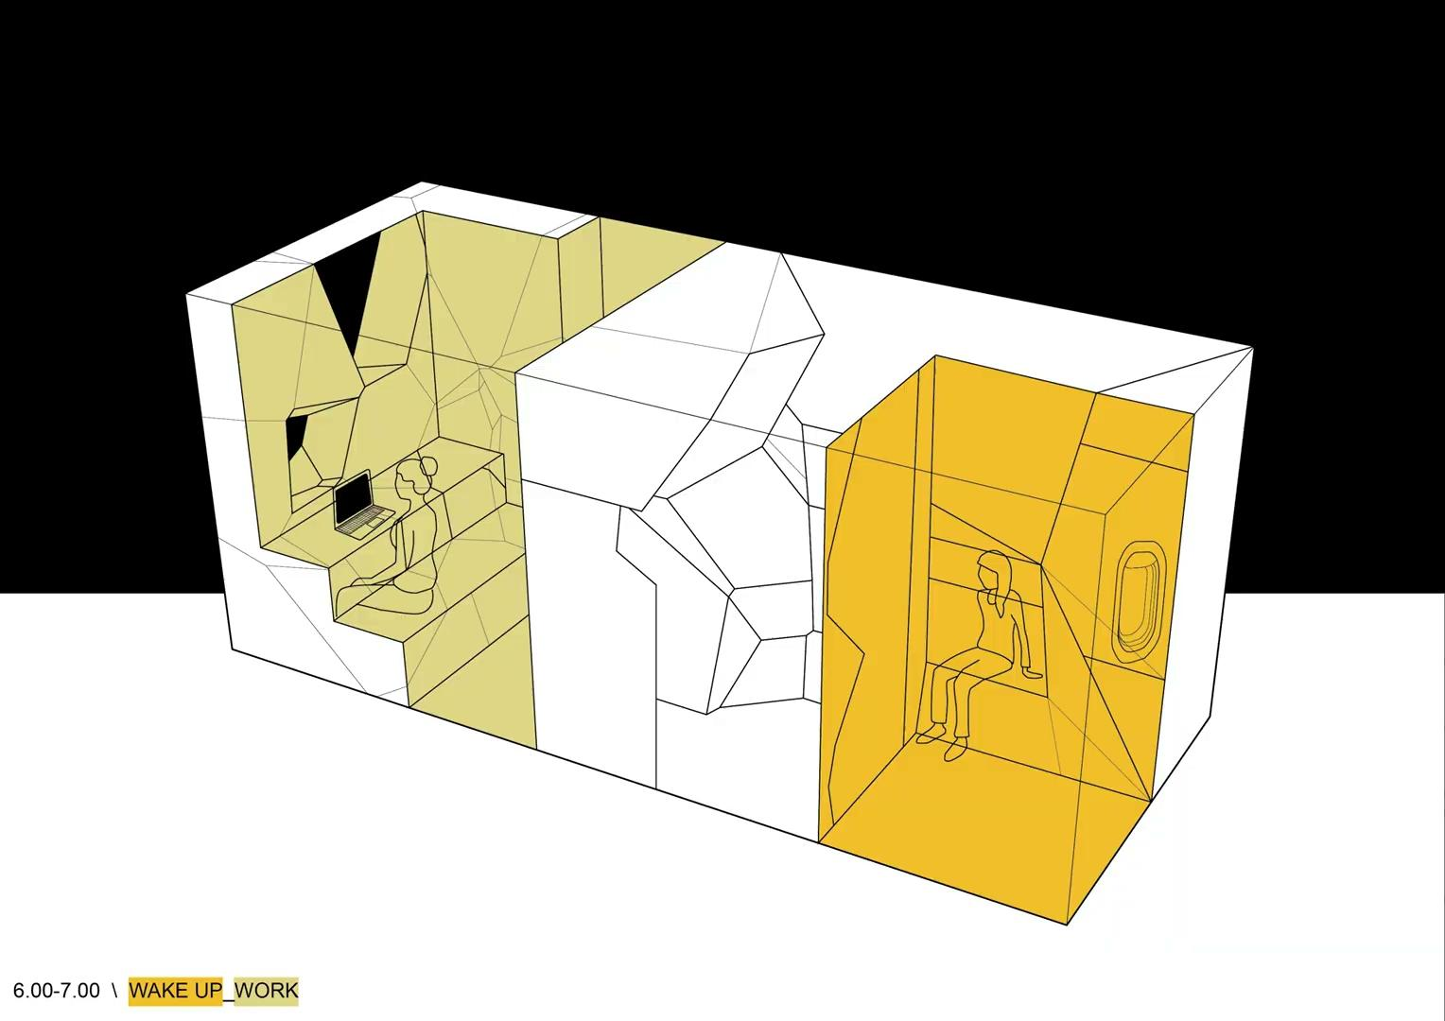
24h of lighting needs
hp. extreme environmental conditions [antarctic winter storm], imposed confinement 24/7.

Slide 8
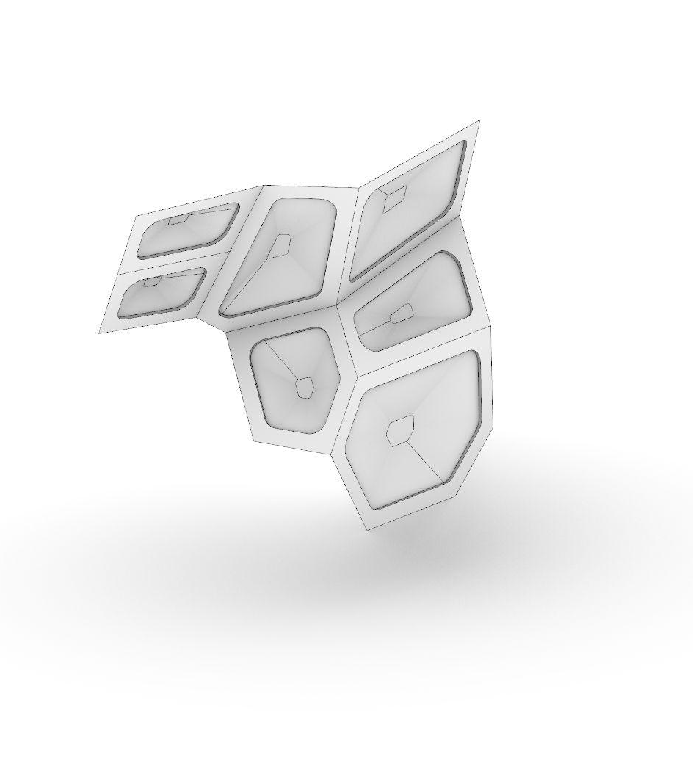
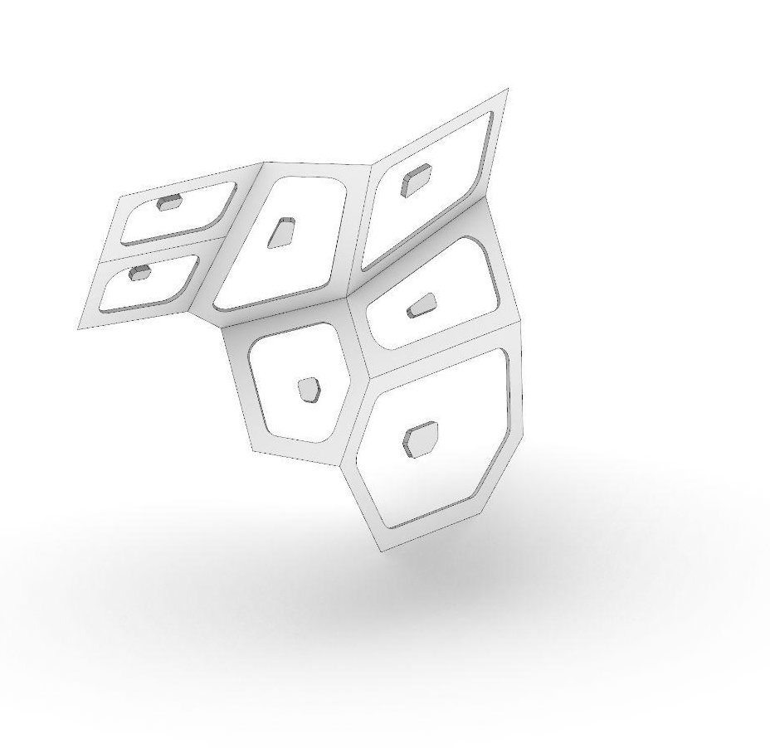
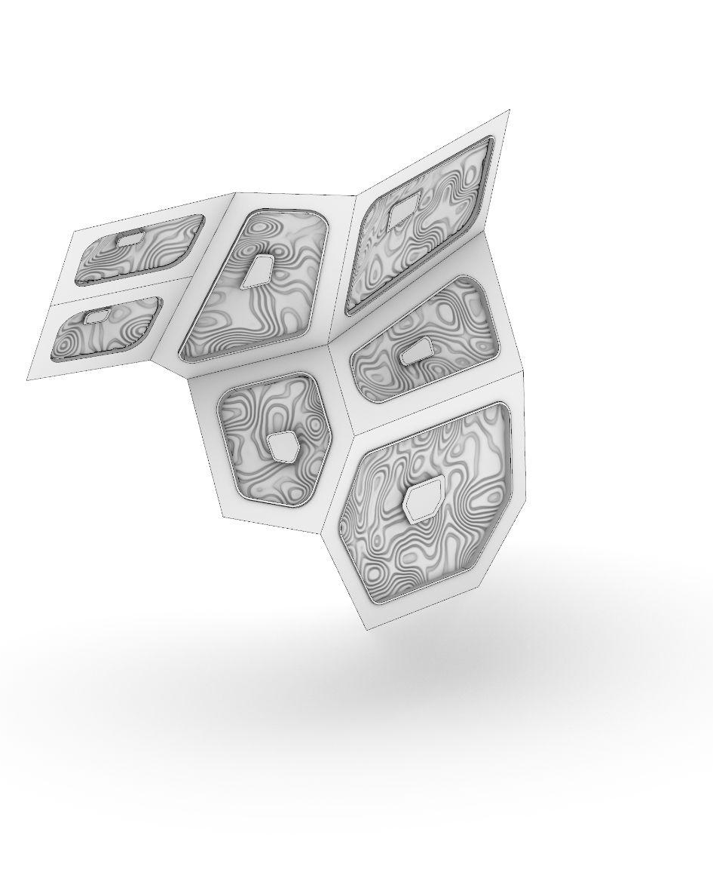
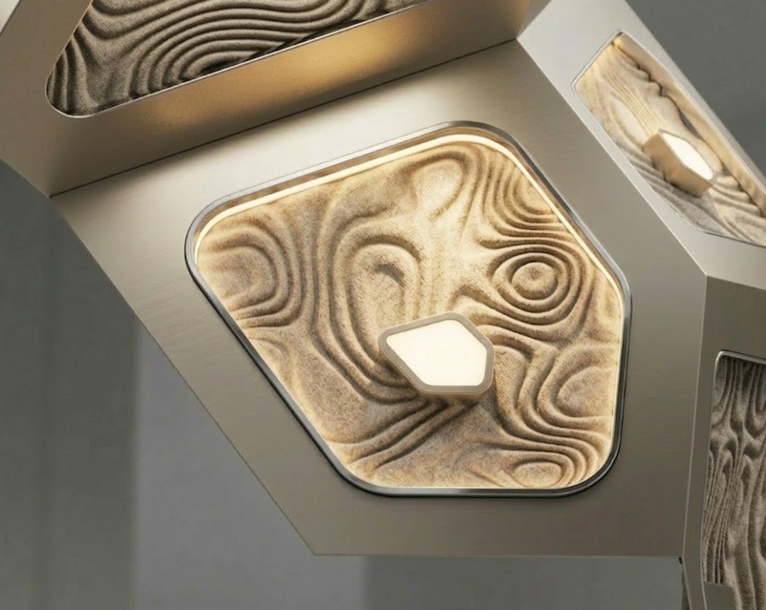
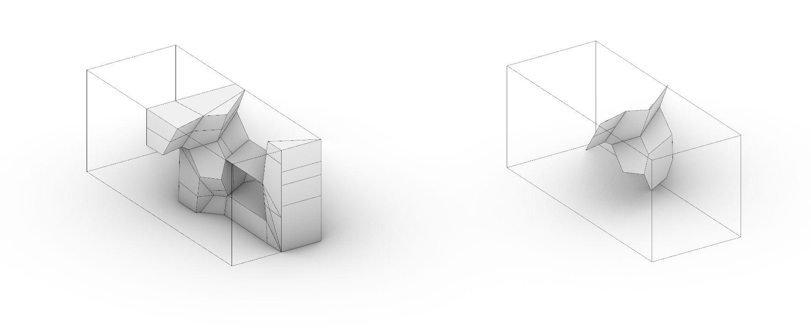
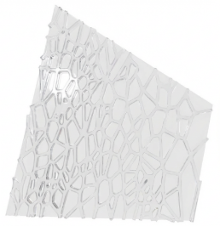
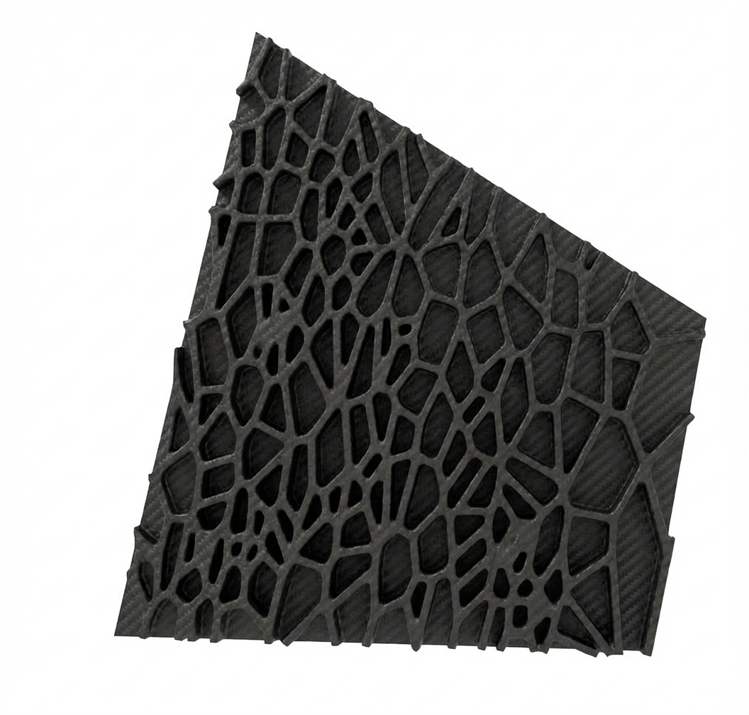
The focus: geometry and light
General Geometry
Structure + Light Points
Version 3.0
Starting surfaces are divided into 2 elements. Light surface and structural surface.
Based on the Arwins tutorial the structural optimisation is run on the edges of the panels that are shown above.
A seamless fusion of light and texture: these waved panels double as acoustic cushions, providing both visual depth and enhanced auditory comfort.
Visualisation of the panel inside the container
Structural optimisation of the panel
To minimze the use of the material and also the weight of the panels structural optimisation have been used only on the edges of the panels.
Starting geometry​
Habitat for two
Extracted surfaces
Habitat for two

Slide 9
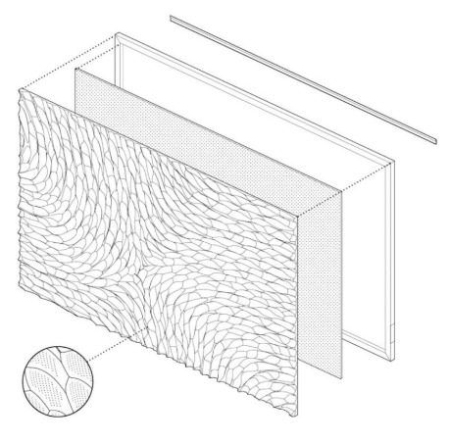
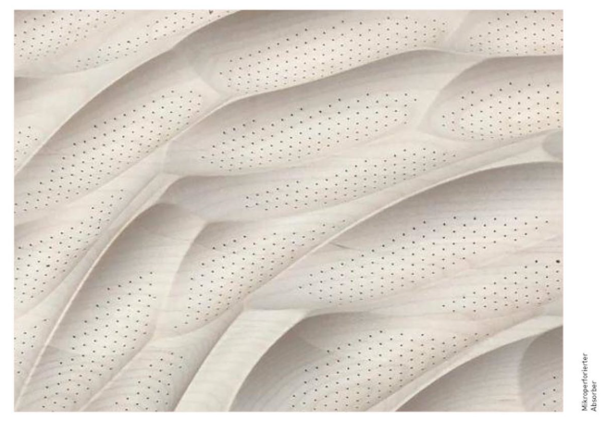
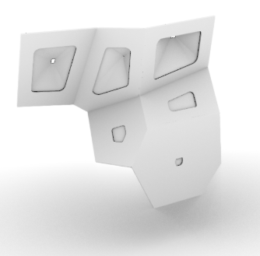
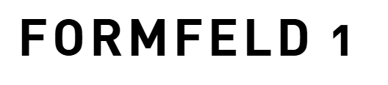
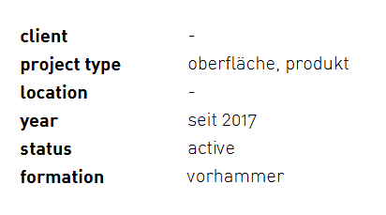
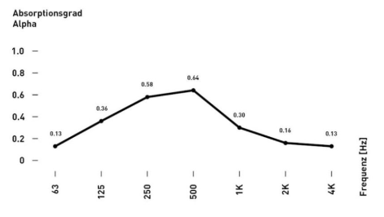
The focus: geometry, light and acoustics!
Light to panel ratio
To mimic a natural light distribution, the density of light panels is greatest on the ceiling and gradually decreases as they reach the lower levels.
images: vorhammer
Correlation Between Panel Aspect Ratio and Structural Efficiency
This panel acts as a mid-frequency tuned absorber, reaching its peak effectiveness (alfa approx 0.64) between 250 Hz and 500 Hz. It is specifically designed to control "boxy" resonances while remaining acoustically reflective at higher frequencies to maintain room liveliness.
As a panel’s height-to-width ratio increases, its geometric efficiency improves. This allows the structure to become lighter while maintaining high stability

Slide 10
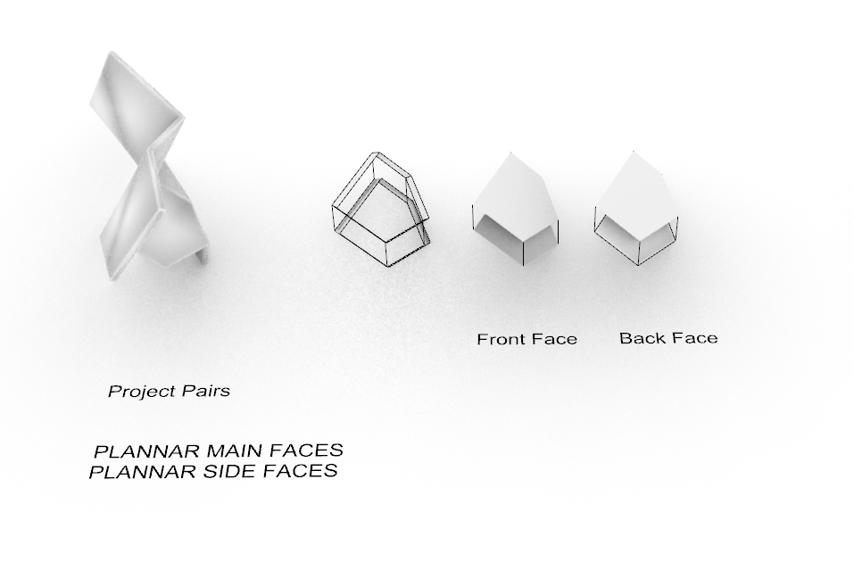
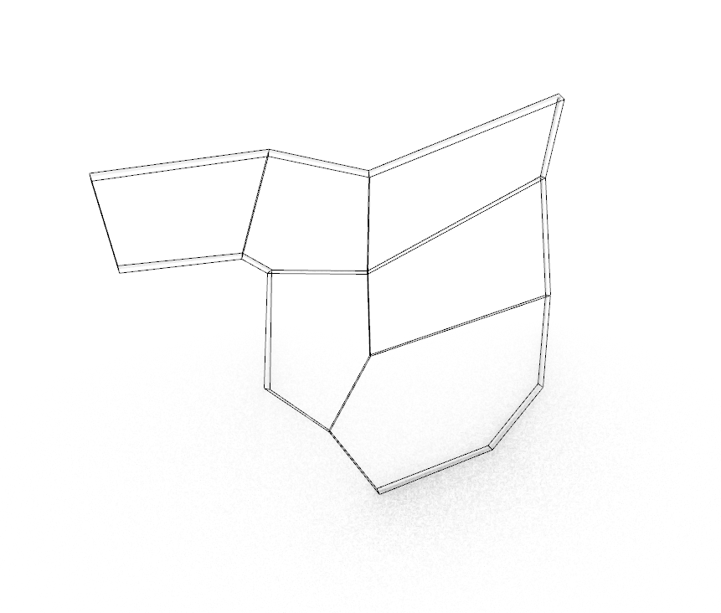
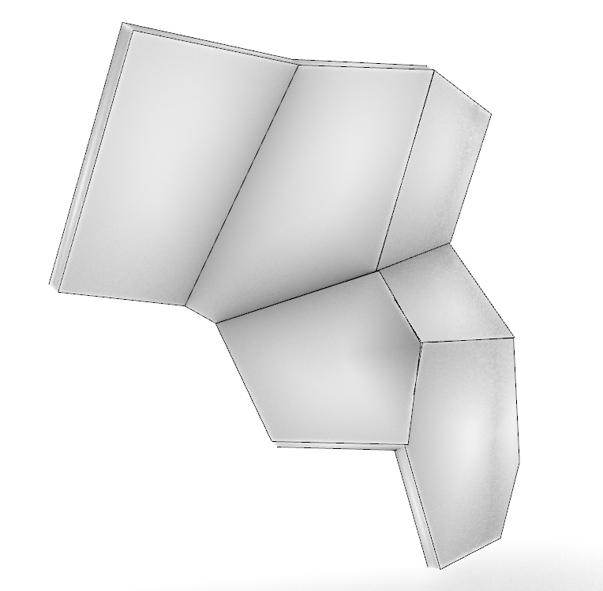
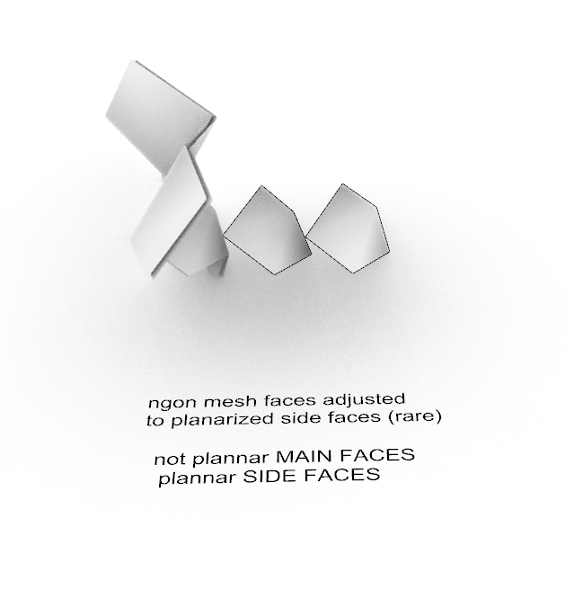
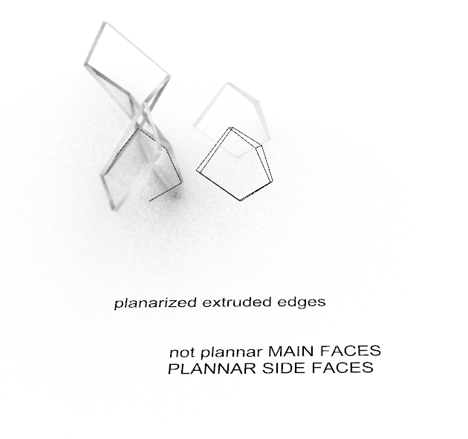
Prefabrication process
Process of planarization panels
planarize extruded edges of the panel
(kangaroo or ngon planarization)
2. Project Pairs - ngon, create flat surfaces maintaining flat flat edge surfeces

Slide 11
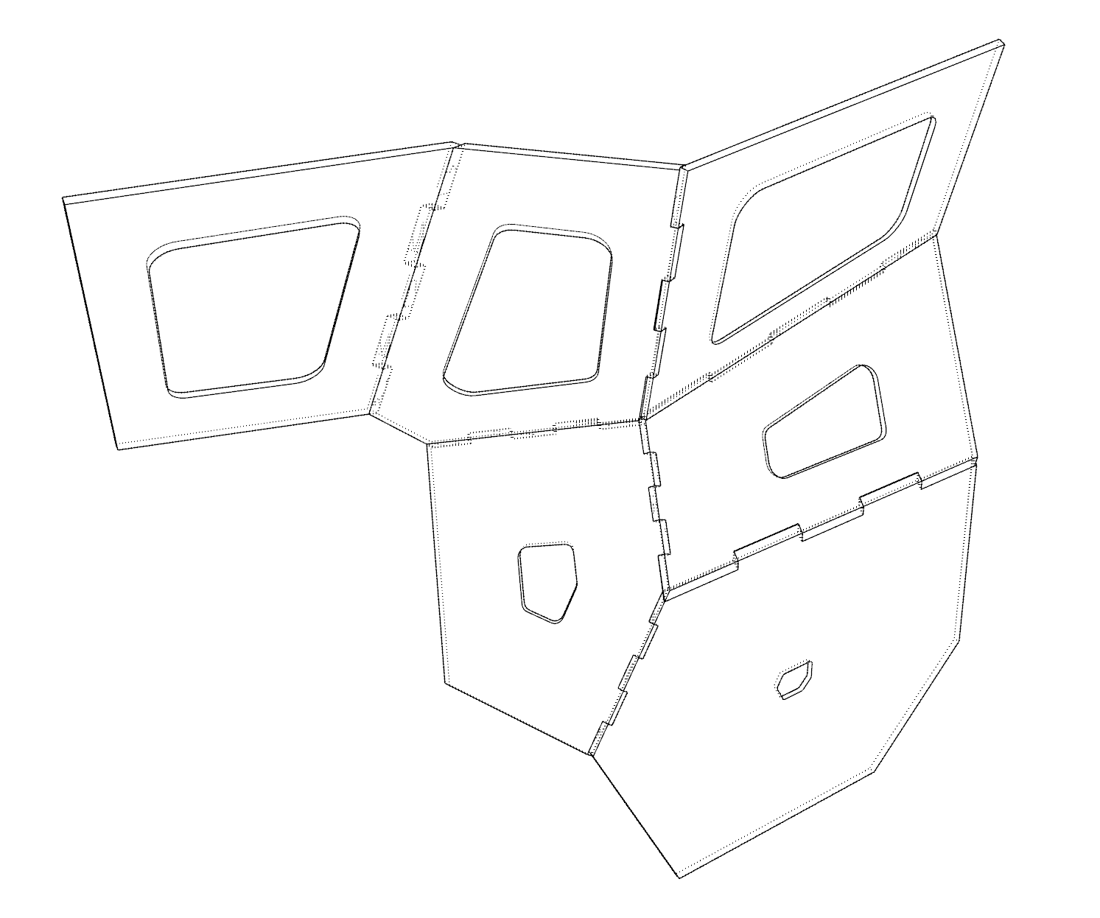
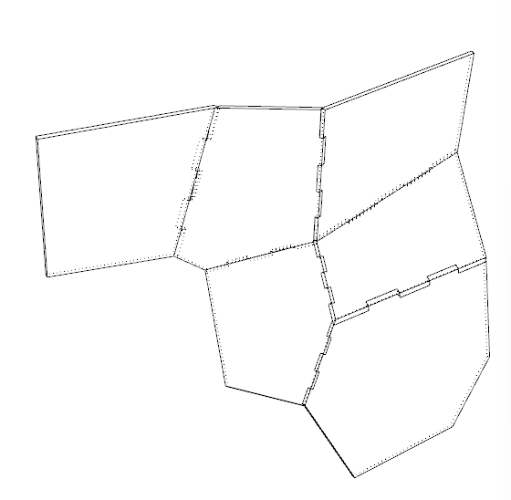
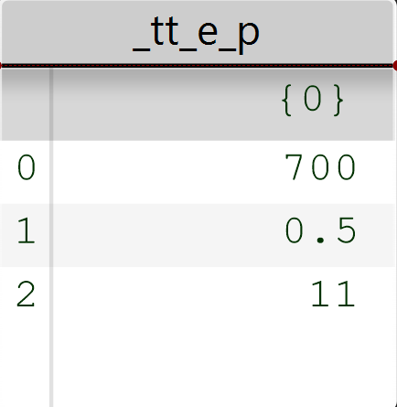
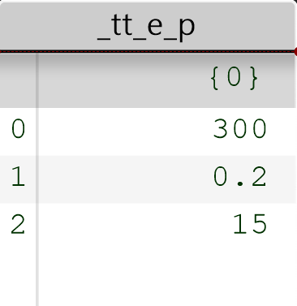
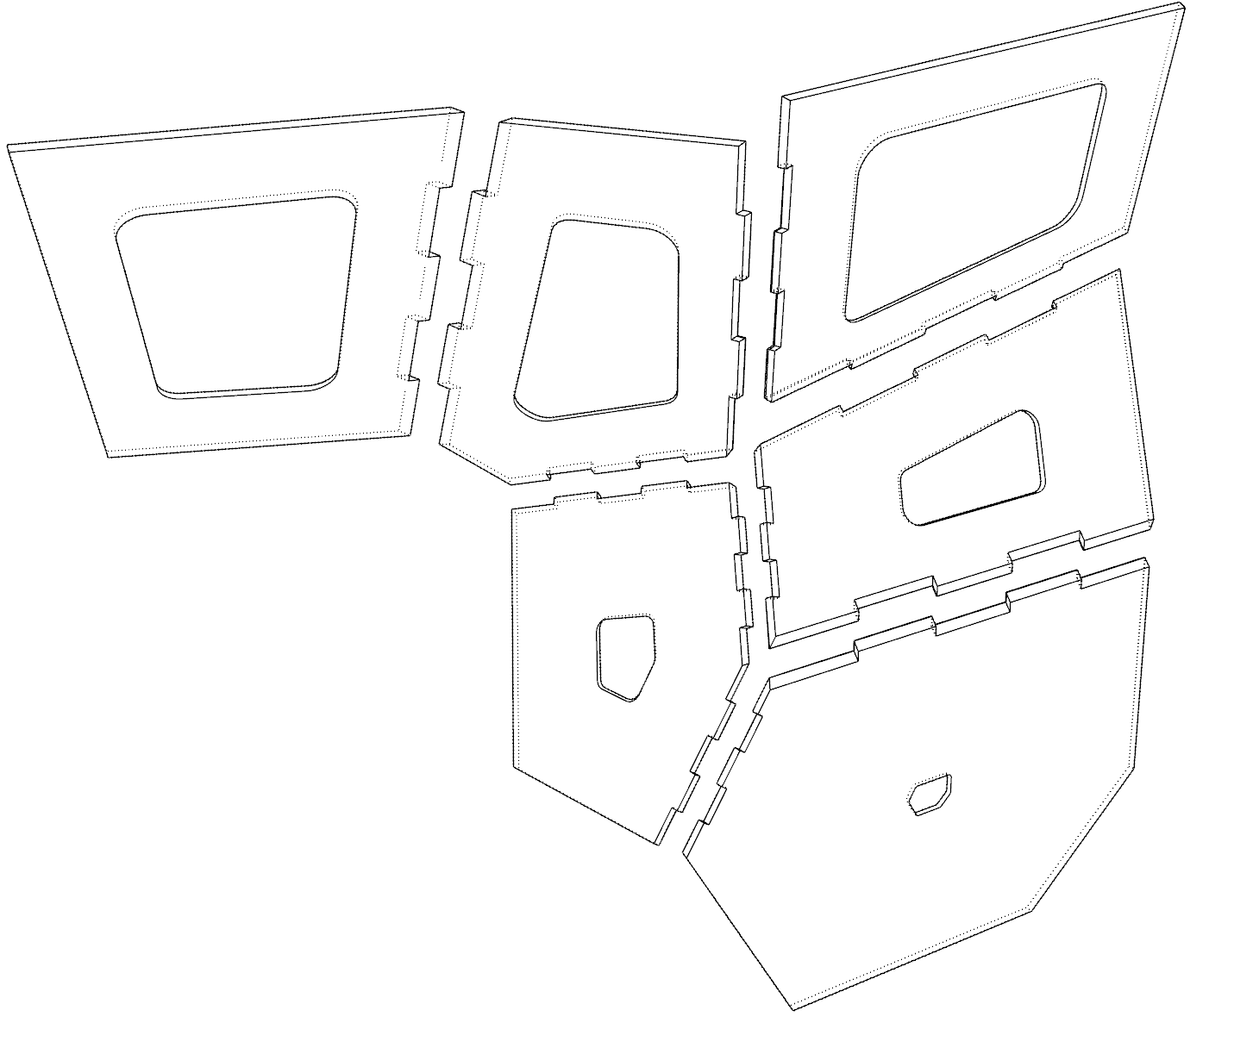
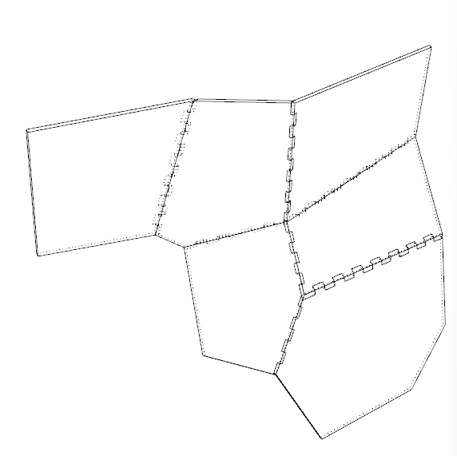
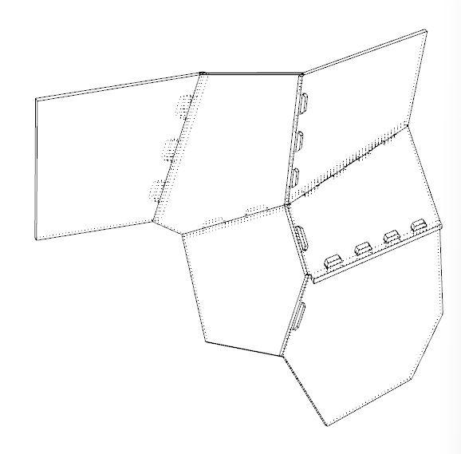
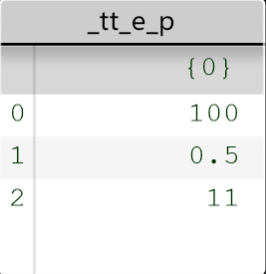
prefabrication process
Joint creation
Connected plates
Disconnected plates

Slide 12
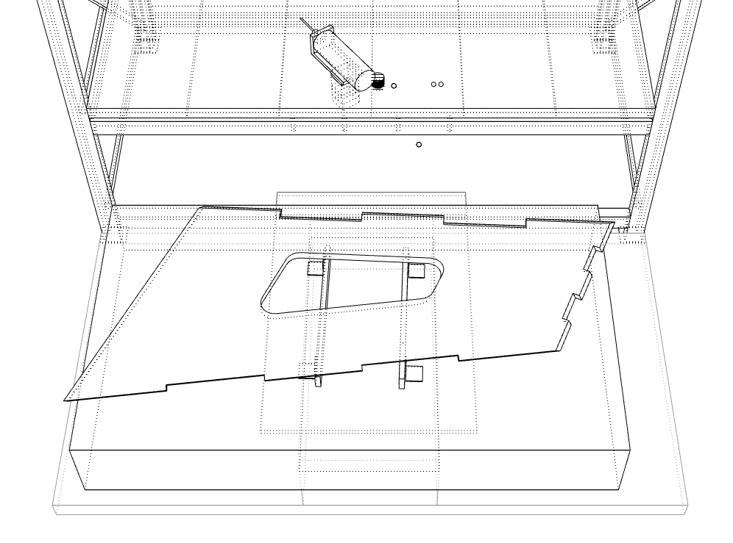
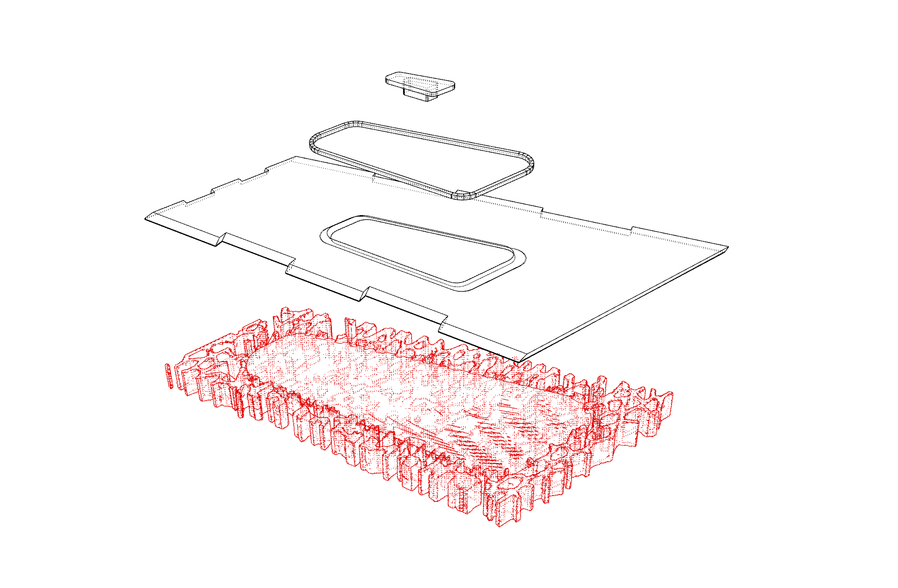
Prefabrication process
point light with a sensor
LED strip
finishing plate
3d printed acoustic pattern with structural coroni optimisation combined
Final Plate design

Slide 13
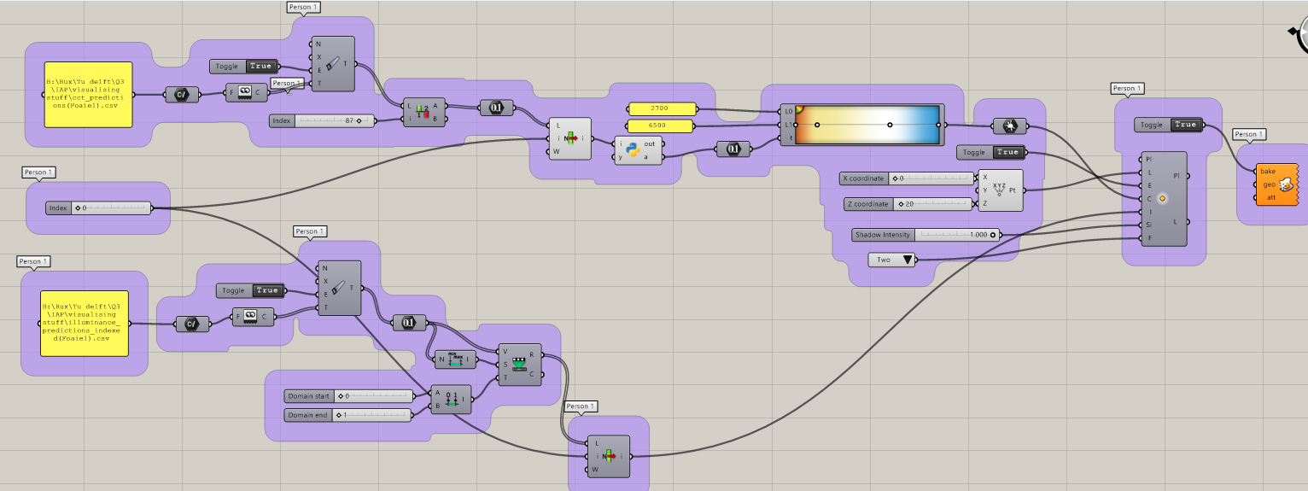
Further expansion on AI implementation
CCT
Light Object
Illuminance

Slide 14
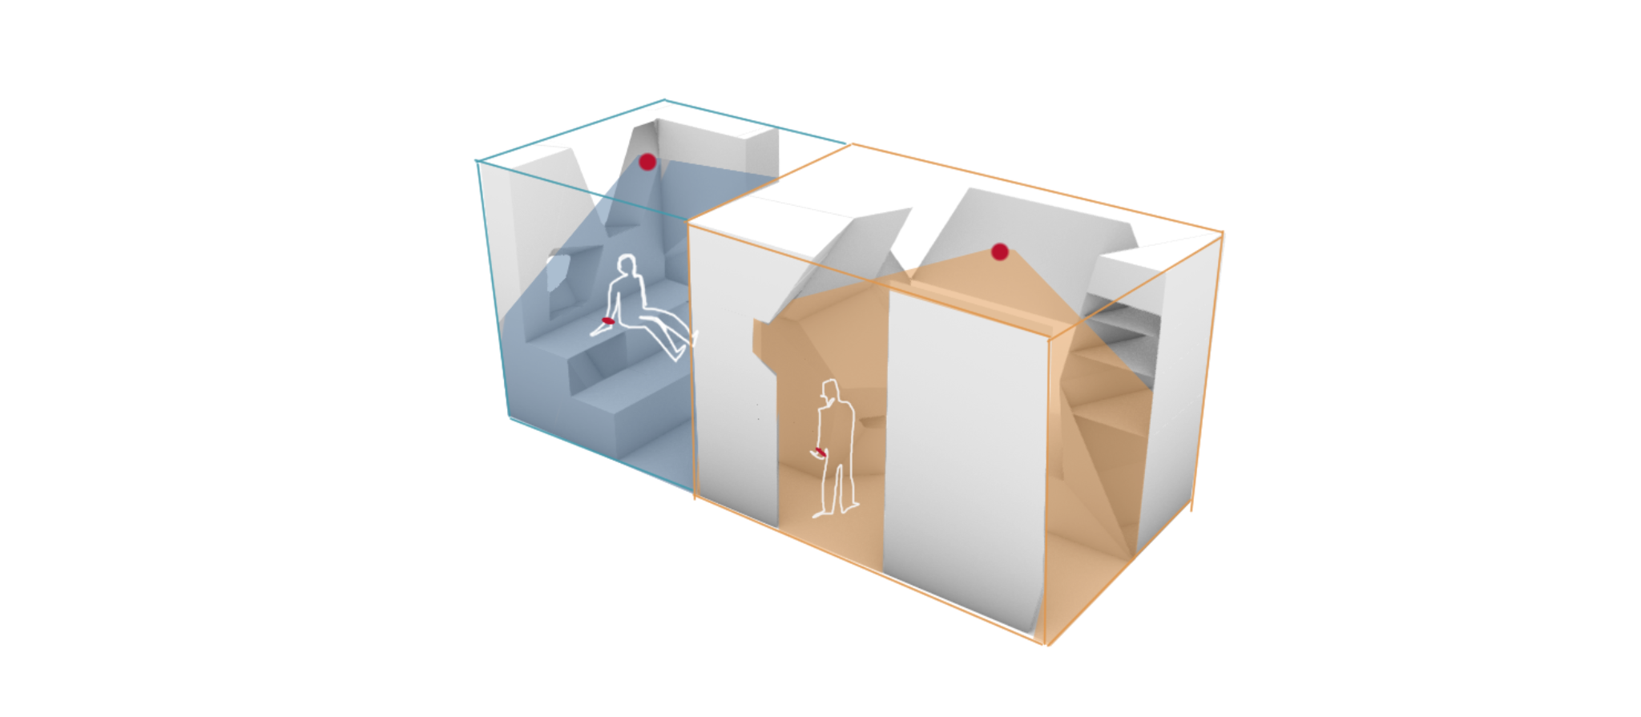
Further expansion on AI implementation
Person 1’s zone
Person 2’s zone
Light zones based on the ai personalised predictions
Watches connect to sensors and adjust light accordingly

Slide 15
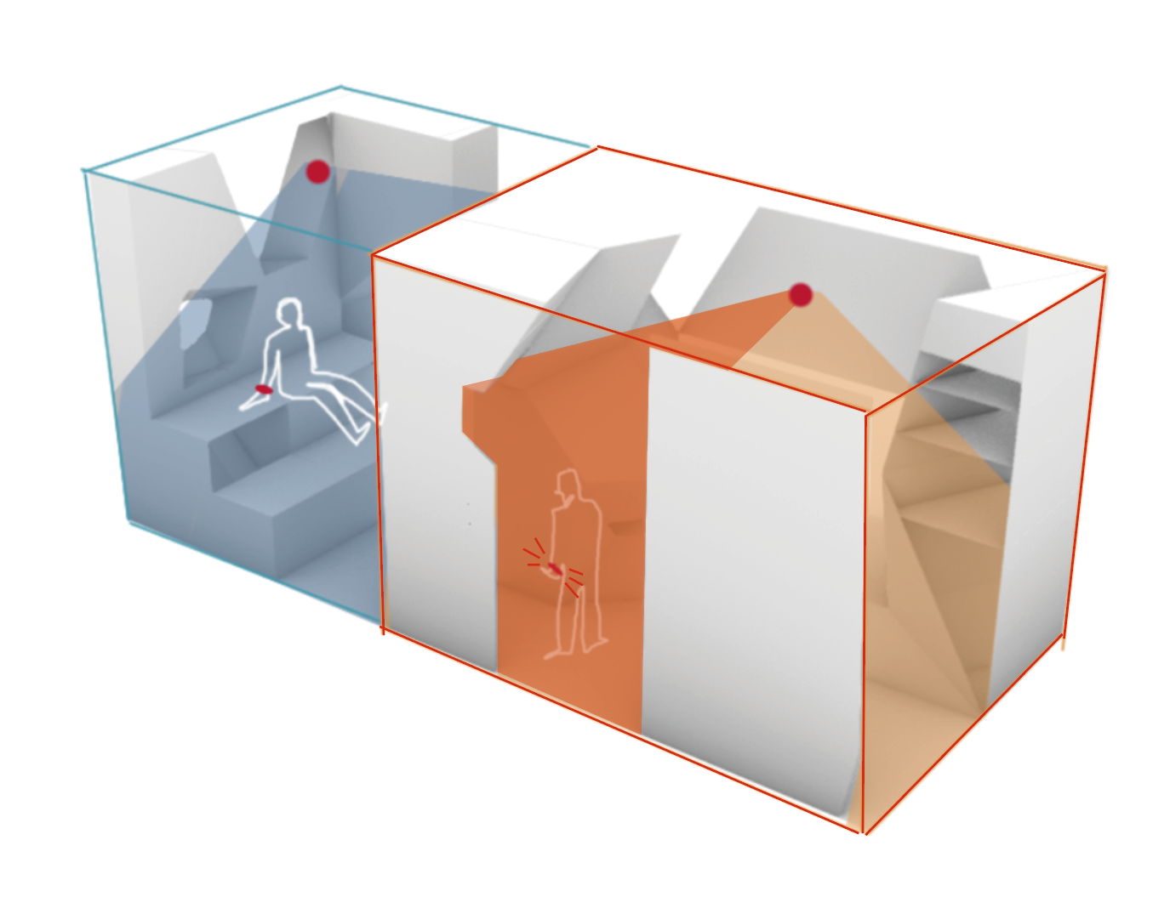
Further expansion on AI implementation
Person 1’s zone
heart _rate
85-110 bmp
(higher than normal)
> 2700K
with amber tones
Person 2’s zone
Real time changes resulting from stress reaction
Watches connect to sensors and adjust light accordingly

Slide 16
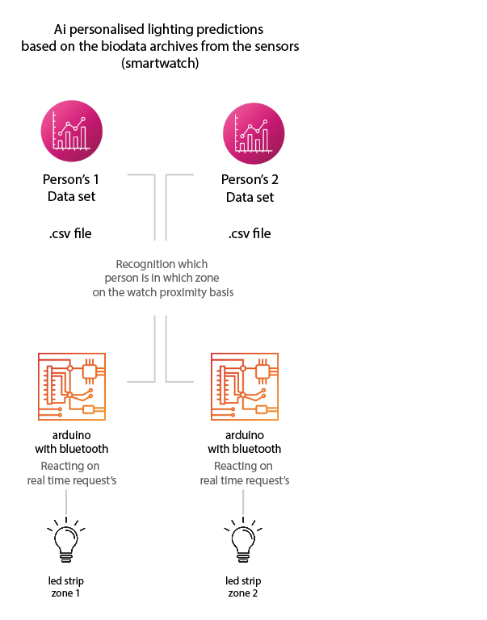
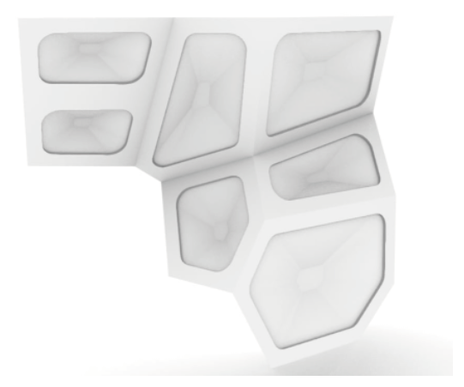
Light implementation
python bridge with USB/ wifi/ bluetooth

Slide 17
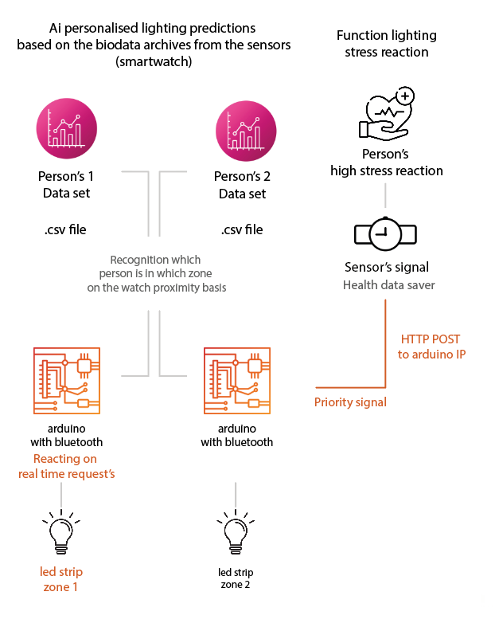
Light implementation
python bridge with USB/ wifi/ bluetooth

Slide 18
Light implementation
Two LED strips represent the two zones
Lighting changes are based on CSV schedule data
Lighting overrides occur in response to real-time stress input

Slide 19
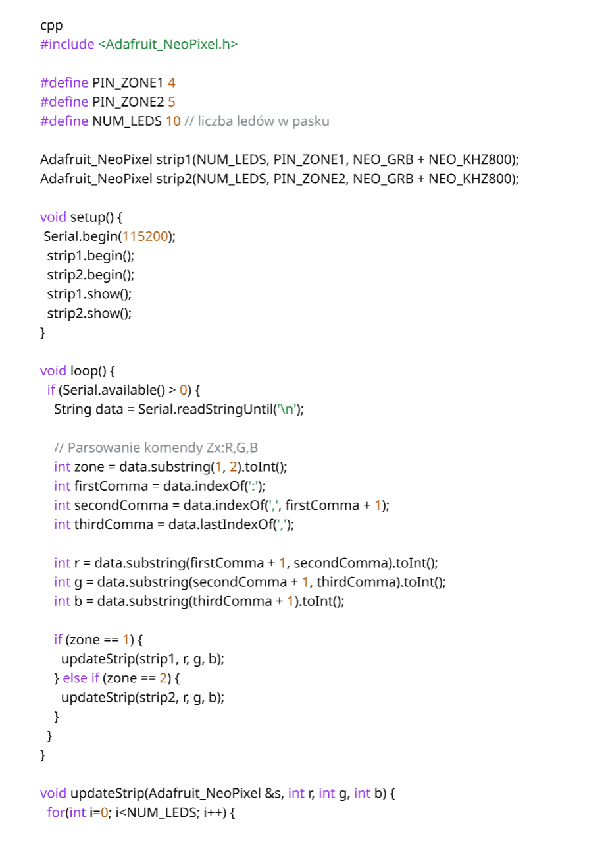
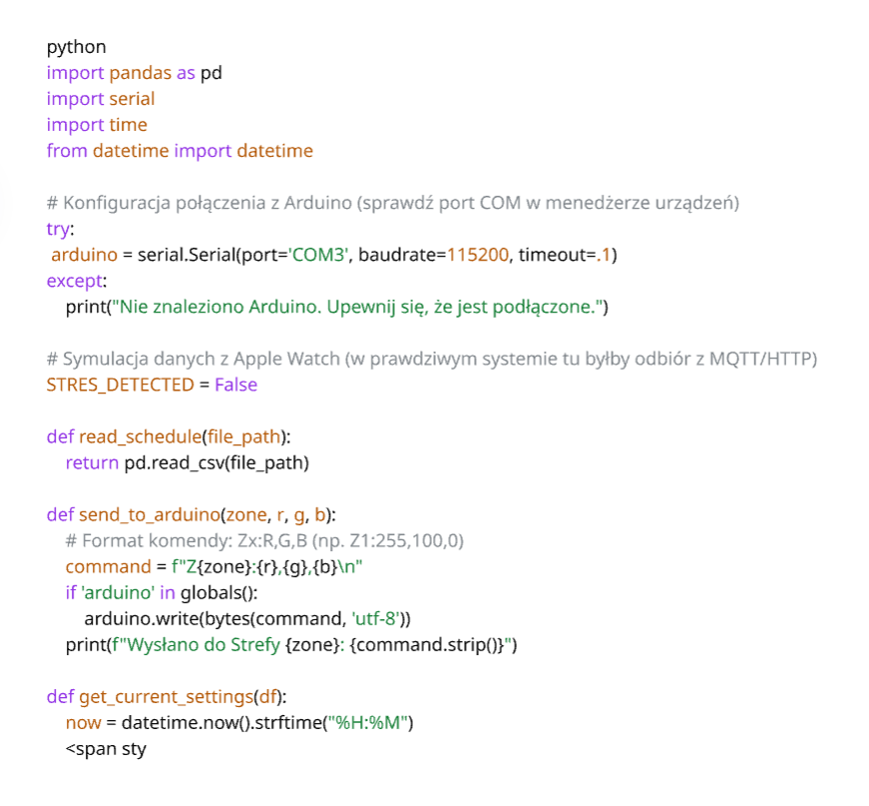
Light implementation
Python script
Arduino (Arduino IDE)
(brain)
as executive

Slide 20
Hardware list
Microcontroller:
1× ESP32 (e.g., NodeMCU or DevKit V1) with built in Bluetooth and wiffi
Lighting (Zones)
2× Addressable LED strip WS2812B (NeoPixel): Short segments are sufficient (e.g., 10–30 LEDs per zone). These allow you to control each LED individually using only a single data wire.
Alternative: 2× RGB LED modules (if you only need point-based lighting instead of full strips).
Power Supply
5V Power supply (minimum 2A–3A): LED strips draw a significant amount of current. Do not power longer strips directly from a computer USB port or Arduino, as this may damage the device.
USB-C or Micro-USB cable: For programming the ESP32 and communication with Python.
Others
Breadboard: For connecting components without soldering.
Jumper wires (male-to-male and male-to-female): Around 20 pieces.
1000µF 6.3V capacitor (optional): Protects LED strips from voltage spikes.
330Ω resistors (2 pieces): Placed between the microcontroller pin and the LED strip data input (to protect the pin).

Slide 21
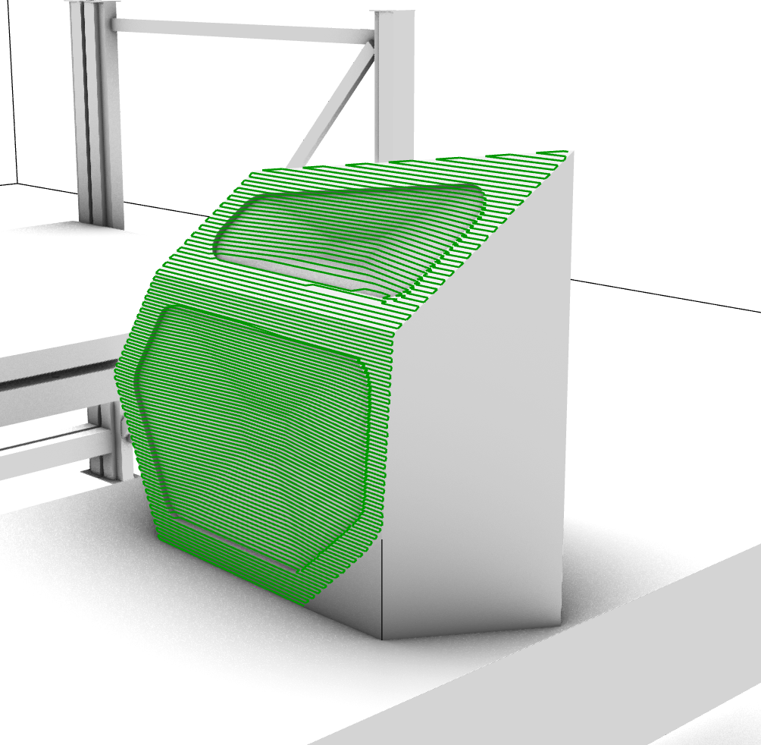
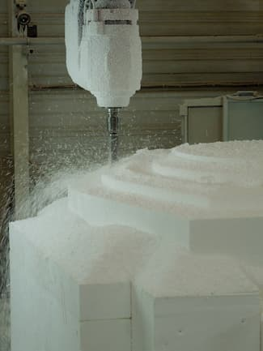
What next? (our practical needs)
Prototype considerations:
1:2 scale
Milled from XPS
LED light stips imbedded
Controlled via Arduino
connected to Grasshopper via Firefly

Slide 22
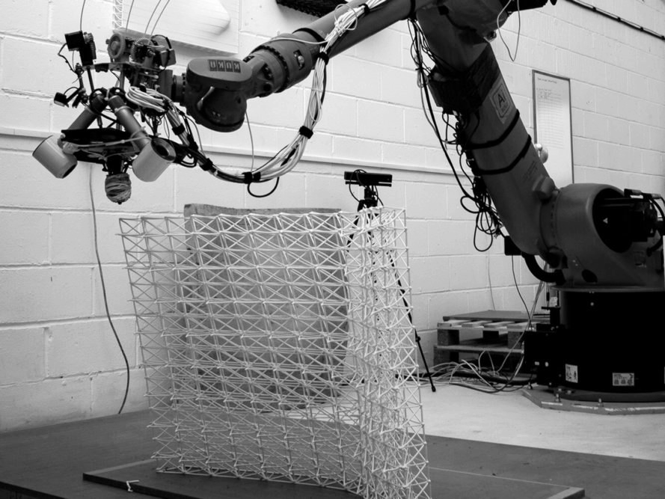
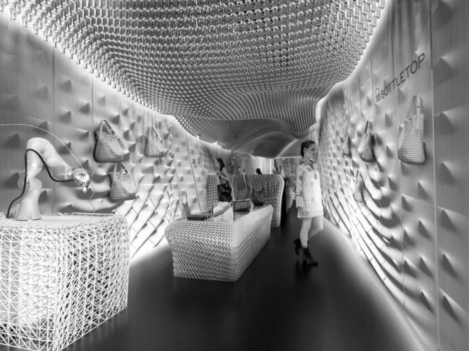
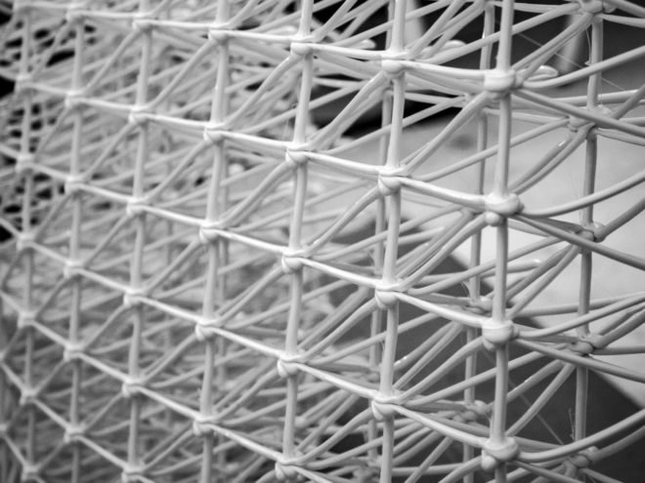
Material considerations
KUKA robotic arm
60,000 plastic bottles were used till this day by the company on multiple projects
ReFlow filament from recycled plastic bottles
credits: Bottletop

