Slide 1
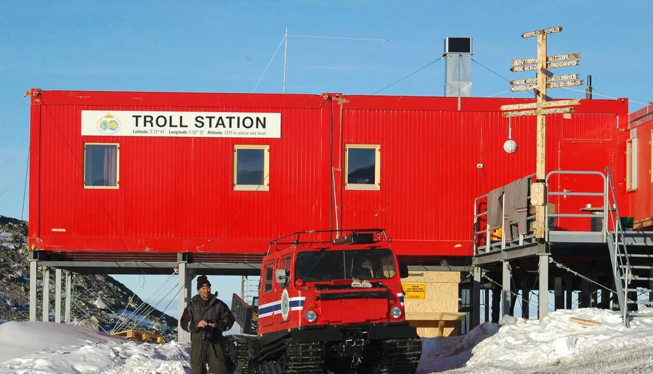
1:1 Interactive Architecture Prototypes (AR0122)
Computational and robotic systems integrated into
physically built environments &
building processes
WHAT
Dr. Dipl.-Ing. Henriette Bier et al.

Slide 2
AR0122 workshop (5 ECTS) 1:1 Interactive Architecture Prototypes (IAP): Focus is on reconfigurable furniture for the research station TROLL;
Learning objectives and methods: Development of skills in Voronoi-based computational design to production and AI-supported environmental control;
Deliverables: Design and prototype/ scaled model;
Tutors: Henriette Bier (h.h.bier@tudelft.nl), Arwin Hidding (RB, A), and Lisa-Marie Mueller (DT, AET);
Education quarter: Q3; tutoring day(s): Fridays;
Tutorials: D2RP and AI-supported D2RO
Collaboration with a.o. AET;
Additional information on the RB website and wiki: http://roboticbuilding.eu and https://e.ta.tudelft.nl (redirected from https://roboticbuilding.studios.tudelft.nl)

Slide 4
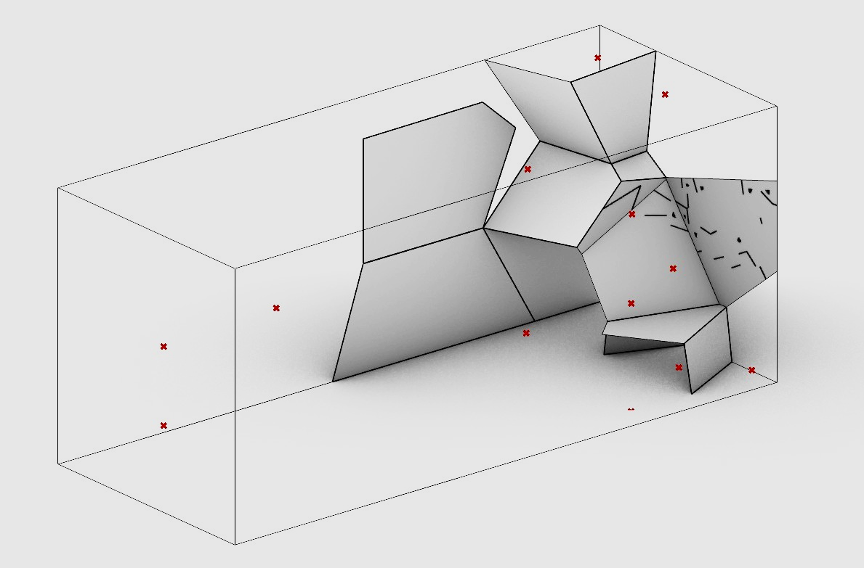
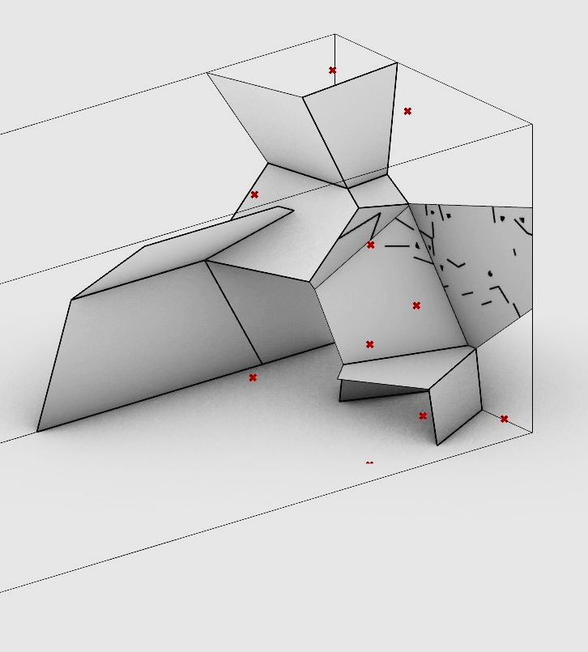
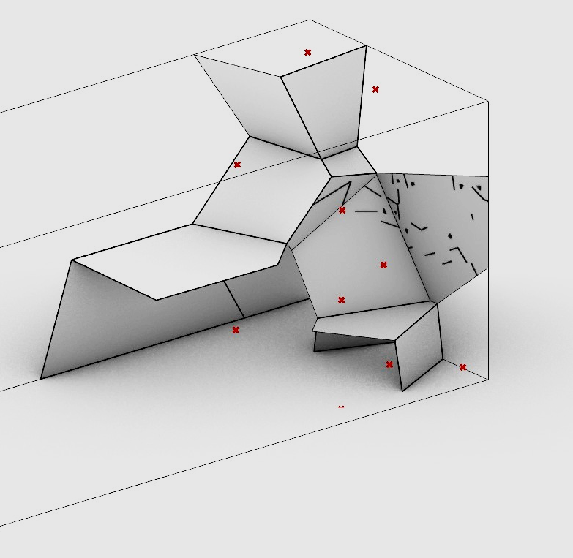
Voronoi-based spatial re-/configuration & AI-supported interactive lighting

Slide 5
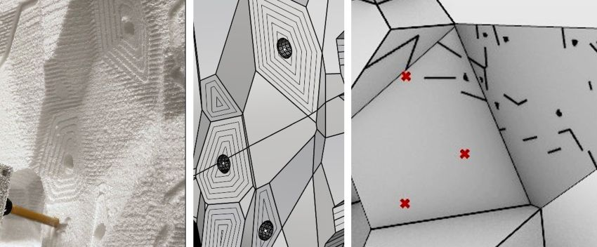
EPS mock-up (left) for 3D printed panels from recycled bottles

Slide 6
NEXT

Slide 7

Integration of energy generation from high-altitude wind

