Slide 1
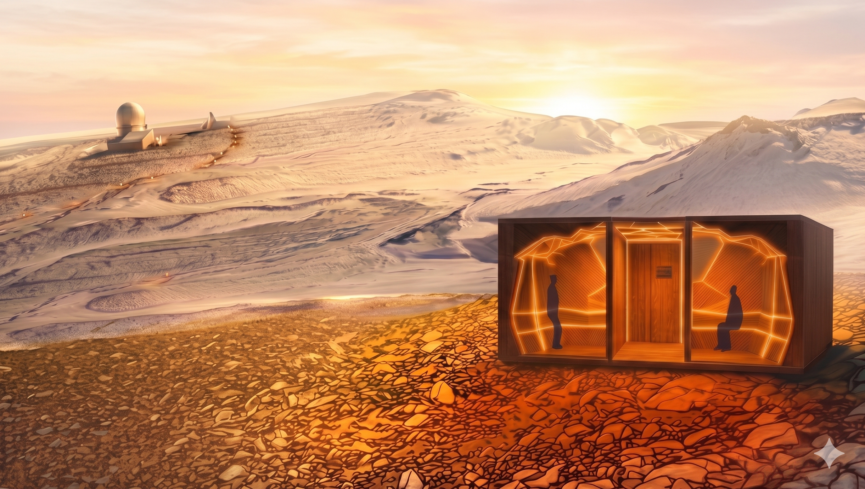
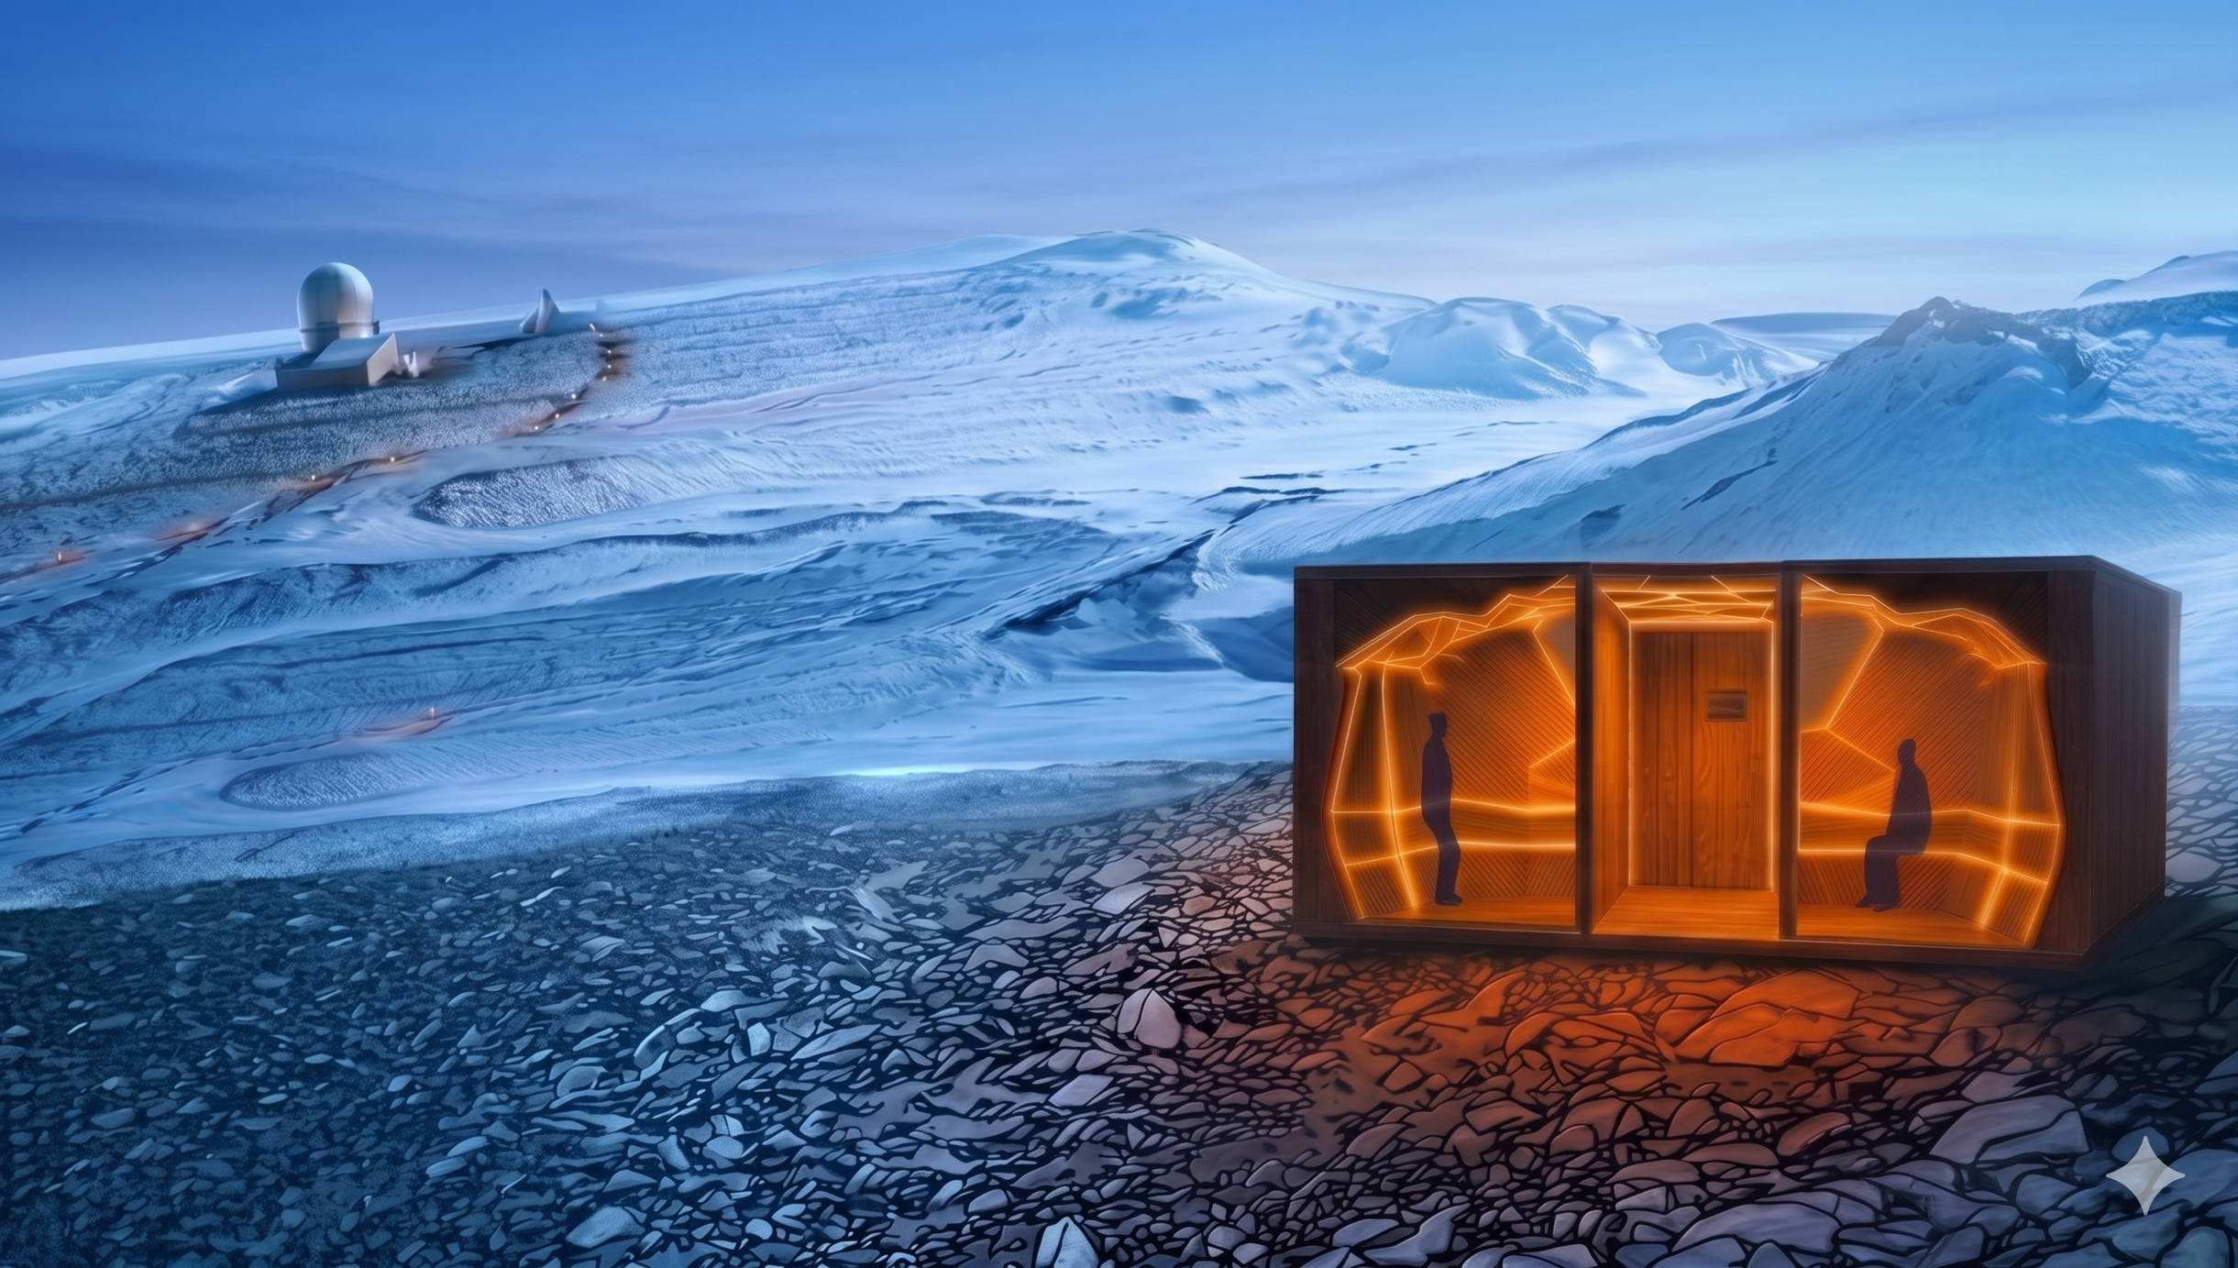
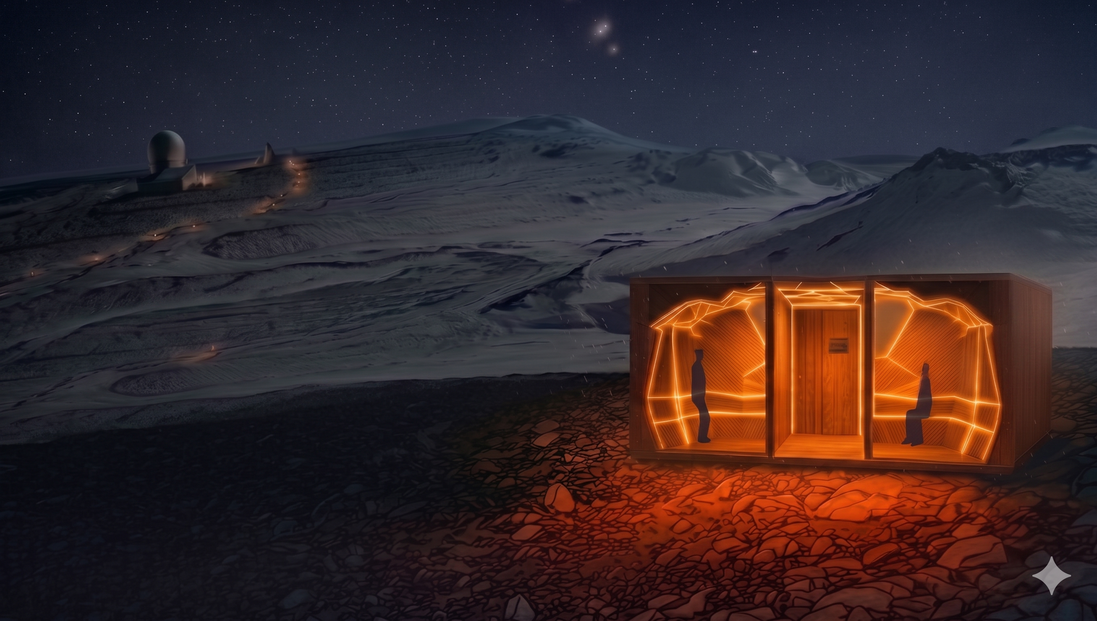
TRANSITIONS
ITIONS
habitat for Troll research station
research station
Iris Claus, Daphne Kamsteeg, Ludovica Pe
rone Pacifico, Chloé Phan, Marieke van Wijk
IAP Workshop - Q3 2026
Prof. Henriette Bier, Arwin Hidding, Lisa-Marie Mueller, Vera Laszlo

Slide 2
00
CONTENT
01
Introduction
Current situation & problem statement
Goal
Project principles
Design
Voronoi-based approach
Activity mapping
Design concept
References
Principles & process
Reconfiguration
24h cycle
Lighting & AI
Lighting layers
Circadian rythm
Natural lighting integration
Control systems - 3 layers
Control systems - Adaptive control
Machine learning
04
Systems integration
Configuration C1
Configuration C2
Configuration C3
Digital prototype
Lighting
Fragment logic
Structural optimization
Material
Render
02
05
03

Slide 3
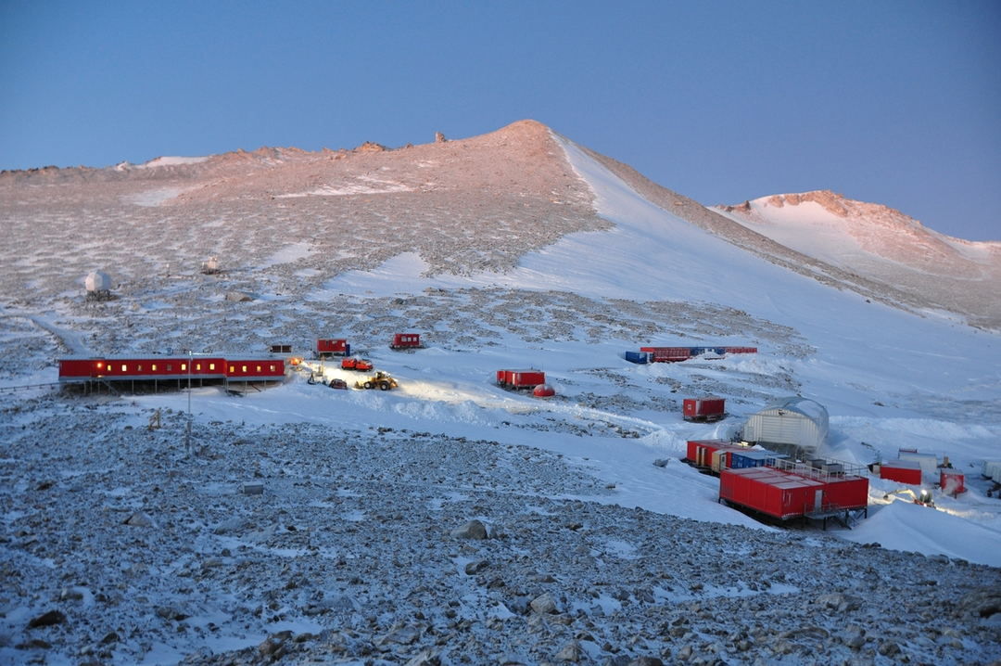
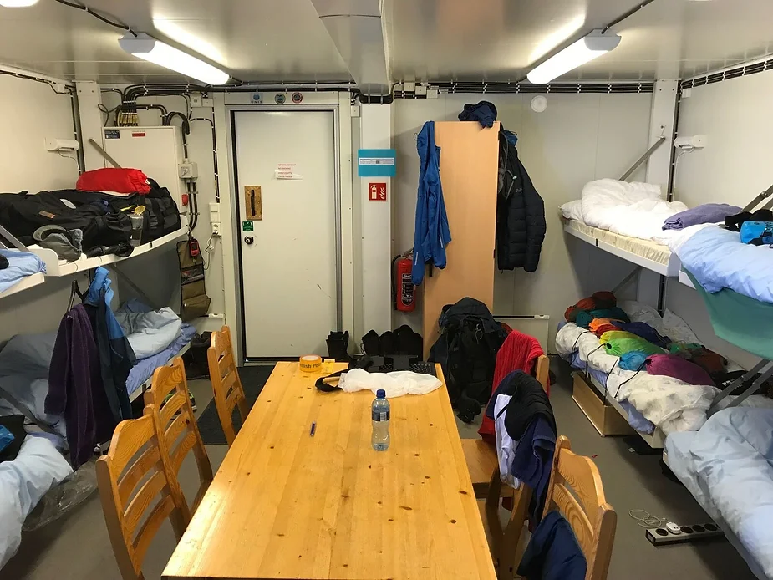

01
INTRODUCTION| CURRENT SITUATION & PROBLEM STATEMENT
Site of Troll research station (DigitalMuseum)
Habitation module interior (MAGIC-DML Team)
Problem statement
Living in a confined, monofunctional space, with natural and artificial lighting that fail to support circadian rhythms during the extreme shifts of the Midnight sun and Polar night
Arctic seasons Lighting needs Spatial limitation
Notes:
Context: Users live and work in compact research stations (e.g., Troll Station, Antarctica)
Problem: Spatial, physiological, and psychological constraints
Opportunity: Need for flexible, adaptive design → leads to nature-inspired Voronoi logic
Challenges:
Limited or no natural light → impacts health, sleep, productivity
Small, static spaces → don’t adapt to activities or individual needs
Conflicting rhythms and preferences → affects wellbeing

Slide 4
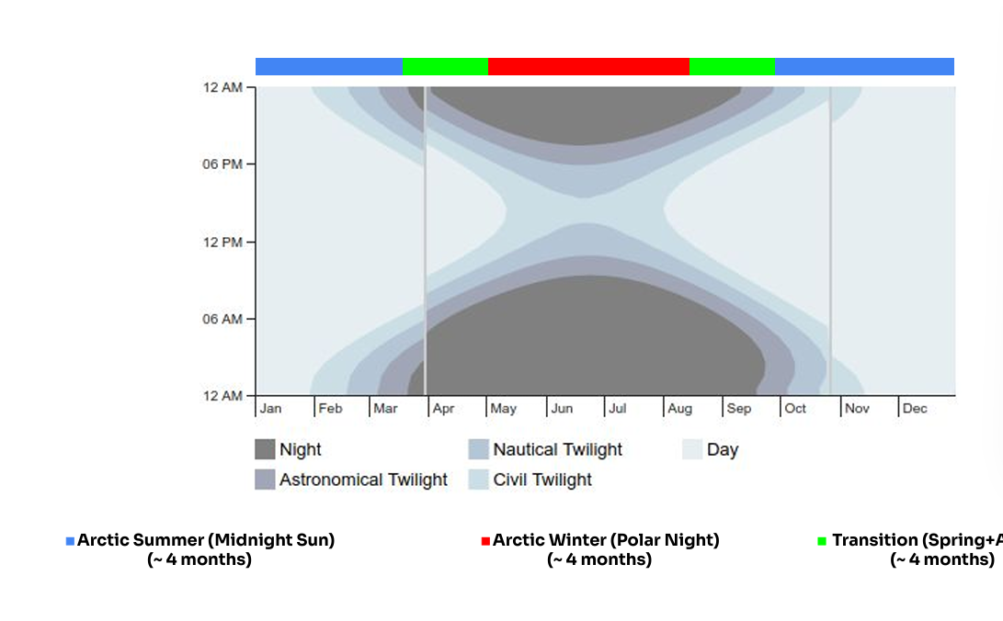
01
INTRODUCTION| GOAL
Goal
To create an efficient, reconfigurable and smart space that fulfills the psychological and physical needs of its inhabitants with 3 main principles
-
Midnight sun
(3-4 months)
Twilight period
(1-2 months)
Polar night
(3-4 months)
Shoulder seasons
(1-2 months)
Midnight sun
(3-4 months)
Daylight Chart for Norway’s Troll Antarctic Research Station (EP Salt)
Notes:
change text & Also mention what we are designing for:
-2 people
-emergency situation, different schedules
-for most extreme conditionsduring the 8 month

Slide 5

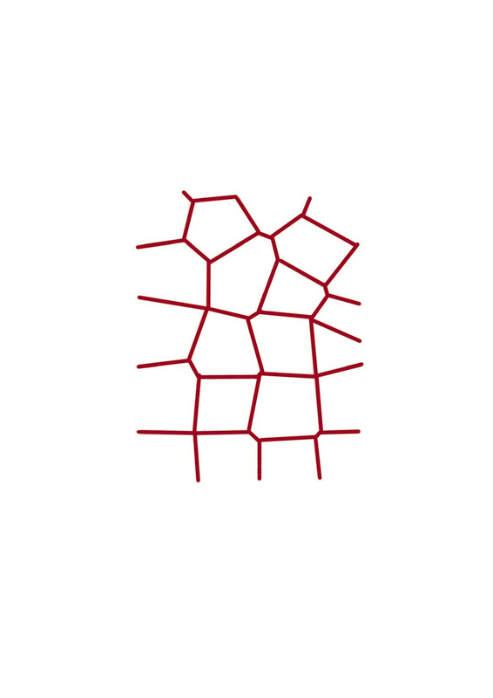
01
INTRODUCTION| PROJECT PRINCIPLES
VORONOI | AI | LIGHTING

Slide 6
DESIGN

Slide 7
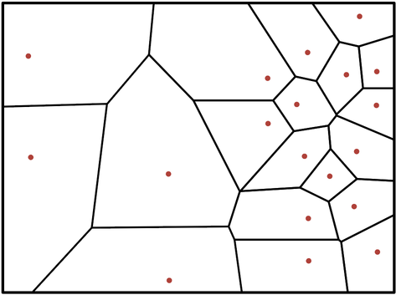
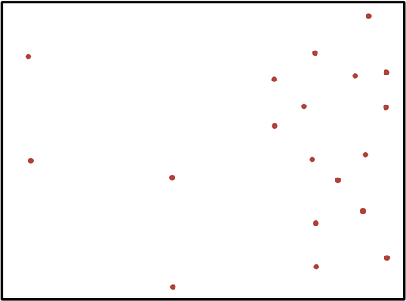
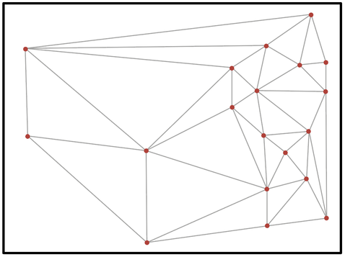
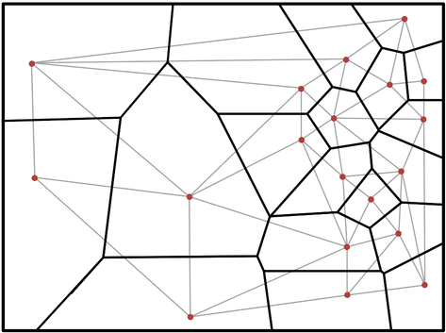
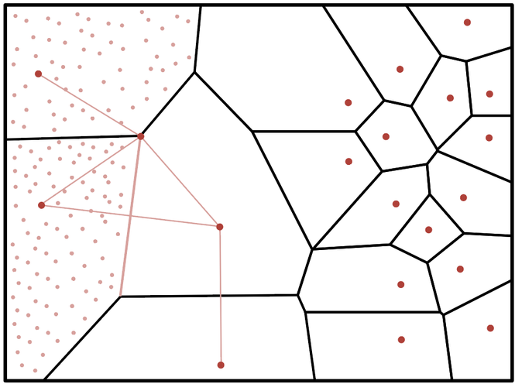
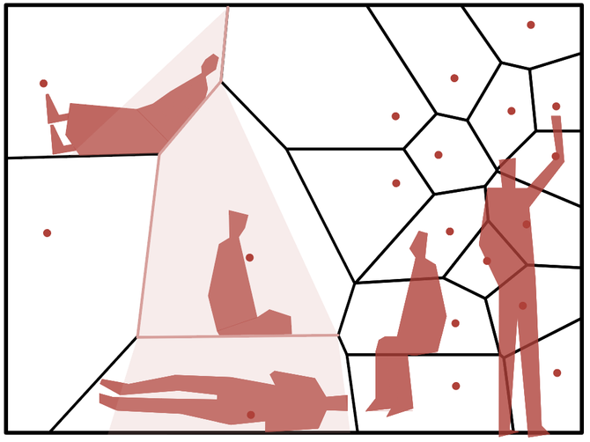
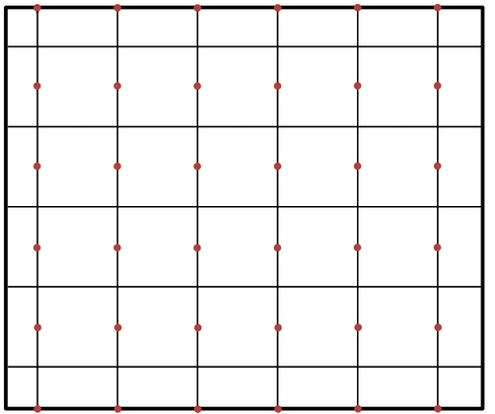
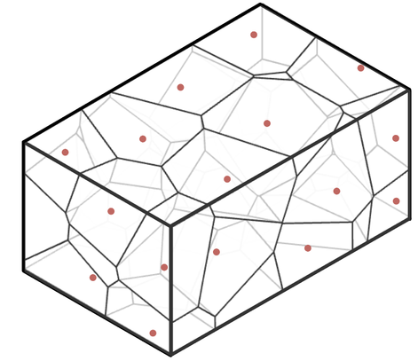
02
DESIGN | VORONOI-BASED APPROACH
Generation
Configurations
max space clearance
fast reconfiguration
temporary activities
ergonomic niches
  Random seed points
  Delaunay triangulation
  Extending triangles bisectors: voronoi cells
Irregular
2D
Properties
vs
vs
  Nearest neighbour
  Point density variation
⟶ Center of activities as seed points
d
⟶ Function variation
alignment with geometry of the container
max storage efficiency
d
d
permanent activities
d
d
  Equidistant vertices/edges
1
1
  Point vertical/
horizontal
alignment
⟶ Lighting in edges
⟶ Horizontal/
vertical
surfaces
Orthogonal
3D
Notes:
Activity mapping in container + minimum dimensions for each activity.
lighting requirements for each activity? (is it a repetition with lighting needs?)

Slide 8
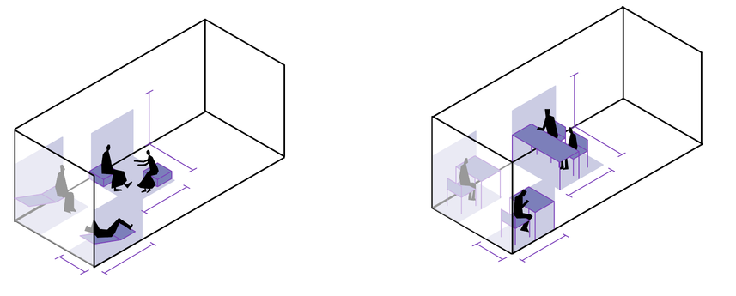
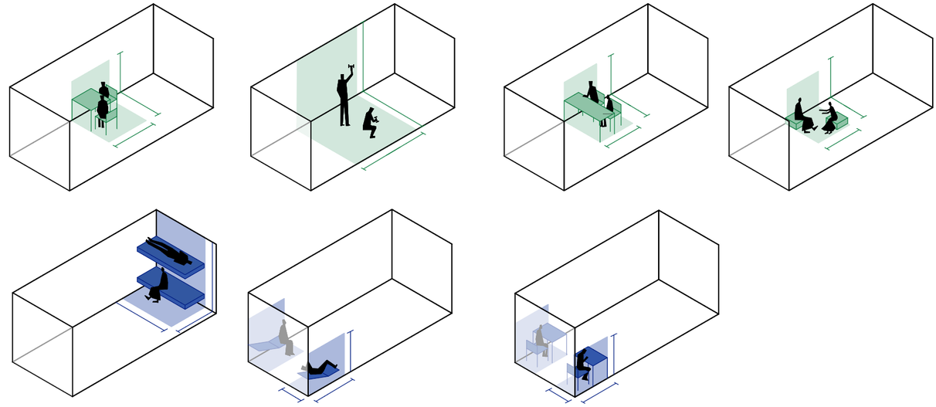
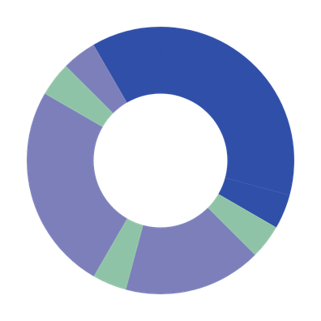
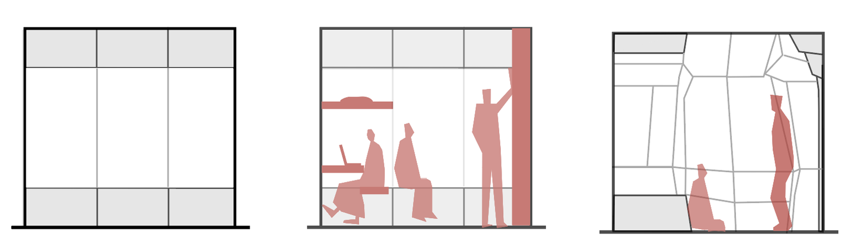
02
DESIGN | ACTIVITY MAPPING
In time & space
Relaxing
21.00 - 22.00
2.5 m
1.4 m
2 m
1.6 m
1.5 m
In height
1.6 m
Dining
20.00 - 21.00
Sleeping
22.00 - 7.00
1 h
Highest duration. Lowest frequency, hence must be folded away or reconfigured. At extremities to minimise daytime circulation interference.
2.50 m
0.8 m
1.5 m
1 h
00.00
9 h
“dead space”
Relaxing / exercising
18.00 - 20.00
2.10 m
2 h
low/medium intensity use
18.00
06.00
1.70 m
2.5 m
High intensity use
2.5 m
4 h
1 h
Hygiene
7.00 - 8.00
1.4 m
Working
14.00 - 18.00
12.00
1 h
1.6 m
2.5 m
1.6 m
0.45 m
1 h
4 h
Dining
8.00 - 9.00
Demands maximum clearance of floor area.
Dining
13.00 - 14.00
Highest frequency, hence must be easily accessible.
+ Storage space
of personal items, clothing, working equipment.
Fixed. Compact, to maximise space clearance
at least two modules
Legend
1.4 m
Individual
3.7 m
peripheral zones
Collective
central zones
Working
9.00 - 13.00
1.5 m
1.5 m
demand two configurations, one for collective and one for private fruition
Both
1.5 m
0.8 m
1.5 m
0.8 m
Notes:
Activity mapping in container + minimum dimensions for each activity.
lighting requirements for each activity? (is it a repetition with lighting needs?)

Slide 9
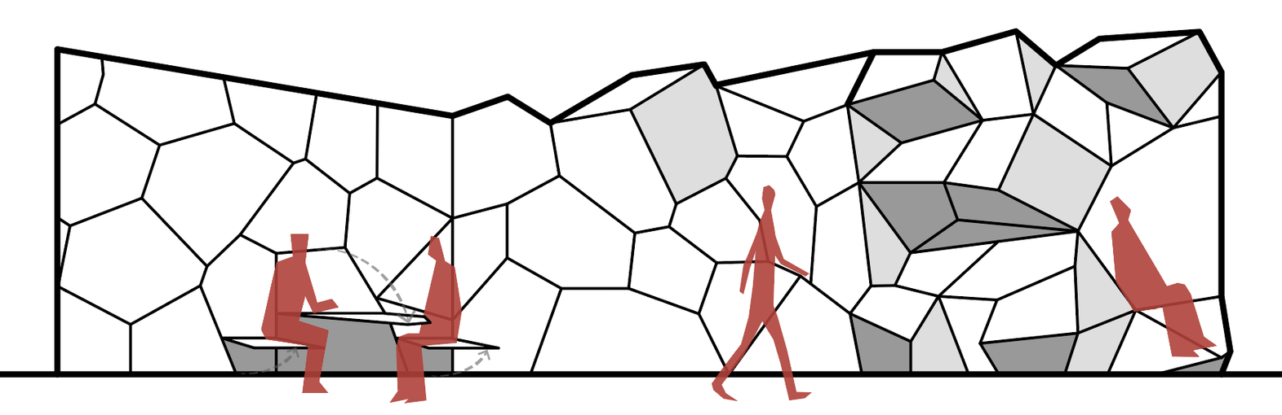
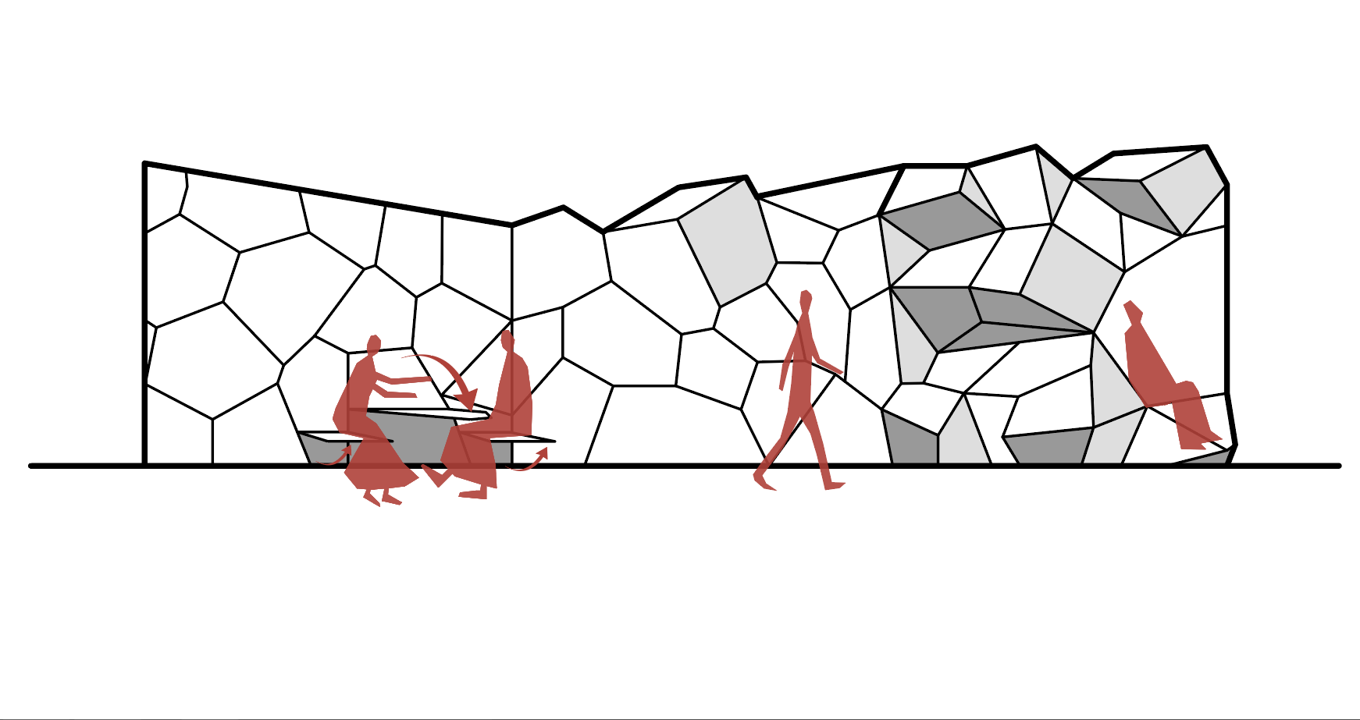
02
DESIGN | CONCEPT
TRANSITIONS
2D/foldable
3D/Reconfigurable
Collective
Private

Slide 10
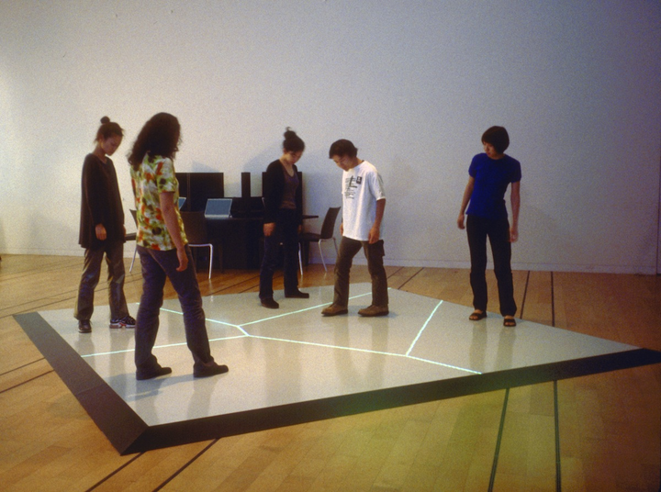
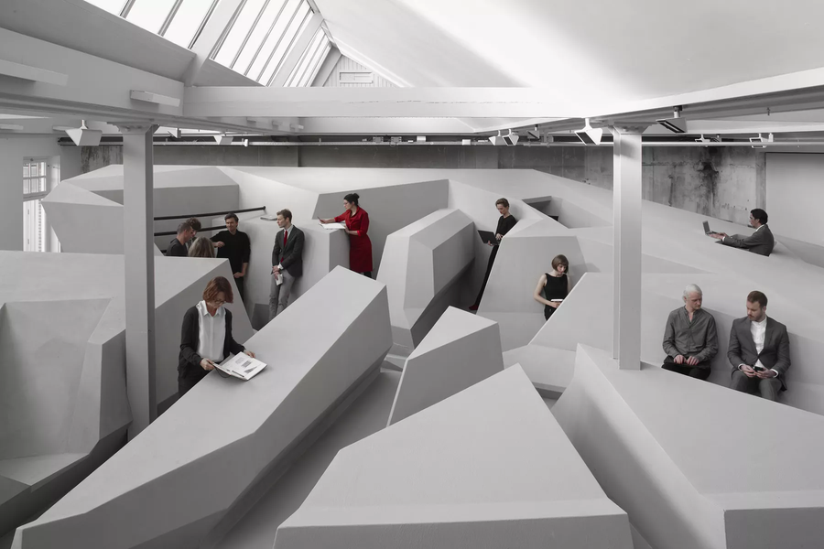
02
DESIGN | REFERENCES
Scott Snibbe, 1998
Boundary Functions (Snibbe.com)
RAAAF, 2014
The End of Sitting (RAAAF.nl)
Notes:
Activity mapping in container + minimum dimensions for each activity.
lighting requirements for each activity? (is it a repetition with lighting needs?)

Slide 11
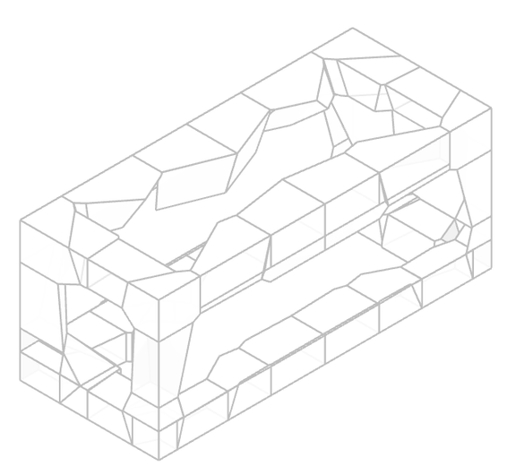
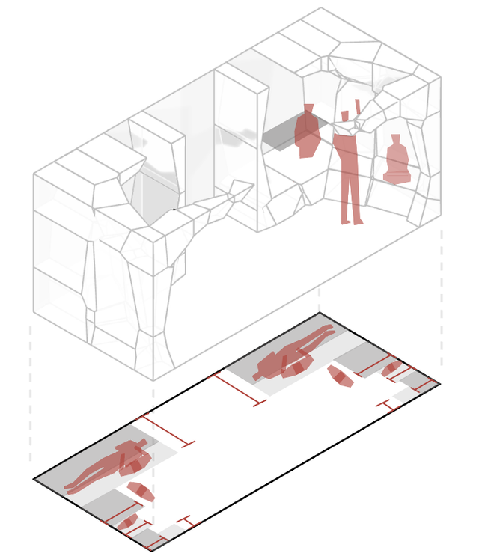
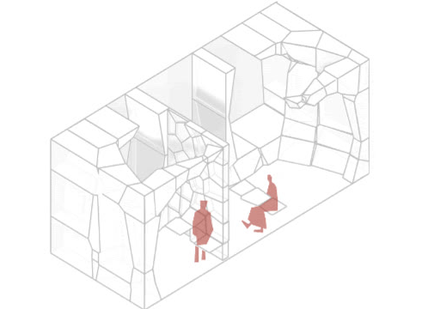
02
DESIGN | PRINCIPLES & PROCESS
  Storage in corners
  2. Width-based zoning
  3. Boundary reconfigurability
Sleeping area/ workstation
Storage
0.6 m
Seating
Shelves
1.0 m
0.45 m
0.35 m
Transition orthogonal-voronoi
1.0 m
0.25 m
Transition collective-private
0.6 m
0.25 m
0.45 m
0.35 m
Transition 2d-3d
Notes:
Activity mapping in container + minimum dimensions for each activity.
lighting requirements for each activity? (is it a repetition with lighting needs?)

Slide 12
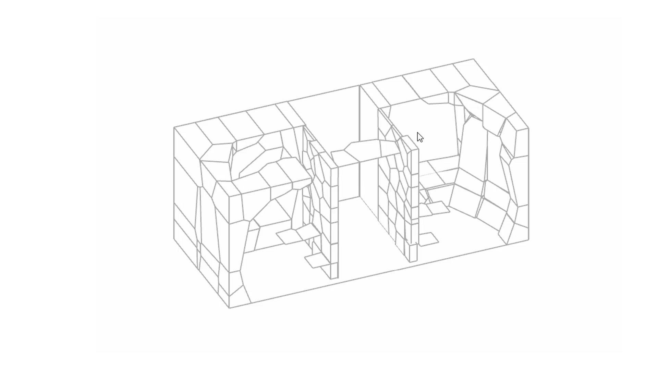
02
DESIGN | RECONFIGURATION

Slide 13
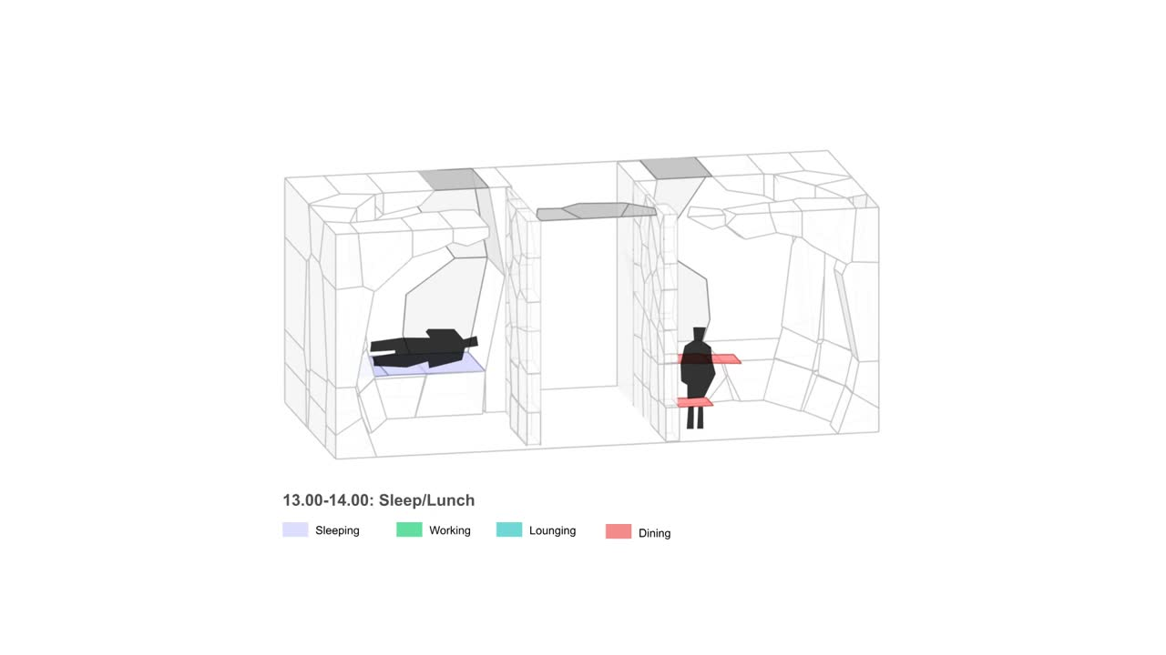
02
DESIGN | 24H CYCLE
Notes:
Activity mapping in container + minimum dimensions for each activity.
lighting requirements for each activity? (is it a repetition with lighting needs?)

Slide 14
LIGHTING & AI

Slide 15
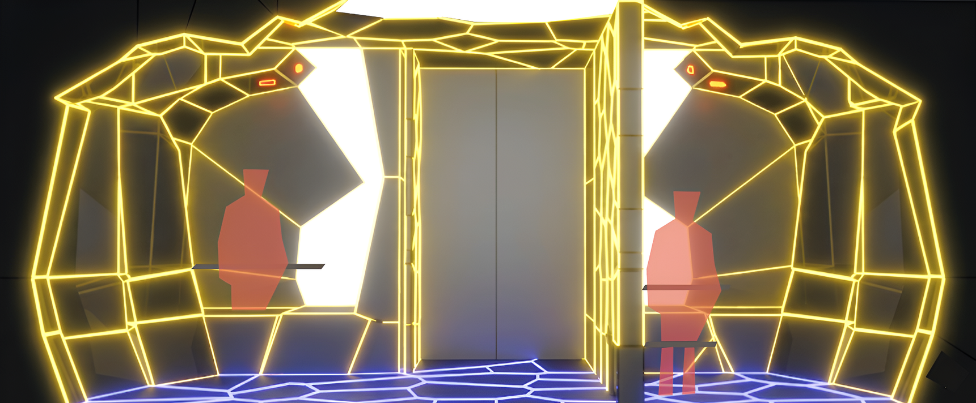
03
LIGHTING & AI | LIGHTING LAYERS
Primary lighting
Secondary lighting
Tertiary lighting
Natural lighting

Slide 16
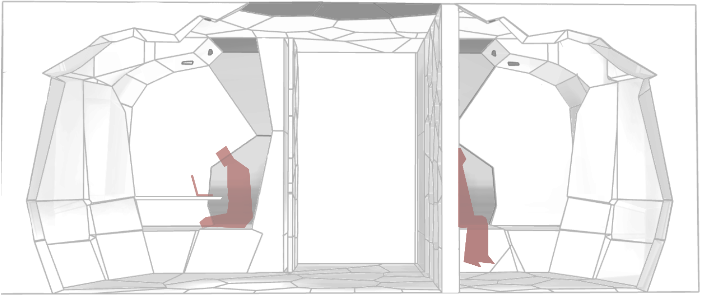
03
LIGHTING & AI | CIRCADIAN RYTHM
Waking up
Working
Relaxing
Sleeping
CCT: 2700-4000 K
Illuminance: 100-300 lux
CCT: 5000-6000 K
Illuminance: 500-1000 lux
CCT: 2200-3000 K
Illuminance: 50-200 lux
CCT: 1800-2200 K
Illuminance: 0-50 lux
Notes:
With our activity mapping, we established our lighting needs, Which we divided Into primary secondary and tertiary.
The primary lighting need is the circadian light, which will be the base lighting.
Layered on top will be the Secondary lighting like, task-, ambient- and natural light. (Additional)
And last, Tertiary lighting, our navigation lighting. (Incidental)
no times: so it functions for both schedules

Slide 17
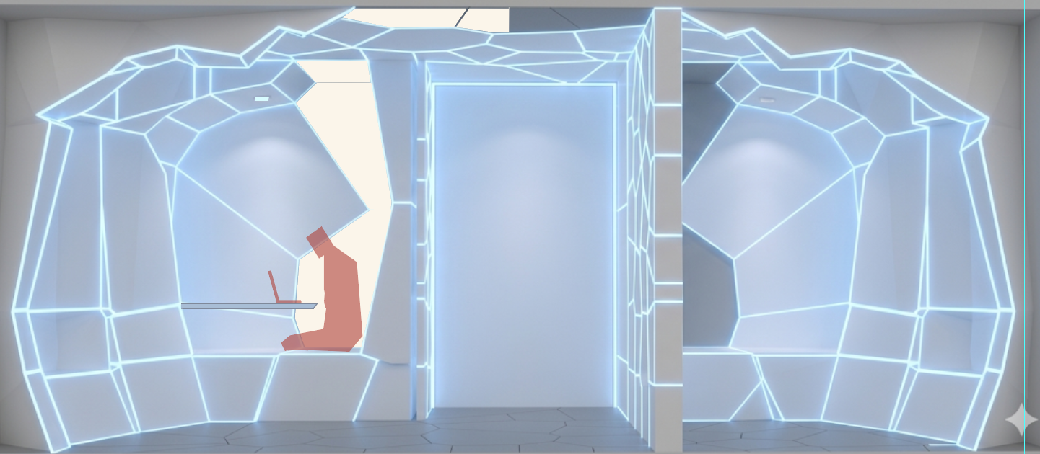
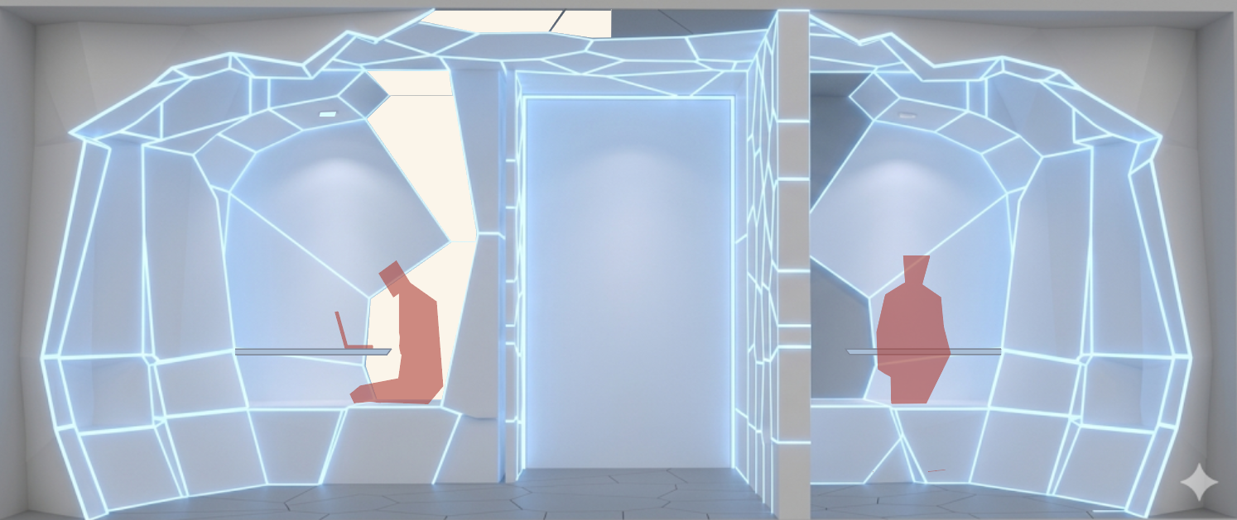
03
LIGHTING & AI | NATURAL LIGHT INTEGRATION
Midnight sun
Polar night
filtered window contribution
200–350 lux
filtered window contribution
5-20 lux
artificial circadian contribution:
250–450 lux
artificial circadian contribution:
450–730 lux
final perceived
CCT: 5500-6500 K
Illuminance: 750-1000 lux
Notes:
With our activity mapping, we established our lighting needs, Which we divided Into primary secondary and tertiary.
The primary lighting need is the circadian light, which will be the base lighting.
Layered on top will be the Secondary lighting like, task-, ambient- and natural light. (Additional)
And last, Tertiary lighting, our navigation lighting. (Incidental)

Slide 18
03
LIGHTING & AI | CONTROL SYSTEMS - 3 LAYERS
Input
Output
LAYER 3
CONTEXT
Environment
Color &
Intensity
AI
CCT
&
INTENSITY
LAYER 2
Decision
system
USER
Smartwatch
LAYER 1
On/Off
ACTIVITY
Motion Sensors

Slide 19


03
LIGHTING & AI | CONTROL SYSTEMS - ADAPTIVE CONTROL
Control System
Manual Overrides
Safety check
Illuminance
Color
Illuminance/ CCT limits
3 CONTEXT
Environment
–
–
–
–
2 ACTIVITY
–
–
Motion Sensors
–
–
Health issues
–
–
1 USER
Smartwatch
ON OFF
30 min corrective fade
CCT
&
INTENSITY
Notes:
Health Safeguards:
Red Warning: Shown when manual settings are outside healthy ranges.
Corrective Fade: A gradual 30-minute transition back to healthy light levels.

Slide 20
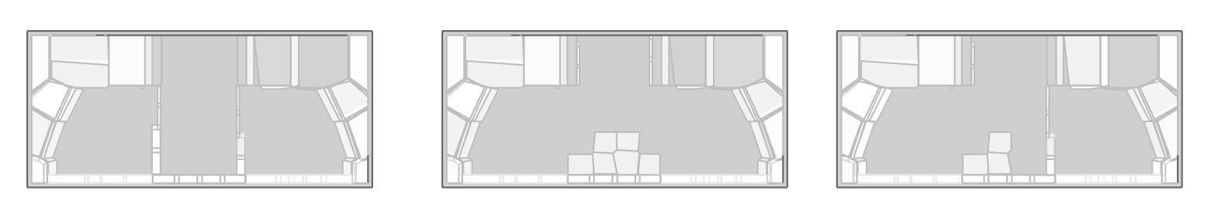
03
LIGHTING & AI | CONTROL SYSTEMS - ADAPTIVE CONTROL
Private configuration
Collective configuration
Semi private configuration
Personal preferences
Transition zone
Personal preferences
Balancing between both preferences
Personal preferences
Personal preferences
Legend
Cool light
Dark
Warm light
Balanced lighting

Slide 21
03
LIGHTING & AI | CONTROL SYSTEMS - ADAPTIVE CONTROL
30 min corrective fade
CCT: 5000-6000 K
Illuminance: 500-1000 lux
CCT: 2200-3000 K
Illuminance: 50-200 lux
Legend
Cool light
Dark
Warm light
Balanced lighting

Slide 22
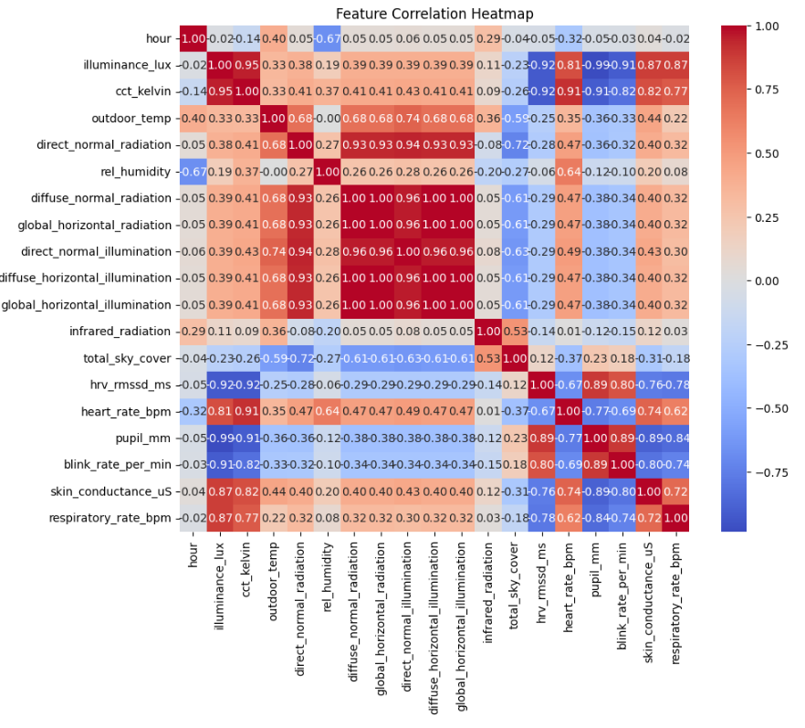
03
LIGHTING & AI | MACHINE LEARNING
Feature correlation heatmap
  Machine learning to transform the system from reactive
→ predictive
  Jupyter Notebook
  Supervised learning
  Neural networks
Notes:
Supervised learning uses input variables, called features, to predict output values, called labels.
Possible weather features include temperature, humidity, radiation, illumination, and sky cover.
Possible physiological features include heart rate, HRV, pupil size, blink rate, skin conductance, and respiratory rate.
The output labels in this case are the predicted illuminance (lux) and CCT (Kelvin).
Feature selection is important because the model must balance accuracy with the risk of overfitting.
Features with very high correlation to each other may be redundant, so they can be grouped or removed.
Features with high correlation to the labels are likely to be strong predictors for the model.
Cross-validation is used to check overfitting, and if the validation results are close to the test score, the model is likely not overfitting strongly.

Slide 23
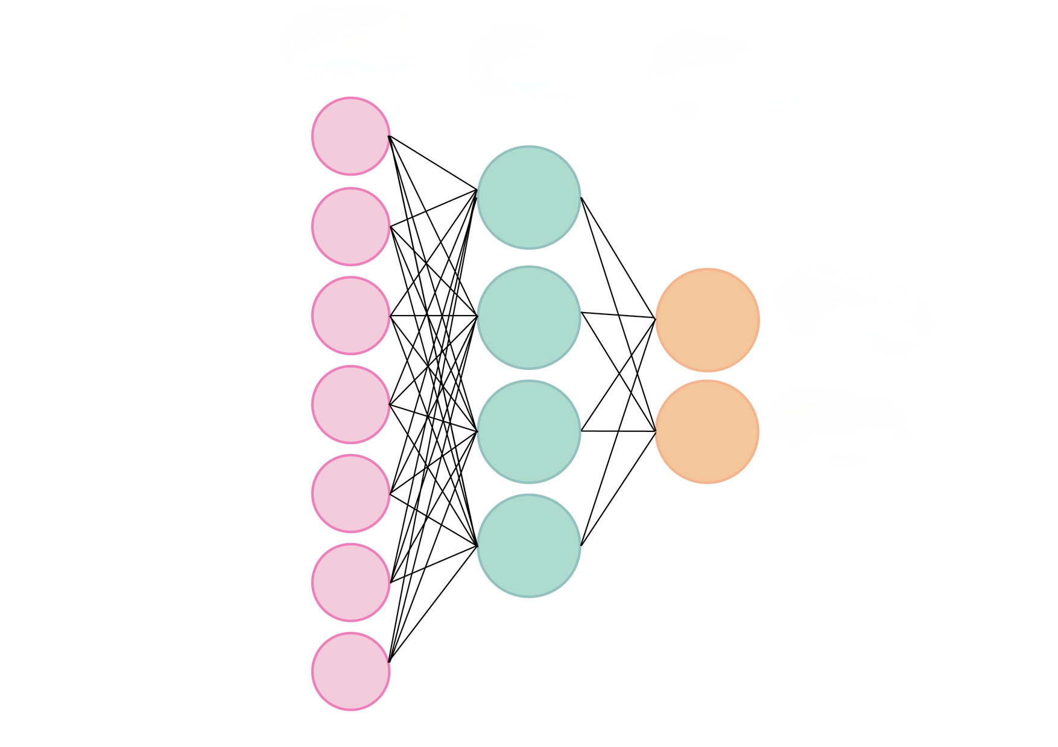
03
LIGHTING & AI | MACHINE LEARNING
Data grouping
  feature grouping based on correlation heatmap
Physological Features
Weather Features
INPUT HIDDEN OUTPUT
Filtering out redundant features
1
2
3
4
5
6
7
  Features with a high positive correlation could be measuring the same thing, so removing them prevents the model from overfitting
  Scatter plots will show this correlation
HVR
heart rate
pupil dialationil
blink ratek
skin conductance
respiration rate
Illuminance LUX
CCT Kelvin
temperature
humidity
skycover
diffuse radiation
global horizontal radiation
infrared radiation
direct radiation
direct illumination
diffuse horizontal illuminatio
global horizontal illumination

Slide 24
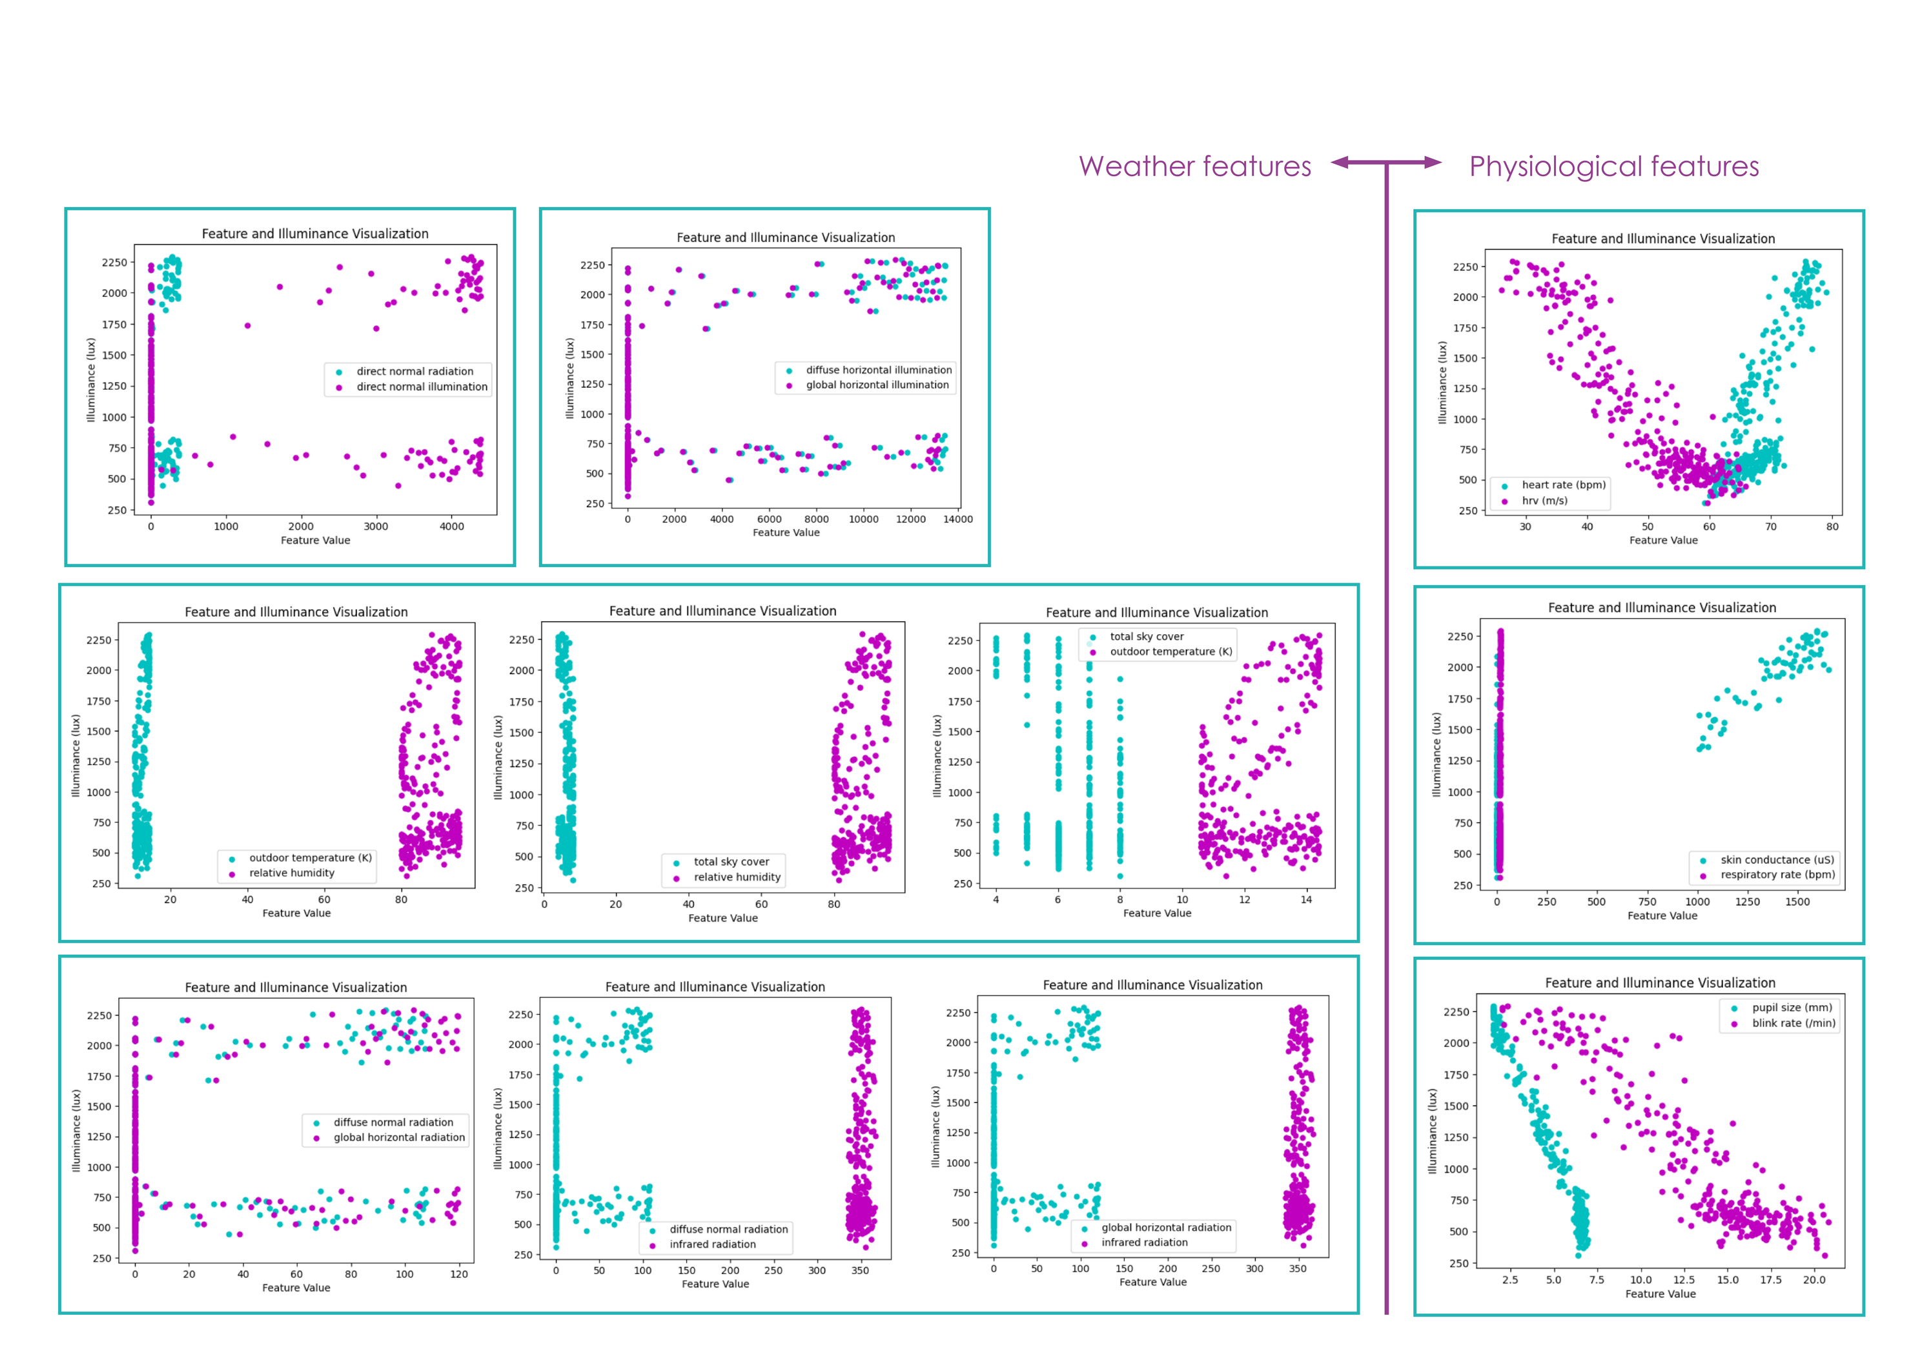
03
LIGHTING & AI | MACHINE LEARNING
Scatterplot Illuminance

Slide 25
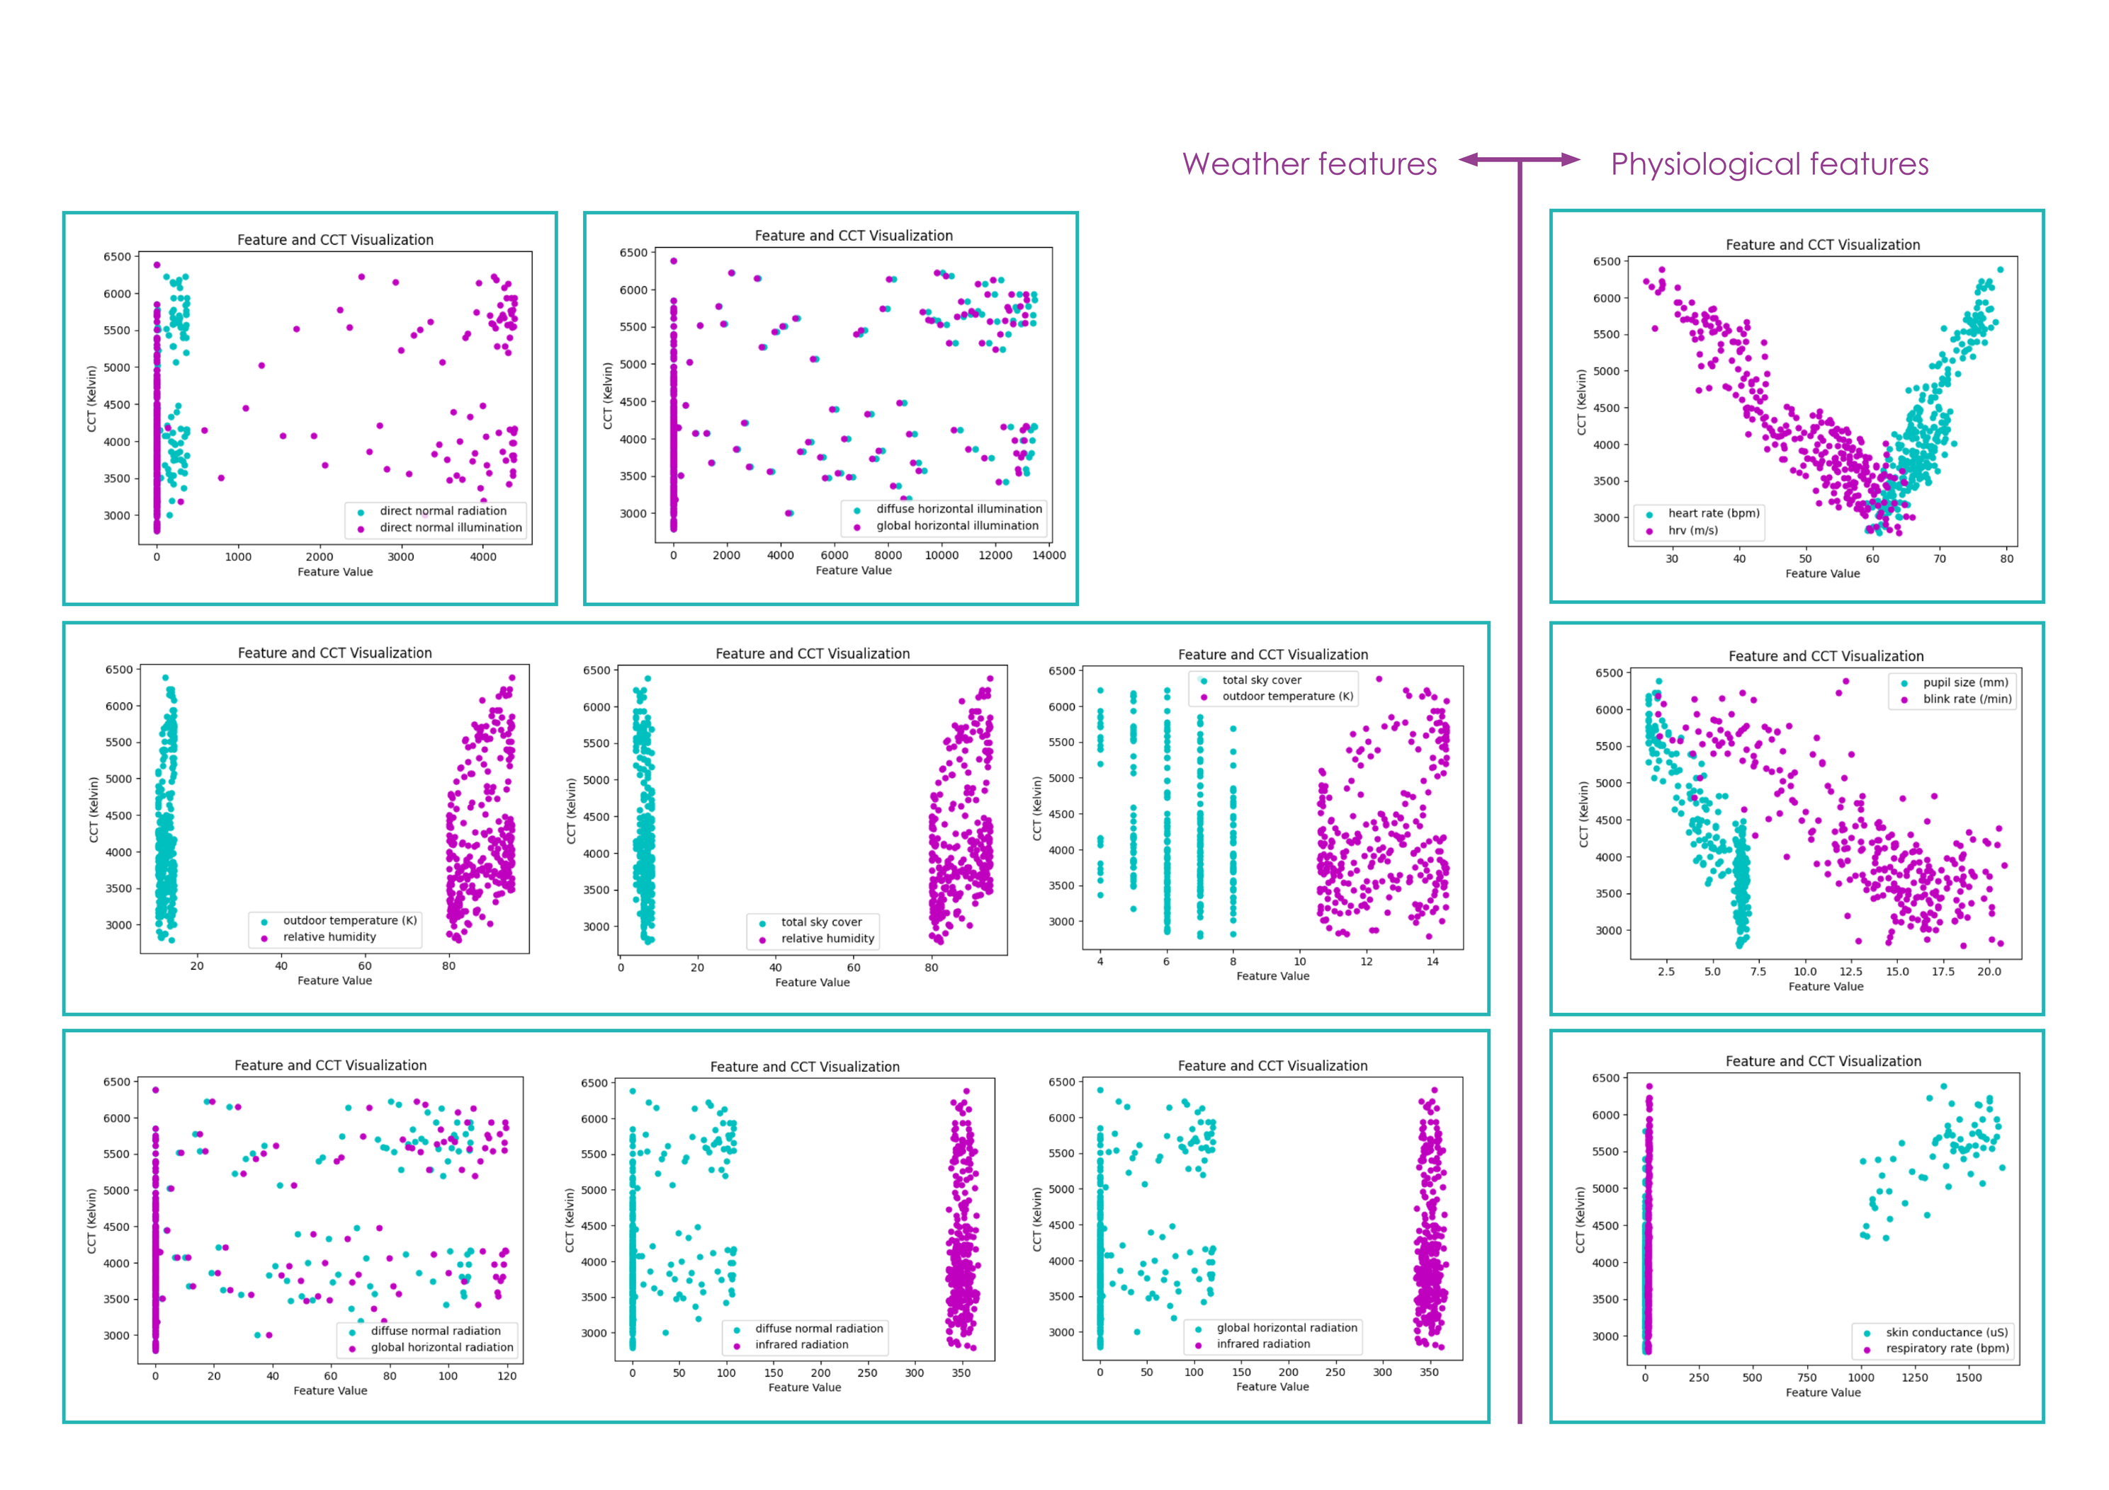
03
LIGHTING & AI | MACHINE LEARNING
Scatterplot CCT

Slide 26
03
LIGHTING & AI | MACHINE LEARNING
Data grouping conclusion
  Redundant features were removed or grouped
  Direct normal illumination, global horizontal illumination, diffuse normal radiation and pupil size were dropped
FINAL FEATURE GROUPS | WHAT DO THEY REPRESENT | TYPE OF CORRELATION
hrv_rmssd_ms + heart_rate_bpm | Stress level of person | High negative correlation
skin_conductance_uS + respiratory_rate_bpm + blink_rate_per_min | Stress, alertness, tiredness of person | High positive correlation
outdoor_temp + rel_humidity + total_sky_cover | Atmospheric conditions | Differs
global_horizontal_radiation + infrared_radiation + direct_normal_radiation + diffuse_horizontal_illumination | Scatterd light in atmosphere | Differs

Slide 27
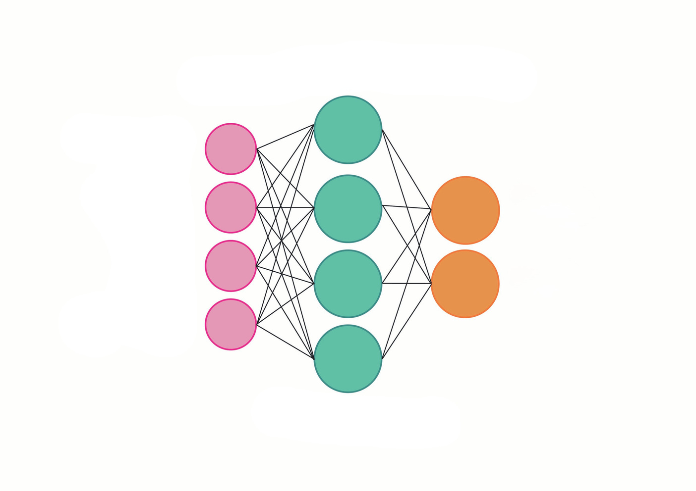
03
LIGHTING & AI | MACHINE LEARNING
Data grouping before & after dropped features
Physological Features
Weather Features
INPUT HIDDEN OUTPUT
INPUT HIDDEN OUTPUT
Physological Features
Weather Features
1
2
3
4
5
6
7
HVR
heart rate
pupil dialationil
blink ratek
skin conductance
respiration rate
HVR
heart rate
skin conductance
respiration rate
blink rate
1
2
3
4
Illuminance
CCT Kelvin
Illuminance LUX
CCT Kelvin
temperature
humidity
skycover
diffuse radiation
global horizontal radiation
infrared radiation
temperature
humidity
skycover
diffuse radiation
global horizontal radiation
infrared radiation
direct radiation
direct illumination
diffuse horizontal illuminatio
global horizontal illumination

Slide 28
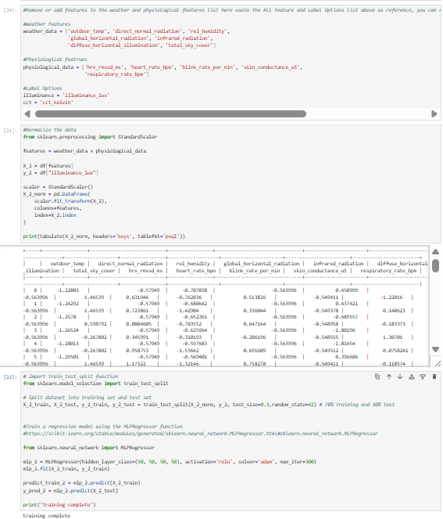
03
LIGHTING & AI | MACHINE LEARNING
Training and evaluating model
  The model was trained with the first selected features and compared to the final feature groups
  The model performance was evaluated using R², RMSE, and MAE
  The results show a strong improvement in accuracy, with higher R² and lower error values
Illuminance
  R-square = 75,4% → 96,1%
  RMSE = 292.06 → 116.67
  MAE = 239.49 → 93.74
CCT
  R-square = 27,5% → 80,2%
  RMSE = 761.90 → 397.62
  MAE = 321.18 → 239.49
Notes:
TRaining the model
The model was trained with the selected features. To see if this selection made an positive impact, the performance of the first model was compared to the second model trained with adjusted features.
Evaluating model performance
R-square is used to evaluate how well the model represents the data in %.
Error functions such as RMSE and MAE provide information about how far off the estimation is from the actual value. RMSE penalizes large errors and MAE takes the average. Both are relative to the scale of the dataset.
Illuminance
R-square = 75,4% → 96,1%
RMSE = 292.06 → 116.67
MAE = 239.49 → 93.74
Conclusion: clear improvement of the model performance.

Slide 29
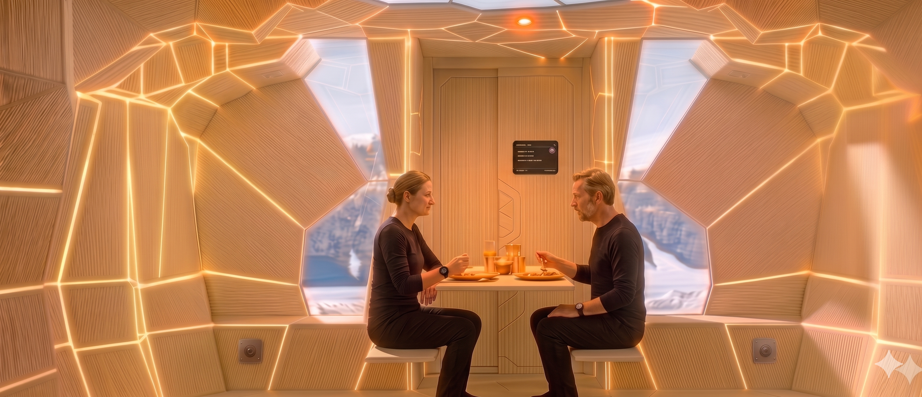

04
SYSTEMS INTEGRATION | CONFIGURATION C1
7.00-8.00: Dinner/Breakfast | Midnight sun
Lighting
Filtered window contribution:
250-400 lux, 5000-6500 K
Artificial circadian system:
  Base light, ambient lights
200-300 lux, 3000-3500 K
  direct light
300-500 lux, 2700-3000 K
Final perceived: 450-900 lux, 3500-5000 K
Control system
Motion sensor:
  Both walls folded
  Dining table unfolded
Smart watch:
  User A: regular heart rate
  User B: heart rate increases
Environmental data: Midnight sun
Rendered with Gemini
Light
Brightness
Warmth
Notes:
three configurations for showing our main variables:
- arctic summer not shaded
- arctic summer shaded (evening)
- arctic winter
- collective
- private
- semiprivate
(all of the lights)
Lighting
Filtered window contribution:
250-400 lux, 5000-6500 K
Artificial circadian system:
Base light, ambient lights
200-300 lux, 3000-3500 K
direct light
300-500 lux, 2700-3000 K
Final perceived: 450-700 lux, 4000-5000 K
Control system
Motion sensor:
Both walls folded
Dining table unfolded
Smart watch:
User A: regular heart rate
User B: high heart rate
Environmental data: Midnight sun

Slide 30
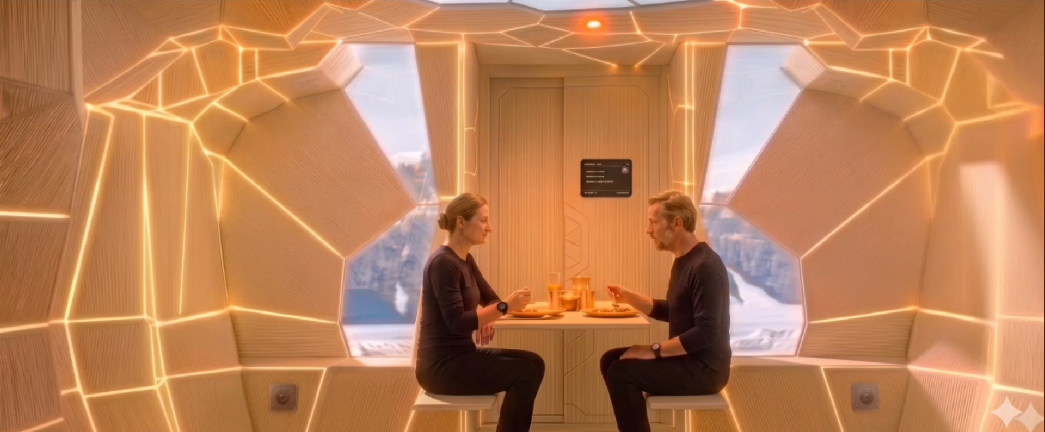

04
SYSTEMS INTEGRATION | CONFIGURATION C1
7.00-8.00: Dinner/Breakfast | Midnight sun
Lighting
Filtered window contribution:
250-400 lux, 5000-6500 K
Artificial circadian system:
  Base light, ambient lights
200-300 lux, 3000-3500 K
  direct light
300-500 lux, 2700-3000 K
Final perceived: 450-900 lux, 3500-5000 K
Control system
Motion sensor:
  Both walls folded
  Dining table unfolded
Smart watch:
  User A: regular heart rate
  User B: heart rate increases
Environmental data: Midnight sun
Rendered with Gemini
Heart rate adjustment
Light
Brightness
Warmth
Notes:
three configurations for showing our main variables:
- arctic summer not shaded
- arctic summer shaded (evening)
- arctic winter
- collective
- private
- semiprivate
(all of the lights)

Slide 31
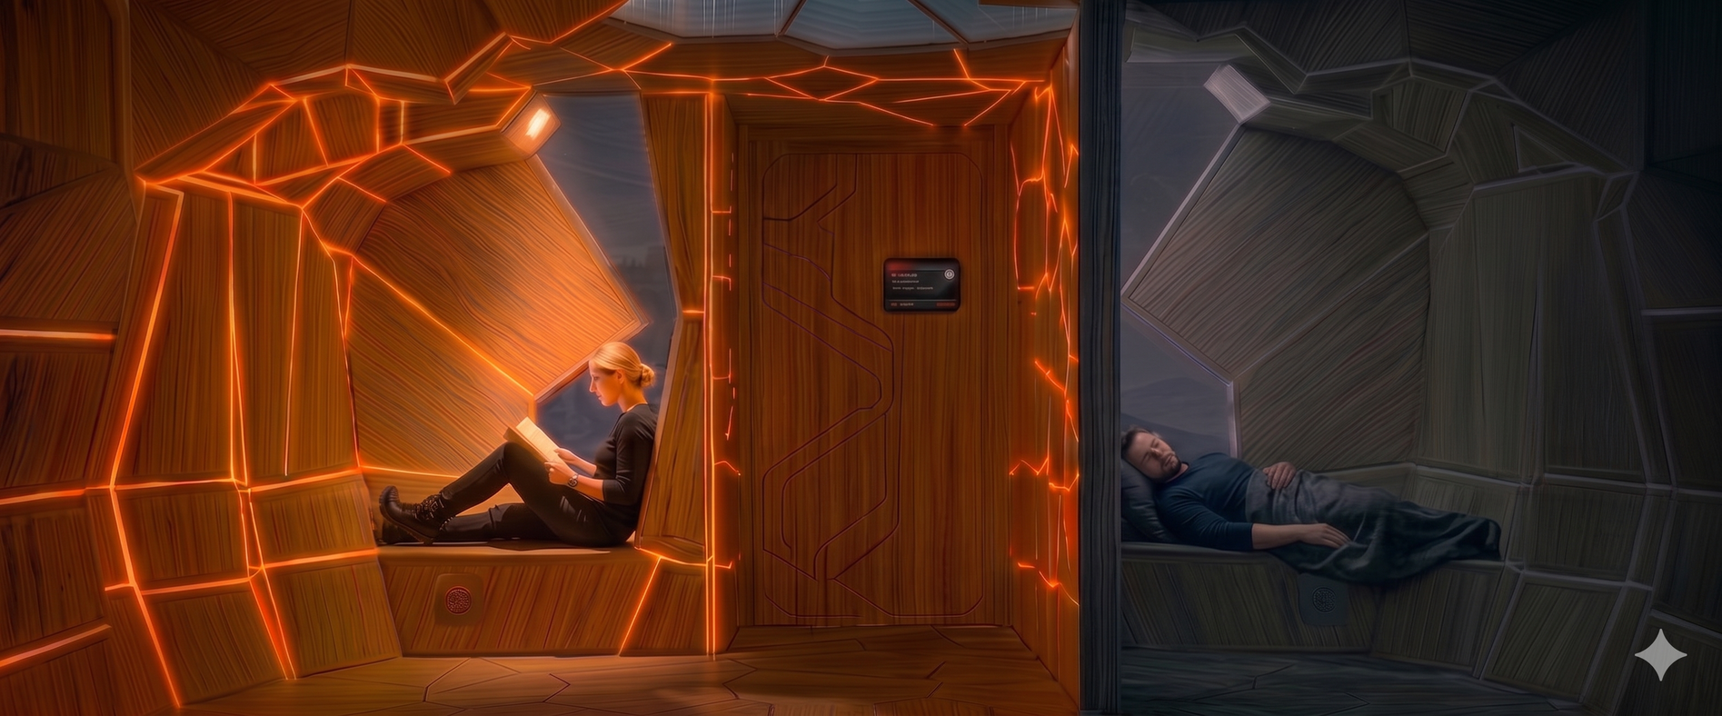
04
SYSTEMS INTEGRATION | CONFIGURATION C2
05.00-07.00: Leisure/Sleep | Midnight sun
Lighting
Filtered window contribution:
10-40 lux, 5500-6500 K (Selective shading)
(User A) Artificial circadian system:
  Base lights, ambient lights
40-150 lux, 1700-2000 K
  Direct light 150-300 lux, 2700-3500 K
Final perceived: 50-200 lux, 2000-3200 K
(User B) Artificial circadian system: 0 lux, 0 K
Final perceived: 0-20 lux, 8500-10000 K
Control system
Motion sensor:
  Wall user A folded
  Bed user B unfolded
Smart watch:
  User A: low heart rate
  UserB: very low heart rate
Environmental data: Midnight Sun, shaded
Rendered with Gemini
Light
Brightness
Warmth
Notes:
Lighting
Filtered window contribution: 150-300 lux and 5000-65000 K
Artificial circadian system:
- Base light, ambient lights, direct
illuminance: 200-350 lux
colour: 3500-4500 K
Navigation light:
illuminance: 3-10 lux
color: 1800-200 K
Final perceived:
illuminance: 350-650 lux
colour: 5500-6400 K
Controls | Rest & Recovery:
Motion sensor:
Both walls unfolded
Beds unfolded
Smart watch:
Person A: low heart rate
Person B: very low heart rate
Environmental data:
Midnight sun, but shaded

Slide 32
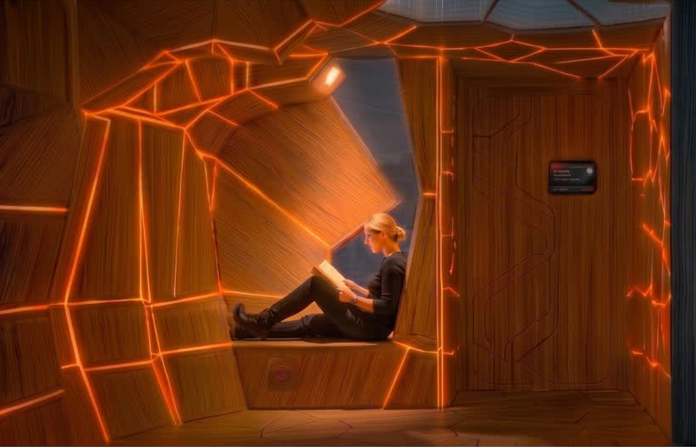
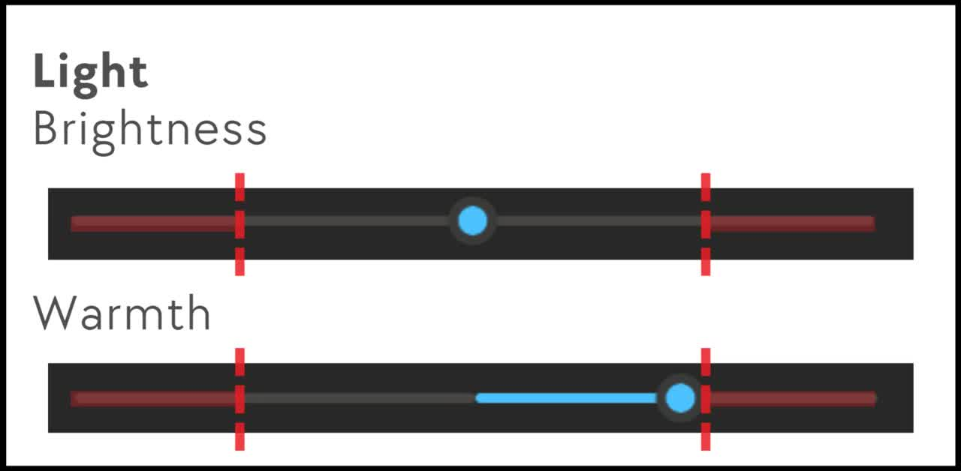
04
SYSTEMS INTEGRATION | CONFIGURATION C1
05.00-07.00: Leisure/Sleep | Midnight sun
Lighting
Filtered window contribution:
10-40 lux, 5500-6500 K (Selective shading)
(User A) Artificial circadian system:
  Base lights, ambient lights
40-150 lux, 1700-2000 K
  Direct light 150-300 lux, 2700-3500 K
Final perceived: 50-200 lux, 2000-3200 K
(User B) Artificial circadian system: 0 lux, 0 K
Final perceived: 0-20 lux, 8500-10000 K
Control system
Motion sensor:
  Wall user A folded
  Bed user B unfolded
Smart watch:
  User A: low heart rate
  UserB: very low heart rate
Environmental data: Midnight Sun, shaded
Rendered with Gemini
Personal preference
Warmth

Slide 33
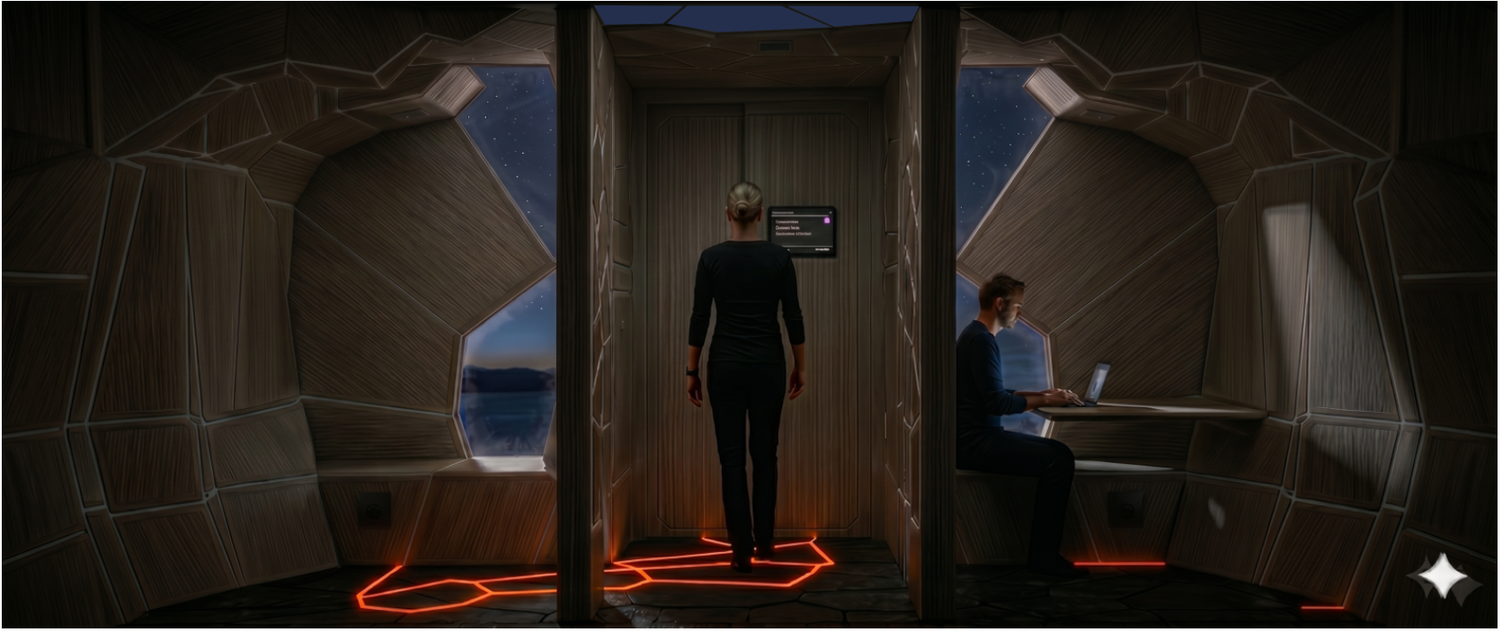
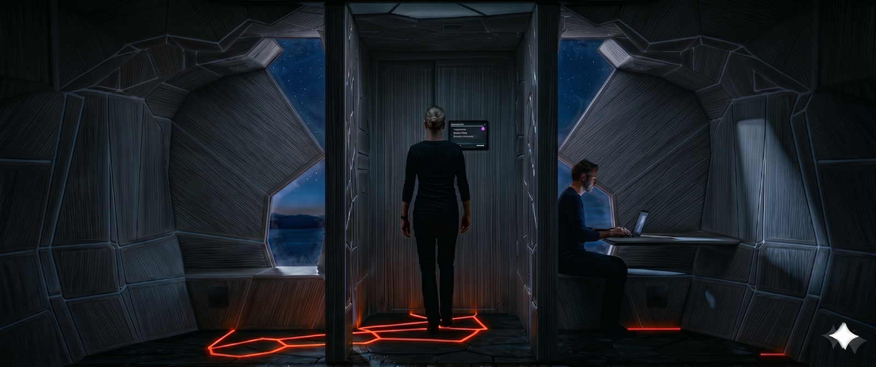
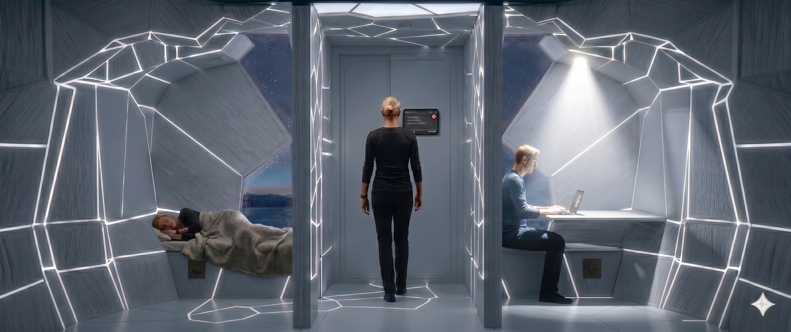
04
SYSTEMS INTEGRATION | CONFIGURATION C3
14.00-17.00: Sleep/work | Polar night
Lighting
Filtered window contribution:
0-20 lux, 8500-10000 K
(User A) Artificial circadian system:
  Navigation lights 3-10 lux, 1700-2000 K
Final perceived: 3-30 lux, 1700-2000 K
(User B) Artificial circadian system:
  Base light, ambient lights
600-750 lux, 5500-6500 K
  Direct light 500-650 lux, 4000-5000 K
Final perceived: 600-770 lux, 5500-6500 K
Control system
Motion sensor:
  Both walls unfolded
  Bed user A & desk user B unfolded
  User A out of bed
Smart watch:
  User A: low heart rate
  UserB: high heart rate (stress)
Environmental data: Polar night
2700-4000 K
100-300 lux
2700-4000 K
100-300 lux
Rendered with Gemini
Light
Brightness
Warmth

Slide 34
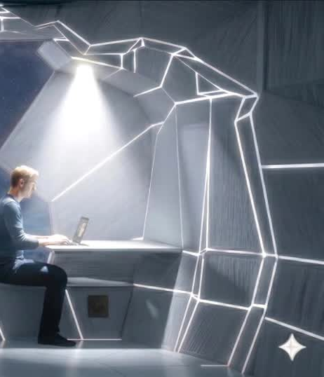
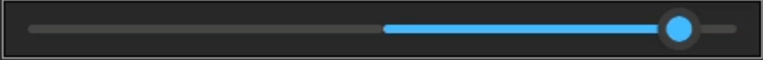
04
SYSTEMS INTEGRATION | CONFIGURATION C3
14.00-17.00: Sleep/work | Polar night
Lighting
Filtered window contribution:
0-20 lux, 8500-10000 K
(User A) Artificial circadian system:
  Navigation lights 3-10 lux, 1700-2000 K
Final perceived: 3-30 lux, 1700-2000 K
(User B) Artificial circadian system:
  Base light, ambient lights
600-750 lux, 5500-6500 K
  Direct light 500-650 lux, 4000-5000 K
Final perceived: 600-770 lux, 5500-6500 K
Control system
Motion sensor:
  Both walls unfolded
  Bed user A & desk user B unfolded
  User A out of bed
Smart watch:
  User A: low heart rate
  UserB: high heart rate (stress)
Environmental data: Polar night
2700-4000 K
100-300 lux
2700-4000 K
100-300 lux
Rendered with Gemini
Corrective fading
Light
Brightness
Warmth

Slide 35
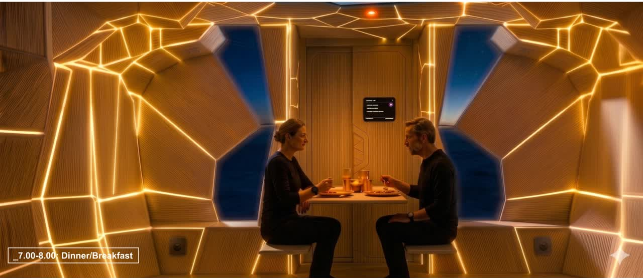
Rendered with Gemini

Slide 36



05
DIGITAL PROTOTYPE | LIGHTING
Arduino prototype setup
Jupyter code
Gate
MOSFET 1
Warm channel
MOSFET 2
Cool channel
Drain
Warm white LED lights
&
Cool white LED lights
&
Arduino code
Serial via
USB
Source
12V
Power supply
+ GND
Arduino UNO
+ calculate warm_pwm and cold_pwm

Slide 37


05
DIGITAL PROTOTYPE | FRAGMENT LOGIC
Selected fragment
Shelf fixed hinge housing
Metal axle
Table panel fixed hinge housing
Rotating table panel
  3D printed automated rotating mecanism
  attached to the table base and to the shelf edge
  wires integrated in the thickness of the table panel and shelf lower surface
Notes:
Goal: Show intelligence of assembly
Content:
Exploded axonometric of the fragment
detachable parts
Add labels:
automatically movable

Slide 38


05
DIGITAL PROTOTYPE | FRAGMENT LOGIC
Arduino microcontroller
Motor integrated into the fixed structure
To control the mechanism
High-torque servo motor (MG996R type)
  Direct angle control (0–180°)
  Compact (40mm x 19mm x 43mm)
  easy to hide in the Voronoi structure
Notes:
Goal: Show intelligence of assembly
Content:
Exploded axonometric of the fragment
detachable parts
Add labels:
automatically movable

Slide 39







05
DIGITAL PROTOTYPE | STRUCTURAL OPTIMIZATION
Mesh with load from Karamba
(for the table panel)
Selection of a single panel
Stress curves
(red:compression, blue: tension)
Voronoi ribs structure from the stress curves

Slide 40
05
DIGITAL PROTOTYPE | MATERIAL
Production Method
Material
Prototype geometry
Hinge connection
Additive D2RP
RECYCLED PLASTIC
METAL
Robotically 2D printed components
Printed from recycled PET bottles
filament
reliable rotation and strength
Complex Voronoi
geometries
Demountable and
reconfigurable elements
Lightweight, durable, and suitable for modular furniture components
precise inserted technical parts that complement printed geometry
color: neutral tone: calm and cohesive aesthetic, subtly diffused light across the Voronoi surfaces
Repair
Replacement
Adaptation
Notes:
Recycled PET
Goal: Show material thinking (not generic sustainability talk)
Content:
Close-up render or photo of of texture
Small diagram:
PET bottles → filament → printed element
Text
lightweight
durable
circular lifecycle
material reduction through geometry (very important concept)

Slide 41


05
DIGITAL PROTOTYPE | RENDER
Prototype
Use scenario

Slide 42

Thank you for your attention !

