Slide 1
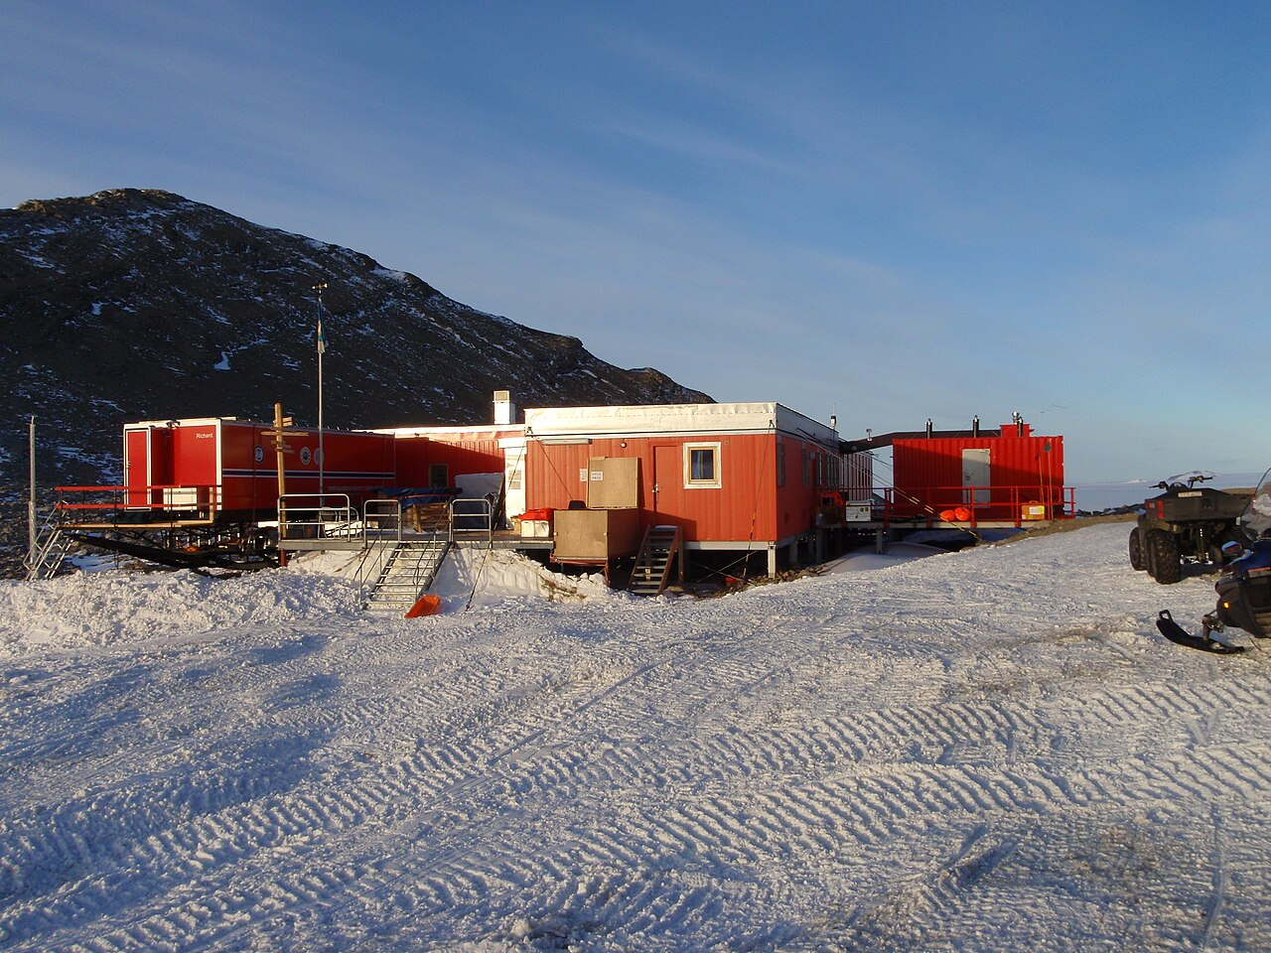
TROLL RESEARCH STATION
Project presentation_week 3
Group 1: Iris Claus, Daphne Kamsteeg, Ludovica Perone Pacifico, Chloé Phan, Marieke van Wijk
IAP Workshop
Q3 2026
Prof. Henriette Bier, Arwin Hidding, Lisa-Marie Mueller, Vera Laszlo

Slide 2
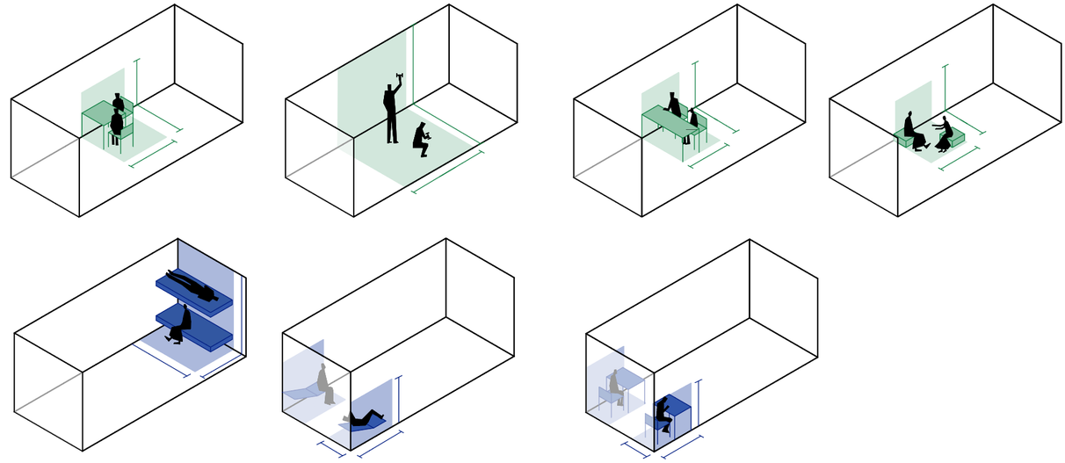
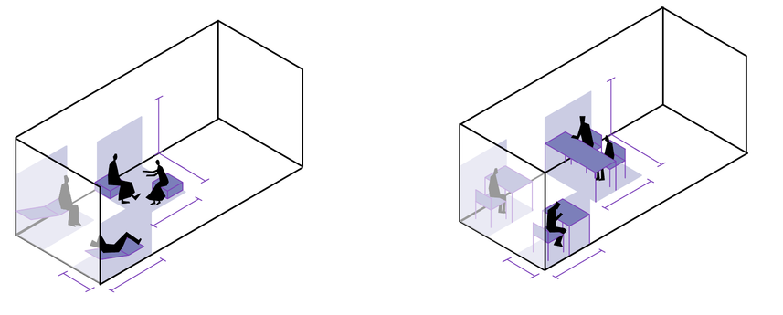
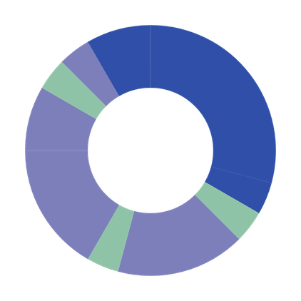
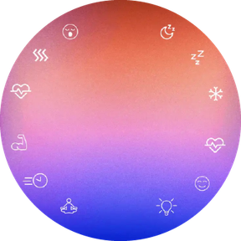
01
ACTIVITY MAPPING | 24/7
ceiling
Relaxing
21.00 - 22.00
2.5 m
Waking up: 6500K Low-intensity bluish light that gradually increases
light
2 m
1.5 m
1.4 m
1.6 m
1.6 m
Sleeping
22.00 - 7.00
wall
1.5 m
Dining
20.00 - 21.00
1 h
0.8 m
1 h
9 h
Highest duration. Lowest frequency, hence must be folded away or reconfigured. At extremities to minimise daytime circulation interference.
Night: Amber-red light (<2000K), only near the floor for orientation
Diffused light
00.00
Relaxing / exercising
18.00 - 20.00
2 h
18.00
06.00
2.5 m
1 h
Hygiene
7.00 - 8.00
1.4 m
2.5 m
Working
14.00 - 18.00
4 h
12.00
1 h
1.6 m
2.5 m
1 h
1.6 m
4 h
Dining
8.00 - 9.00
Ceiling uniform light
Demands maximum clearance of floor area.
Dining
13.00 - 14.00
Highest frequency, hence must be easily accessible.
Ceiling vertical light
+ Storage space
of personal items, clothing, working equipment.
Fixed. Compact, to maximise space clearance
at least two modules
1.4 m
Legend
3.7 m
Individual
peripheral zones
1.5 m
Collective
central zones
Working
9.00 - 13.00
1.5 m
Cool White, can be adjusted for the light to hit the work surface vertically
Both
demand two configurations, one for collective and one for private fruition
1.5 m
0.8 m
1.5 m
0.8 m

Slide 3
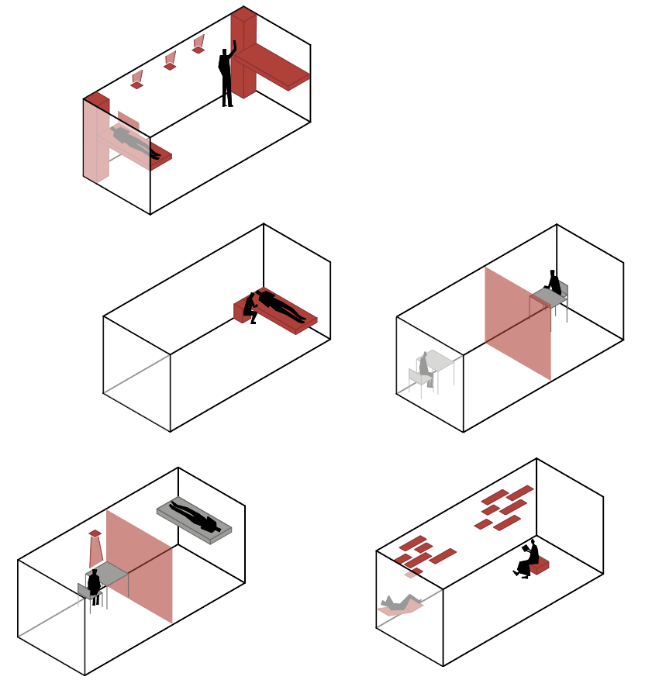
02
ACTIVITY MAPPING | SCENARIO ANALYSIS
1 - Standard ops day
4 - Asynchronous shifts
3 - Emergency mode
Separate beds with integrated personal storage and privacy separator. For optimized circulation with no functional overlap and light and acoustic shielding in sleeping zone.
Foldable partition to subdivide container into two private rooms.. Indepentent light control between the two zones. For increase acoustic and light insulation.
2 - Active recovery day
5 - Patient care
Foldable partition to subdivide container into two private rooms. For increased privacy and psychological benefits during prolonged isolation
Adjustable modules for user-driven spatial reconfiguration to enable environmental personalization and reduce visual monotony.
Bed at ergonomic standing height and integrated bedside surface to enable assisted care.

Slide 4

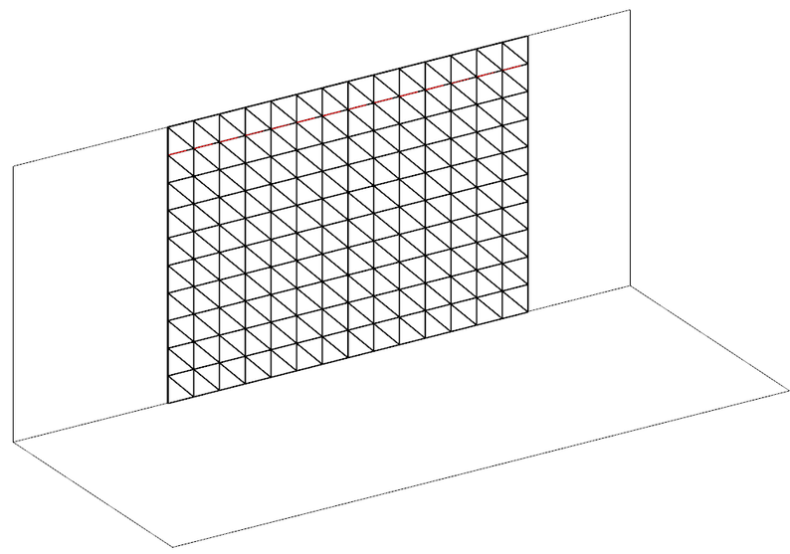




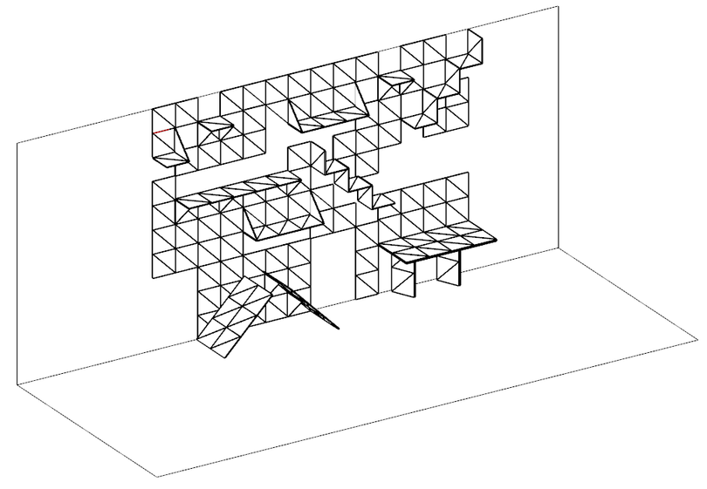
03
ADAPTIVE FURNISHING
Distribution principles
Voronoi - orthogonal integration
The cleared space mantains a orthogonal volume to optimise furniture integration and fruition of space
2
5
2
6
3
4
1
7
1
Legend
The Voronoi acts as a skin on the walls of the container, allowing for reconfiguration
“Permanent” furniture
More space-consuming and/or fixed furnitures are placed in peripheral spaces
  Storage 2. Bed and workstation
Temporary furniture
Furniture in the center of the container is easily reconfigurable and can be folded to a surface, for maximum clearance of the space
3. (lounge) chair 4. Dining table 5. Room divider 6. Terra peel 7. Multipurpose wall
Next steps: integrate irregularity in shape

Slide 5


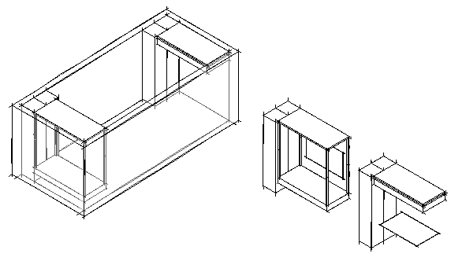
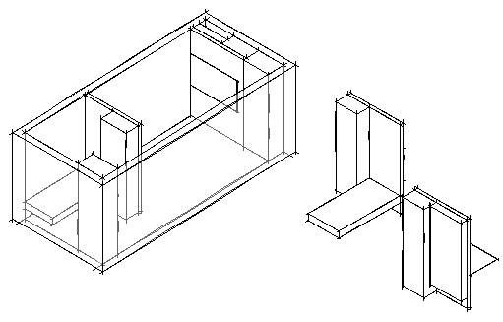
03
Option 1:
Option 2:
ADAPTIVE FURNISHING |
BED
Option 1:
Option 2:
Bed up
Bed down
Bed up
Bed down
Focus points:
  This space can be closed off for privacy and that it can be made completely dark while sleeping
  The bed takes up a lot of space, while it's only really used at night, so it needs to be foldable.
Working desk
Option 1:
Bed can be pushed up to the ceiling -> space underneath
Option 2:
sliding wall with a fold-out bed for private space
Relationship to Lighting:
  Personalized lighting
  sun-cycle lighting integrated in the ceiling
Working desk

Slide 6
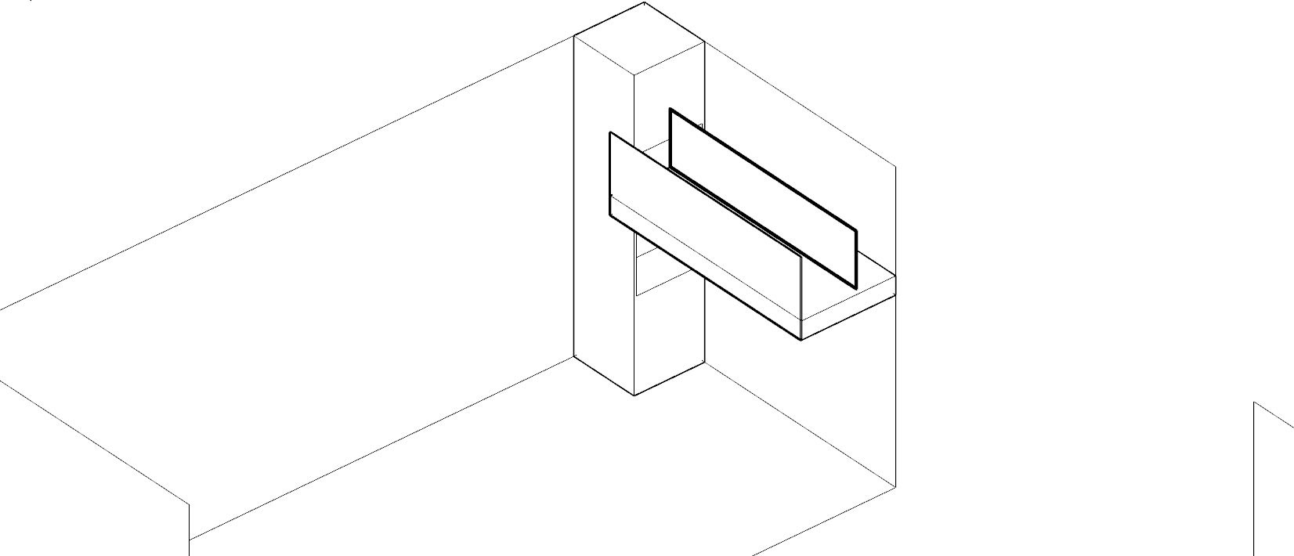
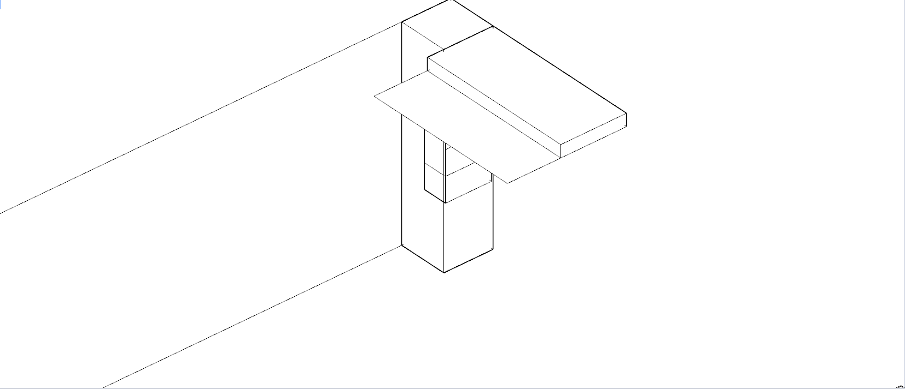
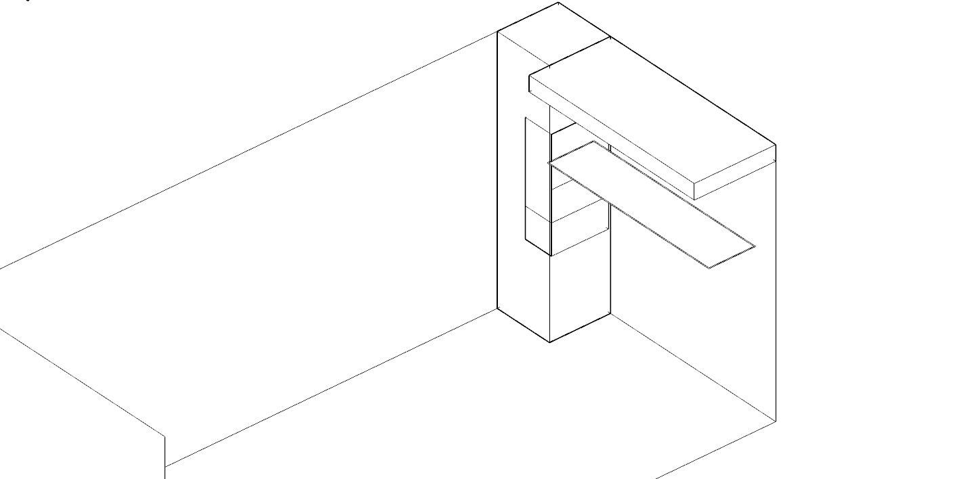
04
ADAPTIVE FURNISHING | WORKSTATION
Integrated reconfigurable lighting system
container key plan
1 - Perimeter glow integrated into bedframe
2 - Panel positioned vertically for desk illumination
When the bed is in use, for the regulation of the circadian rythm.
  Control system: CV
direct light above desk, hitting the desk vertically to avoid shadows cast from researcher body
  Control system: CV

Slide 7
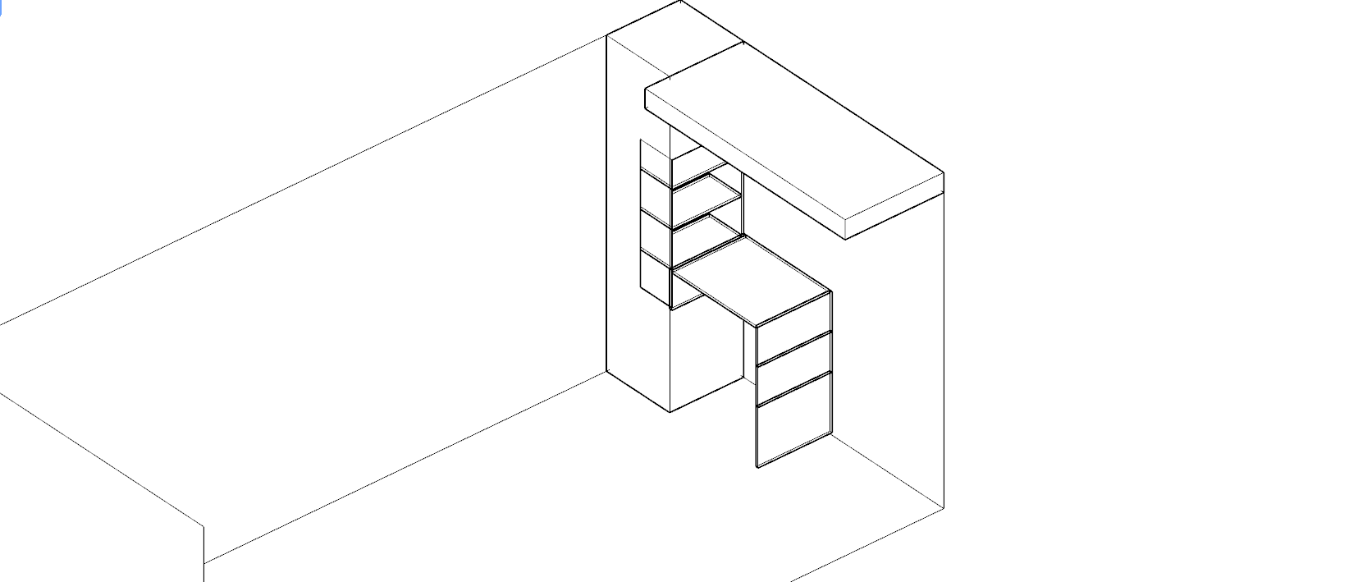
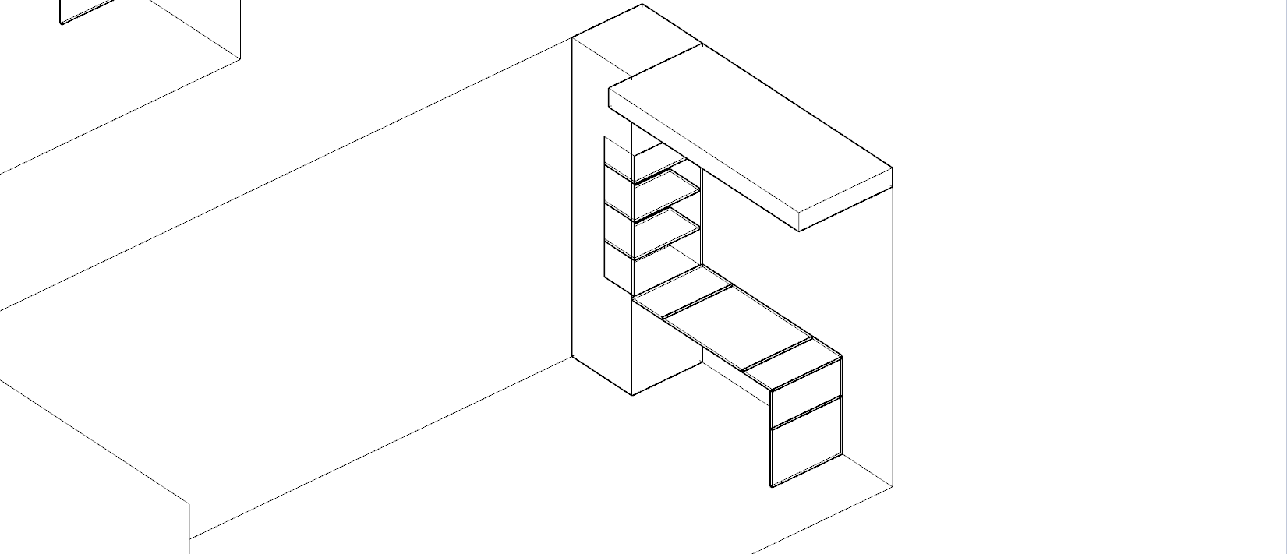
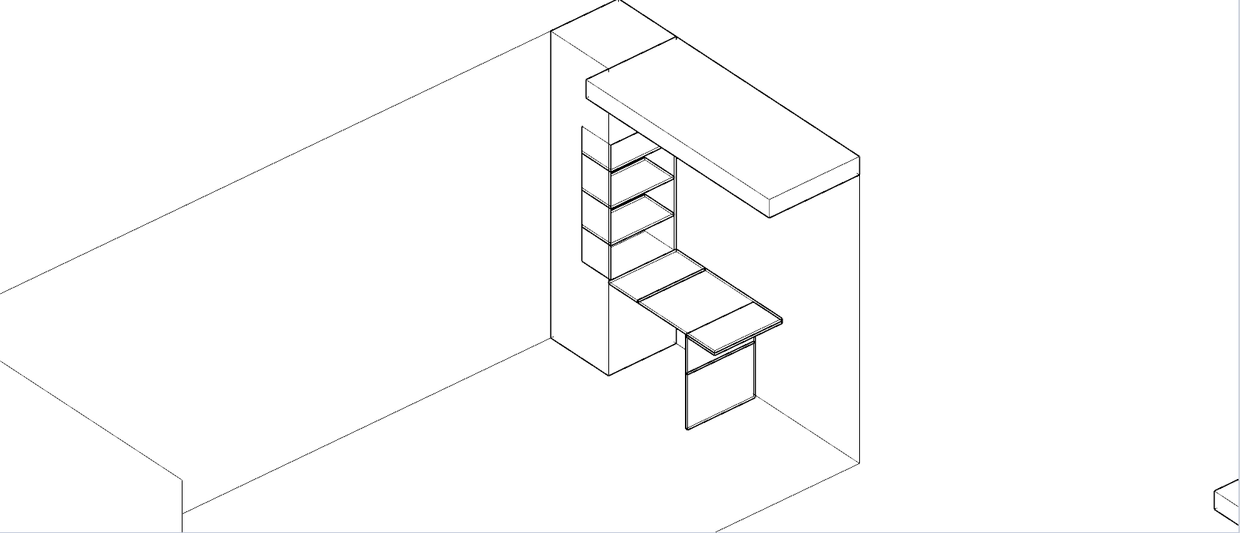
04
ADAPTIVE FURNISHING | WORKSTATION
Reconfigurable furniture system
container key plan
1 - Workdesk for two people
2 - workdesk for one person
3 - standing desk

Slide 8
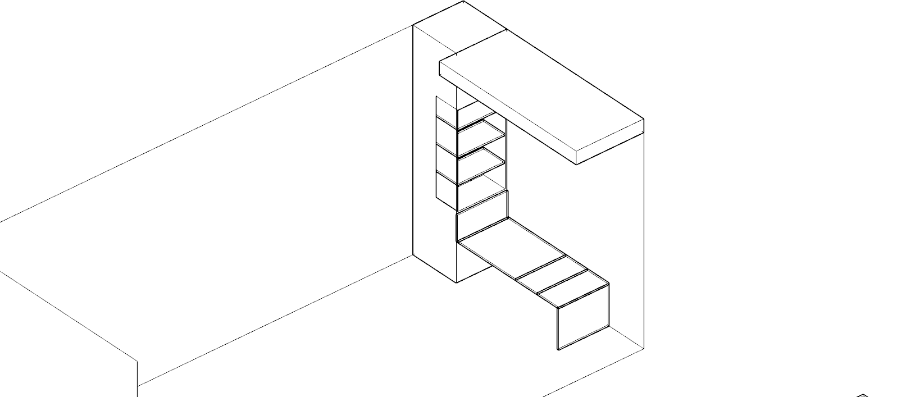
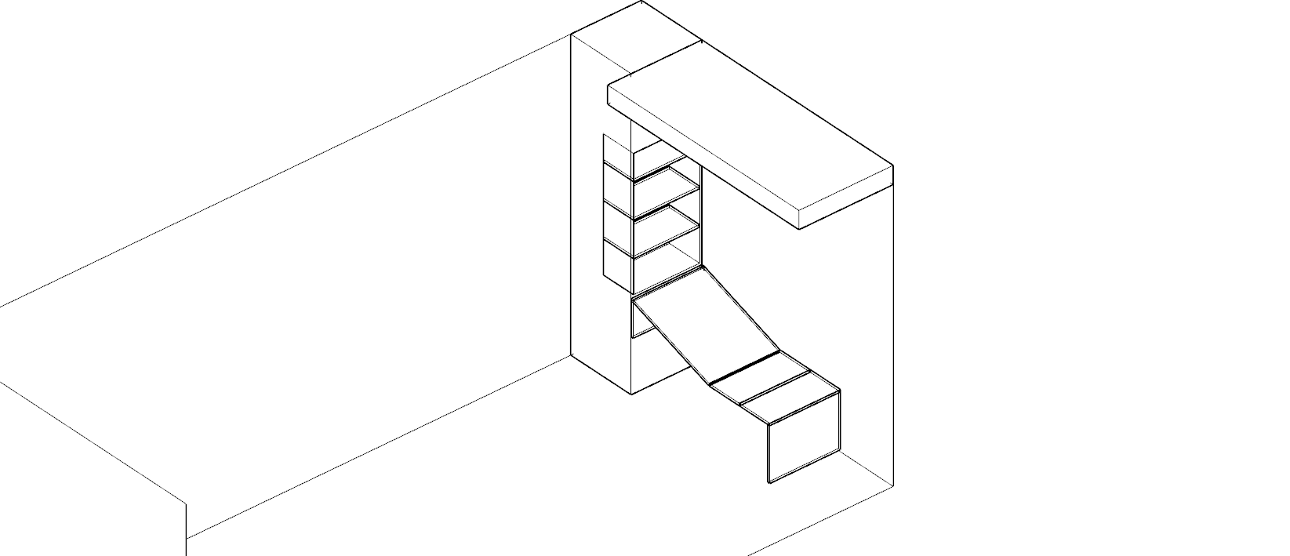
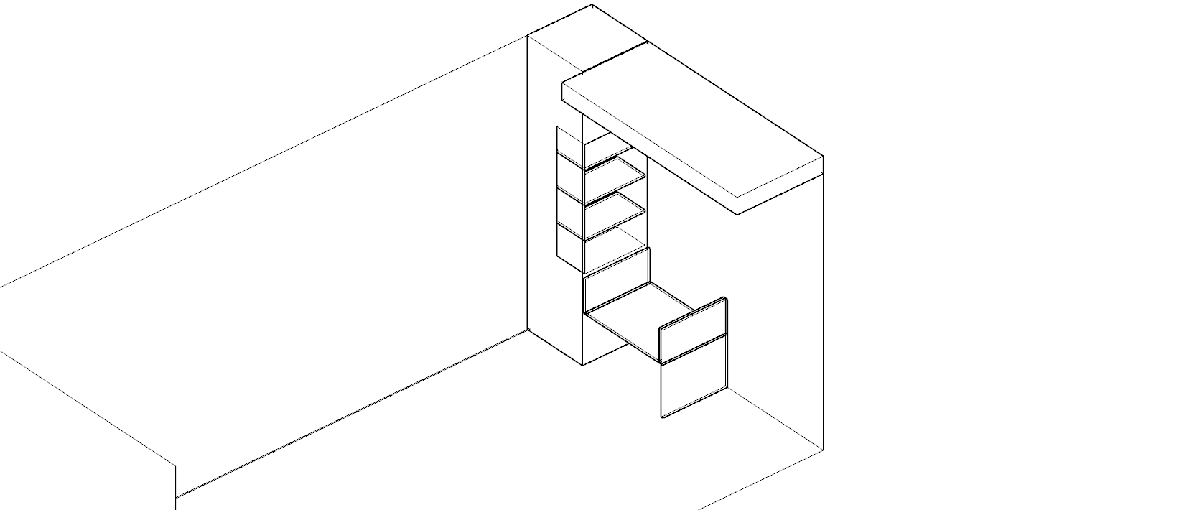
04
ADAPTIVE FURNISHING | WORKSTATION
Reconfigurable furniture system
container key plan
4 - Reading bench
5 - lounge chair
6 - Armchair frame

Slide 9

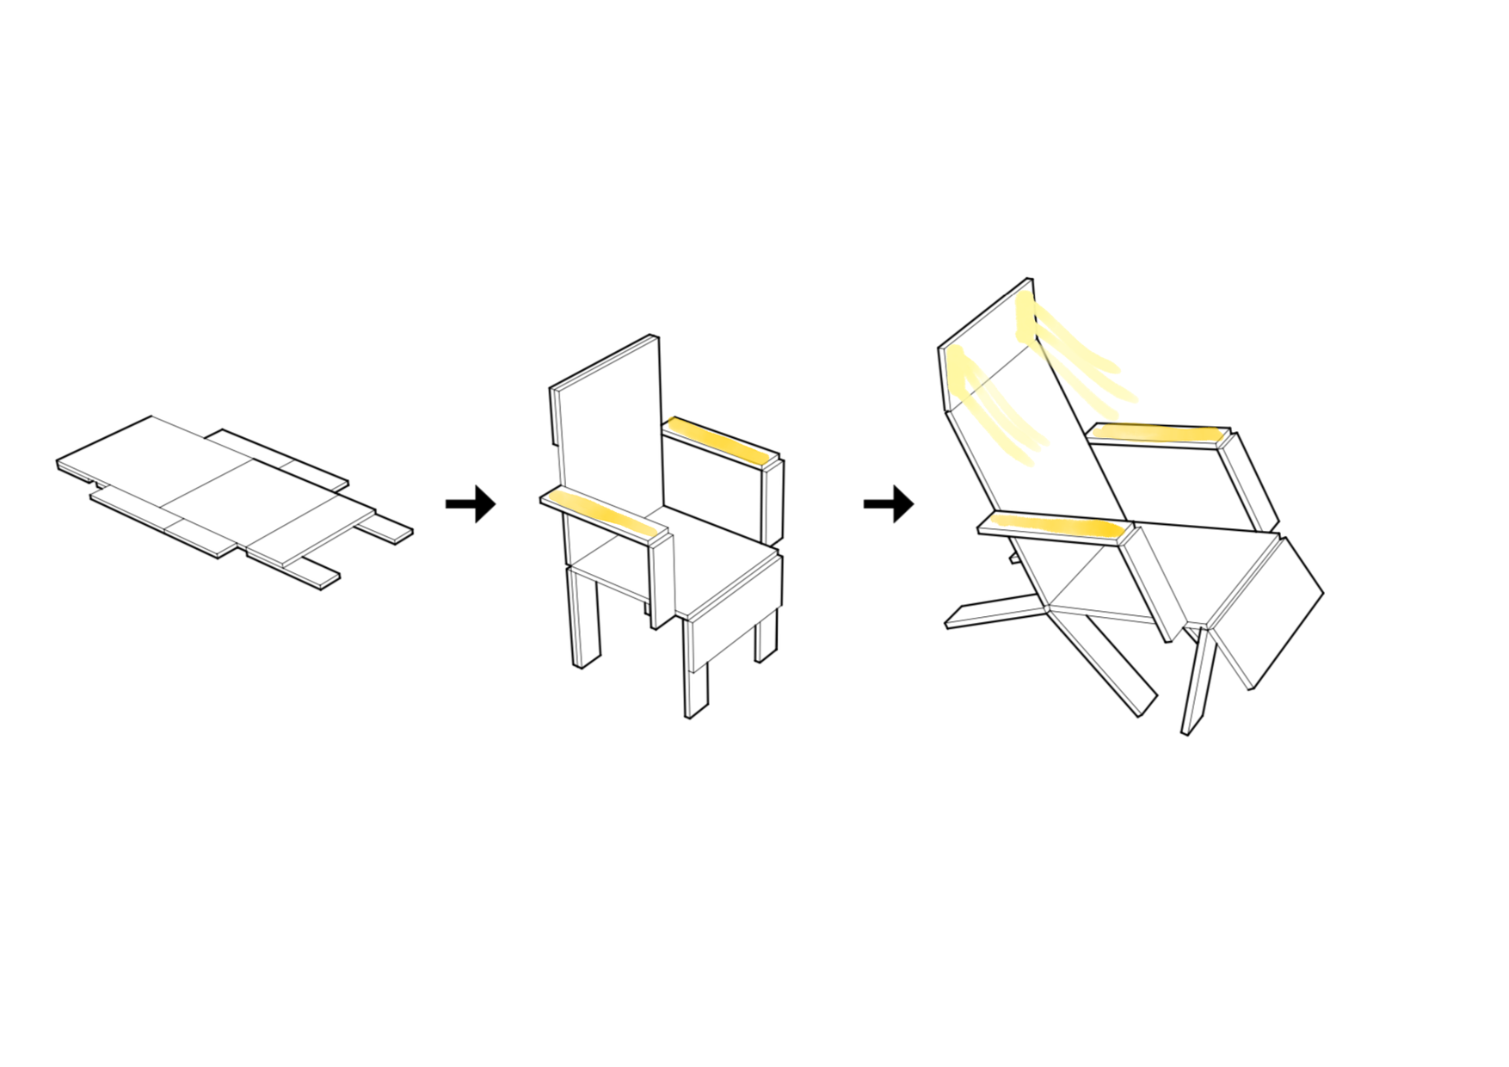
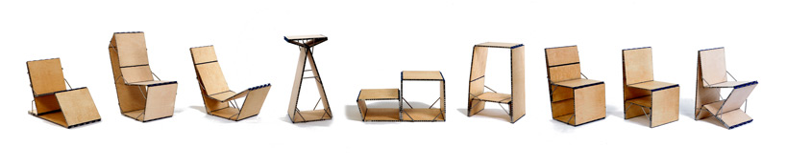
05
ADAPTIVE FURNISHING | (LOUNGE) CHAIR
Focuspoints
The chair can be used at the desk, the dining table and for lounging.
  It is not fixed on the wall but a moveable object.
  Can be folded flat
Lighting
  Ambient light in the armrests, pressure sensors
  Focused reading light in the headrest for for example reading and other lounging activities, hinge sensor light
Reference: Loop chair by Boaz Mendel
  a lot of different configurations possible, but it is not quickly changeable

Slide 10
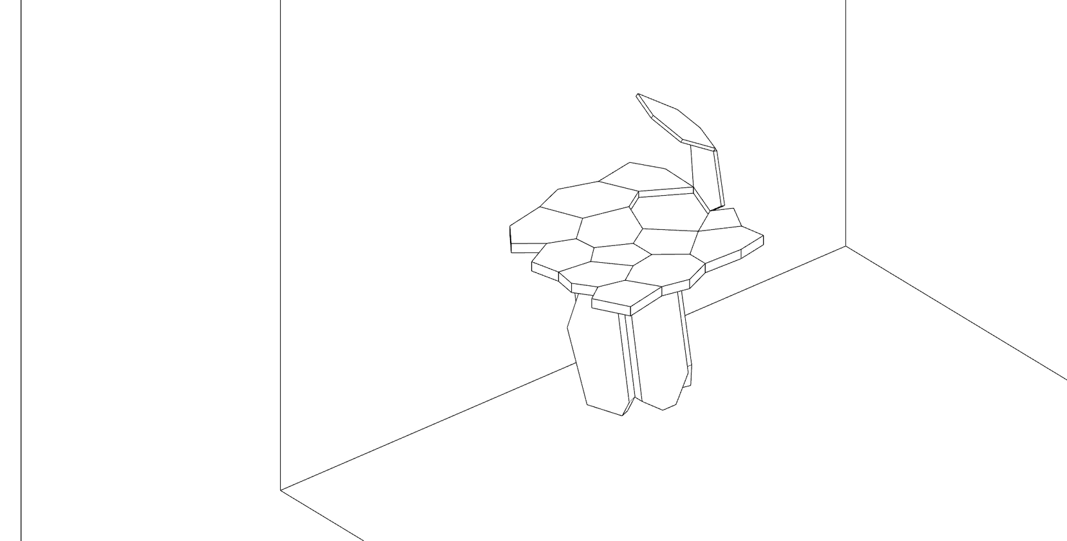
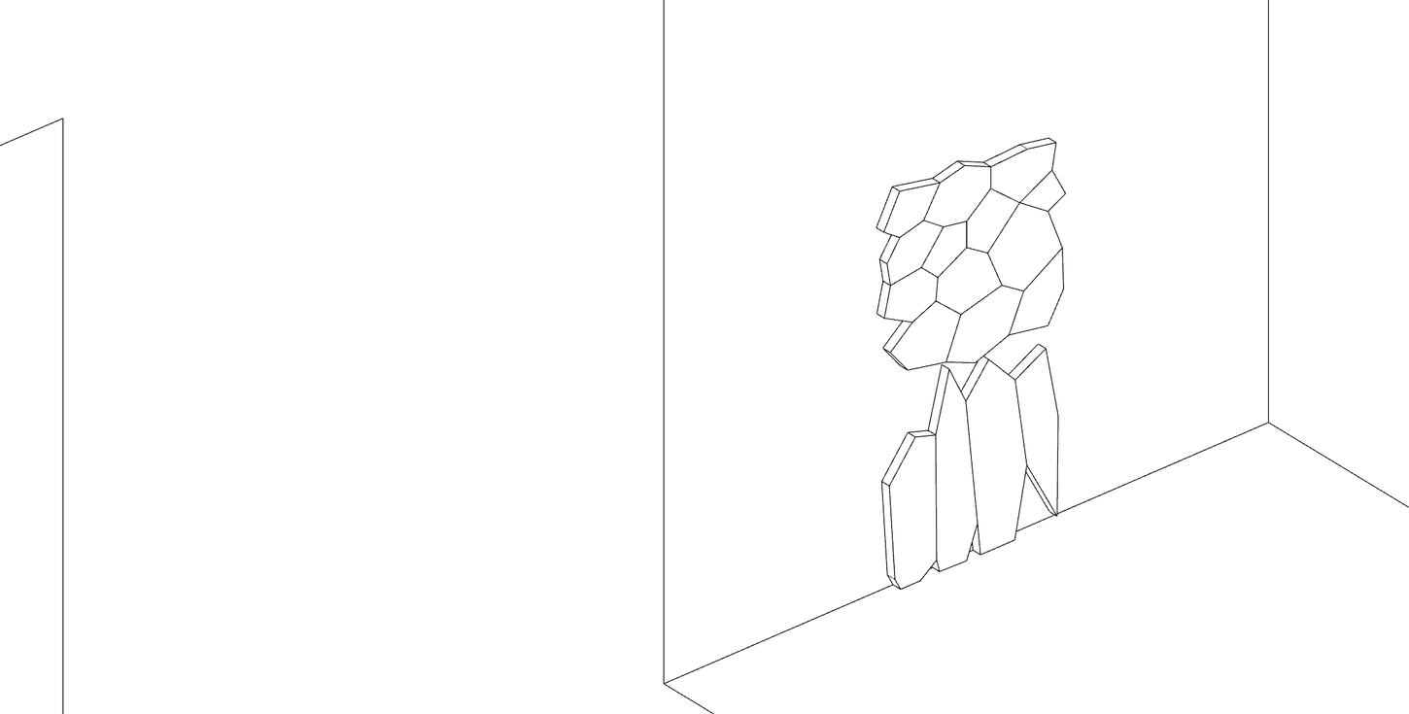
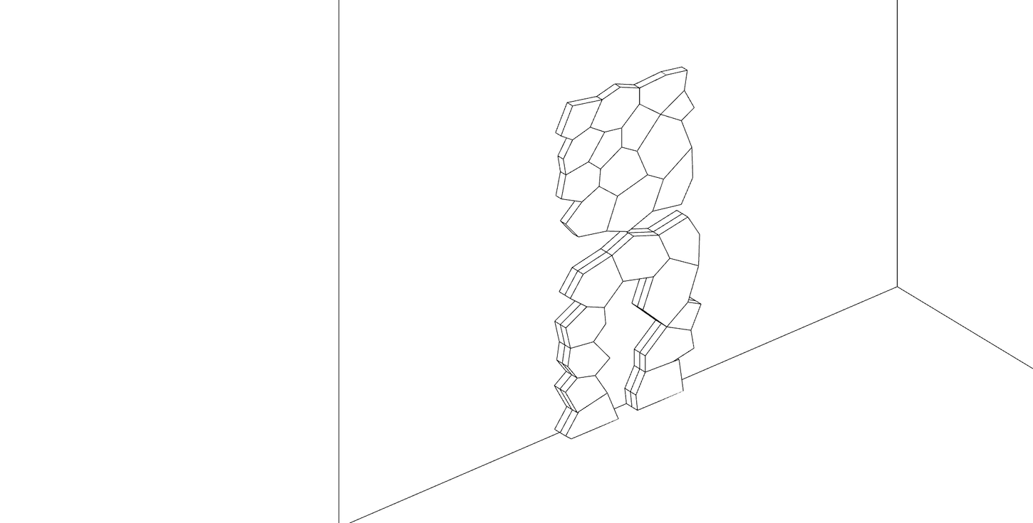
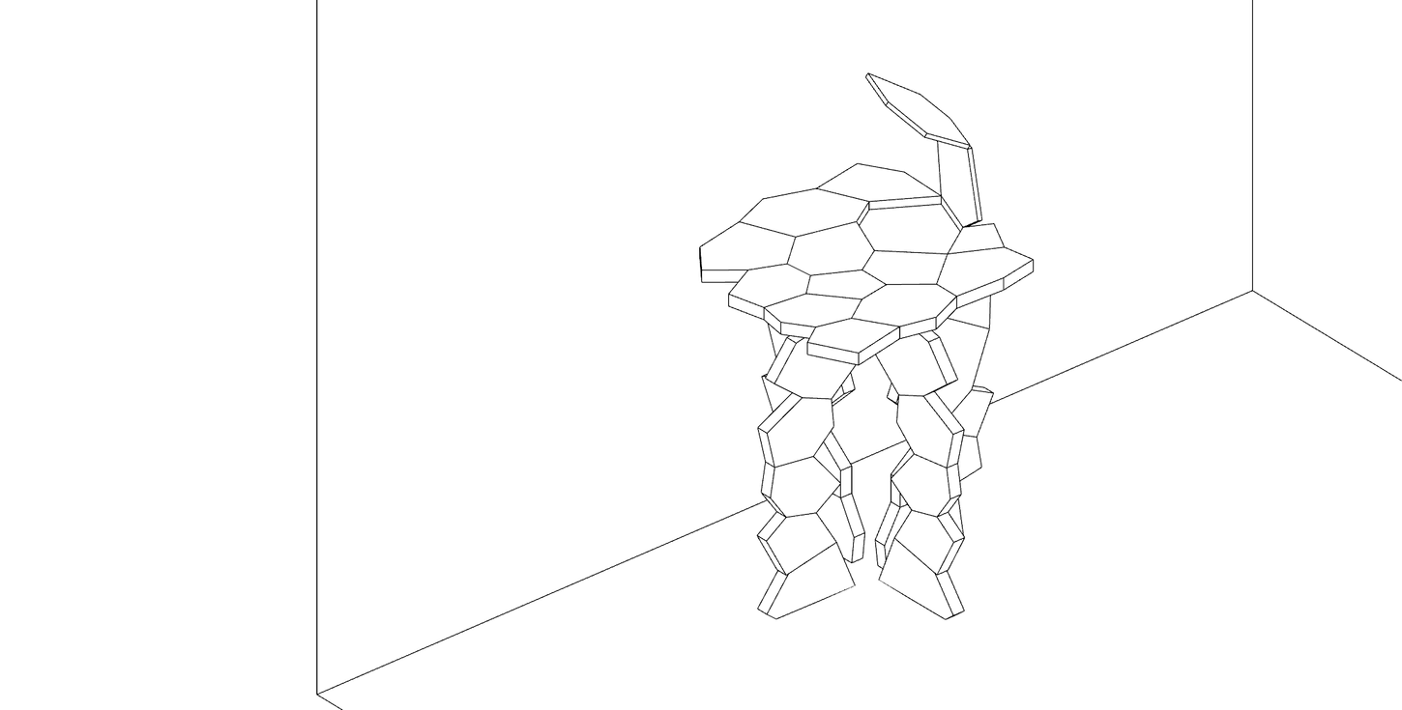
06
ADAPTIVE FURNISHING | DINING TABLE
The table can be folded flat against the wall.
  the table can serve both as a dining table and as a workspace for two people.
  An integrated hinged light cell allows better light control according to the activity and time of day.
  Tabletop pivots downwards to rest on the table legs.
Option 1:
Option 2:
Table legs in the shape of an arch are joined by a hinge at their center at the top so that they can be unfolded perpendicular to eachother.
Table legs are flat against the wall and folded at their commmon edge to create a hollow single table leg in the middle.

Slide 11
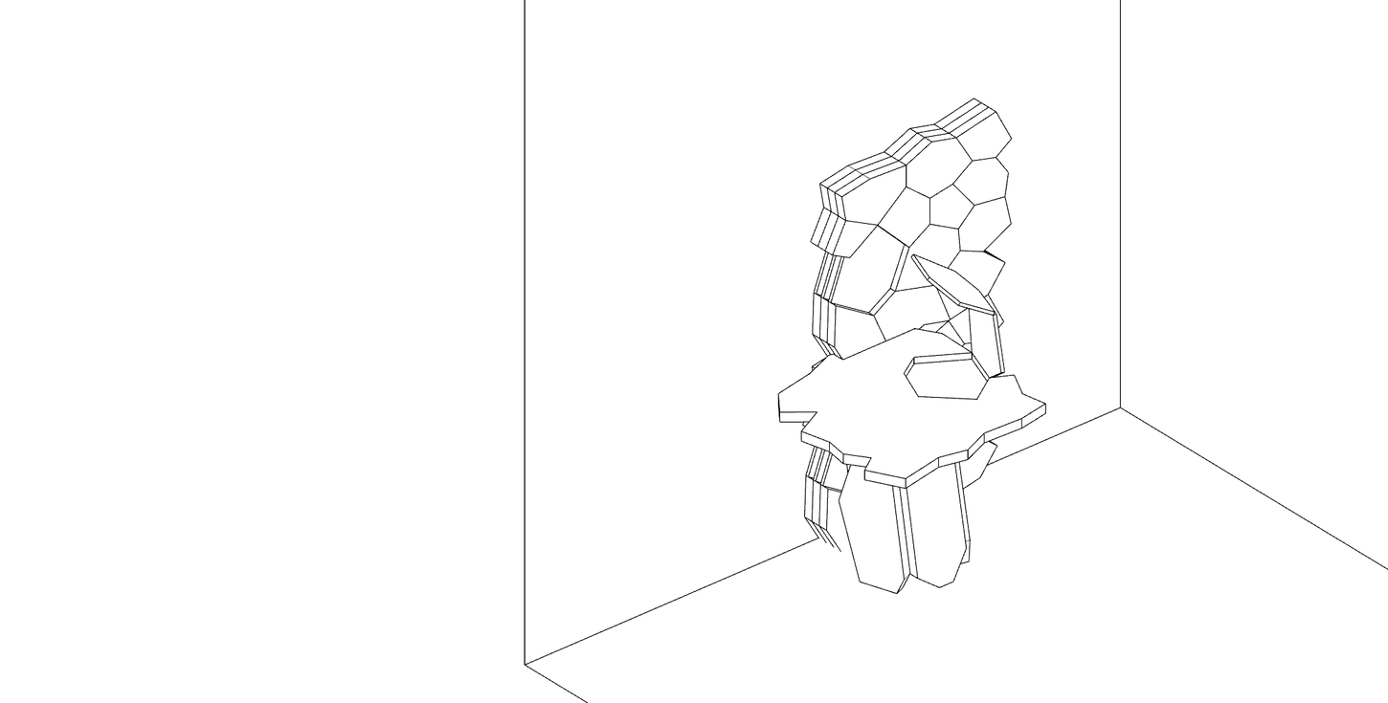
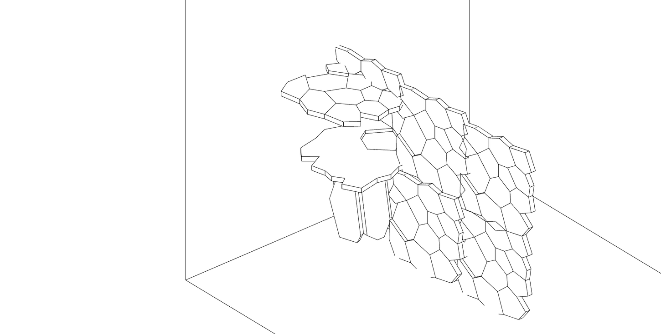
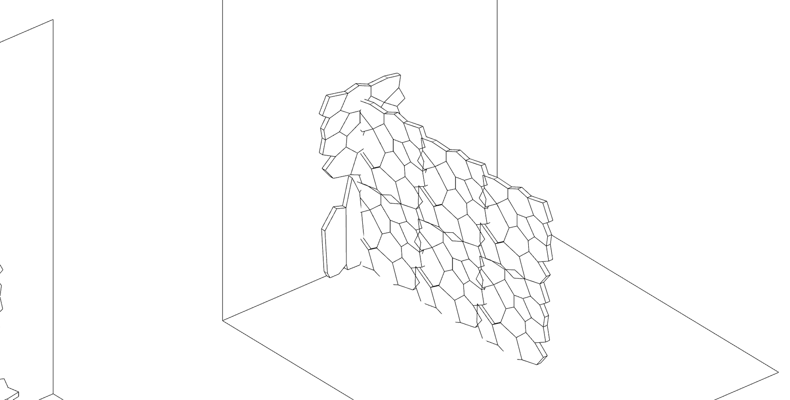
07
ADAPTIVE FURNISHING | ROOM DIVIDER
The room divider has a foldable part so that it can be used at the same time as the dining table.
When stored away, the room divider in closed position put flat against the wall and doesn’t get in the way of the dining table.
Table and room divider opened
Table closed and room divider opened
Table opened and room divider closed

Slide 12

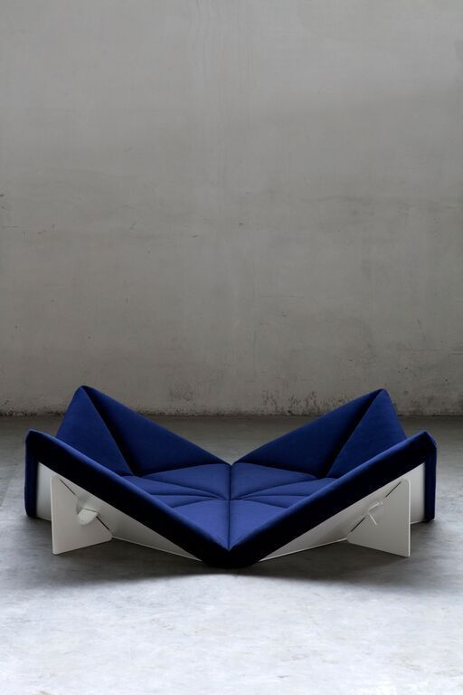
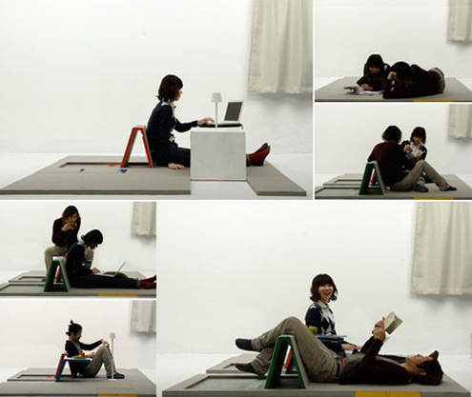
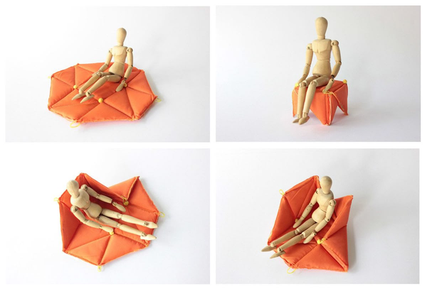
08
ADAPTIVE FURNISHING | INTERACTIVE CARPET
Advantages Interactive Carpet
  One surface, multiple functions
  Quick and intuitive reconfiguration
  Restores personal agency anf confinement
  Supports mood and activity changes
  Reduces monotony and enhances wellbeing

Slide 13
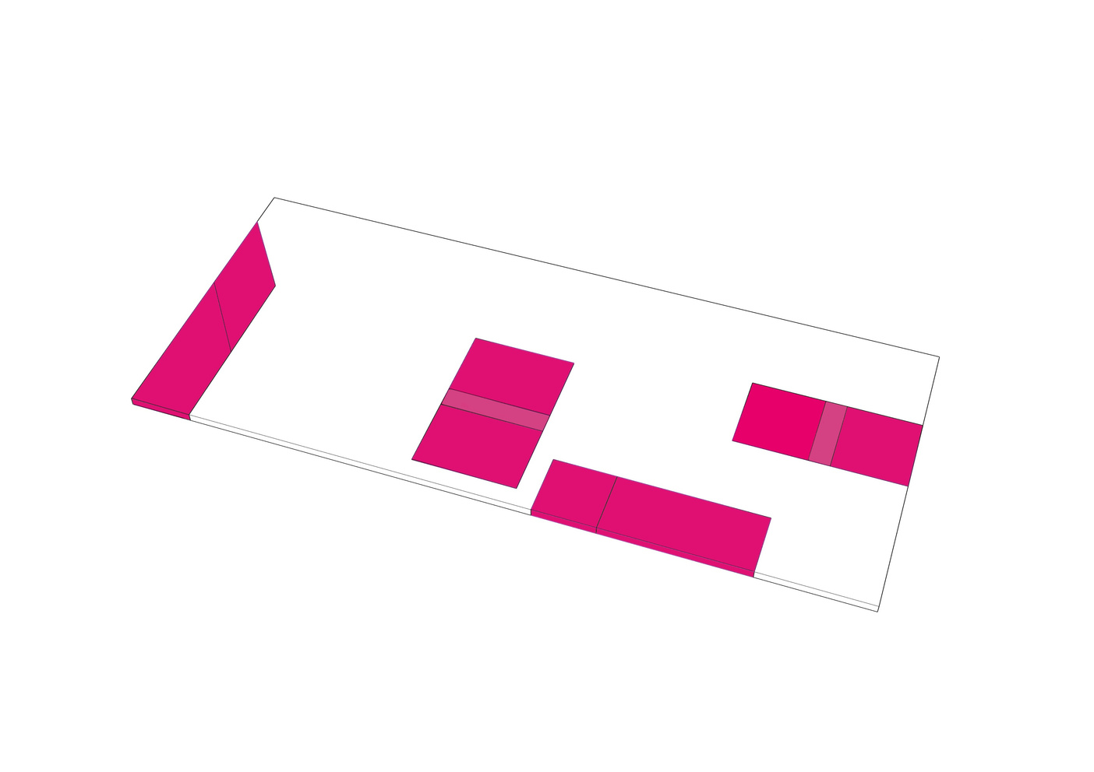

08
FURNITURE IDEA INTERACTIVE CARPET
Foldable mat into variable relaxing/working configurations.

Slide 14
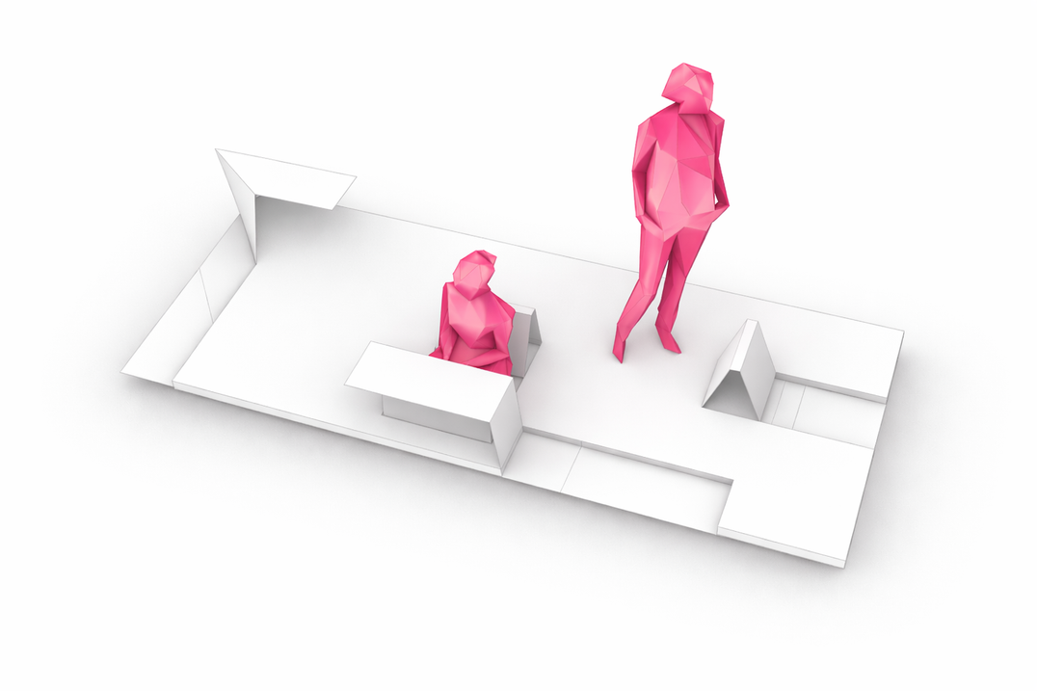
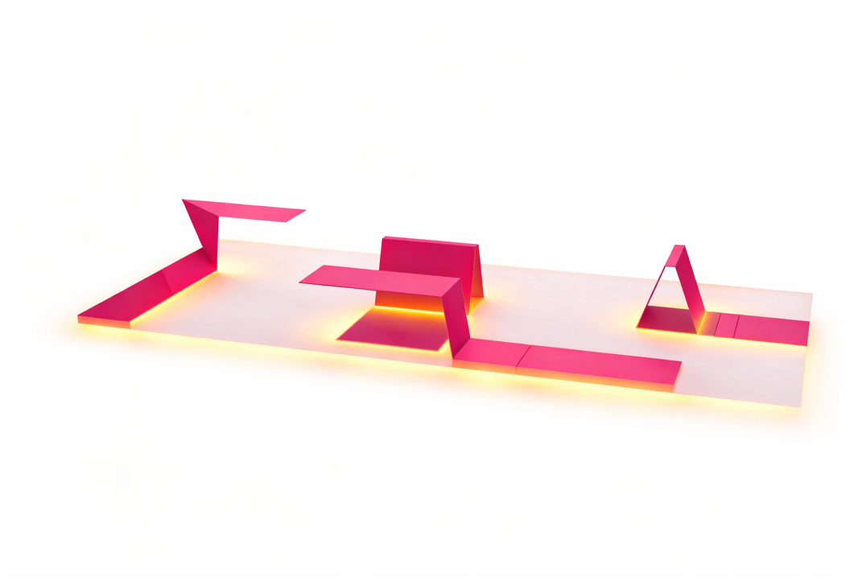
08
FURNITURE IDEA 'PEEL'
'Carpet' as Initial state
Initially this piece will be folded flat on the ground and serve as a carpet/division of space.
Several Configurations
For a relaxed setting that can vary, depending on prefference of a person or mood.
Relationship to Llighting
LED light, diffused under the surfaces and activated when folded out.

Slide 15

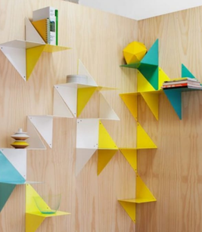
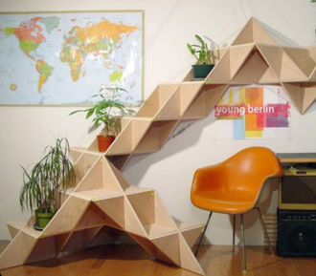
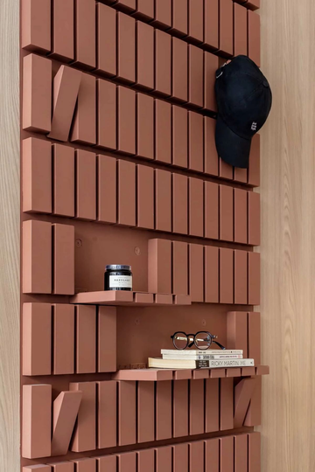
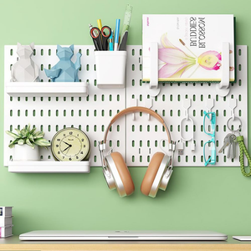
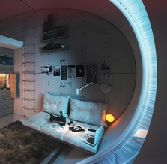
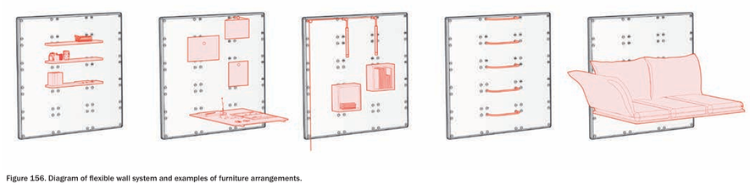
09
ADAPTIVE FURNISHING | MULTIPURPOSE WALL
container key plan
References
1 - Folded modules
2 - Personalised wall
Triangular modules and can be copletely folded up, for maximum space clearance
Modules create ambient lights, temporary shelves, seatings to fit the users necessities and taste.
IKEA,
Pegboard wall oraniser
Hassell,
Lunar Masterplan

Slide 16
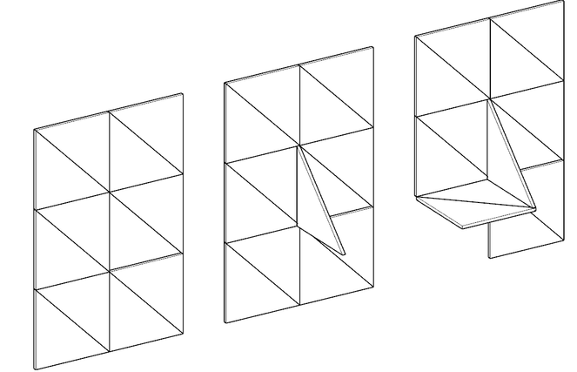
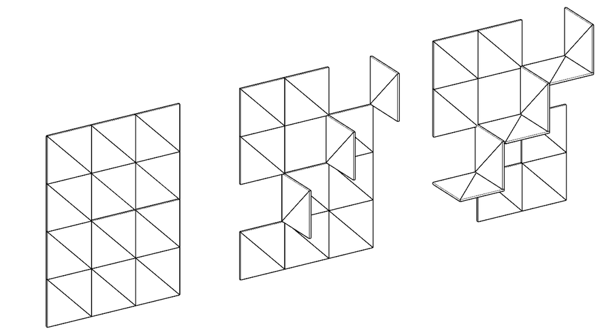
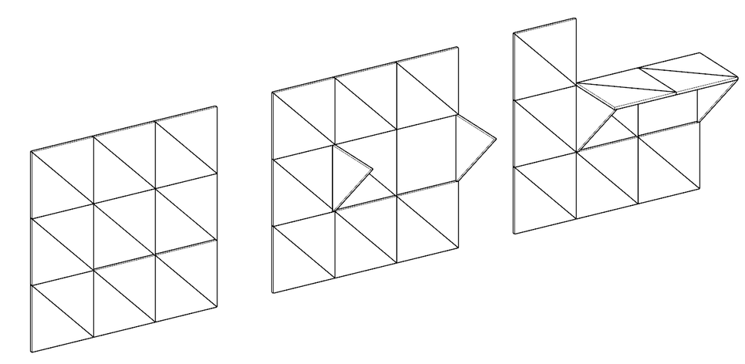
09
ADAPTIVE FURNISHING | MULTIPURPOSE WALL
Shelves
container key plan
1 - Hanging shelves
3 - L shelves
2 - Supported shelves

Slide 17
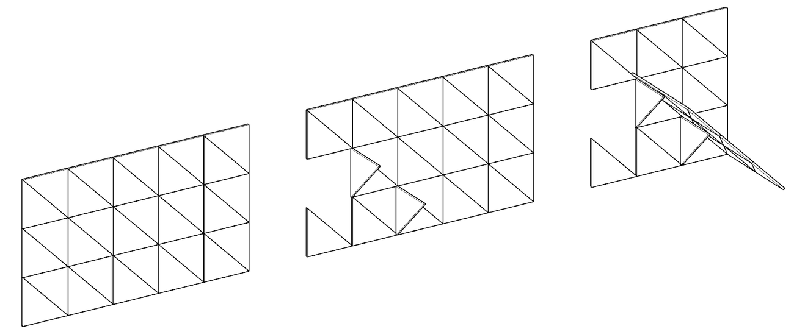
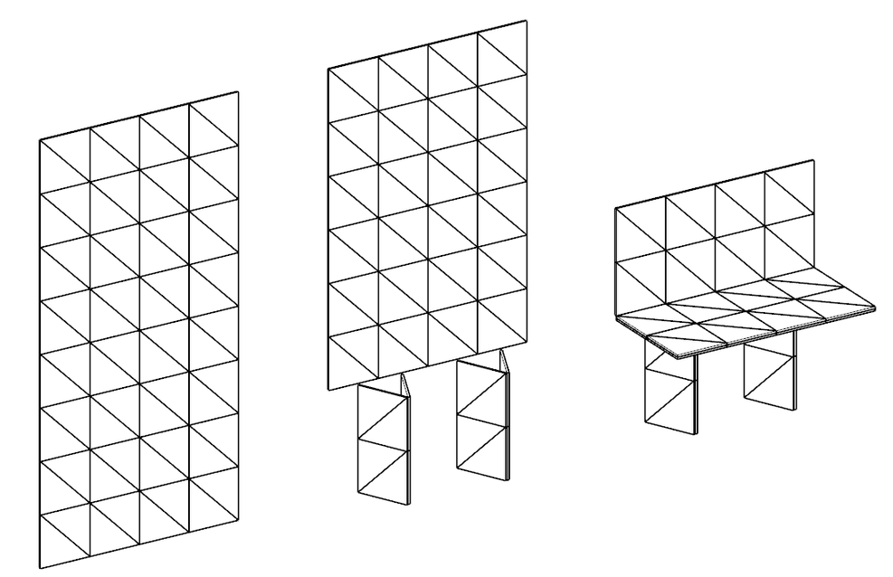
09
ADAPTIVE FURNISHING | MULTIPURPOSE WALL
Temporary seatings
container key plan
1 - Sofa
2 - Lounge chair

Slide 18
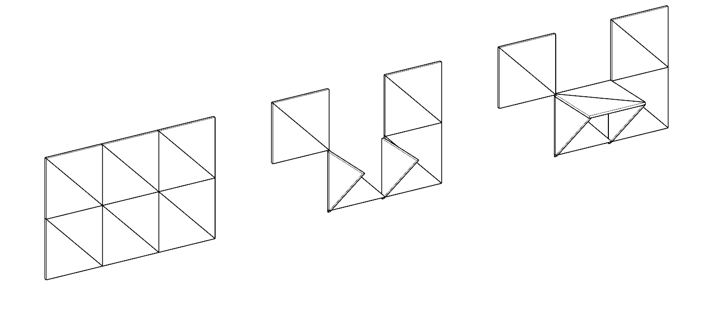
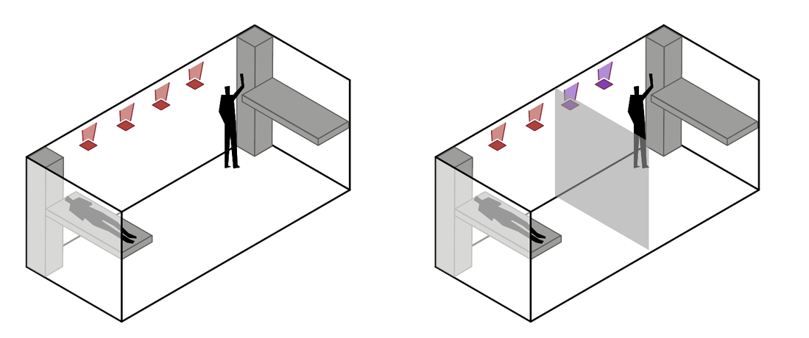
09
ADAPTIVE FURNISHING | MULTIPURPOSE WALL
Ambient lighting
container key plan
Common activities configuration
One ambient lighting system
Private activities configuration
Two ambient lighting systems, working autonomously
Control system
computer vision, image classification in “private activities configuration” and “common activities configuration”
Reconfigurability

Slide 19
Thank you for your attention !

