Slide 1
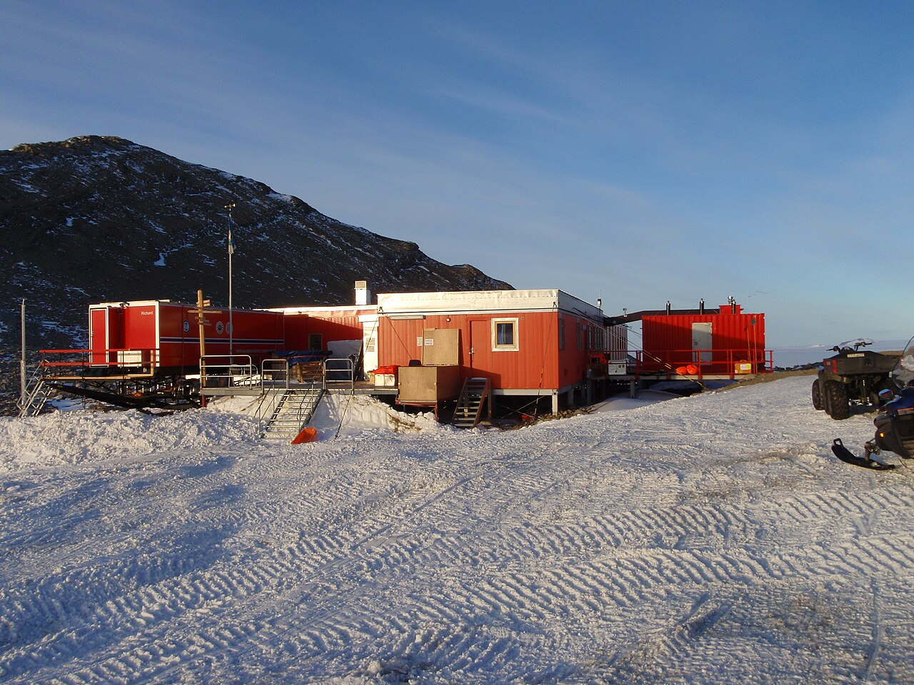
TROLL RESEARCH STATION
Project presentation_week 4
Group 1: Iris Claus, Daphne Kamsteeg, Ludovica Perone Pacifico, Chloé Phan, Marieke van Wijk
IAP Workshop
Q3 2026
Prof. Henriette Bier, Arwin Hidding, Lisa-Marie Mueller, Vera Laszlo

Slide 2
01
LIGHTING | GOALS IN THE CONTAINER
Problems
  Extreme daylight conditions
  Circadian rhythm disruption
  Small confined spaces that need adaptable lighting
Goal:
To create an adaptive lighting system that supports health, work performance and wellbeing.

Slide 3
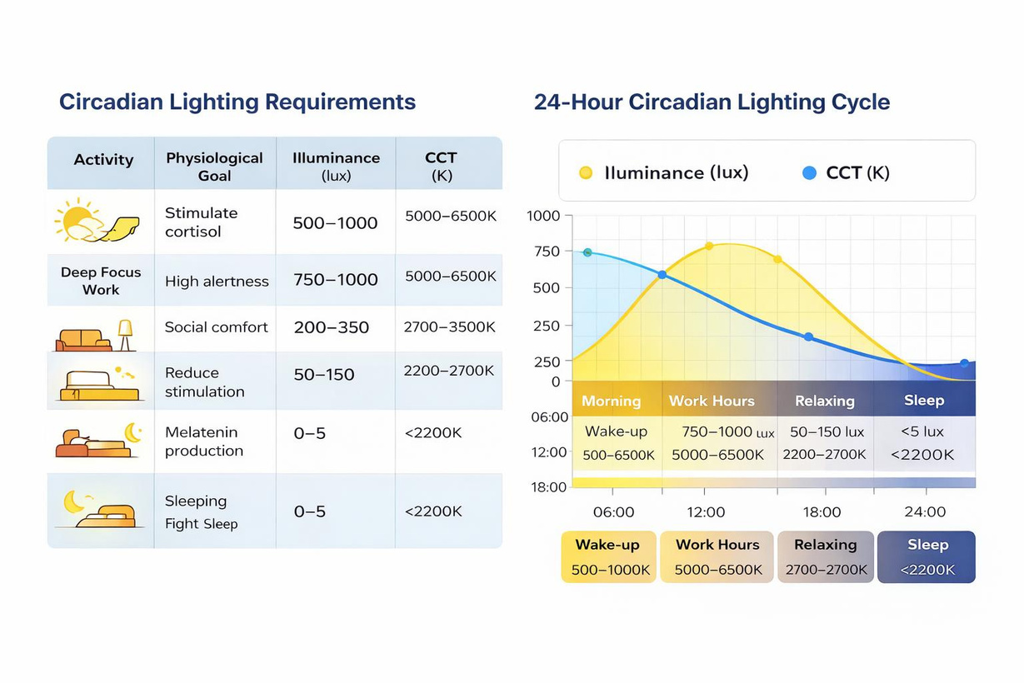


02
LIGHTING | GOALS IN THE CONTAINER
Artificial light must...
  simulate natural daylight cycles
  adapt to different situations and activity’s inside the container.

Slide 4
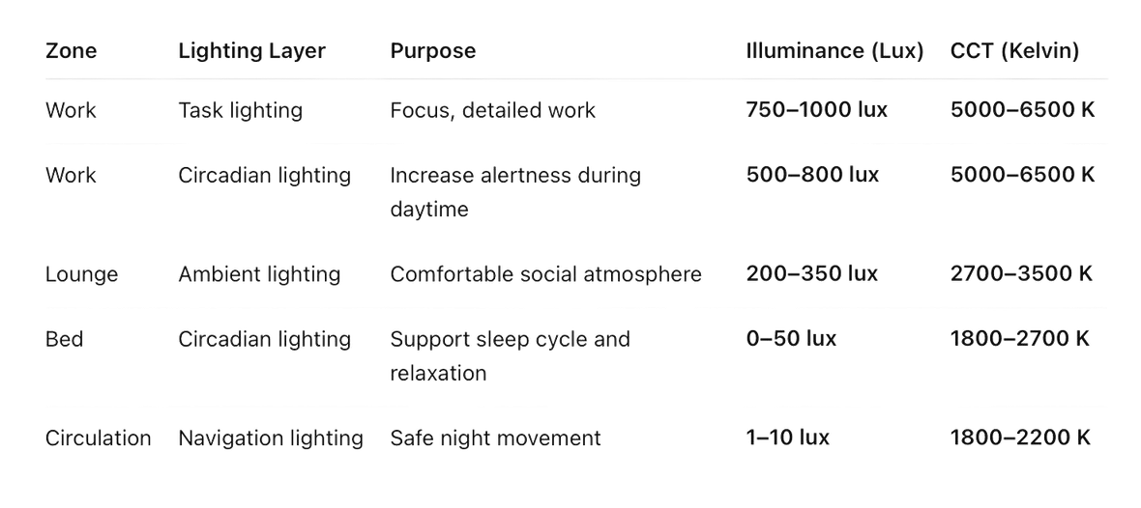
03
LIGHTING | SYSTEM LAYERING
Daylight overcast
Sunlight at midday
Fluorescent lamp
Halogen lamp
Candle light

Slide 5
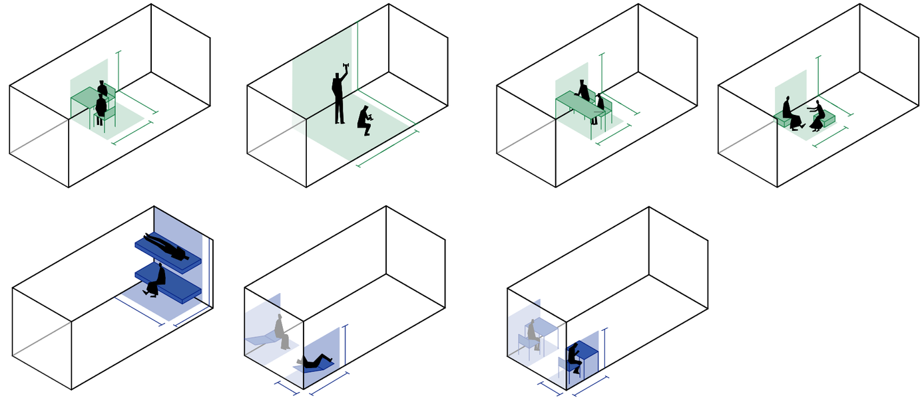
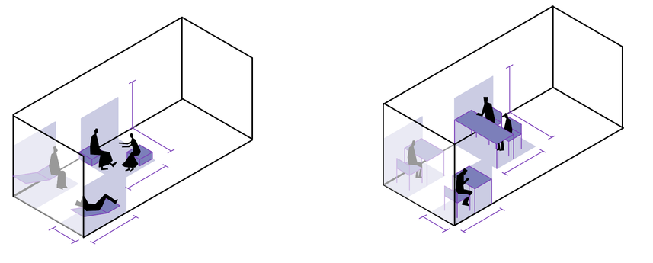
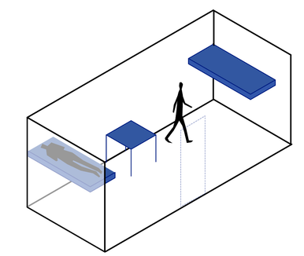
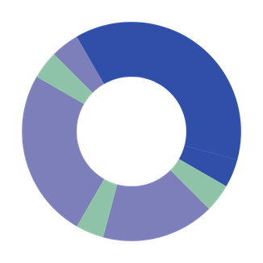
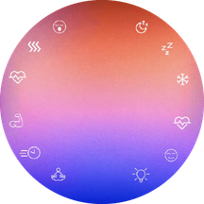
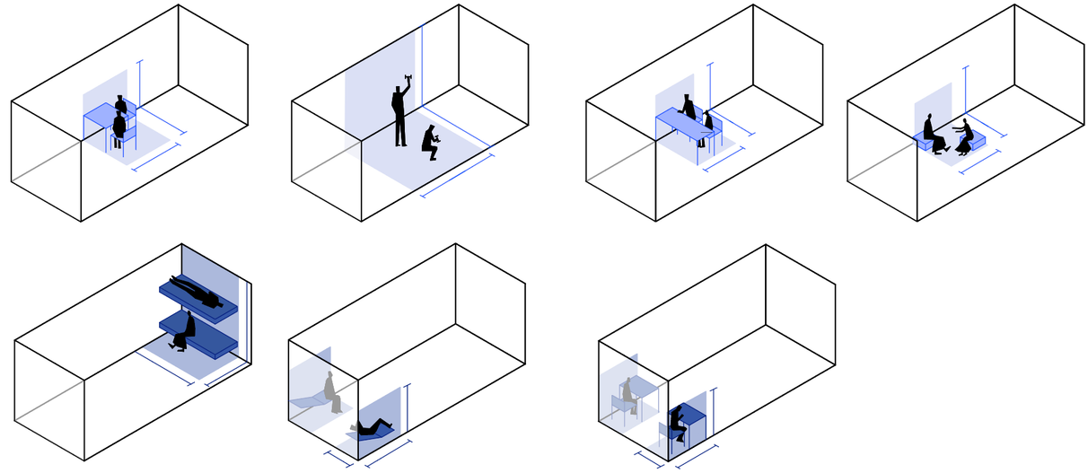
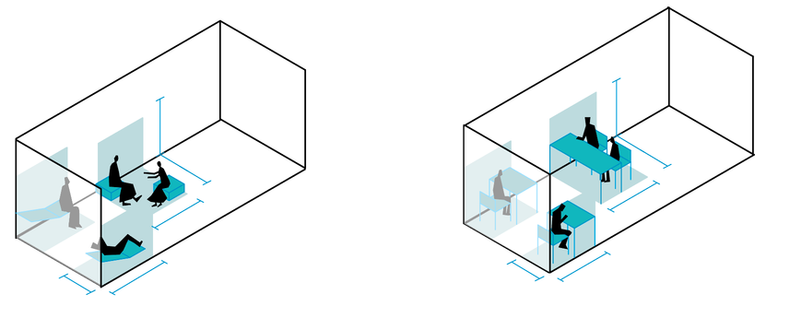
04
Circadian lighting
LIGHTING | LAYERS
Ambient lighting
2.5 m
Navigating lighting
2 m
1.5 m
1.4 m
Relaxing
21.00 - 22.00
1.6 m
Sleeping
22.00 - 7.00
1.6 m
Dining
20.00 - 21.00
1 h
0.8 m
1.5 m
1 h
00.00
9 h
Relaxing / Exercising
18.00 - 20.00
2 h
18.00
06.00
4 h
1 h
Hygiene
7.00 - 8.00
Task lighting
Working
14.00 - 18.00
12.00
1 h
2.5 m
1 h
Dining
8.00 - 9.00
4 h
1.4 m
(individual)
2.5 m
Dining
13.00 - 14.00
1.6 m
2.5 m
1.6 m
Working
9.00 - 13.00
Navigating lighting
1.4 m
3.7 m
1.5 m
1.5 m
Task lighting
1.5 m
0.8 m
1.5 m
0.8 m

Slide 6
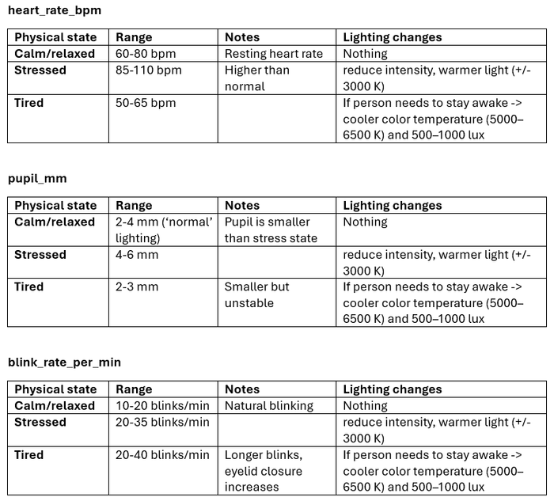



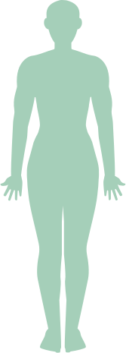

05
LIGHTING | AI-SUPPORTED (& PERSONAL) LIGHTING SYSTEM
System with..
Sensors→ AI model→ lighting adjustment & personal lighting system
Inputs (basic data):
• physiological signals (pupil dialation,
heartrate etc.)
• time of day
• activity
• occupancy
Outputs:
• illuminance (lux)
• color temperature (CCT)
• LED activation in zones
Stressed
Normal
60-90 bpm
90-100 bpm
Input
dialated
normal
200-350
lux
500-700
lux
Output
2700-3500 K
4000-5000 K

Slide 7
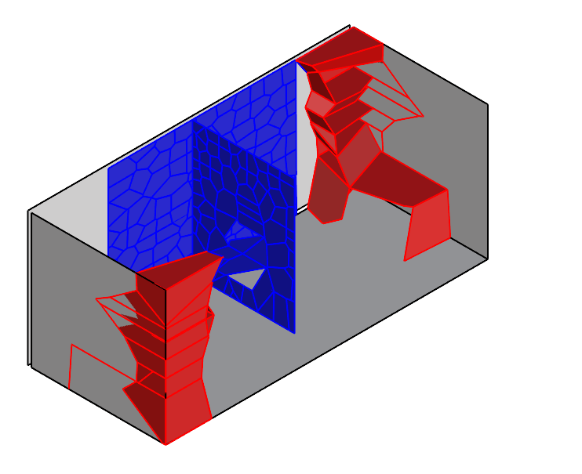



07
DISTRIBUTION STRATEGIES
2
2
3
2
3
4
4
1
1
1
5
Legend
“Permanent” furniture
Necessities
More space-consuming and/or fixed furnitures are placed in peripheral spaces
  Storage 2. Bed and workstation
  Separate beds with integrated personal storage
  Adjustable modules for user-driven spatial reconfiguration to enable environmental personalization and reduce visual monotony
  Foldable partition to subdivide container into two private rooms. For increased privacy and psychological benefits during prolonged isolation
Temporary furniture
Furniture in the center of the container is easily reconfigurable and can be folded to a surface, for maximum clearance of the space
3. Partition wall 4. Dining table 5 Multipurpose wall

Slide 8

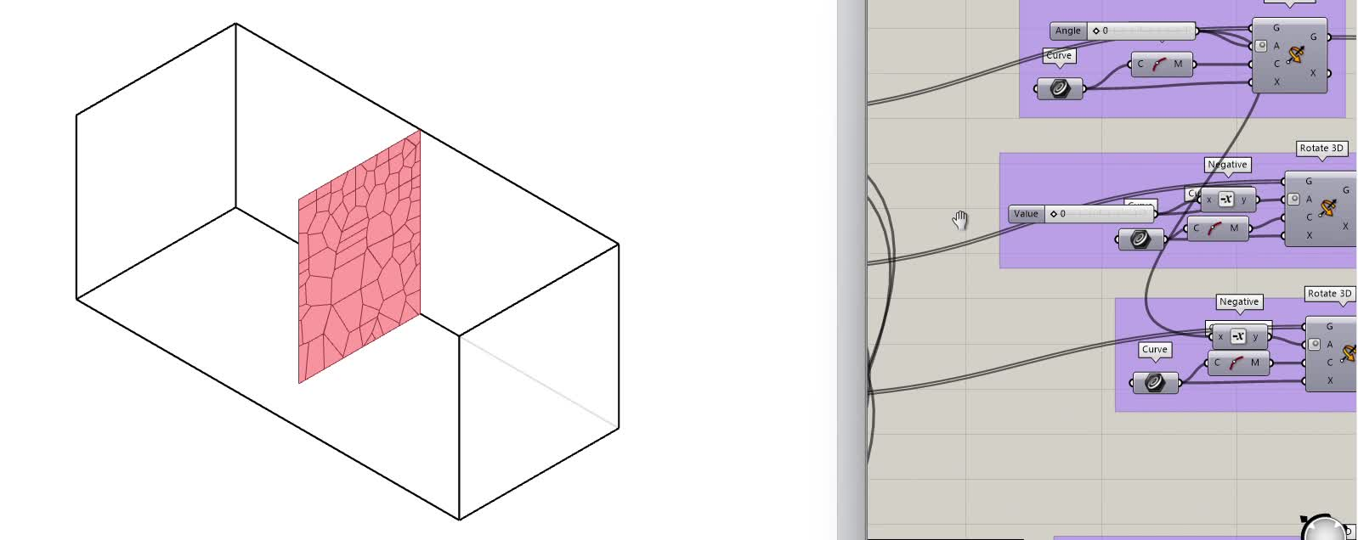
08
ADAPTIVE FURNISHING |
FOLDABLE WALL + DINING TABLE
container key plan

Slide 9
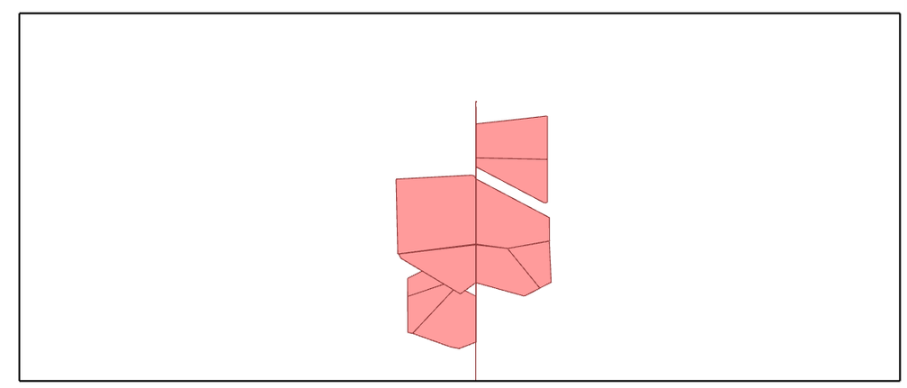
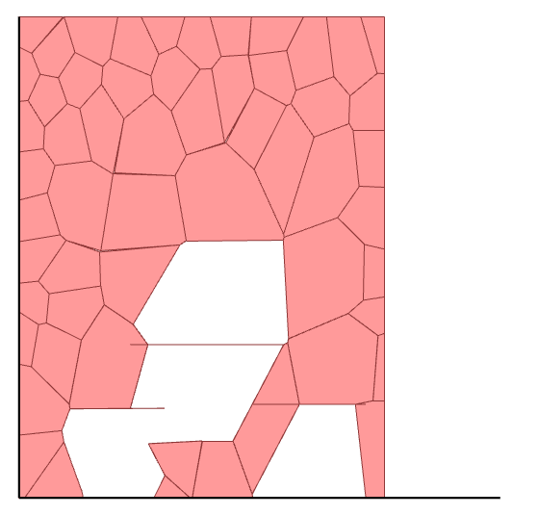
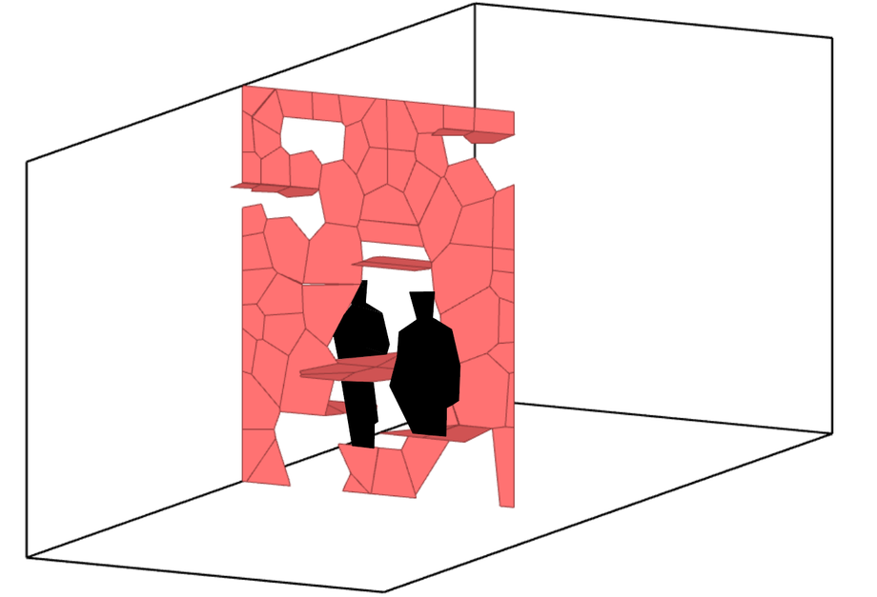
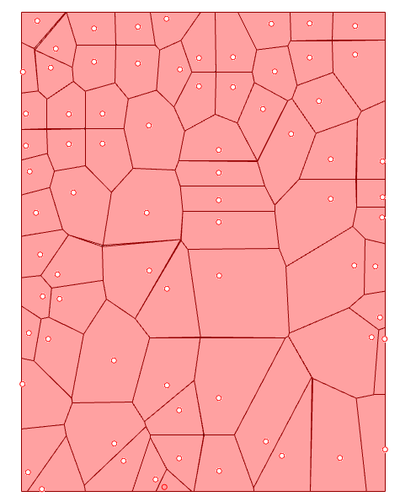
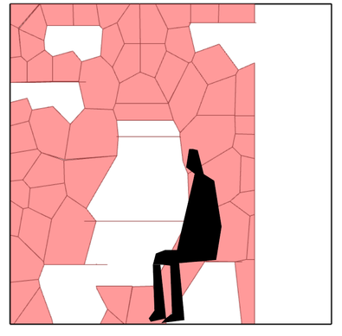
09
ADAPTIVE FURNISHING |
FOLDABLE WALL + DINING TABLE
container key plan
shelves modules
lighting modules
table modules
seating modules
Right elevation
Plan view and right elevation
Perspective view NE
2d voronoi generation
Geometrical and functional configuration
Visual permeability

Slide 10
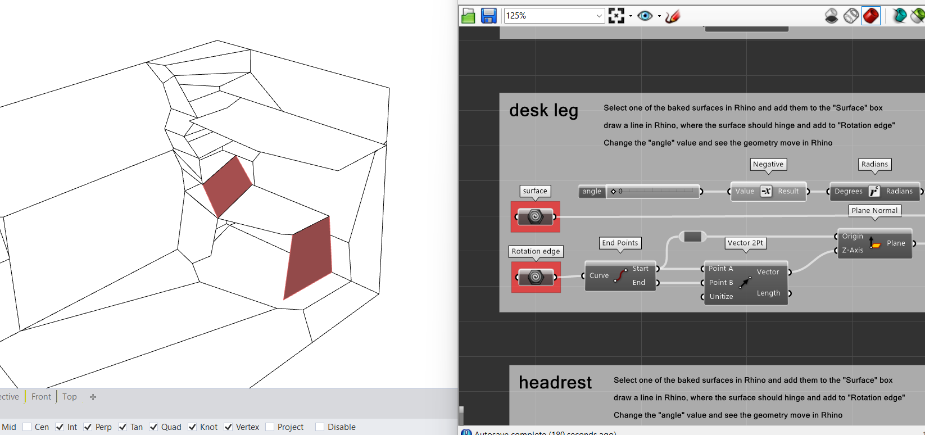
01
ADAPTIVE FURNISHING |
FOLDABLE DESK
container key plan

Slide 11
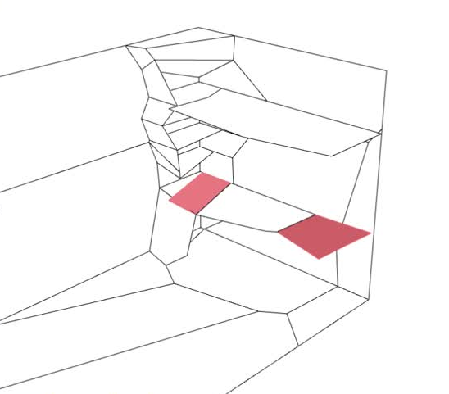
01
ADAPTIVE FURNISHING |
FOLDABLE DESK
container key plan
Desk can be folded into lounge chair

Slide 12
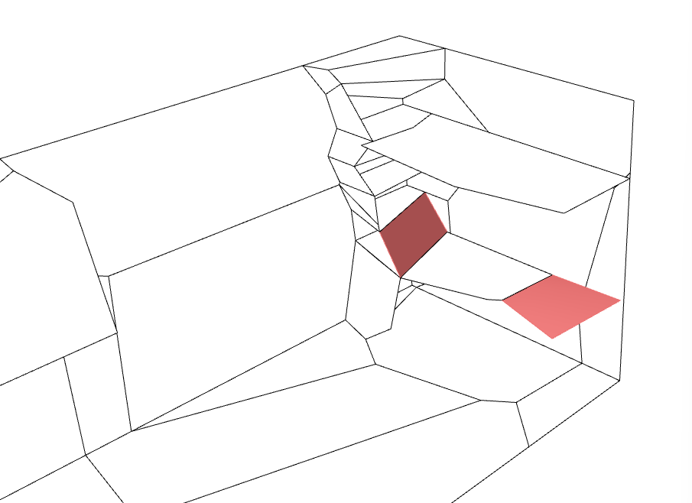
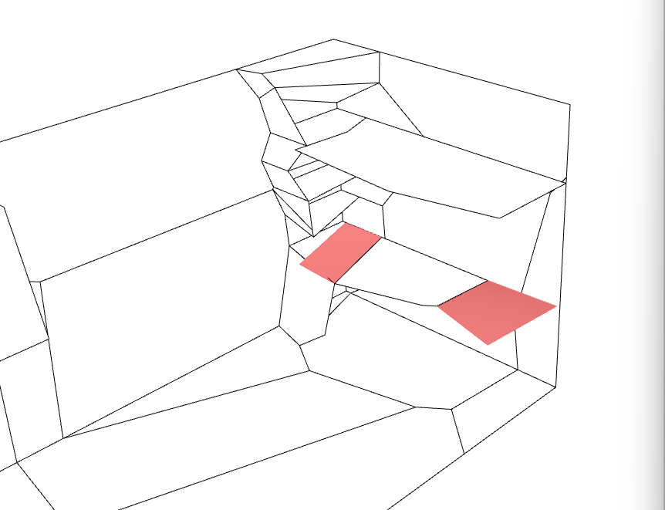
01
ADAPTIVE FURNISHING |
FOLDABLE DESK
container key plan
Desk can be folded into lounge chair

Slide 13
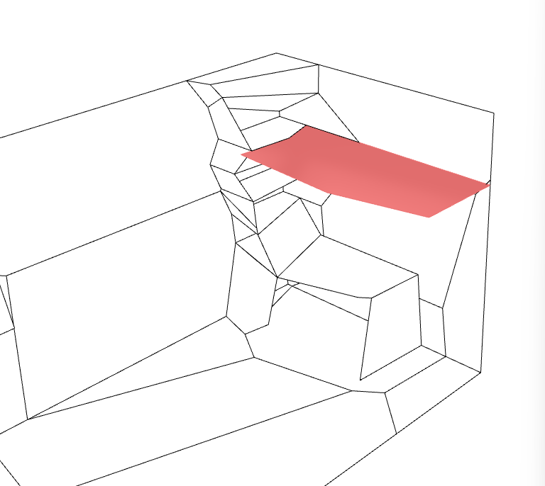
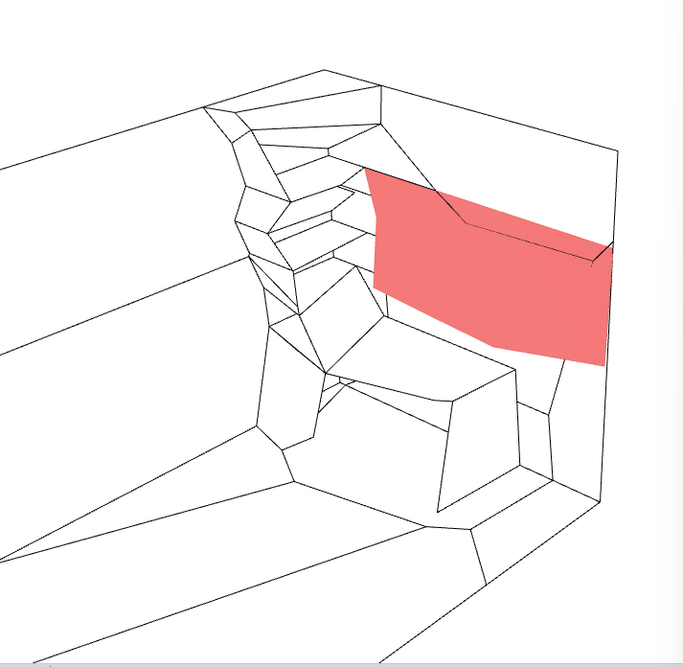
01
ADAPTIVE FURNISHING |
FOLDABLE BED
container key plan
Bed can be folded against the wall
Aligns with the shelves

Slide 14
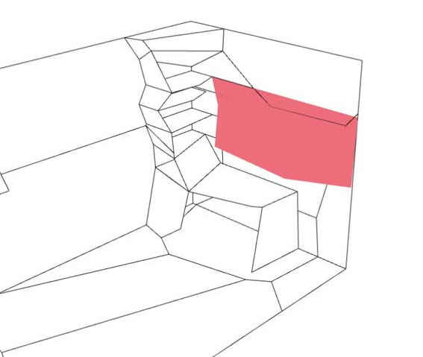
01
ADAPTIVE FURNISHING |
FOLDABLE BED
container key plan
Bed can be folded against the wall
Aligns with the shelves, start thinking about what is the most representatiove fragment to represent

Slide 15
Thank you for your attention !

