Slide 1
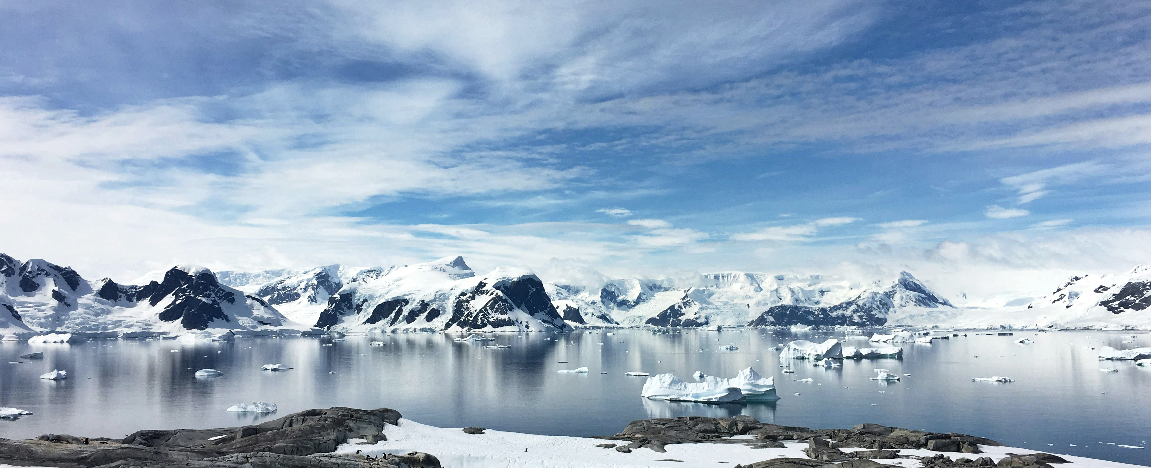
Juliette Zamani Alavijeh
Caterina Lovo
Domina Lučin
Niklas Murmann
Cyrill Haas
Lisa Holbrook
Polar Cave
AR122
1:1 Interactive Architecture Prototypes
20/03/2026

Slide 2
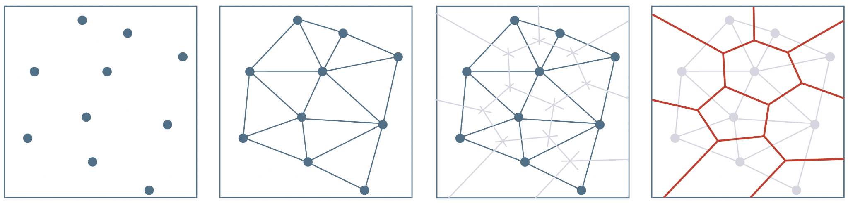
0
VORONOI | GENERAL PRINCIPLE
1) Seed distribution within the design domain (adaptive node definition)
2) Delaunay triangulation
3) Bisector line identification
4) Voronoi tessellation -
(2d polygons)
Fig. 16 – Voronoi Principle
Notes:
Ambient Intelligence means environments that are:
Context-aware
Adaptive
Responsive to human presence
Example:
Lights automatically adjust when people enter a room.
Lighting changes depending on daylight or time of day.
Office lights dim when natural light increases.
WSNs provide the sensing and communication layer that enables AmI.
Step 3: Data Collection
Sensors continuously measure:
Illuminance (lux)
Occupancy
Time of day
Data is transmitted to controller.

Slide 3

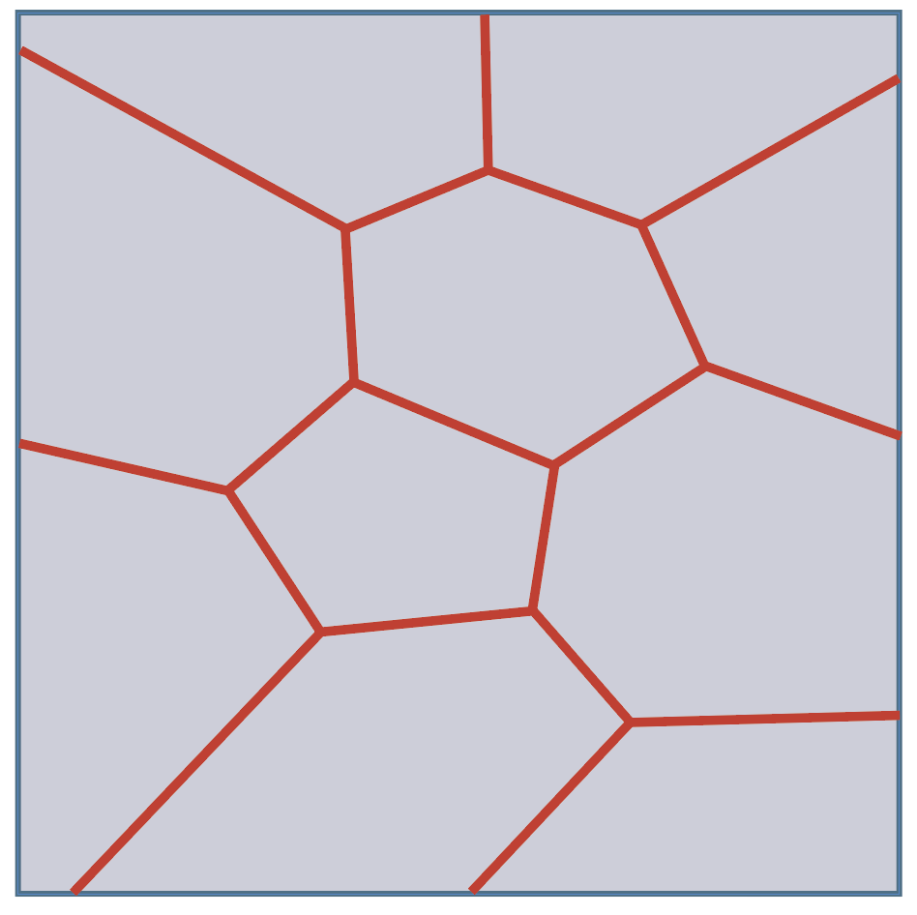
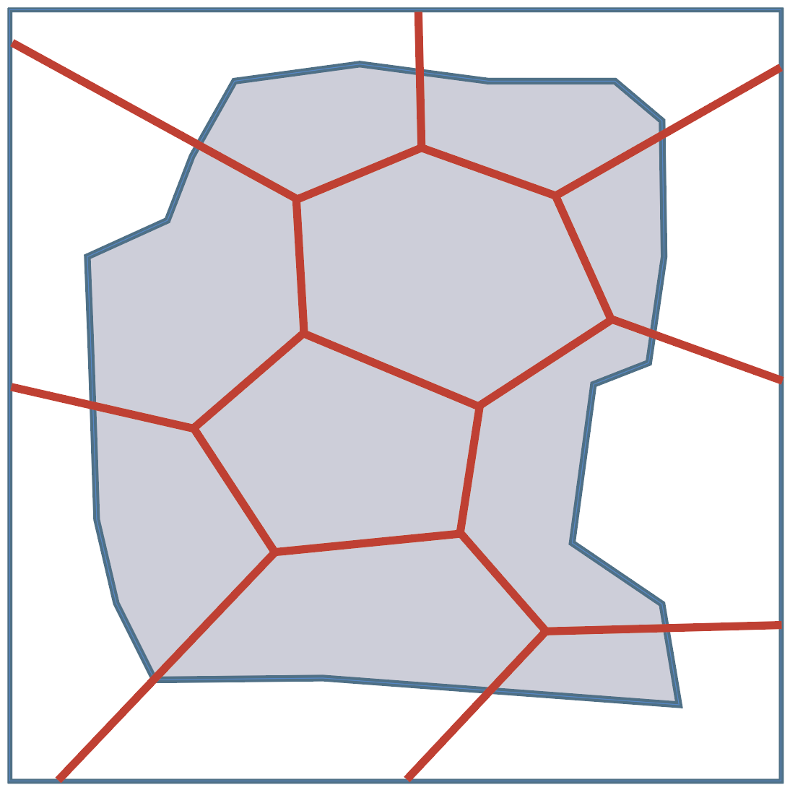
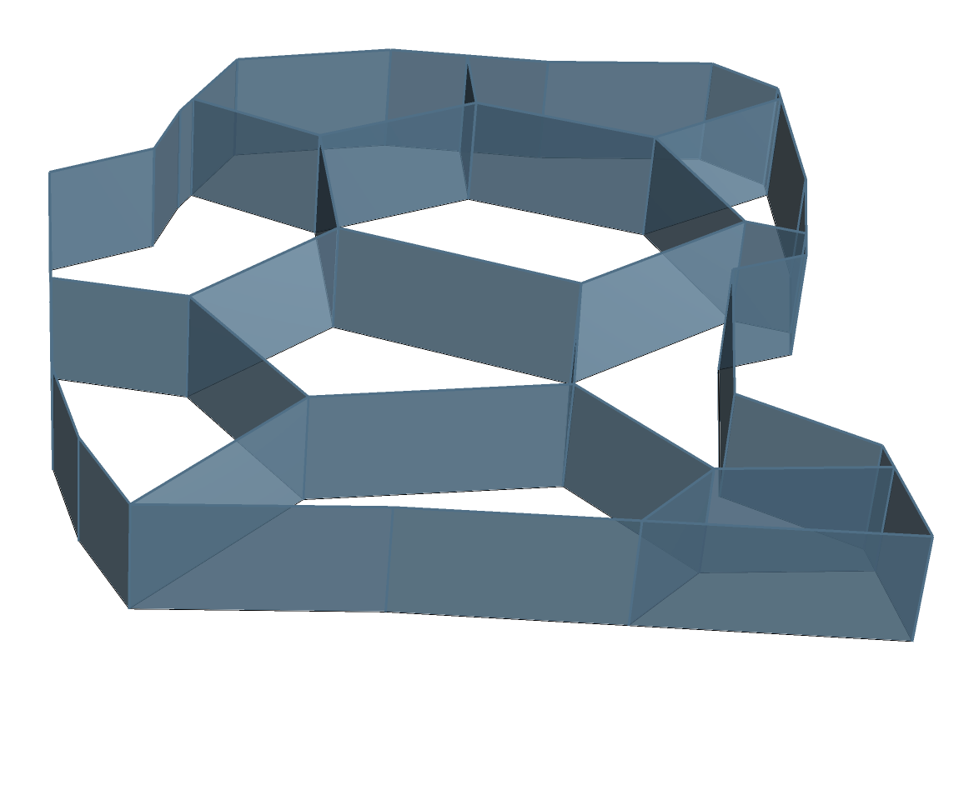
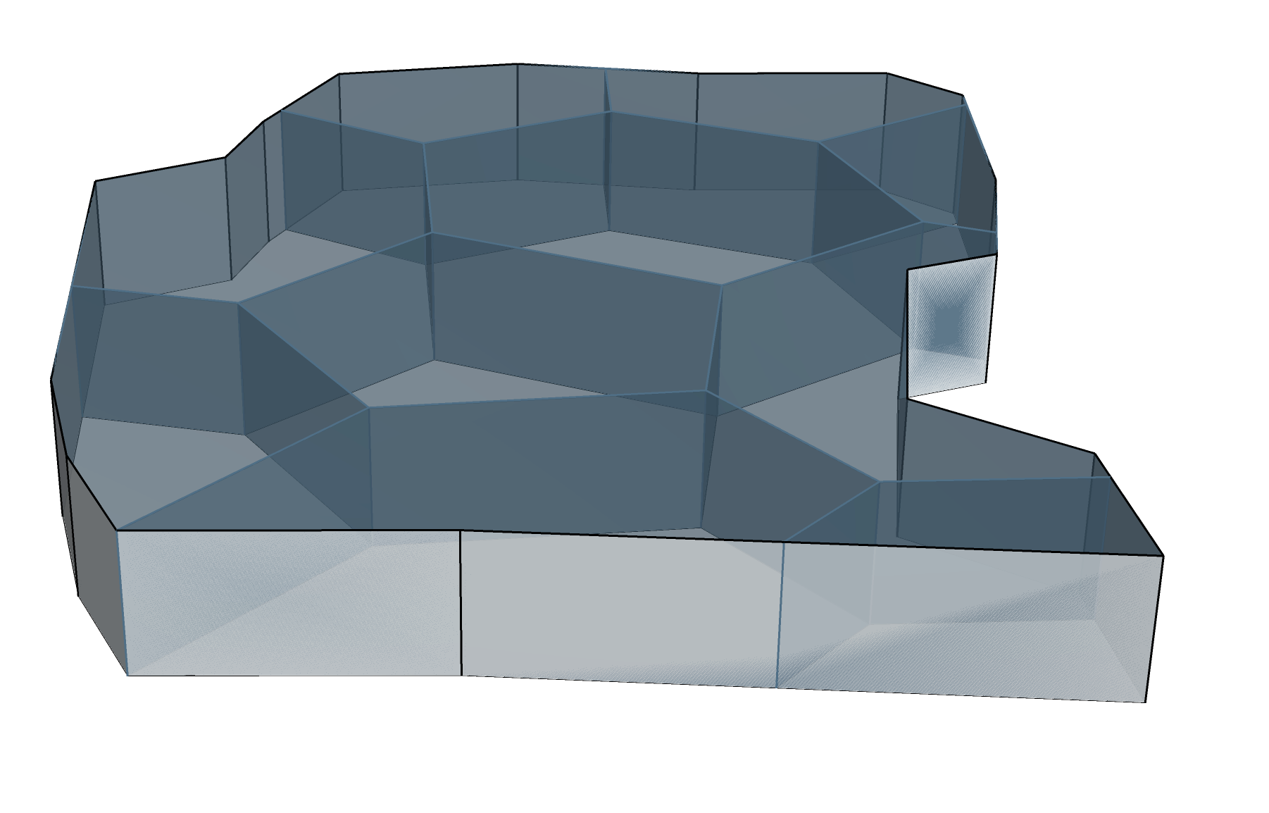
0
VORONOI | WORKFLOW
1) Generating points
2) Creating voronoi diagram
a) Simple random sampling
b) Grid sampling
c) Transect sampling
d) Grid sampling with random replacements
Connecting points into polygonal cells
3) Defining boundary
4) Modifying the geometry
5) Bake with Rhino
Cutting the pattern to fit the chosen shape
Turning flat lines into 3D elements
Getting solid manually adaptable polygons
Notes:
Ambient Intelligence means environments that are:
Context-aware
Adaptive
Responsive to human presence
Example:
Lights automatically adjust when people enter a room.
Lighting changes depending on daylight or time of day.
Office lights dim when natural light increases.
WSNs provide the sensing and communication layer that enables AmI.
Step 3: Data Collection
Sensors continuously measure:
Illuminance (lux)
Occupancy
Time of day
Data is transmitted to controller.

Slide 4
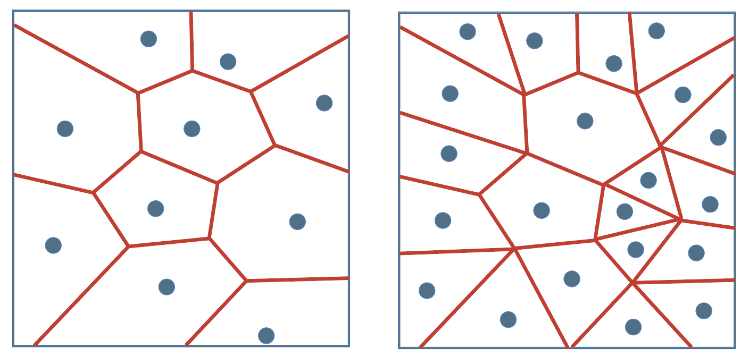
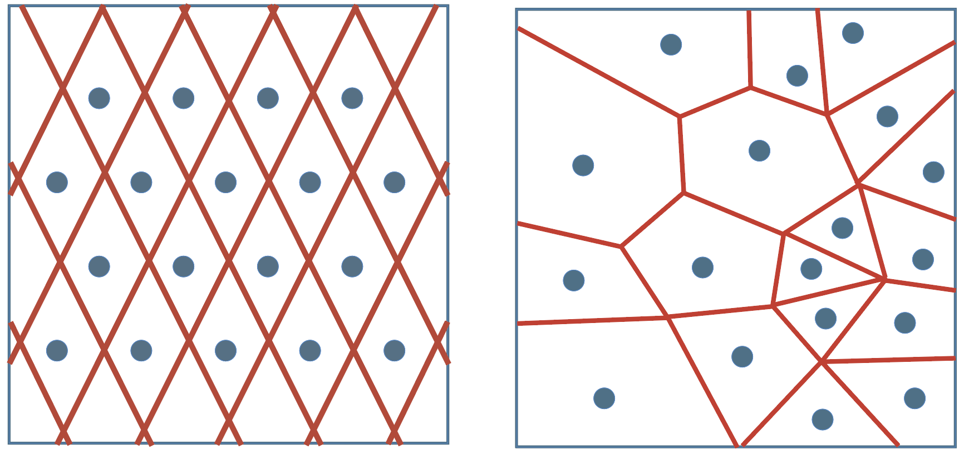
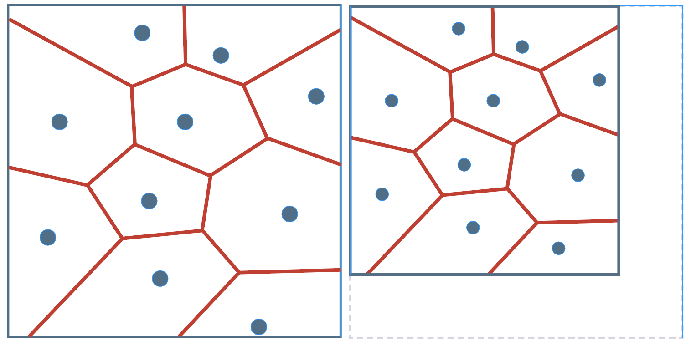
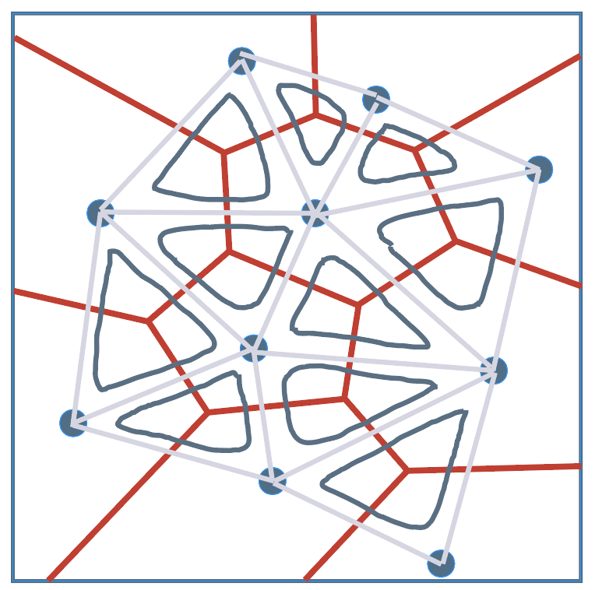
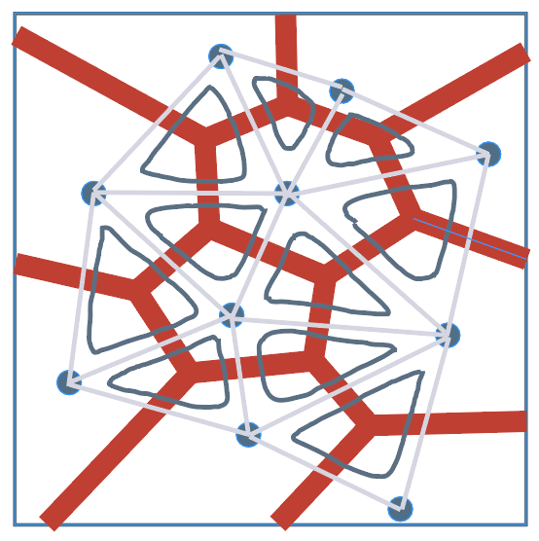
0
VORONOI | KEY CONTROLS
1) Point Count
2) Point distribution
Fewer points --> larger, simpler cells
More points --> smaller, denser cells
Even spacing --> uniform pattern
Clustered/attractor --> gradients (dense --> sparse area)
3) Boundary shape
4) Cell thickness
Changes overall form
Visually: same pattern adapts to any outline
Controls depth and weight
Visually: thin = light/graphic, thick = structural/solid
v
Group 3
Notes:
Ambient Intelligence means environments that are:
Context-aware
Adaptive
Responsive to human presence
Example:
Lights automatically adjust when people enter a room.
Lighting changes depending on daylight or time of day.
Office lights dim when natural light increases.
WSNs provide the sensing and communication layer that enables AmI.
Step 3: Data Collection
Sensors continuously measure:
Illuminance (lux)
Occupancy
Time of day
Data is transmitted to controller.

Slide 5
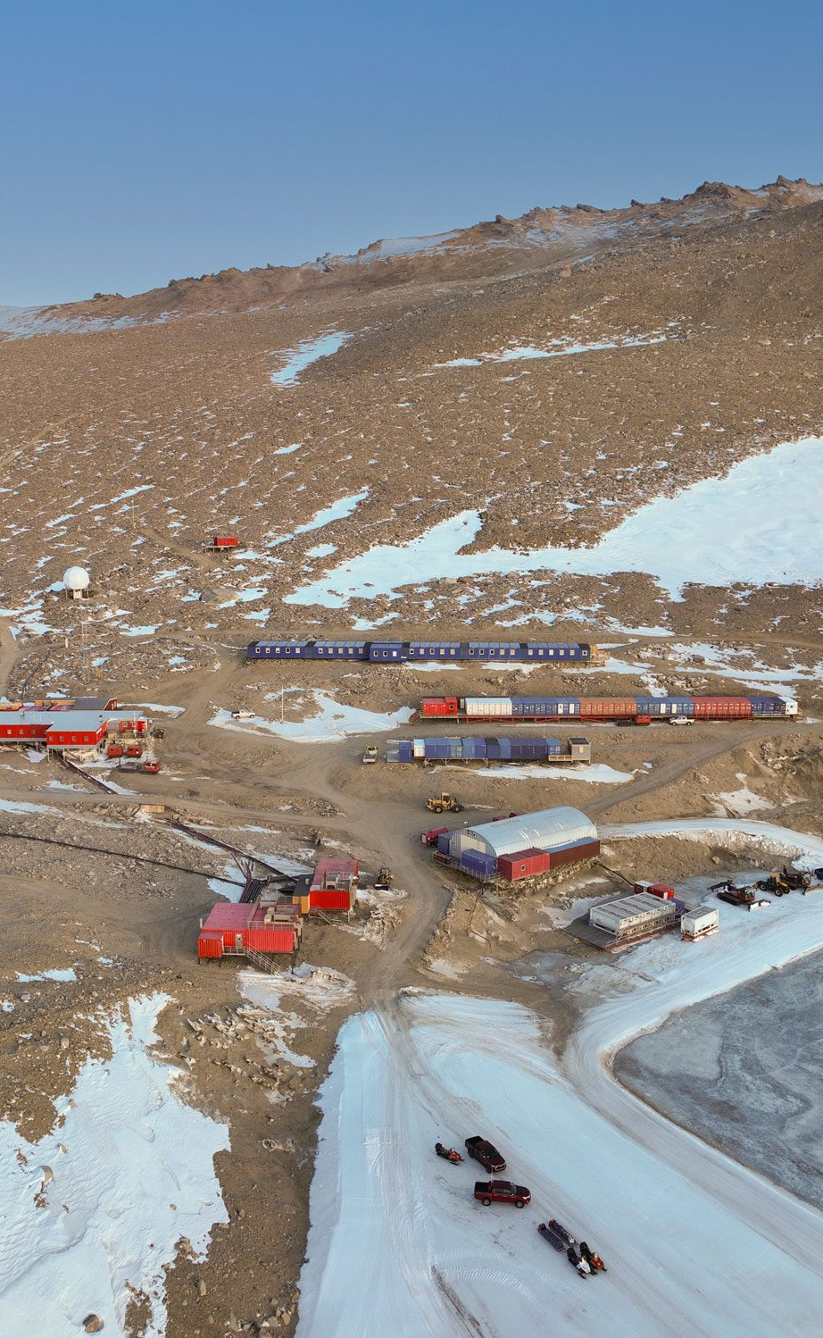






Fig. 2 – Troll Research Station, Norsk Polarinstitutt
1
LIVING IN ANTARCTICA | KEY CHALLENGES
CHALLENGES
Weather conditions
Arctic seasons
Lighting conditions
Spatial limitation
Severe Temperatures
Strong Catabatic Winds
Minimal Precipitation
Low Humidity
Extreme Light Cycles
Circadian Rhythm Disruption
Reduced Work Efficiency
Sleep & Mood issues
Lack of Privacy
Lower Productivity
Stress and Discomfort
Design compromises
IMPACT ON
PHYSICAL AND MENTAL HEALTH
Fig. 1 – Diagram Challenges
AR122 1:1 Interactive Architecture Prototypes

Slide 6
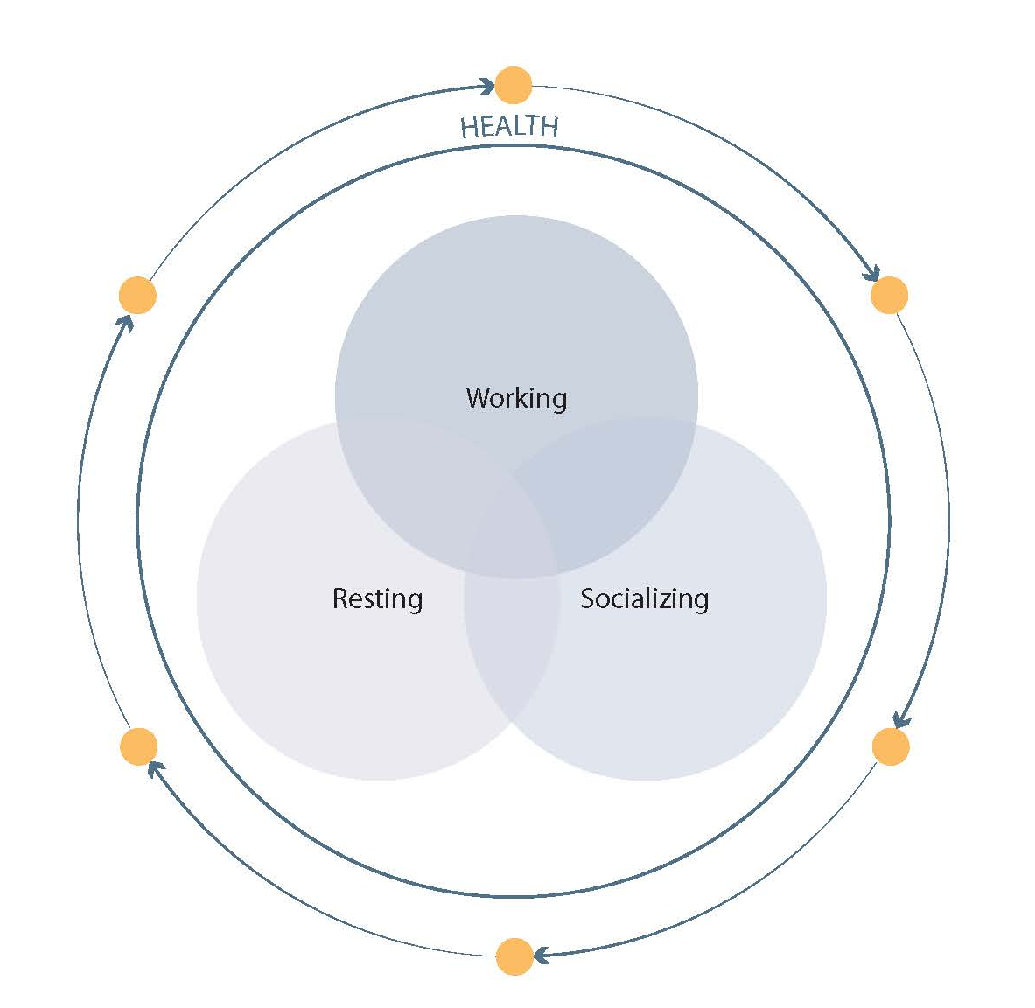
Fig. 2 – Troll Research Station, Norsk Polarinstitutt
1
LIVING IN ANTARCTICA | PROJECT GOAL
Fig. 3 – Functional Division
AR122 1:1 Interactive Architecture Prototypes

Slide 7
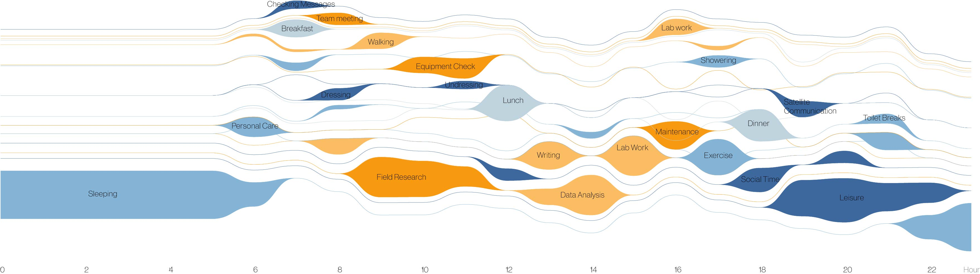
4
FUNCTIONAL SPACES | ACTIVITY MAPPING
Fig. 9 – Activity mapping

Slide 8

Fig. 2 – Troll Research Station, Norsk Polarinstitutt
2
DESIGN CONCEPT | THE MOUNTAIN EXPEDITION
CAVE | Protective space
Fig. 4 – Concept Cave
AR122 1:1 Interactive Architecture Prototypes

Slide 9
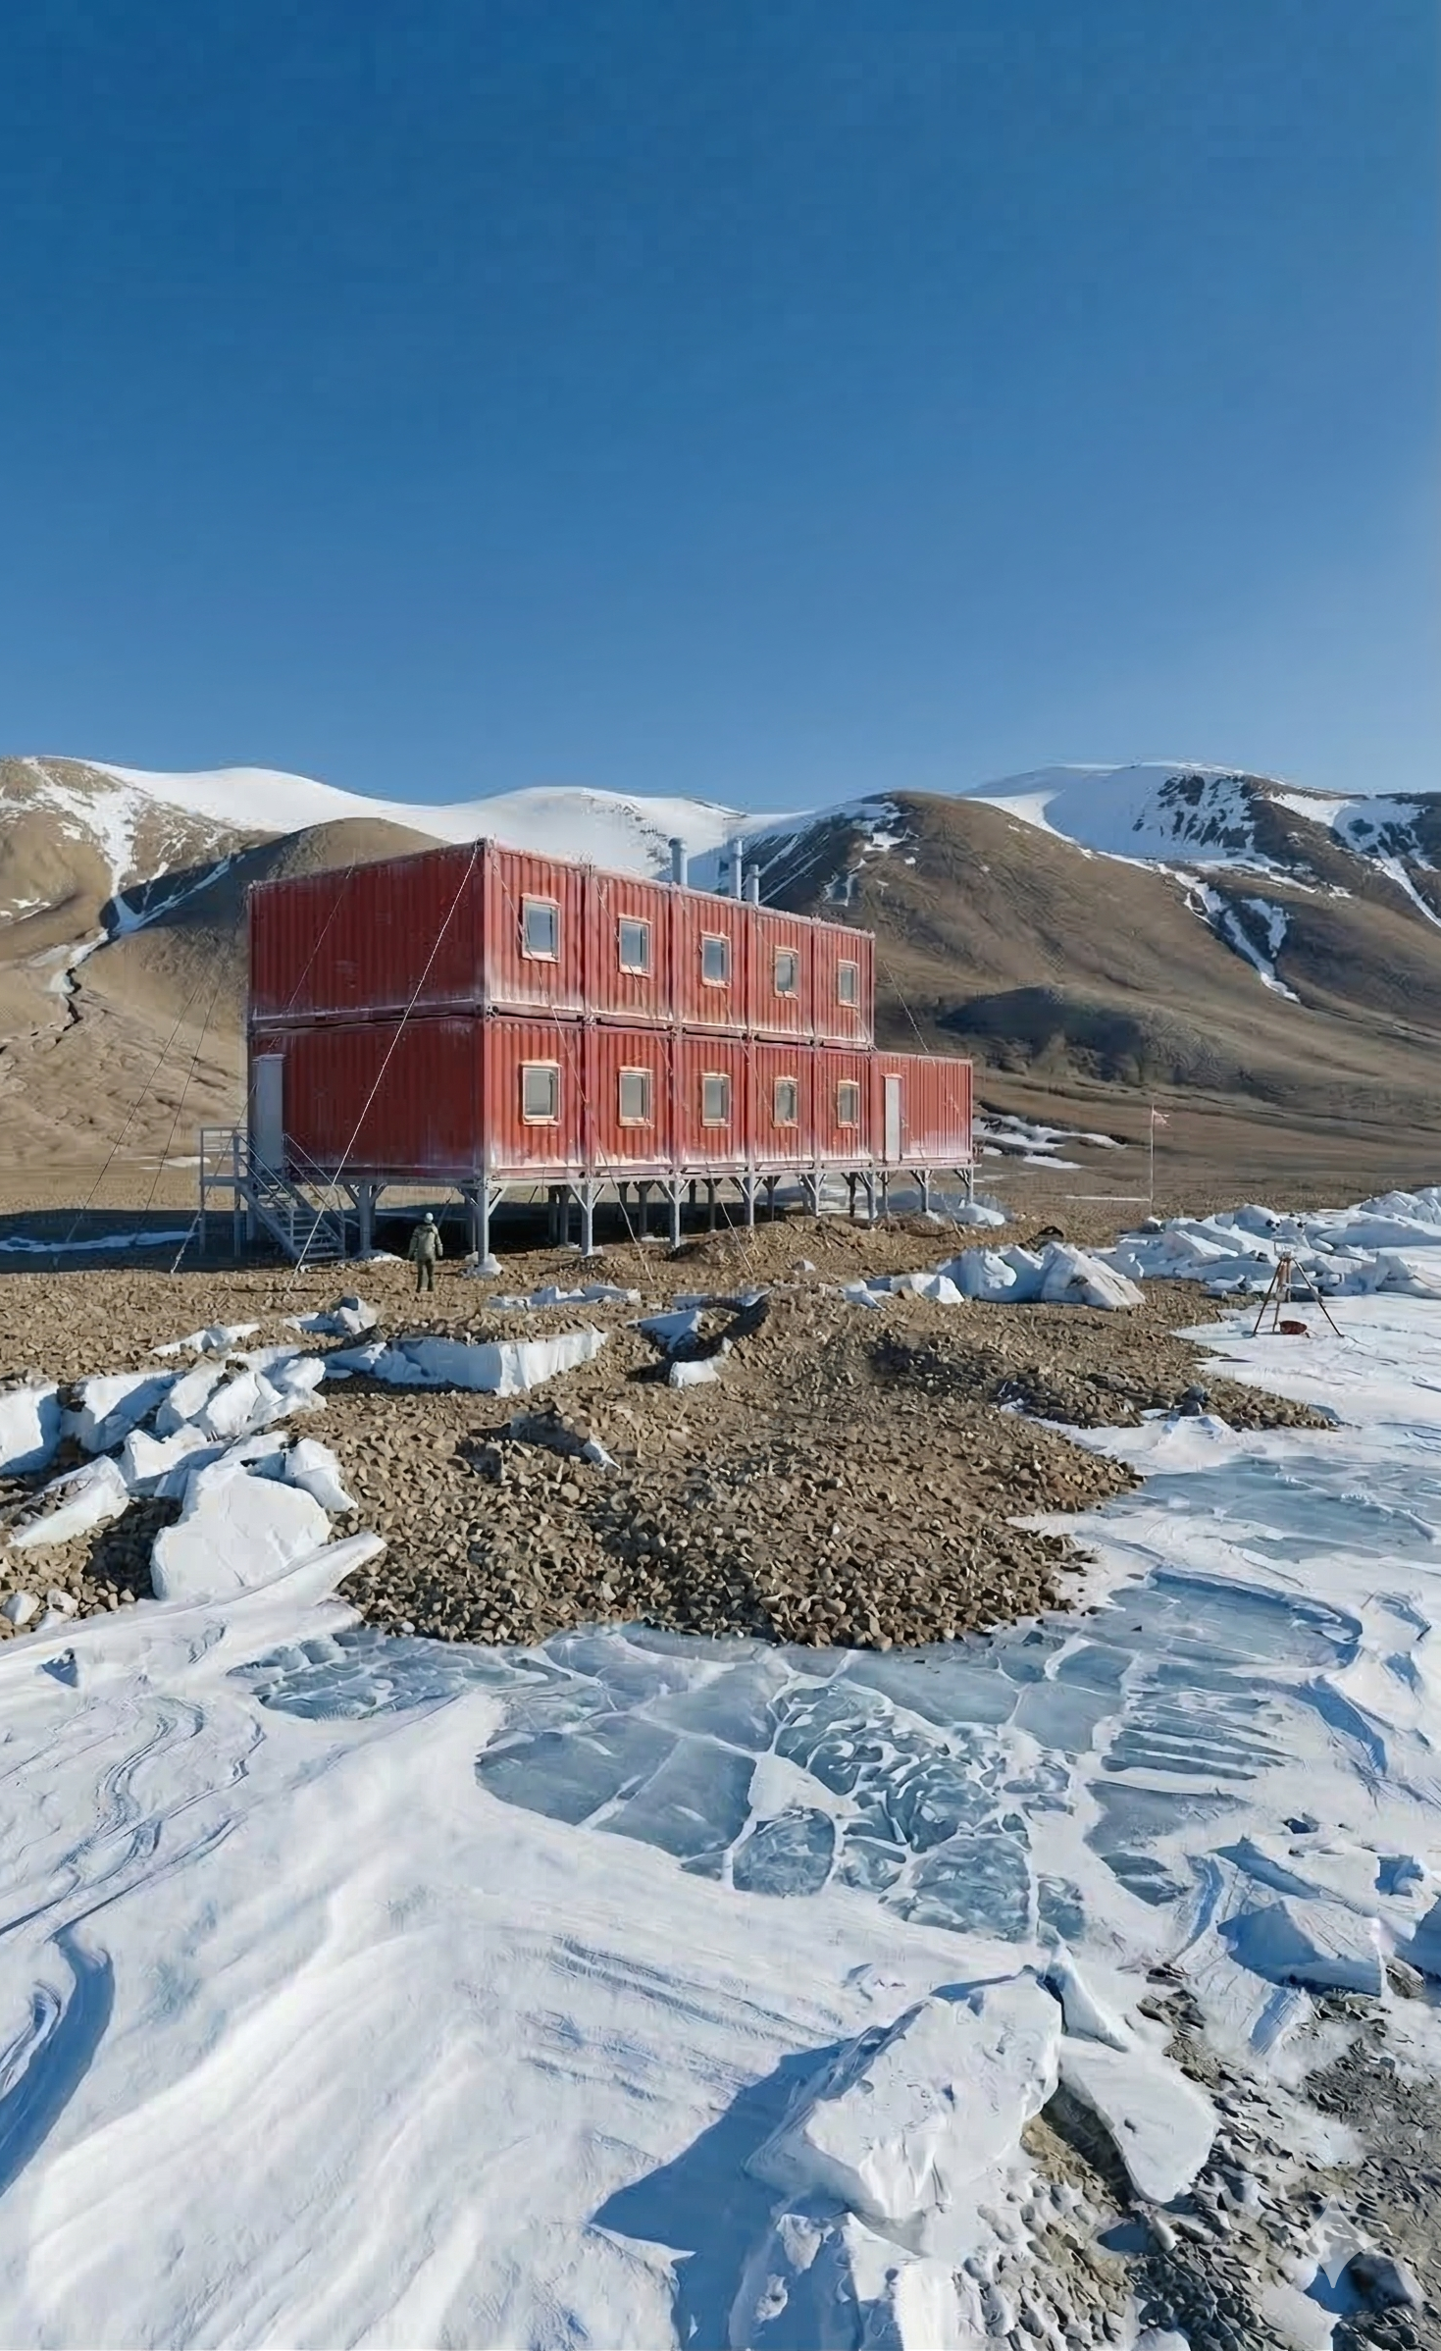
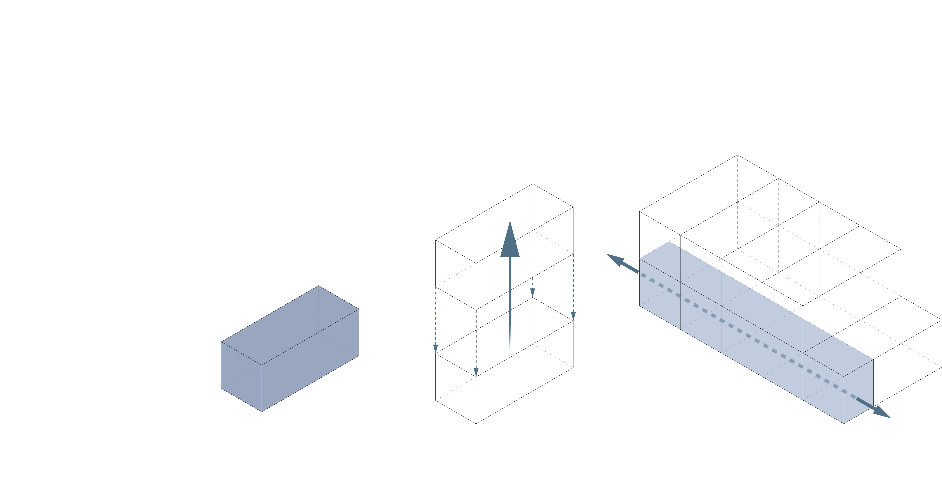
Fig. 6 – Exterior Vision, AI generated
2
DESIGN CONCEPT | STACKING
Spatial Varity
Amplify the quality of each function
Vertical corridor
Reduced footprint
Less foundation
Vertical rising point
Fig. 5 – Diagram Stacking & Arraying

Slide 10
Fig. 6 – Exterior Vision, AI generated
2
DESIGN CONCEPT | ARRAYING
Air Lock as a horizontal connector
Air lock
Fig. 5 – Diagram Stacking & Arraying

Slide 11
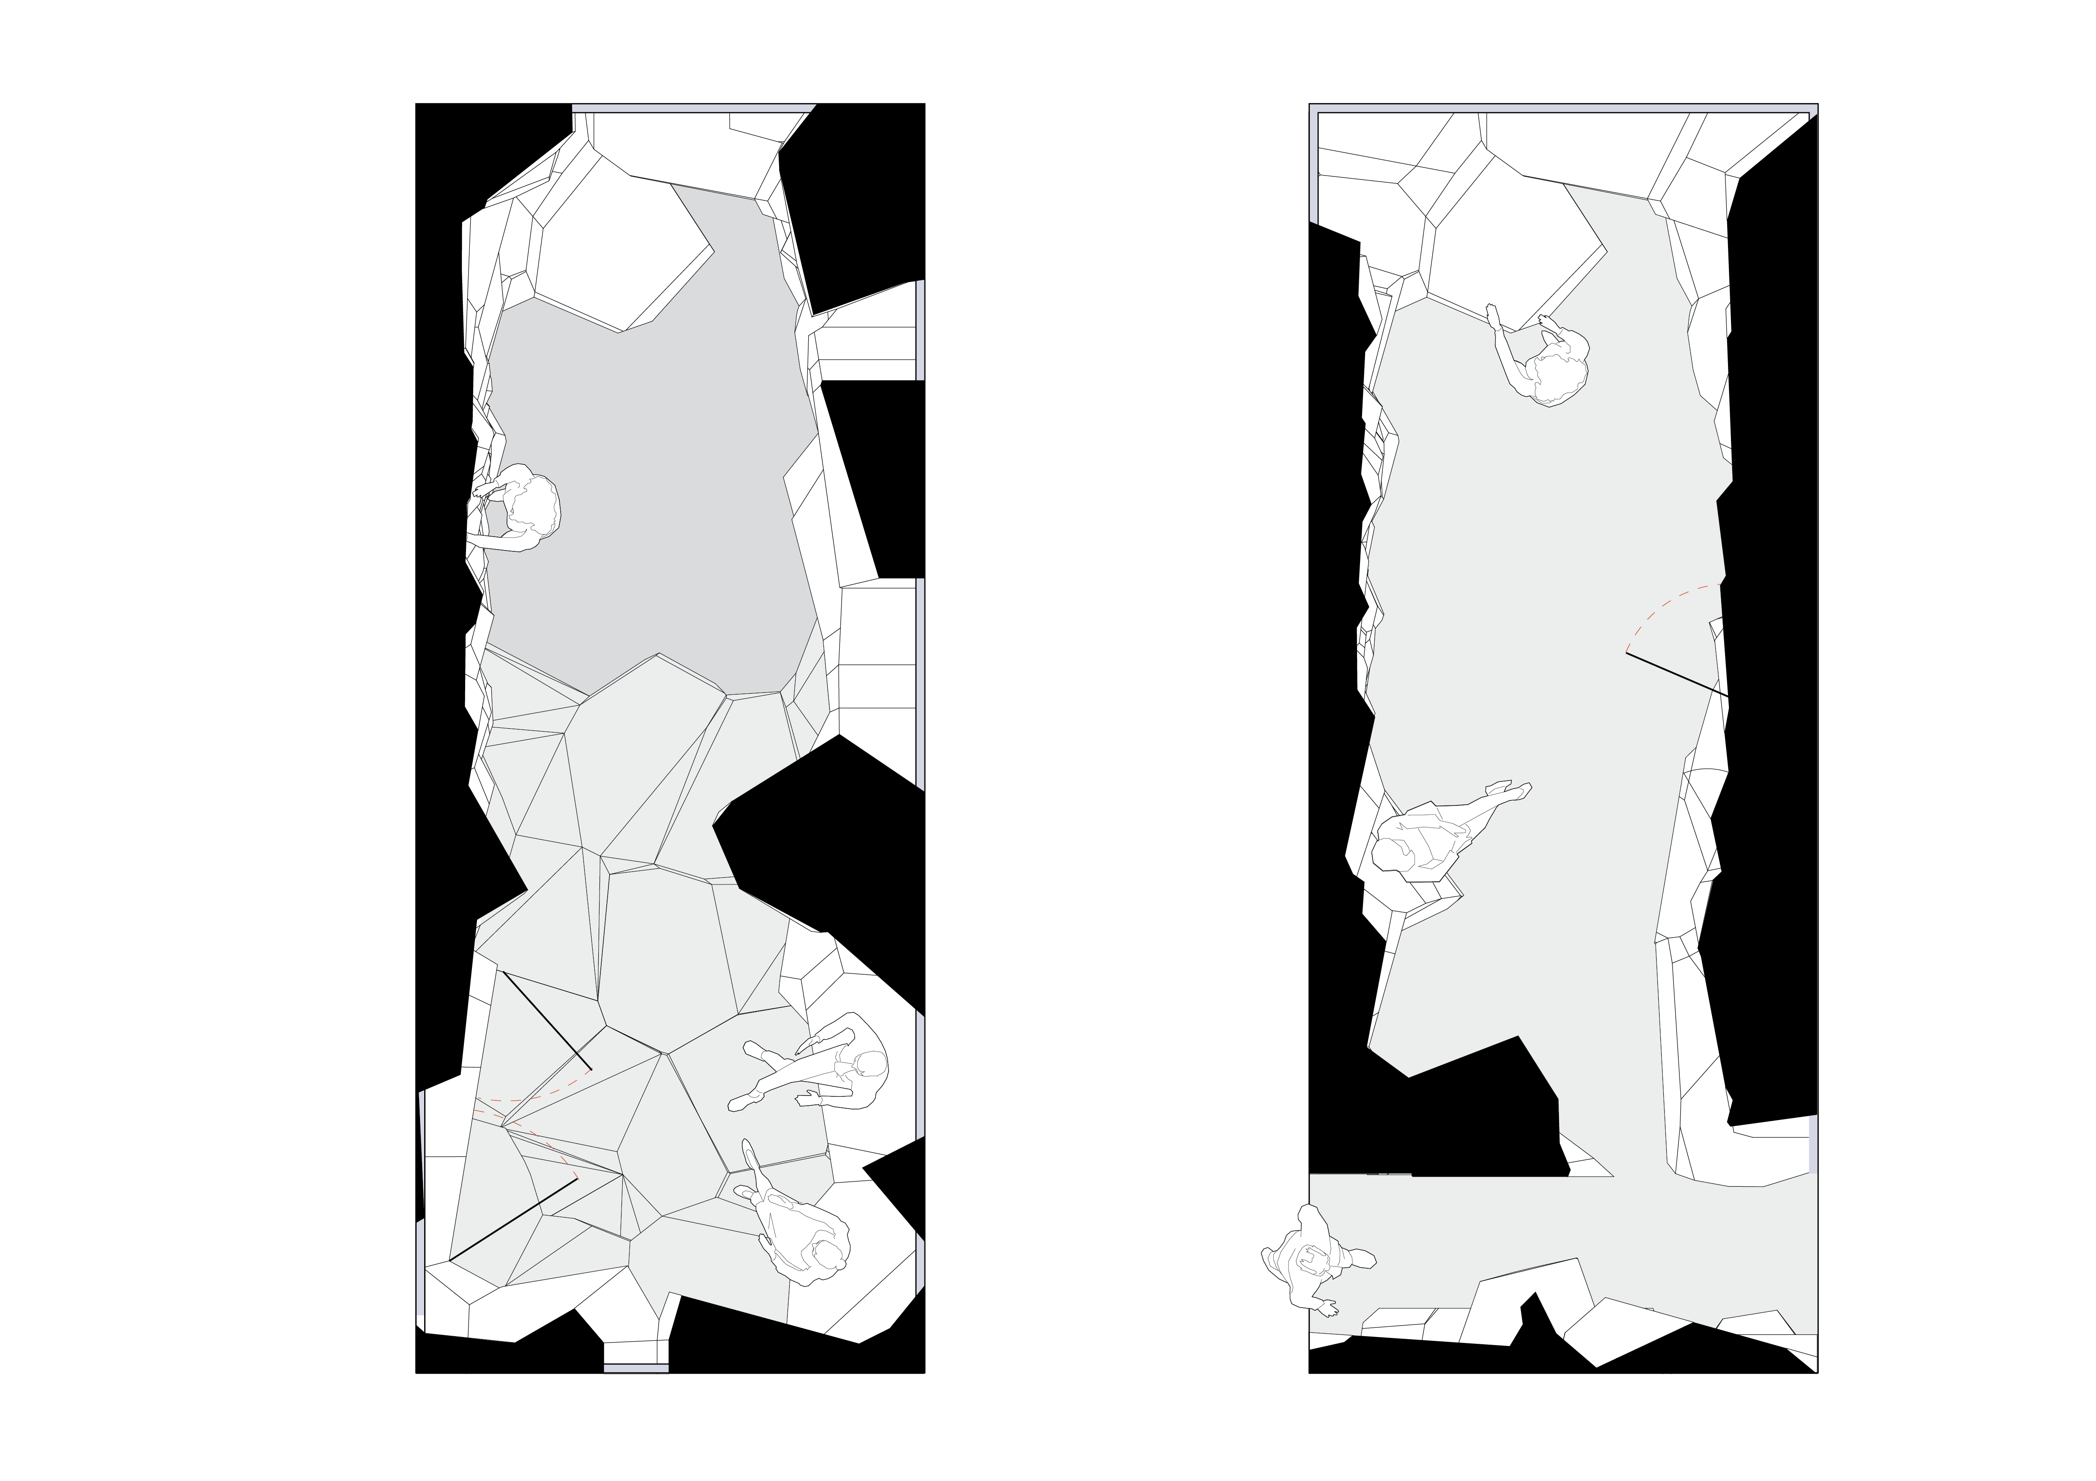
2
DESIGN | FLOORPLAN
Lower
Floor
Upper
Floor
Fig. 16 – Floorplans
AR122 1:1 Interactive Architecture Prototypes

Slide 12
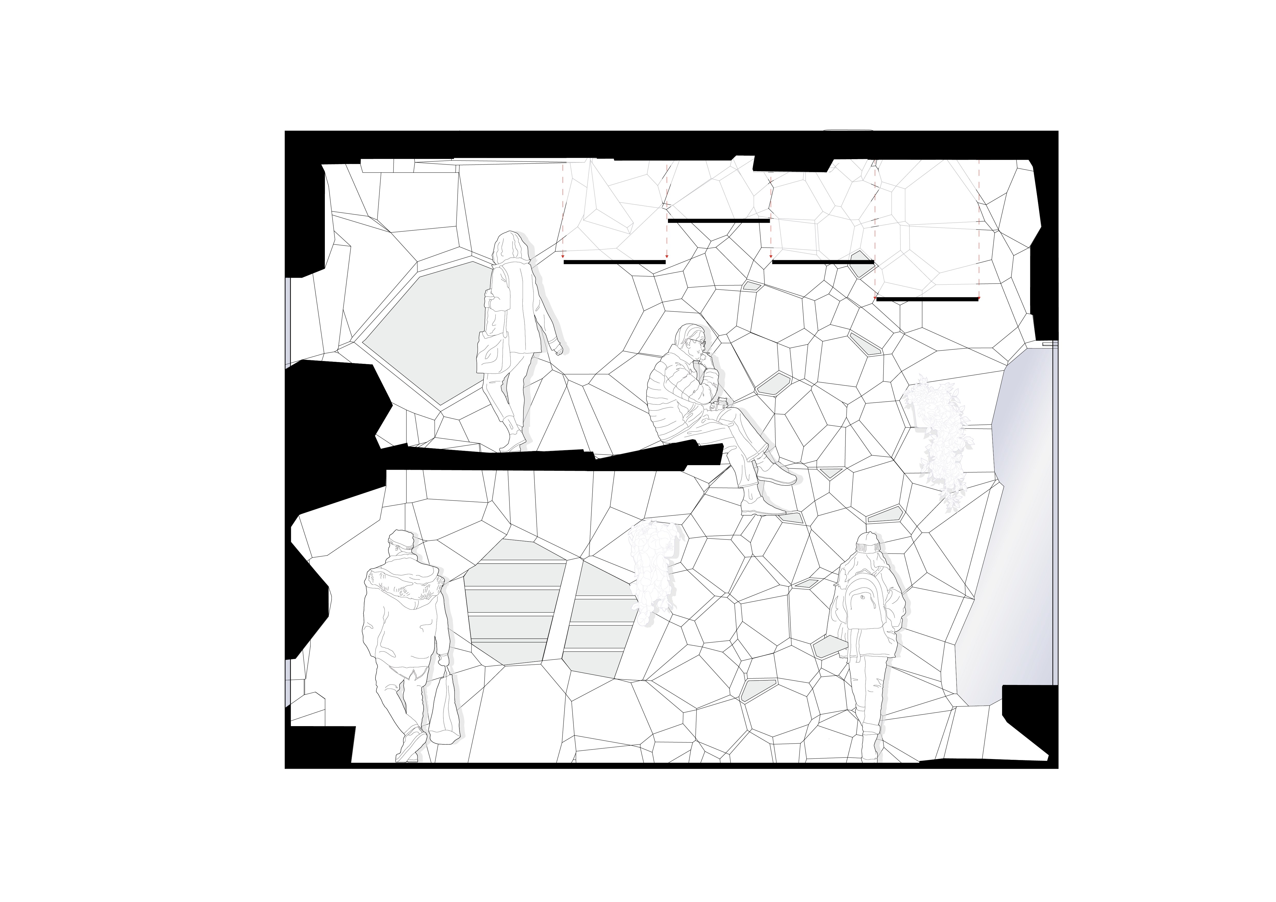
2
DESIGN | SECTION
Fig. 16 – Section
AR122 1:1 Interactive Architecture Prototypes

Slide 13

3
FRAGMENT | CLIMB
Fig. 7 – Diagram Planting Fragment
AR122 1:1 Interactive Architecture Prototypes

Slide 14

2
FRAGMENT | STORE
Fig. 7 – Diagram Planting Fragment
AR122 1:1 Interactive Architecture Prototypes

Slide 15

2
FRAGMENT | STORE
Fig. 7 – Diagram Storage Fragment
AR122 1:1 Interactive Architecture Prototypes

Slide 16

2
FRAGMENT | PLANT
Fig. 8 – Diagram Planting Fragment
AR122 1:1 Interactive Architecture Prototypes

Slide 17

2
FRAGMENT | PLANT
Fig. 8 – Diagram Planting Fragment
AR122 1:1 Interactive Architecture Prototypes

Slide 18
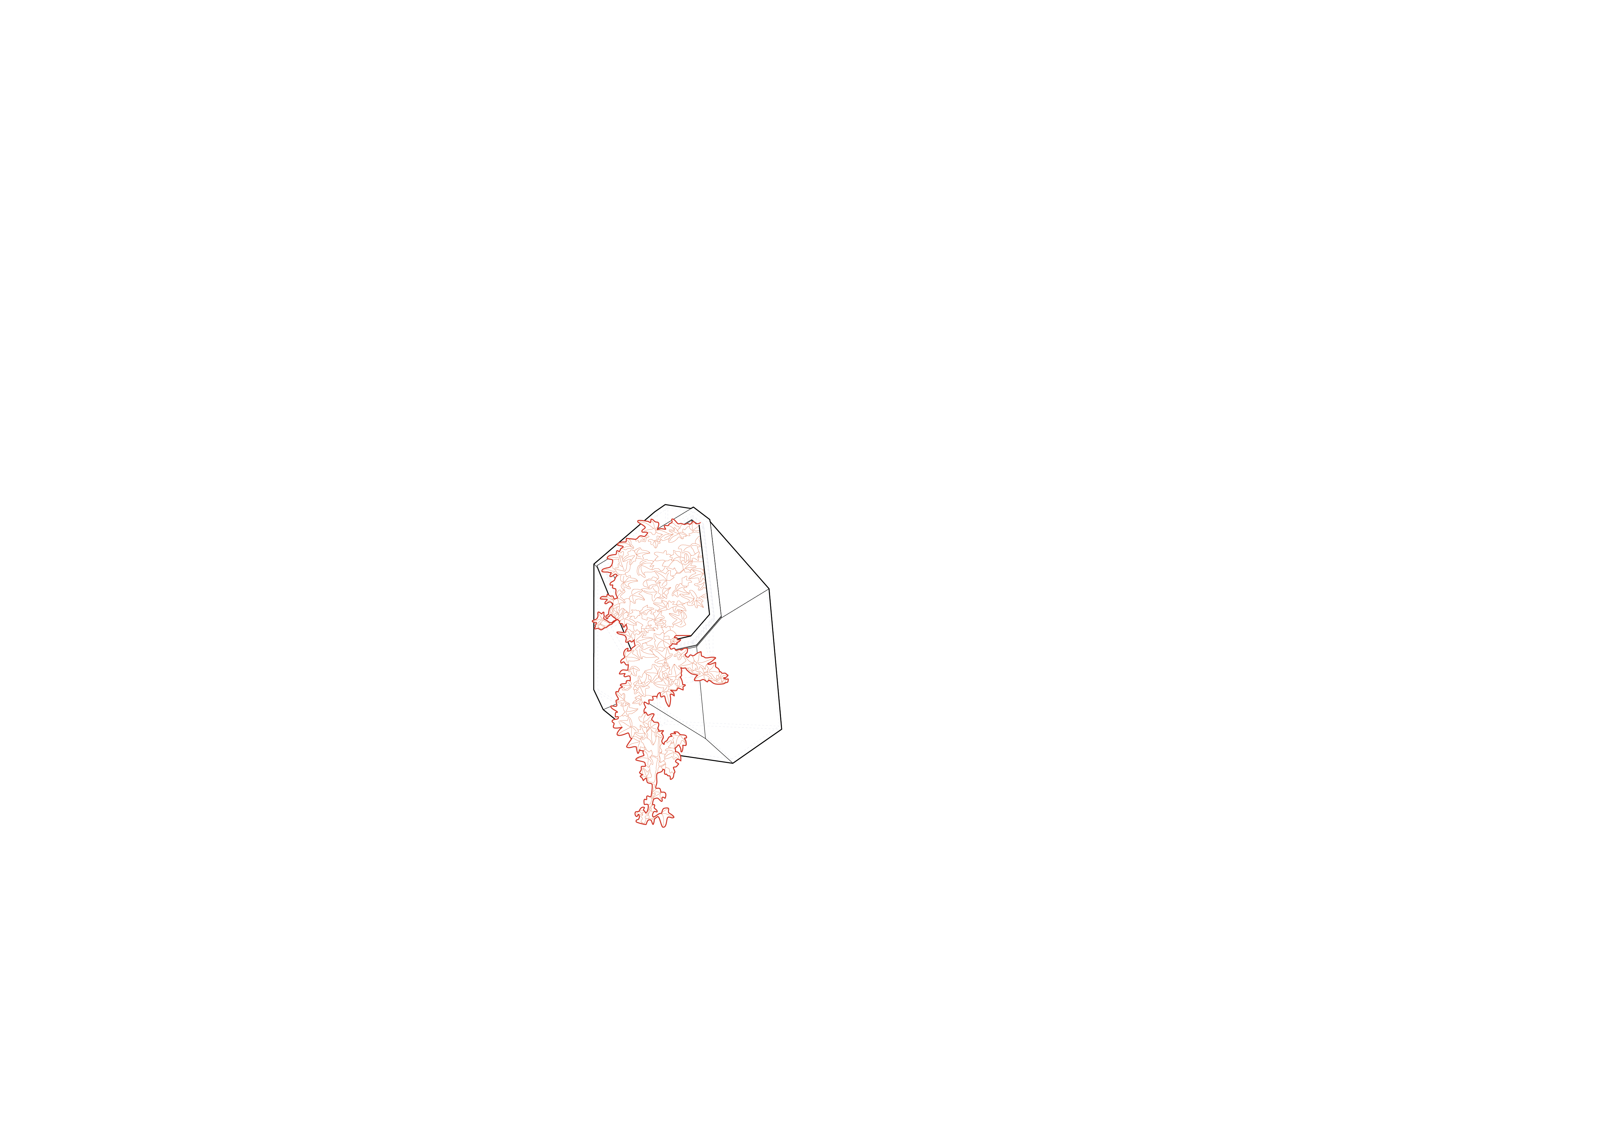
2
FRAGMENT | PLANT
Fig. 8 – Diagram Planting Fragment
AR122 1:1 Interactive Architecture Prototypes

Slide 19
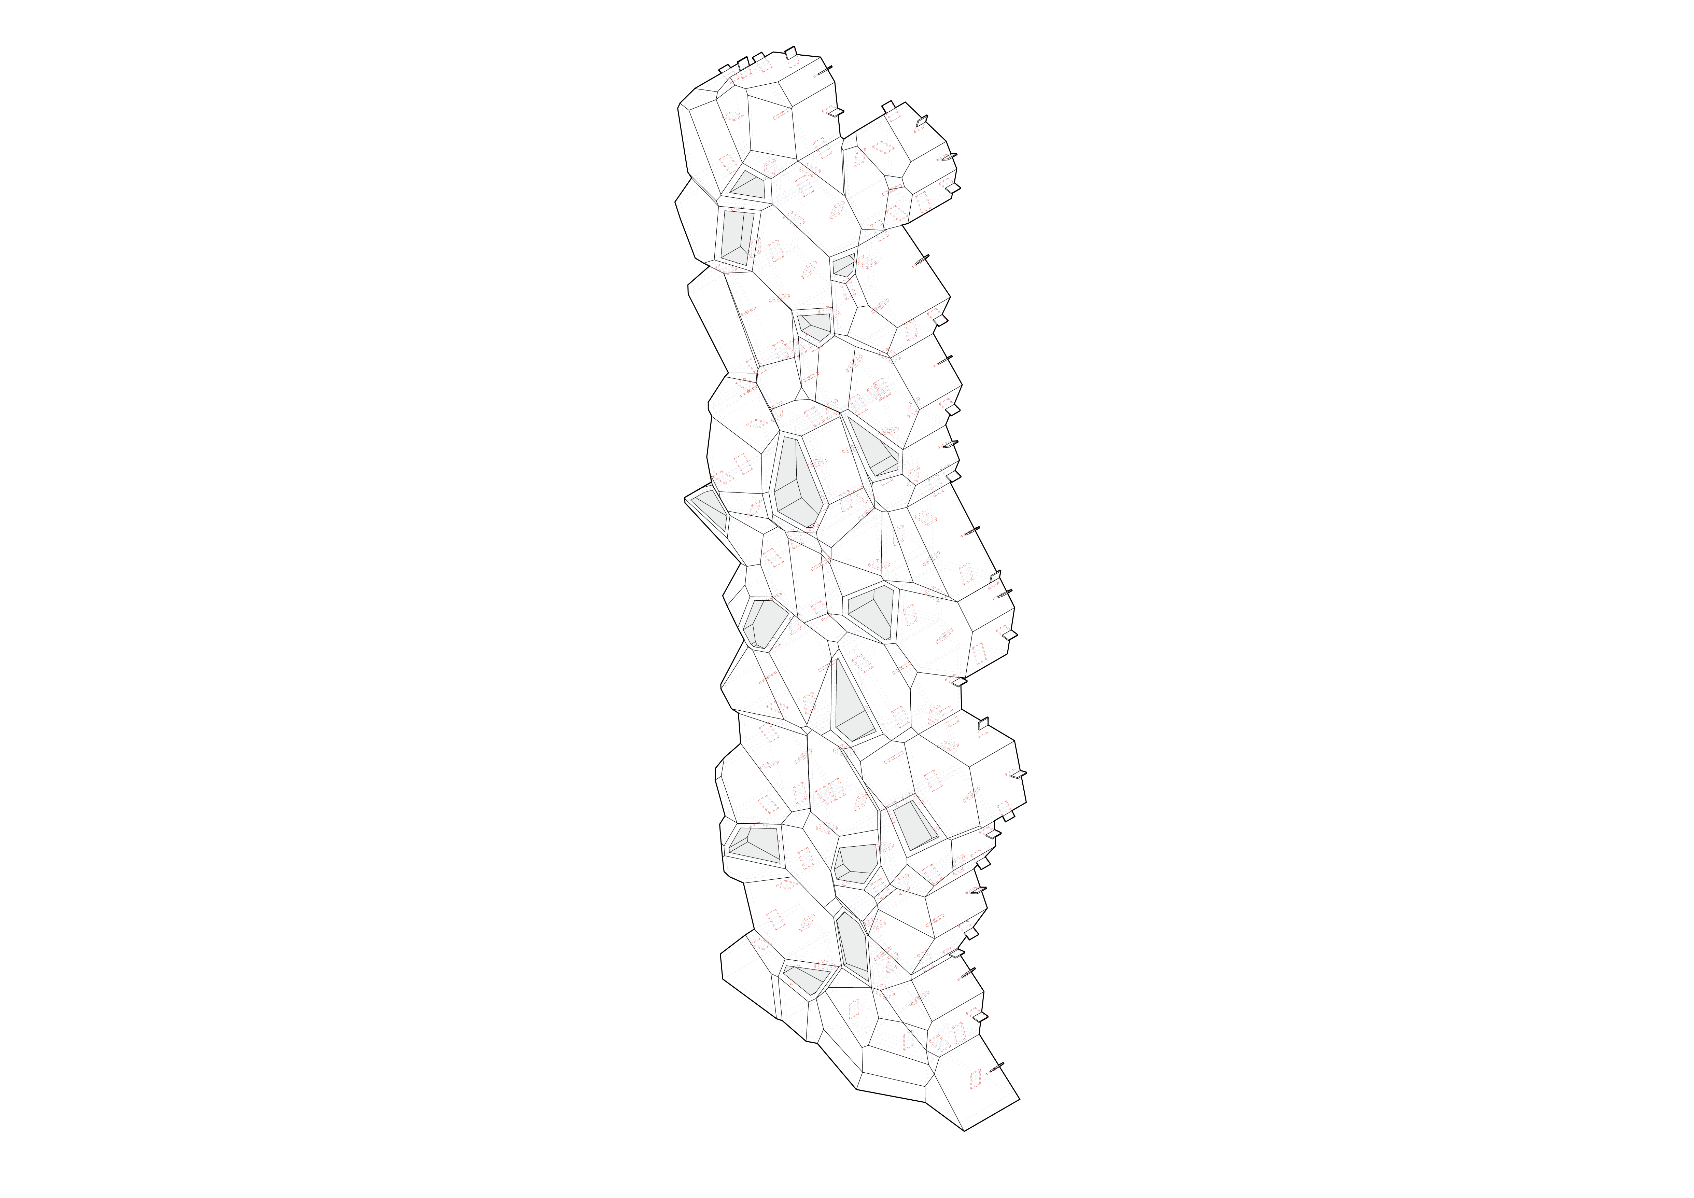
2
FRAGMENT | CLIMB
Front
Climbing
Fig. 9 – Diagram Climbing Fragment
AR122 1:1 Interactive Architecture Prototypes

Slide 20
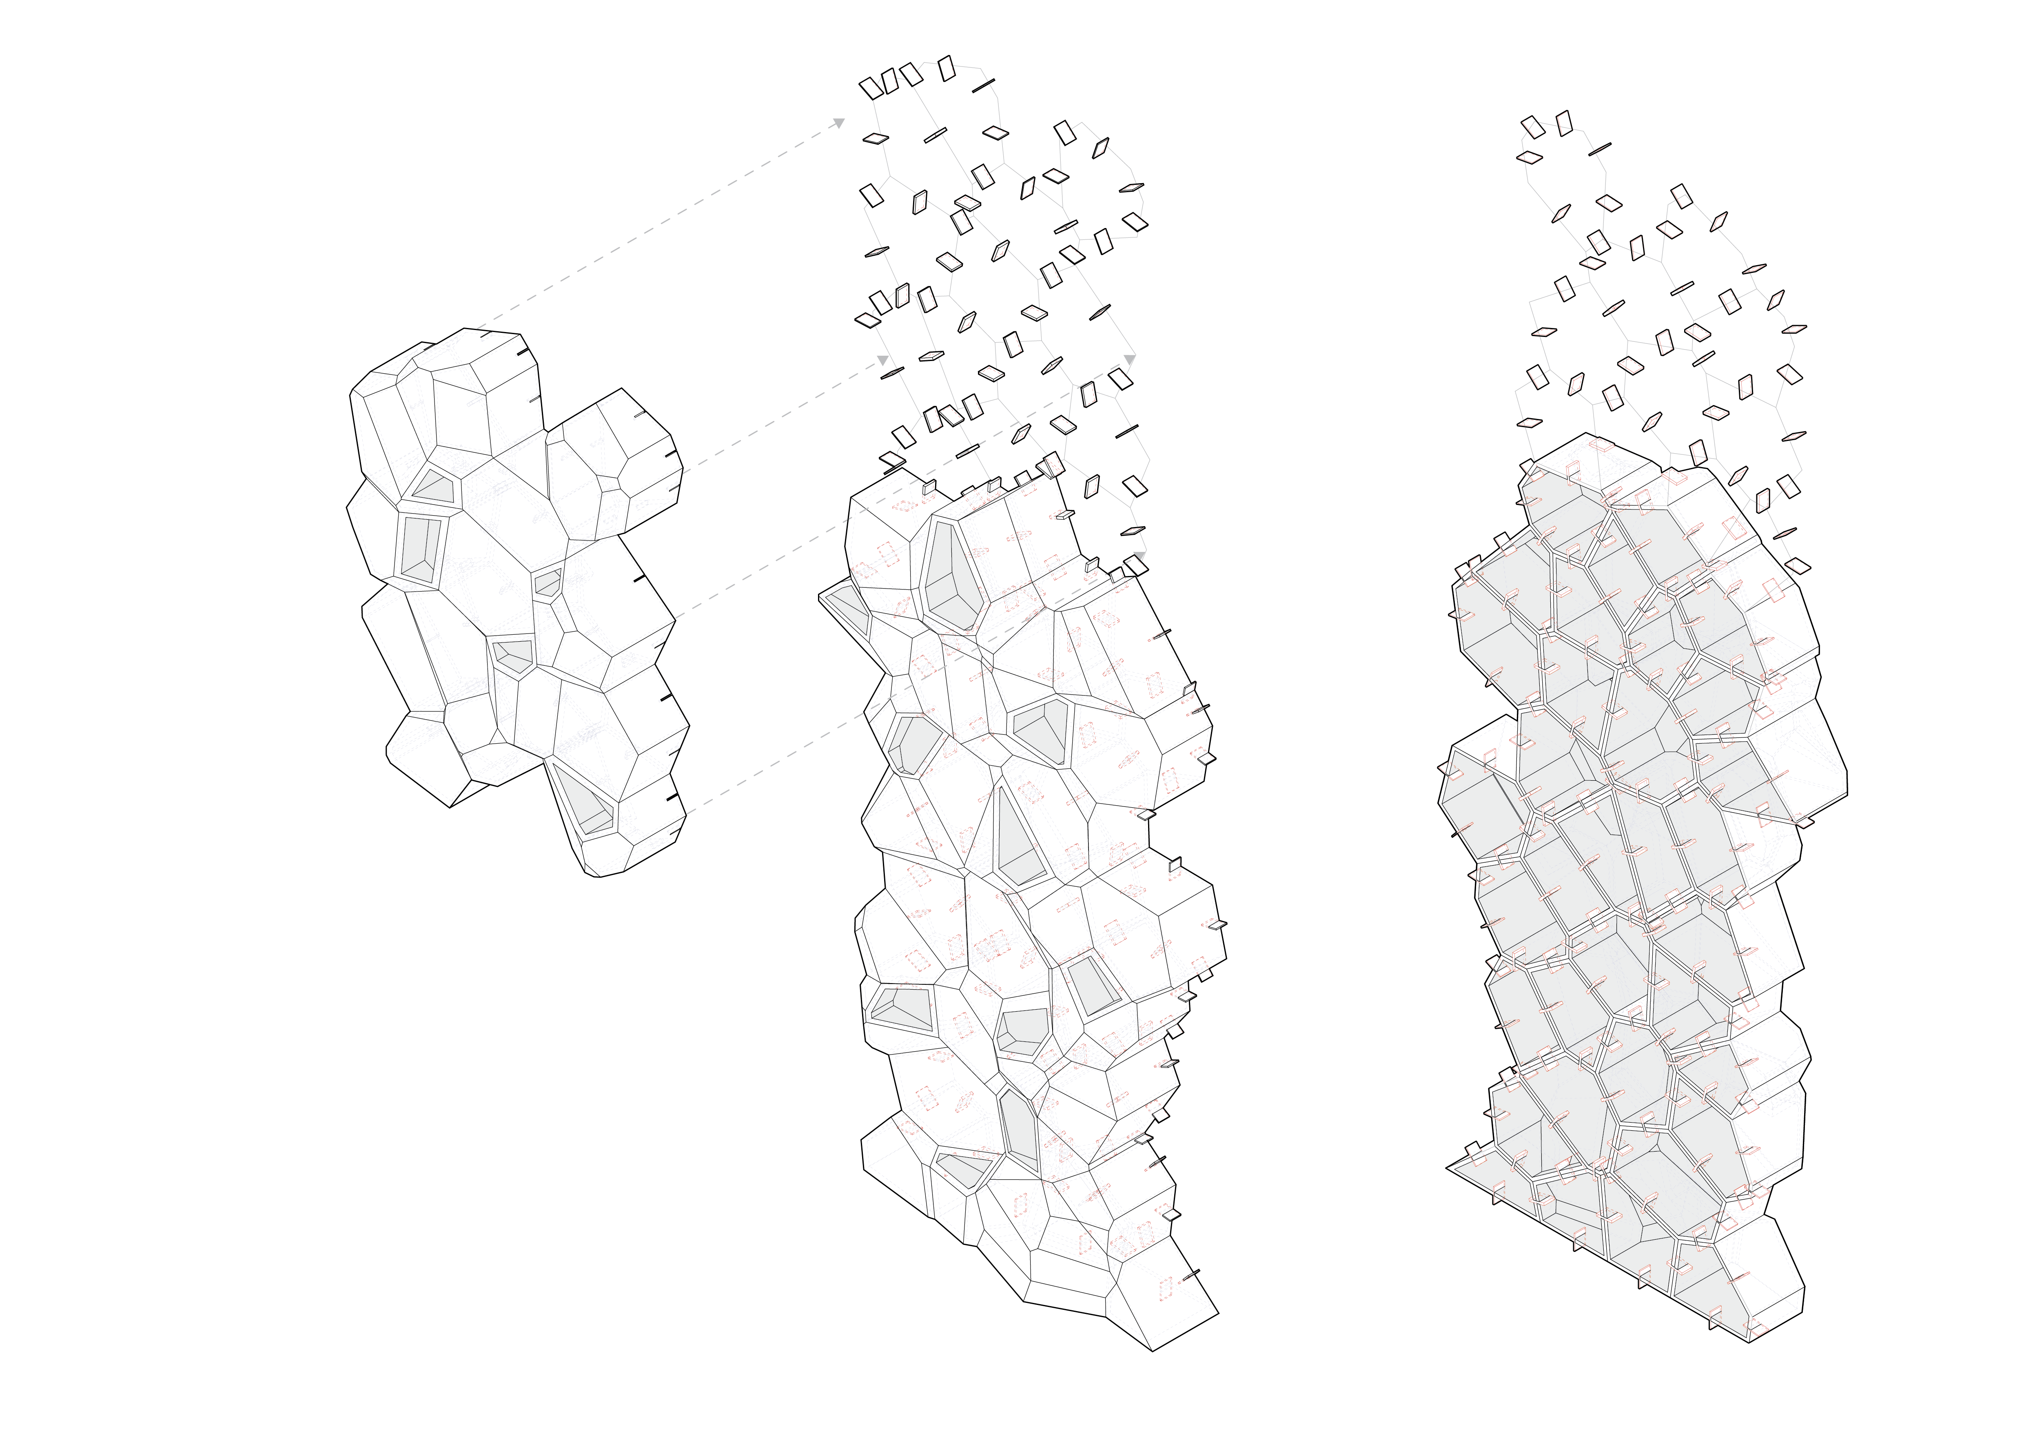
2
FRAGMENT | CLIMB
Notched cells
Connected with clips
Front
Climbing
Back
Hollow/Insulated
Fig. 9 – Diagram Climbing Fragment
AR122 1:1 Interactive Architecture Prototypes

Slide 21
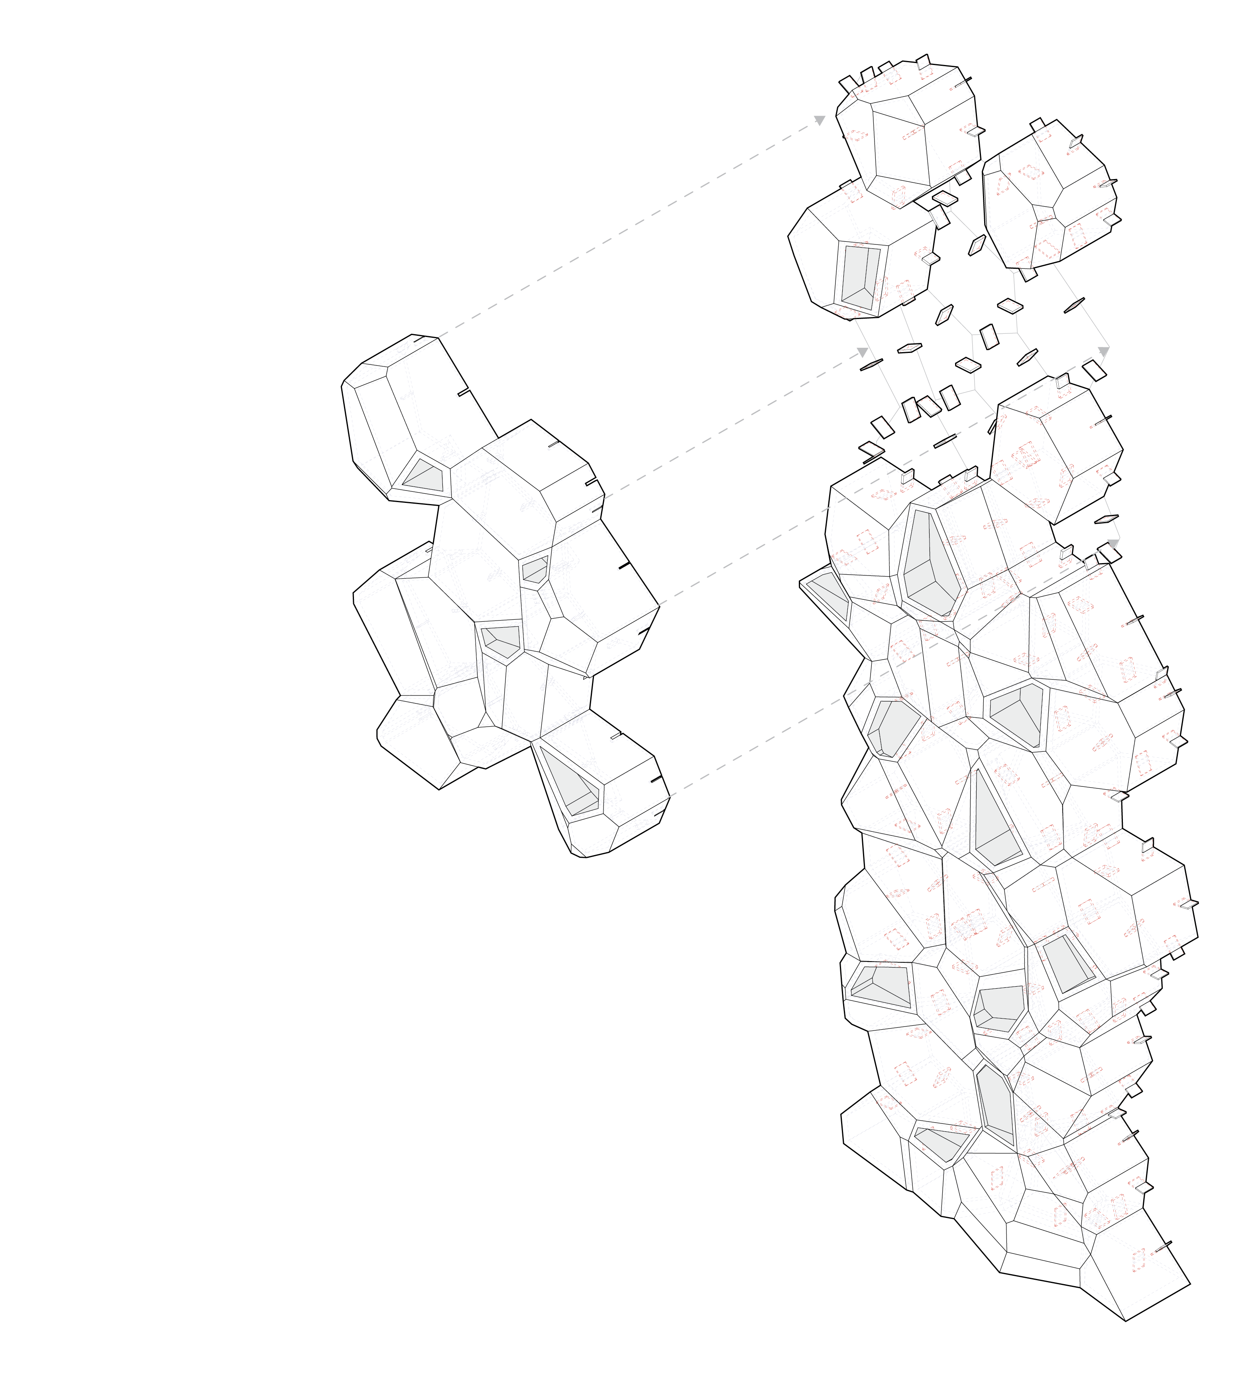
2
FRAGMENT | CLIMB
Notched cells
Connected with clips
Front
Climbing
Back
Hollow/Insulated
Fig. 9 – Diagram Climbing Fragment
AR122 1:1 Interactive Architecture Prototypes

Slide 22


2
FRAGMENT | 3D PRINTING
G-CODE | Toolpath for shelving WIP & Toolhead?
Fig. 10 – Generating 3D printing files with grasshopper
(Ozdemir, Doubrovski, Castro, 2024)
Fig. 11 – 3D Print Toolpath WIP
AR122 1:1 Interactive Architecture Prototypes

Slide 23
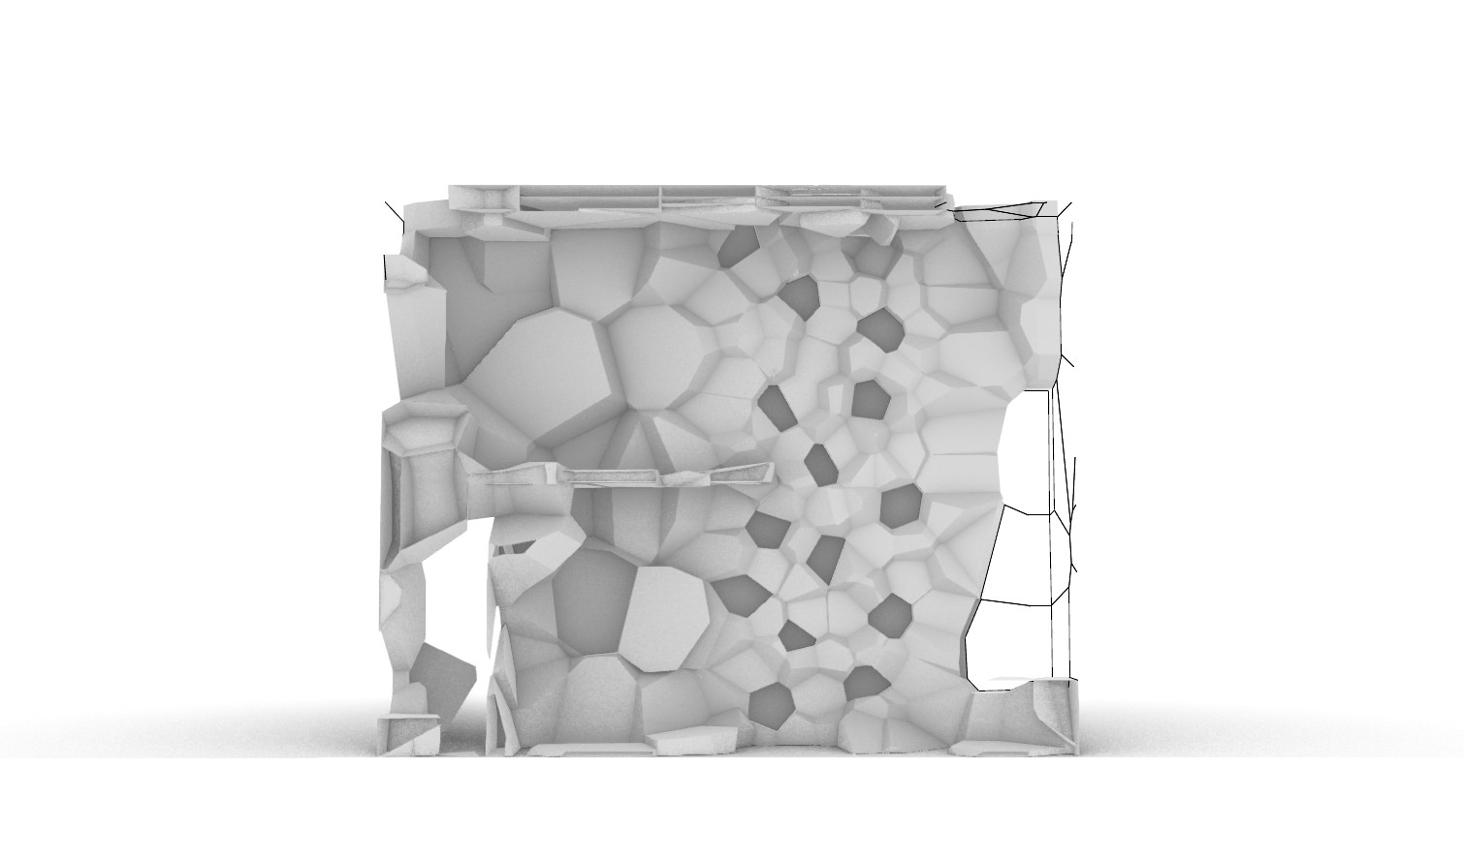
3
DESIGN SIMULATION | STORAGE UNITS
Fig. 12 – Animation Storage Units
v
Group 3

Slide 24
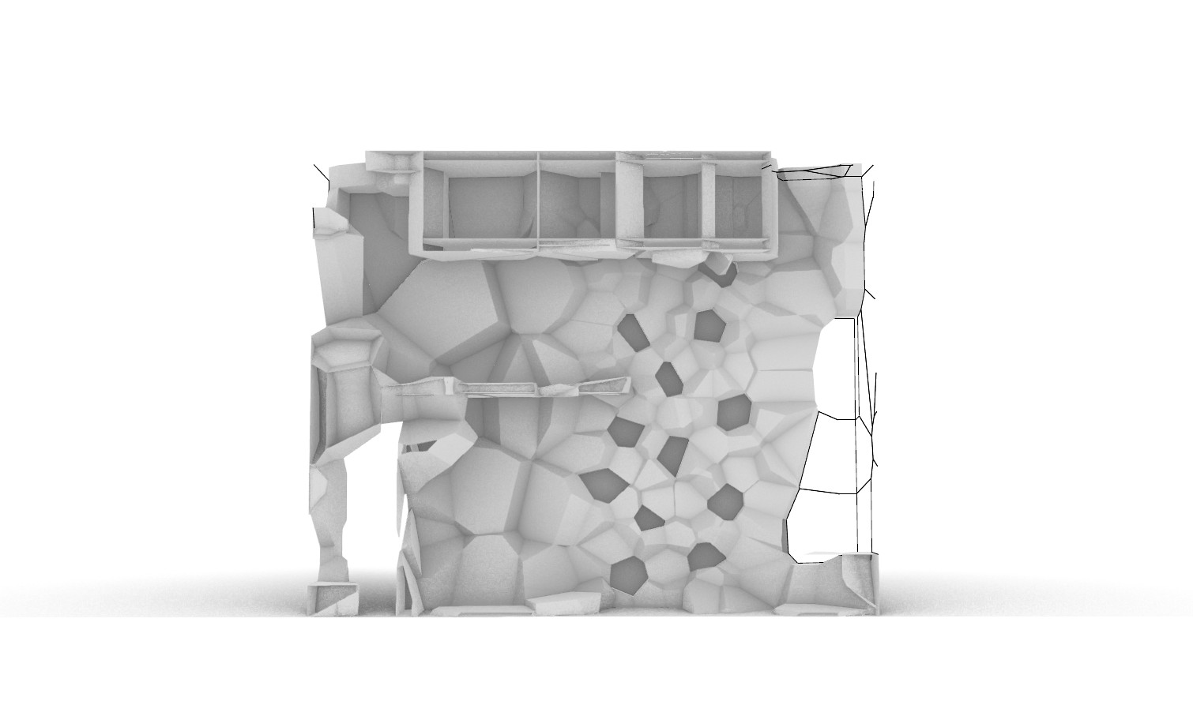
3
DESIGN SIMULATION | BED
Fig. 13 – Animation Folding Bed
v
Group 3

Slide 25
3
DESIGN SIMULATION | CABINETS
Fig. 14 – Animation Folding Cabinets
v
Group 3

Slide 26
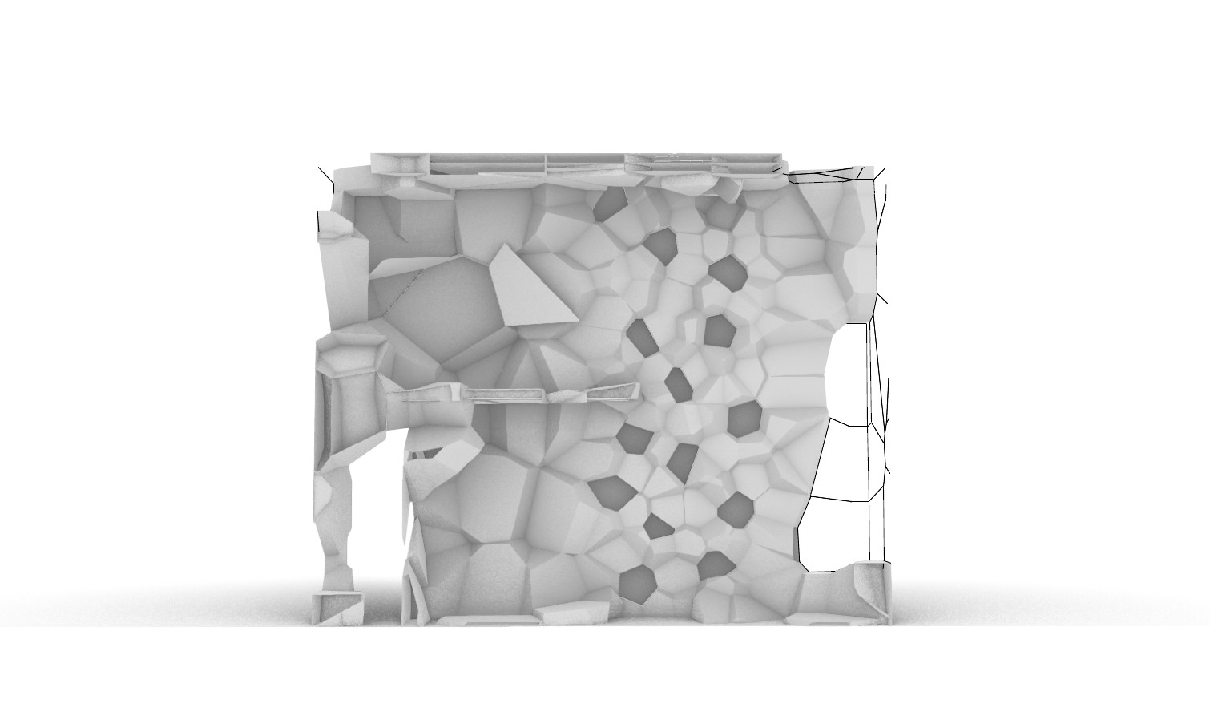
3
DESIGN SIMULATION | PRIVATE NICHE
Fig. 15 – Animation Folding Cabinets
v
Group 3

Slide 27
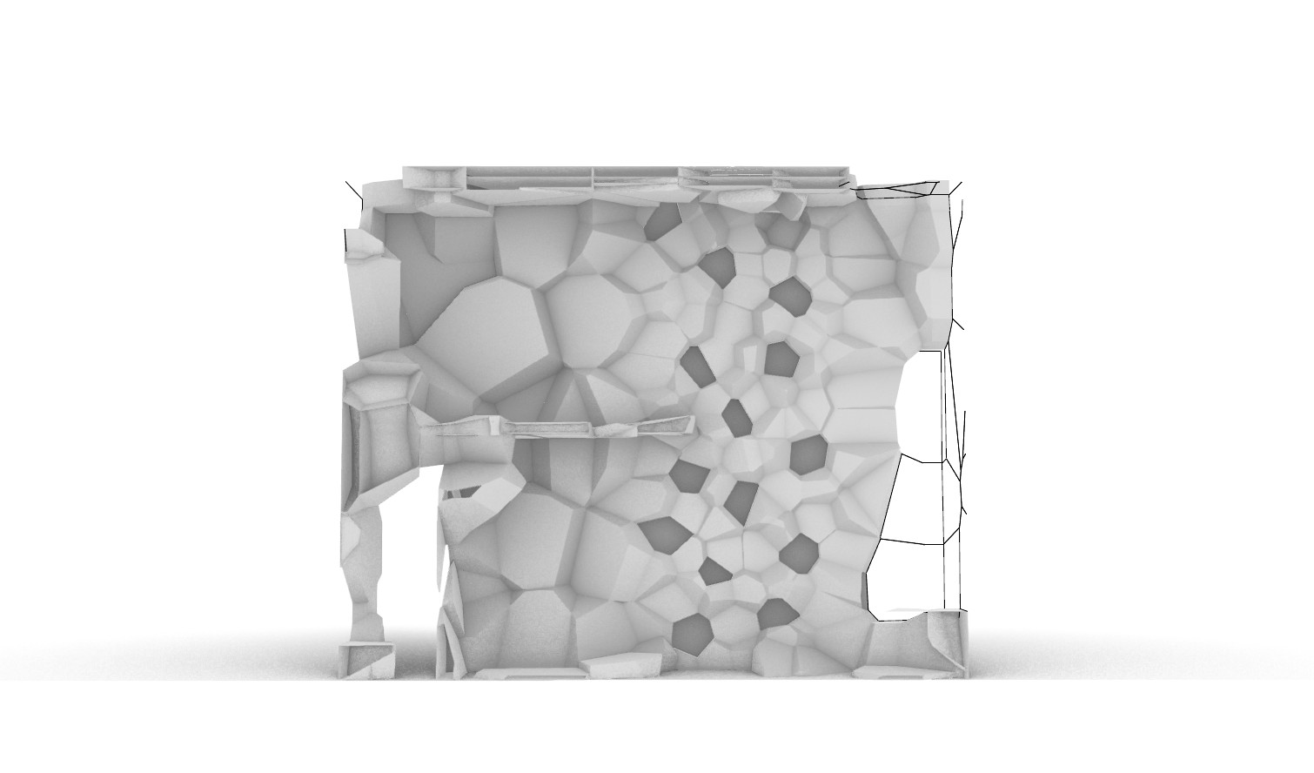
3
DESIGN SIMULATION | FOLDING TABLE
Fig. 13 – Animation Folding Bed
v
Group 3

Slide 28
4
LIGHTING | AI Integration
PROBLEM | No natural Light cycles
HYPOTHESIS | Light can regulate physiology
DATA | Key correlations to define rules
DESIGN | Apply design rules
v
Group 3
AR122 1:1 Interactive Architecture Prototypes

Slide 29


Fig. 18 – Troll Research Station, Norsk Polarinstitutt
4
LIGHTING | AI Integration & Light Approach
PROBLEM | No natural Light cycles
HYPOTHESIS | Light can regulate physiology
Weather conditions
Severe Temperatures
Strong Catabatic Winds
Minimal Precipitation
Low Humidity
Physiology
Sleep
Mood
Cognitive performance
Physiological regulation
Arctic seasons
Extreme Light Cycles
Lighting conditions
Circadian Rhythm Disruption
Reduced Work Efficiency
Sleep & Mood issues
IMPACT ON
PHYSICAL AND MENTAL HEALTH
IMPLEMENTING
CIRCADIAN CLOCK
Fig. 17 – Diagram Challenges
v
Group 3
AR122 1:1 Interactive Architecture Prototypes

Slide 30
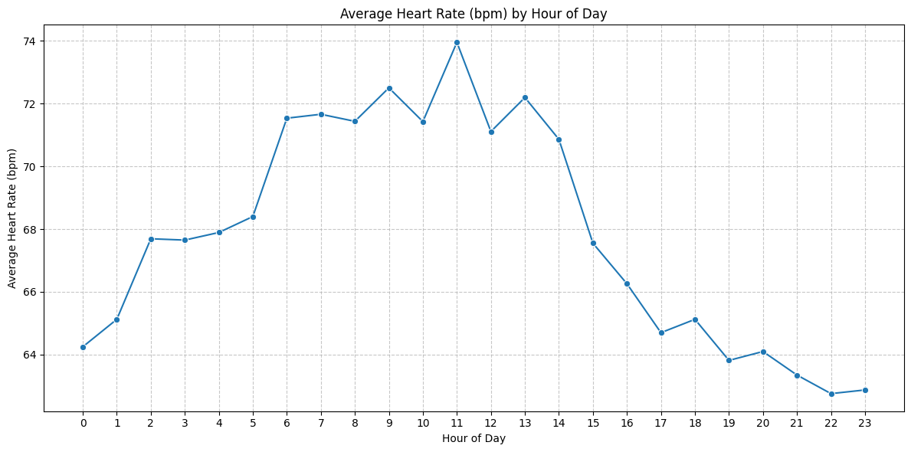
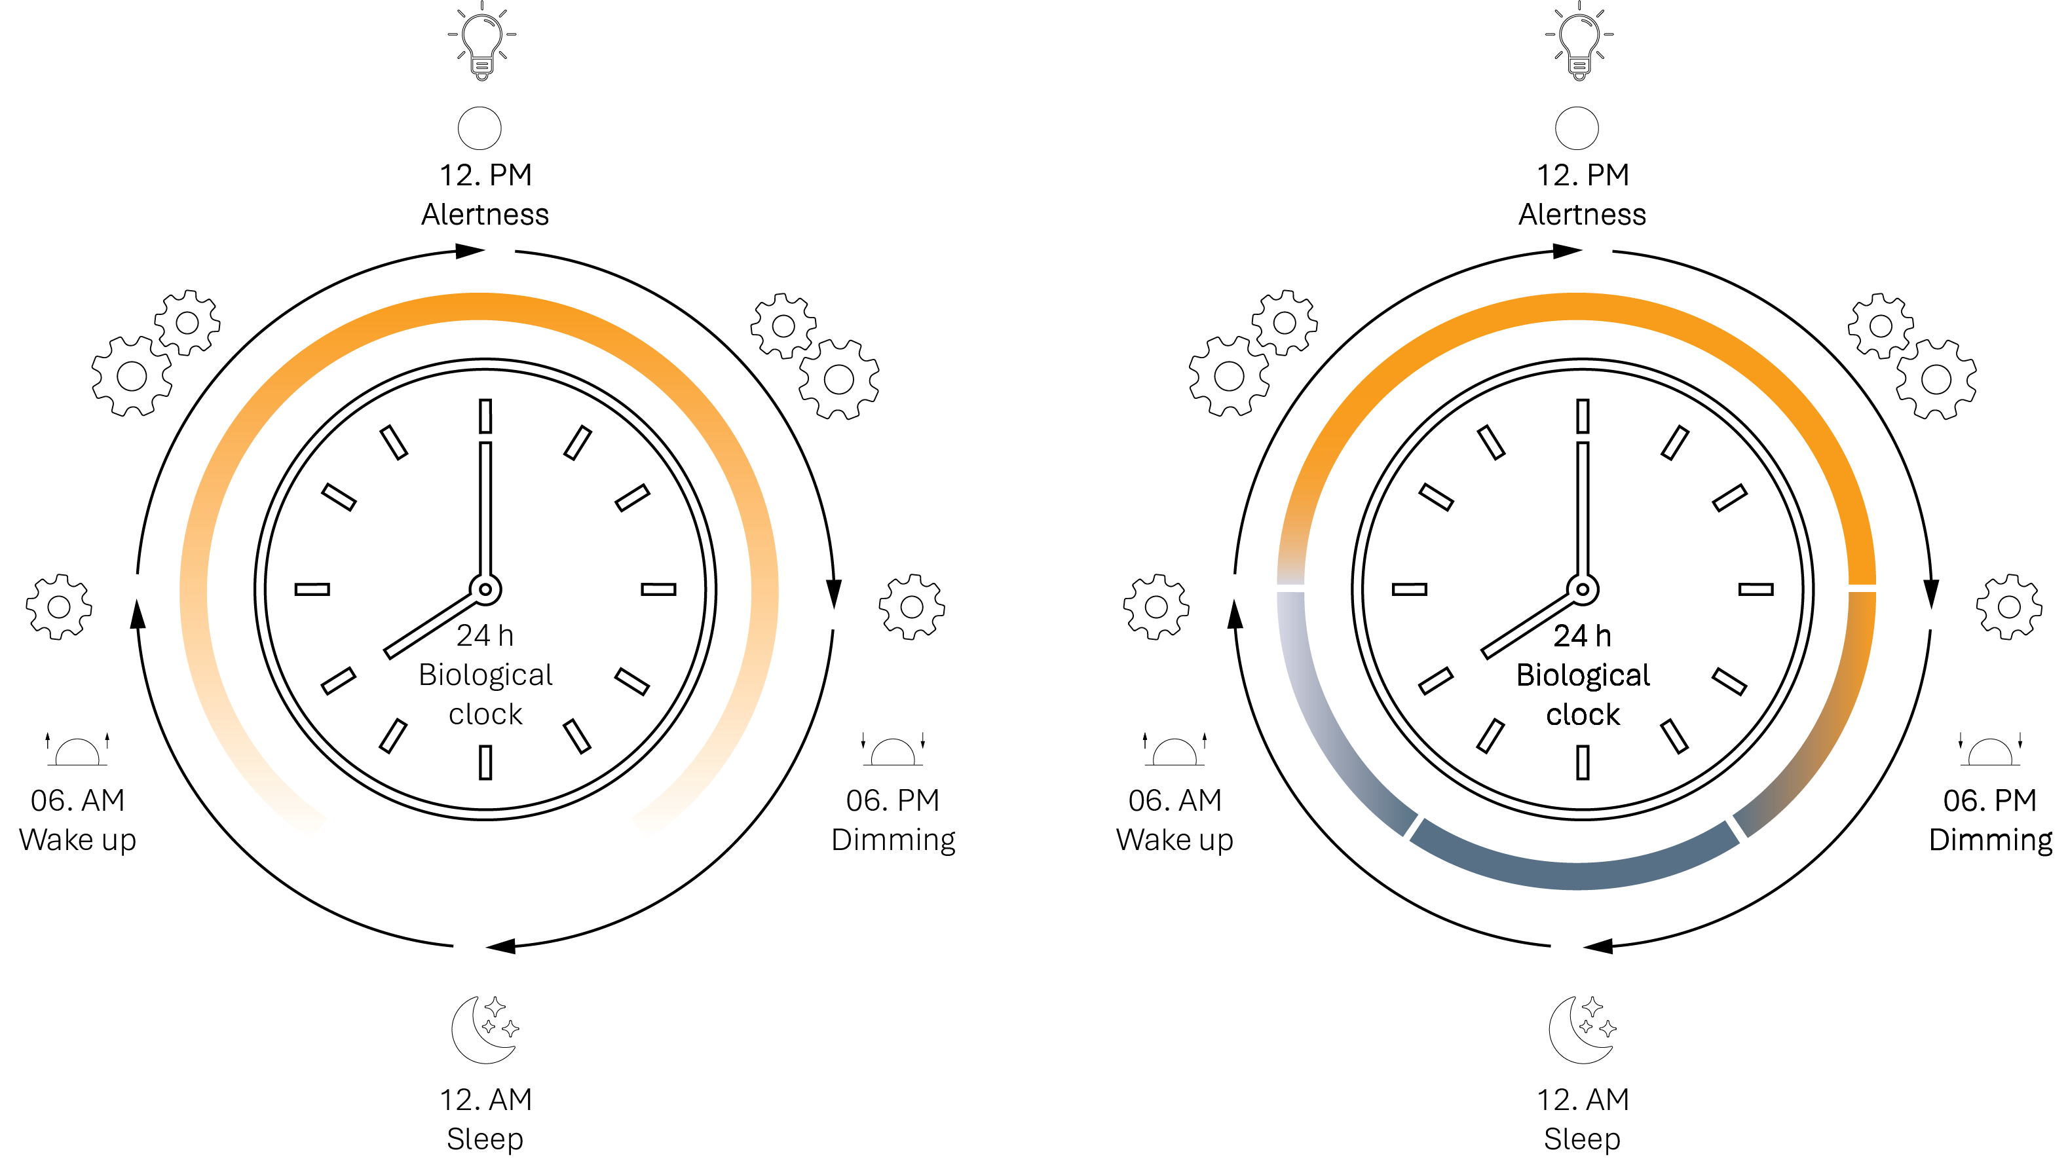
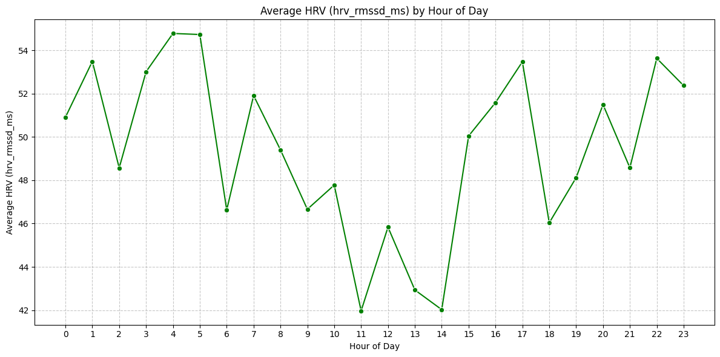
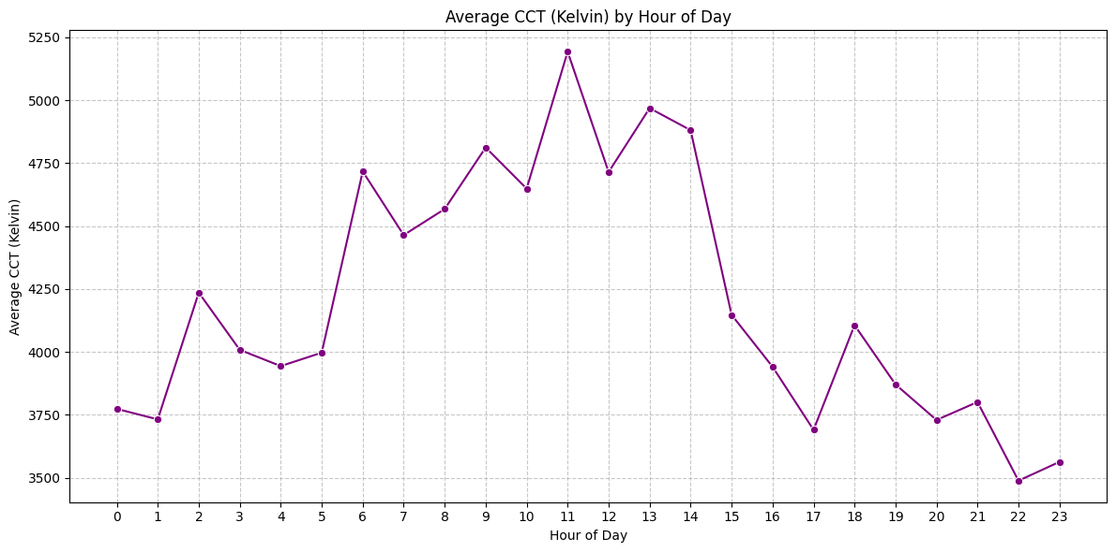
4
LIGHTING | AI Integration & Light Approach
There is a natural daily rhythm
In Antarctica → this rhythm is missing → must be simulated
The lighting system becomes a “synthetic circadian clock”
Fig. 20 & 21 – Graphs (Hour of day) and Biological clock
v
Group 3

Slide 31







Fig. 18 – Troll Research Station, Norsk Polarinstitutt
4
LIGHTING | AI Integration DATA
DATA | Key correlations to define rules
Variables: Weather data
Variables: Physiological data
​Time stamp
Skin conductance
​Illuminance lux
Respiratory rate bpm
Cct kelvin
Heart rate variability
Outdoor temperature
​Heart rate bpm
Total sky cover
Pupil mm
Blink rate per min
Fig. 19 - Data
AR122 1:1 Interactive Architecture Prototypes

Slide 32
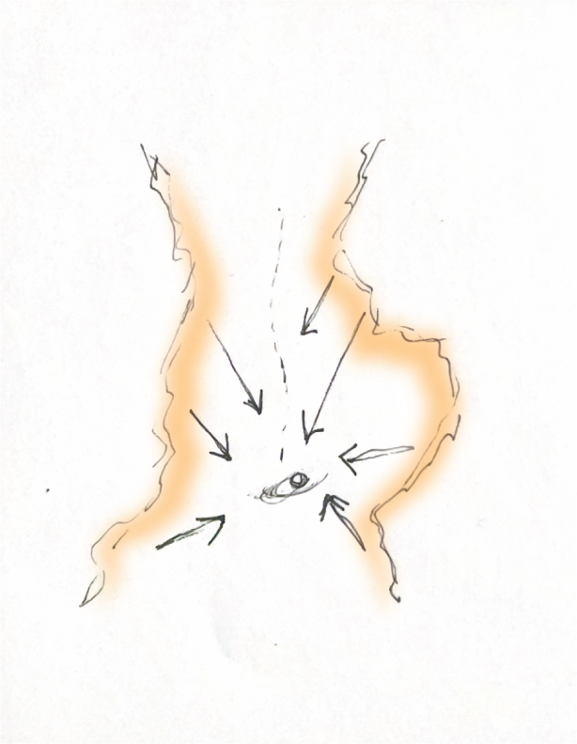
4
LIGHTING | AI Integration Light Approach
GOAL | Developing an adaptive lighting system that combines environmental data and Physiological data
GOAL | Implementing the adaptive lighting system in Grasshopper for real-time dataset driven simulation
​Result: ​
Heart rate prediction using:​
Lux​
Cct_kelvin​
Time​
Next phase:
Heart rate should be used as:
Input signal (real-time feedback)
​Time stamp
Heart rate variability
​Illuminance lux
​Heart rate bpm
Cct kelvin
Fig. 20– Illustration Lighting Concept​
​
v
Group 3

Slide 33
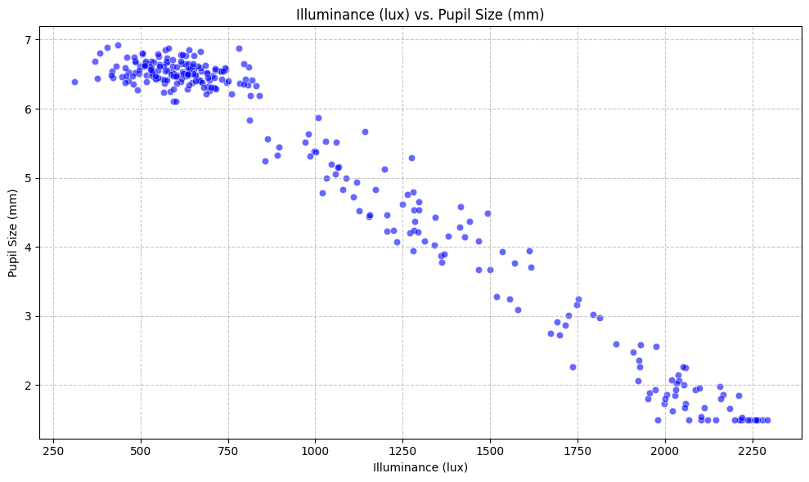
4
LIGHTING | AI Integration DATA
Key findings: Illuminance > Pupil size
Relevance to 'Indoor lighting can simulate real-world daylight conditions:
The analysis examined the relationship between illuminance (lux) and pupil size using a scatter plot and correlation calculation.
The result showed an extremely strong negative correlation of -0.9852, indicating an almost perfect inverse relationship: as light intensity increases, pupil size decreases very predictably, and in lower light conditions, pupils dilate.
The scatter plot would reflect this with data points tightly aligned along a downward slope, confirming the consistency of this response.
This aligns directly with a fundamental physiological mechanism, where the eye automatically adjusts pupil size to regulate light intake.
The finding is highly significant for indoor lighting design, as it demonstrates that controlling illuminance can reliably influence this core visual response.
Lighting systems that accurately replicate natural daylight levels can evoke natural pupil behavior, making environments feel more comfortable and realistic.
Fig. 24 – Graph (Illuminace/Pupil Size)
v
Group 3

Slide 34
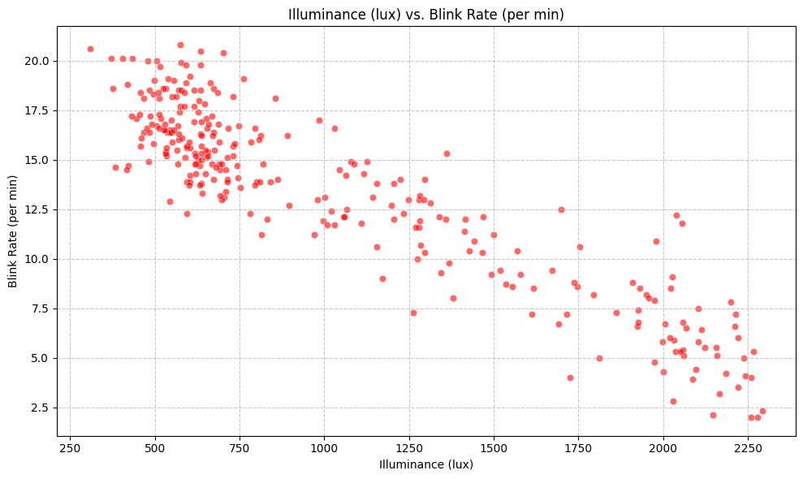
4
LIGHTING | AI Integration DATA
Key findings: Illuminance > Blink rate
Relevance to 'Indoor lighting can simulate real-world daylight conditions:
The analysis explored the relationship between illuminance (lux) and blink rate using a scatter plot and correlation calculation.
The result showed a very strong negative correlation of -0.9131, meaning that as light levels increase, blink rate significantly decreases, and in dimmer conditions, blink rate increases.
Visually, the scatter plot would display a clear downward trend, with data points closely following this pattern, confirming the strength of the relationship.
This reflects a meaningful physiological response: in brighter environments, the eyes appear more comfortable and require fewer blinks, while in lower light conditions, increased blinking may indicate strain or an effort to maintain visual clarity.
These findings suggest that well-designed lighting that mimics natural daylight can promote visual comfort, while poor lighting conditions may lead to fatigue, making blink rate a useful objective indicator of lighting quality.
Fig. 25 – Graph (Illuminace/Blink rate)
v
Group 3

Slide 35
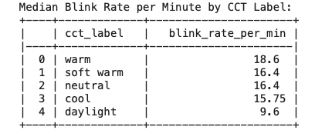
4
LIGHTING | AI Integration DATA
Key findings: Illuminance > Blink rate
Median Blink Rate per minute by CCT Label trends:
The warm CCT label has the highest median blink rate at 18.60 blinks per minute.
The daylight CCT label has the lowest median blink rate at 9.60 blinks per minute.
This suggests that blink rates tend to be higher in warmer color temperatures and significantly lower in daylight conditions.
This could be interpreted as a potential indicator of visual comfort or strain, where warmer lights might lead to more frequent blinking, while daylight, being a natural and typically optimal lighting condition, results in fewer blinks.
Fig. 25 – Graph (Illuminace/Blink rate)
v
Group 3

Slide 36
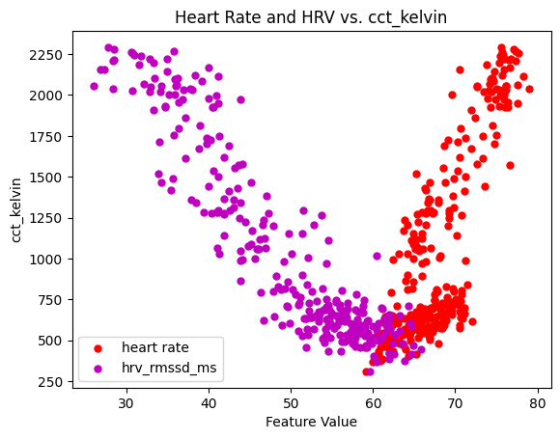
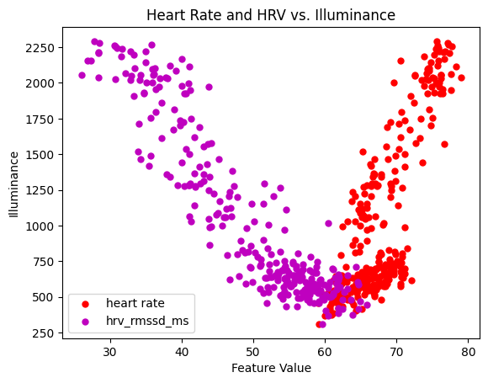
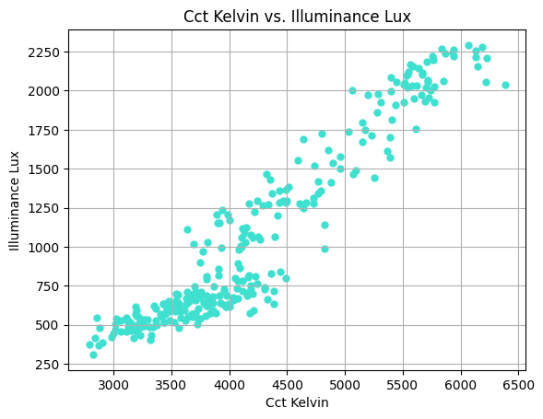
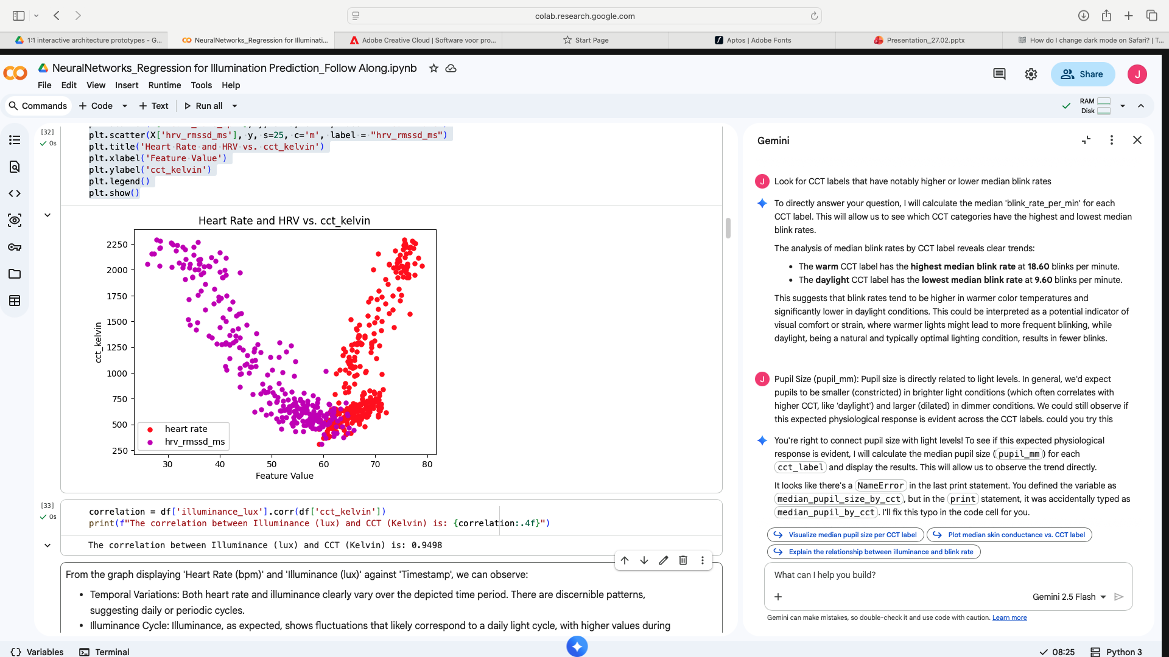
4
LIGHTING | AI Integration DATA
DATA | Dataset combining
High Correlation Between Illuminance and CCT Kelvin: These two environmental factors tend to change together. Both are influenced by timestamp.
The correlation between Illuminance (lux) and CCT (Kelvin) is: 0.9498​
​
Direct Relationship: There is a clear trend where as the correlated color temperature (CCT) increases, the illuminance (brightness) also tends to increase. This indicates that, 'cooler' light (higher Kelvin) is generally associated with brighter conditions.​
​
​
Fig. 26 – Graphs (Combined Data Sets)
v
Group 3

Slide 37
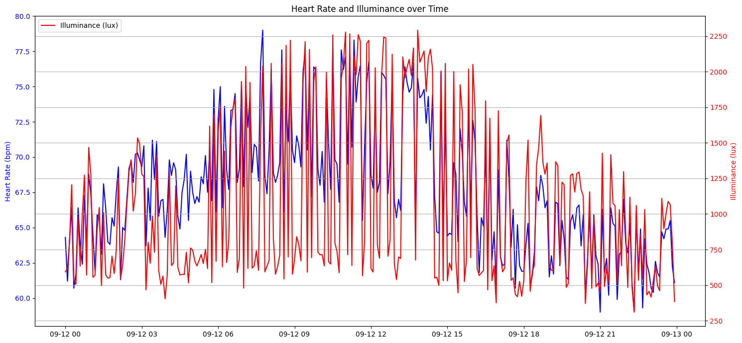
4
LIGHTING | AI Integration DATA
Heart Rate (bpm) and 'Illuminance (lux) vs Timestamp:
Temporal Variations: Both heart rate and illuminance clearly vary over the depicted time period. There are discernible patterns, suggesting daily or periodic cycles.
Illuminance Cycle: Illuminance, shows fluctuations that likely correspond to a daily light cycle, with higher values during the day and lower values during the night.
Heart Rate Trends: The heart rate also exhibits changes over time, potentially indicating periods of higher or lower activity corresponding to different times of the day.
Co-occurrence: We can visually identify if peaks or troughs in heart rate tend to align with peaks or troughs in illuminance. For example, a general trend might show higher heart rates during periods of higher illuminance, possibly reflecting daytime activity levels.
Fig. 27 – Graph (Heart Rate/Illuminance)
v
Group 3

Slide 38
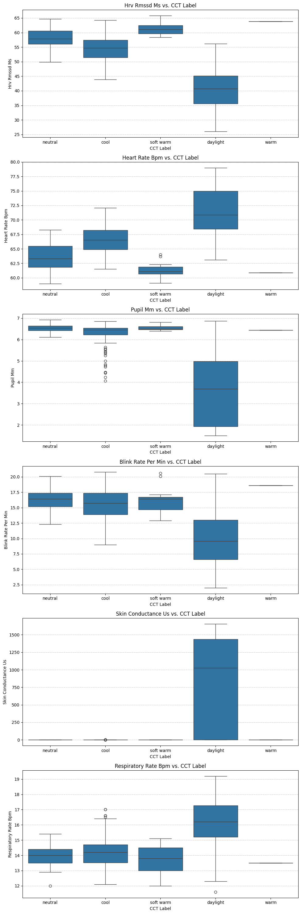
4
LIGHTING | AI Integration DATA
HRV (hrv_rmssd_ms):​
The median HRV changes across different CCT labels. For instance, if 'daylight' CCT shows a higher median HRV compared to 'warm' CCT, it might suggest a more relaxed or less stressed state in brighter, cooler light.
​
​
Heart Rate (heart_rate_bpm):​
Examine the median heart rate for each CCT label. Higher heart rates in specific CCT conditions could indicate increased physiological arousal or activity under those lighting conditions. Conversely, lower heart rates might suggest relaxation or reduced activity.
​
Pupil Size (pupil_mm):​
Pupil size is directly related to light levels. In general, we'd expect pupils to be smaller (constricted) in brighter light conditions (which often correlates with higher CCT, like 'daylight') and larger (dilated) in dimmer conditions. We could still observe if this expected physiological response is evident across the CCT labels.
Fig. 29 – Findings
v
Group 3

Slide 39
4
LIGHTING | AI Integration DATA
Blink Rate (blink_rate_per_min):
Changes in blink rate can be an indicator of visual comfort or fatigue. For example, very high or very low blink rates under specific CCT conditions could suggest discomfort or focused attention, respectively. Look for CCT labels that have notably higher or lower median blink rates.
​
Skin Conductance (skin_conductance_uS):
Skin conductance is a measure often associated with emotional arousal or stress. If there are noticeable differences in median skin conductance across CCT labels, it could point to varying levels of physiological arousal induced by different light color temperatures.
Respiratory Rate (respiratory_rate_bpm):
​Respiratory rate can also be influenced by physiological state. Observe if the median respiratory rate shows any consistent patterns (e.g., higher or lower) in response to different CCT labels, which might correlate with states of alertness or relaxation.
Fig. 30 – Findings
v
Group 3
General Observations to Look For Across All Plots:
Shift in Medians: Are the medians generally shifting upwards or downwards as CCT labels change from 'warm' to 'daylight' (or vice-versa)? This suggests a direct relationship.
Variability: Do some CCT labels show a much wider spread (taller boxes and longer whiskers) in physiological responses than others? This indicates more individual variation under those specific lighting conditions.
Outliers: Are there a significant number of outliers for certain CCT labels? This might point to unusual individual responses or specific events occurring under those conditions.
By comparing these distributions, you can gain insights into how different light color temperatures might be influencing various physiological responses in your dataset.

Slide 40
4
LIGHTING | AI Integration DATA
General Observations to Look For Across All Plots:
Shift in Medians: Are the medians generally shifting upwards or downwards as CCT labels change from 'warm' to 'daylight' (or vice-versa)? This suggests a direct relationship.
Variability: some CCT labels show a much wider spread (taller boxes and longer whiskers) in physiological responses than others. This indicates more individual variation under those specific lighting conditions.
Outliers: Are there a significant number of outliers for certain CCT labels? This might point to unusual individual responses or specific events occurring under those conditions.
By comparing these distributions, we can gain insights into how different light color temperatures might be influencing various physiological responses.
Fig. 29, 30 – Findings
v
Group 3
AR122 1:1 Interactive Architecture Prototypes

Slide 41
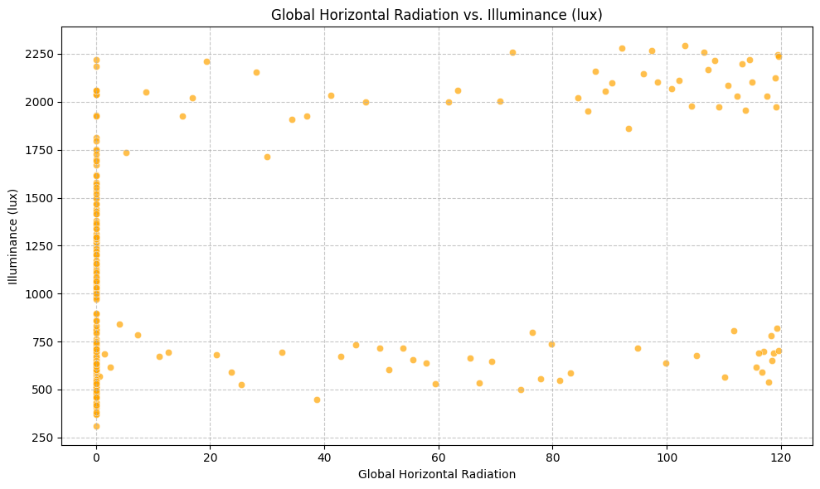
4
LIGHTING | AI Integration DATA
Environmental relationships
Context for 'Indoor lighting can simulate real-world daylight conditions:
Global Horizontal Radiation is a measure of incoming solar radiation, which directly contributes to natural daylight.
The moderate correlation suggests that while natural radiation is a factor, illuminance is not solely determined by this external radiation.
Controlled indoor lighting could potentially mimic or complement natural conditions, as the natural input itself isn't the sole driver of the observed illuminance levels.
We need to look at other factors like total_sky_cover or the actual indoor lighting control to fully understand the simulation aspect.
Fig. 29 – Distribution (GHR/Illuminance)
v
Group 3

Slide 42
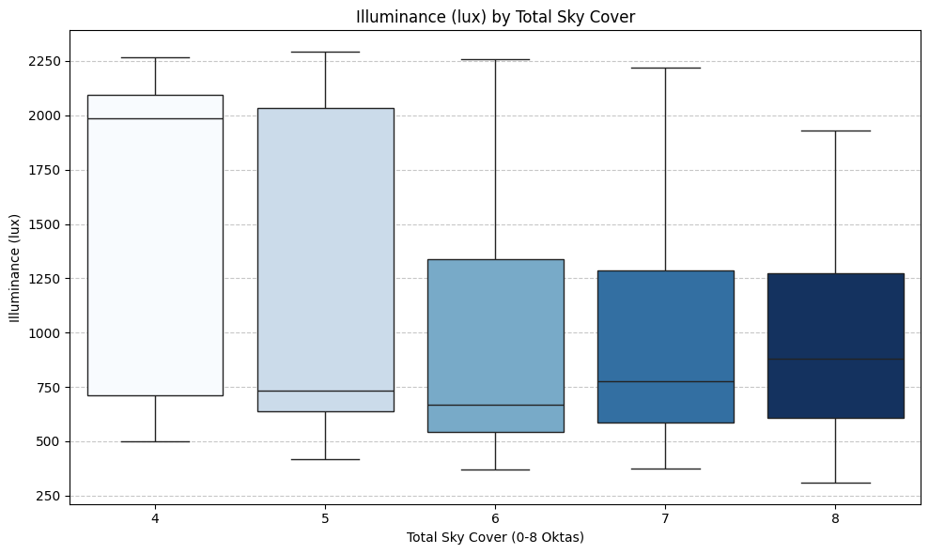
4
LIGHTING | AI Integration DATA
Relevance to 'Indoor lighting can simulate real-world daylight conditions:
The analysis examined the relationship between total sky cover and illuminance using a box plot and correlation calculation.
The box plot showed that as sky cover increases, illuminance generally decreases, with higher light levels under clearer skies and lower levels under cloudier conditions.
The calculated correlation of -0.2296 indicates a weak to moderate negative relationship, meaning that while more clouds tend to reduce light, the effect is not very strong.
This suggests that other factors—such as time of day, sun angle, or artificial lighting—also significantly influence illuminance.
As a result, the findings support the idea that indoor lighting can be designed to simulate daylight conditions, since natural light alone does not fully determine the observed illuminance levels.
This can be translated in Lighting panels that mimic:
diffuse sky
direct sun
overcast conditions
Fig. 30 – Distribution (Illuminance/Sky Cover)
v
Group 3

Slide 43
4
LIGHTING | AI Integration DESIGN
General conclusions:
Artificial lighting systems can operate independently while still referencing environmental conditions.
Physiological signals can be interpreted into behavioral or emotional states that drive lighting adaptation.
You can define user states, based on different values.
Lighting and time alone are insufficient to fully predict complex physiological states.
Light intensity affects activation of increasing HeartRate and Heart Rate Variability
Light Temperatures affect alertness and calmness
Indoor lighting can simulate real-world daylight conditions
Lighting + time → physiological response
Light intensity and color temperature produce highly predictable visual physiological responses. These are reliable control variables for adaptive lighting
​Result: ​
Heart rate prediction using:​
Lux​
Cct_kelvin​
Time​
Next phase:
Heart rate should be used as:
Input signal (real-time feedback)
​Time stamp
Heart rate variability
​Illuminance lux
​Heart rate bpm
Cct kelvin
Fig. 19 - Data
Fig. 20– Illustration Lighting Concept​
​
v
Group 3

Slide 44
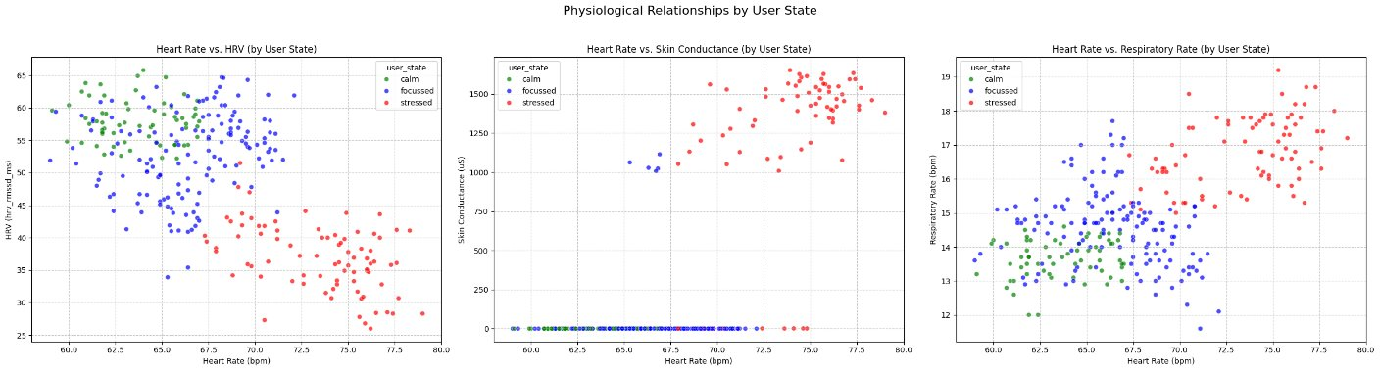
4
LIGHTING | AI Integration DESIGN
We classified physiological data into three user states:
Calm: defined by low heart rate, high HRV, and decreased skin conductance and breathing rate,
Focused: defined by moderate state
Stressed: defined by high heart rate, low HRV, and elevated skin conductance and breathing rate,
The results show that most instances are “focused,” followed by “stressed” and then “calm.” Three scatter plots (heart rate vs HRV, skin conductance, and respiratory rate) visually confirm expected physiological patterns:
Calm states clustered at low arousal levels
Focused states in between, illustrating how these signals change together across different conditions.
Stressed states at high arousal
Fig. 30 – Physiological Relationship by User State
v
Group 3

Slide 45


4
LIGHTING | AI Integration Design
Morning
Bright Blue
enritched light for alertness
Day
Bright White
Concentration​
Evening
Warm Amber
Relaxation​
Night
Dimmed blue
Sleep
Fig. 21 – Day cycle
v
Group 3

Slide 46
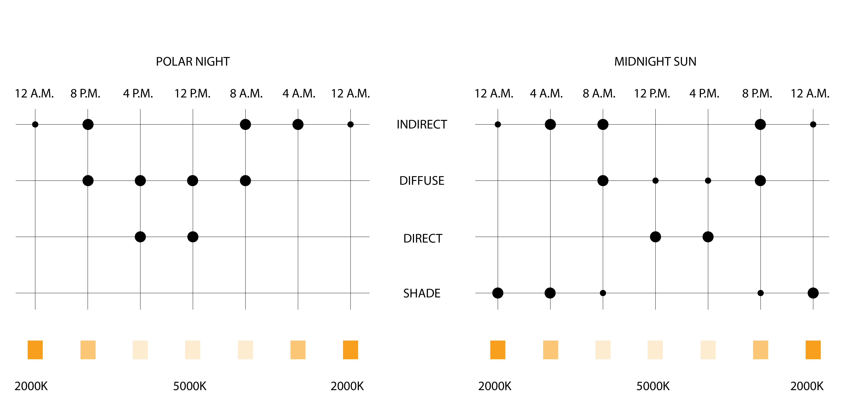








4
LIGHTING | MATRIX & SIMULATION
Fig. 20 & 21 – Lighting Matrix & Light Simulation

Slide 47
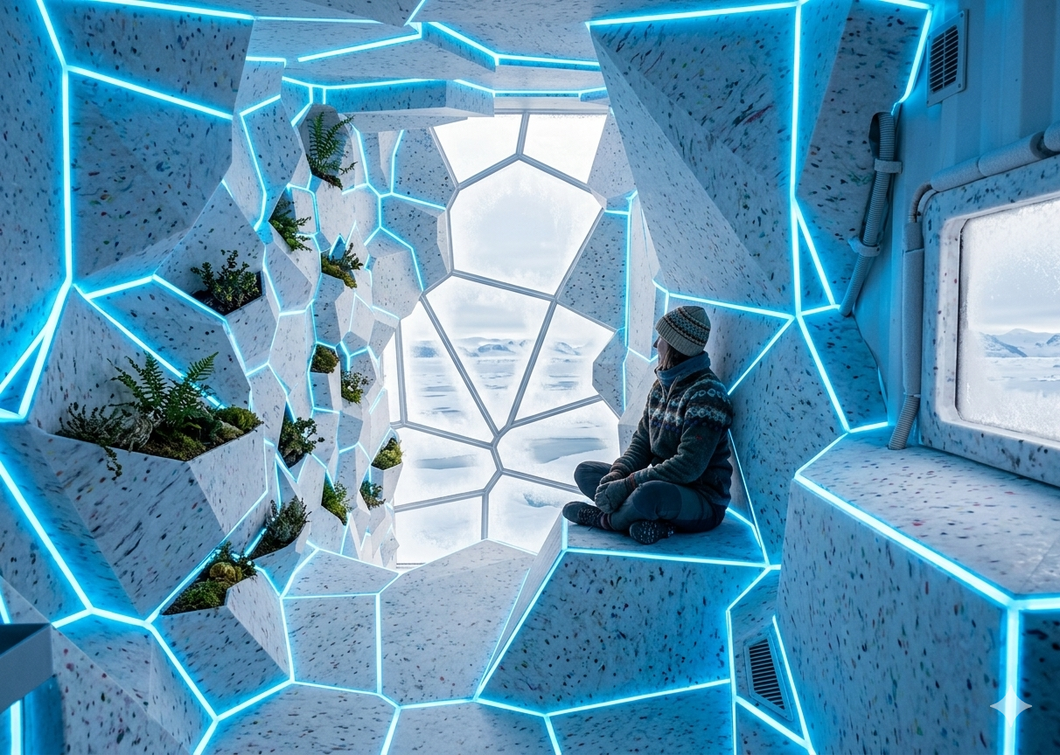
Fig. 25– Gemini principle visual

Slide 48

Fig. 27 – Instagram Norsk Polarinsitutett
THANK YOU FOR YOUR ATTENTION!

